Slide 1

Mini Project Presentation on “Tutor Finder”
Apeksha Neupane[21075402]
Bidwota Giri[21075407]
Lalit Pant[21075416]
Sagar Adhikari[31075430]
Date:2080/11/09

Slide 2
Topics
Introduction
Problem Statement/Background
Objective
Literature Review
Methodology
Implementation
Evaluation/Testing
Result and Discussion
Conclusion
Future work/Enhancement

Slide 3
Introduction
A web application that aims to connect students with qualified tutors.
Alternative of expensive teaching institution
Good platform for teacher as well as student
Unemployment minimizer

Slide 4
Problem Statement
Finding tutors is difficult without a central platform.
Current methods are slow and inefficient.
Comparing tutors is challenging.
Need a simple web app for easy tutor searching.

Slide 5
Objective
To build a complete web application which is useful for connecting students with qualified tutors.

Slide 6
Literature Review
W. Taveekarn, R. Latthitham, N. Kittichareonjit and V. Visoottiviseth, "FindMyTutor: An Android application for matching students and private tutors.
M. Saad, F. Iqbal and M. Q. Pasta, "Smart Tuition Finder: An Educational App
T. Chisenga, “NEARBY TEACHER FINDER: A LOCATION-BASED PRIVATE TEACHER RECOMMENDATION SYSTEM FOR PUPILS”
Authors Somefun T.E, Awosope C.O.A, “”

Slide 7
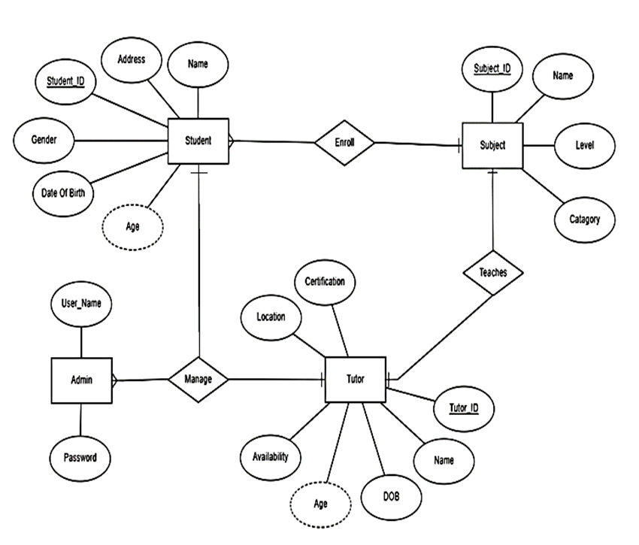
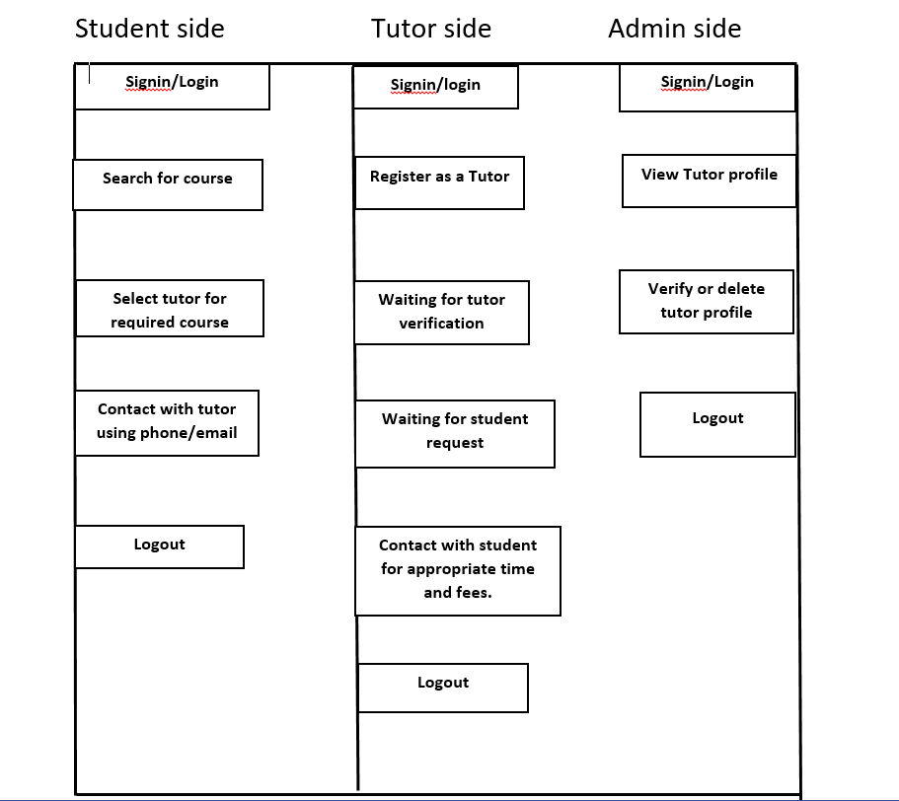
Methodology

Slide 8
Programming Language and Database
HTML: Structures web content.
CSS: Styles webpage elements.
JavaScript: For Enables interactivity on our web application.
MYSQL: Used for storing and managing data.
XAMPP: It simplifies local development with MySQL.

Slide 9
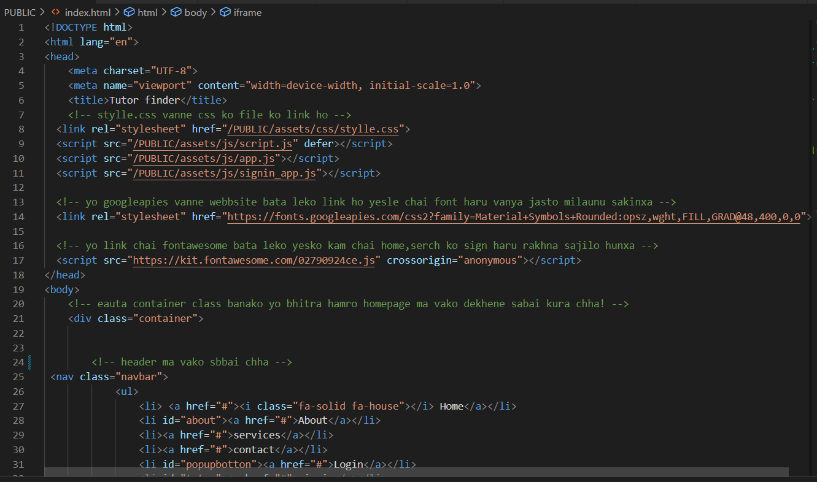
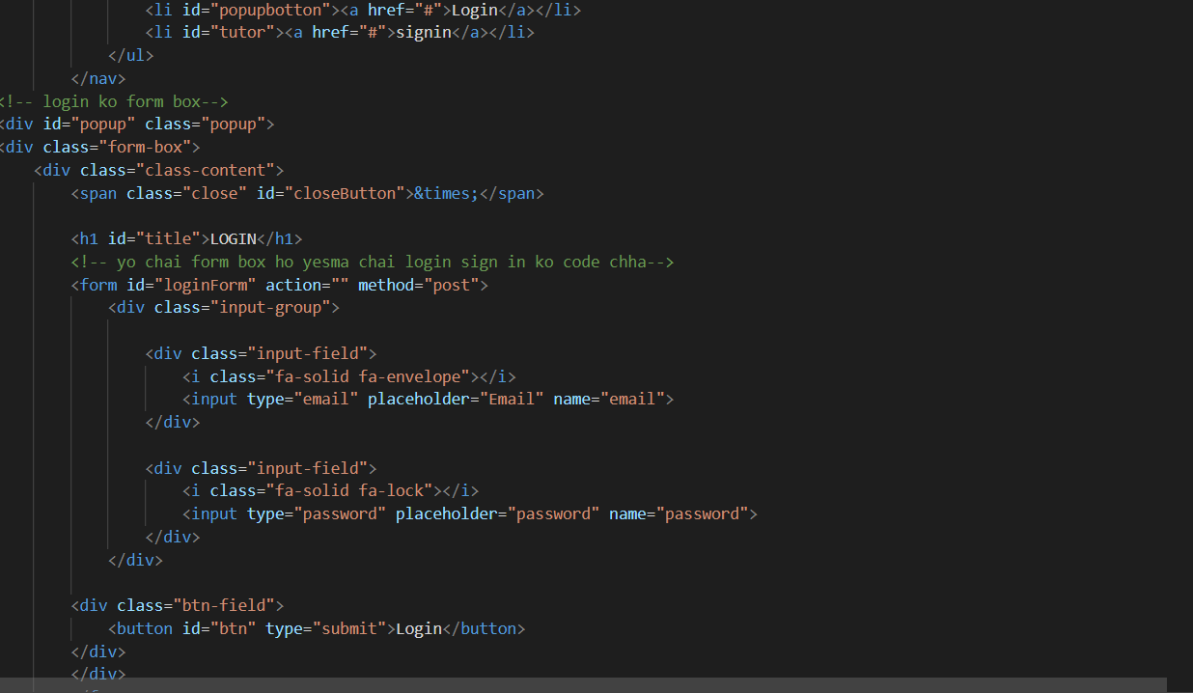
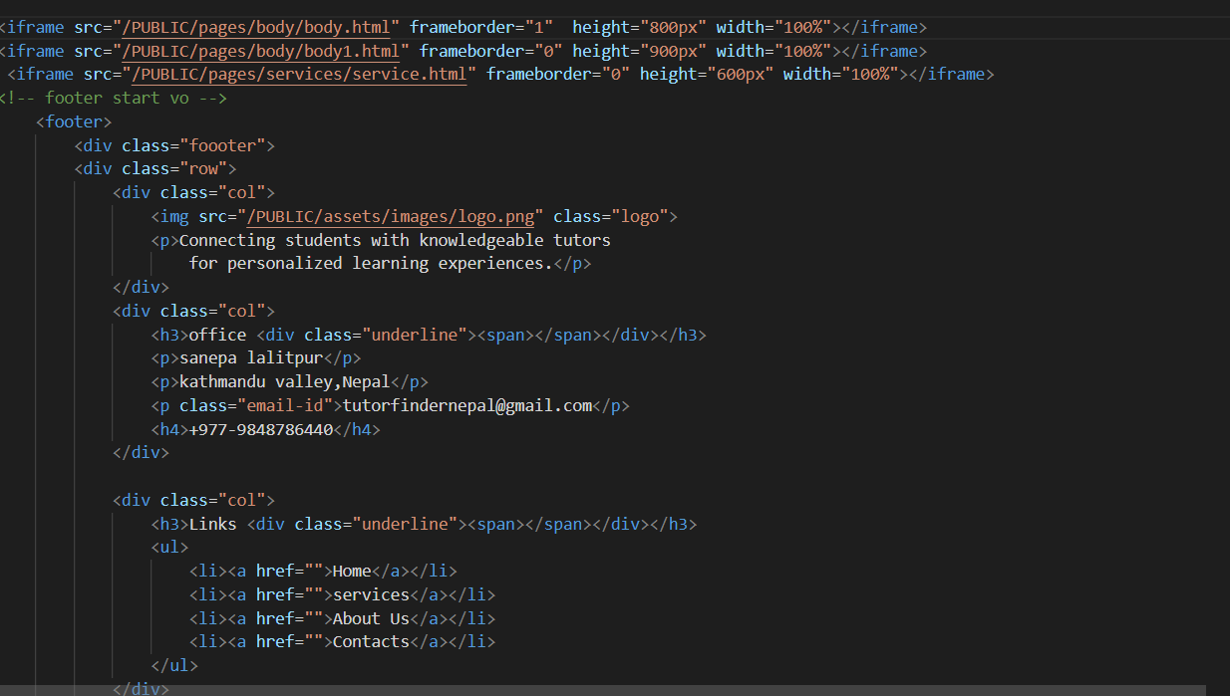
Implementation

Slide 10
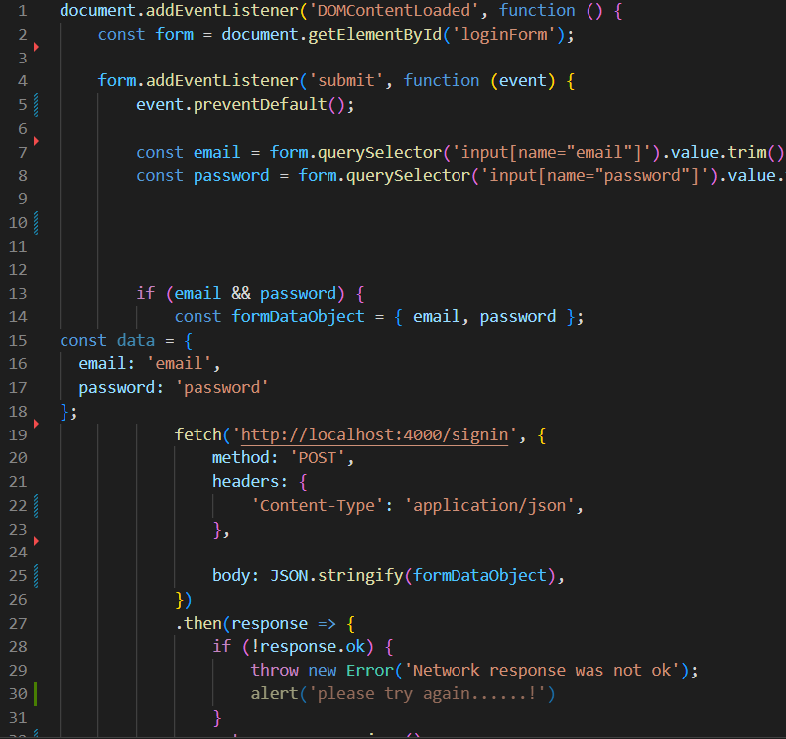
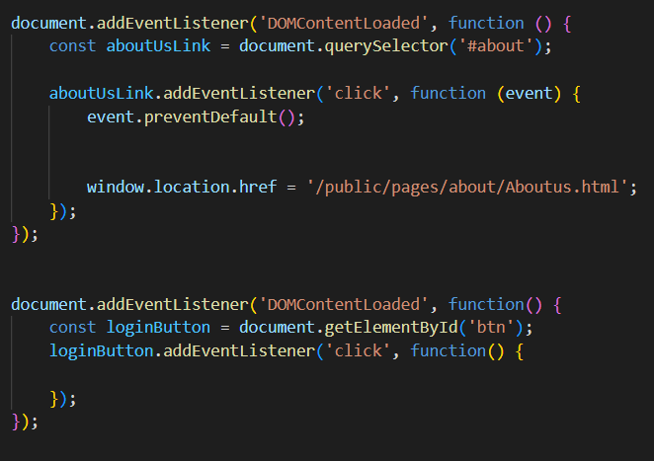
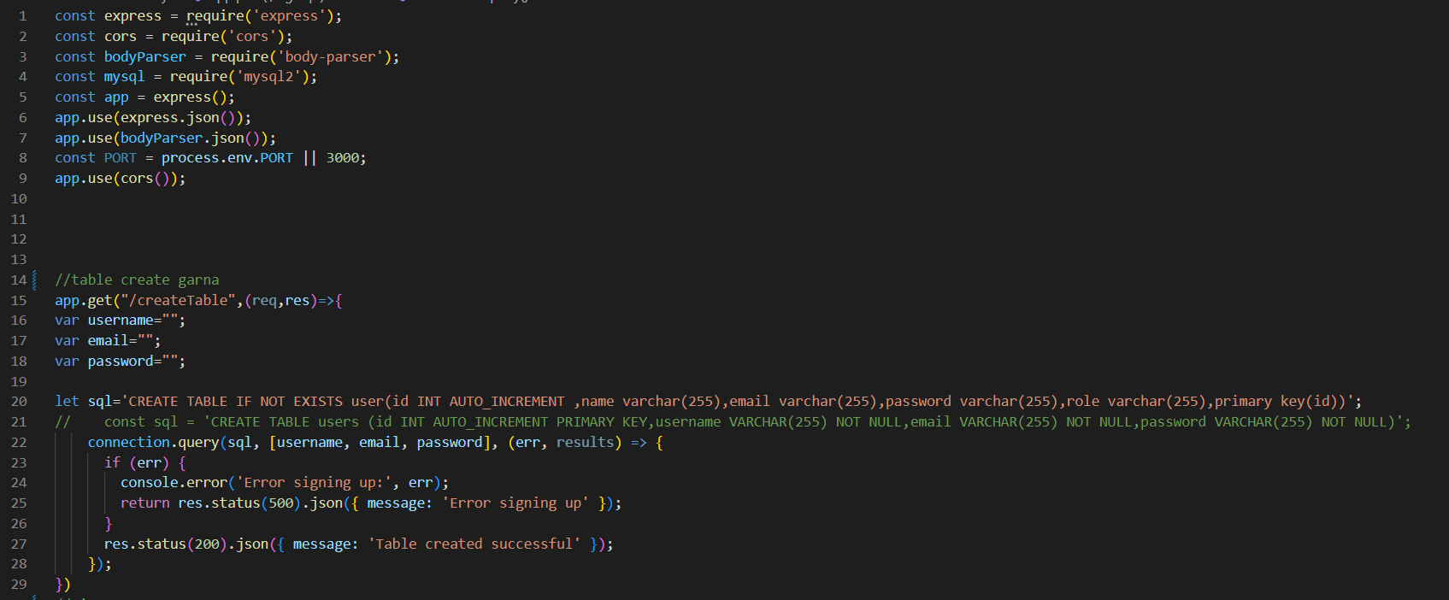

Slide 11
Evaluation/testing
Functionality Testing
Performance Testing
Database Testing
Usability Testing

Slide 12
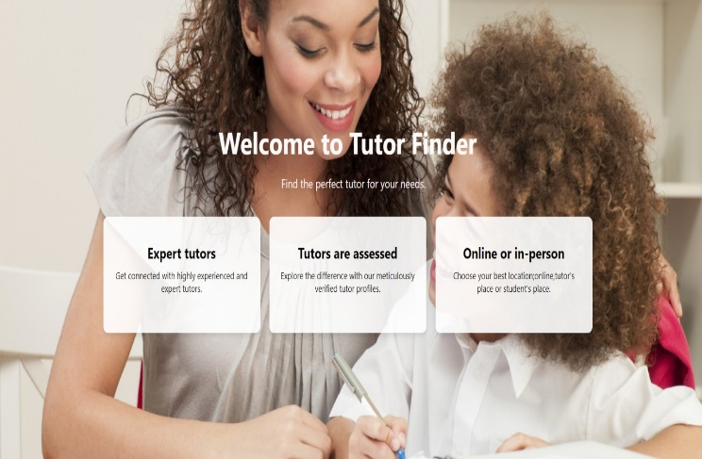
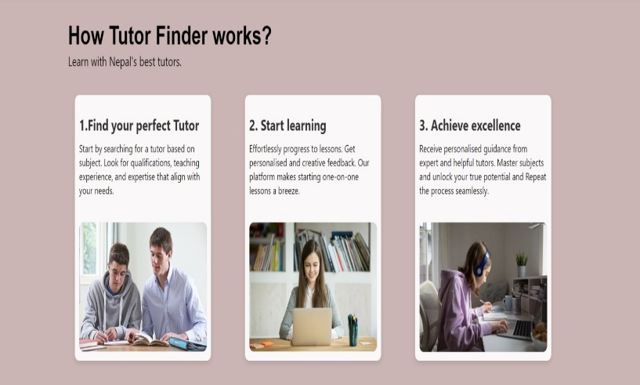
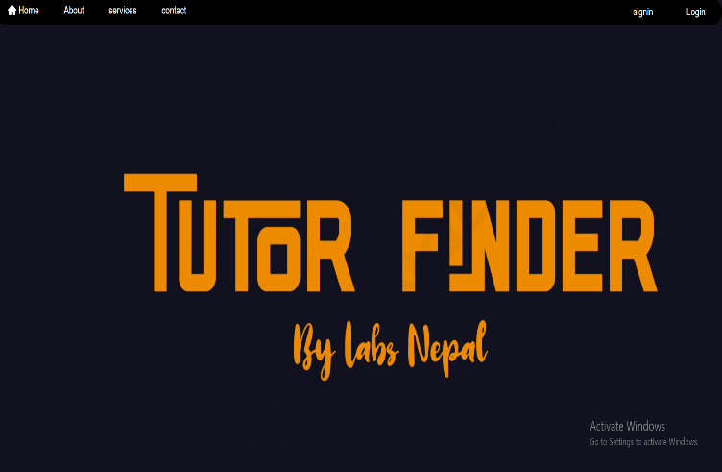
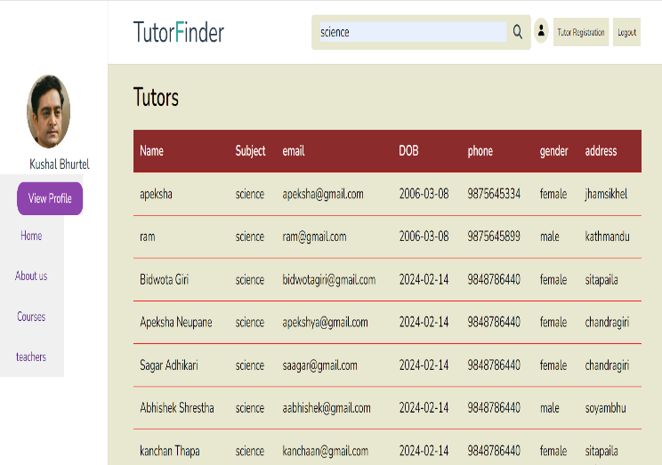
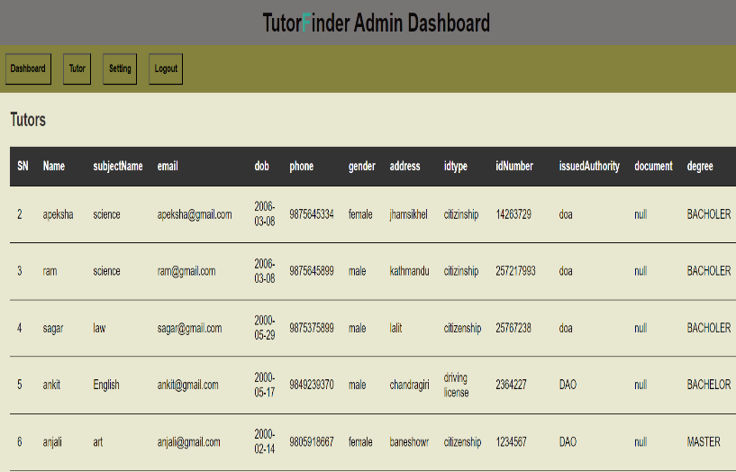
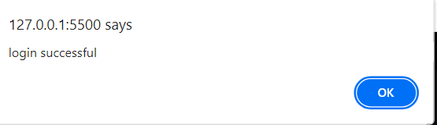
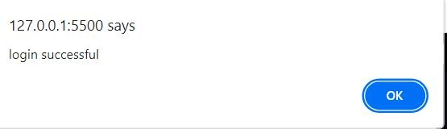
Result and Discussion

Slide 13
Discussion
The website is designed to be simple and straightforward for anyone
The design is eye-catching and making it enjoyable to use
We can quickly find tutors that match which subject you looking for
Everything runs smoothly and fast

Slide 14
Conclusion
We make our website fast and easy for students to find tutors
Our service is affordable
Our process is headache free, meaning you can find tutor without any headaches
Tutor shares their knowledge easily.

Slide 15
Future Enhancement
Some future enhancements include:
Show when tutors are available right away.
Let you rate tutors and give feedback.
Create a mobile app for easy access.
A payment method can be added.
Can add new features as and when require.

Slide 16
Thank you!!

