Slide 1

Effective Short-Term Temperature Forecasting for Hourly Time Series using ARIMA, LSTM, TBATS
Notes:
NOTE:
To change the image on this slide, select the picture and delete it. Then click the Pictures icon in the placeholder to insert your own image.

Slide 2
1. Research Question
"Can we efficiently forecast air temperature of Cork considering Wet
Bulb Air Temperature, Dew Point Air Temperature, Vapor Pressure for
twenty-four hours using time series techniques ARIMA, LSTM, TBATS ?"

Slide 3
2 Literature Review Summary
2.1 Significance of Time Series in Weather Forecasting.
Farmers can known when to plant or harvest their crops
People cam choose where and when to take their holidays to take advantages of good weather
Surfers known when large waves are expected
Regions can be evacuated if hurricanes or floods are expected
Aircraft and shipping rely heavily on accurate weather forecasting

Slide 4
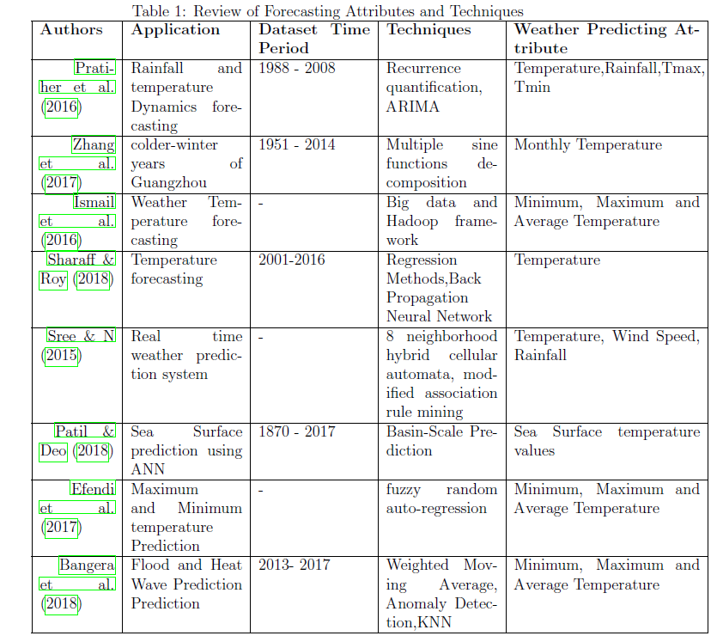
2.2 A Review of Attributes used in Weather Forecasting.

Slide 5
2.3 FORECASTING TECHNIQUE FOR WEATHER PREDICTION
There are various forecasting method for the weather prediction such as judgmental fore-casting, Time series regression models, Time series decomposition, Exponential smoothing, ARIMA models and advance forecasting methods which includes Complex seasonality, Vector autoregression, Neural Network models
For this Research ARIMA, LSTM and TBATS will implement
TBATS : In our case, data is daily and sub-daily, and it is challenging because of multiple seasonal patterns, so the model selection is essential. In this case, the time series is not short, instead it is long, and some of the more extended periods became apparent. It is necessary to use the TBATS or Dynamic harmonic regression.
LSTM : There are several exciting features of the ANN as
it is self-adaptive and data-driven method and are universal approximator.
ANN also handles non-linear problems efficiently to get the better
performance.
3. ARIMA : ARIMA models with time series are generally uncertainty as previous
knowledge not considered while forecasting and consider the past value and
the previous error terms for forecasting.

Slide 6
Research Methods and Specifications
Data Selection
https://kaggle.com/conorrot/irish-weather-hourly-data
Exploratory Data Analysis (EDA)
Identifying number of observation and count of columns in dataset.
Summary Statistics
Identification of Missing Values
Outlier Detection
Correlation Matrix
Pre-Processing :
Data cleaning
Missing values
Noisy data
Data Transformation
Data Reduction
Tools And Technologies
Python, Google Colab

Slide 7
Implementation of models

Slide 8
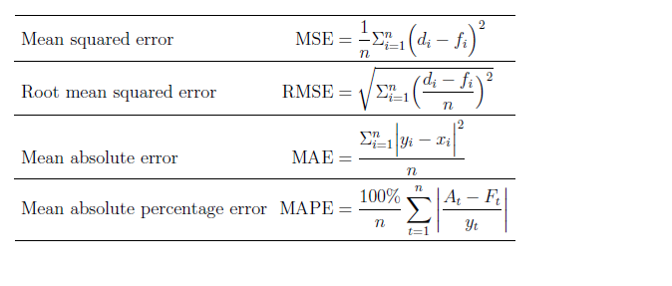
Interpretation/Performance Metrics

Slide 9
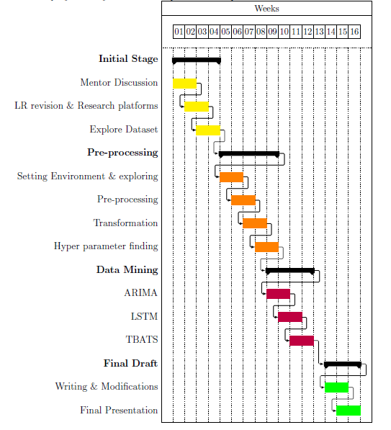
Gantt Chart and Professors Feedback

Slide 10


