Slide 1
MCBC Exams
-An Examination Software

Slide 2
INTRODUCTION
PURPOSE
Reduced Entry Work
To increase efficiency in test taking
To Allows neat handling of data rather than error prone records
To design an examination-cum-practice system.
FUTURE SCOPE
Developed discussion forums.
Implementation on clouds server.
Integration of learning material.

Slide 3




COMPARISON
MCBC Exam
Software
MANUAL
SYSTEM
Complete Automation
100% Accuracy
Time Economical
Easy to maintain record
Environment friendly.
Manual Intervention
Error Prone
Time Consuming
Difficult to record and maintain.
Not environment friendly.

Slide 4
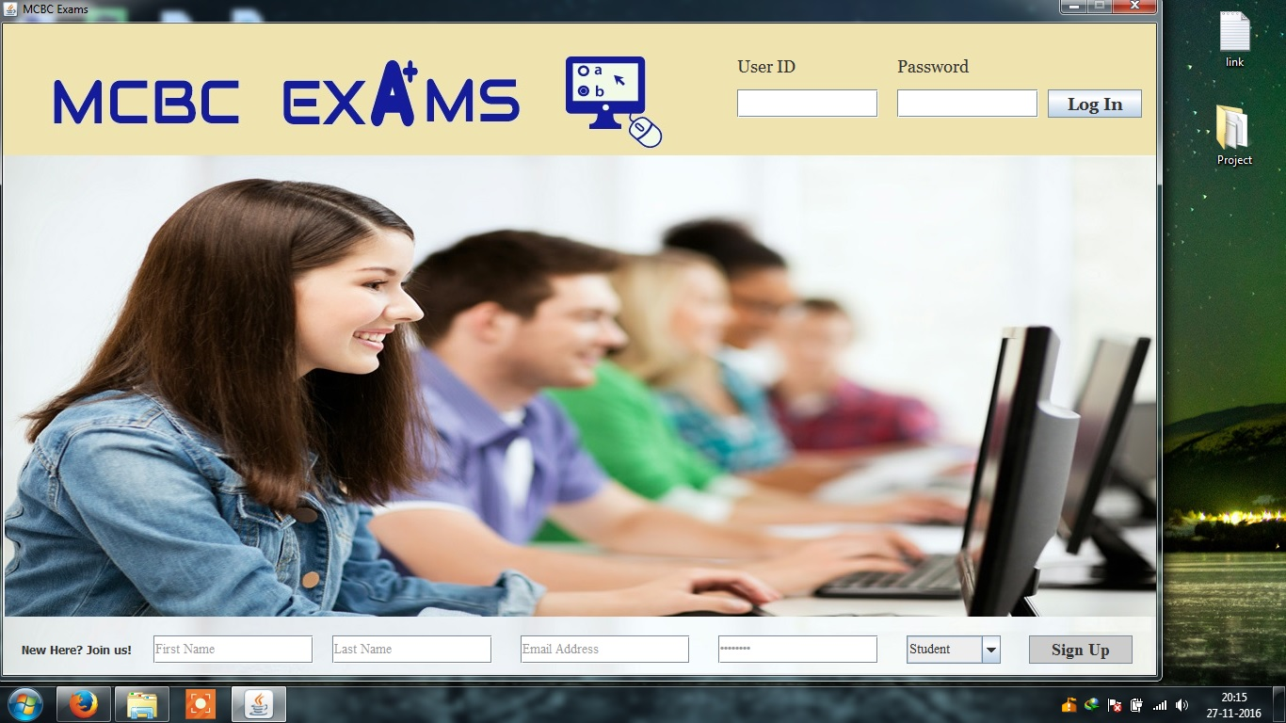
HOMEPAGE

Slide 5
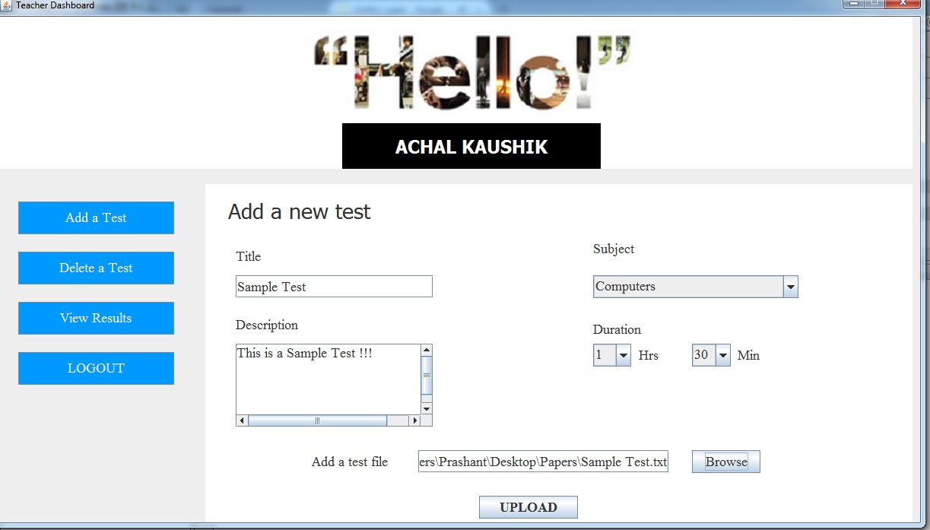
Teacher Dashboard

Slide 6
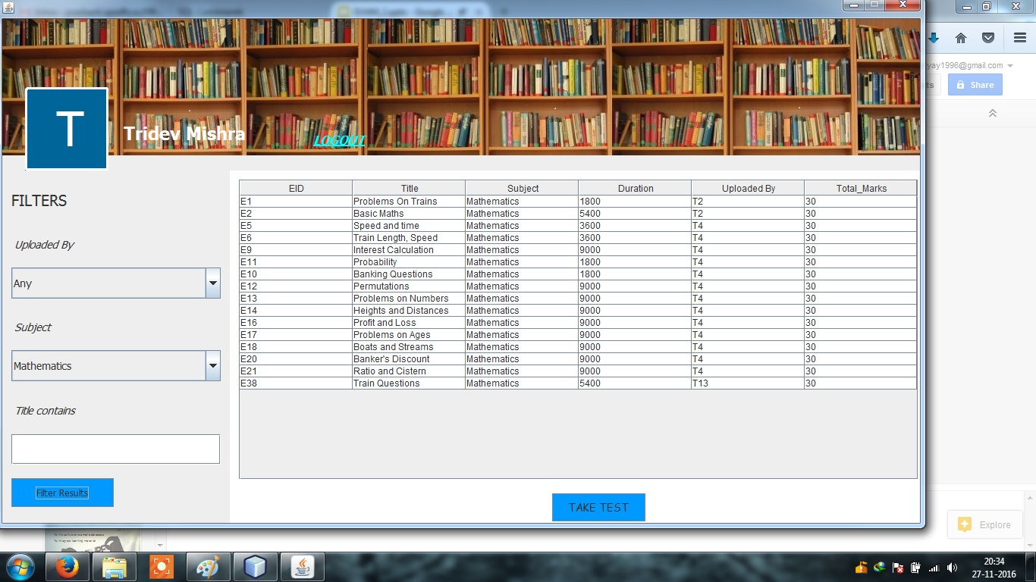
Student Dashboard

Slide 7
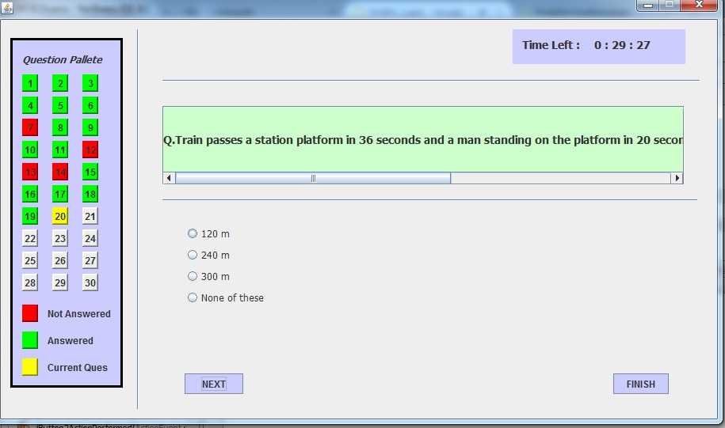
Test Window

Slide 8

FUTURE PLAN
To link software to email addresses
To Integrate learning material
Include Notifications
Digital Report Card

