Slide 1



Command Based Interpreter and Developer’s Library
Prepared By
Elias Bachaalany

Slide 2
Outline
Introduction & Background
Problem Statement
Purpose of Project
Possible Solutions
Design Specifications
Implementation Languages
Testing & Verification
Conclusions & Future Work
1/17

Slide 3
Introduction & Background
Command Based Language Library for Software developers
Teaching and academic tool for students and beginner programmers
A replacement for DOS batch file scripting
2/17

Slide 4
Problem Statement
Lack of command line interfaces in emergent GUI programs
Redundancy of work and no easy way to batch-in repeated commands / tasks
Too complicated: Modern programming languages are too complicated for beginners
Lack of simple and integrated programming tools
3/17

Slide 5
Purpose of Project
Give developers a solution to easily integrate command line programming into their application with little work
Provide teachers and academic institutions a simple tool to teach programming concepts
A powerful tool and replacement of DOS batch files
4/17

Slide 6
Possible Solutions
Flexible/easily pluggable developer library that require no effort from the part of the implementer
Comprehensive tool covering most of academic and teaching purposes needs
General purpose scripting tool
5/17

Slide 7
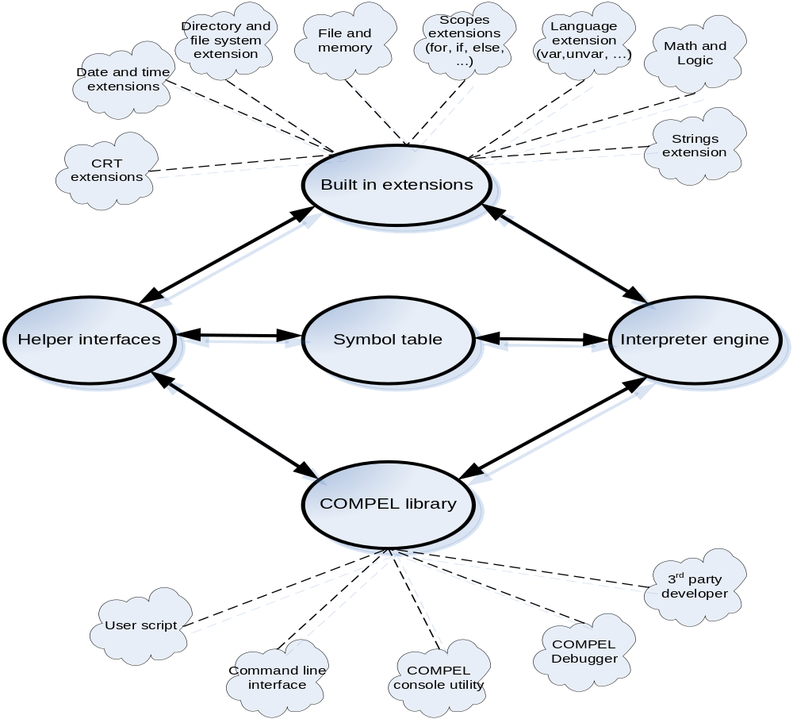
Design Specifications – Engine overview
6/17

Slide 8
Design Specifications – Engine overview
Engine design
Modular: The engine is modular as seen in the previous graph
Extensible: Allows easy extension and modification of code
Portability: It is designed with high level of abstraction thus allowing portability
Contribution: Extensions can be created by third party users and plugged into the system
Language features: A wide range built-in extensions giving COMPEL a powerful stance among other programming languages
7/17

Slide 9
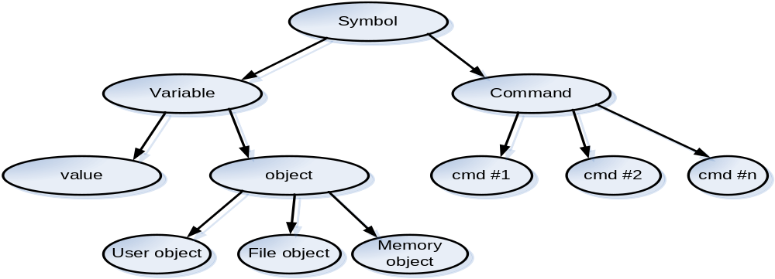
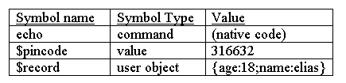
Design Specifications – Symbol table overview
Symbol table hierarchical view:
Symbol table tabular view (sample):
8/17

Slide 10
Symbol table design
Hierarchical: Symbols derive from basic type to different advanced typed.
Inherent relationship: Different symbols can be inherently transformed into other symbol types
Commands/Functions: Even commands and functions are considered as symbols and are managed by the symbol table manager
9/17

Slide 11
Implementation Languages
C++ language used for the engine development
Borland Delphi was used for the COMPEL IDE tool
.NET and other languages used to build demo application and COMPEL extensions
10/17

Slide 12
Why use C++ for the COMPEL engine?
C++ is a portable language
C++ allows natural expression of objects and OOP programming principles
C++ generates fast and tight code thus the speed of execution
C++ compilers are widely available and mostly for free
11/17

Slide 13
Why use Delphi for the COMPEL IDE tool?
Borland Delphi / VCL is the best choice for RAD (rapid application development) and GUI programming
Delphi code can be ported to Linux using the Kylix tool
Borland Provides a free personal non-commercial use of their Delphi tool
12/17

Slide 14
Design Constraints
Unicode scripts are not supported
IDE does not support multiple scripts per workspace
Scripts cannot be compiled into p-code
IDE is not symbol aware
Language is too simple thus advanced data structures cannot be easily described
13/17

Slide 15
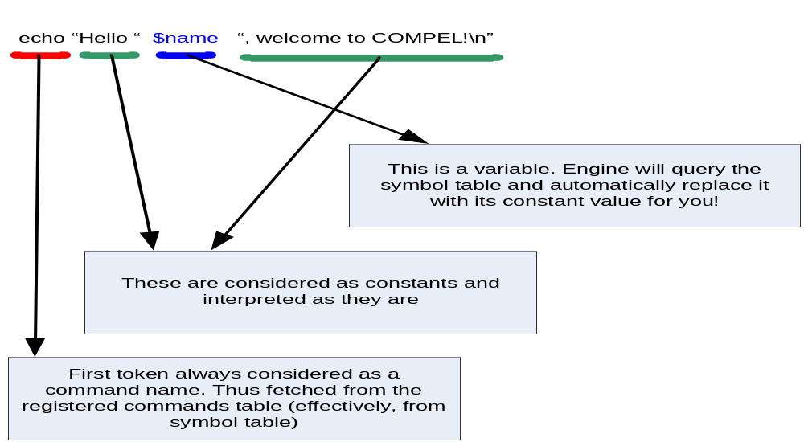
Description of System Operation
14/17

Slide 16
Equipment Configuration
Developer (COMPEL Library):
Windows Operating system
Windows development tool such as: C++, Delphi, Visual Basic or .NET
End user (COMPEL interpreter):
Windows Operating system
A command prompt tool (such as cmd.exe)
32MB of RAM
2MB disk space
15/17

Slide 17
Testing & Verification
Interpreter detects pre-parse / run-time script errors
Correct symbol evaluation and command registration
IDE / Debugger can debug and edit scripts
Testing Results
Interpreter runs large script with a reasonable amount of time
Accurate, relevant, complete, and concise information about variables and program state when using the debugger
Simple and tight code can yield a handy application
16/17

Slide 18
Conclusions & Future Work
Conclusions:
COMPEL language is simple and user friendly
COMPEL IDE assists as a visual tool to develop and debug programs
COMPEL developer library is well documented and developer-friendly
Future work:
Complete re-design of the COMPEL grammar to allow dynamic script grammar
Allow the compilation of a script into p-code
Enhance the debugging engine
Enhance the developer library and allow more control to the COMPEL engine internals for developers
17/17

