Slide 1
Play Tango
Team members:
Lal Bahadur Reshmi Thapa
Sadiksha Chitrakar
Suraj Thapa
April 06, 2025

Slide 2
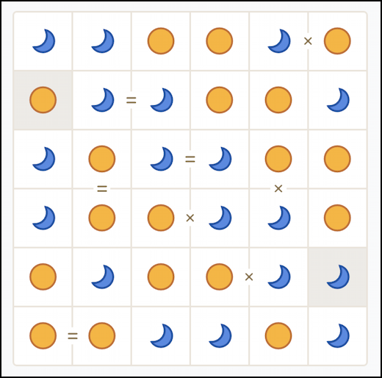
Project topic: Play Tango
How to play:
Fill each cell with either a suns or moons (for instance) can be any two distinct symbols
No more than 2 of the same symbol may be next to each other, vertically or horizontally
Each row and column must have an equal number of suns and moons
Cells separated by = must be the same type
Cells separated by × must be opposite types
Each puzzle has one right answer and can be solved via deduction

Slide 3

Statement of project objectives
Implement A* Search
Apply the A* search algorithm to find the optimal solution to the Tango puzzle, using admissible heuristics that guide the search effectively—penalizing poor decisions without overestimating the true cost.
Apply Arc Consistency (AC-3)
Use arc consistency techniques to detect early failures by pruning inconsistent values from the puzzle, improving efficiency through constraint satisfaction.
Train with Q-Learning
Utilize Q-learning, a model-free reinforcement learning approach, to train an agent that learns to make optimal symbol placements by assigning values to actions based on its current state.

Slide 4

Approach
Programming Language
The project will primarily be implemented using Python, along with relevant libraries for search algorithms, constraint satisfaction, and reinforcement learning (e.g., numpy, heapq, pygame, etc.).
Techniques and Algorithms
Implement the A* algorithm with admissible heuristics for optimal puzzle solving.
Apply Arc Consistency (AC-3) to handle the puzzle as a Constraint Satisfaction Problem (CSP).
Use Q-learning, a model-free reinforcement learning algorithm, to train an agent that learns puzzle-solving strategies through exploration.

Slide 5
Deliverables
Optimal Puzzle Solver Using A*
Develop and demonstrate an A* search-based solver that uses admissible heuristics to find the optimal solution efficiently.
Early Failure Detection with Arc Consistency
Implement arc consistency techniques to prune invalid choices early in the solving process, reducing computation time and enhancing performance.
Reinforcement Learning Agent with Q-Learning
Train a Q-learning agent to learn optimal symbol placement policies (Sun or Moon) by maximizing the expected cumulative reward across the grid.

Slide 6
Evaluation methodology
A* Search Evaluation
Assess the effectiveness of admissible heuristics by verifying whether the A* algorithm consistently finds the optimal solution with minimal search effort.
Arc Consistency Validation
Confirm that all constraints are satisfied using arc consistency. Ensure that each grid cell is correctly assigned (Sun or Moon) without violating the puzzle rules.
Q-Learning Assessment
Analyze the learned Q-values over training episodes to evaluate if the agent is improving its decisions—i.e., learning to choose optimal actions with increasing accuracy and reward.

