Slide 1
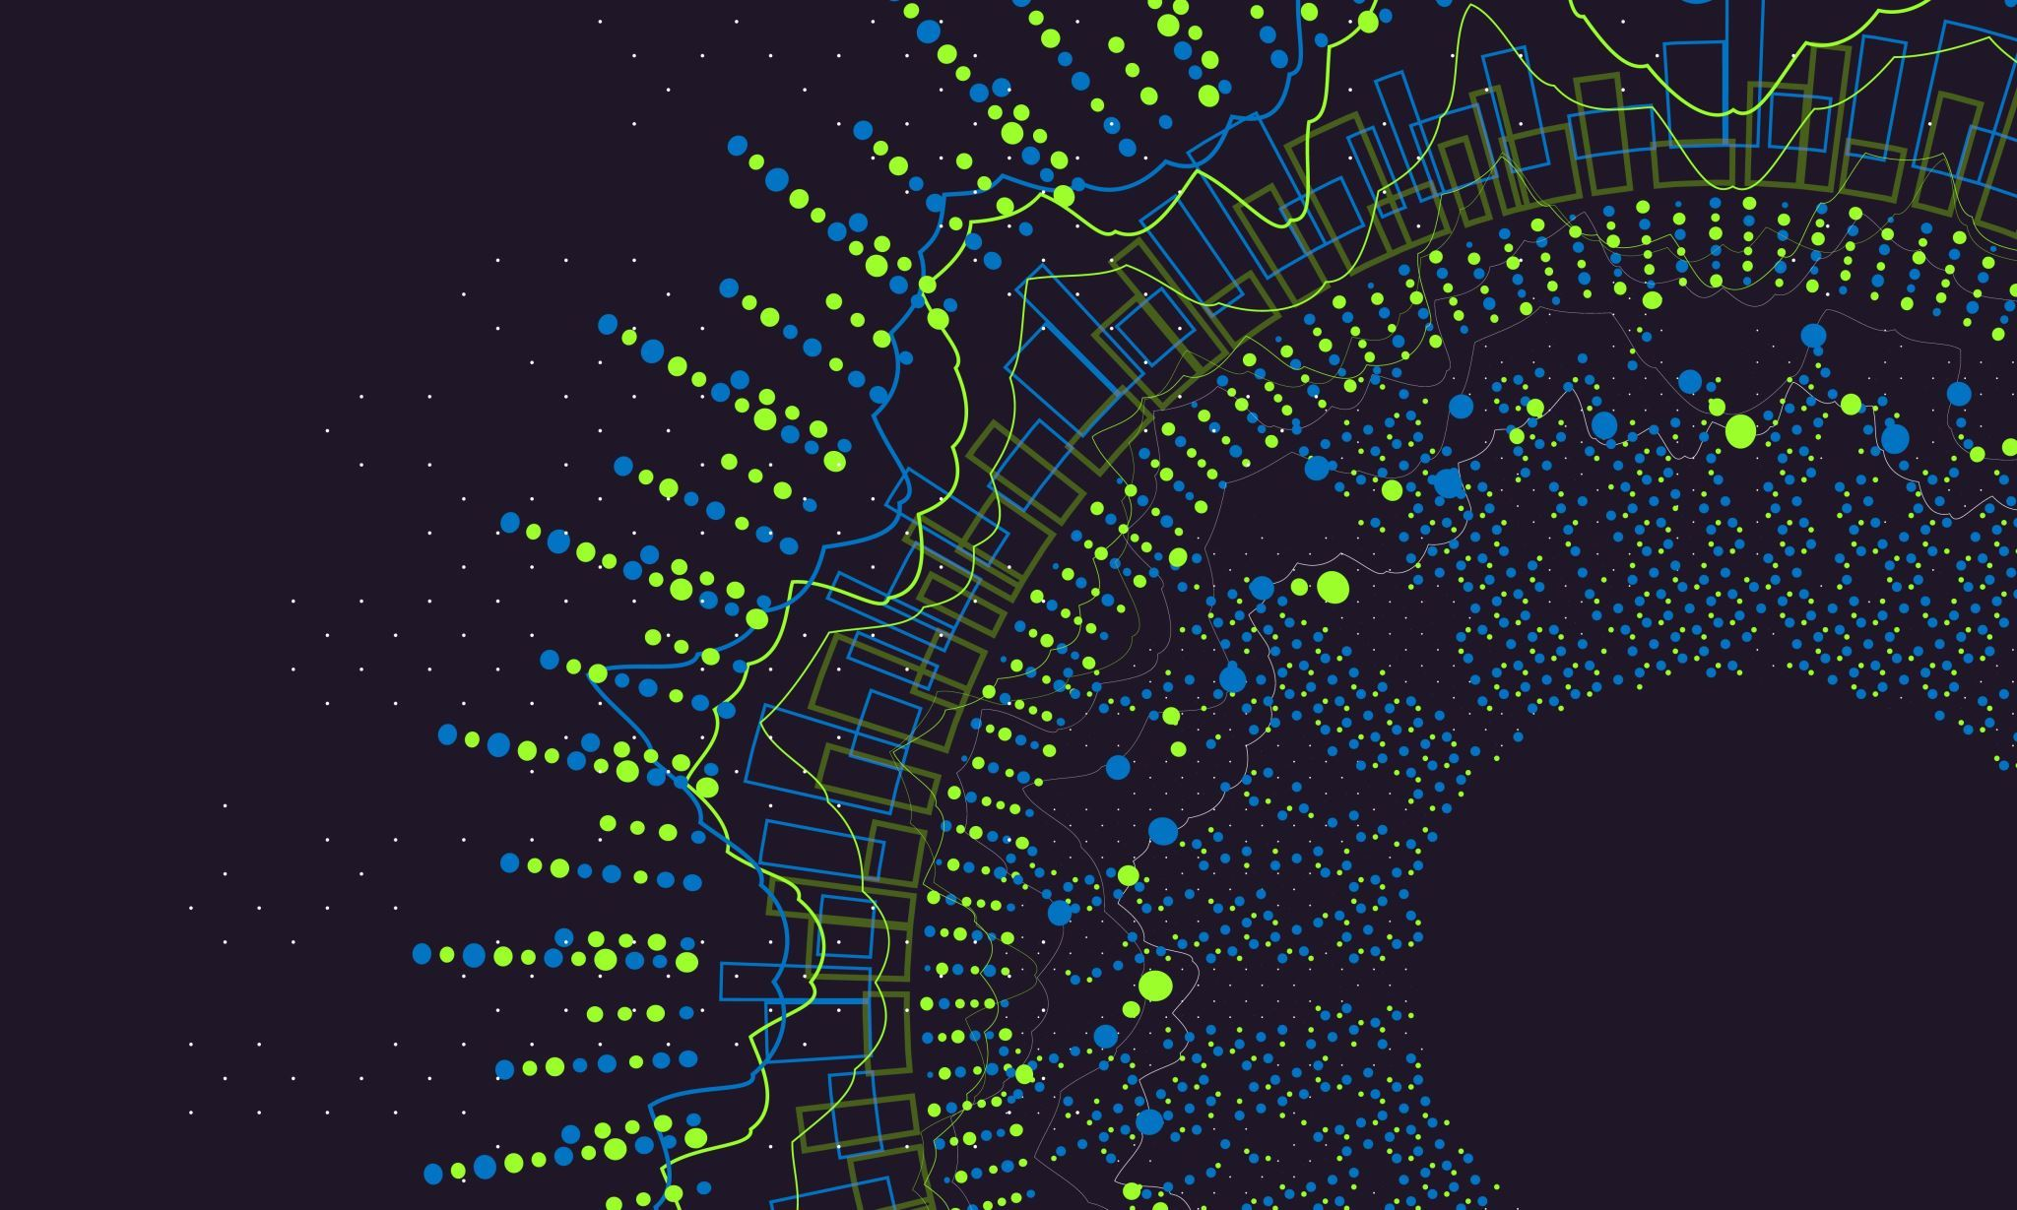
Kraken2

Slide 2
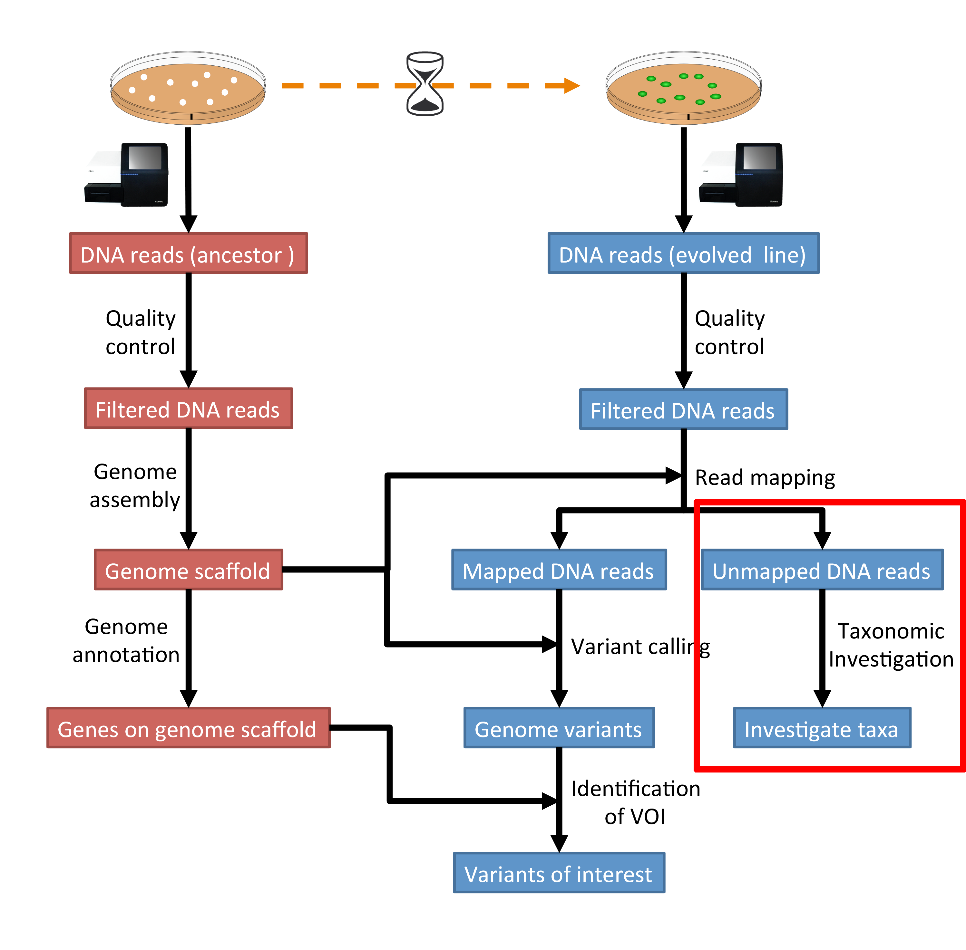
What is this tutorial?
This tutorial follows a computational genomics tutorial
Specifically, the taxonomic investigation section
The data is next-generation sequencing data of "actual research data"
E. coli, to be precise
We will be using Kraken2 to perform the classification
Image is from the tutorial

Slide 3
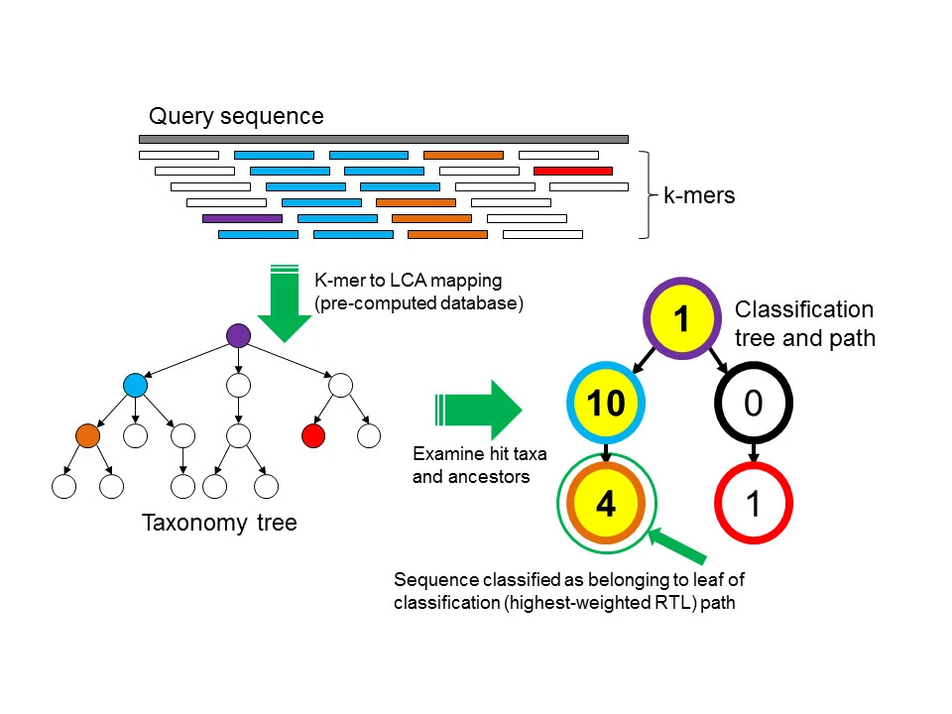
What is kraken?
It's a taxonomic investigator!
It works by attempting to exactly match k-mers
Default k-mer length is 31
Matches lowest common ancestor and works up
Image is Figure 1 from Wood and Salzberg 2014
Notes:
Normal mode matches all k-mers, while quick only grabs the first k-mer.
Precision and recall are likely next slide, but the exact match process means higher precision, and they use sensitivity instead of recall. Sensitivity is low, but when it's right, it's right
Also they measured from genus level.

Slide 4
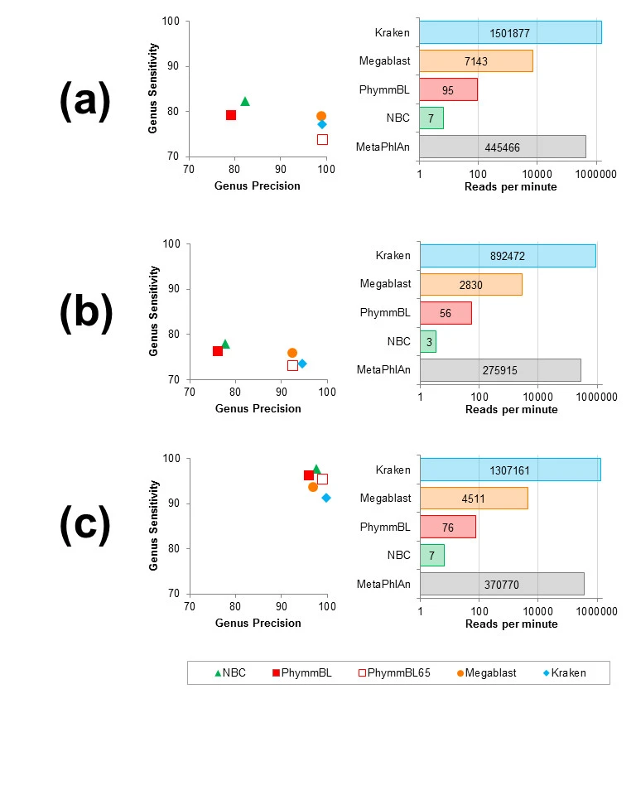
Performance
It's fast
Like, really fast
Precision is prioritized over sensitivity/recall
Requires 70 GB RAM for Kraken
Alternative is MiniKraken, which needs 4
There's also a quick mode for both
A) HiSeq metagenome (mean length:92 bp)
B) MiSeq metagenome (mean length:156 bp)
C) simBA-5 metagenome (simulated 100 bp reads)
Image is Figure 3 from Wood and Salzberg 2014

Slide 5
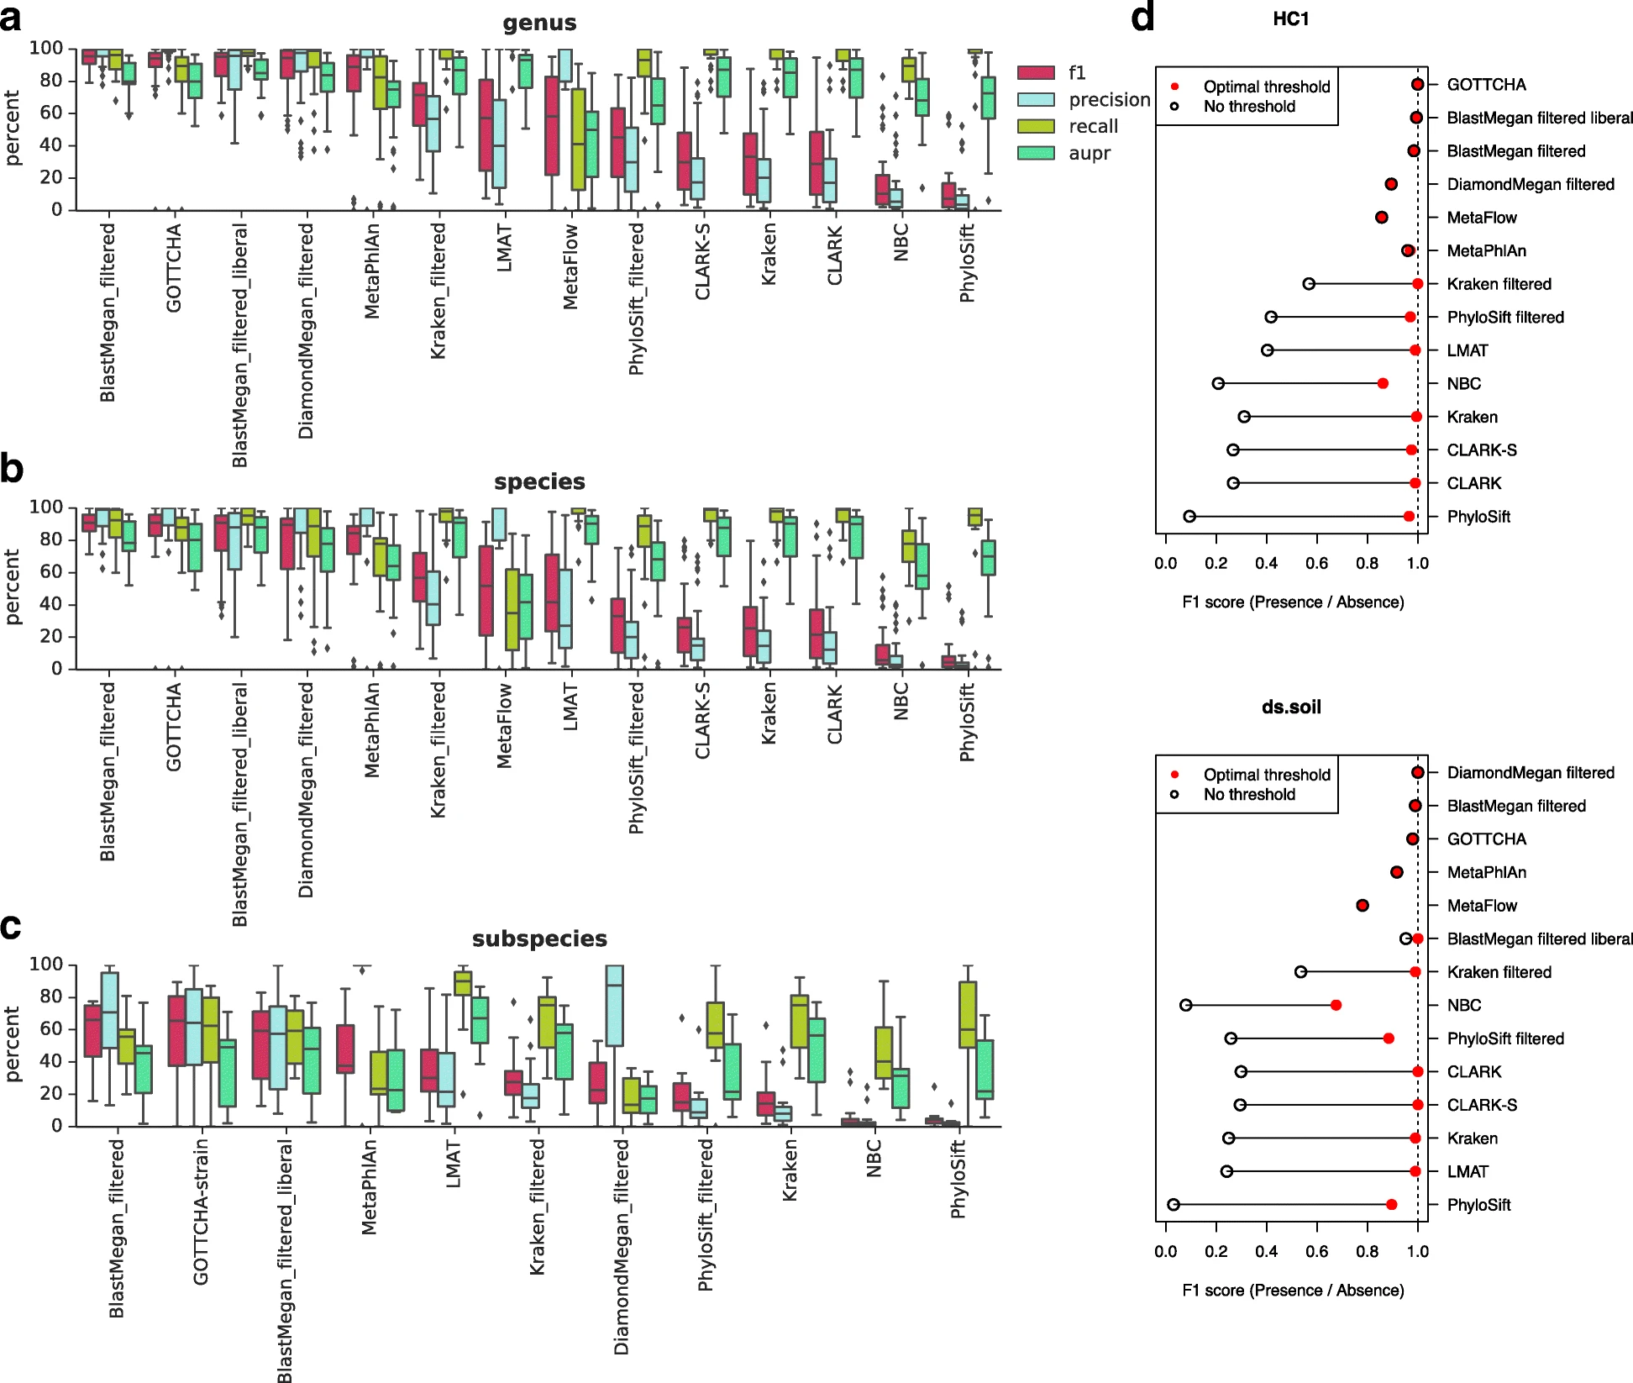
Comparison to Other Techniques
At genus-/species-level, Kraken's recall is reliably top-tier[1]
Performance falls off at subspecies-level
^{[1]} McIntyre et. al. 2017, Figure 1

Slide 6
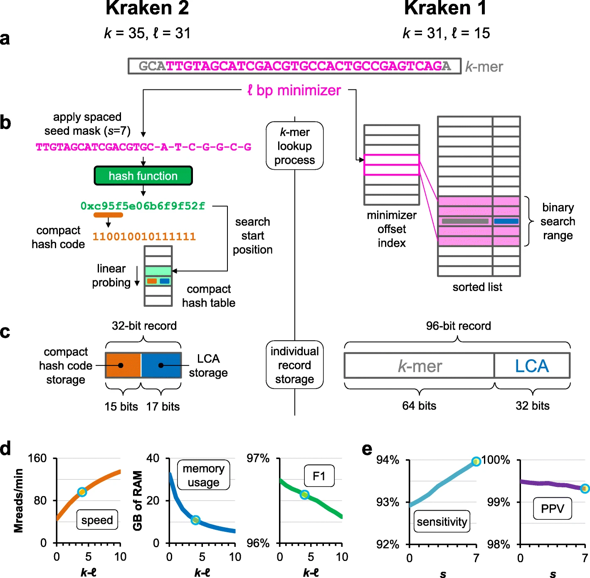
Kraken2
70 GB RAM is a lot
Requirements can easily exceed 100GB
The full k-mer storage is brutal
Kraken2 introduces probabilistic hashing
Memory requirements drop substantially
Sensitivity is also improved
Accuracy/specificity are hurt
Image is Figure 1 from Wood et al. 2019

Slide 7
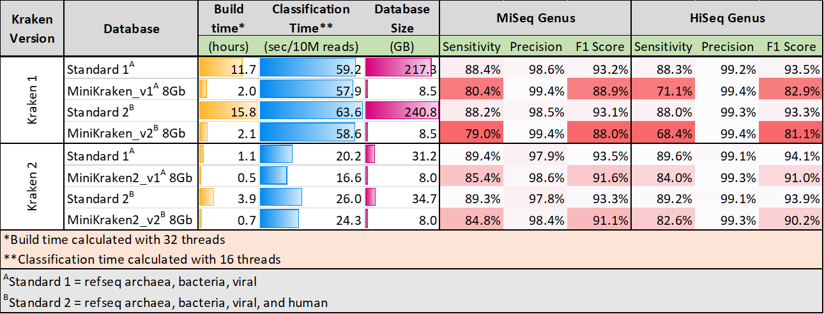
Significant improvements to Kraken1
Faster database build times
Smaller database sizes
Faster classification speeds
Storage of minimizers: instead of storing/querying entire k-mers, K2 stores minimizers (l-mers) of each k-mer.
Introduction of Spaced Seeds: spaced seeds used to store/query minimizers to improve classification accuracy
Database Structure: probabilistic hashing
Protein Databases: allows for databases built from amino acid sequences
16S Databases: support for databases not based on NCBI's taxonomy

Slide 8
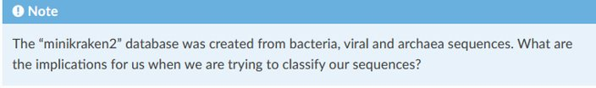
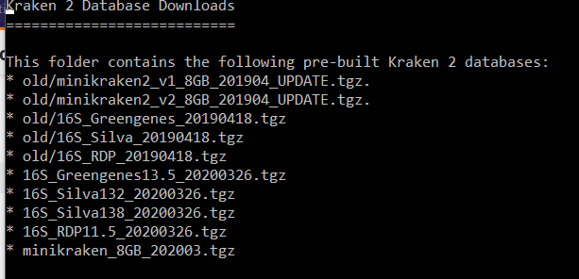
Prebuilt Databases Available for Kraken2
RDP: bacterial and archaeal 16S data
SILVA: Small subunit NR99 sequence set
Custom databases are allowed!

Slide 9
Contents of minikraken-v1 database
Not human-readable format files:
Hash.k2d: contains the minimizer to taxon mappings
Opts.k2d: contains information about the options used to build the database
Taxo.k2d: contains taxonomy information used to build the database

Slide 10
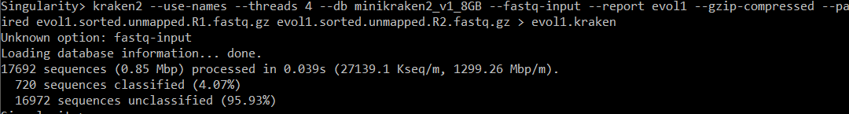
Using minikraken-v1 database

Slide 11
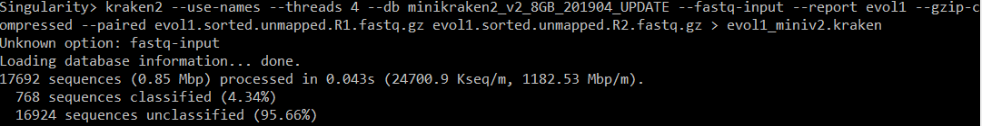
Using minikraken-v2 database

Slide 12
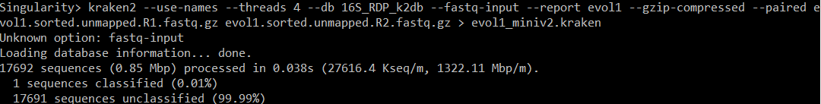
Using 16s_RDP database

Slide 13
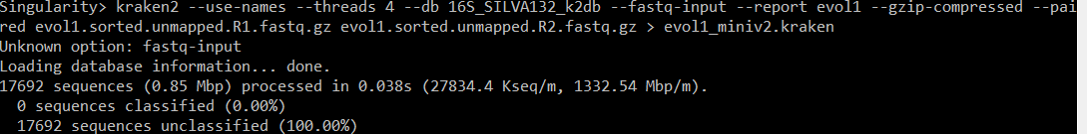
Using 16s_silva132 database

Slide 14
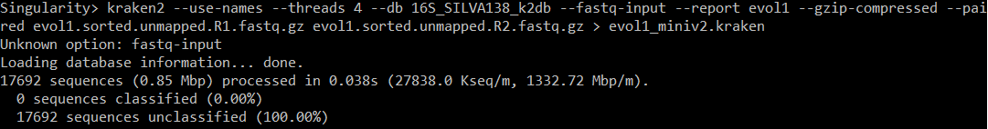
Using 16s_silva138 database

Slide 15
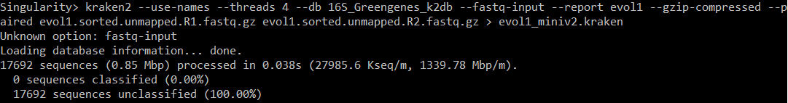
Using 16s_Greengenes database

Slide 16
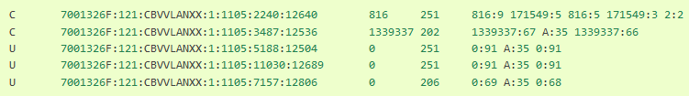
Minikraken-v2 evol.kraken output file
C/U: one letter code indicating that the sequence was either classified or unclassified.
The sequence ID, obtained from the FASTA/FASTQ header.
The taxonomy ID Kraken2 used to label the sequence; this is 0 if the sequence is unclassified and otherwise should be the NCBI Taxonomy identifier.
The length of the sequence in bp.
A space-delimited list indicating the lowest common ancestor (in the taxonomic tree) mapping of each k-mer in the sequence. For example, 562:13 561:4 A:31 0:1 562:3 would indicate that:
the first 13 k-mers mapped to taxonomy ID #562
the next 4 k-mers mapped to taxonomy ID #561
the next 31 k-mers contained an ambiguous nucleotide
the next k-mer was not in the database
the last 3 k-mers mapped to taxonomy ID #562
|:| token indicates the end of one read and the beginning of another.

Slide 17
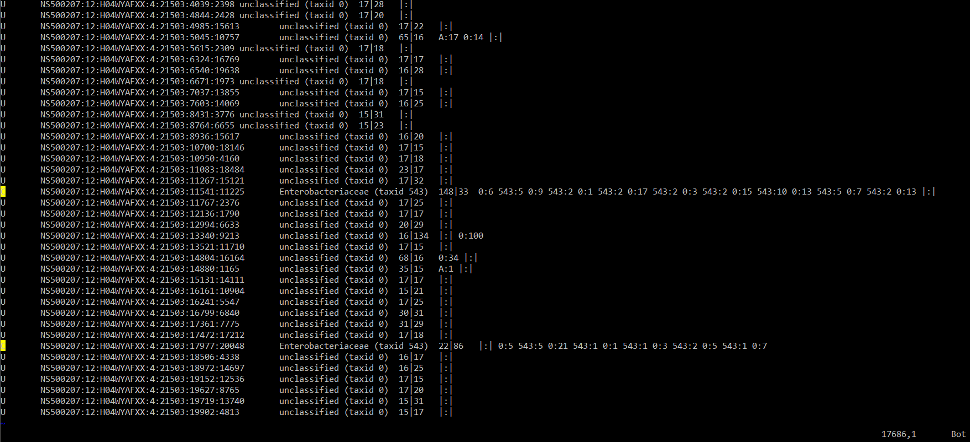
Minikraken-v2 evol.kraken output file

Slide 18
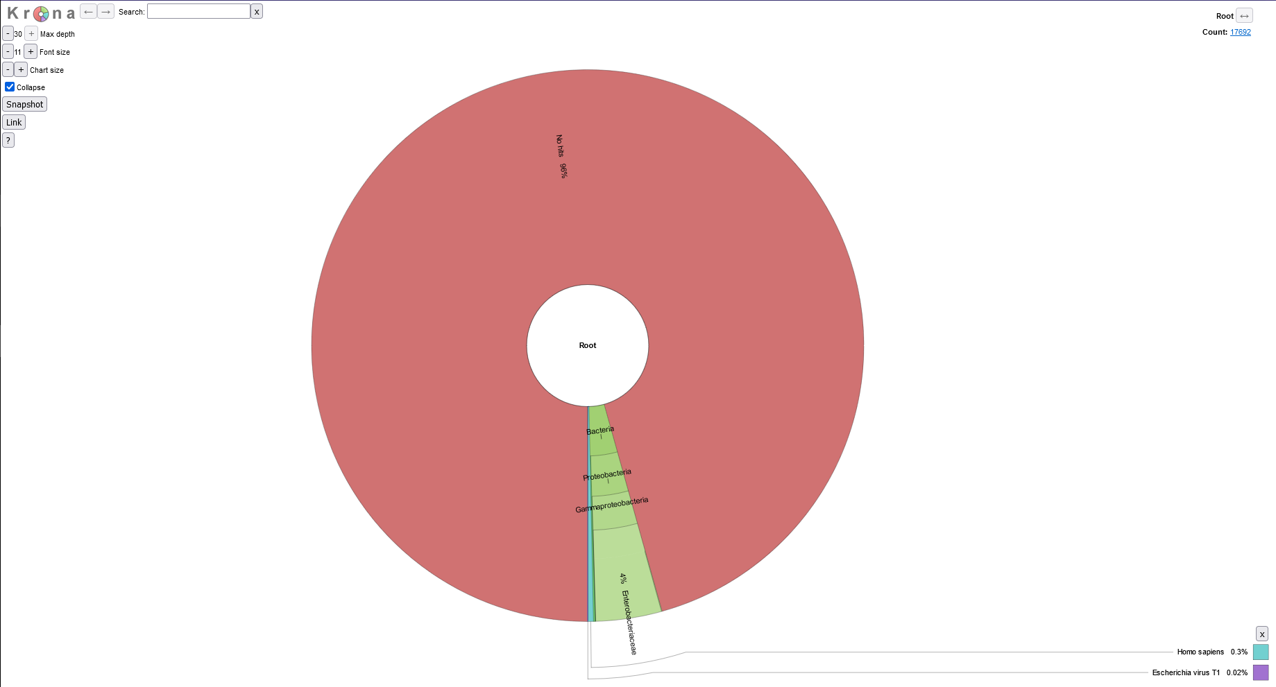
Minikraken-v2 (matches evol1 report)

Slide 19
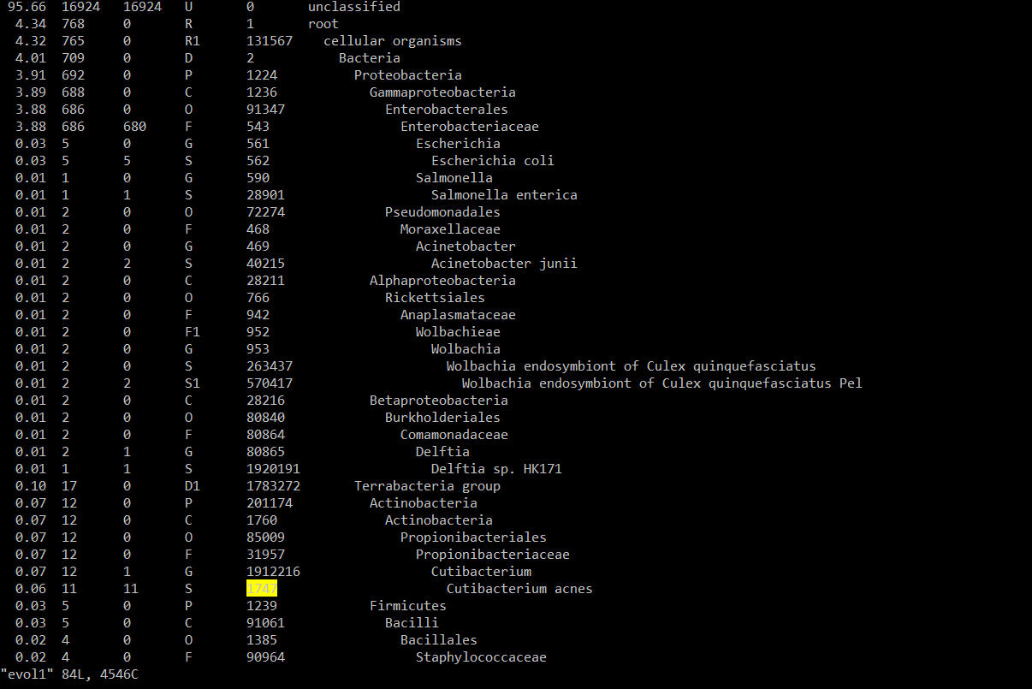
Evol1 report file form Kraken2

Slide 20
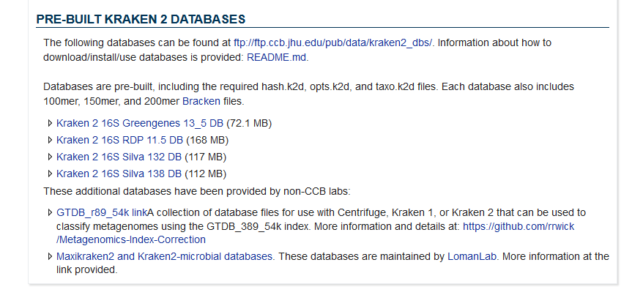
Useful links
https://genomebiology.biomedcentral.com/articles/10.1186/gb-2014-15-3-r46
https://proteusmaster.urcf.drexel.edu/urcfwiki/index.php/Singularity#Pull_an_Image
https://singularity-tutorial.github.io/
https://singularity-user-docs.readthedocs.io/en/latest/singularity_and_docker.html
https://github.com/DerrickWood/kraken2
https://genomics.readthedocs.io/en/latest/ngs-taxonomic-investigation/index.html#kraken2
https://www.ccb.jhu.edu/software/kraken2/index.shtml?t=downloads

Slide 21
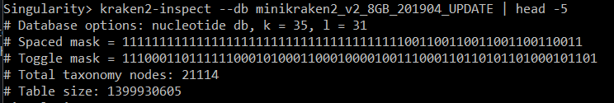
Appendix: Inspecting the database

