Slide 1
RailSense AI
1.28M
station delay records
16
See the delay before it cascades.
railway zones modelled
Predictive intelligence for how one late train becomes many, across Indian Railways.
0.9153
AUC-ROC, LightGBM
Disha Takawale (2413195) Prerana Patankar (2413196) Saloni Patil (2413210) Neha Maniyar (2413211)
Mentor : Dr. Seema Kolkur
Notes:
Open with the one-line promise. RailSense AI turns a late-train problem into a network problem: it shows where time was lost, who is hurt next, and how likely a trip is to run late. Introduce the team and supervisor.

Slide 2
Problem Statement: Delay Propagation in Rail Networks
1
Shared infrastructure
HOW A DELAY SPREADS
Trains share tracks, signalling blocks, junctions and platforms. A delayed train can hold up whoever is scheduled next.
A
Train A
Delayed by fog or a breakdown
2
Rake turnaround
B
Train B
Held outside the station
The same rake is reused for the next service. If it arrives late, there is less time to clean and prepare it.
C
Train C
Forced to slow down
3
A prediction gap
Train-by-train estimates can miss how congestion and linked services spread delay across the network.
Train D
D
Cascades further down the line
Notes:
Delay travels through shared infrastructure and shared rakes, so it is a network property, not a single-train property. The domino diagram is conceptual.

Slide 3
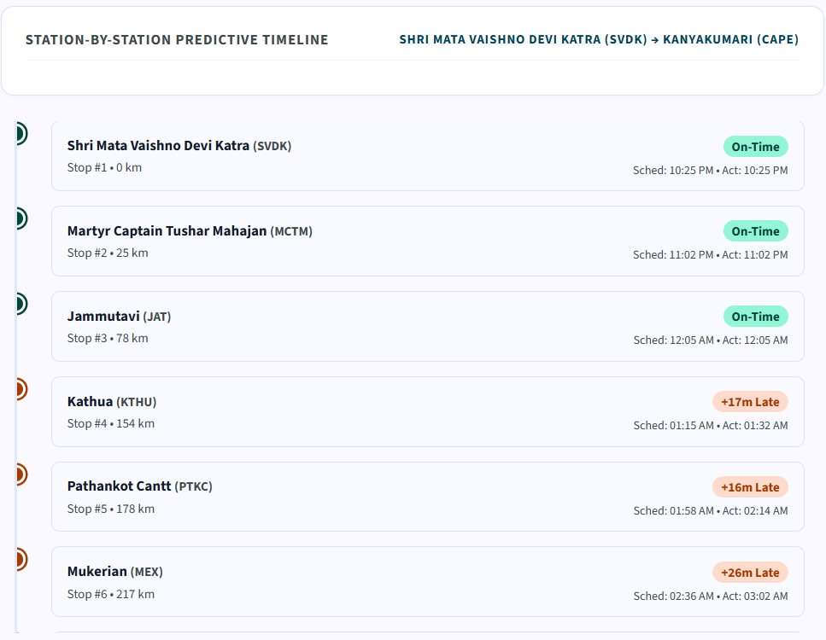
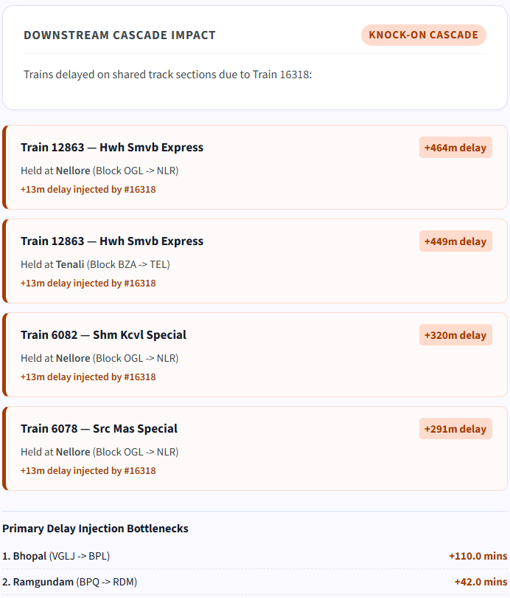



System Demonstration: Trip Timeline and Cascade Impact
Where time slipped
On time to Jammutavi, then +17 min at Kathua.
Who got held up
Trains 12863 and 6082 held at Nellore.
How much it cost
+13 min injected by 16318; Bhopal tops the bottleneck list at +110 min.
Stop-by-stop timeline: Train 16318, Katra to Kanyakumari
Downstream cascade impact panel
Notes:
Left: the stop-by-stop timeline, first three stops on time then delay appears at Kathua. Right: the knock-on panel names the trains held on shared blocks and the minutes injected by 16318. The big figures on each card (+464m etc.) are those trains' own total delays. The screenshot is from an earlier build labelled 'Predictive Timeline'; the current dashboard describes these as recorded historical trips, not live status or a forecast.

Slide 4


Target Users and Application Areas
Passengers
Railway planners and control rooms
Clear, jargon-free stop-by-stop trip history
See where time was lost or recovered
Delay forecast, risk tier and delay chance
Chronic bottleneck sections and zones
Trains held on shared blocks, minutes injected
Track vs platform loss shows what to fix
Notes:
Two audiences: passengers get a plain-language explanation of a trip; planners and control rooms get bottleneck sections, zones and the knock-on view.

Slide 5

Datasets Used
BREADTH | MACRO JOURNEYS
DEPTH | STATION TELEMETRY
Kaggle national railway corpus
IIT Kharagpur RSTGCN benchmark
ir_train.csv
Station-level delay records, Sep 2024
1.5M
1.28M
stop records, one row per station stop
train journeys across 45 columns
Route length, scheduled hours, zone, stops
Rake sharing and late incoming rake flags
Fog risk and monsoon severity scores
Scheduled vs actual arrival and departure
Section distance and stop sequence
Ganesh Chaturthi festival surge, 7 to 17 Sep
Trains the LightGBM delay and risk models
Computes track running vs platform dwell loss
Notes:
Two complementary datasets. Left: the Kaggle national journey corpus (ir_train.csv, 1.5M journeys, 45 columns) gives breadth and trains the LightGBM models. Right: the IIT Kharagpur RSTGCN station records (1.28M stops, Sep 2024) give depth, so we can split track running loss from platform dwell loss and see the Ganesh Chaturthi surge (7 to 17 Sep). Both are loaded into one local DuckDB file (db/railway.duckdb). CHECK BEFORE PRESENTING: your draft content also quoted 3,892 trains and a join on train_number and date in under 15 ms; neither figure appears in the repo docs, so they are left off this slide.

Slide 6






System Architecture: Five-Layer Local Pipeline
DATA SOURCES
WAREHOUSE
ANALYTICS ENGINES
ML LAYER
DASHBOARD
Station delays
DuckDB
Trajectory
LightGBM
Streamlit
1.28M stops, IIT Kgp RSTGCN (Sep 2024)
Polars streaming ETL, about 14 s. Tables: station_stops, section_analytics, journeys.
Stop-by-stop waterfall, track vs dwell loss, bottlenecks
Delay regressor in minutes plus a 15-minute risk classifier. Benchmarked against Ridge, Random Forest, XGBoost.
Find a train, trip timeline, knock-on cascade and trouble spots.
Journeys
Graph + cascade
1.5M trips, 45 columns (Kaggle)
16-zone graph, rake chains, zone delay pressure
Notes:
Read left to right: two datasets feed a Polars and DuckDB warehouse, two engines derive trajectory and graph features, LightGBM predicts, Streamlit presents. The local-first figures (45 MB, 18-25 ms vs 150-400 ms for Neo4j) are project-reported. Note the dashboard shows historical recorded trips, not a live feed.

Slide 7
Implementation Architecture: Modules and Request Flow
BUILD TIME
Ingest
src/station_etl.py
src/etl.py
Polars, about 14 s
Store
db/railway.duckdb
3 indexed tables
Engineer
graph_builder.py
cascade_features.py
3 cascade features
Train
benchmark.py, train.py
champion_models.pkl
LightGBM champion
Runs once, offline
RUN TIME
Passenger
Searches a train
by number or name
Streamlit
app/dashboard.py
3 tabs
trajectory_profiler.py
Stop history from DuckDB
Result
Timeline, forecast,
knock-on view
On every train search
predictor.py
Loads champion_models.pkl
Notes:
Complements the five-layer overview slide with the actual repo files. Top lane runs once, offline: ETL into DuckDB, graph and cascade features, benchmark and training, which writes models/champion_models.pkl. Bottom lane runs on every search: Streamlit (app/dashboard.py) calls the TrajectoryProfiler for stop-level history from DuckDB and the DelayPredictor, which loads the saved champion models. The pickle file is the hand-off between the two lanes. Optional: if this feels repetitive next to the five-layer slide, drop one of the two.

Slide 8

Mathematical Formulation of Delay Metrics
Inter-station running delta
73.4%
Platform dwell delta
26.6%
of accumulated delay
of accumulated delay
Δ_{running}(i) = arr_delay_{i} − dep_delay_{i−1}
Δ_{dwell}(i) = dep_delay_{i} − arr_delay_{i}
Time gained or lost between stations: signal halts, speed restrictions, queuing behind other trains.
Extra time standing at a station beyond the timetable: boarding, loading, platform clearance.
Rolling zone delay pressure
#1
Betweenness centrality
0.342
ranked model feature
NCR (Prayagraj), top of 16
ZDP(z, t) = (1/20) · Σ delay_{k} k = t−19 … t
C_{B}(v) = Σ σ_{st}(v) / σ_{st}
Mean of the last 20 train delays in zone z: how saturated a corridor is before a train enters it.
Share of shortest paths passing through zone v (normalised). A delay at a high-score zone ripples furthest.
Notes:
Four formulas carry the project. The first two split every delay into track running loss and platform dwell loss (73.4% vs 26.6% of accumulated delay). The third is the rolling zone pressure feature, a mean over the last 20 train delays in a zone (min_samples=1 in the code), ranked first among model features. The fourth is betweenness centrality on the 16-zone graph, computed with NetworkX (normalised), where NCR (Prayagraj) scores 0.342. Your draft quoted a split score of 1,229 for zone_delay_pressure; it is not in the repo docs, so it is not shown.

Slide 9
Network Analysis: Betweenness Centrality of Railway Zones
0.342
NR
NFR
NER
NWR
NCR (Prayagraj) betweenness centrality, the highest of the 16 zones. A delay here ripples across the national grid.
NCR
ECR
ER
WR
WCR
SECR
SER
zone_delay_pressure
Rolling 20-period average delay per zone. Ranked #1 among the model's features.
CR
SCR
ECoR
rake_cascade_chain_length
SWR
SR
Counts linked services sharing one rake, so late arrivals carry into the next trip.
Schematic: 16 zones, 25 links. Positions and links are illustrative, not the real corridor map.
Notes:
Zones are nodes and corridors are links; betweenness centrality scores how many shortest paths pass through each zone. The drawing is schematic: node positions and the 25 links are illustrative, so check them against src/graph_builder.py before claiming specific corridors. 0.342 for NCR and the #1 feature ranking for zone_delay_pressure are project-reported.

Slide 10
Delay Decomposition: Track Running vs Platform Dwell
Where accumulated delay comes from
Track running loss
73.4%
Δ running = arrival delay (stop i) − departure delay (stop i−1)
Time lost between stations: signal halts, speed restrictions, queuing behind other trains.
Platform dwell loss
26.6%
Δ dwell = departure delay (stop i) − arrival delay (stop i)
Extra time standing at a station: boarding, loading, platform clearance.
Why it matters: it tells planners whether to fix the track or the platform.
Notes:
The split is computed from 1.28M station records. Project docs quote ~72% / ~28% in one place and 73.4% / 26.6% in another; this slide uses 73.4 / 26.6 from the earlier deck. Align with your report before presenting.

Slide 11
Model Benchmarking: Comparative Performance Analysis
Model | Paradigm | MAE (min) ↓ | RMSE ↓ | R² ↑ | AUC-ROC ↑ | Train time | Latency
Ridge Regression | Linear, L2 regularised | 36.76 | 47.74 | 0.4175 | 0.9140 | 0.04 s | < 0.001 ms
Random Forest (n=50) | Bagging ensemble | 33.95 | 46.35 | 0.4510 | 0.9068 | 3.69 s | 0.002 ms
XGBoost | Exact gradient boosting | 33.80 | 45.87 | 0.4623 | 0.9148 | 0.88 s | < 0.001 ms
LightGBM (champion) | Histogram gradient boosting | 33.65 | 45.76 | 0.4648 | 0.9153 | 0.47 s | < 0.001 ms
−3.11 min
0.9153
< 0.001 ms
MAE vs the Ridge baseline, so delay is non-linear
AUC-ROC for delays above 15 minutes
inference per query, suited to instant lookup
100,000 journeys, identical 80/20 train/test split. Ridge trains fastest (0.04 s); LightGBM is the fastest of the boosted models.
Notes:
Four model families, identical 80/20 split on 100,000 journeys. LightGBM has the lowest MAE and RMSE and the highest R2 and AUC-ROC. Be honest about the margins: it beats XGBoost by 0.15 min MAE, so call it a modest edge with the fastest training among the boosted models. Ridge actually trains fastest (0.04 s) and has near-zero latency. The 3.11 min gap to Ridge supports the claim that delay dynamics are non-linear. Source: models/benchmark_report.json and README.

Slide 12
Ablation Study: Impact of Cascade Features
ABLATION STUDY
Same model, with and without graph and cascade features
−0.53 min
MAE: 34.18 to 33.65
+0.0059
AUC-ROC: 0.9094 to 0.9153
LightGBM : MAE 33.65 min | RMSE 45.76 | AUC-ROC 0.9153 | 0.47 s training | < 1 ms inference
Notes:
Project-reported results on 100,000 journeys (80/20 split). The lead over XGBoost is small, so present it as a modest edge with the fastest training among the boosted models. The ablation shows a consistent gain; no statistical significance test is claimed. Ridge trains fastest (0.04 s).

Slide 13

Results: Dashboard Interface and Functional Modules
TAB 1 | PASSENGERS
TAB 2 | PLANNERS
TAB 3 | RESEARCHERS
Train Delay Forecast & Cascade
Corridor Chokepoints
Model Benchmarks & Tech Architecture
Arrival forecast
Predicted delay, P(>15 min), risk tier
Zone delay ranking
Average delay across the 16 railway zones
Four-model table
MAE, RMSE, R², AUC-ROC, speed
Prediction reliability
Confidence, fog risk index, zone pressure
Kinematic attribution
Track running loss vs platform dwell loss
National bottlenecks
Top track sections by minutes added per run
Why LightGBM
Champion row with trade-off notes
Station-by-station timeline
Where the trip lost or recovered time
Built on 1.28M stops
Recorded station-level history
Tech architecture
DuckDB and NetworkX vs heavier tools
Downstream cascade impact
Trains held on shared blocks, minutes injected
Runs locally on DuckDB. It shows recorded trips and model outputs, not a live train feed.
Notes:
This reflects app/dashboard.py as it stands in the repo: three tabs. Tab 1 combines the arrival forecast (predicted delay, probability of passing 15 minutes, risk tier), a reliability panel, kinematic attribution, the stop-by-stop timeline and the downstream cascade panel. Tab 2 shows zone delay ranking and top national bottleneck sections. Tab 3 shows the model benchmark table and the tech-architecture rationale. CHECK BEFORE PRESENTING: your draft described five tabs (including a cascade simulator and a festival-rush tab and a probability gauge); those are not in the current dashboard.py, and the Ganesh Chaturthi +14.3 min surge is covered in the project docs only. Also, the reliability percentage in Tab 1 is computed from a formula in the code, so present it as a display value, not a measured calibration.

Slide 14


Key Contributions and Novelty of RailSense AI
CAPABILITY
COMMON APPROACH
RAILSENSE AI
Network-aware cascades
Each train is a lone dot on a map
Models shared blocks, rake turnaround and zone pressure to show whether a delay fades or multiplies
Cause of delay isolated
One total delay number, no cause
Splits track running loss (73.4%) from platform dwell loss (26.6%) at station-to-station sections
Downstream impact named
Shows the delayed train only
Names trains held on shared blocks and minutes injected: 16318 held 12863 and 6082 at Nellore
Local-first, zero cloud
Graph server such as Neo4j, with JVM overhead
Polars + DuckDB + NetworkX: under 45 MB graph engine, centrality in about 20 ms
Notes:
Moves the conversation from "where is my train" to why it slipped and who it hurts next. Compare to the common approach row by row. The cascade example matches the demo slide: 16318 injected about +13 min and trains 12863 and 6082 were held at Nellore. Do not say 12863 was held 464 min because of 16318: 464 min is that train's own total delay, as noted on the demo slide. The local-first figures (under 45 MB, about 20 ms centrality) are for the graph engine and are project-reported. Your draft also claimed 40 km chokepoints and a full run in under 20 ms; neither is in the repo docs, so they are left out.

Slide 15
References
Data and research
Models and data tools
[1] IIT Kharagpur RSTGCN study and station-level delay dataset for Indian Railways, Sep 2024.
[2] Kaggle national railway journey dataset (ir_train.csv), 1.5M journeys, 45 columns.
[3] Brandes, U. (2001). A faster algorithm for betweenness centrality. Journal of Mathematical Sociology, 25(2), 163-177.
[4] Hagberg, A., Schult, D., Swart, P. (2008). Exploring network structure, dynamics, and function using NetworkX. SciPy 2008.
[5] Ke, G. et al. (2017). LightGBM: a highly efficient gradient boosting decision tree. NeurIPS 30.
[6] Chen, T., Guestrin, C. (2016). XGBoost: a scalable tree boosting system. KDD 2016.
[7] Pedregosa, F. et al. (2011). Scikit-learn: machine learning in Python. JMLR, 12, 2825-2830.
[8] Raasveldt, M., Muhleisen, H. (2019). DuckDB: an embeddable analytical database. SIGMOD 2019.
Notes:
Items [1] and [2] are described as in your project docs; add full author and title details for the RSTGCN paper and the Kaggle dataset page from your report. Items [3] to [8] are standard citations for the methods and tools used.

Slide 16
Thank you

