Slide 1
JupyterLab and BinderHub
Team 6:
Ann Sara Sajee
Gunjan Lalwani
Rishabh Jain

Slide 2

JupyterLab:
The Evolution of the Jupyter Notebook

Slide 3
FEATURES:
Web-based user interface for Project Jupyter
Enables to work with documents and activities such as Jupyter Notebooks, text editors, terminals, and custom components in a flexible, integrated, and extensible manner
Provides flexible building blocks for interactive, exploratory computing

Slide 4
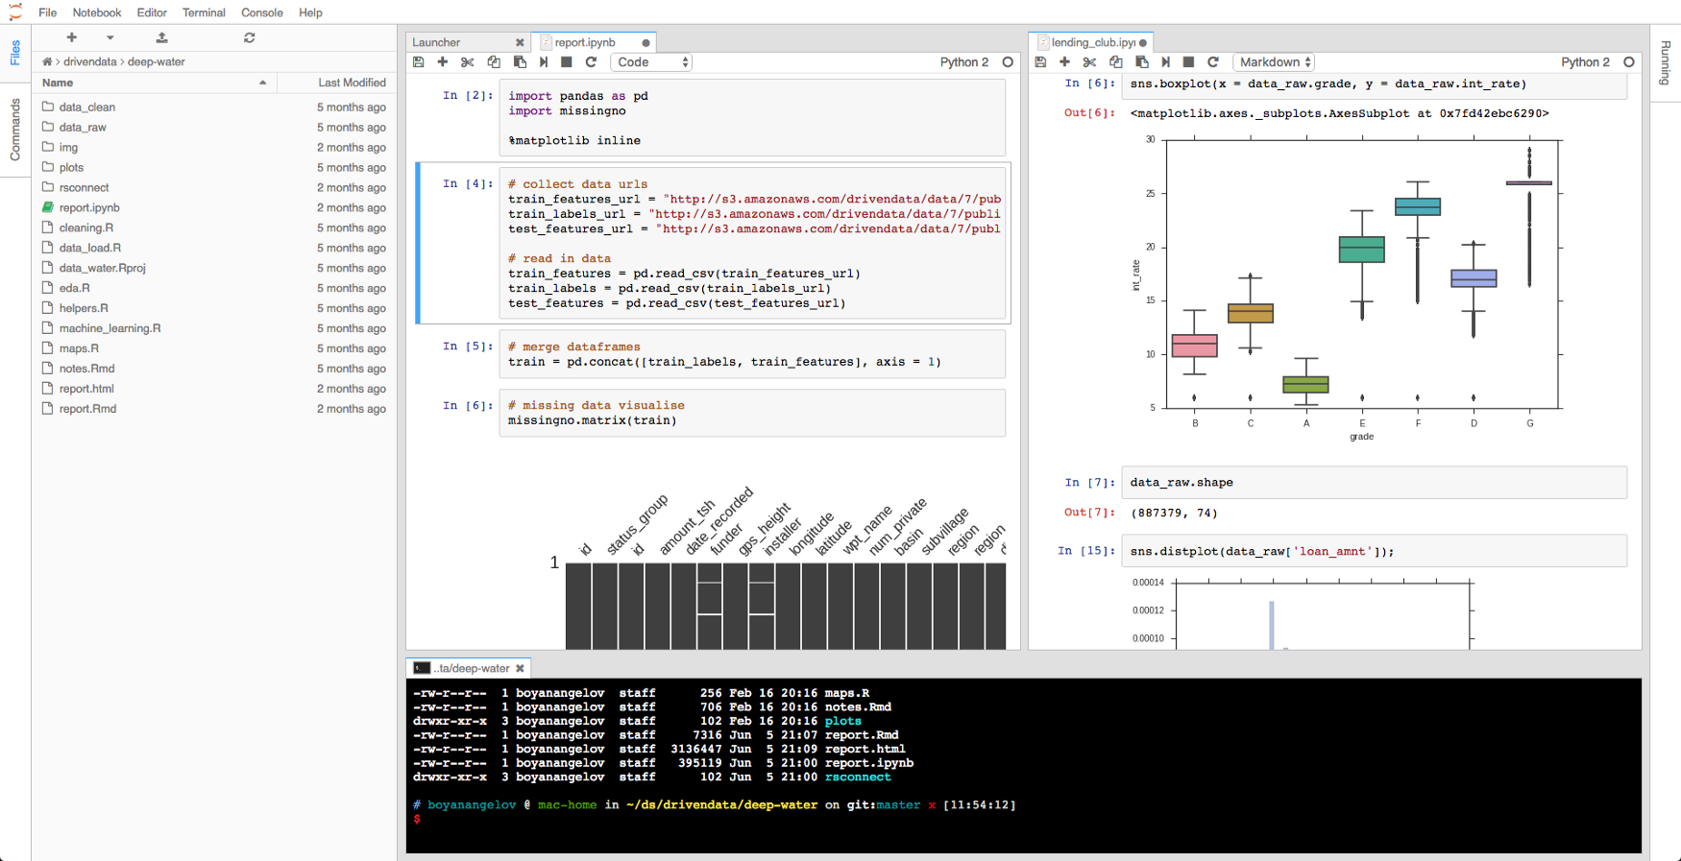
JupyterLab: Integrated Experience

Slide 5
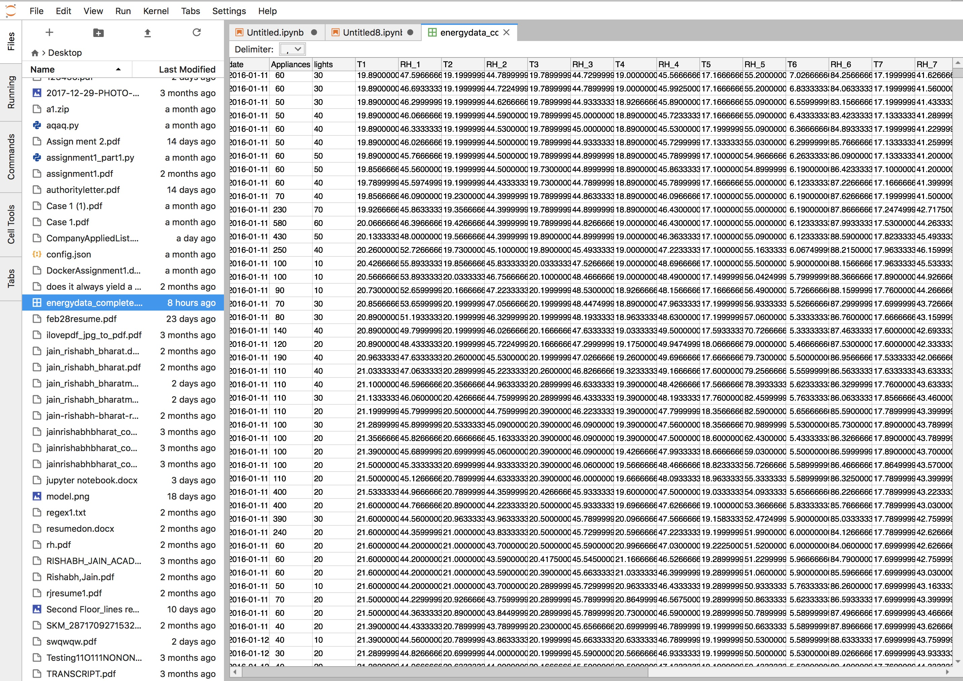
csv file in JupyterLab

Slide 6
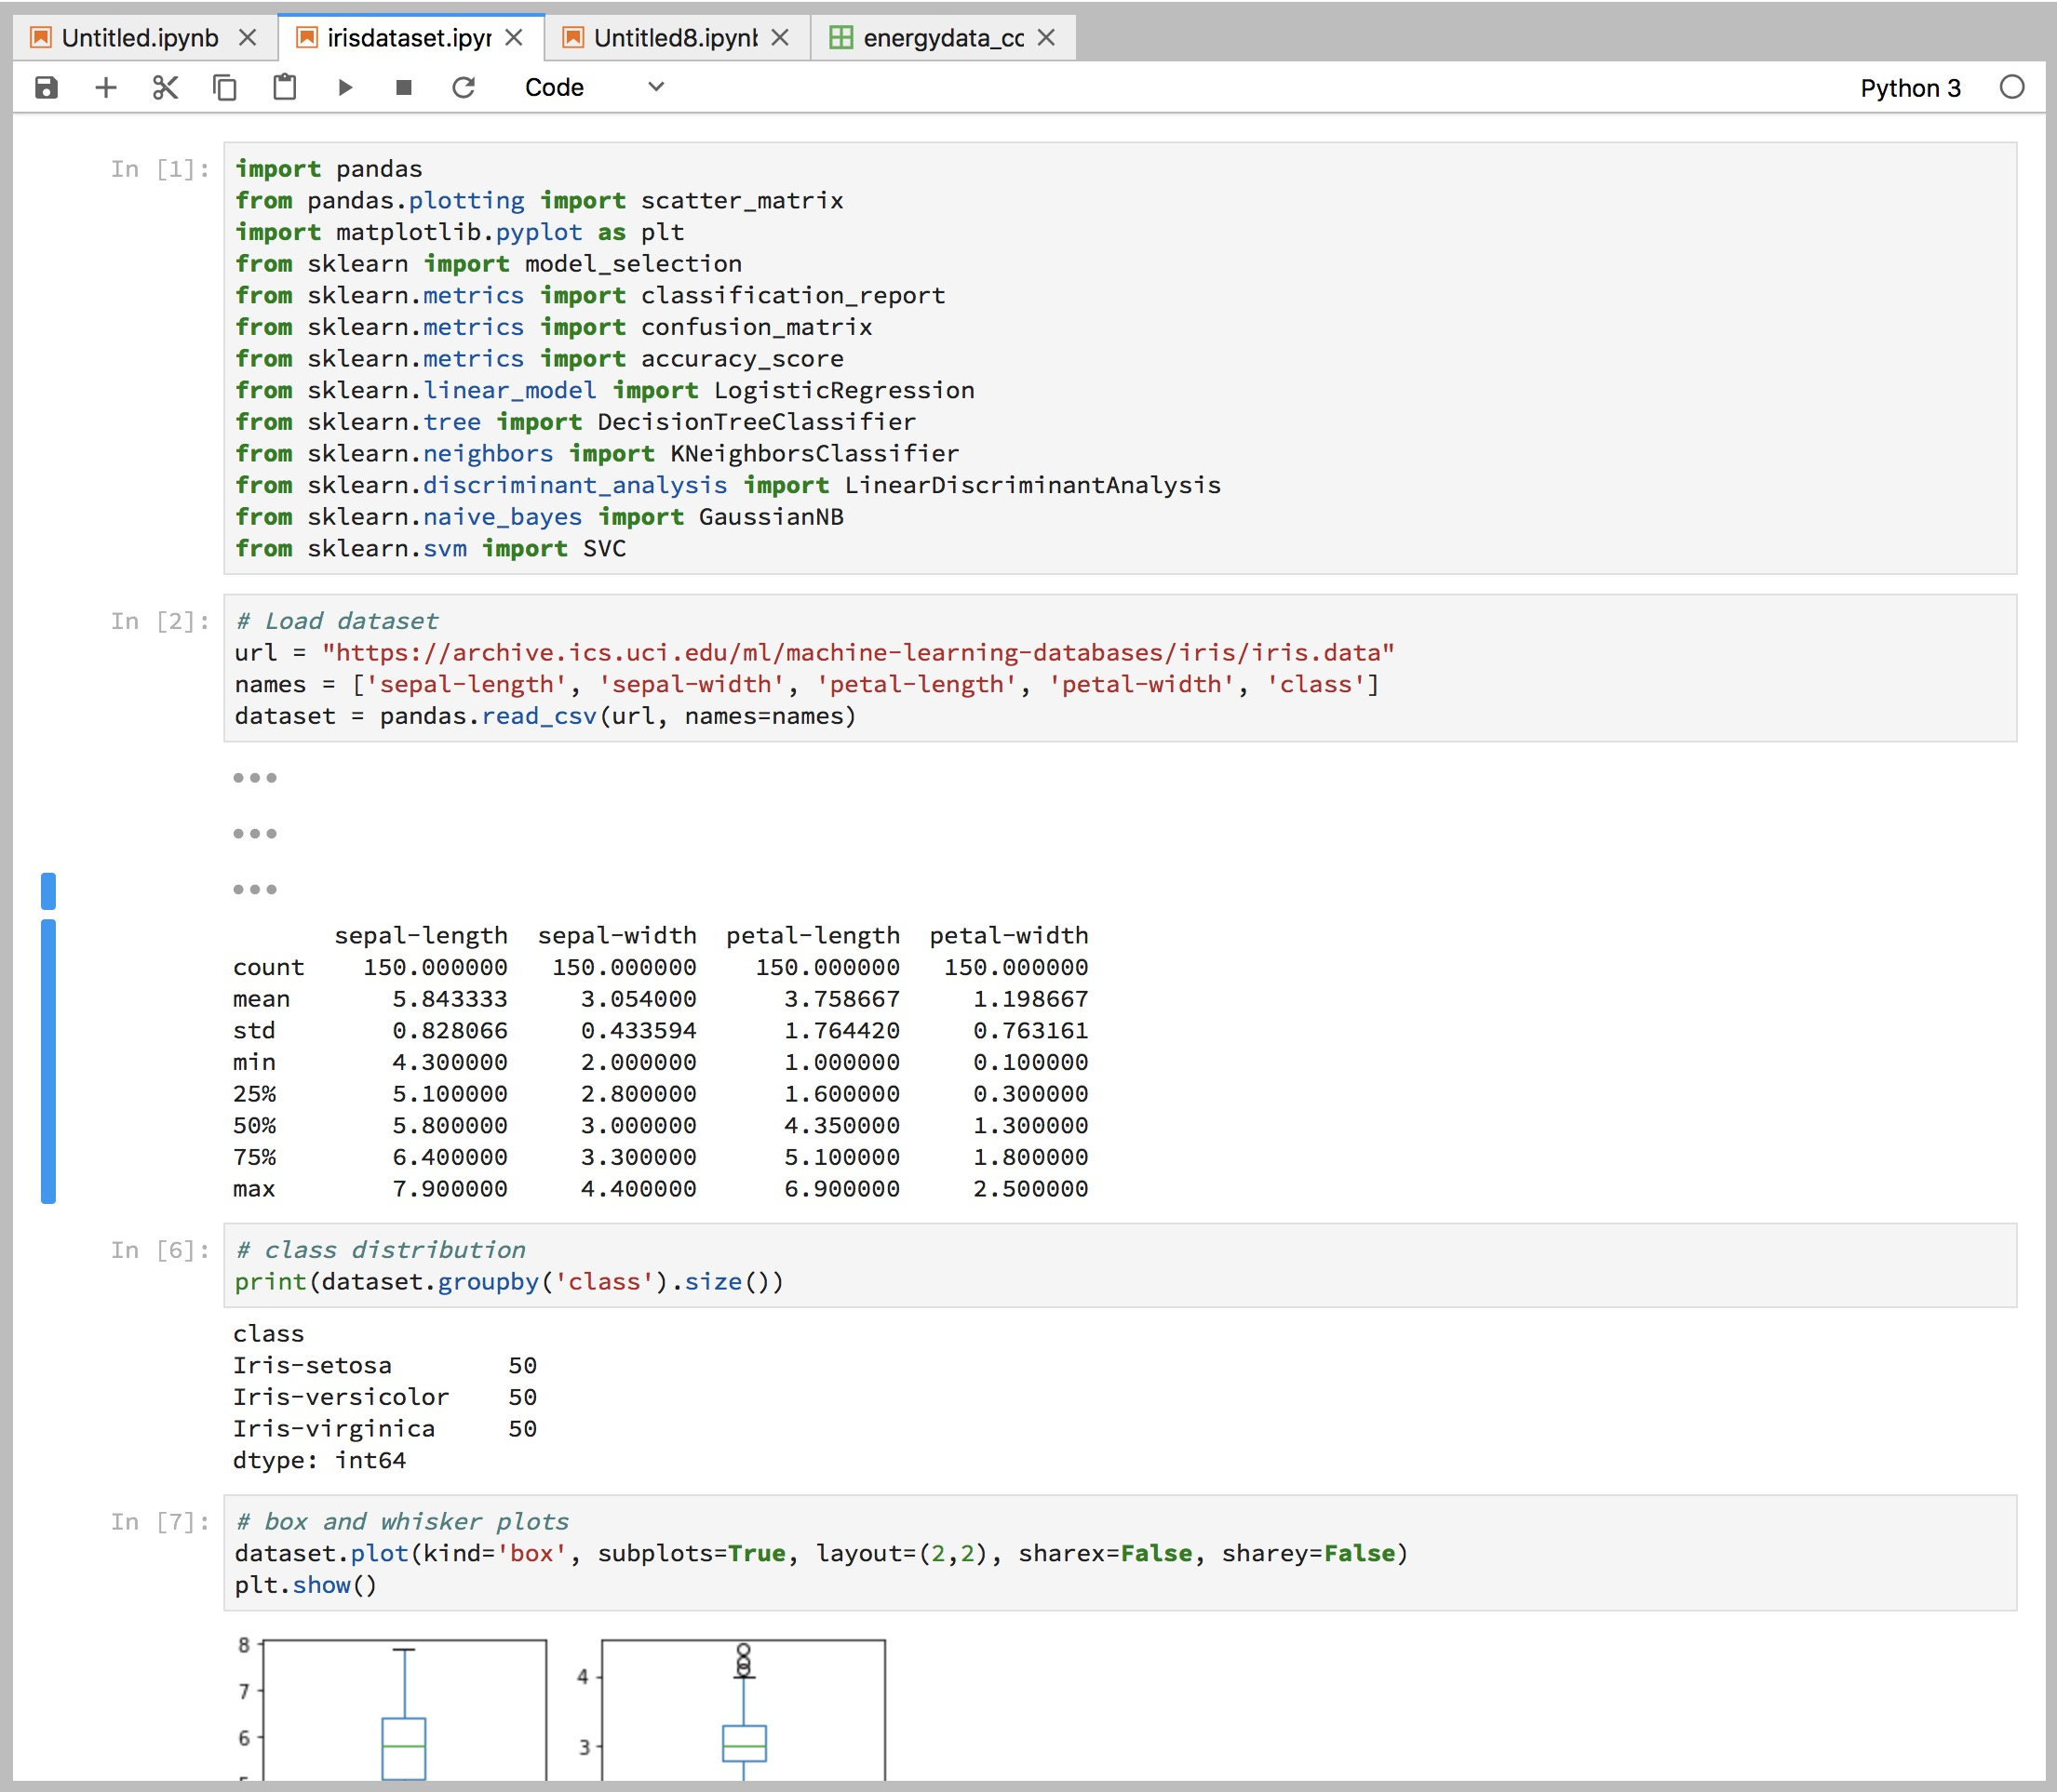
Minimizing cells in JupyterLab

Slide 7
BINDERHUB

Slide 8
What is BinderHub:
Allows you to BUILD and REGISTER a Docker image using a GitHub repository
CONNECT with JupyterHub, allowing you to create a public IP address that allows users to interact with the code and environment within a live JupyterHub instance
BinderHub ties together:
JupyterHub to provide a scalable system for authenticating users and spawning single user Jupyter Notebook servers
Repo2Docker which generates a Docker image using a Git repository hosted online
Installation:
pip install git+https://github.com/jupyterhub/binderhub

Slide 9
The BinderHub Architecture
A cloud provider such Google Cloud, Microsoft Azure, Amazon EC2, and others
Kubernetes to manage resources on the cloud
Helm to configure and control Kubernetes
Docker to use containers that standardize computing environments
A BinderHub UI that users can access to specify GitHub repos they want built
BinderHub to generate Docker images using the URL of a GitHub repository
A Docker registry (such as gcr.io) that hosts container images
JupyterHub to deploy temporary containers for users

Slide 10
Steps to Create your BinderHub:
Setting up Kubernetes on Google Cloud
Install BinderHub
Connect BinderHub and JupyterHub
Try out your BinderHub Deployment

Slide 11
Jupyter-repo2docker
Tool to build, run, and push Docker images from source code repositories
Pre-requisites:
Docker to build & run the repositories
Python 3.4+
Installation:
pip install jupyter-repo2docker

Slide 12
Supported configuration files
Dockerfile - takes priority over and ignores all other build behavior
environment.yml - lets you install packages with conda
requirements.txt - specifies a list of Python packages that should be installed in a virtual environment
postBuild - contain arbitrary commands to be run after the whole repository has been built.
runtime.txt - allows you to control the runtime of Python

Slide 13
Jupyter Notebook Data Science Stack
What it Gives You
Jupyter Notebook 5.2.x
Conda Python 3.x environment
pandas, matplotlib, scipy, seaborn, scikit-learn, scikit-image, sympy, cython, patsy, statsmodel, cloudpickle, dill, numba, bokeh pre-installed
Conda R v3.3.x and channel
plyr, devtools, shiny, rmarkdown, forecast, rsqlite, reshape2, nycflights13, caret, rcurl, and randomforest pre-installed
The tidyverse R packages are also installed, including ggplot2, dplyr, tidyr, readr, purrr, tibble, stringr, lubridate, and broom
Julia v0.6.x with Gadfly, RDatasets and HDF5 pre-installed
Unprivileged user jovyan (uid=1000, configurable, see options) in group users (gid=100) with ownership over /home/jovyan and /opt/conda
tini as the container entrypoint and start-notebook.sh as the default command
A start-singleuser.sh script useful for running a single-user instance of the Notebook server, as required by JupyterHub
A start.sh script useful for running alternative commands in the container (e.g. ipython, jupyter kernelgateway, jupyter lab)
Options for a self-signed HTTPS certificate and passwordless sudo

Slide 14
DEMO

Slide 15
Questions??

Slide 16
Thank You!!!

