Slide 1
Field lines and Gaussian surfaces

Slide 2
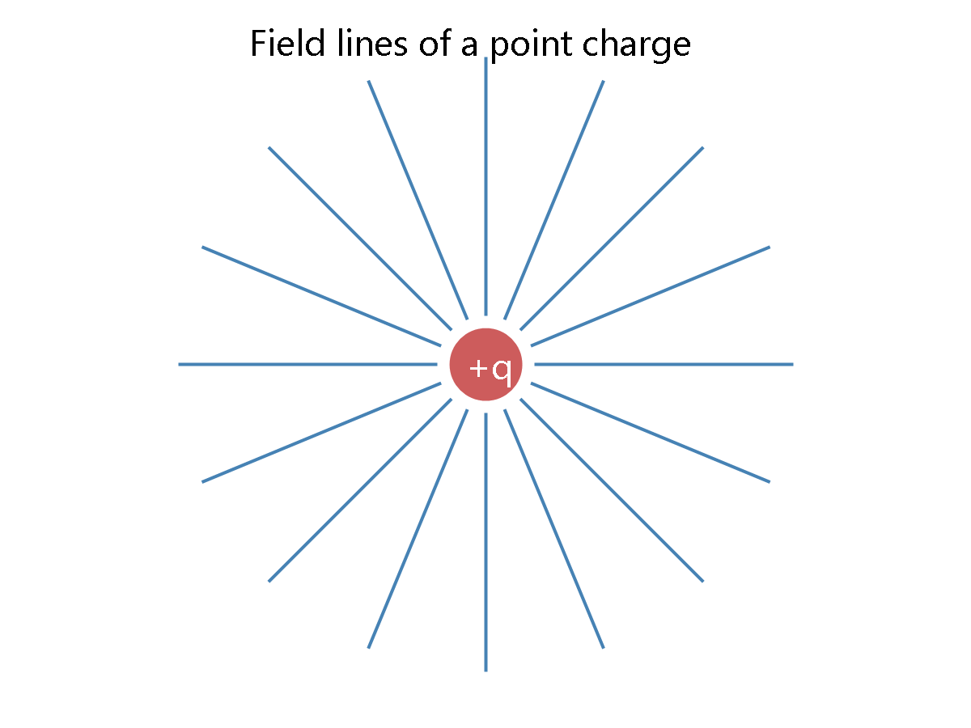

Slide 3
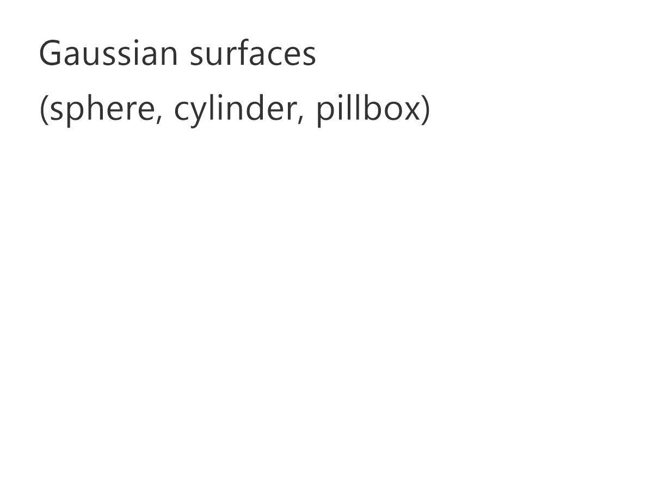

Slide 4
