Slide 1

Learning large systems using peer-to-peer gossip

Slide 2
Policy Against Harassment at ACM Activities
OS Meetup wants to encourage and preserve this open exchange of
ideas, which requires an environment that enables all to
participate without fear of personal harassment. We define
harassment to include specific unacceptable factors and
behaviors listed in the ACM’s policy against harassment.
Unacceptable behavior will not be tolerated.
https://www.acm.org/about-acm/policy-against-harassment

Slide 3
Syscall Preparation: Registers & Memory
Recall:
Page table
Page table contents
Trampoline & Trapframe
Registers in Risc-V
Supervisor Registers
General Purpose Registers
System Calls (User -> Kernel)
What CPU does for us?
What OS does for us?

Slide 4
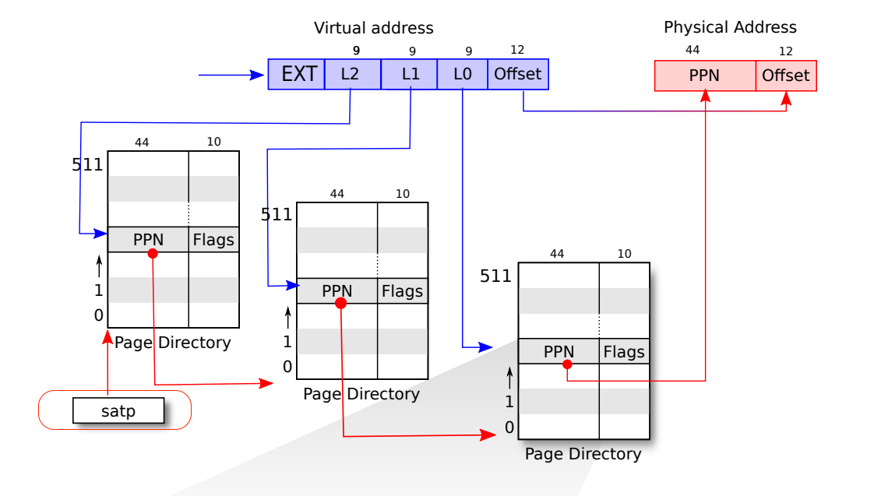
Recall: Page Table

Slide 5
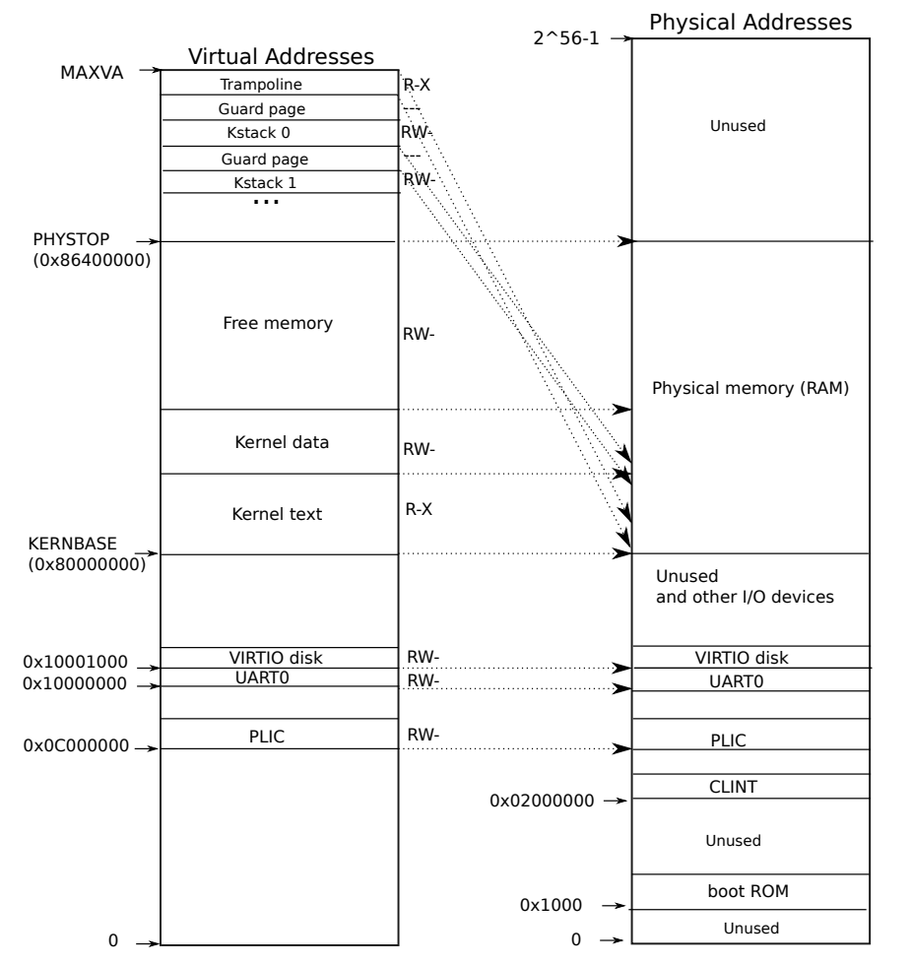
Recall: Page Table

Slide 6
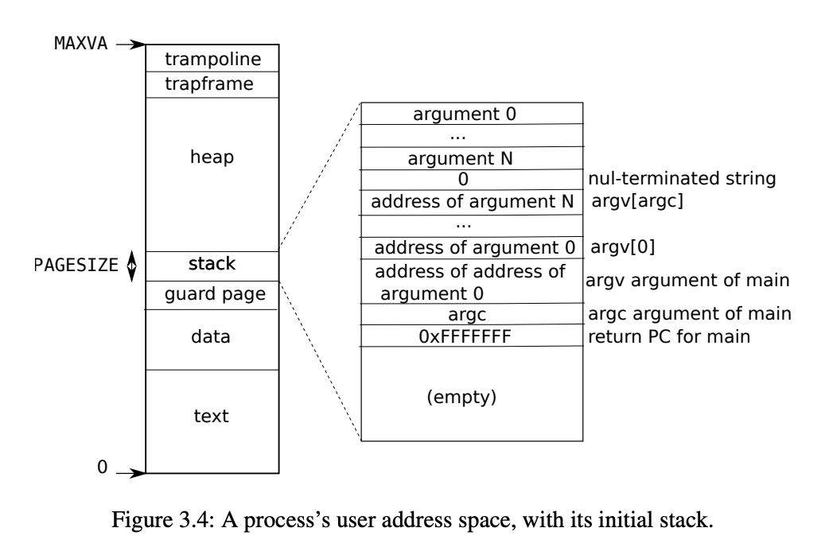
Recall: Page Table

Slide 7
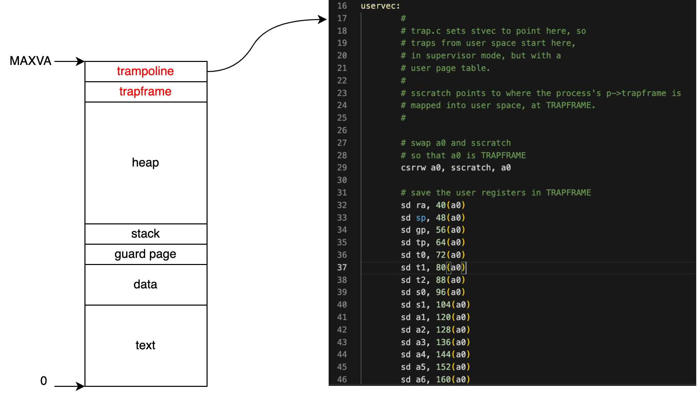
Page: Trampoline

Slide 8
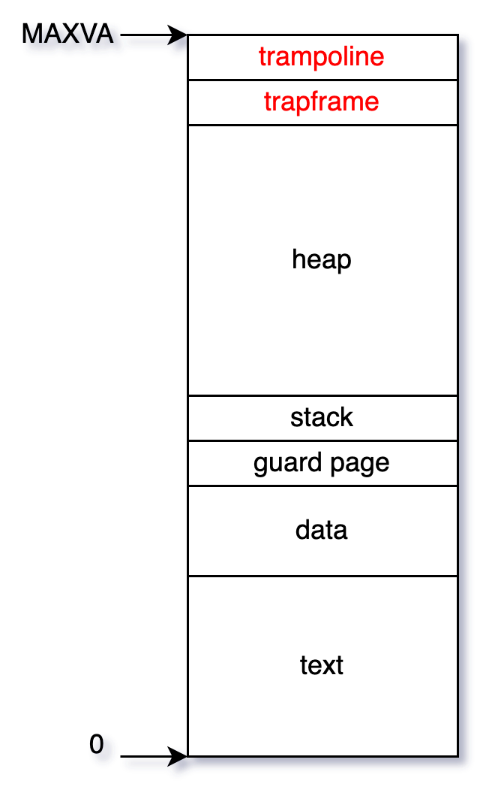
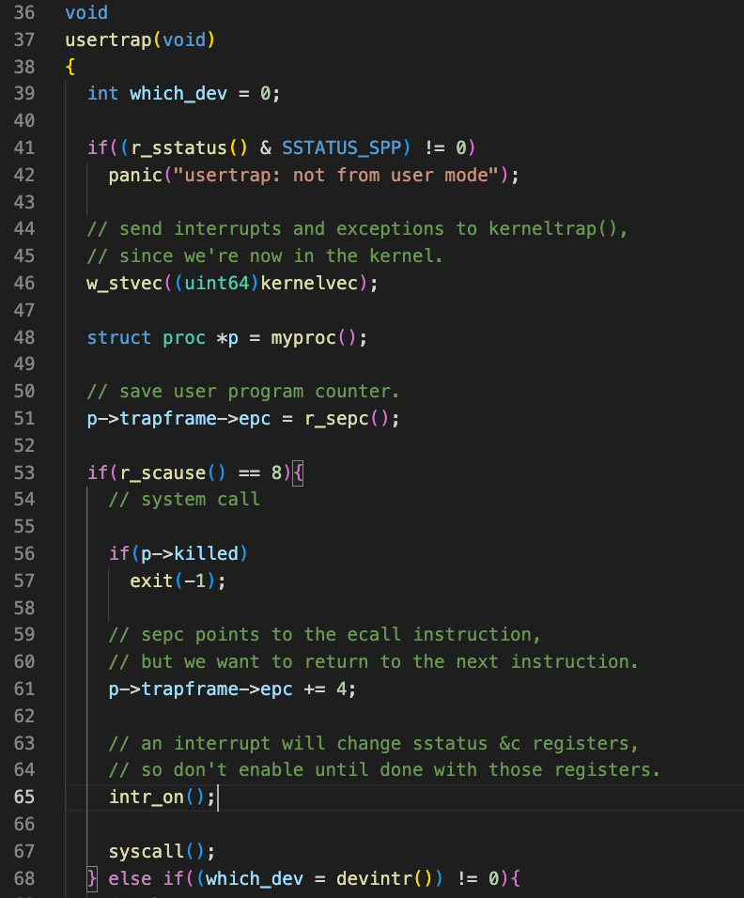
Page: Trapframe
kernel page address
Kernel page
…
…
kernel stack address
…
usertrap func address
…
a7
…

Slide 9
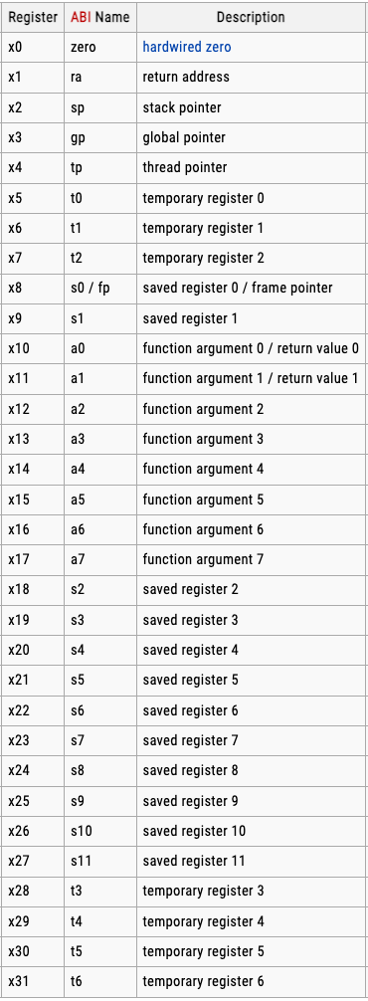
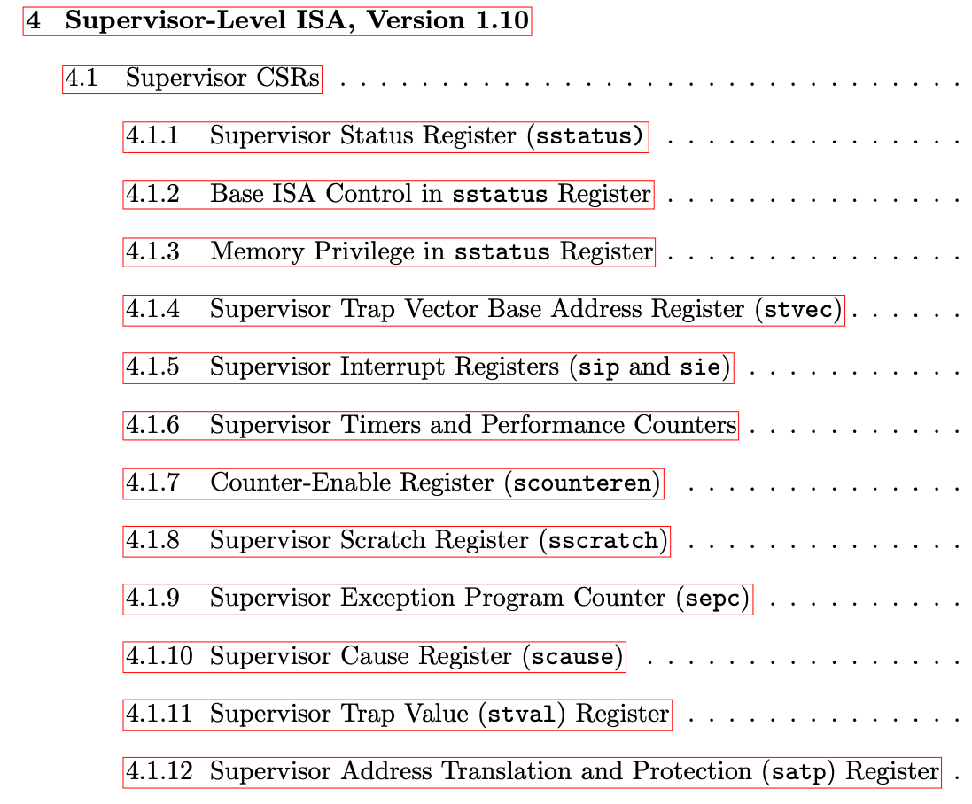
Risc-V Registers
Supervisor control and status registers
General purpose registers
Notes:
Per CPU or Per Core. 每个CPU都有一套这样的

Slide 10
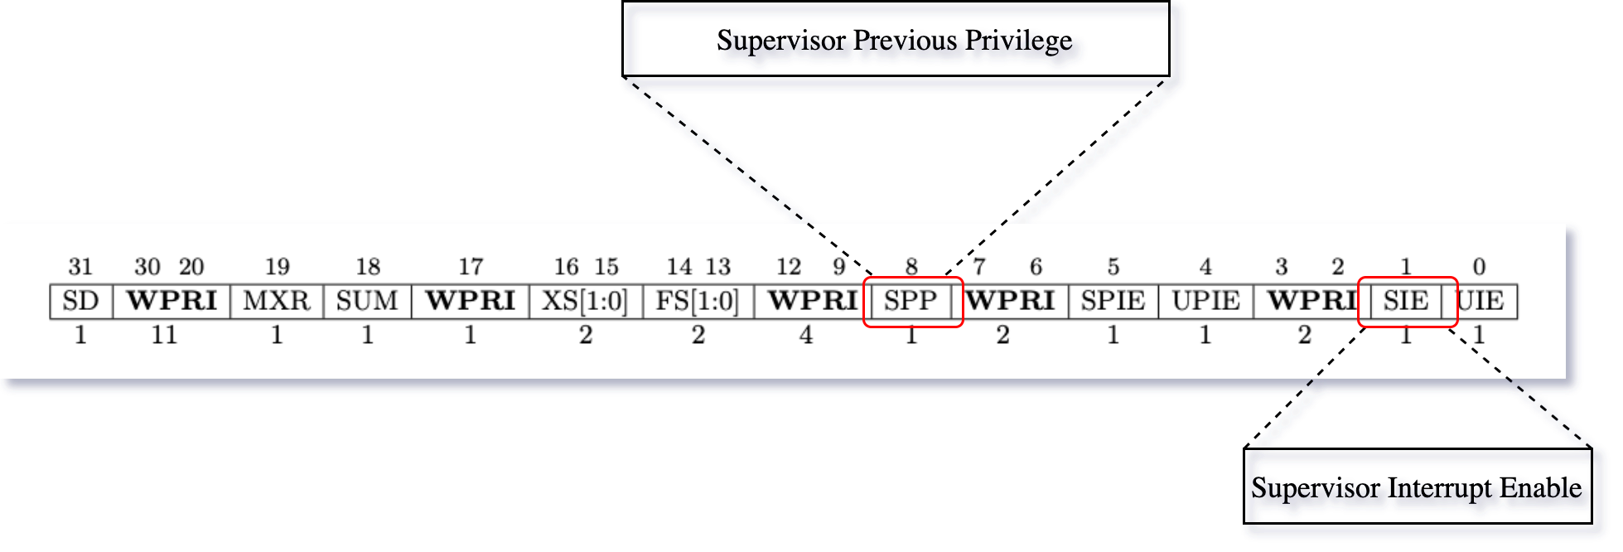
System Calls: CPU
sstatus
0
0
1
?
sstatus
… | SPP: | … | SIE: | …
copy
pc
sepc
How does CPU set the current mode to supervisor mode?
scause
set sv mode
copy
stvec
Notes:
SPP -> 0 User Mode & 1 Supervisor Mode https://www.sifive.com/blog/all-aboard-part-7-entering-and-exiting-the-linux-kernel-on-risc-v

Slide 11
System Calls: OS
swap
sscratch
a0
…
pc
a0
sscratch
?
save
satp
…
load
?
sp
a7
?
t0
…
kernel page address
Any benefits to save these values in trapframe?
kernel stack address
usertrap func address
Notes:
sp: Stack Point
satp: kernel page
t0: UserTrap

Slide 12
System Calls: OS
sstatus
Which part will enable SIE again?
1
0
1
… | SPP: | … | SIE: | …
Notes:
SPP -> 0 User Mode & 1 Supervisor Mode https://www.sifive.com/blog/all-aboard-part-7-entering-and-exiting-the-linux-kernel-on-risc-v

Slide 13
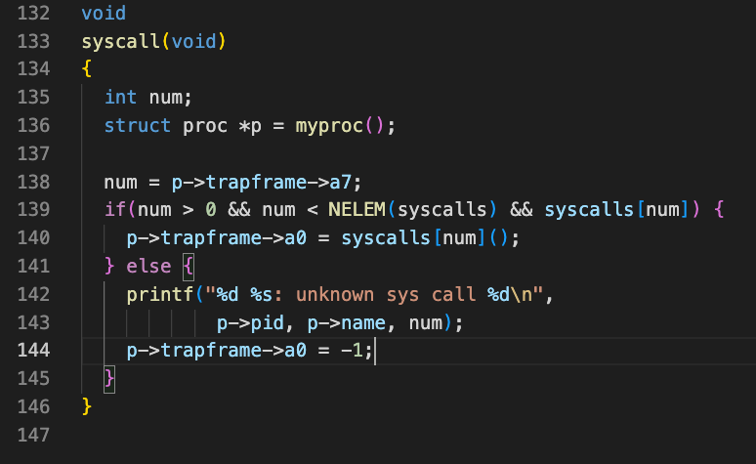
System Calls: OS

Slide 14
System Calls: OS
0
… | SPP: | … | SIE: | …
stvec
kernel page address
satp
kernel stack address
sp
save
usertrap func address
t0
hartid
1
1
… | SPIE: | … | SPP: | …
Notes:
stvec -> Line 100 trap.c

Slide 15
System Calls: OS
swap
swap
satp
a1
t0
sscratch
t0
…
swap
previous a0
a0
sscratch
load
…
a7
…
Notes:
Previous a0 == user process a0

Slide 16
Summary
Trampoline & Trapframe
Registers in Risc-V
CPU preparation for system calls
OS preparation for system calls
Next
Hongwang Li

