Slide 1
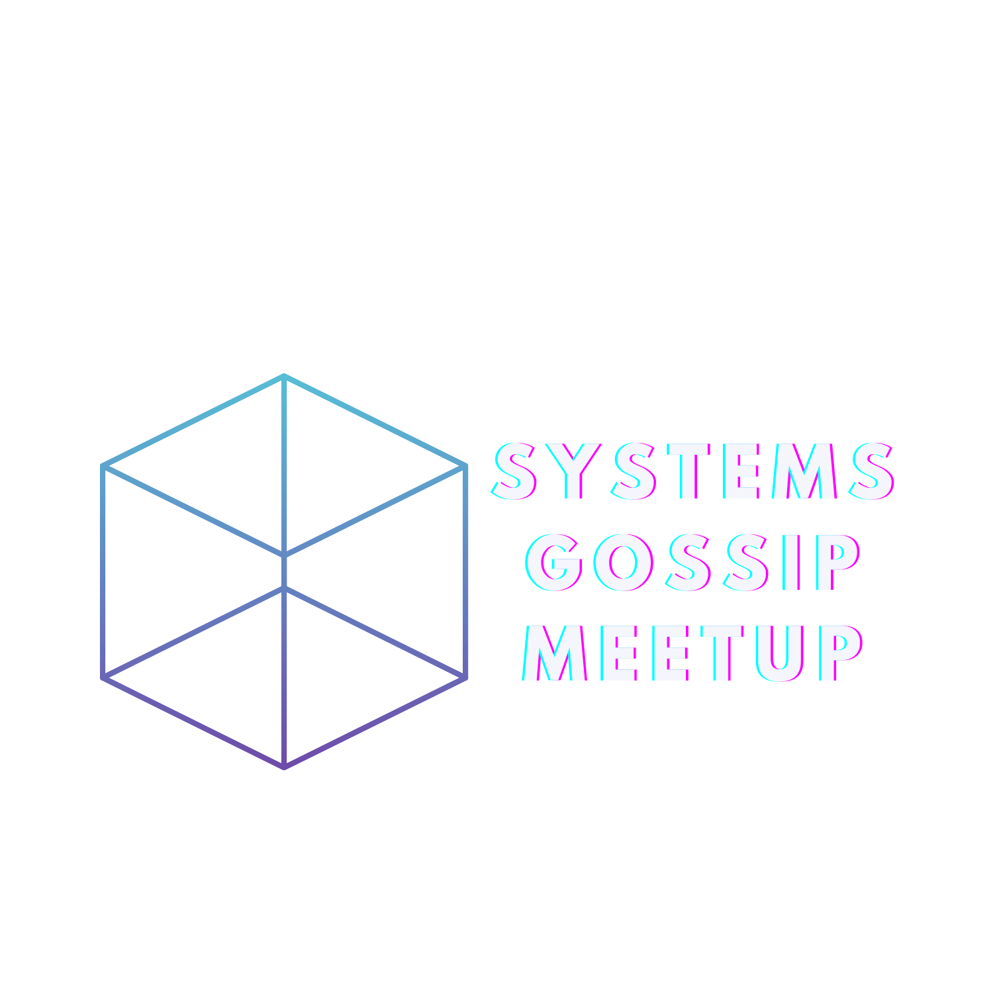
Learning large systems using peer-to-peer gossip

Slide 2
Policy Against Harassment at ACM Activities
OS Meetup wants to encourage and preserve this open exchange of
ideas, which requires an environment that enables all to
participate without fear of personal harassment. We define
harassment to include specific unacceptable factors and
behaviors listed in the ACM’s policy against harassment.
Unacceptable behavior will not be tolerated.
https://www.acm.org/about-acm/policy-against-harassment

Slide 3
Virtual Memory Primitives for User Programs
Recall
User / Kernel Separation
Why Virtual Machine
Virtual Machine Overview
Hypervisor
Hardware Virtualization
Dune Overview
Namespace and Control Group in Linux

Slide 4
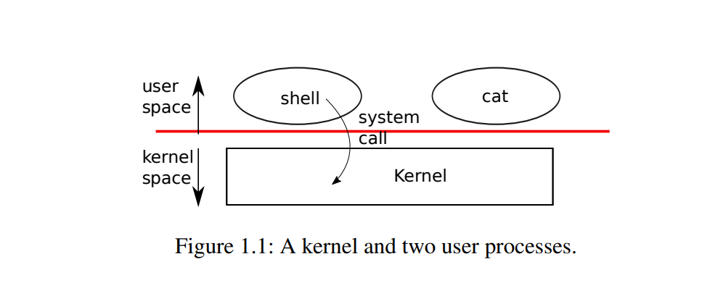
Recall

Slide 5
Why Virtual Machine
App1
App2
App3
App4
…
OS Kernel
Bare Metal

Slide 6
Why Virtual Machine
App1
App2
App3
App4
…
special path
different OS
More CPU
…
OS Kernel
Bare Metal

Slide 7
Why Virtual Machine
App1
App2
App3
App4
…
Linux
Windows
Linux
Linux
1 CPU 2Gi
2 CPU 2Gi
4 CPU 8Gi
…
Hypervisor (VMM)
Bare Metal

Slide 8
Virtual Machine Overview
…
App1
App2
App3
App4
Guest User Mode
Linux
Windows
Linux
Linux
Guest Kernel Mode
1 CPU 2Gi
2 CPU 2Gi
4 CPU 8Gi
…
Hypervisor (VMM)
Bare Metal

Slide 9
Virtual Machine Overview
…
App1
App2
App3
App4
Guest User Mode
Linux
Windows
Linux
Linux
Guest Kernel Mode
1 CPU 2Gi
2 CPU 2Gi
4 CPU 8Gi
…
Hypervisor (VMM)
Operating System
Bare Metal

Slide 10



Virtual Machine Overview: Hypervisor
Microsoft Hyper-V
VMware ESXi
VMware VSphere
Oracle VirtualBox
VMware Fusion
VMware Workstation
Hypervisor (VMM)
Hypervisor (VMM)
Operating System
Bare Metal
Bare Metal

Slide 11
Virtual Machine Overview
…
App1
App2
App3
App4
Guest User Mode
Linux
Windows
Linux
Linux
Guest Kernel Mode
1 CPU 2Gi
2 CPU 2Gi
4 CPU 8Gi
…
Hypervisor (VMM)
Bare Metal

Slide 12
Virtual Machine Overview
overhead
App1
App1
App2
App2
App1
App2
Linux
Windows
1 CPU 2Gi
2 CPU 2Gi
Hypervisor (VMM)
OS Kernel
Bare Metal
Bare Metal

Slide 13
Virtual Machine Overview
overhead
App1
App2
G virtual mem
G virtual mem
App1
App2
Linux
Windows
G physical mem
1 CPU 2Gi
2 CPU 2Gi
Ram
Hypervisor (VMM)
OS Kernel
H virtual mem
Bare Metal
Bare Metal
Ram

Slide 14
Hardware Virtualization: VT-x
overhead
…
App1
App2
App3
App4
Guest User Mode
VMX Non-Root
Linux
Windows
Linux
Linux
Guest Kernel Mode
VMX Root
1 CPU 2Gi
2 CPU 2Gi
4 CPU 8Gi
…
satp
stvec
sepc
scause
…
Hypervisor (VMM)
Bare Metal

Slide 15

Hardware Virtualization: VT-x
overhead
…
App1
App2
App3
App4
Guest User Mode
VMX Non-Root
Linux
Windows
Linux
Linux
Guest Kernel Mode
VMX Root
1 CPU 2Gi
2 CPU 2Gi
4 CPU 8Gi
…
Hypervisor (VMM)
Bare Metal
Extend Page Table
satp
stvec
sepc
…
satp
stvec
sepc
…

Slide 16
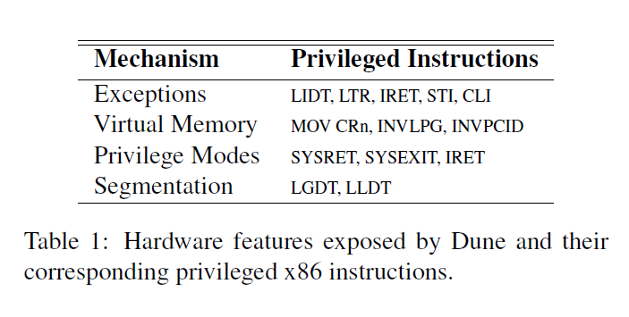
Dune
Notes:
Change the access protections for the calling process’s memory pages containing any part of the address range in the interval.

Slide 17
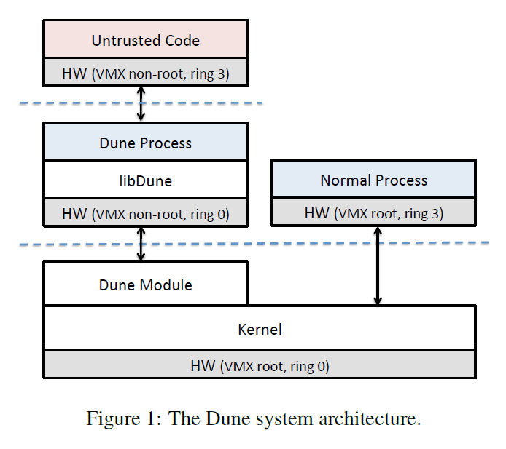
Dune: Linux System Call Filter
Notes:
Change the access protections for the calling process’s memory pages containing any part of the address range in the interval.

Slide 18
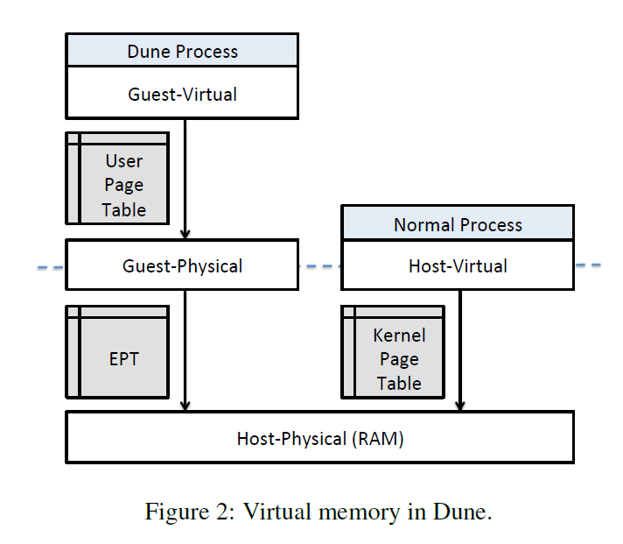
Dune: Linux System Call Filter
Notes:
Change the access protections for the calling process’s memory pages containing any part of the address range in the interval.

Slide 19
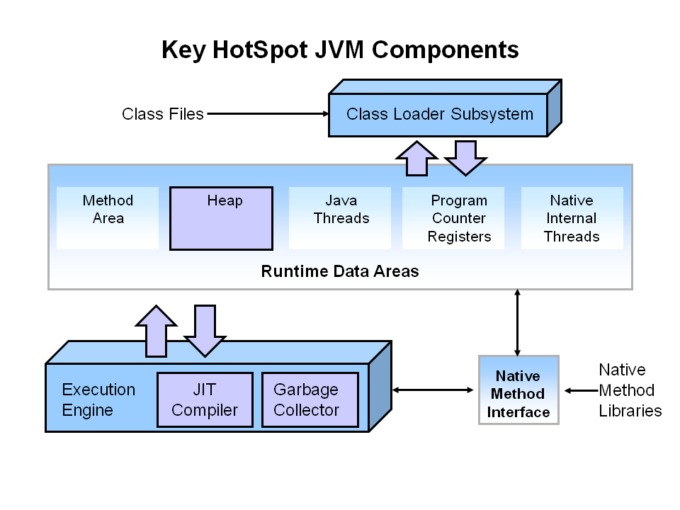
Garbage Collection: JVM
Credit to: Java Garbage Collection Basics (oracle.com)

Slide 20
Linux Namespace and Control Group
2002
2013
present
Namespaces are a feature of the Linux Kernel that partitions kernel resources such that one set of processes sees one set of resources while another set of processes sees a different set of resources.

Slide 21
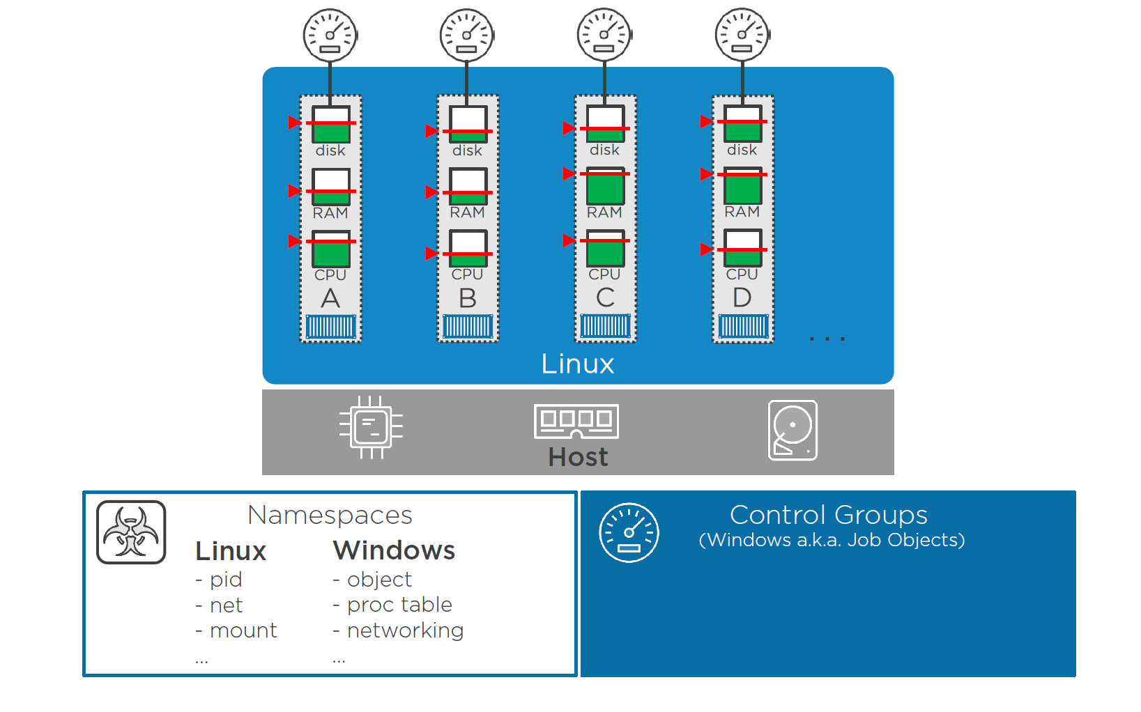
Linux Namespace and Control Group
Credit to: Nigel Poulton (Docker Deep Dive)

Slide 22
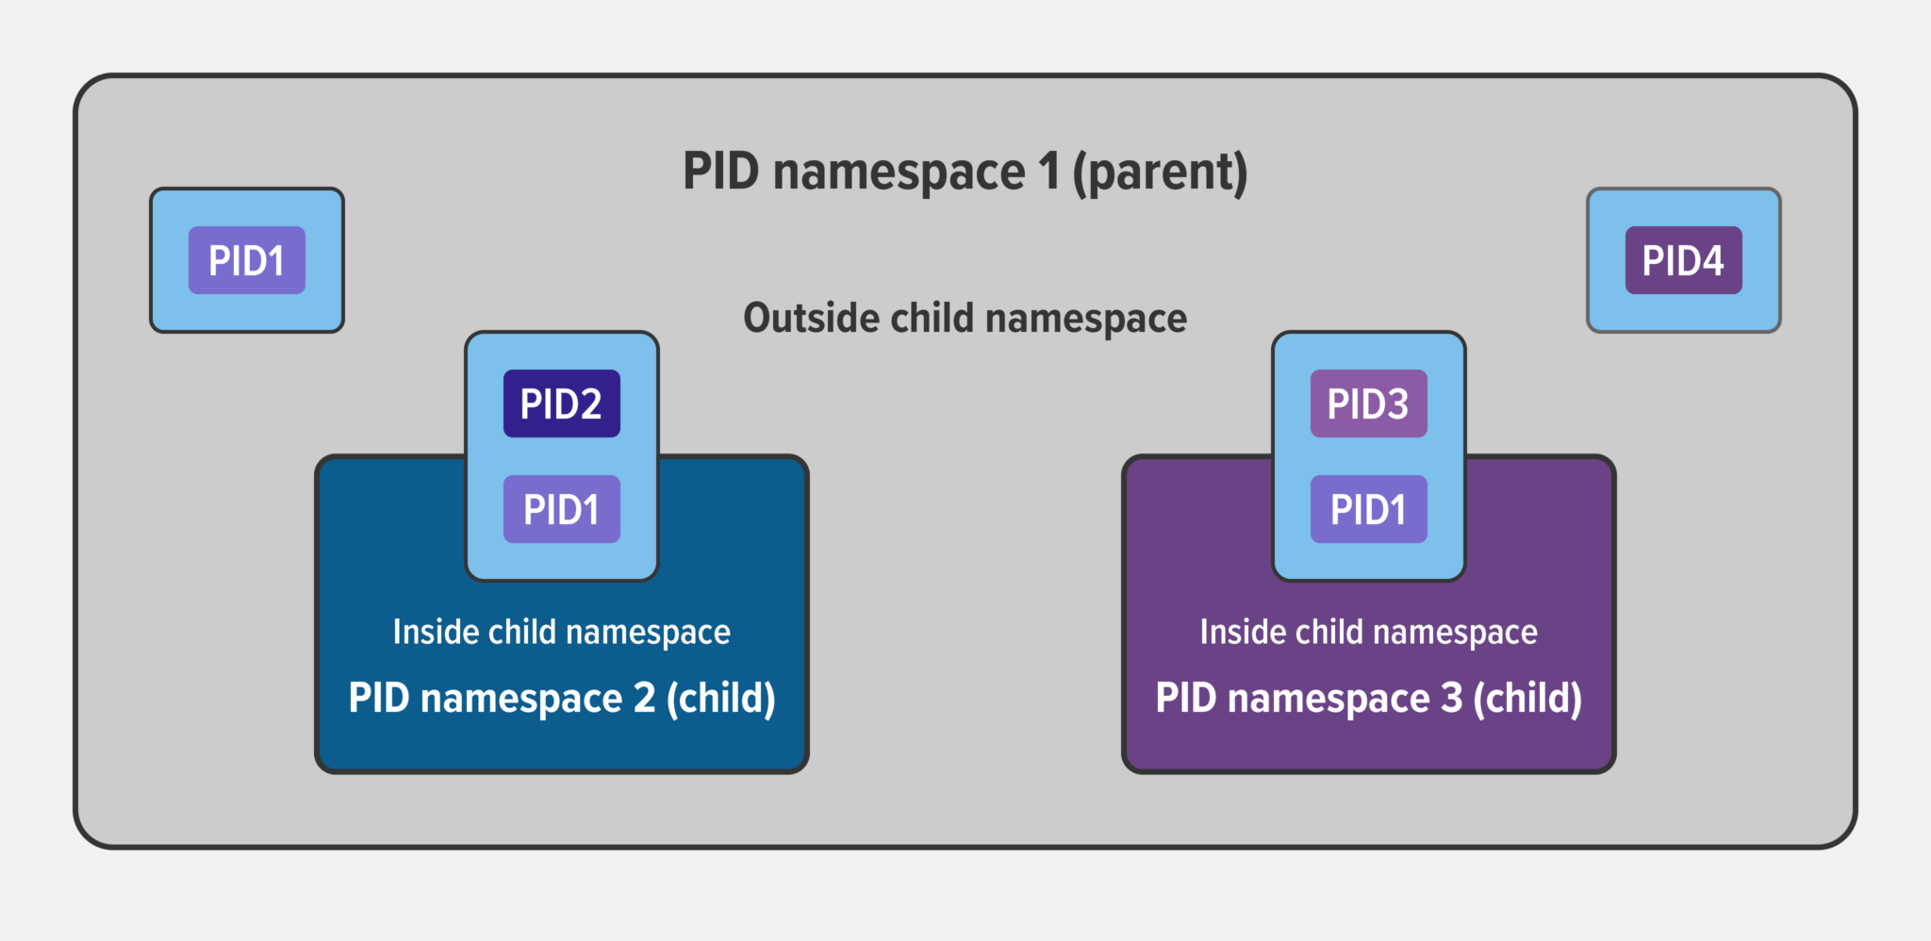
Linux Namespace and Control Group
Source: What Are Namespaces and cgroups, and How Do They Work? - NGINX

Slide 23
Summary
OS Isolation (User / Kernel)
Virtual Machine Overview
Hypervisor
Hardware Virtualization
Dune
Linux Namespace and CGroups
Next
Michael Qiu on Kernels and High Level Languages

