Slide 1
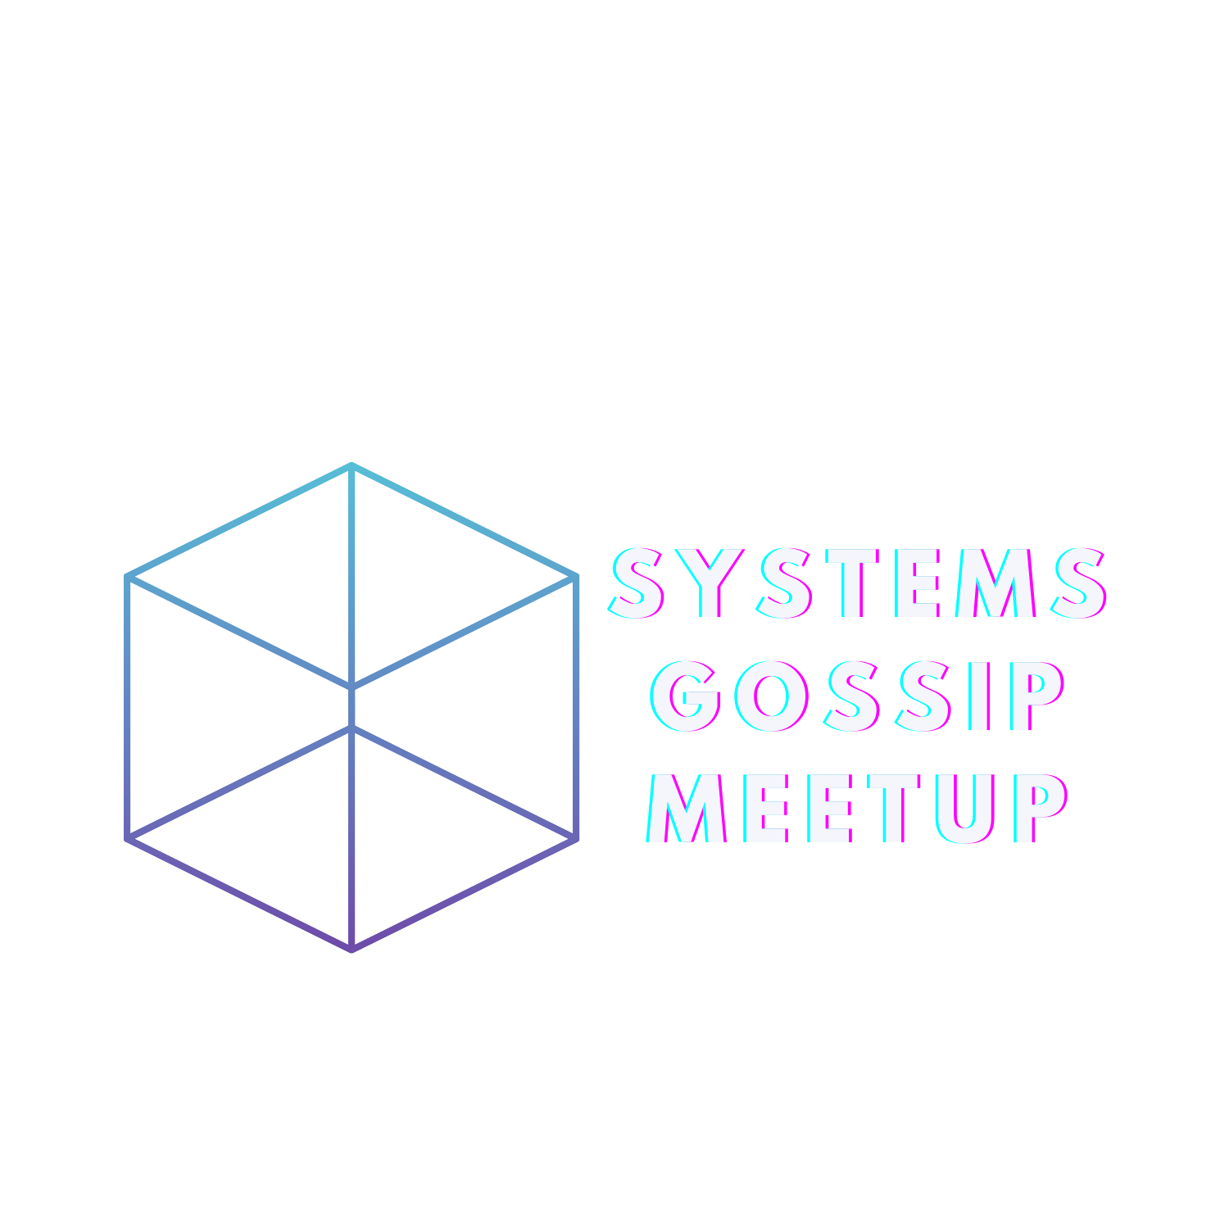
Learning large systems using peer-to-peer gossip

Slide 2
Policy Against Harassment at ACM Activities
OS Meetup wants to encourage and preserve this open exchange of
ideas, which requires an environment that enables all to
participate without fear of personal harassment. We define
harassment to include specific unacceptable factors and
behaviors listed in the ACM’s policy against harassment.
Unacceptable behavior will not be tolerated.
https://www.acm.org/about-acm/policy-against-harassment

Slide 3
Virtual Memory Primitives for User Programs
Recall:
Page table
Trap
Virtual Memory Primitives
mmap, mprotect, munmap
Garbage Collection
Introduction
Using virtual memory primitives
JVM Garbage Collection

Slide 4
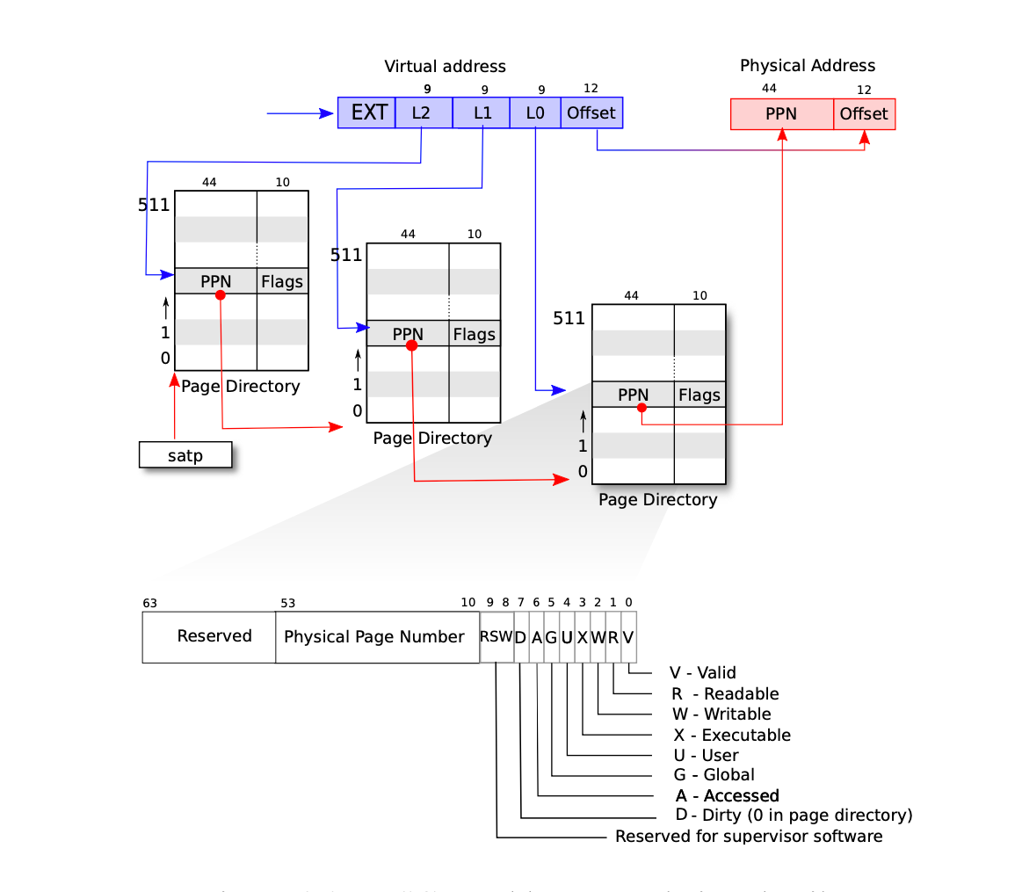
Recall: Page Table

Slide 5





Recall: Page Fault
I want n more memory.
Here you go.
Allocating
p->sz = p->sz + n;
I want to read sz.
Read sz please.
You liar!
sz
MMU
sz
Page fault!

Slide 6
Virtual Memory Primitives: mmap
void *mmap(void *addr, size_t length, int prot, int flags, int fd, off_t offset);
addr: if addr is null, kernel will pick and address for you
length: length of the mapping, must great than 0
prot: PROT_NONE, PROT_READ, PROT_WRITE, PROT_EXEC
flags : MAP_SHARED, MAP_PRIVATE
fd : file descriptor
offset : Map starting position of the target
Notes:
proc.c

Slide 7

Virtual Memory Primitives: munmap
int munmap(void *addr, size_t length);
addr: start position
length: size to unmap
Credit to: How to use mmap function in C language? (linuxhint.com)
Notes:
Deletes the mappings for the specified address range, and causes references to address within the range to generate invalid memory references.

Slide 8
Virtual Memory Primitives: mprotect
int mprotect(void *addr, size_t len, int prot);
addr: start position
len: [addr, addr + len – 1]
prot: PROT_NONE, PROT_READ, PROT_WRITE, PROT_EXEC
Credit to: mprotect() - Unix, Linux System Call (tutorialspoint.com)
Notes:
Change the access protections for the calling process’s memory pages containing any part of the address range in the interval.

Slide 9
Garbage Collection: Basic
Heap
mutator
collector
mutator
Notes:
Pause the world

Slide 10
Garbage Collection: Baker’s Algorithm
To
To
From
From

Slide 11
Garbage Collection: Baker’s Algorithm
free
unscanned
From
To
Credit to: cs426-15.pdf (uiuc.edu)
Notes:
proc.c

Slide 12
Garbage Collection: Baker’s Algorithm
unscanned
free
From
To
Credit to: cs426-15.pdf (uiuc.edu)
Notes:
proc.c

Slide 13
Garbage Collection: Baker’s Algorithm
unscanned
free
From
To
Credit to: cs426-15.pdf (uiuc.edu)
Notes:
proc.c

Slide 14
Garbage Collection: Baker’s Algorithm
unscanned
free
From
To
Credit to: cs426-15.pdf (uiuc.edu)
Notes:
proc.c

Slide 15
Garbage Collection: Baker’s Algorithm
Will we have fraction holes in the to section after cleaning?
unscanned
free
From
To
Credit to: cs426-15.pdf (uiuc.edu)
Notes:
proc.c

Slide 16

Garbage Collection: Baker’s Algorithm
mprotect
Page fault!
unscanned
free
From
To
mutator
collector
Notes:
proc.c

Slide 17
Garbage Collection: Baker’s Algorithm
mprotect
Page fault!
unscanned
free
From
To
mutator
collector
Notes:
proc.c

Slide 18
Garbage Collection: Baker’s Algorithm
mprotect
Page fault!
unscanned
free
From
To
mutator
collector
Notes:
proc.c

Slide 19
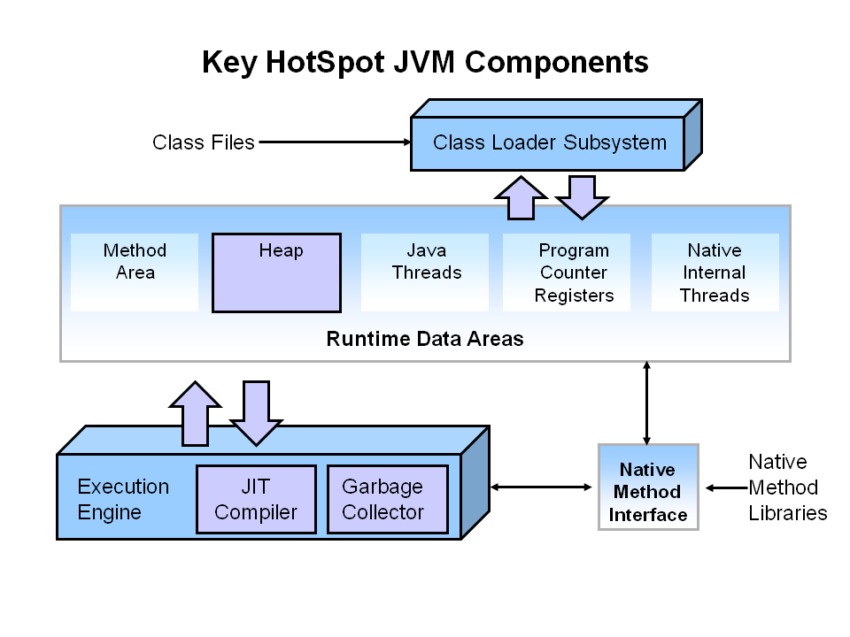
Garbage Collection: JVM
Credit to: Java Garbage Collection Basics (oracle.com)

Slide 20
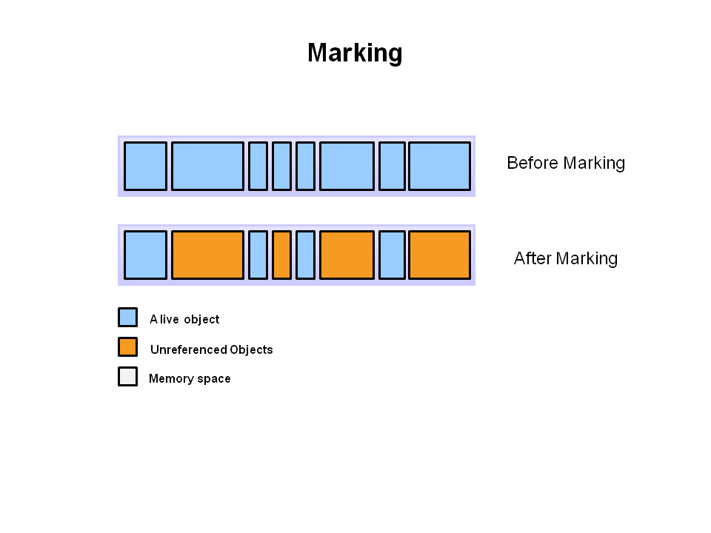
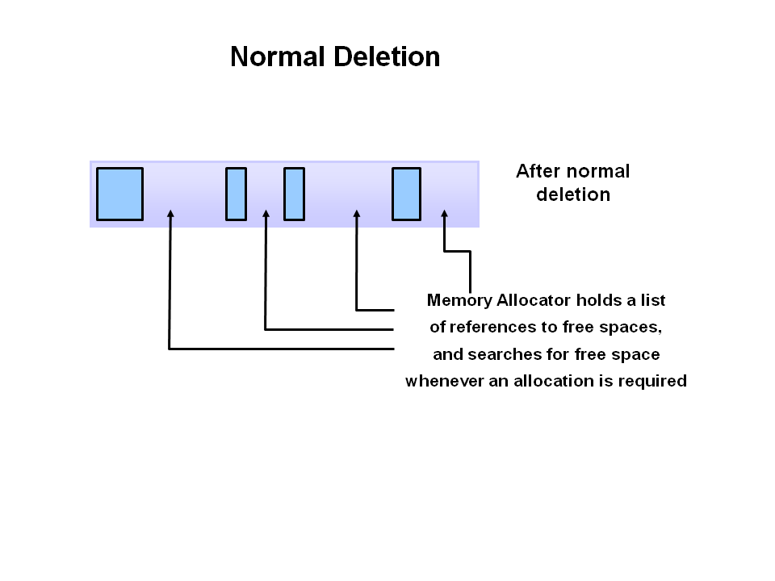
Garbage Collection: JVM
Credit to: Java Garbage Collection Basics (oracle.com)

Slide 21
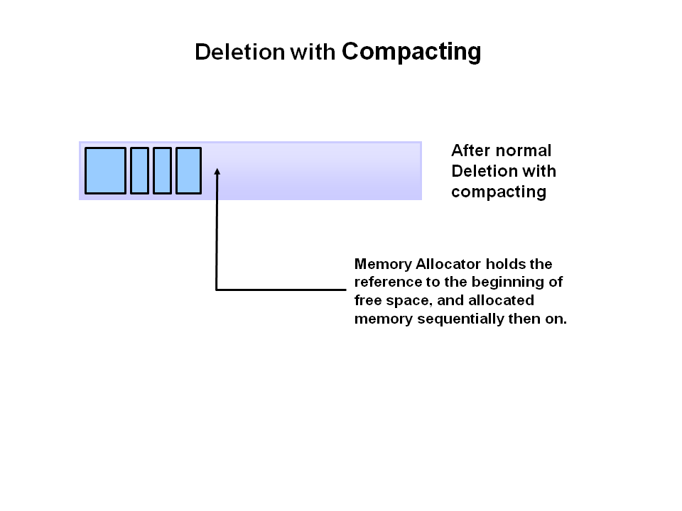
Garbage Collection: JVM
Credit to: Java Garbage Collection Basics (oracle.com)

Slide 22
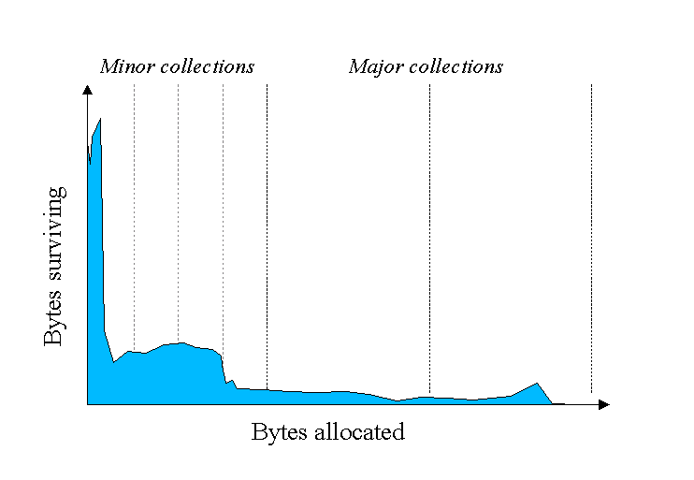
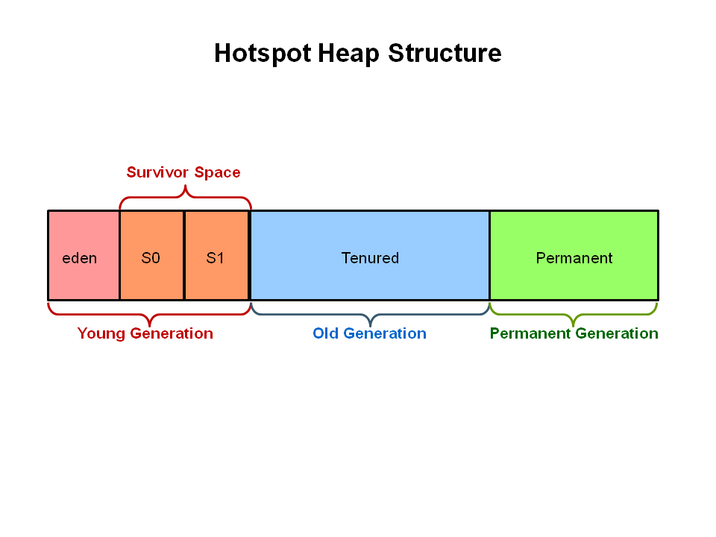
Garbage Collection: JVM
Credit to: Java Garbage Collection Basics (oracle.com)

Slide 23
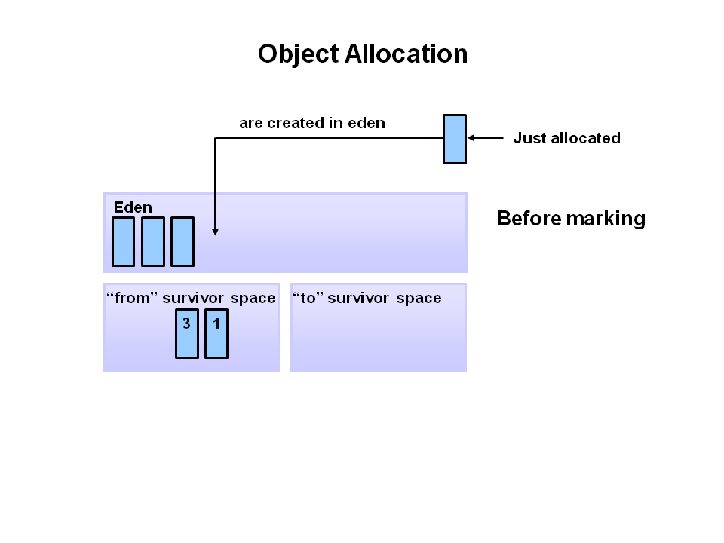
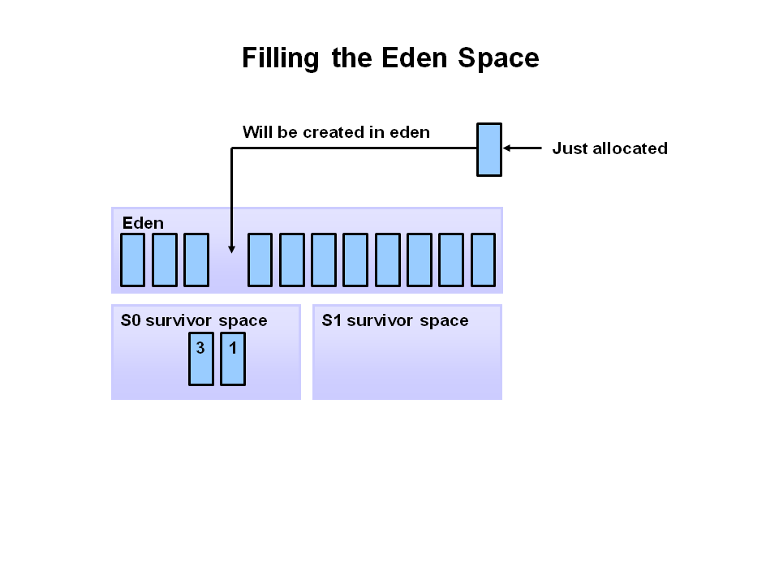
Garbage Collection: JVM
Credit to: Java Garbage Collection Basics (oracle.com)

Slide 24
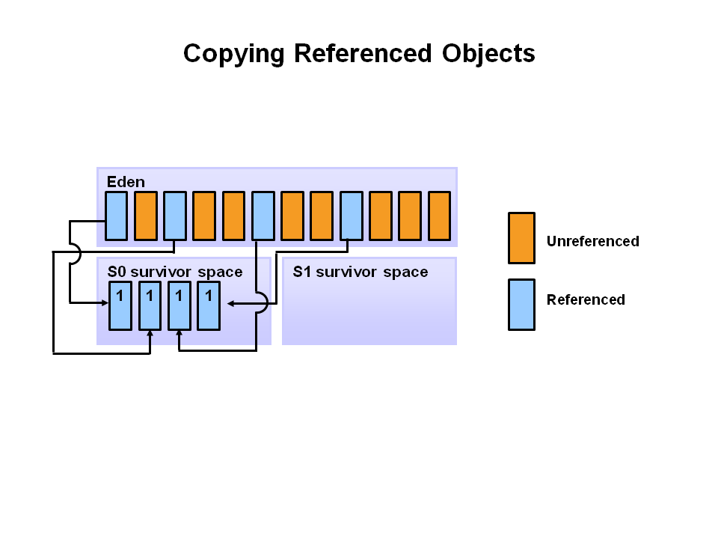
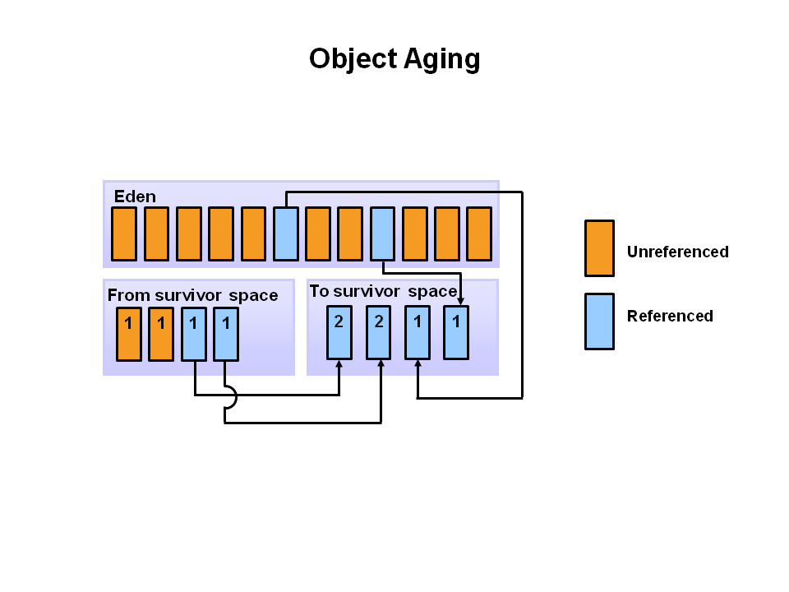
Garbage Collection: JVM
Credit to: Java Garbage Collection Basics (oracle.com)

Slide 25
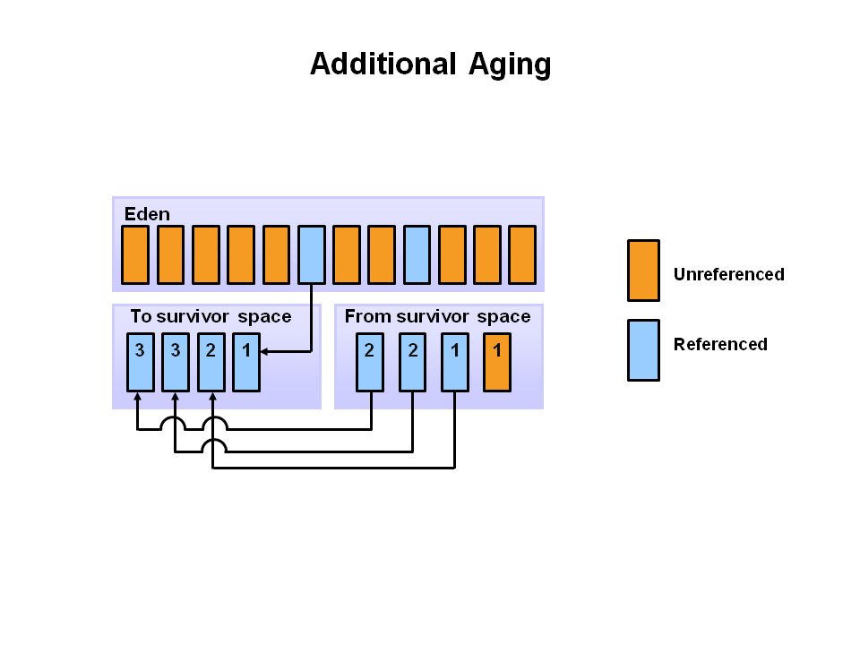
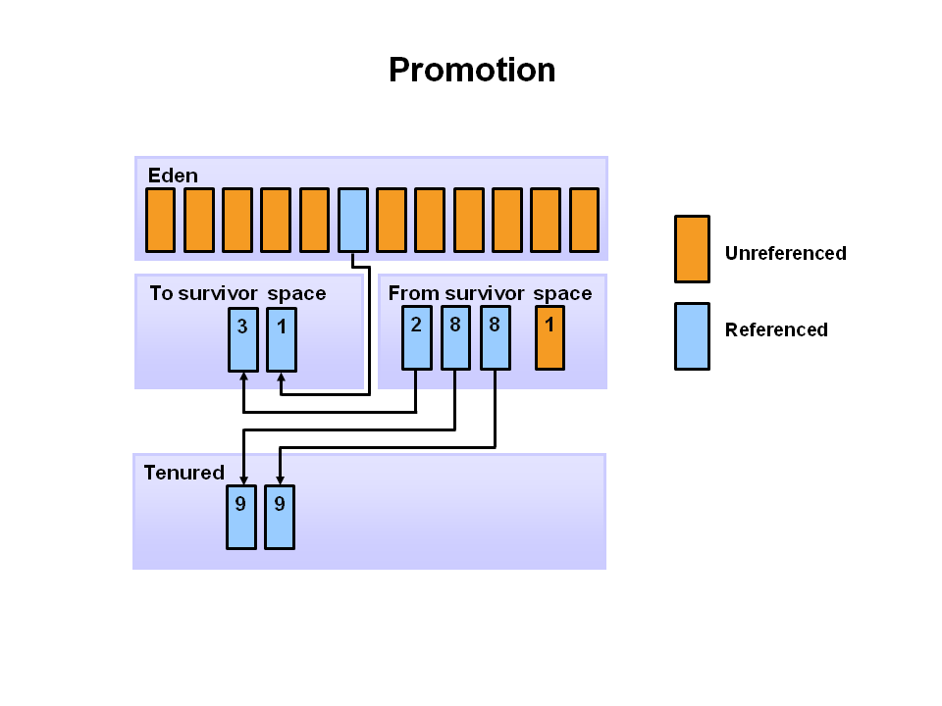
Garbage Collection: JVM
Credit to: Java Garbage Collection Basics (oracle.com)

Slide 26
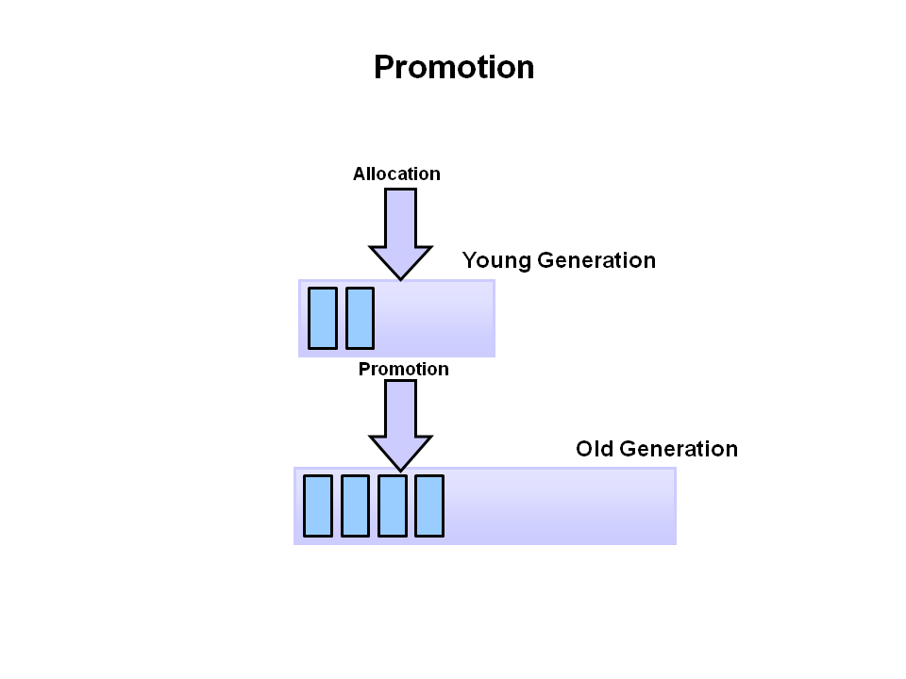
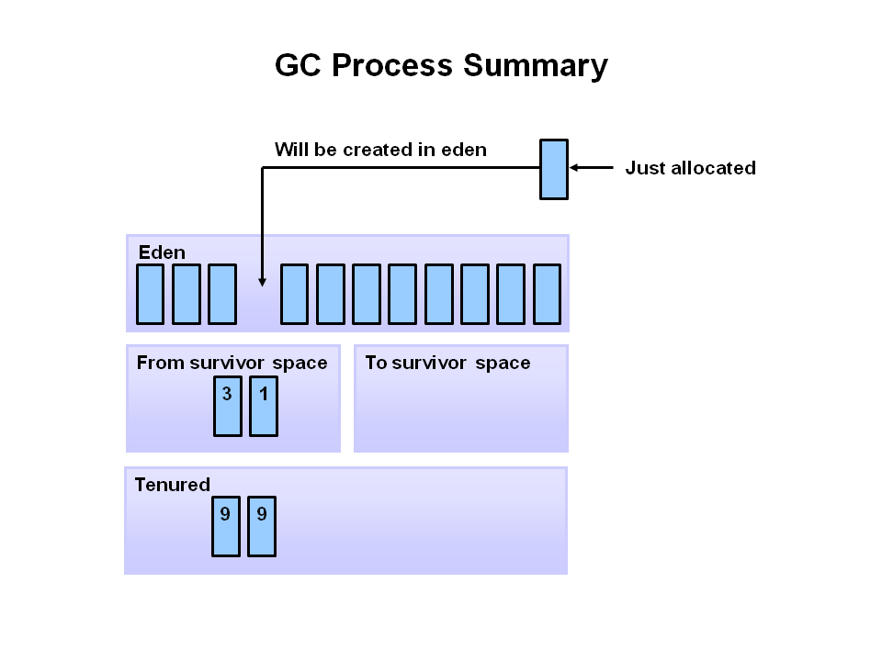
Garbage Collection: JVM
Credit to: Java Garbage Collection Basics (oracle.com)

Slide 27
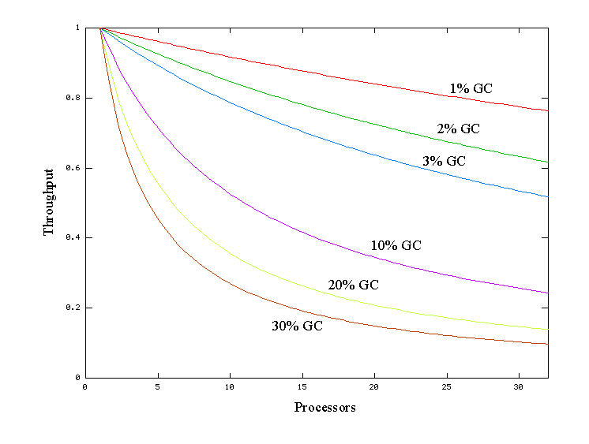
Garbage Collection: JVM
Credit to: Java SE 6 HotSpot[tm] Virtual Machine Garbage Collection Tuning (oracle.com)

Slide 28
Garbage Collection: GC Tuning
Responsiveness: Large pause times are not acceptable
How quickly a desktop UI responds to an event
How fast a website returns a page
How fast a database query is returned
Throughput: High pause time are acceptable
The number of transactions completed in a given time.
The number of jobs that a batch program can complete in an hour.
The number of database queries that can be completed in an hour.

Slide 29
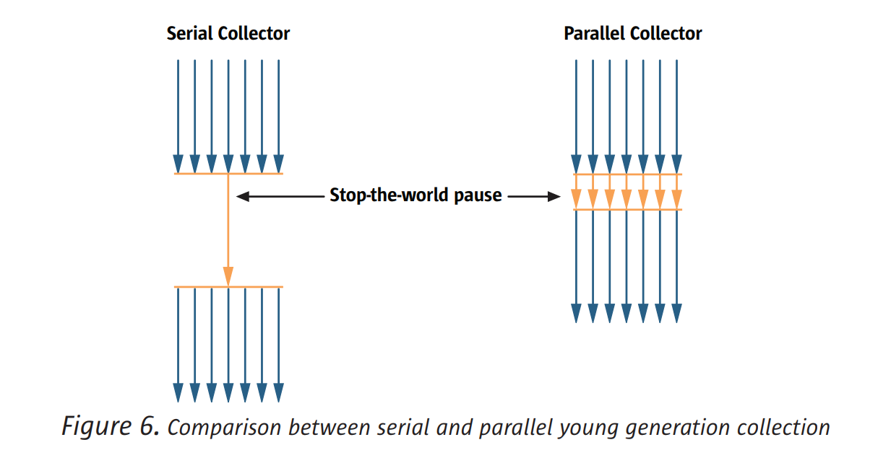
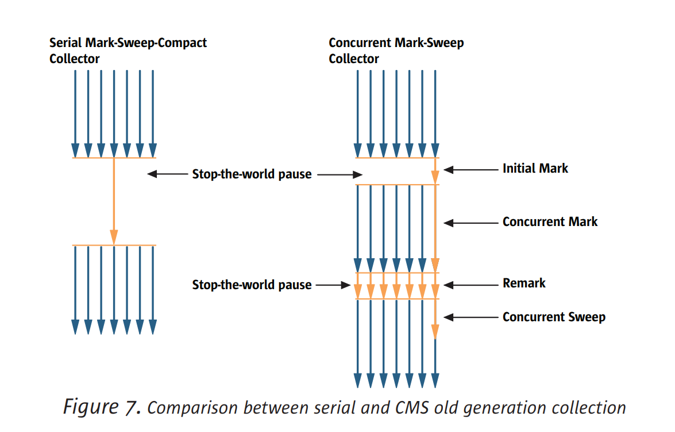
Garbage Collection: Faster

Slide 30
Garbage Collection: Faster
Ensure that as few objects as possible are reachable during the garbage collection.
The fewer objects that are alive, the less there is to be marked.
If the young generation is too small, objects are tenured prematurely to the old generation.
If the young generation is too large, too many objects are alive (undead) and the GC cycle will take too long.

Slide 31
Summary
Page table
Page allocation: fork
Memory sharing between parent and child process
Copy on write: fork
Page fault: lazy allocation
Next
Hongwang Li on Intrrupts

