Slide 1


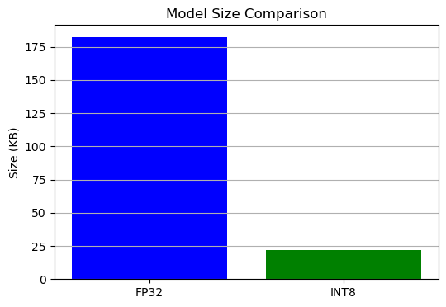
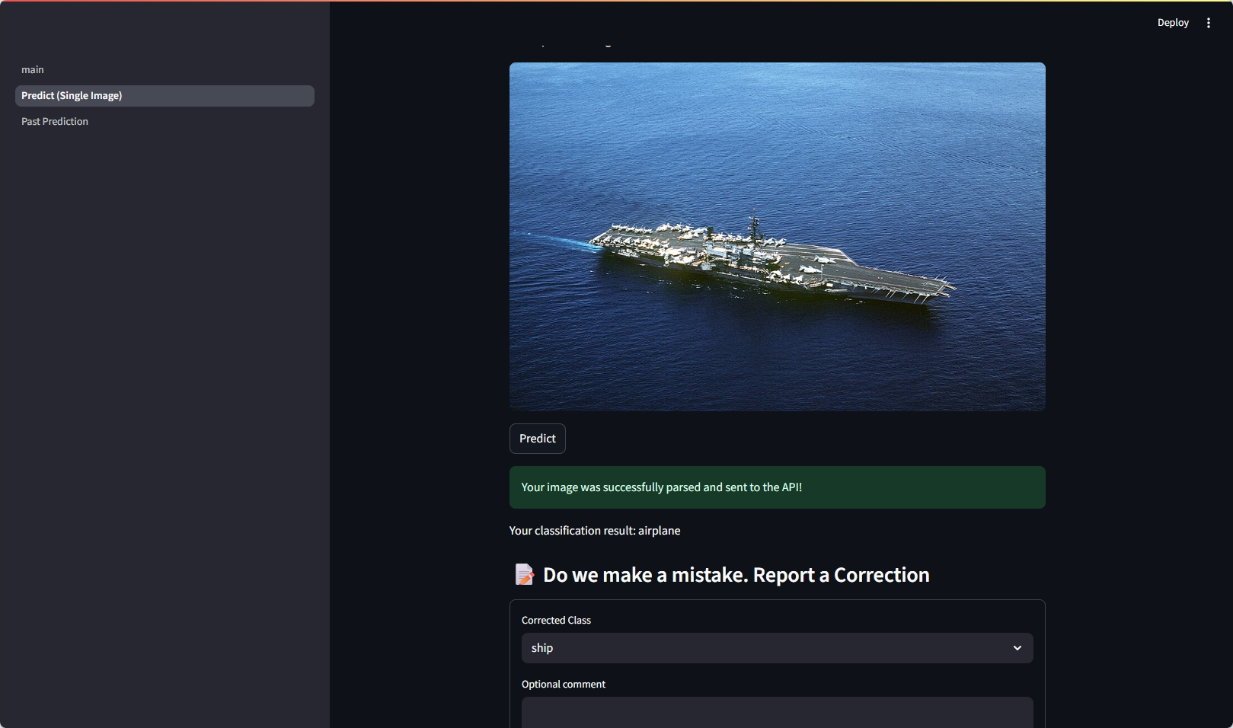
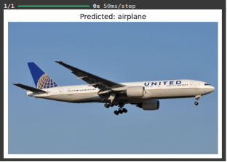
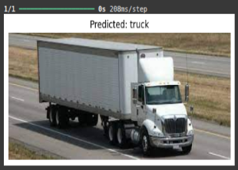
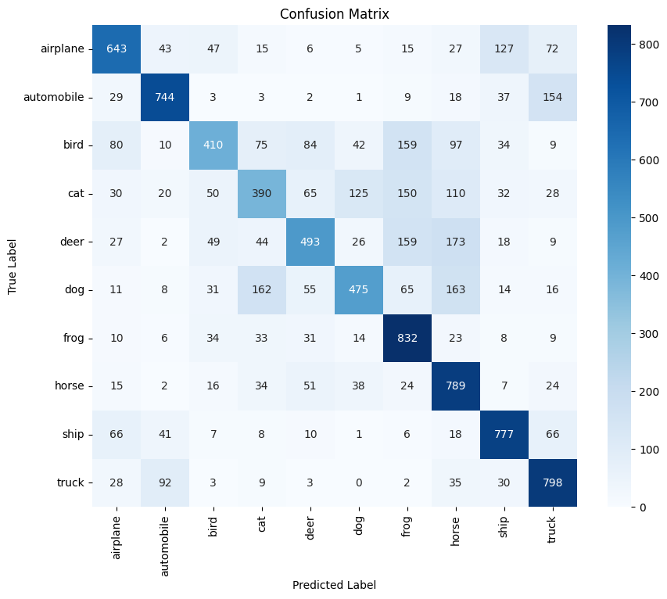
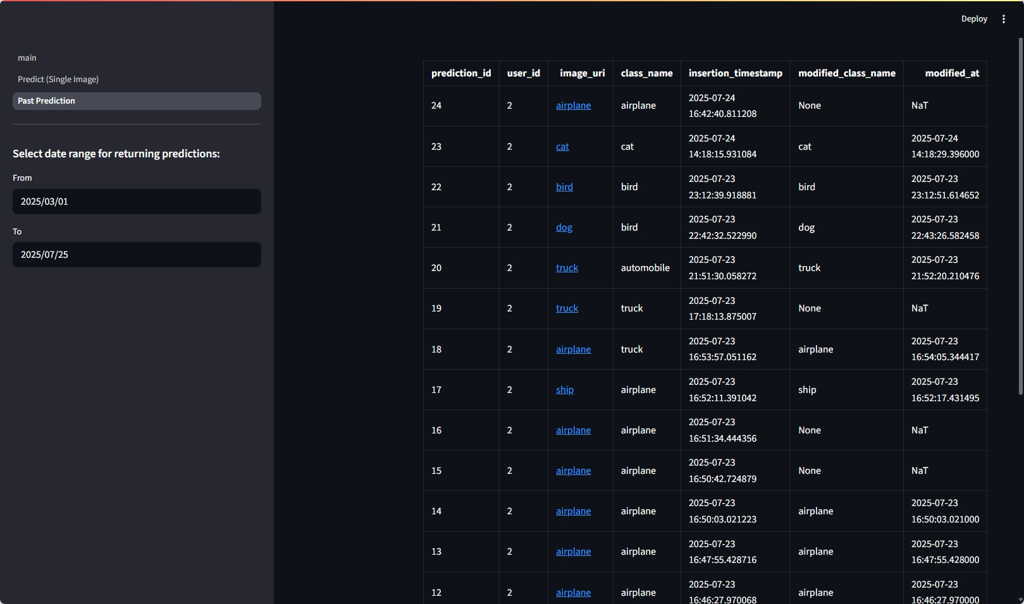
Custom Lightweight Convolutional Neural Network for Edge-Based Inference
Ngoc Lam Nguyen, Jatinkumar keshabhai Parmar, Narigela Grishma Reddy, Revanth Puvaneswaran
Data Science and Analytics (DSA)
PROJECT DESCRIPTION
The high growth of Artificial Intelligence (AI) and deep learning has changed computer vision, natural language processing, and other domains. Although these advancements, utilizing complex models on edge devices, such as emended systems and low-power platforms, remain a great challenge. These devices commonly used on the Internet of Things (IoT), have severe constraints on processing power, memory, and energy consumption.
Our objective is:
To design a custom lightweight CNN architecture
To access model optimization techniques such as Quantization Aware Training (QAT).
To develop and exhibit the model on an Arduino TinyML kit for validation.
Effect of quantization
METHODOLOGY AND TOOLS
Model saw airplanes on an aircraft carrier
We created 2 models. One is an MobileNetV3-small using transfer learning on PyTorch. The other one is our own customed model from scratch in TensorFlow with the aim to be converted to TensorFlow lite.
> Transfer learning model is more complicated but can only be put in a mid-tier edge devices
> Our customed CNN is super simple, can be loaded into the smallest of devices, while still got a respectable score
RESEARCH CONCLUSIONS
Sample prediction of CNN model
SUMMARY / COMMENTS
The team was able to present the planning of a custom lightweight CNN architecture amended for edge devices, specifically the TinyML platform
>Development of a unique lightweight CNN architecture adapted for small appliances
> Successful lineup and up to date inference on an Arduino ML kit
> Quick analysis of functioning balance between model complexity and edge usability
The outcome of this project explains architectural progression; deep learning models can be efficiently completed on limited edge devices. This covers the way for more practical, intelligent applications in the expanding sector of IoT and embedded devices.
To further improve on our project, we can:
Expansion to support additional tasks such as object detection or multi-class classification.
Maintaining progressive optimization methods like pruning and co-training.
Testing the model on varied hardware platforms to promote growth.
Integrate transfer learning to adapt the model for new datasets with refinement
DEVELOPMENT
QUICK FACTS
Most frameworks offered QAT for lightweight model
ShuffleNet is a better choice than MobileNet when very light-weight models are needed
Arduino Nano does not have a pin for the camera
Slight change in the lighting and/or contrast condition can lead to a big swing in the result
A simple 2-layer CNN can achieve close to 65% accuracy, while being extremely small
Two of the most common errors for all models are between cat and dog, and between automobile and truck
After we trained our 2 model, we attempted to create a simple application that let our potential users to test our product
> The application is developed using Streamlit, FastAPI, with the model was loaded to the server by PyTorch framework
> It need user login. After that, it allows users to
Upload the image and get the prediction
Report wrong classification
See past preditions, and the image on the cloud
> To simulate an email service to warn the data scientist about performance of the model
We have set threshhold for reported prediction
It will send an email to notify the concerned parties
For this we are using the scheduler from Python
Confusion matrix of the CNN model
Past prediction table
S3, 2025/07/24
Notes:
Contents
This template must be used for your Action Learning project poster to ensure the same look and feel for all posters.
The best posters will be printed and mounted; displayed in our classrooms.
The category titles for the sections of text are fixed. The amount of text for each section could vary based on your project.
Do not change the fonts, sizes or the colors - pay attention to the title banner at the top.
Text body – Open Sans 30 for description, Other are Open Sans 18 (Quick facts Calibri 22)
Tiles - Encode Sans Normal Black 115 main title, subtitles 40, Quick Facts 28
Methodology and Tools would include your project management method and applicable programming languages that were used.
The “Box Header” title can be changed. The facts should be taken from your research, not about your project
The charts and image boxes are provided only as placeholders. You do not have to use the sample charts provided and likely prefer others.
Three charts and two images are not required, but you should use graphics to illustrate key points and to make your poster attractive.
Ensuring quality printed posters
We will print the final version at A1 size, so you must use high quality images as they will be enlarged.
Zoom the poster by 500% or more, to see any quality issues on your screen.
Print a A3 or A4 version to see the placement of all elements
For trimming, the border around the edges must stay exactly as it is - do not put any information closer to the border
Submit PDF and PPT versions and not any printed copies - when creating the PDF, make it high resolution.

