Slide 1
VAT: A tool for visual assessment of (cluster) tendency)
Group members:
Chansodara DY
Florian Gbaguidi
Huong Ta
Ngoc Lam Nguyen
Liam Emanuel Vargas Becerra

Slide 2
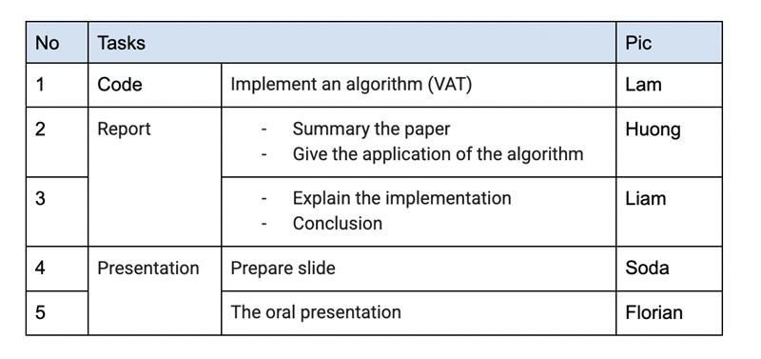
Members Involved in the Project

Slide 3
What is VAT?
VAT (Visual Assessment of Tendency) is a tool to determine whether clusters exist in your data before applying clustering algorithms.
It visually presents reordered pairwise dissimilarity values as a grayscale image.
Dark blocks along the diagonal of the image often indicate cluster presence.

Slide 4
Why Use VAT?
Many clustering algorithms will find clusters even if there are none.
VAT helps visually assess whether real structure exists in the data.
It works for both object data (vectors) and relational data (distance matrices), even when data is incomplete.

Slide 5
How VAT Works – Step by Step
Compute a pairwise dissimilarity matrix using a chosen distance metric (e.g., Euclidean distance).
Reorder the matrix so that similar points appear close together, using a method inspired by Prim’s MST algorithm.
Display the reordered matrix as an image where intensity represents distance (black = similar, white = dissimilar).

Slide 6
Interpreting the VAT Image
Well-defined clusters appear as dark blocks aligned along the diagonal of the image.
Absence of blocks or random patterns indicates no cluster structure.
The VAT image provides a quick, intuitive way to assess the potential for clustering.

Slide 7
Examples from the VAT Paper
Normal(4), Normal(3): VAT reveals clear clusters via distinct diagonal blocks.
Normal(2), Normal(1): Cluster blocks become fuzzier as separation decreases.
Normal(0): Appears random – no natural clusters exist.
IRIS dataset: VAT confirms 2 strong clusters despite 3 class labels.

Slide 8
Advantages and Conclusions
No assumptions or parameters needed to start.
Applicable to any numerical dataset (complete or incomplete).
Easy-to-understand visual feedback before applying complex clustering methods.
Helps avoid bias or overfitting by preventing unnecessary clustering.

