Slide 2
Creating structured and meaningful logs with semantic logging
Julian Dominguez
@juliandominguez
Developer at Microsoft patterns & practices
3-336

Slide 3
Key objectives
Why is consuming logs so difficult?
How can the EventSource class make logging better?
How can the Semantic Logging Application Block help me get there?
Notes:
This is not a talk for Windows Store apps! This is for the .NET Framework (desktop/server).

Slide 4

Logs are a hassle to deal with
No real structure.
What’s in there? (Especially tough if you didn’t create them.)
Sheer number of files and types of logs is overwhelming.
Image credit: Casey Konstantín
bit.ly/126NvV7

Slide 5
Output stream of unstructured logging
176 [main] INFO examples.Sort - Populating an array of 2 elements in reverse order. 225 [main] INFO examples.SortAlgo - Entered the sort method. 262 [main] DEBUG SortAlgo.OUTER i=1 - Outer loop. 276 [main] DEBUG SortAlgo.SWAP i=1 j=0 - Swapping intArray[0] = 1 and intArray[1] = 0 290 [main] DEBUG SortAlgo.OUTER i=0 - Outer loop. 304 [main] INFO SortAlgo.DUMP - Dump of integer array: 317 [main] INFO SortAlgo.DUMP - Element [0] = 0 331 [main] INFO SortAlgo.DUMP - Element [1] = 1 343 [main] INFO examples.Sort - The next log statement should be an error message. 346 [main] ERROR SortAlgo.DUMP - Tried to dump an uninitialized array. 467 [main] INFO examples.Sort - Exiting main method.

Slide 6
Why
Unstructured logging is the predominant approach among .NET developers,
both as matter of available technology and the mindset.
Current logging frameworks in .NET are producing mainly unstructured data.
Hard to consume/automate.
Subject to compatibility/inconsistencies.
Structured logging is an essentially different paradigm.
Putting the effort in the right place.

Slide 7
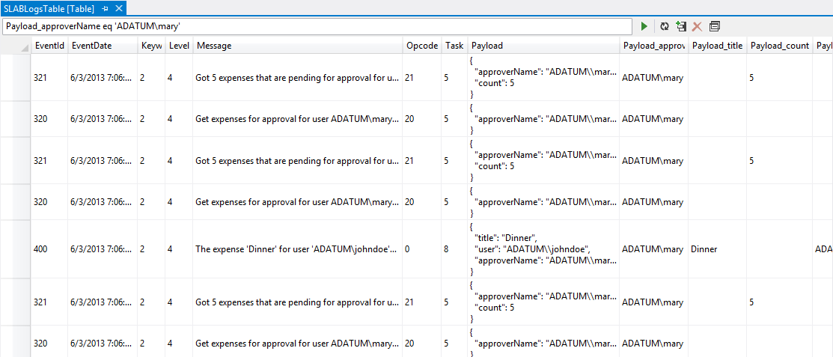
Structured log in Windows Azure table
Query by payload argument

Slide 8
We (P&P and Microsoft) are on a mission
“If I see another unstructured log, I swear I’ll defenestrate someone.”
~Mark Simms
Changing the way people think about logging.
Logging cannot be just a checkmark of doing something.
You have to think about consumption and purpose.
Allow appropriate decisions to be made at appropriate time, explicitly separating:
WHAT to log.
HOW to log it.
WHERE to log.
Notes:
Defenestrate: “to throw something or somebody out of a window”.
Origin of the term
The term originates from two incidents in history, both occurring in Prague. In 1419, seven town officials were thrown from the Town Hall, precipitating the Hussite War (pronounced hassait). In 1618, two Imperial governors and their secretary were tossed from Prague Castle, sparking the Thirty Years War. These incidents, particularly in 1618, were referred to as the Defenestrations of Prague and gave rise to the term and the concept.
Mark Sims Mark is a Principal Program Manager on the SQLCAT (SQL Server Customer Advisory Team), working on large-scale cloud applications. Usually found nerding out on challenging customer problems, he is currently focused on telemetry driven applications and guidance to navigation the distributed system landscape.

Slide 9
Separating concerns
Notes:
Demo shows the explicit separated concerns and also contrasts this with a standard logging framework.

Slide 10
Technologies at play
Event Tracing for Windows (ETW)
Native to Windows platform
EventSource class
New in .NET Framework 4.5
Great performance & OK diagnostic tooling
Historically hard to publish events
Meant to ease authoring experience
Extensible but supports ETW-only out of the box
Semantic Logging Application Block (SLAB)
Provides several destinations for events published with EventSource
Additional tooling support for authoring events
Does not require any knowledge in ETW
Notes:
SLAB can act as a stepping stone. No commitments to how you consume events when using EventSource. You can later decide to replace it with your own tooling or use other existing tools.

Slide 11
SLAB features—sinks
The Semantic Logging Application block allows to persist events to different sinks.
Note: Windows Event Log is not supported by SLAB
Several sinks/destinations:
Windows Azure Table.
SQL Database.
Flat file.
Rolling flat file.
Console.
Formatters (for text-based sinks):
JSON.
XML.
Natural (plain-text).

Slide 12
SLAB features—out of process service
Get events out of the originating process using ETW and has a dedicated process just to persist the events to different destinations.
Hosted as a Windows Service or console.
All sinks are supported.
Configuration-driven with support for re-configuration.
Monitored application does not reference SLAB.
Benefits.
Increased fault tolerance in case of application crash.
Can monitor multiple processes from a single service.
Moves the logging overhead from the application to a separate process (but the overhead is still there!).
Notes:
Drawbacks:
more moving pieces!!
Internal buffers might overflow without notification

Slide 13
Out of process
Notes:
Demo shows how to use out of process service.

Slide 14
SLAB features—Event Source analyzer
Helps you author and validate the Event Source derived class.
Flags hard to detect errors related to plumbing.
Can be run inside a unit test.

Slide 15
SLAB features—Event Source analyzer
// can be run in a unit test
[TestMethod]
public void AnalyzeAExpenseEvents()
{
EventSourceAnalyzer.InspectAll(AExpenseEvents.Log);
}
// will verify correctness of events
// this example has inconsistent ID and order of parameters
[Event(111)]
public void MyInvalidEvent(int someArgument, string otherArgument, int userId)
{
this.WriteEvent(222, someArgument, userId, otherArgument);
}

Slide 16

SLAB features—observable-based
Event listener is IObservable.
Event sinks are IObservers.
Can leverage Reactive Extensions (Rx) to filter, pre-process or transform the event stream before it’s persisted.
Notes:
Rx is a library for composing asynchronous and event-based programs using observable collections.
- Asynchronous and event-based – As reflected in the title, the bread and butter of Rx’s mission statement is to simplify those programming models. Everyone knows what stuck user interfaces look like, both on the Windows platform and on the web. And with the cloud around the corner, asynchrony becomes quintessential. Low-level technologies like .NET events, the asynchronous pattern, tasks, AJAX, etc. are often too hard.
- Composition – Combining asynchronous computations today is way too hard. It involves a lot of plumbing code that has little to nothing to do with the problem being solved. In particular, the data flow of the operations involved in the problem is not clear at all, and code gets spread out throughout event handlers, asynchronous callback procedures, and whatnot.
- Observable collections – By looking at asynchronous computations as data sources, we can leverage the active knowledge of LINQ’s programming model. That’s right: your mouse is a database of mouse moves and clicks. In the world of Rx, such asynchronous data sources are composed using various combinators in the LINQ sense, allowing things like filters, projections, joins, time-based operations, etc.

Slide 17
IObservable—flush on error
Notes:
Demo shows how to use Reactive Extensions to flush buffered information messages only when an error occurs.

Slide 18
SLAB can act as a stepping stone. No commitments to how you consume events when using Event Source. You can later decide to replace it with your own tooling or use other existing tools.

Slide 19
Call to action
Evaluate SLAB and adopt it (search for “slab” in NuGet).
Never use TraceSource again. EventSource is the way to go!
Read the docs. (Enterprise Library Developer’s Guide is in preview form, with an extensive chapter dedicated to Semantic Logging + QuickStarts) – entlib.codeplex.com.
If you’d like to see SLAB in Windows Store apps, tell us: entlib.uservoice.com/forums/89245.

Slide 20
Resources
Docs (in preview) —aka.ms/el6guide
Embracing Semantic Logging—aka.ms/semantic-logging
SLAB videos—channel9.msdn.com/Tags/entlib
More Support for EventSource and strongly typed logging—aka.ms/vance-slab
Introduction Tutorial: Logging ETW events in C#—aka.ms/vance-es-tutorial

Slide 21
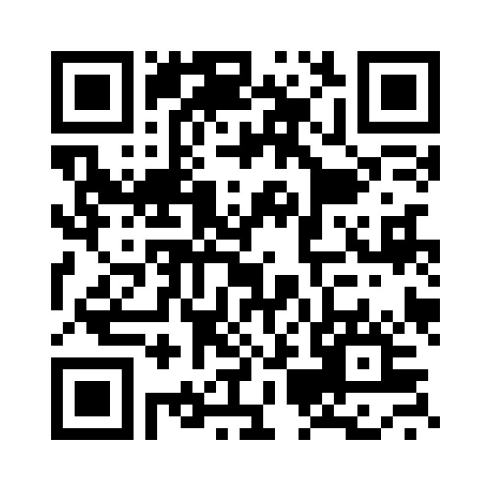

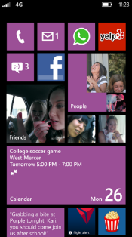
Evaluate this session
Required Slide
*delete this box when your slide is finalized
Your MS Tag will be inserted here during the final scrub.
Scan this QR code to evaluate this session and be automatically entered in a drawing to win a prize!

