Slide 1

Log improvement

Slide 2
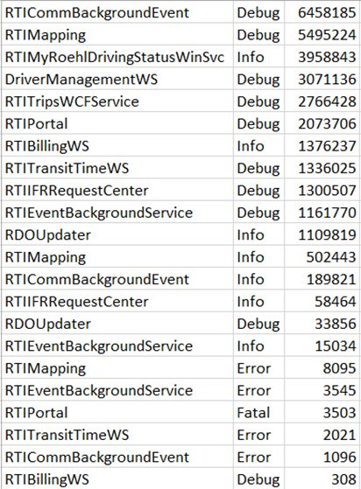
Performance as of late
Planning tool
RTIPortal errors
Background processes
Top 11 offenders do 1 – 6 million log records / month
We removed some
Bottom line: Frank says logging is the worst overhead

Slide 3

Microsoft’s answer: Semantic Logging Application Block!

Slide 4
Aka SLAB
http://slab.codeplex.com/ … goes to
https://github.com/mspnp/semantic-logging
….and https://msdn.microsoft.com/en-us/library/dn775006.aspx
Build 2013 has a presentation: http://channel9.msdn.com/Events/Build/2013/3-336
Blog posts that may help [mentioned in the presentation]: http://blogs.msdn.com/b/vancem/archive/tags/etw/

Slide 5
ETW = Event Tracing for Windows
Rather low level
Built in to .net / OSes for long time
Semantic Logging as of .net 4.5
Write [publish] an event, and the event subscriber will get it.
The application being monitored / doing logging incurs no overhead!
The subscriber potentially could be a separate SQL Server
The subscriber can persist to a flat file, rolling files, SQL, or even Azure!

Slide 6
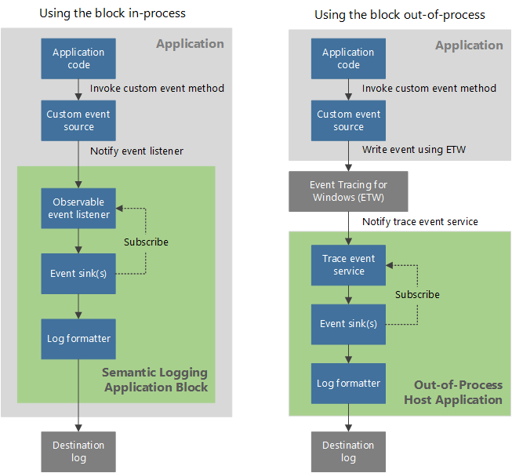
Fire and forget / pub sub / separation of concerns

Slide 7
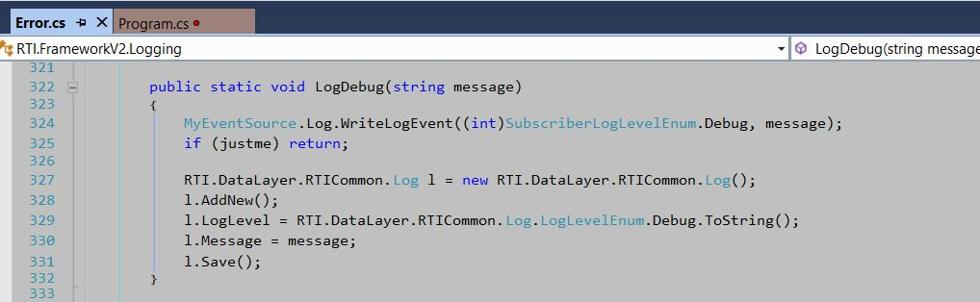
Some code

Slide 8
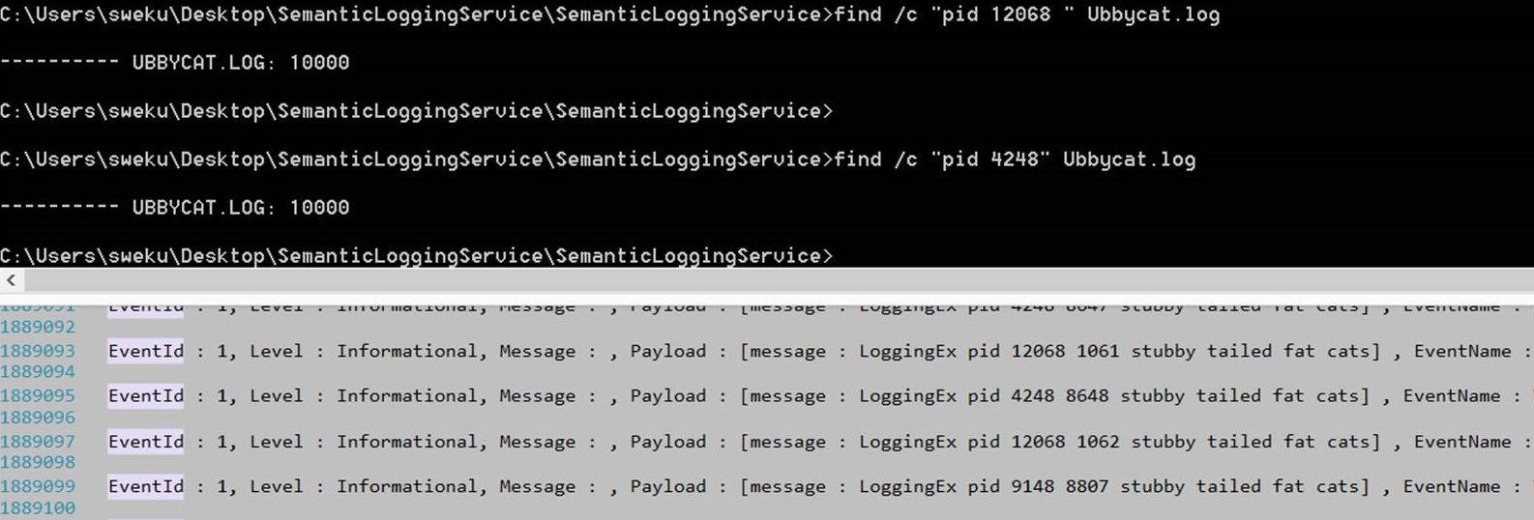
RTI Web app
For /L %i in (1,1,40) do @start iexplore web app page

Slide 9
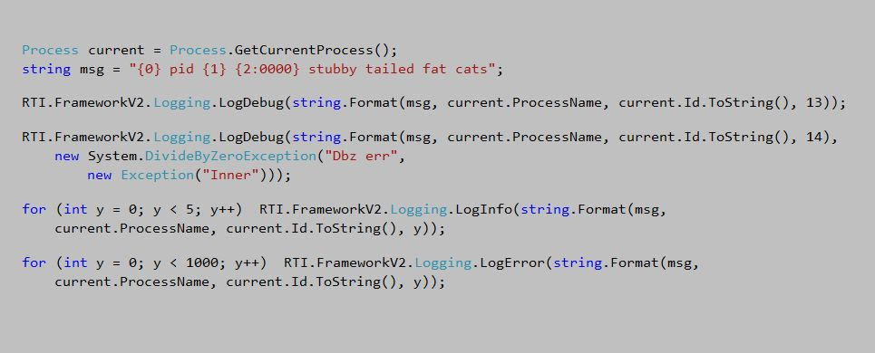
The caller / creator of events

Slide 10
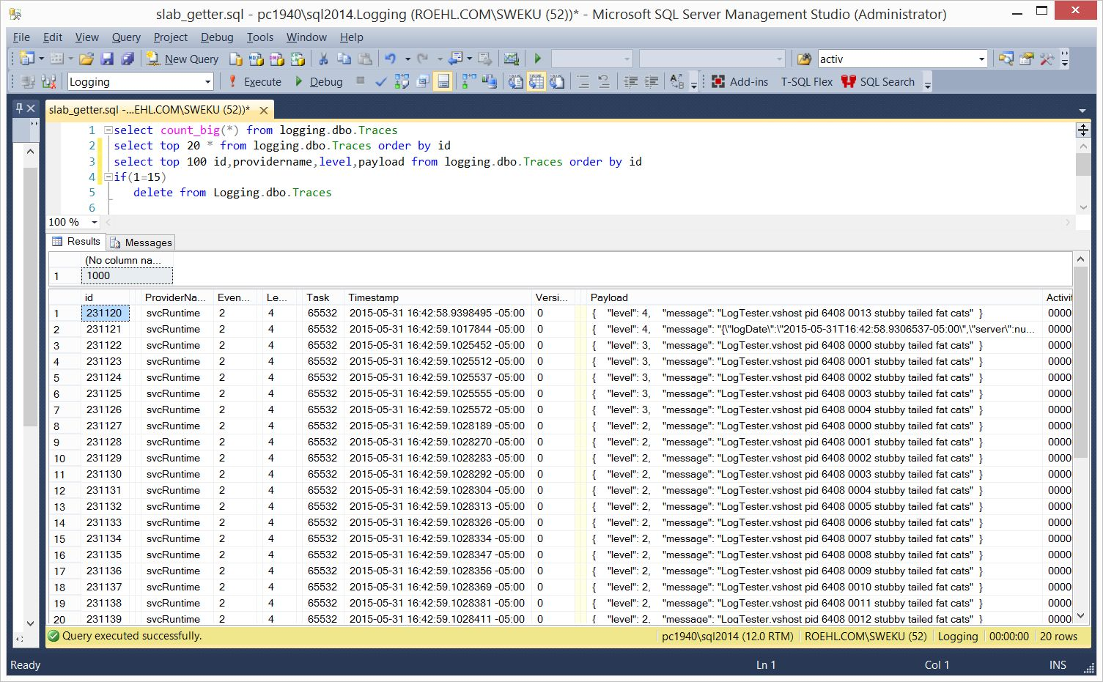
A second worth of work

Slide 11
What we can do
The code shows existing systems can be modified with minimal changes
The logging applications will SPEED UP dramatically
The subscriber, as a service, must run on each box the logger is on
The subscriber potentially could go to another SQL Server instance
The subscriber can be customized [note I persisted as json]
The subscriber can put different log data into different destinations
The subscriber easily configures with an XML config file

Slide 12

Shaping the log for our future

