Slide 1



Muhammad Siddiqi http://shujaat.net
Bringing Semantics into Logs
@SiddiqiMuhammad
Notes:
http://msdn.microsoft.com/en-us/library/windows/desktop/aa964766(v=vs.85).aspx

Slide 2
176 [main] INFO examples.Sort - Populating an array of 2 elements in reverse order. 225 [main] INFO examples.SortAlgo - Entered the sort method. 262 [main] DEBUG SortAlgo.OUTER i=1 - Outer loop. 276 [main] DEBUG SortAlgo.SWAP i=1 j=0 - Swapping intArray[0] = 1 and intArray[1] = 0 290 [main] DEBUG SortAlgo.OUTER i=0 - Outer loop. 304 [main] INFO SortAlgo.DUMP - Dump of integer array: 317 [main] INFO SortAlgo.DUMP - Element [0] = 0 331 [main] INFO SortAlgo.DUMP - Element [1] = 1 343 [main] INFO examples.Sort - The next log statement should be an error message. 346 [main] ERROR SortAlgo.DUMP - Tried to dump an uninitialized array. 467 [main] INFO examples.Sort - Exiting main method.
//build
Notes:
Psycopath joke

Slide 3
Session Agenda?
What is Semantic??
Event Source API
Semantic Logging Application Block
Event Source & ETW Tools
Event Source & Transfer Events
Event Source & Windows Event Logs
Notes:
You can do everything with semantic log that you can do with regular logs. But not everything you can do with semantic log can be done with regular logs.
Semantic : 5 min
EventSource API: 10min
Semantic Logging App. Block: 20 min
EventSource & ETW Tools: 10 min
EventSource & Transfer Events: 10 min
Event Source & Windows Event Log: 10 min

Slide 4
Semantic [Webster]
“Of or relating to meaning, especially meaning in language.”
-------Log What you mean!!! ------ What, Where & How??
Semantic Web { Tim Berners Lee – Scientific American 2001 }
[ converting the unstructured / semi-structured data on web to structured one ]
[ a web of data that can be processed by machines ]
--- Creating logs which can be processed by machines ---
Other Names In the Industry
Structured Logging
Strongly typed events
Semantic Logging is to create logs with machine’s consumption in mind
Notes:
Strongly typed payload values never gets converted to a string, parsed and converted back in the whole event pipeline. They maintain their types from generation to consumption. Hence strongly typed.
This is about logging with consumption in mind. So usage is not an after thought.
Data on the web is in the form of HTML. Now html is a formatting language. It just knows how to display it including text formatting, playing videos and animations, displaying images. It doesn’t know what does that mean. This is useless for machines. That’s why we get so much crap on the google search results.
The Semantic Web is a collaborative movement led by the international standards body, the World Wide Web Consortium (W3C).^{[1]} The standard promotes common data formats on the World Wide Web. By encouraging the inclusion of semantic content in web pages, the Semantic Web aims at converting the current web, dominated by unstructured and semi-structured documents into a "web of data". The Semantic Web stack builds on the W3C's Resource Description Framework (RDF).^{[2]}
According to the W3C, "The Semantic Web provides a common framework that allows data to be shared and reused across application, enterprise, and community boundaries."^{[2]} The term was coined by Tim Berners-Lee for a web of data that can be processed by machines.^{[3]}
Various formats can be converted into RDF. The details can be found here: http://www.w3.org/wiki/ConverterToRdf

Slide 5
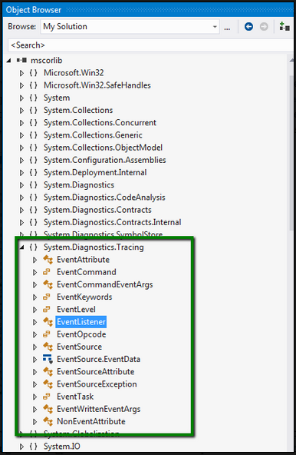
EventSource API
Provides the ability to create events for event tracing for Windows (ETW).
.net for Windows
Store Apps
(Windows 8)
.net framework 4.5
Notes:
It has nothing to do with EventSourcing pattern by Fowler.
Does not require any knowledge in ETW
For crashes, there’s work that the Store does on your behalf when it comes to crash reports so that you can visit the Store dashboard and have a look at your app crashes and download crash dumps in order to load them up into a debugger and take a look. I wrote a little about my own experience of doing that previously.
In terms of analytics – there’s a whole industry around that and you might want to bring in a fully featured analytics package to gather and do deep analysis on that data.
In all cases, it’s likely that you’re going to want to supplement those approaches with some detailed diagnostic instrumentation of your own.
Windows.Fondation.Diagnostics (win 8.1)

Slide 6
EventSource
Provides the ability to create events for event tracing for Windows (ETW).
Helps with…
Allows to separate the event authoring request from writing the event. + Simpler Logging site.
Make it easier to work with ETW.
Takes care of
generating the manifest for your events
converting your method parameters to event data.
XCOPY deployment now possible.
automatic
Performance – ETW based
Structured Payload
Cross-application
Benefits
Notes:
In particular there are not verbosity levels, event ID, or anything that does not need to be at the call site. All of that moved to the definition of the EventSource.
EventSource outputs the meta-data associated with the EventSource as an event before the first event is fired. This way, the log contains the correct meta-data (guaranteed), and thus can be decoded on any machine. Moreover, it avoids the registration step, allow XCOPY deployment.
ETW size limitation of 64K for a single events, the manifest is potentially dumped as ‘chunks’ that are under this size.
The mechanism standardized by the ETW infrastructure is to convert the meta-data to a binary form (using the MC.exe tool), attach it to a DLL as a resource, and then register that DLL with the operating system using a special (administrative), command (wevutil.exe). Unfortunately this has several important disadvantages
If the event data is moved to a different machine, the meta-data that is looked up may not be present or could be the wrong version. This could render the data useless (much like debugging without PDBs)
Registration would have to be done at deployment time, which means that XCOPY install is no longer possible. Worse, administrative privileges would be needed, increasing the administrative pain.

Slide 7
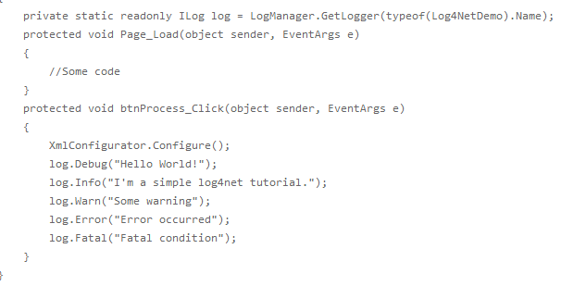
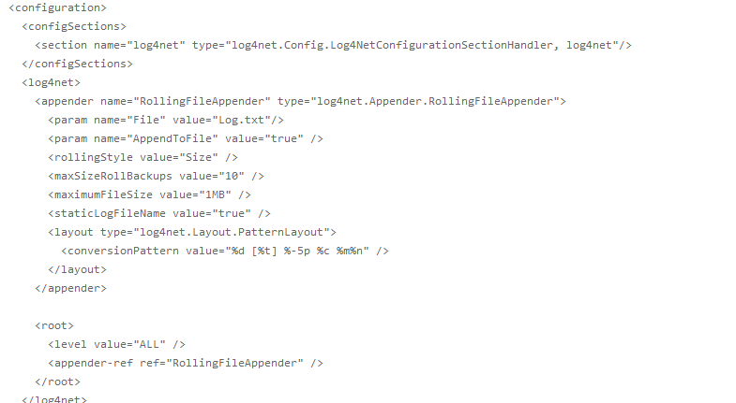
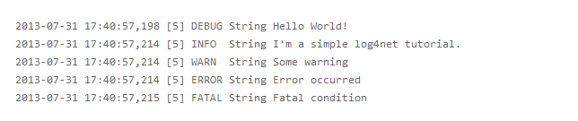
Log4Net Example
Log File
Notes:
What’s wrong here?
Formatting at logging site.
Severity at logging site.
Worrying about log storage on the application side.
Difficult to go through the logs.

Slide 8
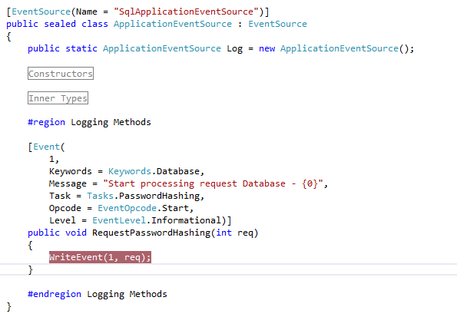
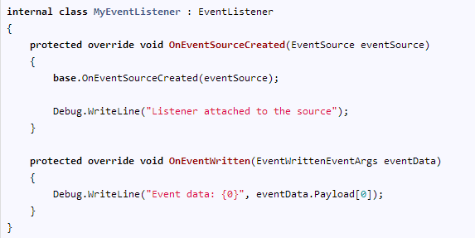

EventSource & EventListener
Listener
Controller
Consumer
Consumer [ OnEventWritten() ]
RFC4122
Controller (Attachment with EventSource)
Logging Call site
In-Proc Usage
Notes:
EventIds can be assigned implicitly or explicitly. They are implicitly assigned when we don’t provide an [Event] attribute for our methods. This is the ordinal number of method in the class starting from 1.
That is why we must decorate all [NonEvent] methods with appropriate attribute.
RFC4122: forming a GUID from a string. It is discouraged to specify the GUID
The EventSourceAttribute also allows the user to explicitly specify a GUID for the EventSource. This allows Existing ETW providers to be upgraded to using EventSources, but generally its use is discouraged.

Slide 9
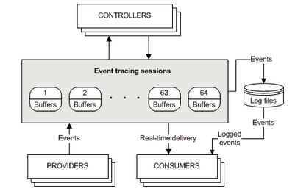
ETW : Event Tracing for Windows
Notes:
Native to Windows platform
Great performance & OK diagnostic tooling
Historically hard to publish events

Slide 10
EventSource & ETW Mapping
.net framework
ETW
Event Source
Event Provider
Event Method
Event Type
Method Parameters
Event Payload
Event Controller
Event Listener
Event Consumer
Notes:
We have native concepts on the right and .net framework options on the left.
EventProvider: a component capable for firing ETW events.
ETW Manifest: metadata describing an ETW provider and the detailed information on the ETW events it might fire.
ETW keywords: bit-flags that can be associated with events to create event categories.
ETW Tasks: Small integers that can be associated with events to define task-oriented groupings. Generally used in conjunction with op-codes.
ETW Opcodes: small integers that identify an operation within a task. The value of opcodes is that there are some well-known ones like ‘Start’ and ‘Stop’ which allow tools to operate on events in a generic way.
Event Source: A user defined sealed class derived from EventSource type.
ETW Event Method: a method defined in an Event Source that fires an ETW event. This must be a non-virtual , instance method returning void, that is not marked with [NonEvent] attribute.
ETW Transfer Event Method: An ETW event method that marks a relation between the current activity and a related activity. (.net 4.5.1 and nuget).

Slide 11
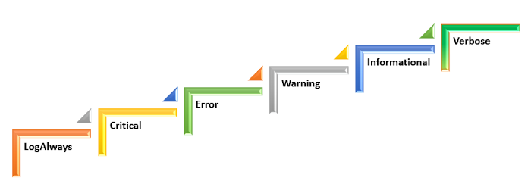
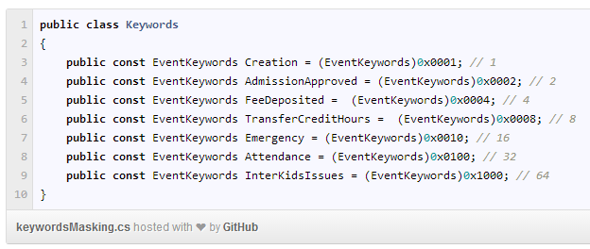
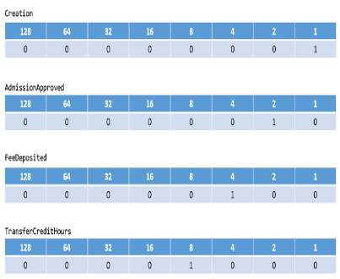
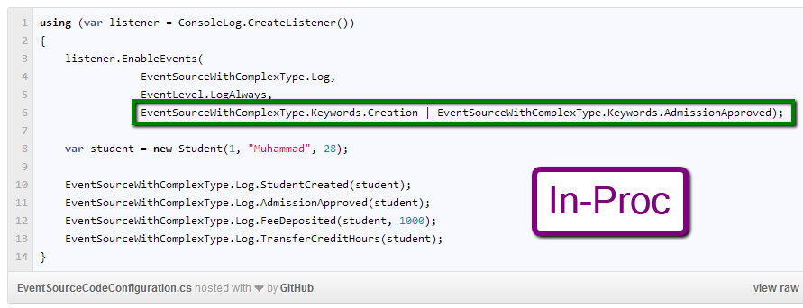
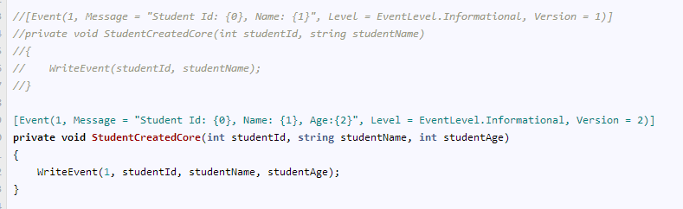
EventSource’s [Event] Methods
Level
Keyword
Power of 2
Max level of events to enable
VIWECL
Very Intelligent & Wise Elfs Can Learn
Task & Opcodes
Versioning
Task oriented grouping of events
Versions cannot co-exist…duplicate Event Ids not allowed
Task
Used in conjunction
Opcodes
Task
Integer Value
Opcodes
Operation within a task
Notes:
Version: No system is free of any changes. Automation systems can pick up the payload based on the version. Just like Service Contract in WCF.
Task and Opcodes are not available for EventListener.EnableEvent() but we can use it with Slab’s ObservableEventListener.

Slide 12
Demo
EventSource with attributes
Notes:
SampleEventSourceWithAttributes solution
Create an event source with attributes. Hook up the EventSource with a listener including keywords and level.

Slide 13
Semantic Logging Application Block [SLAB]
Provides
Customized Listener
Sinks
Unit Testing
Destination specific
Can be consumed
In-Proc
Out-Proc
Flat File
Database
Windows Azure Table Storage
Console
Rolling Flat File
Semantic Logging Service
SLAB is about making your log talk!!!
EventSource : Authoring Logs
SLAB: Example for Logs Consumption
Notes:
As we discussed before, Event Source is about authoring the events. SLAB is an example for events consumption.

Slide 14
SLAB & Rx
ObservableEventListener : IObservable<EventEntry>
ConsoleLog
ConsoleSink
LogToX
(extension methods
-
creates subscription)
CreateListener() : EventListener
[Already hooked up to X]
FlatFileLog
FlatFileSink
RollingFlatFileLog
IObserver<T>
RollingFlatFileSink
SqlDatabaseLog
SqlDatabaseSink
WindowsAzureTableLog
WindowsAzureTableSink
XLog
XSink
Notes:
Rx is a library for composing asynchronous and event-based programs using observable collections.

Slide 15
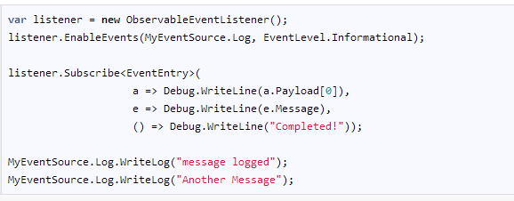
Demo
Notes:
Add example of InProc Sink
Install Rx before this example as the extension method for Iobservable.Subscribe() is available in the Rx nugget package.
When is OnCompleted gets invoked?

Slide 16
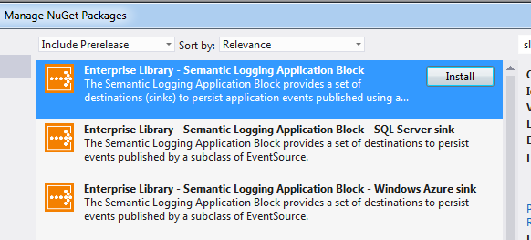
SLAB Nuget Packages
Package Ids
EnterpriseLibrary.SemanticLogging
EnterpriseLibrary.SemanticLogging.Database
EnterpriseLibray.SemanticLogging.WindowsAzure
Console
Flat File
Semantic Logging Service
Rolling Flat File
Separate Download

Slide 17
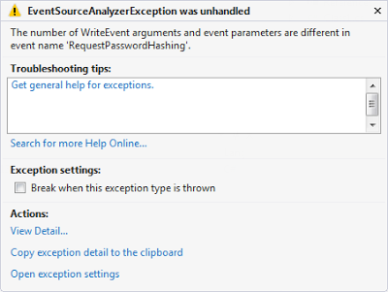
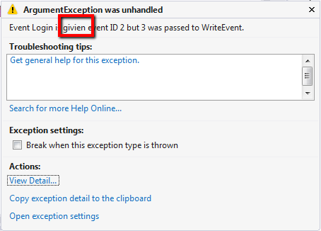
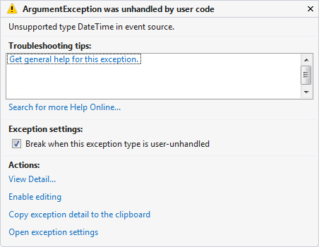
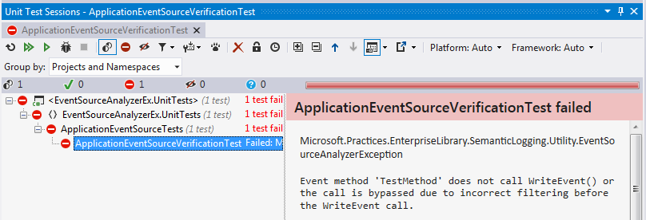
Unit Testing Event Source
Why?
EventSource.EventMethod
[Parameters]
ETW Event Type
EventSourceAnalyzer
Inspect
EventSource
ExcludeWriteEventTypeMapping
ExcludeWriteEventTypeOrder
ExcludeEventListenerEmulation
Checks Performed
Error when the given EventSource is enabled by an EventListener?
Can event schema be requested from the EventSource?
Can all Event based methods be invoked in the specified EventSource class?
Notes:
Why do we need to unit test Event Source?
As we know that Event methods in Event Source are used to generate ETW Event Types. The manifest for these event types are generated based on the [Event] method parameters. It is possible that we are not using the method parameter appropriately in EventSource.WriteEvent() method. It might cause runtime failure.
There are three properties on EventSourceAnalyzer. The static method InspectAll tests the EventSource with default values for these.

Slide 18
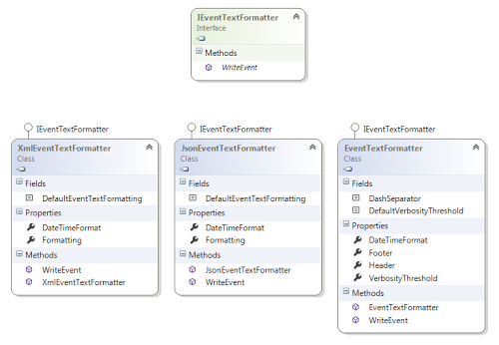
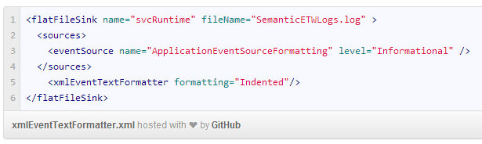
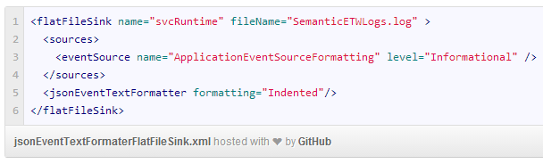
Event Text Formatting
- Flat File Sink
- Rolling Flat File Sink
- Console Sink
+
Custom Event Text Formatter
Supported Sinks
Notes:
Verbosity Threshold is an EventLevel. The value specified would record extra details about the events equal to or greater than the specified level.
The DateTimeFormat is not for the payload data. It is for the event data. If you look at the log file, you can find that all the events are logged withTimeStamp. This formatting is to applied for that Timestamp.

Slide 19
Semantic Logging Service
Out-Proc Event Listener
Increased fault tolerance for Application crashes
Can monitor Event Providers from multiple processes
Console Application
Can run as
Windows Service
Must run on the same machine as source
Dynamically updated
Xml based configurations
No restart required
Available as a separate download
Notes:
Get events out of the originating process using ETW and has a dedicated process just to persist the events to different destinations.

Slide 20
Demo
Using Semantic Logging Service
with
Windows Azure Table Storage Sink &
Sql Database Sink

Slide 21
SLAB Customizations
Custom Text formatters
Custom Sinks
Rx In-Proc filtering
Console color and level mapping

Slide 22
EventSource & ETW Tools
Installed
[Static Registration]
Classic Provider
ETW Manifests
Inline [EventSource]
[Dynamic Registration]
Manifest based Provider
TraceEvent Package
ETW Tools must incorporate support using Trace Event API
Notes:
Reference [Strongly Typed Events.doc]: https://www.google.com/url?sa=t&rct=j&q=&esrc=s&source=web&cd=1&cad=rja&ved=0CCkQFjAA&url=http%3A%2F%2Fblogs.msdn.com%2Fcfs-filesystemfile.ashx%2F__key%2Fcommunityserver-components-postattachments%2F00-10-32-81-89%2FStronglyTypedEvents.docx&ei=EatcUvvGENi34AP-_4CoDg&usg=AFQjCNEFGojvfbQu4td41D9BGR1uIJUTKQ
Event Commands: Enable, Disable, SendManifest, Update
http://msdn.microsoft.com/en-us/library/windows/desktop/aa364101(v=vs.85).aspx
http://msdn.microsoft.com/en-us/library/windows/desktop/aa363881(v=vs.85).aspx

Slide 23
SLAB & ETW Tools
PerfView: An ETW Controller and ETL Viewer
Logman
Tracerpt
Windows Performance analyzer
SvcPerf
TraceLog: http://msdn.microsoft.com/en-us/library/windows/hardware/ff553012(v=vs.85).aspx
Notes:
The manifest is embedded in the provider binary, which means that the provider must be available on the computer for the consumer to consume its events.
There are two fundamentally different ways to access ETW manifests - installed and in-line. All of the older APIs in System.Diagnostics.Eventing expect installed APIs. This is problematic in many scenarios so the new System.Diagnostics.Tracing APIs were added in .NET 4.5
It will not work to cross over this boundary - I the simplest sense. Although if you wish to separately manage the manifest, you could probably make it work.
Moving from what's wrong to what you want to accomplish...
I would suggest that you abandon EventLogReader and explore the NuGet TraceEvent. This is the internals of PerfView (more or less) and has many samples - although the organization of the documentation is a bit weak and scattered and it will probably take you a few hours to feel grounded in this approach.
This would put you entirely on the strongly typed, future focused, System.Diagnostics.Tracing path of in-line manifests.
However, if you have a real reason to remain with the EventLogReader, I suggest that you explore the NuGet version (4.5.1) of EventSource (Microsoft.Diagnostics.Tracing). This has support for creating manifests, particularly in the external (check packages\<ugly>\tools)EventRegister.exe. Yes, I know it's a bit surprising that EventRegister doesn't actually register anything, but if you read the docs I think you'll work out how to create the input to wevtutil.exe. You can find some on this in the 4.5.1 EventSource samples.
If you're using EventSource, it's best to follow Vance Morrison's blog and soon mine, and if you have Pluralsight you might be happy to know that I'm releasing an ETW in .NET video, hopefully in early October.
Hope this helps,
Kathleen Dollard

Slide 24
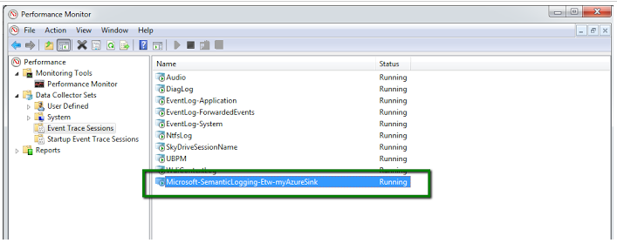
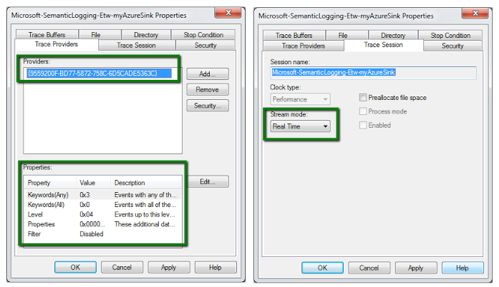
Performance Monitor [Perfmon.exe]
Notes:
http://blogs.msdn.com/b/vancem/archive/2013/08/10/wpr-wpa-support-for-viewing-system-diagnostics-tracing-eventsource.aspx
We can use either of PerfView, Xperf or WPR to collect events data. For xperf, we need GUID as it cannot work with EventSource’s name.

Slide 25
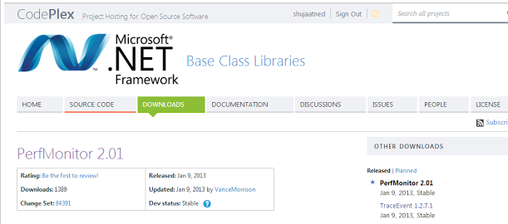
PerfMonitor 2.01
Not a next version of PerfMon but a different utility.
Also called command line version of PerfView
Based on Trace Event Library
Single file deployment
Perfmonitor listSessions
PerfMonitor listSources MyApp.exe
PerfMonitor monitor MyApp.exe <args>
Notes:
perfmonitor listSessions [all ETW sessions in system]
perfmonitor.exe listsources "./../PerfView/ProjectOutput/EventSourceFormatting/EventSourceFormatting.exe"
perfmonitor.exe monitor "./../PerfView/ProjectOutput/EventSourceFormatting/EventSourceFormatting"
* perfMonitor collect (automatically start / stop - wait for pressing 's')
*
•perfMonitor start
•Foo.exe FooArg
•perfMonitor stop
*
PerfMonitor is really just a generic ETW Controller, but since EventSources are just ETW providers, it can be used to control EventSources.
Invokes the ‘monitor’ command, which does the following:
Inform the operating system that the ‘MyCompany.MyApp’ provider should be turned on, and indicate that the output should go to a default (binary) file called ‘PerfMonitorOutput.etl’.
Run the ‘MyApp.exe’ with the given arguments
When the application completes, turn off logging (which closes the PerfMonitorOutput file)
Convert (print) the log file to XML as the file ‘PerfMonitorOutput.print.xml’

Slide 26
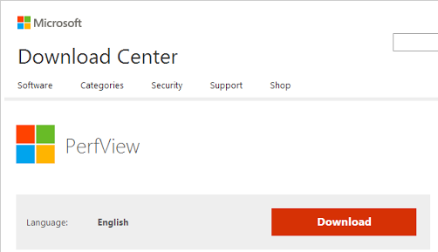
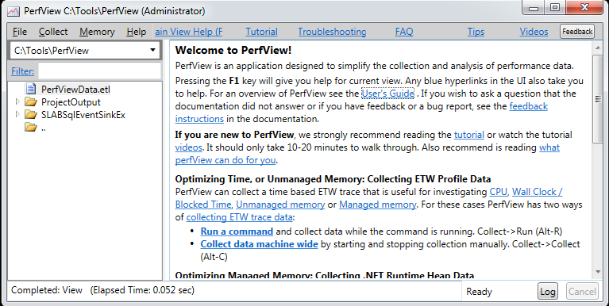
PerfView
Based on Trace Event Library
Can run using Command Line
Shows Event Data on User Interface
Vance Morrison’s for WPA support
Notes:
PerfView /OnlyProviders=*ApplicationEventSourceFormatting run "C:\Tools\PerfView\ProjectOutput\EventSourceFormatting\EventSourceFormatting.exe“
Before provider name: The name is not being looked up in the registration table.
The problem is that WPA relies on special WPA specific events that it injects into the ETL file when it stops a trace. The support for this came after PerfView V1.4.1 was released, so it does not have the necessary information in the ETL file.

Slide 27
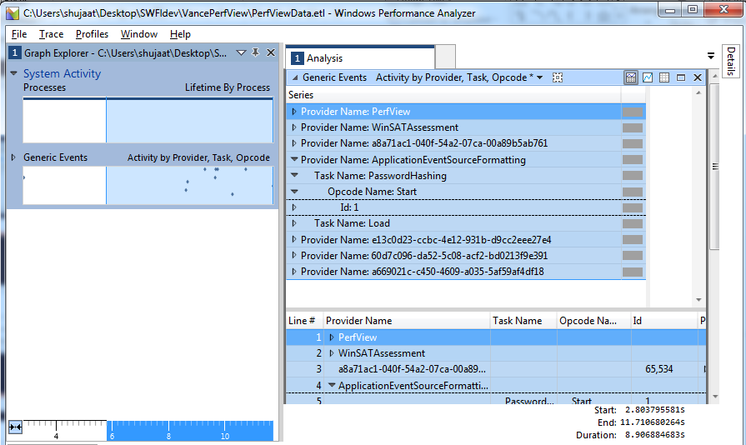
Windows Performance Analyzer
WPR
…..
…..
…..
…..
XPerf
Collectors
PerfView
ETL File

Slide 28
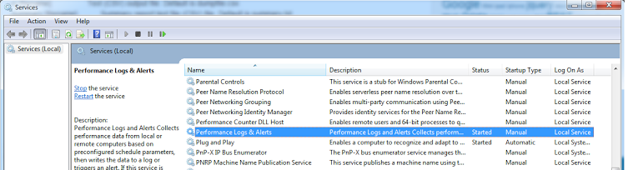
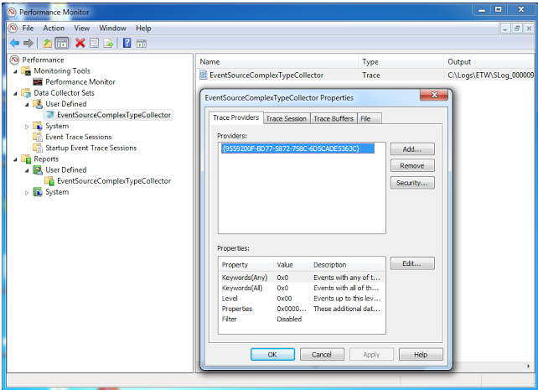
Log Manager [LogMan]
Notes:
Uses Performance Logs & Alerts Service: Utility starts it if it is shut down
Commands
logman delete EventSourceComplexTypeCollector
Logman Create trace EventSourceComplexTypeCollector -o "C:\Logs\ETW\SLog.etl" -p "{60d7c096-da52-5c08-acf2-bd0213f9e391}" -f bincirc -max 1000
Logman query EventSourceComplexTypeCollector
logman /start EventSourceComplexTypeCollector
Run the application writing ETW data
logman /stop EventSourceComplexTypeCollector
(it should flush out the data to ETL file)
Convert ETL to human readable format using TraceRpt

Slide 29

TraceRpt
- Command line utility
- Processing binary ETL files into human readable formats including XML / CSV
- Xml (default) or Html based report for generated events data
Notes:
Xml is the default format for conversion result.
The tracerpt command can be used to parse Event Trace Logs, log files generated by Performance Monitor, and real-time Event Trace providers.

Slide 30
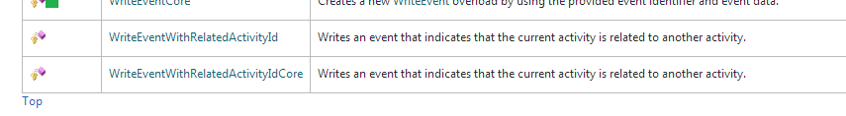
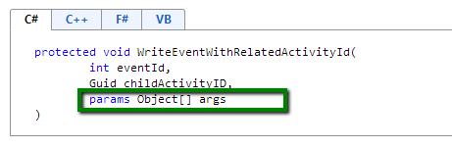
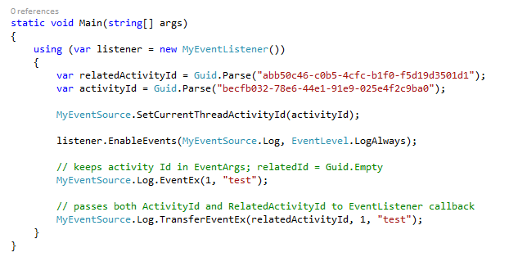
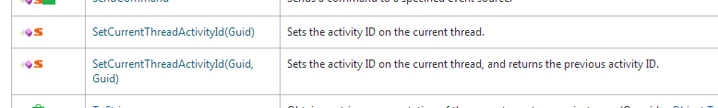
Helps in understanding
End-to-End scenarios
Activity Id for Events [Transfer Event]
Grouping related events from more than one component
Supported in both Manifest based and Classic ETW provider
Correlation between calls and tiers.
Can span applications
Additional WriteEvent like methods
EventSource
EventWrittenEventArgs
EventListener.OnEventWritten()
.net framework 4.5.1
Notes:
The whole idea is that we would be setting ActivityId on EventSource. Then as the scenario continues, it would continue to register events using their respective related Activity Ids. From the recording in EventListener, we can determine how the scenario proceeded.
Since we can specify an activity id manually, it can span across applications.
WriteEventCore provides better performance because it does not have to unbox the childActivityID and dataarguments.
ETW provides a way to group related events from more than one component. For example, if several components (either on the same computer or on different computers) are involved in processing the same data, and each component logs events for their portion of the activity, you can group all of the related events together. This will allow a consumer to consume all of the events, from the beginning of the process to the end of the process.

Slide 31
Application 1
ActivityId = X, RelatedActivityId = A
Application 2
ActivityId = X,
RelatedActivityId = B
ETW Infrastructure
Semantic Logging Service
Application 3
ActivityId = X, RelatedActivityId = C
Event Store

Slide 32
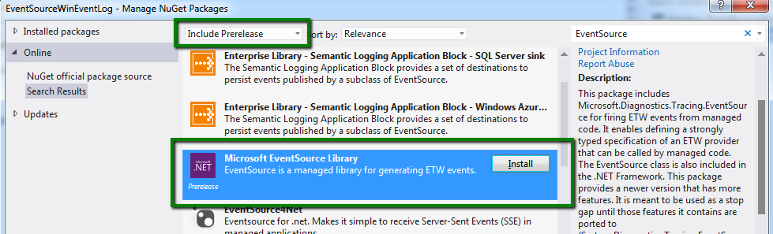
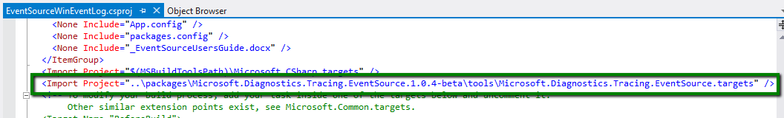
EventSource & Windows Event Log
EventSource doesn’t support Windows Event Log by default
No Channel support!
Microsoft.Diagnostics.Tracing.EventSource (Standalone New definition)
Provides
Compile time checks
Supports .net framework 4.0
Notes:
Events which are assigned with a channel are passed on to Windows Event Log. These are the messages which can be seen in Windows Event Log.
http://msdn.microsoft.com/en-us/library/windows/desktop/aa363652(v=vs.85).aspx
The EventSource class is integrated with the Event Tracing for Windows (ETW) subsystem. ETW includes a feature calledETW channels, which allows you to direct your ETW events to the Windows Event Log, without you needing to know anything about how to interact with event log APIs. This release builds on top of ETW channels, enabling you take advantage of that feature from EventSource, in your .NET code.
It is an out-of-band release
The package provides a new implementation of EventSource with added on features including channels support.
Id verification in the attribute and WriteEvent().
Type must be sealed.
http://blogs.msdn.com/b/dotnet/archive/2013/08/09/announcing-the-eventsource-nuget-package-write-to-the-windows-event-log.aspx
LogStash: http://logstash.net/

Slide 33

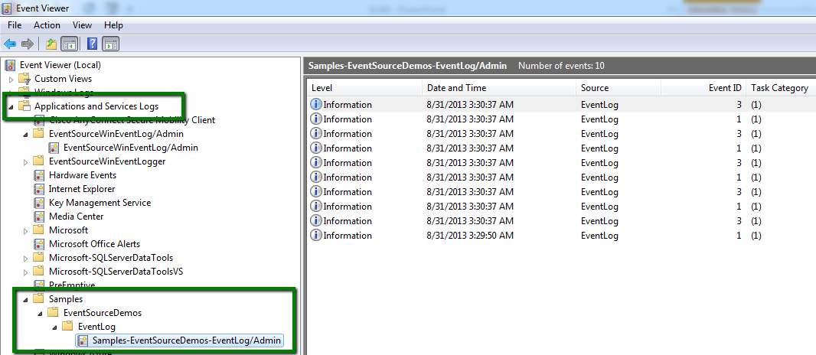
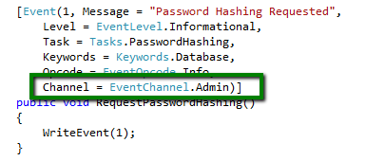
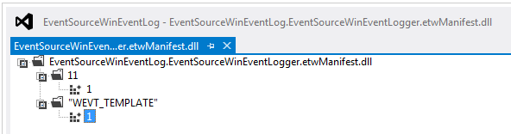
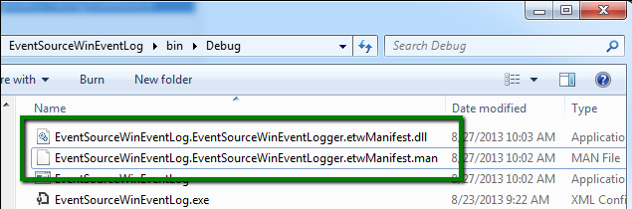
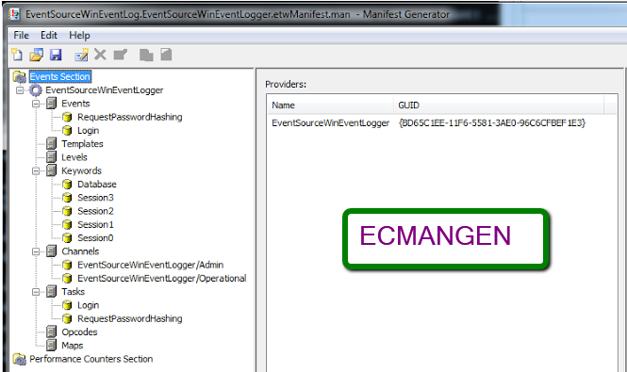

Using the Package…
Step I : Implementing EventSource
Naming Event Source – Hyphenated Friendly names
Consult IT
Consult IT
[Channel]
Step II : Compile the Project
Step III : Registering Provider
Notes:
Step 2:
The dll has just manifest and no code. It should have WEVT_TEMPLATE entry.
The manifest is in xml. We can view it in ECManGen.
Event Channels:
Admin, Operational, Analytic and Debug.

Slide 34
Questions

Slide 35
Limitations & Possible Workarounds
Supporting Inherited Members
Supporting Complex Types
Making it a little easier to implement
Notes:
There are two limitaitons when we implement our customized EventSource.
Only direct members are supported – issue when implementing interfaces
Limited DataTypes supported

Slide 36
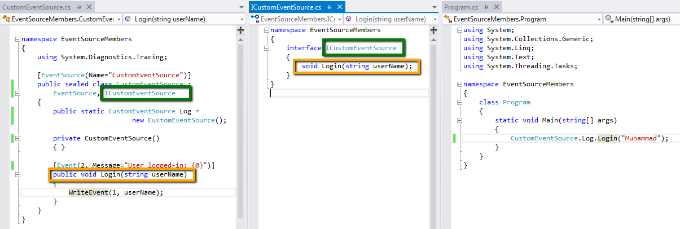
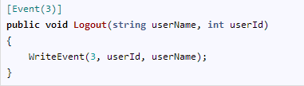
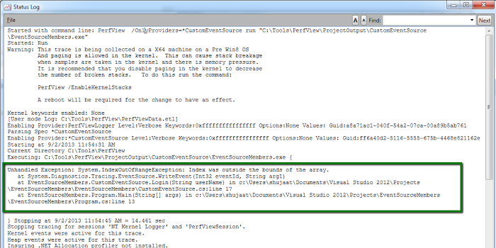
EventSource and Inherited Members
Limited Data Types Support
[Event] methods must be direct members
Boolean, SByte, Byte, Int16, UInt16, Int32, UInt32, Int64, UInt64, Single, Double, String, Guid
Issue?
Interface Implementation
Complex Types??
Notes:
EventSourceMembers example
DateTime?? Page 2 of the nugget reference doc. It supports different types of integers, string, GUID and their arrays.
PerfView /OnlyProviders=*CustomEventSource run "C:\Tools\PerfView\ProjectOutput\CustomEventSource\EventSourceMembers.exe"

Slide 37
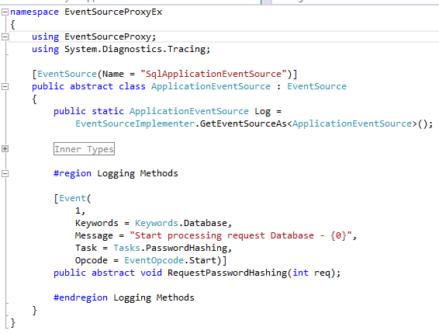
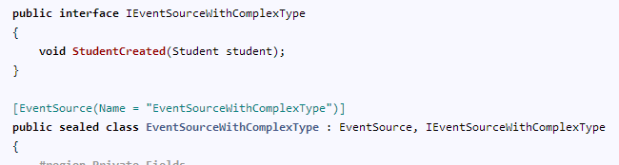
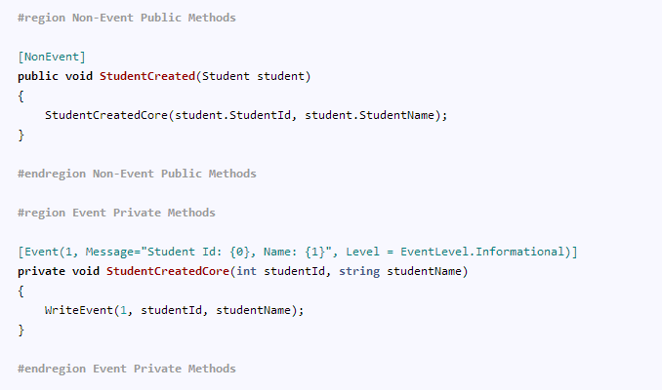
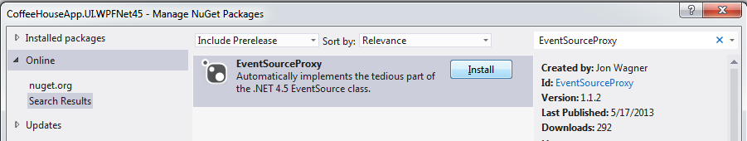
WriteEvent Restrictions
Solutions
Supporting Complex Types & Inherited Members
Implements abstract [Event] methods
Decorates an implementation with ETW Tracing
- [NonEvent] public methods with complex Types
Converts an interface to ETW Tracepoint
[Event] methods can be private
EventSourceProxy
[Jon Wagner]
Notes:
ESP will use the attributes specified to create a proxy for EventSource using EventSourceImplementer.
ESP automatically serializes complex types in JSON format (string) for verbose level.
It also helps in providing a an EventSource based proxy for an implementation of an interface. So the type is provided with a decorator for the interface implemented. All the calls to the implemented methods are automatically logged, including the parameters. [complex types: Json Serialization]

Slide 38
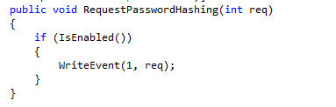
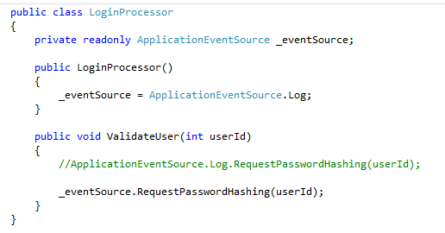
Performance Considerations – High Vol. Events
- Use explicit overload of WriteEvent() in [Event] method
Otherwise [ 10-20 times more expensive ]
Can’t find an overload?
Provide Additional WriteEvent() in custom EventSource
- [NonEvent]
- Uses WriteEventCore() method.
- Use IsEnabled() before WriteEvent()
Don’t write if not active…
Just a field fetch
- Assign static Log object to local variable
Static variable fetch
more expensive
- Minimize number of EventSources
Share between logically related components
Notes:
When logging is off, there is almost (can be noticeable for high volume events) [fall on the floor]no overhead to the logging infrastructure. When you turn logging on, you can control the amount of data that is collected and the overhead depends on how much you need to log.
Why is the overload of WriteEvent() expensive?
Allocates an array to hold the variable arguments
Casts each parameter to an object (which causes allocations for primitive types)
Assigns these objects to the array
Calls the function, which then
Figures out the type of each argument, to determine how to serialize it to ETW
Minimize number of EventSources
EventSource does as little as possible at startup but it ALWAYS has to hook up to existing Listeners or ETW, which means
Calling the ETW API to get a callback if an ETW command is made.
Place itself in the AppdomEventRegister ain wide list of EventSources that allow EventListeners to subscribe to it.

Slide 39
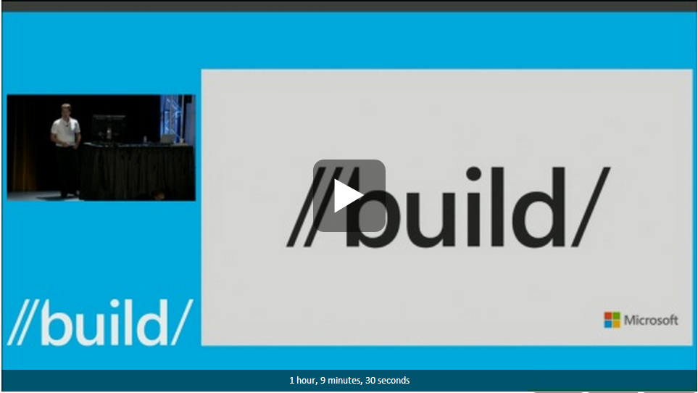


Resource / Further Quest
Grigori Melnik:
http://channel9.msdn.com/Events/Build/2013/3-336
Julian Dominguez
http://channel9.msdn.com/posts/Introducing-Semantic-Logging
https://github.com/jonwagner/EventSourceProxy
http://msdn.microsoft.com/en-us/library/windows/desktop/bb968803(v=vs.85).aspx
http://blogs.msdn.com/b/vancem/
@SiddiqiMuhammad
http://shujaat.net

