Slide 1
ARC PROGRAMMABLE MONEY HACKATHON · DEFI
Probability
Yield from prediction-market liquidity
Working Arc Testnet MVP
July 2026
USDC
FEE
YIELD
Notes:
[Sources]
- https://github.com/lam368910/Probability
- https://lam368910.github.io/Probability/
[/Sources]
Open with the non-directional liquidity thesis and immediately state that this is an unaudited testnet MVP, not guaranteed yield.

Slide 2
PROBABILITY / ARC TESTNET
Prediction markets need a second role
THE GAP
Most interfaces make every user choose an outcome.
But liquid probability markets also need capital that quotes both sides—and understands the risk of doing so.
Traders bet on outcomes
LPs earn the flow
Directional exposure
Fragmented depth
Gross APY without loss context
Two-sided USDC liquidity
80% LP / 20% protocol fee split
Risk-adjusted analytics
02
Notes:
[Sources]
- https://github.com/lam368910/Probability/blob/main/docs/PRODUCT_STRATEGY.md
- https://github.com/lam368910/Probability/blob/main/docs/RISK_MODEL.md
[/Sources]
Frame Probability as market-making infrastructure: traders express views; LPs supply depth and receive fee accounting without choosing YES or NO as a thesis.

Slide 3
PROBABILITY / ARC TESTNET
One Arc-native loop creates fee yield
PRODUCT LOOP
Every step is visible in the UI and enforced by the contracts.
01 LPs seed both sides
USDC becomes YES and NO inventory while preserving the reserve ratio.
02 Traders move price
A fixed-product quote turns each trade into an implied-probability update.
03 Fees accrue
30 bps total; the live market assigns 80% to LPs and 20% to treasury.
04 Risk stays visible
Reserves, fee APR scenarios, inventory loss, and safety boundaries remain explicit.
03
Notes:
[Sources]
- https://github.com/lam368910/Probability/blob/main/contracts/src/BinaryPredictionMarket.sol
- https://testnet.arcscan.app/address/0x6C61d4e599EdBD181DD815aFA83B3029b6AFFA42
[/Sources]
Walk clockwise through the loop. Emphasize that fee terms are immutable per market and that the frontend is not trusted for pricing or authorization.

Slide 4
PROBABILITY / ARC TESTNET
Arc makes dollar markets feel native
WHY ARC
Probability settles, charges gas, and accounts for liquidity in the same dollar-denominated asset.
USDC
<1s
EVM
Gas + collateral
Deterministic finality
Existing tooling
04
Notes:
[Sources]
- https://docs.arc.io/arc/references/connect-to-arc
- https://docs.arc.io/arc/references/contract-addresses
- https://docs.arc.io/arc-chain
[/Sources]
Explain the 18-decimal native gas precision versus the 6-decimal ERC-20 interface. The product reads and transfers collateral only through the standard ERC-20 interface.

Slide 5
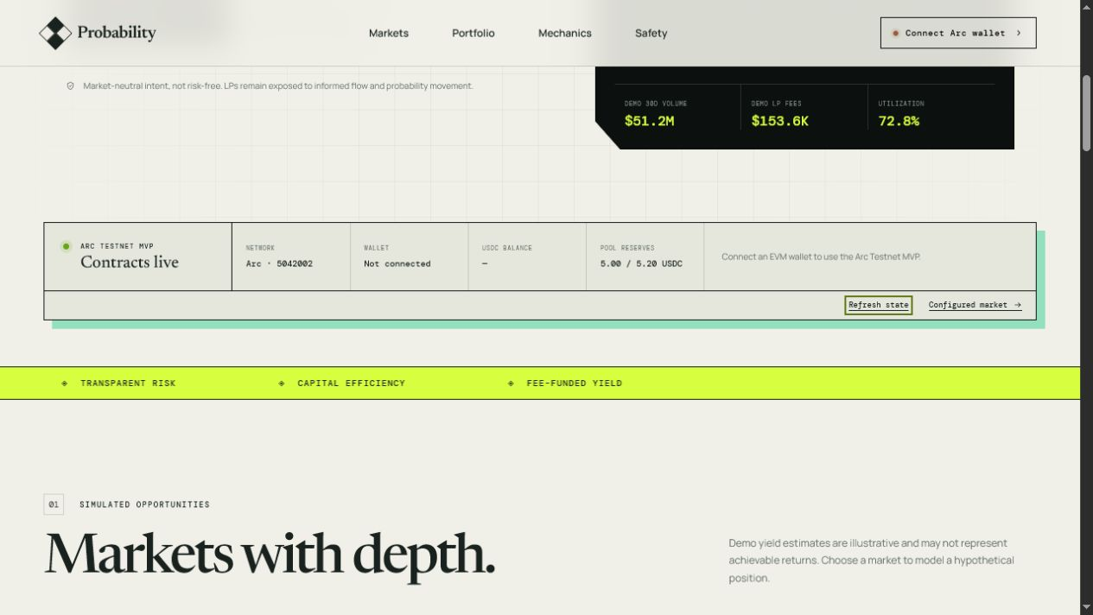
PROBABILITY / ARC TESTNET
Live MVP. Public receipts.
Proof, not a dead button
Factory + market deployed 5.20 USDC fully collateralized Canonical YES trade finalized Canonical liquidity deposit finalized Public state refresh with RPC fallback
YES trade
0x72c9…35be
Liquidity
0x6a0e…2c7d
05
Notes:
[Sources]
- https://lam368910.github.io/Probability/
- https://testnet.arcscan.app/address/0x9d86B15bFb272B7b6702b9B0dDB3EA2a30B29601
- https://testnet.arcscan.app/address/0x6C61d4e599EdBD181DD815aFA83B3029b6AFFA42
- https://testnet.arcscan.app/tx/0x72c9c287ff2bea33379f5c2d068da23b25eff9aeb49c372bafc011104bcc35be
- https://testnet.arcscan.app/tx/0x6a0eb79e63afd3556a8a3079242e479938319b1a2f186d569132131d592e2c7d
[/Sources]
Pause on the two transaction hashes. The smoke test confirms market registration, live phase, roles, reserves, and exact collateral backing after both actions.

Slide 6
PROBABILITY / ARC TESTNET
Yield is fees minus what the market knows first
HONEST ECONOMICS
Probability makes the complete LP return equation visible—not just gross fee APR.
+ Trading fees
Earned when traders use the pool; dependent on realized volume.
− Inventory repricing
Outcome reserves change value as implied probability moves.
− Adverse selection
Informed order flow can extract more value than fees replace.
− Oracle + contract risk
Resolution, governance, and software failure remain explicit loss paths.
06
Notes:
[Sources]
- https://github.com/lam368910/Probability/blob/main/docs/ECONOMICS.md
- https://github.com/lam368910/Probability/blob/main/docs/RISK_MODEL.md
[/Sources]
This is the trust slide. State plainly that LP capital can lose money and that no simulated APR is a promise or a quote from the Solidity AMM.

Slide 7
PROBABILITY / ARC TESTNET
From hackathon MVP to controlled pilot
LIVE NOW
Arc market + factory Wallet execution Public state + evidence Risk simulator and CI
HARDEN
Invariant + fuzz tests Independent audit Dispute-capable oracle Multisig + timelock
PILOT
Curated markets LP caps + monitoring Indexed history Jurisdiction-specific launch
MVP
AUDIT
PILOT
07
Notes:
[Sources]
- https://github.com/lam368910/Probability/blob/main/docs/ROADMAP.md
- https://github.com/lam368910/Probability/blob/main/docs/SECURITY_AND_COMPLIANCE.md
[/Sources]
The ask is design feedback, pilot partners, and audit/oracle collaborators—not deposits. Keep mainnet explicitly out of scope until every hardening gate is complete.

Slide 8
PROBABILITY · DEFI TRACK
Make market activity earnable.
ARC
TESTNET
LIVE
Live demo · lam368910.github.io/Probability
GitHub · github.com/lam368910/Probability
Arc market · 0x6C61…FA42
Notes:
[Sources]
- https://lam368910.github.io/Probability/
- https://github.com/lam368910/Probability
- https://testnet.arcscan.app/address/0x6C61d4e599EdBD181DD815aFA83B3029b6AFFA42
[/Sources]
Close in one sentence: Probability turns prediction-market volume into transparent, risk-aware USDC fee yield on Arc.

