Slide 1
University of Palestine · Software Engineering
GazaCare Connect
A remote medical bridge linking Gaza patients with external specialists
University of Palestine — Software Engineering
Graduation Project 2025–2026
Supervisor: Dr. Fatma Alrubaei
Team: Lama Al-Darbi · Hala Al-Darbi · Dima Ayoub · Reem Salama · Ismail Abdelall · Ahmed Abo Shamala
1 / 60

Slide 2
GazaCare Connect
GazaCare Connect
Agenda
1
Ch.1 Problem, context, and scope
2
Ch.2 Technologies and prior-platform weaknesses
3
Ch.3 Methodology, Increment phases, survey, and requirements
4
Ch.4 Use cases for the three roles
5
Ch.5 UML diagrams in detail
6
Ch.6 Implementation, architecture, and UI
7
Ch.7 Testing and security
8
Ch.8 Achievements, recommendations, and future work
University of Palestine · 2025–2026
2 / 60

Slide 3
GazaCare Connect
Chapter 1
Chapter 1 — Introduction
• The starting point is Gaza’s healthcare reality
• The research problem is defined clearly
• The system goals and limits are clarified
University of Palestine · 2025–2026
3 / 60

Slide 4
GazaCare Connect
Chapter 1
What Reality Motivated the Project?
1
Shortage of specialists inside Gaza
2
High pressure on hospitals and clinics
3
Hard to get timely specialty medical advice
4
Many patients use WhatsApp/Facebook for medical advice
5
These channels are informal: no organized medical oversight and weak privacy
University of Palestine · 2025–2026
4 / 60

Slide 5
GazaCare Connect
Chapter 1
Research Problem and Solution
1
Problem: no secure, organized, integrated remote-consultation platform
2
Solution: GazaCare Connect as a formal digital bridge between Gaza patients and external physicians
3
Supports: registration, text consults, uploads, follow-up, and physician verification
4
Important: non-emergency consults only — not a substitute for ER or in-person care
University of Palestine · 2025–2026
5 / 60

Slide 6
GazaCare Connect
Chapter 1
Scope and Limitations
Item | Details
Geographic scope | Patients in Gaza and specialists outside the area
Functional scope | Register, text consult, uploads, reply, follow-up, admin verification
Technical scope | Web platform: React/Next.js + Laravel + MySQL
Limits | Weak internet · legal constraints · not for emergencies · Gaza-specific context
University of Palestine · 2025–2026
6 / 60

Slide 7
GazaCare Connect
Chapter 2
Chapter 2 — Literature Review
• First: technologies used to build the platform
• Second: documented weaknesses of three Gaza-related platforms
University of Palestine · 2025–2026
7 / 60

Slide 8




GazaCare Connect
Chapter 2
Chosen Technologies and Why
Area | Technology | Role in the project
UI design | Figma | Screen design and interactive prototypes before coding
Modeling | Edraw Max and Draw.io | Flowcharts and UML
Frontend | React.js, Next.js, TypeScript | Fits weak internet via a lightweight fast UI
Markup/styling | HTML5 and CSS3 | Page structure, styling, and responsiveness
Dev tools | VS Code and Git | Coding and team version control
Backend | Laravel and PHP | Fits medical-data security via auth and permissions
Database | MySQL and phpMyAdmin | Store users, consultations, and medical files
React
Next.js
Laravel
MySQL
University of Palestine · 2025–2026
8 / 60

Slide 9
GazaCare Connect
Chapter 2
Weaknesses of Previous Platforms
Source: direct screenshot documentation of the listed platforms.
Platform | Main weakness
Gxza Health | When demand is high, consultation intake shuts down entirely — no queue, just a closed form
MENA Health | No direct in-platform consultation — patient must go through Telegram, then a separate registration link
Heal Gaza | Official website is fully down; only Instagram remains, with a dead site link in the Instagram bio
University of Palestine · 2025–2026
9 / 60

Slide 10
GazaCare Connect
Chapter 3
Chapter 3 — Research Methodology
• Methodology: Incremental Model
• Then the survey and its findings
• Then turning findings into requirements
University of Palestine · 2025–2026
10 / 60

Slide 11
GazaCare Connect
Chapter 3
Why Incremental? And What Are Its Phases?
1
Delivers an early working prototype
2
Integrates user feedback in every increment
3
Helps manage technical risks early
4
Prioritizes core features before secondary ones
5
Each increment: analysis → design → implementation → testing
University of Palestine · 2025–2026
11 / 60

Slide 12
GazaCare Connect
Chapter 3
Comparing the Phases of Each Increment
Each Increment goes through four phases — and why each matters · Note: The four phases repeat inside every Increment — not only once at the end of the project.
Phase | What happens? | Why it matters
Analysis | Define roles and needs; examine informal channels such as WhatsApp | Ensures features are based on real user needs, not assumptions
Design | Design UI, UML diagrams, and database structure before coding | Reduces later errors and clarifies system structure before implementation
Implementation | Build the functional part of the increment (Frontend / Backend / Database) | Turns design into an early testable system within each Increment
Testing | Unit, integration, security, and usability testing for the current increment | Catches issues early before the next increment and supports reliability
University of Palestine · 2025–2026
12 / 60

Slide 13
GazaCare Connect
Chapter 3
From Survey to Design Decisions
Survey question | What we found | Rate | What we decided in the system
Which channels are used now for medical advice? | Informal channels (Facebook/WhatsApp 52% + acquaintances 38%) | 90% | Build a verified environment instead of informal channels
Is it important for you that your data stays confidential? | Most participants said their data confidentiality is very important | 94% | Strong file protection with Authentication and Authorization, and choosing Laravel
What are the main technical barriers to using the platform? | Weak internet is a main barrier | 45% | Light UI and asynchronous consultation using Next.js
Is the participant a patient or a caregiver? | A large share of participants are caregivers | 60% | Add Caregiver Mode
Which specialties are hardest to access? | Hardest access: dermatology consults | 30% | Focus on simple, organized specialty consults
University of Palestine · 2025–2026
13 / 60

Slide 14
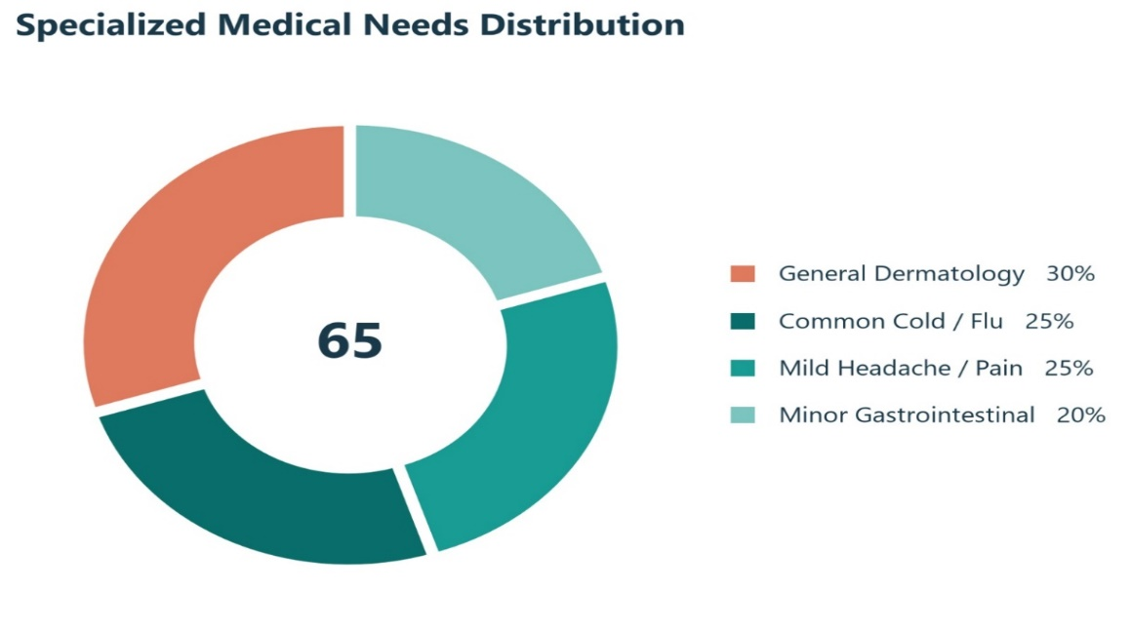
GazaCare Connect
Chapter 3
From Survey to Design Decisions
Specialized medical needs
University of Palestine · 2025–2026
14 / 60

Slide 15
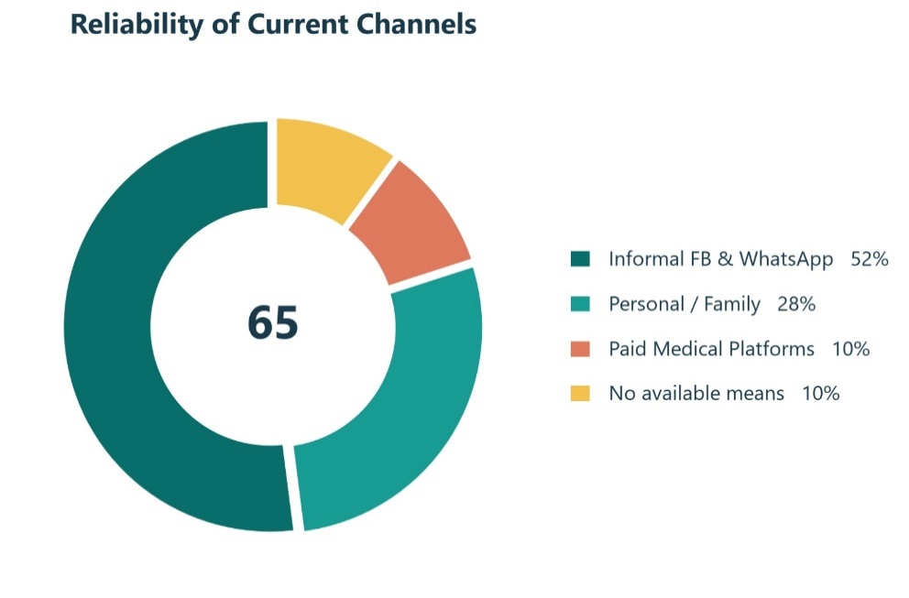
GazaCare Connect
Chapter 3
From Survey to Design Decisions
Current channels
University of Palestine · 2025–2026
15 / 60

Slide 16
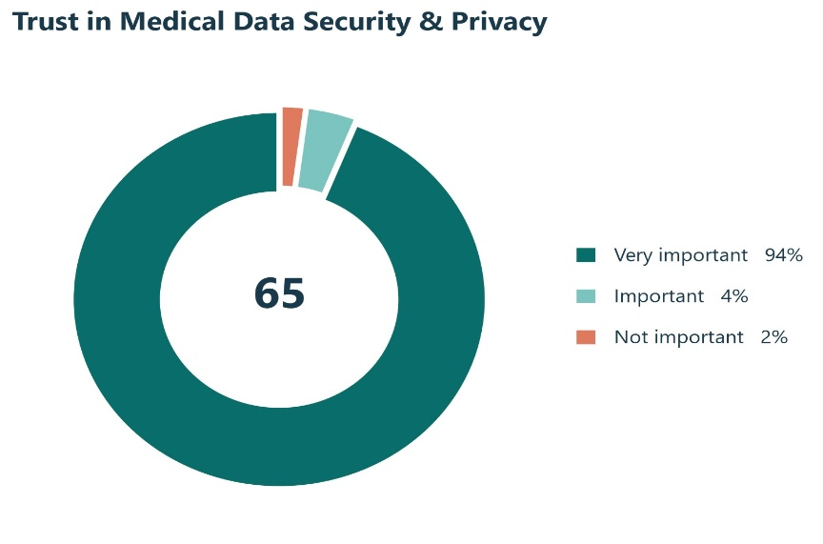
GazaCare Connect
Chapter 3
From Survey to Design Decisions
Trust in medical data security
University of Palestine · 2025–2026
16 / 60

Slide 17
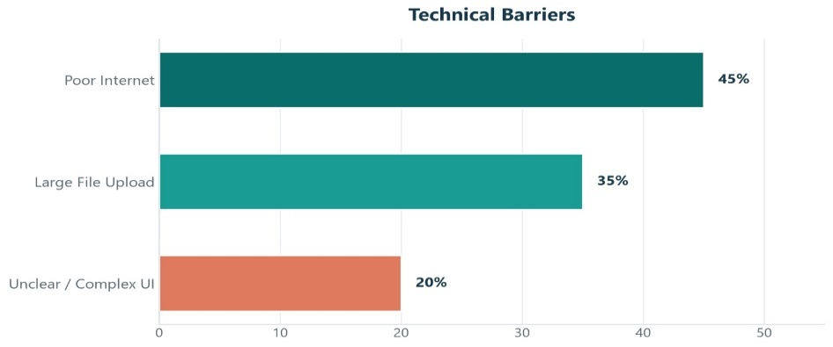
GazaCare Connect
Chapter 3
From Survey to Design Decisions
Technical barriers
University of Palestine · 2025–2026
17 / 60

Slide 18
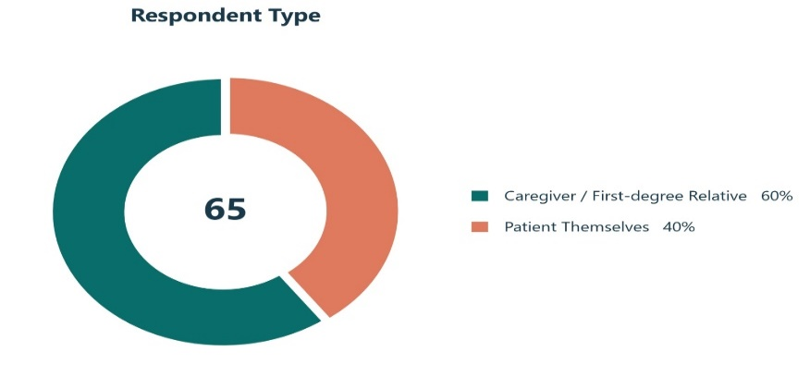
GazaCare Connect
Chapter 3
From Survey to Design Decisions
Respondent type: patient / caregiver
University of Palestine · 2025–2026
18 / 60

Slide 19
GazaCare Connect
Chapter 3
Shared Requirements for All Roles
We started by defining Functional and Non-functional requirements
1
RQ-01: Secure login with email and password
2
RQ-02 and RQ-03: Reset password and change password from settings
3
RQ-04: Update personal profile (patient medical/personal data; physician specialty/credentials)
4
RQ-05: In-app notifications (verification, assignment, reply, follow-up)
5
RQ-06: Logout and end the session
6
Shared requirements RQ-01 to RQ-06 for patient, physician, and admin
University of Palestine · 2025–2026
19 / 60

Slide 20
GazaCare Connect
Chapter 3
Role Requirements in Detail
Non-functional: strong security · Arabic RTL UI · performance under weak network · reliability
Patient | Physician | Admin
RQ-07 Register | RQ-15 Register pending admin verification | RQ-23 Manage users
RQ-08 Enable Caregiver Mode | RQ-16 View consultation requests | RQ-24 Disable or enable accounts
RQ-09/RQ-10 Browse verified physicians and view details | RQ-17 Take a general consult | RQ-25 Approve or reject physician verification with notice
RQ-11 Submit text consultation (general or physician-directed) | RQ-18/RQ-19 View patient data and medical attachments
RQ-12 Upload medical attachments (images/PDF) | RQ-20 Reply with Mild / Moderate / Critical severity
RQ-13 Track consult status and physician reply | RQ-21 Follow-up message
RQ-14 Send follow-up message after reply | RQ-22 View previous cases
University of Palestine · 2025–2026
20 / 60

Slide 21
GazaCare Connect
Chapter 4
Chapter 4 — Use Cases
• Each UC maps 1:1 to the same-number RQ
• One key documentation-table example per group
• Shared UC-01 to UC-06 · Patient UC-07 to UC-14 · Physician UC-15 to UC-22 · Admin UC-23 to UC-25
University of Palestine · 2025–2026
21 / 60

Slide 22
GazaCare Connect
Chapter 4
Shared example: UC-01 / RQ-01 — Login
Key shared use case — group UC-01 to UC-06 · Other shared: UC-02 Reset Password · UC-03 Change Password · UC-04 Update Profile · UC-05 Notifications · UC-06 Logout
Field | Details
Use Case ID | UC-01 / RQ-01
Use Case Name | Login
Actors | Patient, Physician, Admin
Description | Users log into the system using their email and password.
Precondition | The user already has an account and the account is not disabled.
Basic Flow | 1. User opens the login page. 2. Enters email and password. 3. System verifies credentials. 4. User is redirected to the role-based dashboard.
Alternate Flow | a. Invalid credentials → Error message shown. b. Disabled account → Access denied. c. Forgot password → Redirect to Reset Password.
Postcondition | User is authenticated and logged into the system.
University of Palestine · 2025–2026
22 / 60

Slide 23
GazaCare Connect
Chapter 4
Patient example: UC-11 / RQ-11 — Submit Consultation
Key patient use case — group UC-07 to UC-14 · Other patient: UC-07 Register · UC-08 Caregiver Mode · UC-09/10 Browse physicians · UC-12 Attachments · UC-13 Status · UC-14 Follow-up
Field | Details
Use Case ID | UC-11 / RQ-11
Use Case Name | Submit Consultation
Actors | Patient
Description | Patient submits an asynchronous text consultation either to the shared physician queue or directly to a selected verified physician.
Precondition | Patient is logged in.
Basic Flow | 1. Patient opens "New Consultation". 2. Writes the medical question (text). 3. Chooses assignment mode: queue or direct. 4. If direct, selects a verified physician. 5. Optionally attaches medical files (max 20 files). 6. Submits the consultation. 7. System stores the case as pending.
Alternate Flow | a. Invalid/short question → Error message. b. Direct mode without physician → Validation error. c. Selected physician unavailable → Error message.
Postcondition | A new consultation is created and awaiting physician handling.
University of Palestine · 2025–2026
23 / 60

Slide 24
GazaCare Connect
Chapter 4
Physician example: UC-20 / RQ-20 — Medical Recommendation
Key physician use case — group UC-15 to UC-22 · Other physician: UC-15 Register · UC-16 View requests · UC-17 Take general · UC-18/19 Patient data & files · UC-21 Follow-up · UC-22 Previous cases
Field | Details
Use Case ID | UC-20 / RQ-20
Use Case Name | Send Medical Recommendation
Actors | Physician
Description | Physician sends a medical recommendation, assigns case severity, and optionally marks the consultation as completed.
Precondition | Consultation is assigned to the verified physician.
Basic Flow | 1. Physician writes the recommendation. 2. Selects case severity (mild / moderate / critical). 3. Optionally marks the case as completed. 4. Submits the response. 5. System notifies the patient.
Alternate Flow | a. Missing recommendation or severity → Validation error.
Postcondition | Recommendation is sent; consultation is updated (pending review or completed).
University of Palestine · 2025–2026
24 / 60

Slide 25
GazaCare Connect
Chapter 4
Admin example: UC-25 / RQ-25 — Physician Verification
Key admin use case — group UC-23 to UC-25 · Other admin: UC-23 Manage users · UC-24 Disable/enable account
Field | Details
Use Case ID | UC-25 / RQ-25
Use Case Name | Approve / Reject Physician
Actors | Admin
Description | Admin reviews pending physician credentials and approves or rejects verification.
Precondition | At least one physician registration is pending verification.
Basic Flow | 1. Admin opens pending physicians page. 2. Reviews specialty and certificate information. 3. Approves or rejects the physician. 4. System updates verification status and notifies the physician.
Alternate Flow | a. No pending physicians → Empty list.
Postcondition | Physician is verified (can handle consultations) or rejected with the reason for rejection and the ability to resubmit a verification request.
University of Palestine · 2025–2026
25 / 60

Slide 26
GazaCare Connect
Chapter 4
Consultation path: general and physician-directed
Shared steps
1 · UC-11 / RQ-11
Submit text consultation
Patient writes the question, chooses general or directed, then sends
2 · UC-12 / RQ-12
Upload medical attachments
Optional photos or PDF to support diagnosis
3 · Pending
Awaiting physician
Consultation stays pending until a verified physician replies
Branch by consultation type
UC-17 / RQ-17
General consultation
Goes to a shared list; any verified physician can take it
No UC-17
Directed to a specific physician
Request goes directly to the physician chosen by the patient
Paths meet and continue
4 · UC-20 / RQ-20
Send medical reply
Recommendation with severity: Mild / Moderate / Critical
5 · UC-14 + UC-21
Follow-up after first reply
Patient and physician continue the thread in the same consult
University of Palestine · 2025–2026
26 / 60

Slide 27
GazaCare Connect
Chapter 4
Verification and Permission Rules
A clear sequence from physician registration to verification and permissions
1
UC-15 / RQ-15 (physician registration) — the new physician creates an account and stays Pending Verification
2
Before UC-25 / RQ-25 (approve or reject physician verification): the physician can see the dashboard only — no UC-17 / RQ-17 (take a general consult) and no UC-20 / RQ-20 (send medical reply)
3
UC-25 / RQ-25 (Admin approves verification) — after approval, take-case and reply permissions are enabled
4
If rejected via UC-25 / RQ-25 (reject verification with a reason): the physician can re-submit later
5
UC-24 / RQ-24 (disable or enable account) — disabling blocks access to protected features
University of Palestine · 2025–2026
27 / 60

Slide 28
GazaCare Connect
Chapter 5
Chapter 5 — Modeling and Design
• UML maps were prepared before coding
• Activity + use case + sequence + class diagrams
• These diagrams are the basis for Chapter 6 implementation
University of Palestine · 2025–2026
28 / 60

Slide 29
GazaCare Connect
Chapter 5
Activity and Use Case Diagrams
1
Activity diagram shows the consult path end to end
2
It branches by role: patient, physician, admin
3
Use case diagram defines the three actors and their functions
4
Actors: Patient, Physician, and Admin
University of Palestine · 2025–2026
29 / 60

Slide 30
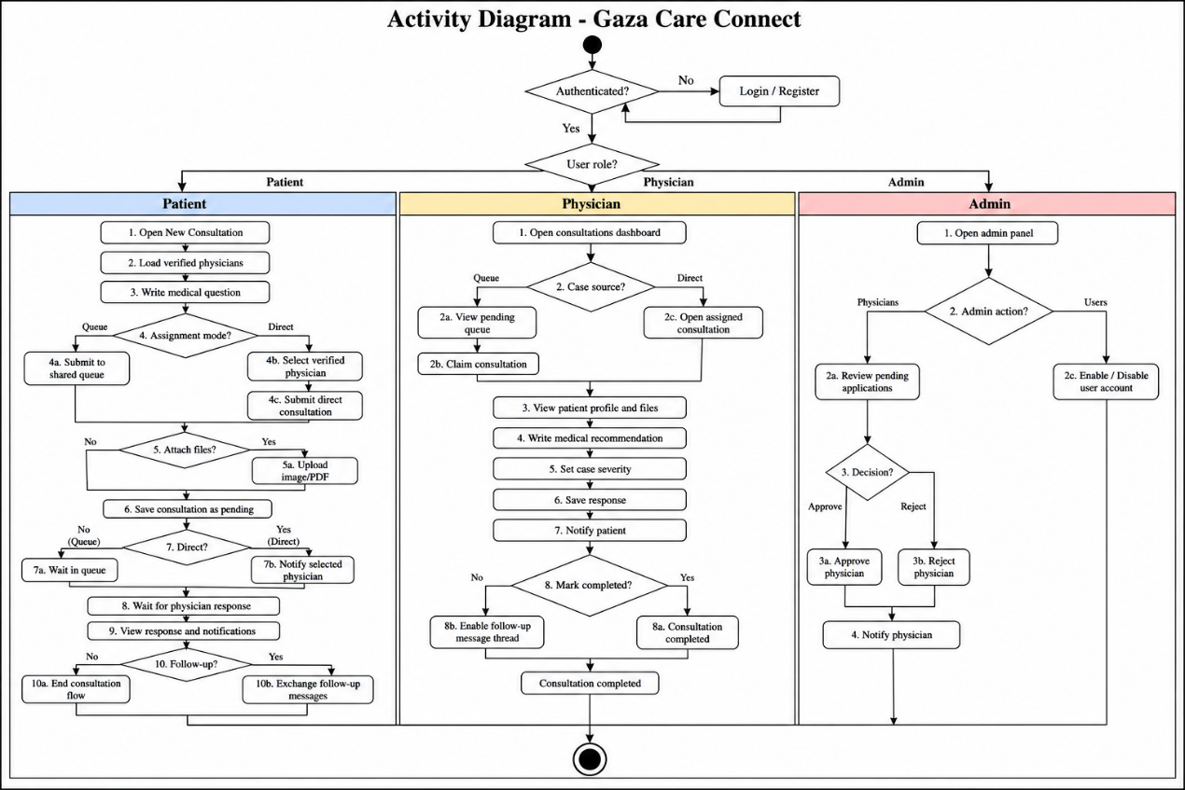
GazaCare Connect
Chapter 5
Activity and Use Case Diagrams
Activity diagram
University of Palestine · 2025–2026
30 / 60

Slide 31
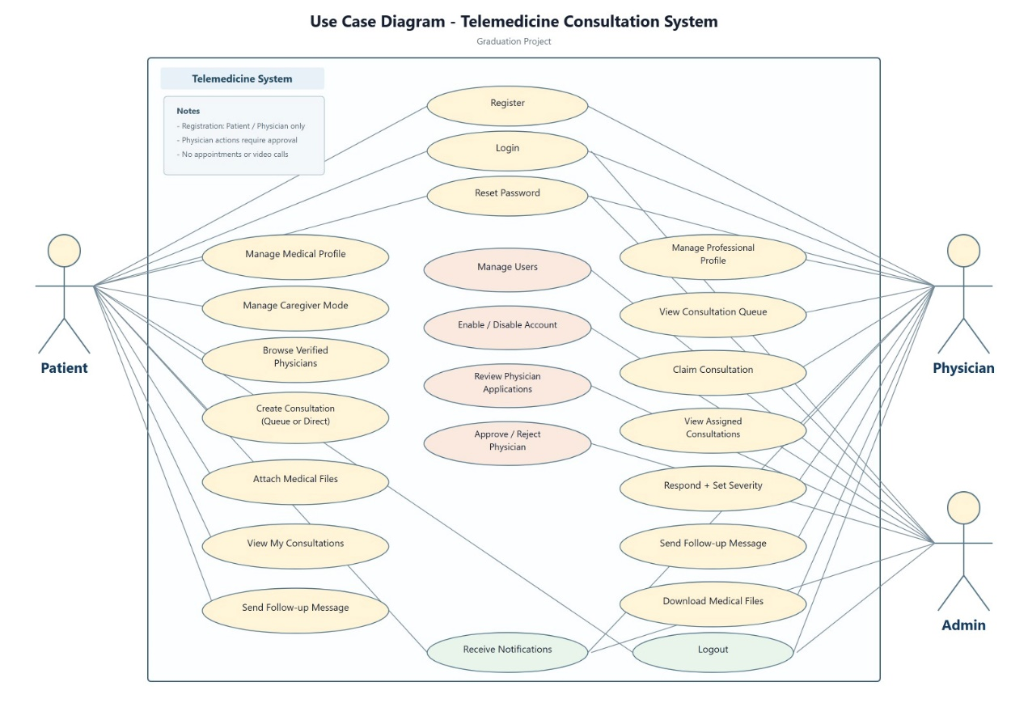
GazaCare Connect
Chapter 5
Activity and Use Case Diagrams
Use case diagram
University of Palestine · 2025–2026
31 / 60

Slide 32
GazaCare Connect
Chapter 5
The seven sequence diagrams — at a glance
Each row explains the process across frontend, backend, and database
Process | What happens? | On success | On failure
1) Register | User fills the form; frontend sends data to backend then database | Account created and user enters the dashboard | Email already used → error message
2) Login | Enter email and password and verify them | Go to the matching role dashboard | Wrong credentials or disabled account → access denied
3) Reset password | Request an email link then set a new password | Password updated successfully | Email not found → failure message
4) Edit medical profile | Load current data then save edits | Success message shown | Invalid data → error message
5) Create consultation | Write the question, choose general or directed, optional attachments | Consultation saved as Pending | Short question or missing physician → error
6) Physician reply | Take the case then write reply with severity | Patient receives reply with Mild / Moderate / Critical | Already taken or missing severity → error
7) Logout | End the session and remove the access token | Return to the Login page | No main failure path
University of Palestine · 2025–2026
32 / 60

Slide 33
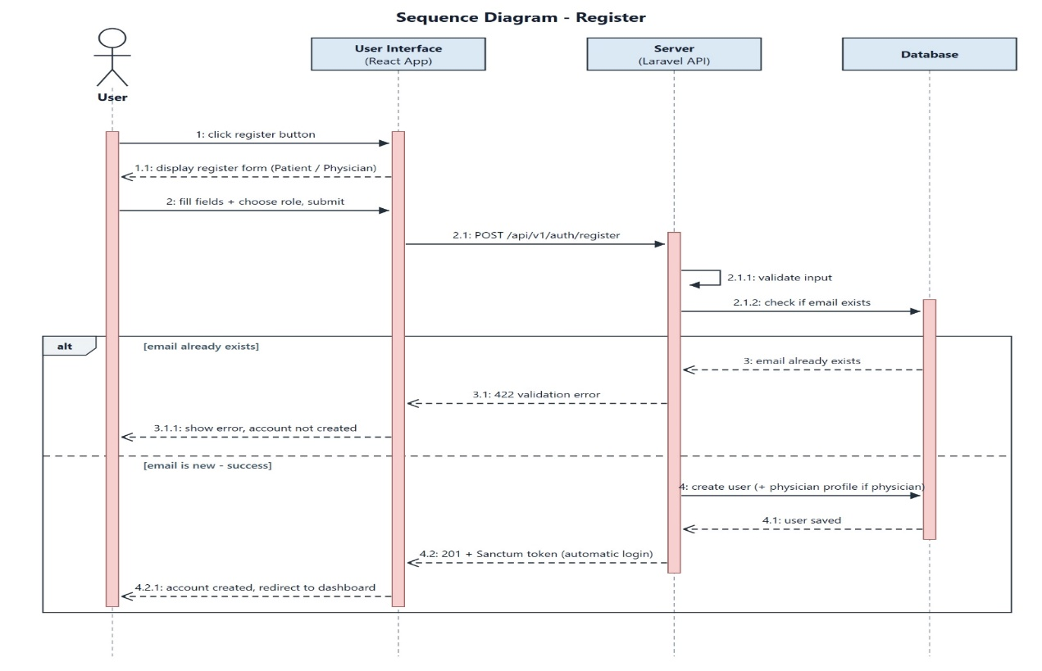
GazaCare Connect
Chapter 5
UML Sequence Diagrams
Sequence 1 — Register
University of Palestine · 2025–2026
33 / 60

Slide 34
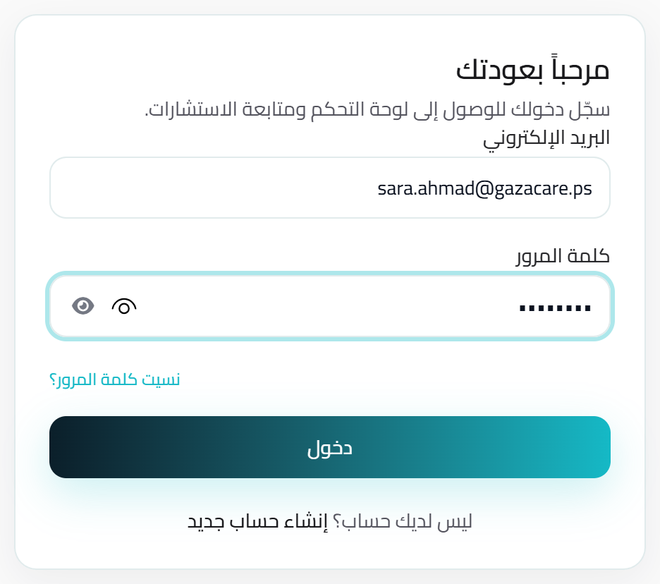
GazaCare Connect
Chapter 5
UML Sequence Diagrams
Sequence 2 — Login
University of Palestine · 2025–2026
34 / 60

Slide 35
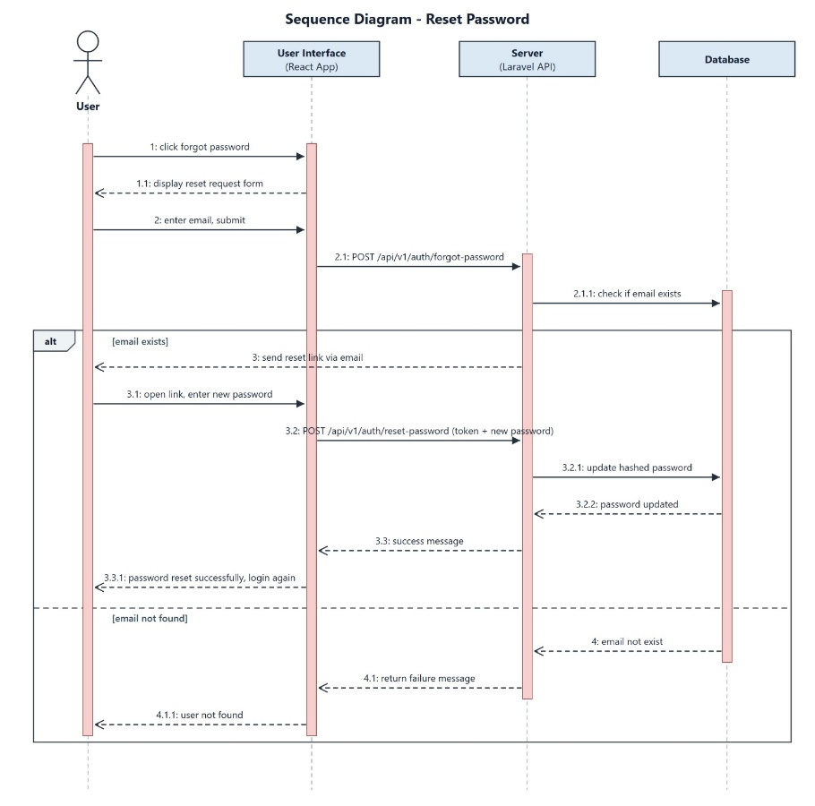
GazaCare Connect
Chapter 5
UML Sequence Diagrams
Sequence 3 — Reset Password
University of Palestine · 2025–2026
35 / 60

Slide 36
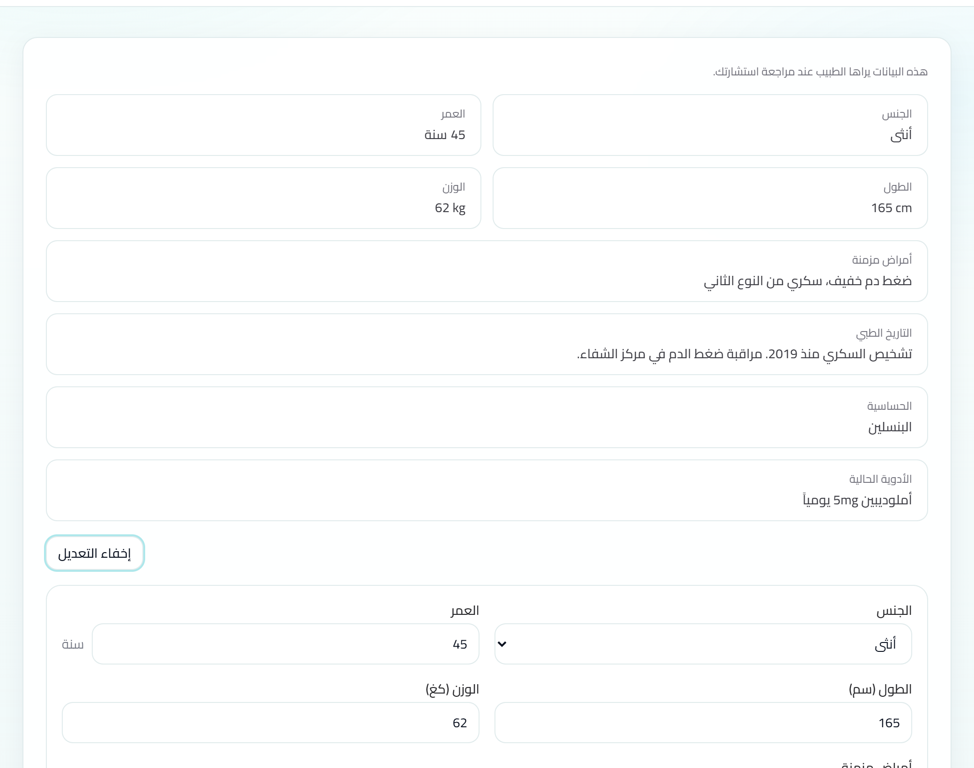
GazaCare Connect
Chapter 5
UML Sequence Diagrams
Sequence 4 — Edit Medical Profile
University of Palestine · 2025–2026
36 / 60

Slide 37
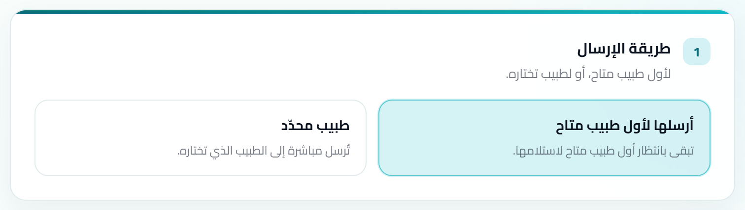
GazaCare Connect
Chapter 5
UML Sequence Diagrams
Sequence 5 — Create Consultation
University of Palestine · 2025–2026
37 / 60

Slide 38
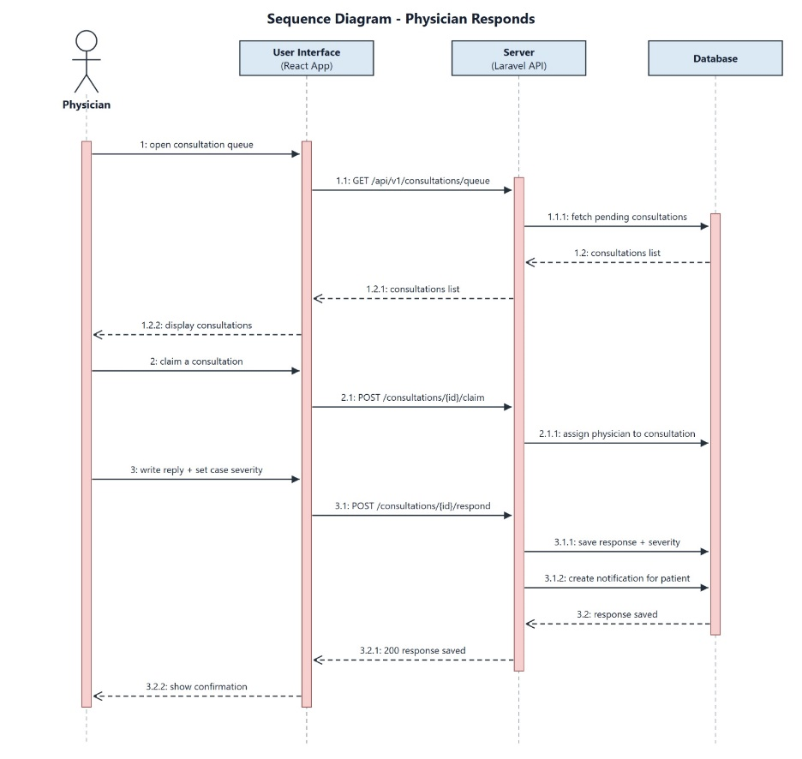
GazaCare Connect
Chapter 5
UML Sequence Diagrams
Sequence 6 — Physician Responds
University of Palestine · 2025–2026
38 / 60

Slide 39
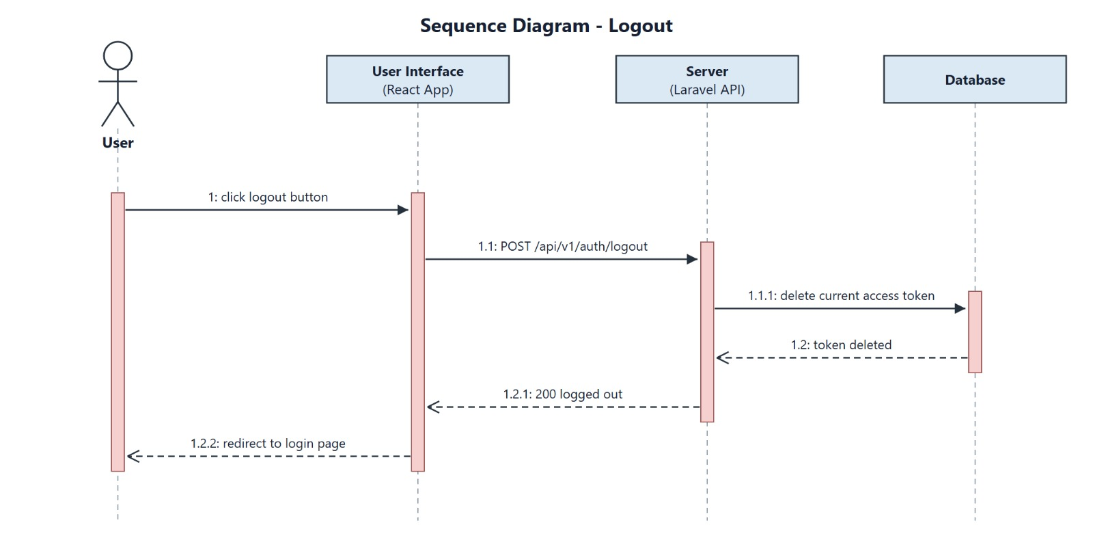
GazaCare Connect
Chapter 5
UML Sequence Diagrams
Sequence 7 — Logout
University of Palestine · 2025–2026
39 / 60

Slide 40
GazaCare Connect
Chapter 5
Class Diagram
1
User is the base class for Patient, Physician, and Admin
2
Consultation links to medical files and follow-up messages
3
Consultation events create notifications: case assignment, physician reply, and follow-up message
4
Severity: Mild / Moderate / Critical
5
Assignment mode: general or physician-directed consultation
6
This diagram leads directly to MySQL tables in implementation
University of Palestine · 2025–2026
40 / 60

Slide 41
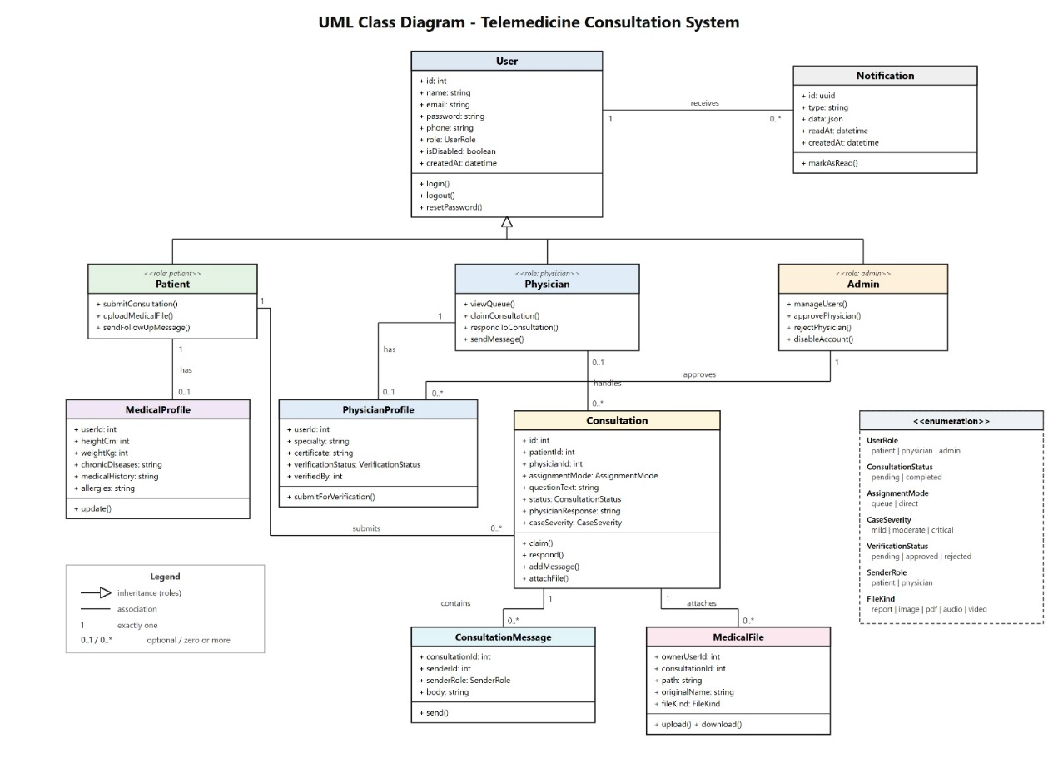
GazaCare Connect
Chapter 5
Class Diagram
Class diagram
University of Palestine · 2025–2026
41 / 60

Slide 42
GazaCare Connect
Chapter 6
Chapter 6 — Implementation
• This chapter shows the design implemented as a fully working web platform
• Three-tier architecture: frontend, Laravel server, and MySQL database
• Implemented through functional modules, with each role’s interfaces shown
University of Palestine · 2025–2026
42 / 60

Slide 43
GazaCare Connect
Chapter 6
How Was the System Built?
1
Presentation layer: React.js, Next.js, TypeScript
2
Application layer: Laravel/PHP with REST API
3
Data layer: MySQL
4
Auth: Laravel Sanctum tokens
5
Authorization via Middleware by role: Patient / Physician / Admin
University of Palestine · 2025–2026
43 / 60

Slide 44
GazaCare Connect
Chapter 6
Main Database Tables
Table | Purpose
users | All role accounts with a unified role field
physician_profiles | Physician specialty and verification status
medical_profiles | Patient medical profile
consultations | Consult, reply, and severity
consultation_messages | Follow-up messages in the same consult
medical_files | Attached files
notifications | User notifications
personal_access_tokens | Sanctum session tokens
University of Palestine · 2025–2026
44 / 60

Slide 45
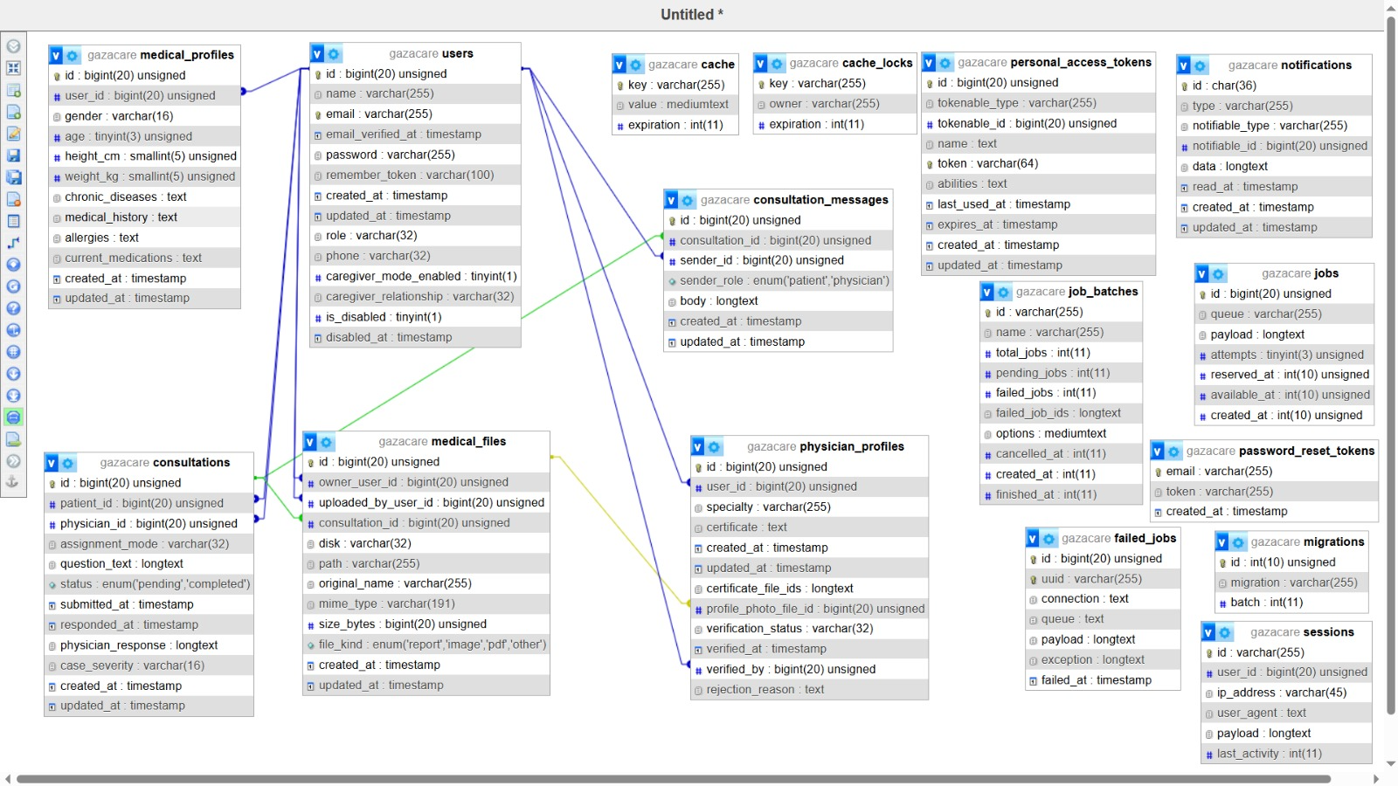
GazaCare Connect
Chapter 6
Main Database Tables
Database schema
University of Palestine · 2025–2026
45 / 60

Slide 46
GazaCare Connect
Chapter 6
Functional modules and their Use Cases (1/2)
1) Authentication
2) User Profile
Secure access and password management
Role-specific profile data
UC-07 / UC-15 Register — patient or physician
UC-01 Login — email and password
UC-02 / UC-03 Reset / Change Password
UC-06 Logout — end session
UC-04 Update Profile — medical or credentials
3) Caregiver Mode
4) Physician Directory
Consult on behalf of a relative
Choose a verified physician first
UC-08 Enable Caregiver Mode — relationship
UC-09 Browse Physicians by specialty
UC-10 View Physician Details
5) Consultations
6) Medical Files
Consultation lifecycle
Attachments linked to the consult
UC-11 Submit — general or directed
UC-13 View Status & Response
UC-16 / UC-17 View / Take requests
UC-18 / UC-20 Patient details / medical reply
UC-12 Upload Reports — images/PDF
UC-19 View / Download Reports
University of Palestine · 2025–2026
46 / 60

Slide 47
GazaCare Connect
Chapter 6
Functional modules and their Use Cases (2/2)
7) Follow-up Messaging
8) Notifications
Follow-up after first reply
In-app alerts
UC-14 Patient Follow-up
UC-21 Physician Follow-up
UC-05 Receive Notifications
9) Administration
10) Dashboards
Admin controls
Role workspace
UC-23 Manage Users
UC-24 Disable / Enable Account
UC-25 Approve / Reject Physician
Patient Patient dashboard
Physician Physician dashboard
Admin Admin dashboard
University of Palestine · 2025–2026
47 / 60

Slide 48
GazaCare Connect
Chapter 6
Login and Account Interfaces
1
Login
2
Patient registration
3
Physician registration pending verification
4
Password recovery
University of Palestine · 2025–2026
48 / 60

Slide 49
GazaCare Connect
Chapter 6
Patient Interfaces
1
Patient dashboard
2
Medical profile
3
Create consultation
4
Consultation details
5
Notifications and follow-up
University of Palestine · 2025–2026
49 / 60

Slide 50
GazaCare Connect
Chapter 6
Physician and Admin Interfaces
1
Physician dashboard
2
Take a case and reply
3
Admin dashboard
4
Manage users and verify physicians
University of Palestine · 2025–2026
50 / 60

Slide 51
GazaCare Connect
Chapter 7
Chapter 7 — Testing
• Testing accompanied every increment, not left to the end
• Four levels: unit, integration, usability, security
• Result: the system works reliably and protects medical data
University of Palestine · 2025–2026
51 / 60

Slide 52
GazaCare Connect
Chapter 7
Unit Testing
1
PHPUnit was used inside Laravel
2
Registration and validation tests
3
Token tests: requests without a token are rejected
4
Medical-profile tests
5
Consult creation: reject too-short descriptions; initial state Pending
6
Physician reply: only assigned physician can reply; then state becomes Completed
University of Palestine · 2025–2026
52 / 60

Slide 53
GazaCare Connect
Chapter 7
Integration Testing
1
Trace the full consult lifecycle from creation to reply
2
File upload/retrieval integration with unauthorized access blocked
3
Permission control across different roles
4
On connection failure, users see a clear Arabic message — e.g. “Failed to connect to the server. Check your internet.”
University of Palestine · 2025–2026
53 / 60

Slide 54
GazaCare Connect
Chapter 7
Usability Testing
Can users complete tasks easily?
Item | What we verified
Task completion | Users complete core tasks without technical help
RTL layout | Arabic interface displays correctly right-to-left
Mobile fit | Interface works well on small screens
University of Palestine · 2025–2026
54 / 60

Slide 55
GazaCare Connect
Chapter 7
Security Testing
Protecting access, data, and permissions
Test type | What we verified
Authentication | Reject access without a valid Sanctum token
Passwords | Passwords stored as a hash only, never as plain text
Authorization | Block role bypass: no cross-patient access; physicians reply only to assigned cases
Files | Private storage outside public; view/download only via protected API after login and authorization (link alone is not enough)
Transport | HTTPS protects data in transit
University of Palestine · 2025–2026
55 / 60

Slide 56
GazaCare Connect
Chapter 8
Chapter 8 — Conclusion
• Project achievements
• Recommendations for stakeholders
• Future development directions
University of Palestine · 2025–2026
56 / 60

Slide 57
GazaCare Connect
Chapter 8
What Did the Project Achieve?
1
A secure organized web platform for remote specialty consults
2
A practical alternative to informal channels like WhatsApp/Facebook
3
Full path: register, consult, attachments, reply, follow-up, physician verification
4
Grounded in a local survey of 60+ participants
5
Maintainable extensible three-tier architecture
6
Tests confirmed function, usability, and security
University of Palestine · 2025–2026
57 / 60

Slide 58
GazaCare Connect
Chapter 8
Recommendations
1
For health institutions/NGOs: adopt organized telemedicine platforms
2
For medical institutions: formal physician-verification procedures
3
For policymakers: support secure digital health solutions
4
For future developers: make the platform easier to use, improve patient access, and add continuous monitoring of system performance
University of Palestine · 2025–2026
58 / 60

Slide 59
GazaCare Connect
Chapter 8
Future Developments
1
Physician rating after completed consultations
2
Advanced physician search by specialty and ratings
3
Admin analytics for volume and response time
4
Mobile app or Progressive Web App (PWA)
5
English support while keeping Arabic primary
6
Dark mode for visual comfort
7
Optional video consults in later versions
8
AI assistance with the physician as final decision-maker
9
Note: these are later-development ideas, not part of the current system.
University of Palestine · 2025–2026
59 / 60

Slide 60
Thank You
GazaCare Connect — a secure structured remote consultation platform
Thank you for listening
We welcome your questions
60 / 60

