Slide 1
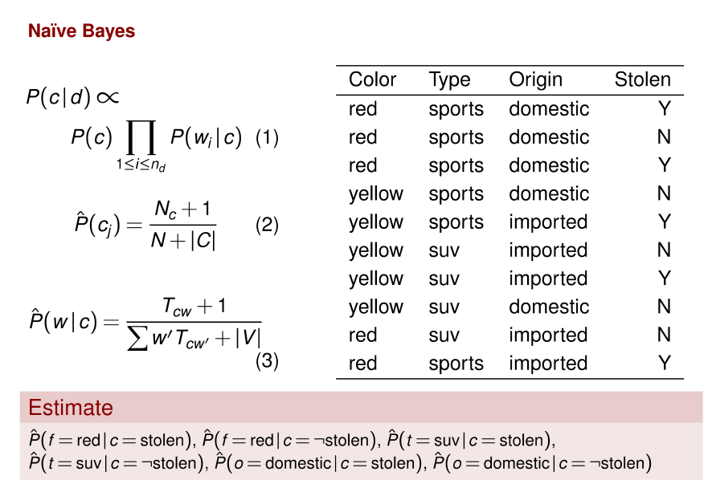
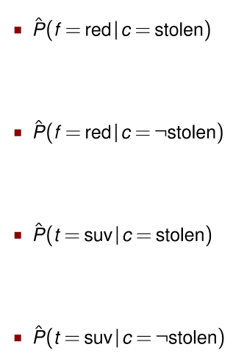
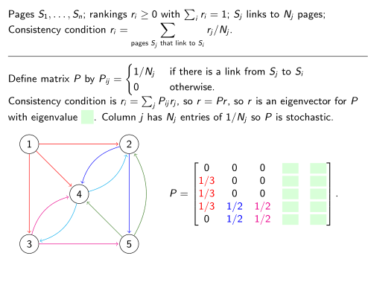


Red domestic SUV:

Slide 2
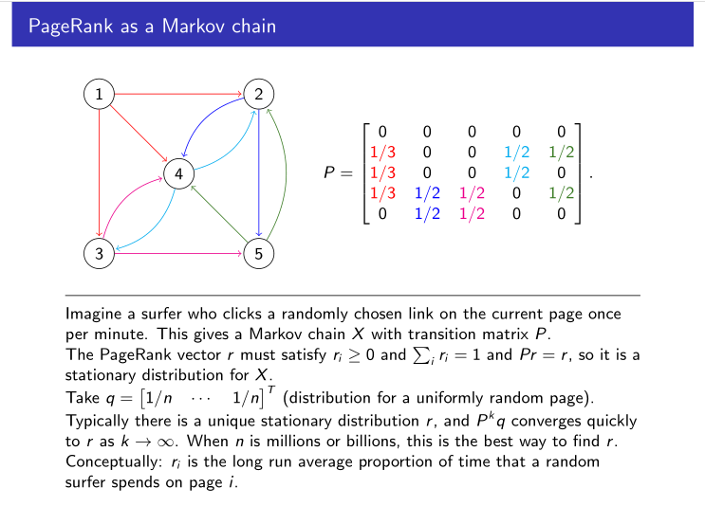

Slide 3
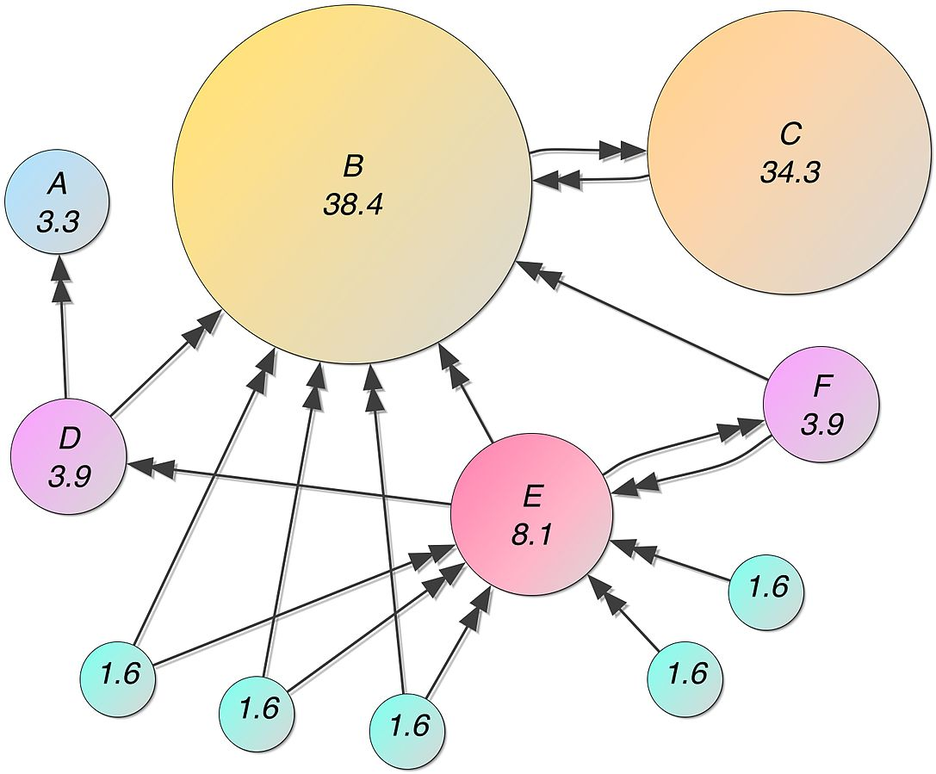
Mathematical PageRanks for a simple network, expressed as percentages. (Google uses a logarithmic scale.) Page C has a higher PageRank than Page E, even though there are fewer links to C; the one link to C comes from an important page and hence is of high value. If web surfers who start on a random page have an 85% likelihood of choosing a random link from the page they are currently visiting, and a 15% likelihood of jumping to a page chosen at random from the entire web, they will reach Page E 8.1% of the time. (The 15% likelihood of jumping to an arbitrary page corresponds to a damping factor of 85%.) Without damping, all web surfers would eventually end up on Pages A, B, or C, and all other pages would have PageRank zero. In the presence of damping, Page A effectively links to all pages in the web, even though it has no outgoing links of its own.

Slide 4
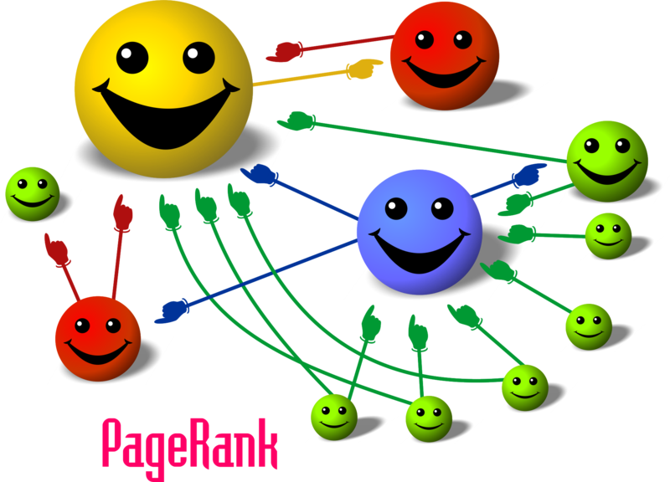
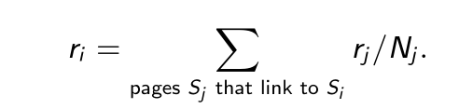
Recursive Definition !
Bootstrap
Cartoon illustrating the basic principle of PageRank. The size of each face is proportional to the total size of the other faces which are pointing to it.

Slide 5
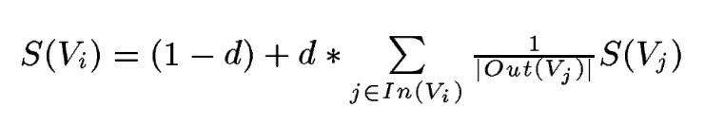
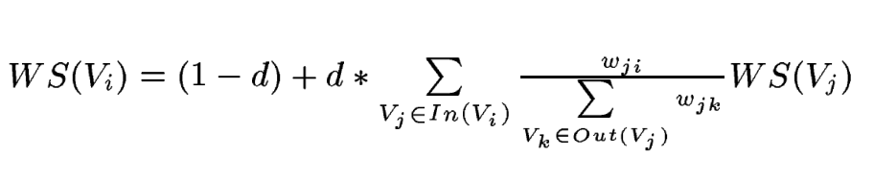
Weighted Graphs
Original version does not account for weights
Modified formula for graph-based ranking that takes into account edge weights when computing the score associated with a vertex in the graph. Notice that a similar formula can be defined to integrate vertex weights.

Slide 6
Text Rank, Algorithm
Identify text units that best define the task at hand, and add them as vertices in the graph.
Identify relations that connect such text units, and use these relations to draw edges between vertices in the graph. Edges can be directed or undirected, weighted or unweighted.
Iterate the graph-based ranking algorithm until convergence.
Sort vertices based on their final score. Use the values attached to each vertex for ranking/selection decisions
Key Ingredient: Similarity Measure!

Slide 7
TextRank for Keyword Extraction
Any relation that can be defined between two lexical units is a potentially useful connection (edge) that can be added between two such vertices.
We are using a co-occurrence relation, controlled by the distance between word occurrences: two vertices are connected if their corresponding lexical units co-occur within a window of maximum N words
The vertices added to the graph can be restricted with syntactic filters, which select only lexical units of a certain part of speech. One can for instance consider only nouns and verbs for addition to the graph

Slide 8
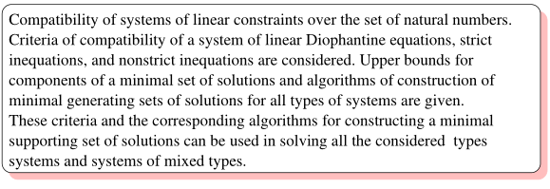
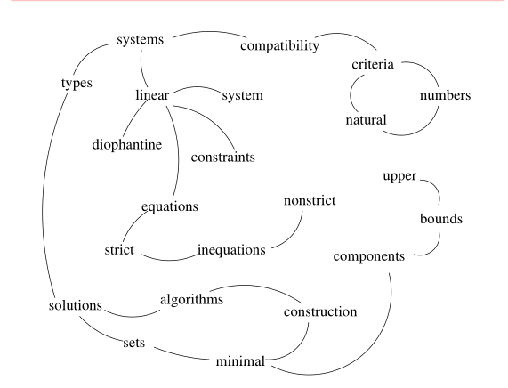
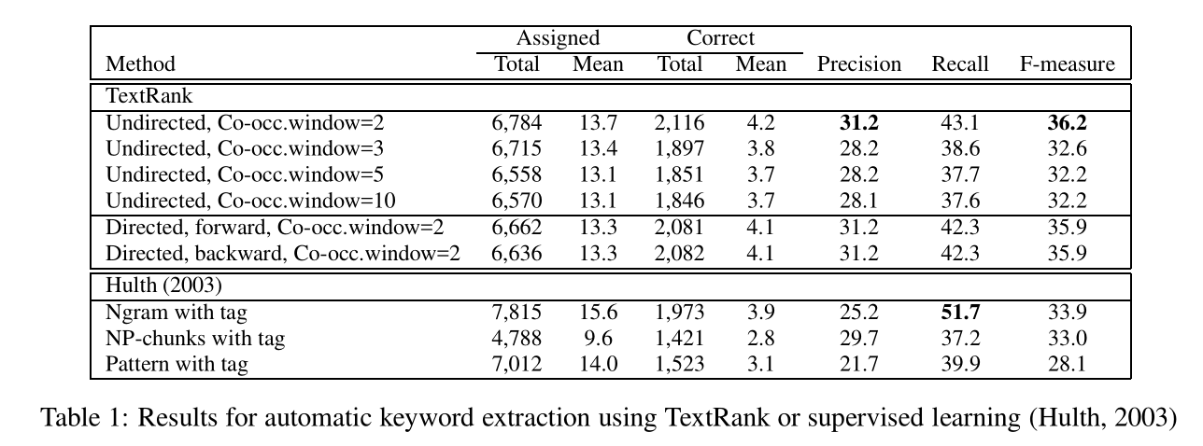
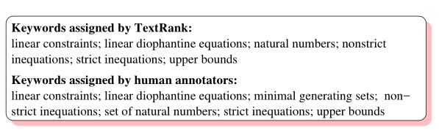

Slide 9
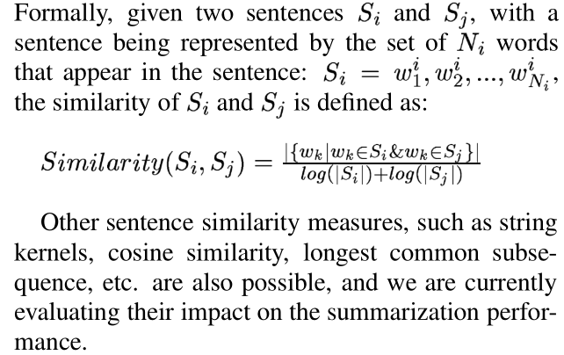
TextRank for Sentence Extraction
The overlap of two sentences can be determined simply as the number of common tokens between the lexical representations of the two sentences, or
it can be run through syntactic filters, which only count words of a certain syntactic category, e.g. all open class words, nouns and verbs, etc

Slide 10
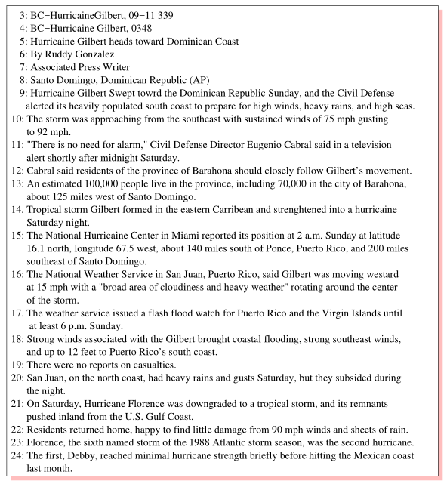
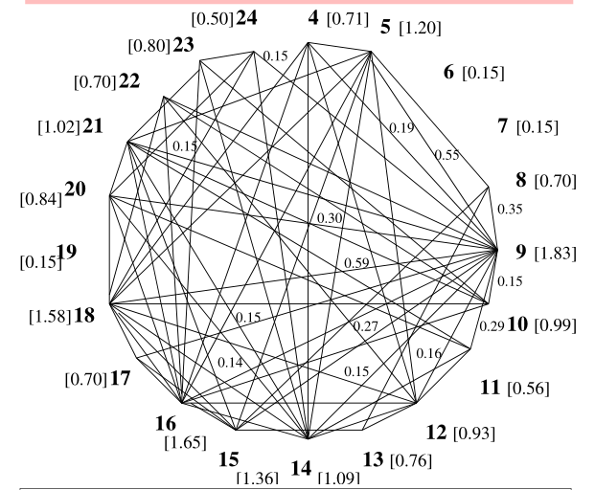
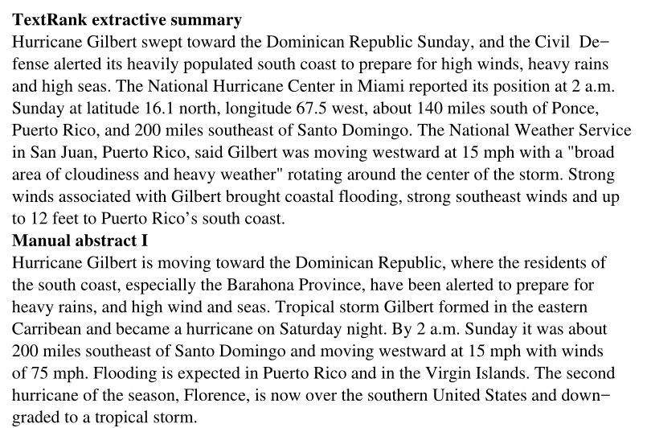

Slide 11
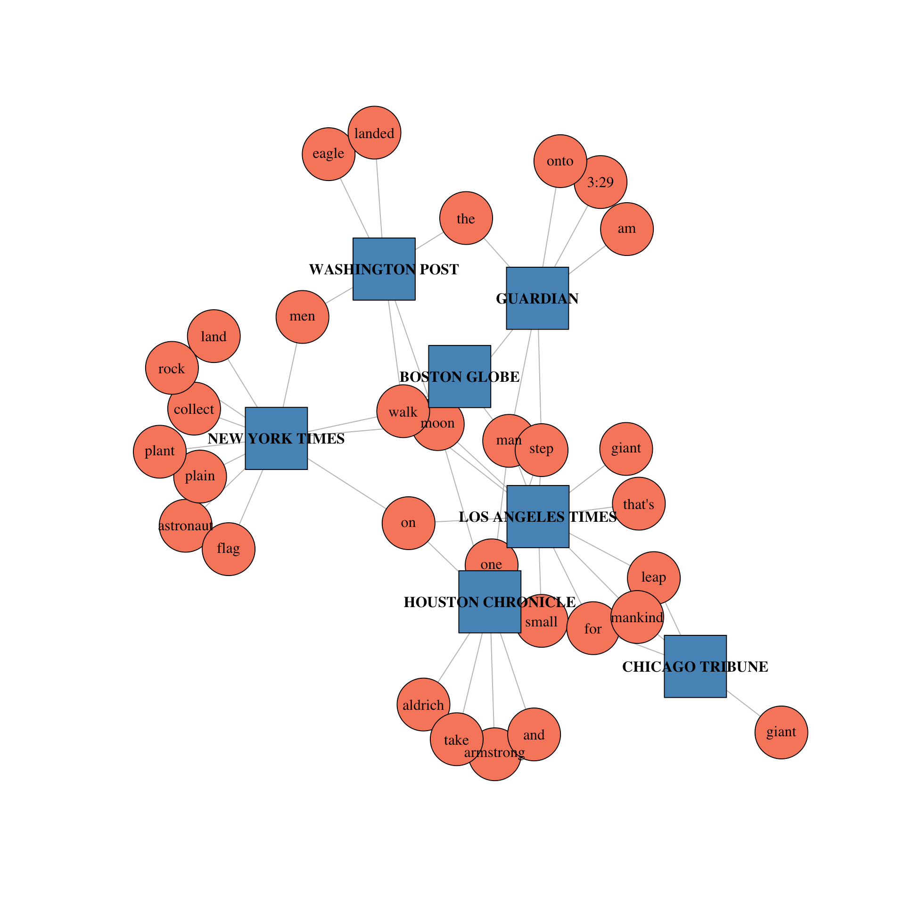
Text Networks
https://compsocialscience.github.io/summer-institute/2018/materials/day3-text-analysis/text-networks/rmarkdown/SICSS_Text_Networks.html

