Slide 1
ConvNets

Slide 2
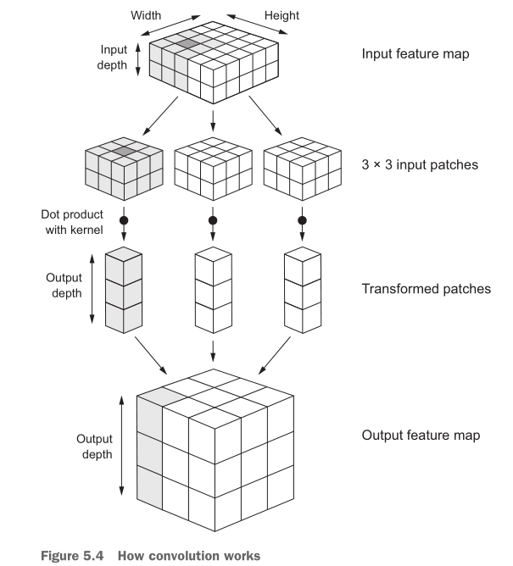
total_params = (filter_height x filter_width x input_image_channels + 1) x number_of_filters

Slide 3
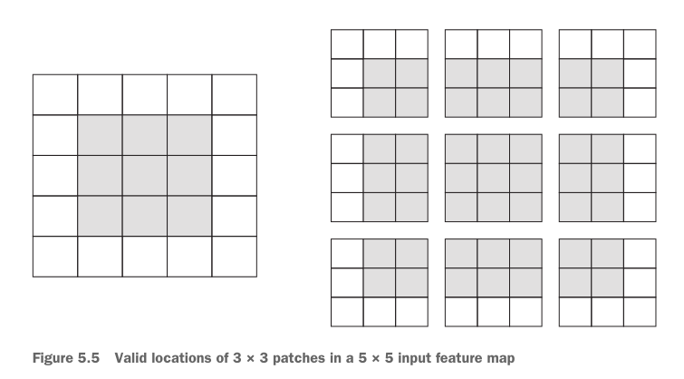
Border Effects
Consider a 5 × 5 feature map (25 tiles total). There are only 9 tiles around which you can center a 3 × 3 window, forming a 3 × 3 grid
It shrinks by exactly two tiles alongside each dimension

Slide 4
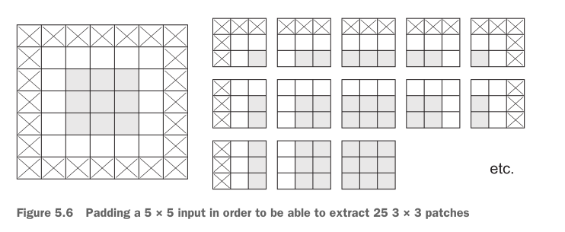
Padding
Padding consists of adding an appropriate number of rows and columns on each side of the input feature map so as to make it possible to fit center convolution windows around every input tile

Slide 5
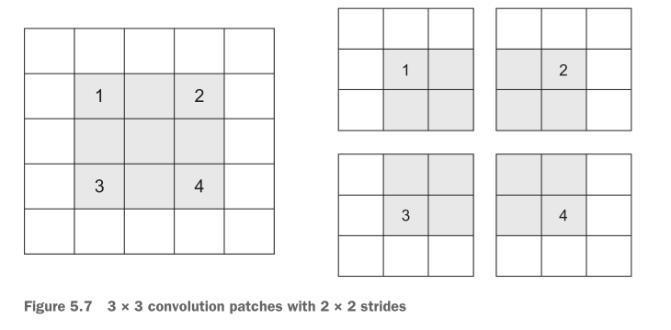
CONVOLUTION STRIDES
The distance between two successive windows is a parameter of the convolution, called its stride
Using stride 2 means the width and height of the feature map are downsampled by a factor of 2

Slide 6
The max-pooling operation
Max pooling consists of extracting windows from the input feature maps and outputting the max value of each channel.
Usually done with 2 × 2 windows and stride 2, in order to downsample the feature maps by a factor of 2
(Convolution is typically done with 3 × 3 windows and no stride)
The reason to use downsampling is to reduce the number of feature-map coefficients to process, as well as to induce spatial-filter hierarchies by making successive convolution layers look at increasingly large windows

Slide 7
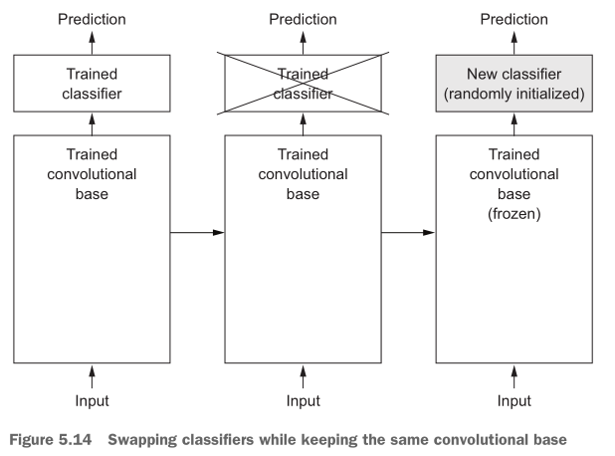
Pretrained ConvNets
freezing convolutional base vs. training on extracted features

