Slide 1
CONTENT
1
RDBMS
2
MySQL
3
PostgreSQL
4
SQL SERVER
SQL SERVER vsPostgreSQL
vs MySQL
5

Slide 2
1
what is a RDBMS

Slide 3
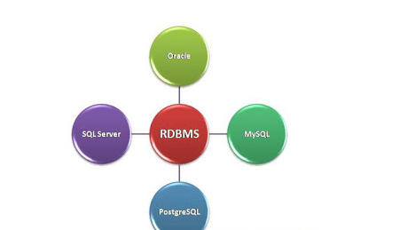
What Is RDBMS?
RDBMS stands for Relational Database Management System. RDBMS is the basis for SQL, and for all modern database systems like MS SQL Server, PostgreSQL?Oracle, MySQL and Microsoft Access. An RDBMS is a type of database management system with row-based table structure that connects related data elements and includes functions that maintain the accuracy, security, consistency and integrity of data.

Slide 4
3. SQL RDBMS Concept
Tables
Column
The data that gets stored in databases objects are stored in Tables. It is the simplest form of storing data. A Table has rows and columns used to store the entities.
A column could be a vertical entity in a very table that contains all info related to a particular field in a very table.
Field
NULL value
Every table is shifting into smaller entities known as fields.A field could be a column in a very table that’s designed to take care of specific info concerning each record within the table ..
field with a NULL price is that the one that has been left blank throughout a record creation.
Record or a Row
A record is additionally known as a row of data is every individual entry that exists in a very table.. A record could be a horizontal entity in a very table ..

Slide 5
2
MySQL

Slide 6
MYSQL :
MySQL is a relational database management system (RDBMS) developed by Oracle that is based on structured query language (SQL). MySQL is integral to the most popular software stacks for building and maintaining everything from customer-facing web applications to powerful, data-driven B2B services. Its open-source nature, stability, and rich feature set, paired with ongoing development and support from Oracle. Internet-critical organizations such as Facebook, Flickr, Twitter, Wikipedia, and YouTube all employ MySQL backends.

Slide 7
Add your title
Data security
Comprehensive transactional support
Advantages of MySQL
The flexibility of open source
On-demand scalability
High performance
The reduced total cost of ownership

Slide 8
3
PostgreSQL

Slide 9
PostgreSQL
PostgreSQL is a powerful, open-source object-relational database system that uses and extends the SQL language combined with many features that safely store and scale the most complicated data workloads. PostgreSQL has earned a strong reputation for its proven architecture, reliability, data integrity, robust feature set, extensibility, and the dedication of the open-source community behind the software to consistently deliver performant and innovative solutions. PostgreSQL runs on all major operating systems, is ACID-compliant, and has powerful add-ons such as the popular PostGIS geospatial database extender.

Slide 10
Advantages of Postgresql:
Supports Multi-version concurrency control (MVCC)
Supports image, video, audio storage and also supports graphical data
1
2
Has user-defined data-types.
Table inheritance.
Runs on all operating system
Requires low maintenance,
High recovery
3
4

Slide 11
4
SQL Server

Slide 12
SQL Server
SQL Server is a relational database management system, or RDBMS, developed and marketed by Microsoft. Similar to other RDBMS software, SQL Server is built on top of SQL, a standard programming language for interacting with the relational databases. SQL server is tied to Transact-SQL, or T-SQL, Microsoft’s implementation of SQL that adds a set of proprietary programming constructs

Slide 13
Advantages of SQL Server:
02
Streamlined Installation
Great Security Features
01
03
Low Cost Of Ownership
Enhanced Performance
04

Slide 14
5
SQL SERVER vsPostgreSQL
vs MySQL

Slide 15
SQL Server VS MySQL VS PostgreSQL
Add your title
SQL Server
MySQL
PostgreSQL
commercial
Open Source
Open Source
License
Implementation language
c++
C and C++
c
large amount of operational storage space.
less amount of operational storage
less amount of operational storage
Storage Space
does not block the database during backup
blocks the database while taking the backup.
does not block the database during backup
Back Up

