Slide 1

Lamarr Energy Tracking
LET there be Resource-Awareness in ML and AI!
Raphael Fischer & Sebastian Buschjäger

Slide 2
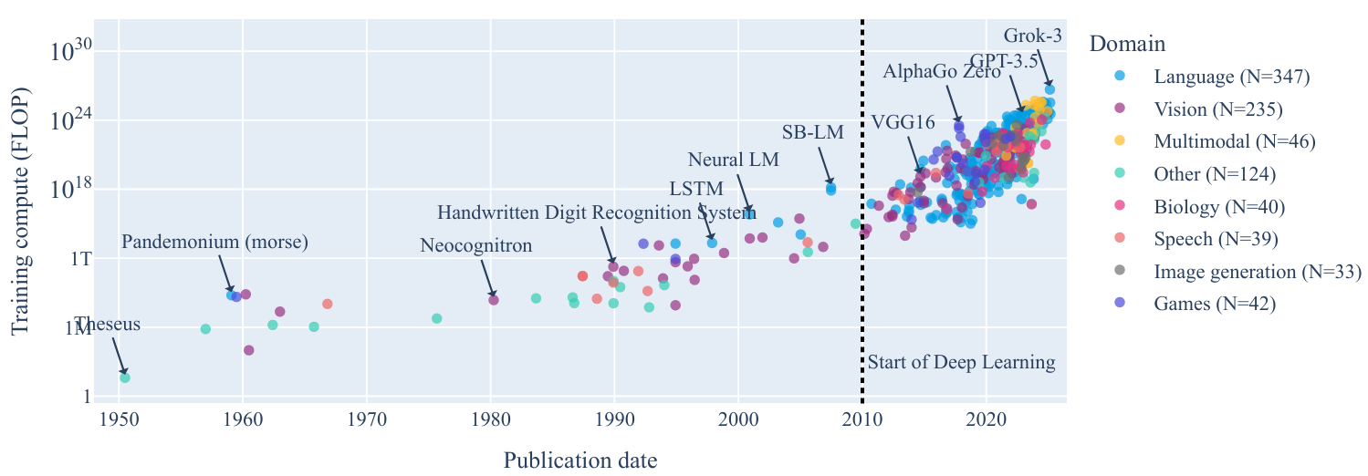
[Fischer 2025a / Sevilla et al. 2022] (Epoch AI)
Initiate a paradigm shift in reporting! [Fischer et al. 2024]
This allows us to develop and use AI in sustainable ways!
Challenge the bigger-is-better paradigm! [Varoquaux et al. 2025]
This should be an important joint effort at Lamarr Institute!

Slide 3
To be resource-aware and trustworthy, we have to inform on the energy-versus-quality performance of our methods! Assessing this trade-off becomes easier thanks to
github.com/lamarr-institute/lamarr-energy-tracker

Slide 4
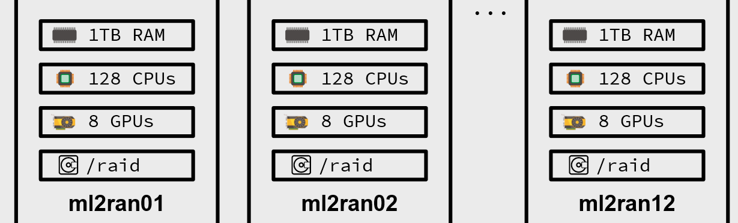




Computing on the Cluster?
Automatic tracking of energy consumption with personalized reports → launching soon!
Computing on Custom Setup?
Use the LET library for tracking and reporting
the energy consumption of your experiments!
github.com/lamarr-institute/lamarr-energy-tracker

Slide 5
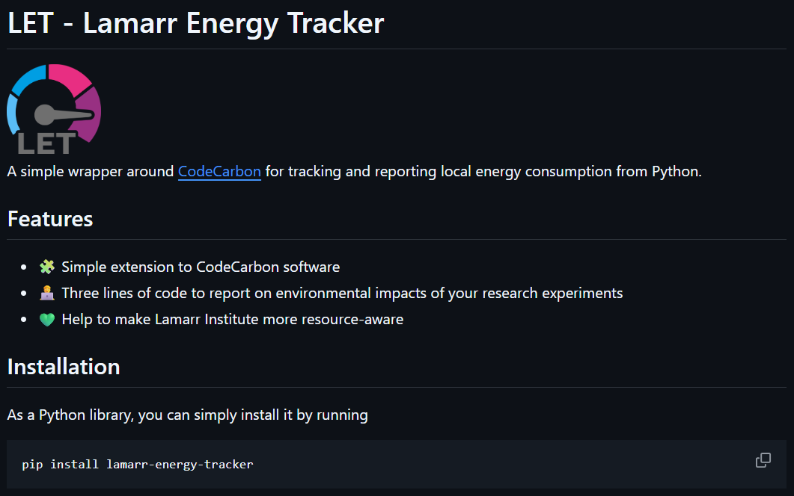
github.com/lamarr-institute/lamarr-energy-tracker

Slide 6
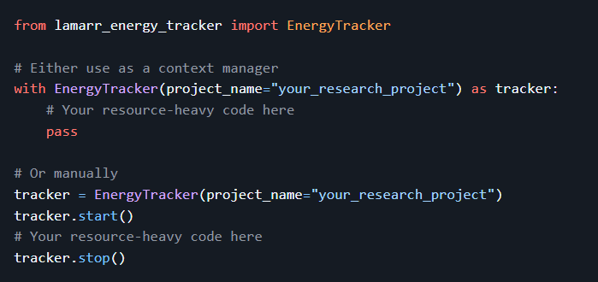
“Using CodeCarbon 3.0.8, the energy consumption of running all experiments on an Intel(R) Core(TM) i7-10610U CPU is estimated to 0.135 kWh. This corresponds to estimated carbon emissions of 0.051 kg of CO2-equivalents, assuming a carbon intensity of 380 gCO2/kWh.”
github.com/lamarr-institute/lamarr-energy-tracker

Slide 7
Resource-awareness benefits:
You gain a new understanding of “SOTA”
You can discuss the efficiency and sustainability of your research
Your work might become more environmentally friendly
We can connect different
research groups @ Lamarr
We can become a pioneering
research institute for Green AI
We can perform meta-studies
on compute demand
Impact statements
in every publication
Individual awareness
Pioneering
work
github.com/lamarr-institute/lamarr-energy-tracker

Slide 8


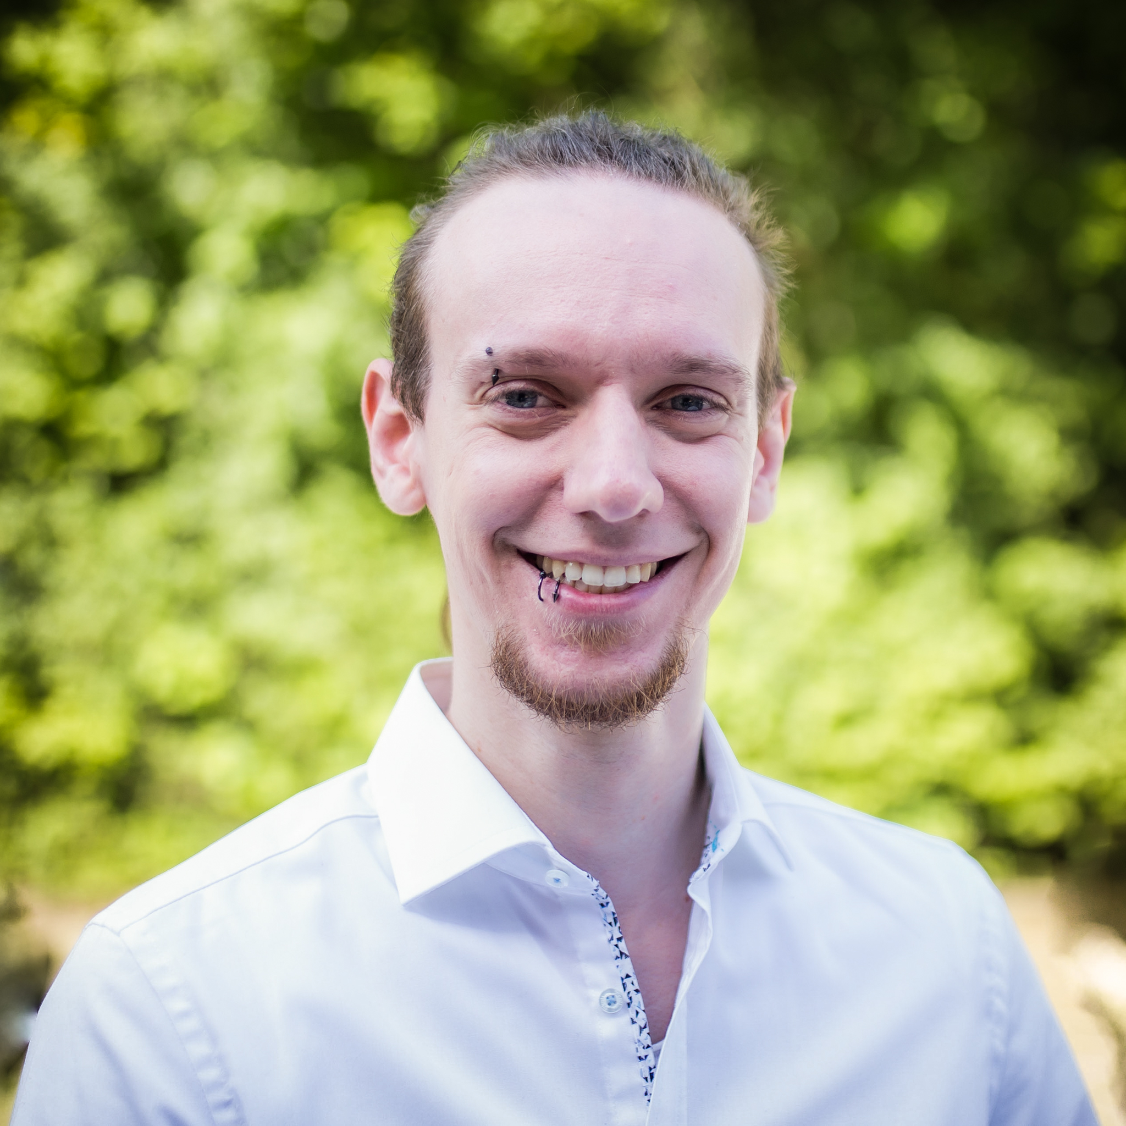
TL;DR - LET’s all become more resource-aware @ Lamarr!
Questions or Feedback?
Get in touch with ReAML!
github.com/lamarr-institute/lamarr-energy-tracker

