Slide 1
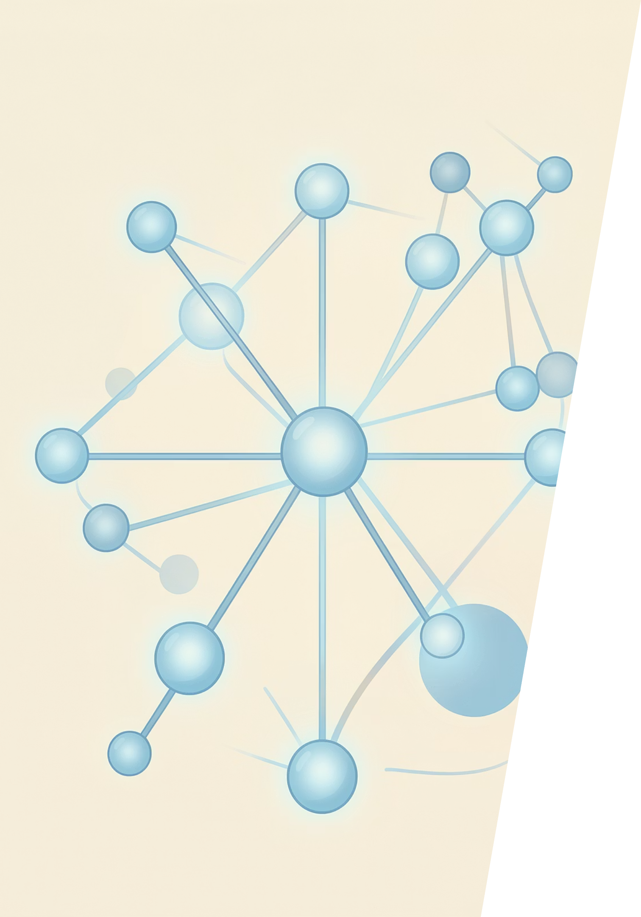
Artificial Intelligence and Machine Learning
6CS012 — Task 2: Scene Classification & Sentiment Analysis
Student: Unik Ghalan · ID: 2409043 · Tutor: Ms. Jinu Nyachhyon · Submitted: 10 May 2026

Slide 2
Agenda
This presentation covers two core machine learning tasks — scene classification with CNNs and sentiment analysis with recurrent networks — followed by key findings and conclusions.
01
02
Part 2 — Scene Classification
Part 3 — Sentiment Analysis
Convolutional Neural Networks for classifying natural outdoor scenes across six categories
RNN and LSTM architectures applied to IMDb movie review classification
03
04
Key Findings & Comparison
Conclusion & Future Work
Cross-task performance analysis and notable observations
Summary of outcomes and directions for further research

Slide 3

PART 2
Research Question: Scene Classification
Central Question
Can a Convolutional Neural Network effectively classify natural outdoor scenes into six distinct categories, and does transfer learning with a pre-trained model outperform a CNN trained from scratch?
Target Categories
Buildings
Forest
Glacier
Mountain
Sea
Street

Slide 4

PART 2 — DATASET
Intel Image Classification Dataset
~17K
6
Total Images
Scene Classes
14,000 training · 3,000 test
Nearly balanced (≤15% variance)
150
42
Resolution (px)
Corrupted Removed
150×150 RGB input
Cleaned programmatically
Key Challenge: High visual similarity between Glacier ↔ Mountain and Sea ↔ Glacier pairs increases misclassification risk.

Slide 5
PART 2 — METHODOLOGY A
CNN Architectures: From Scratch
Baseline CNN
Data Augmentation Pipeline
3 × Conv2D + MaxPool blocks (32 → 64 → 128 filters)
3 Dense layers + Softmax output
Applied to all from-scratch models to improve generalisation and reduce overfitting:
Deeper CNN
6 Conv layers (3 blocks of 2)
Batch Normalization + Dropout (0.25)
Optimizer comparison: Adam vs SGD
Flip
Rotation
Zoom
Shift
Horizontal
±20°
20%
10%

Slide 6

PART 2 — METHODOLOGY B
VGG16 Transfer Learning
The VGG16 base, pre-trained on ImageNet, provides rich feature representations. A two-stage training strategy balances efficiency with fine-grained adaptation to the scene dataset.
Stage 1: Freeze Base
Custom Head
Stage 2: Fine-tune
Input images resized to 224×224 to match VGG16's expected input dimensions. Stage 1 learns the custom classification head; Stage 2 fine-tunes higher-level features with a reduced learning rate.

Slide 7
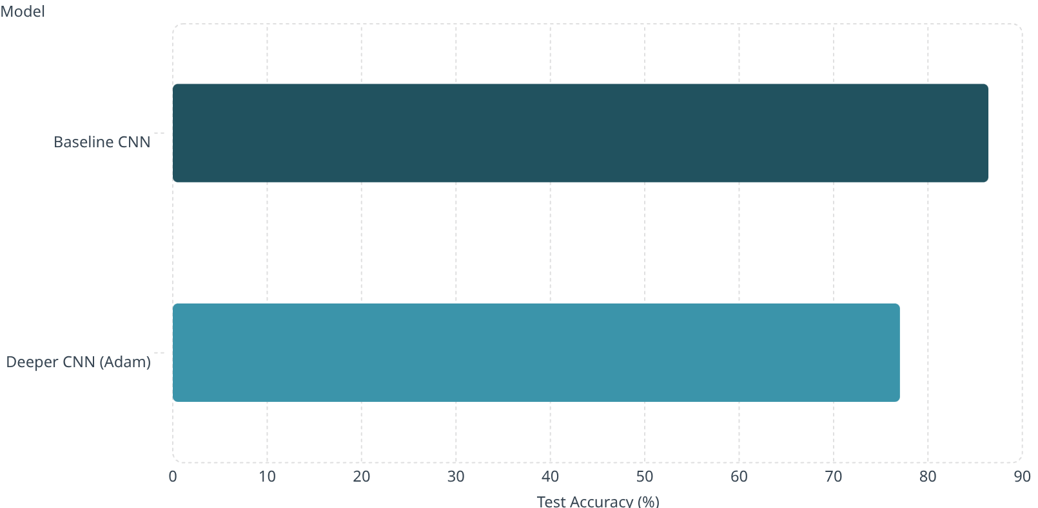

PART 2 — RESULTS
Scene Classification: Results Summary
Key Observations
Baseline CNN — 86.40%
Best overall performance among trained-from-scratch models
Deeper CNN — 77.03%
Unstable training with noisy learning curves; Adam optimiser underperformed
VGG16 Transfer
Expected to achieve the highest accuracy; results pending final evaluation
Primary Confusion: Glacier ↔ Mountain and Street ↔ Buildings remain the most challenging class boundaries.

Slide 8

PART 3
Sentiment Analysis on IMDb Reviews
Task
Binary sentiment classification — Positive vs Negative — using recurrent neural network architectures on the IMDb Large Movie Review Dataset.
Models Compared
1
SimpleRNN + Trainable Embedding
2
LSTM + Trainable Embedding
3
LSTM + Pre-trained GloVe
Long Short-Term Memory network
Transfer learning with word embeddings
Baseline recurrent model

Slide 9
PART 3 — DATASET
IMDb Large Movie Review Dataset
50K
35K
Total Reviews
Training Set
25K Positive · 25K Negative
5K validation · 10K test
280
20K
Max Sequence Length
Vocabulary Size
Reviews padded to uniform length
Top 20,000 most frequent tokens
Preprocessing Pipeline
Embedding Strategies
Text cleaned and tokenised
Padded to MAX_LEN = 280 words
Perfectly balanced class distribution
Trainable: Learned from scratch during training
GloVe: Pre-trained 100d vectors on Common Crawl

Slide 10

Conclusion & Future Work
Scene Classification
Sentiment Analysis
The baseline CNN achieved 86.40% test accuracy. Transfer learning with VGG16 is expected to surpass this, confirming the value of pre-trained features for visual tasks.
LSTM with GloVe embeddings is anticipated to outperform SimpleRNN, demonstrating the benefit of long-range dependency modelling and pre-trained semantic representations.
Future Directions
Explore ResNet/EfficientNet backbones, attention mechanisms (Transformers), and ensemble methods to further improve generalisation across both tasks.

Slide 12
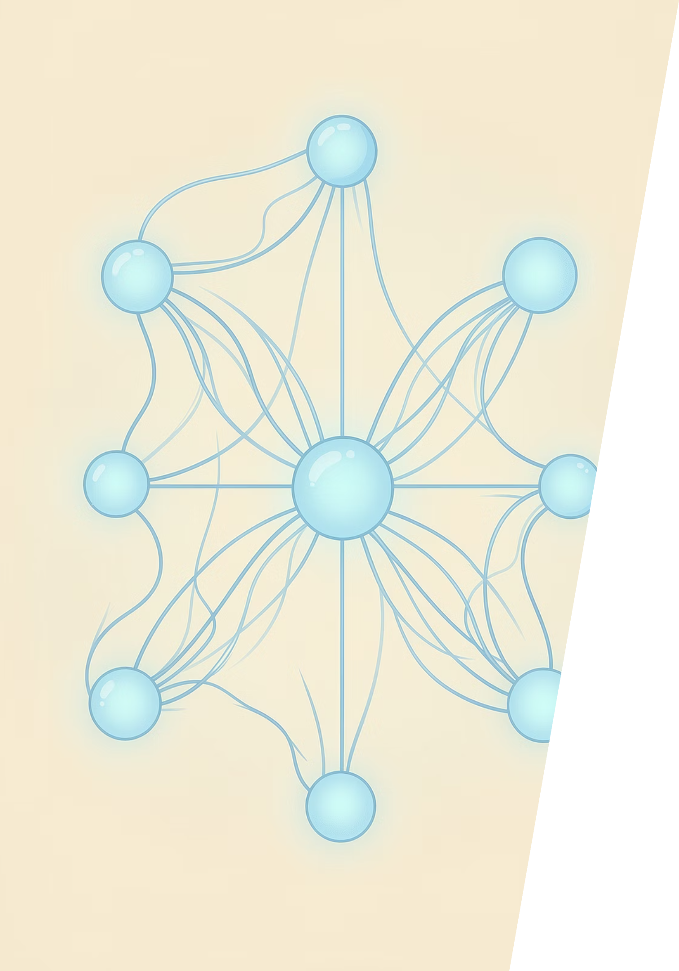
PART 3 — NLP
Methodology: Text Preprocessing Pipeline
A four-stage pipeline transforms raw review text into model-ready sequences, preserving semantic meaning while reducing noise.

Slide 13




Text Preprocessing Steps
HTML Removal
Normalize Text
Strip tags and markup from scraped review text
Lowercase all characters and expand contractions (e.g., "don't" → "do not")
Stopword Removal
Lemmatization
Remove common words while preserving negations critical for sentiment
Reduce words to base dictionary form for vocabulary consistency
Tokenization: Keras Tokenizer with a 20,000-word vocabulary, using post-padding to standardize input lengths across batches.

Slide 14
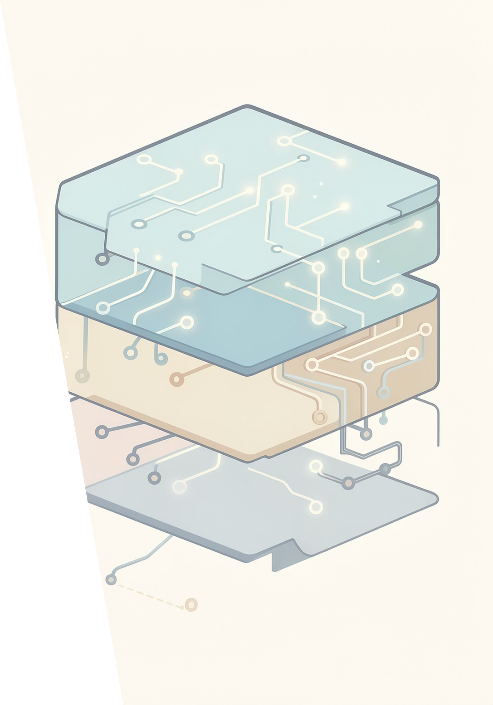
PART 3 — ARCHITECTURES
Three Model Architectures Compared
Each architecture builds on the last, progressively improving sentiment capture through better memory mechanisms and richer embeddings.

Slide 15
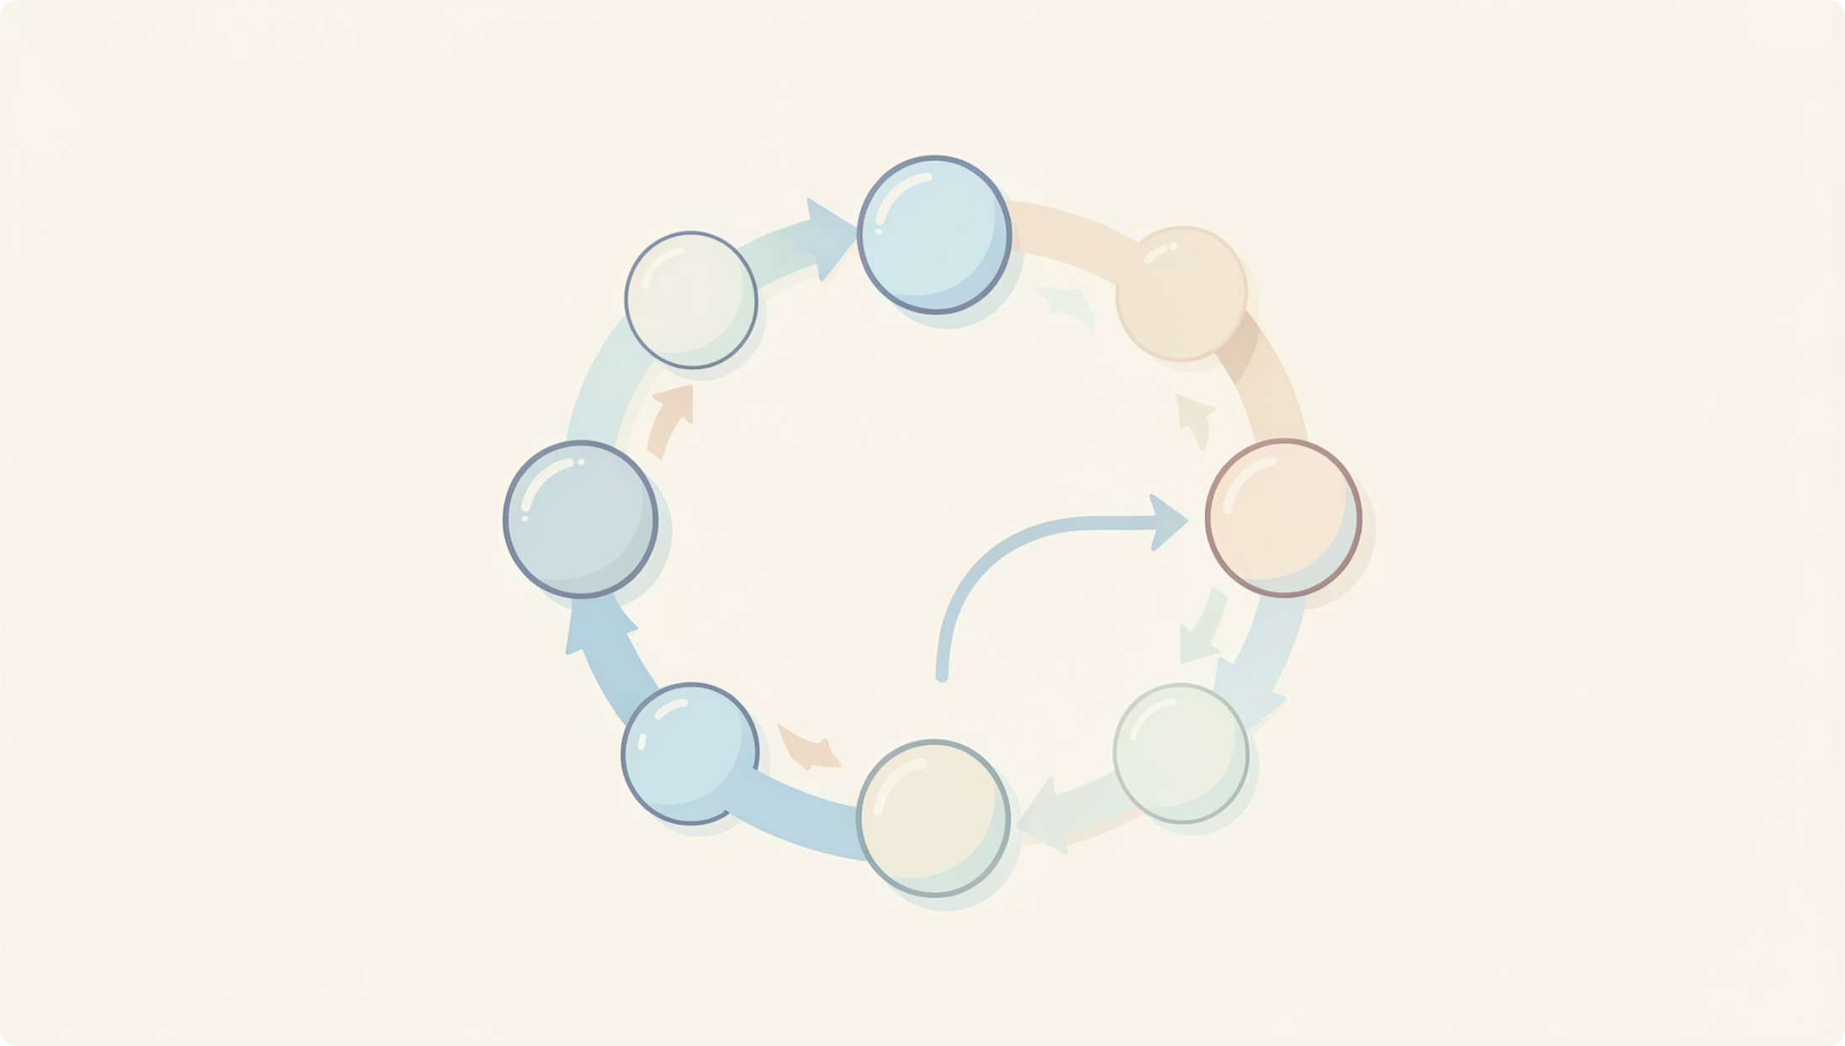

Model 1: SimpleRNN
Architecture
Embedding layer (100 dimensions)
SimpleRNN (64 units)
Dense output layers with sigmoid
Limitation
Vanishing gradients prevent the model from learning long-range dependencies, capping accuracy near ~50% — barely better than random.
SimpleRNNs struggle to retain context over long sequences, making them ill-suited for full review analysis.

Slide 16
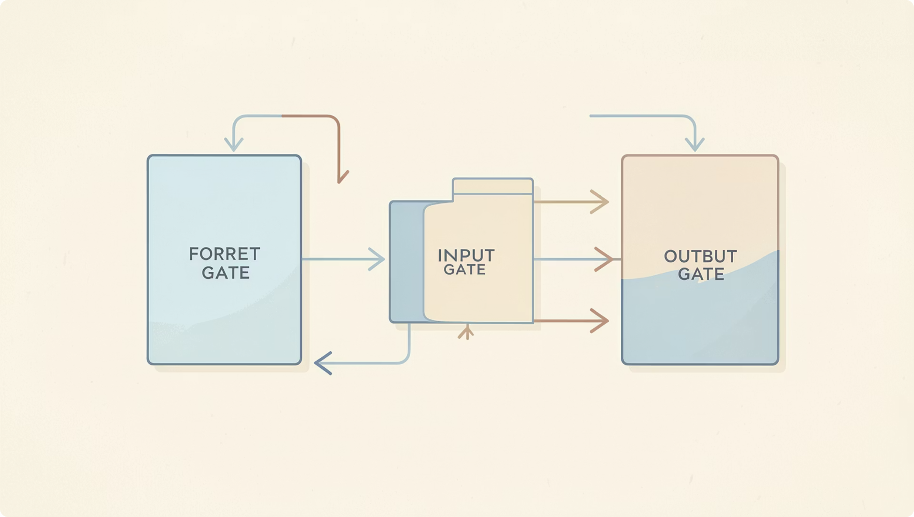

Model 2: LSTM
Architecture
Embedding layer (100 dimensions)
LSTM layer with gated memory cells
Dense layers + Dropout regularization
Improvement Over SimpleRNN
LSTM's forget, input, and output gates selectively retain or discard information, enabling meaningful learning of longer sequences and improved sentiment detection.
Gated architecture directly addresses the vanishing gradient problem inherent to SimpleRNNs.

Slide 17
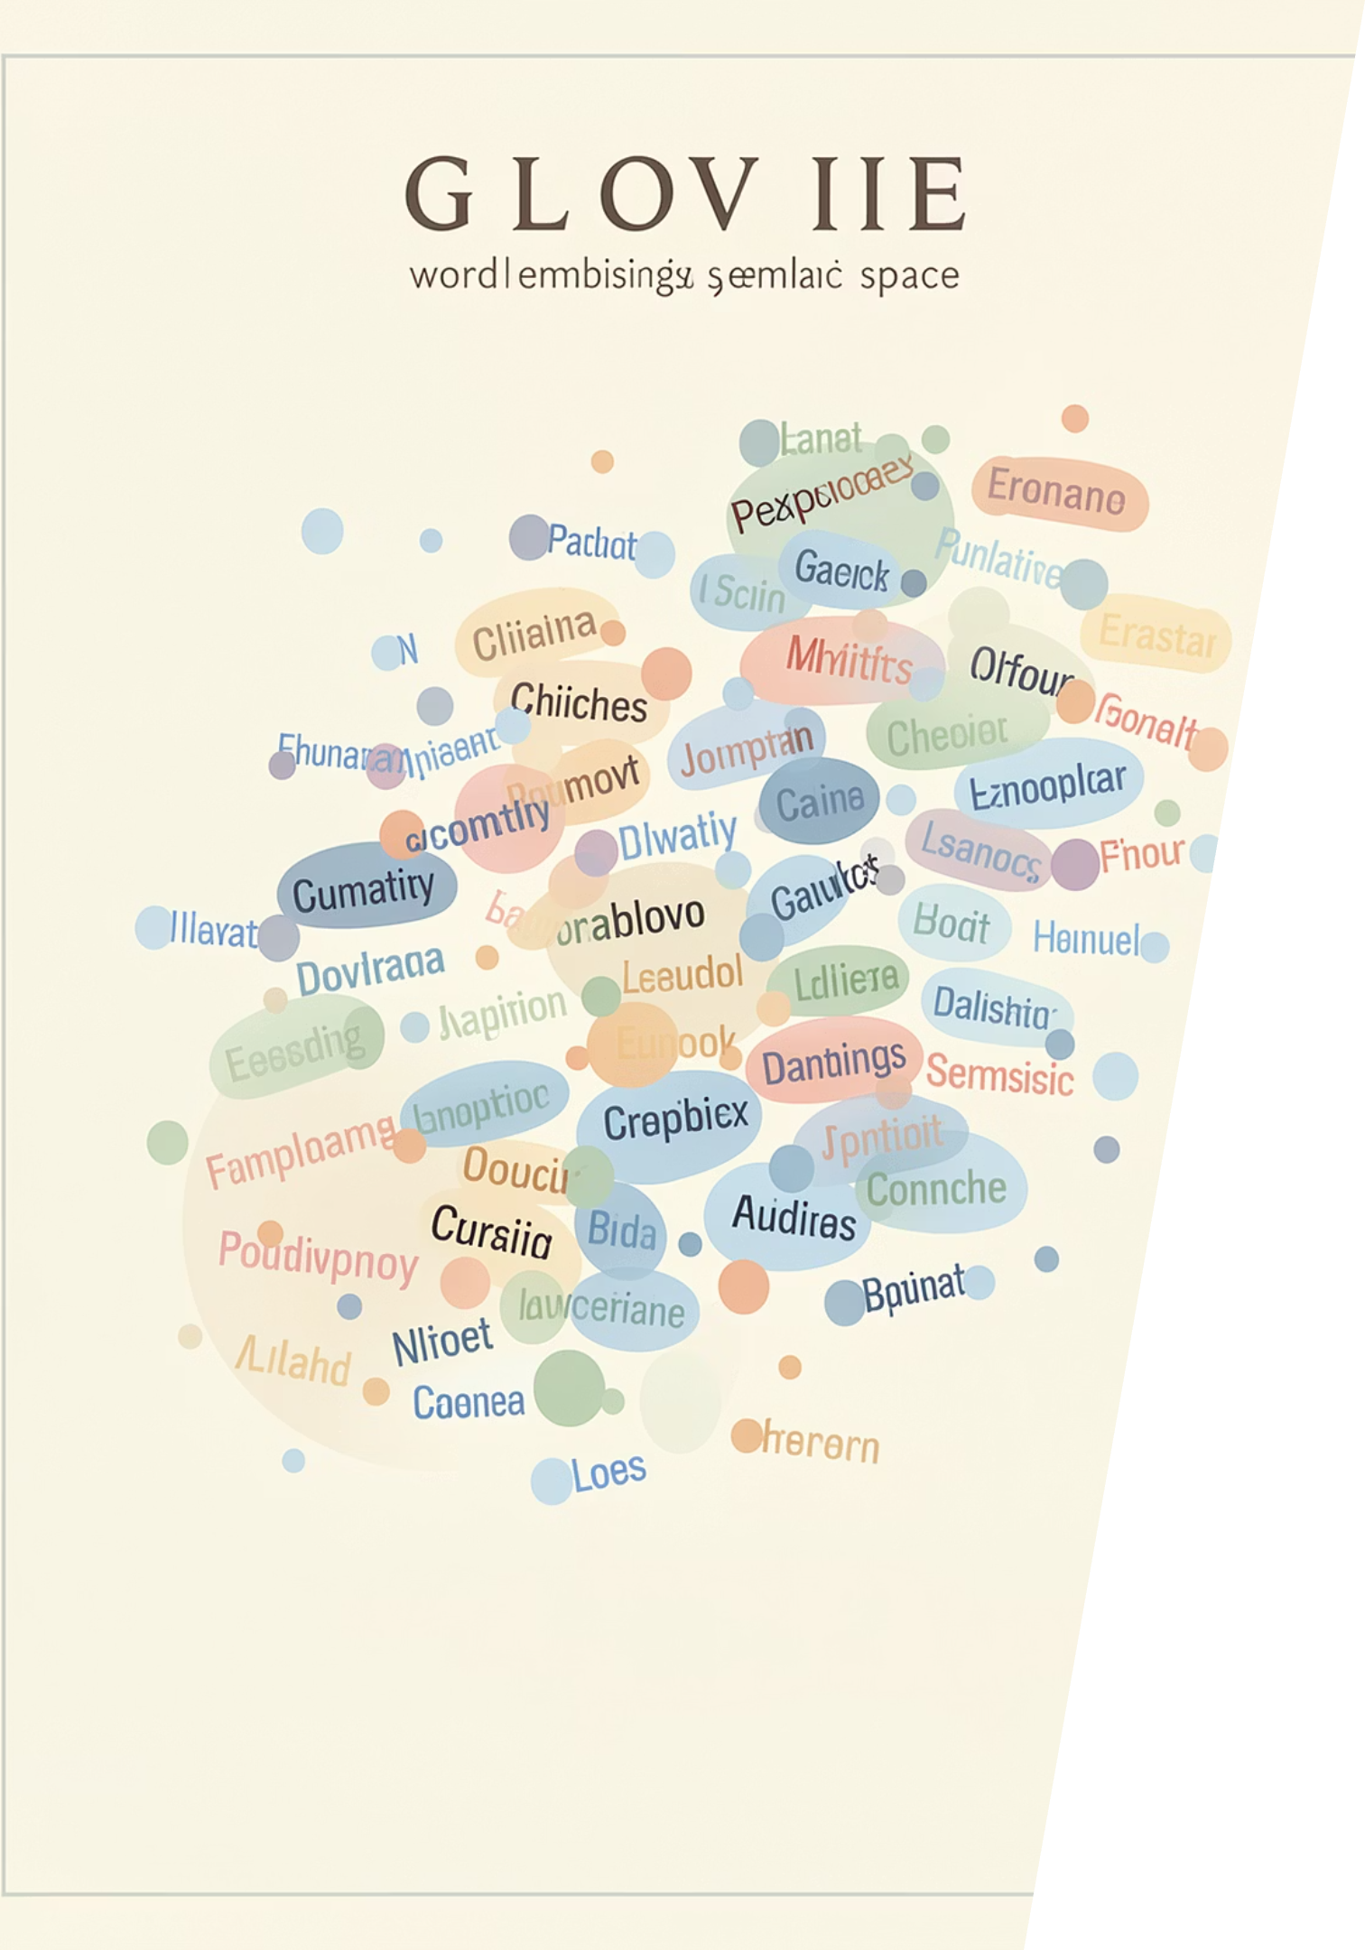
BEST PERFORMING MODEL
Model 3: LSTM + Pre-trained GloVe Embeddings
Replacing trainable embeddings with Twitter-specific GloVe vectors injects rich semantic knowledge learned from millions of real-world tweets — dramatically boosting sentiment discrimination.
Transfer Learning
Semantic Richness
Pre-trained on Twitter corpus, capturing informal language patterns
Word vectors encode meaning, not just co-occurrence statistics
Best Accuracy
Outperformed both SimpleRNN and trainable LSTM significantly

Slide 18
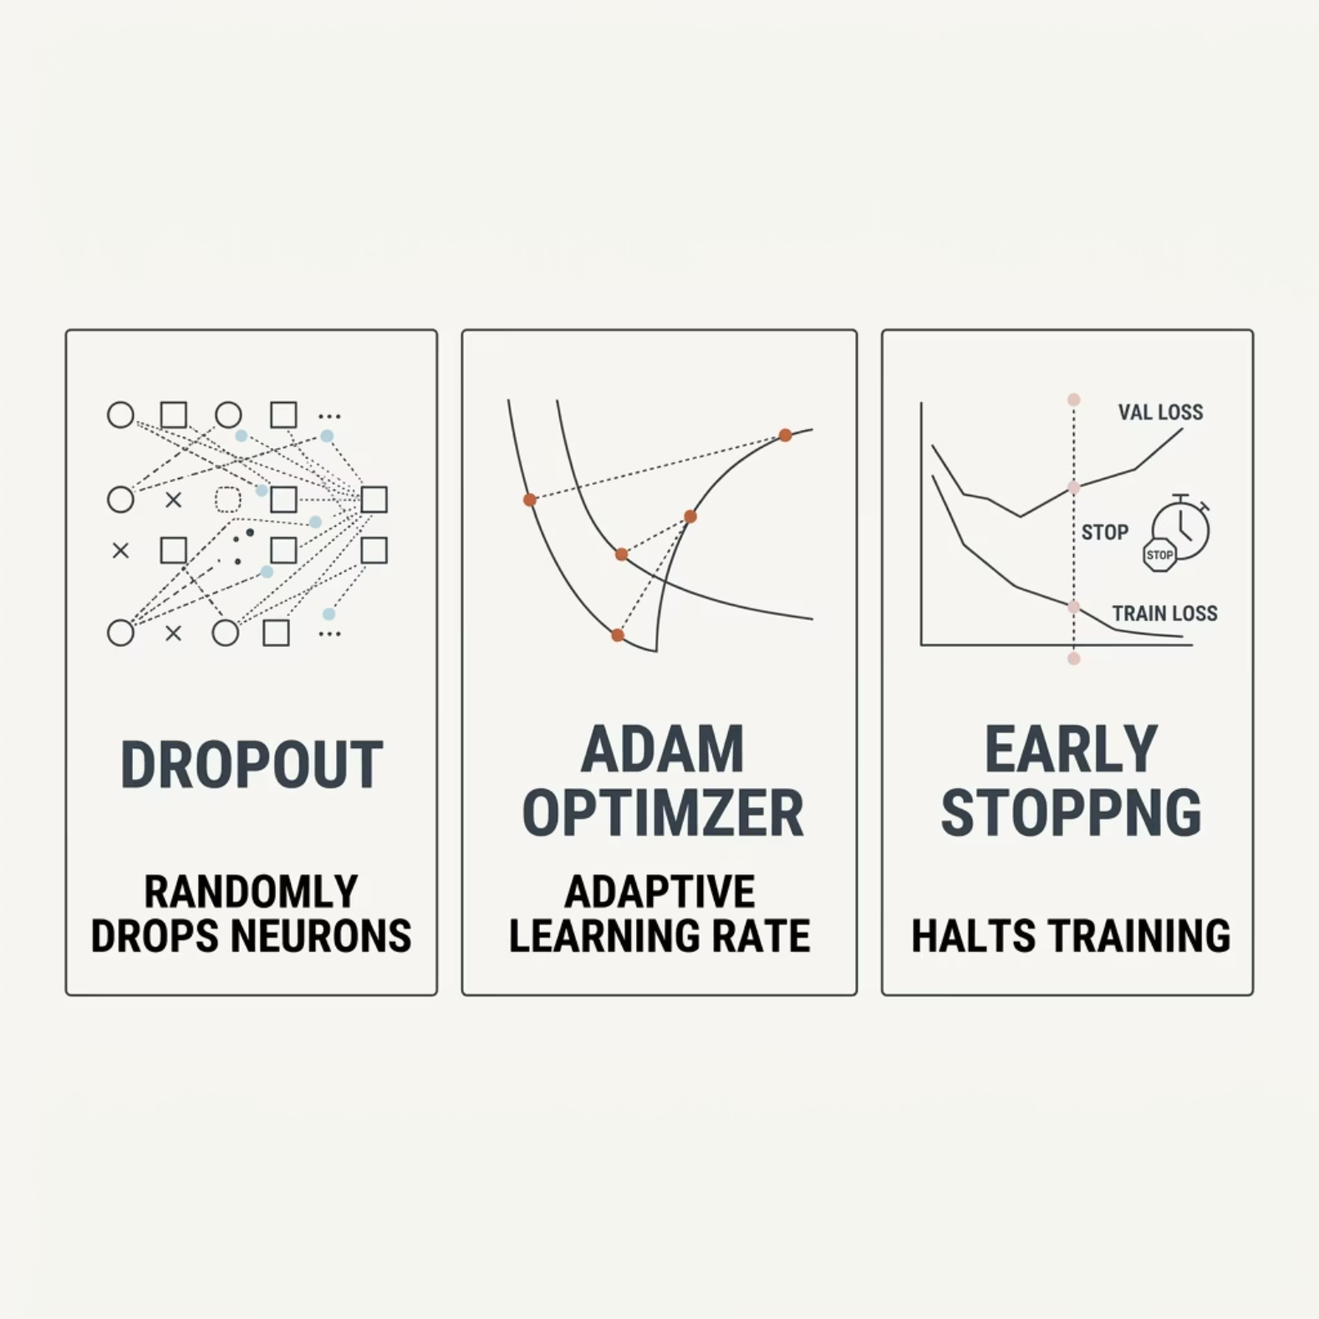

Training Configuration & Regularization
Shared Across All Models
Optimizer: Adam — adaptive learning rate for faster convergence
Regularization: Dropout layers to prevent overfitting on small datasets
Early Stopping: Halts training when validation loss plateaus
Loss: Binary cross-entropy for sentiment classification

Slide 19
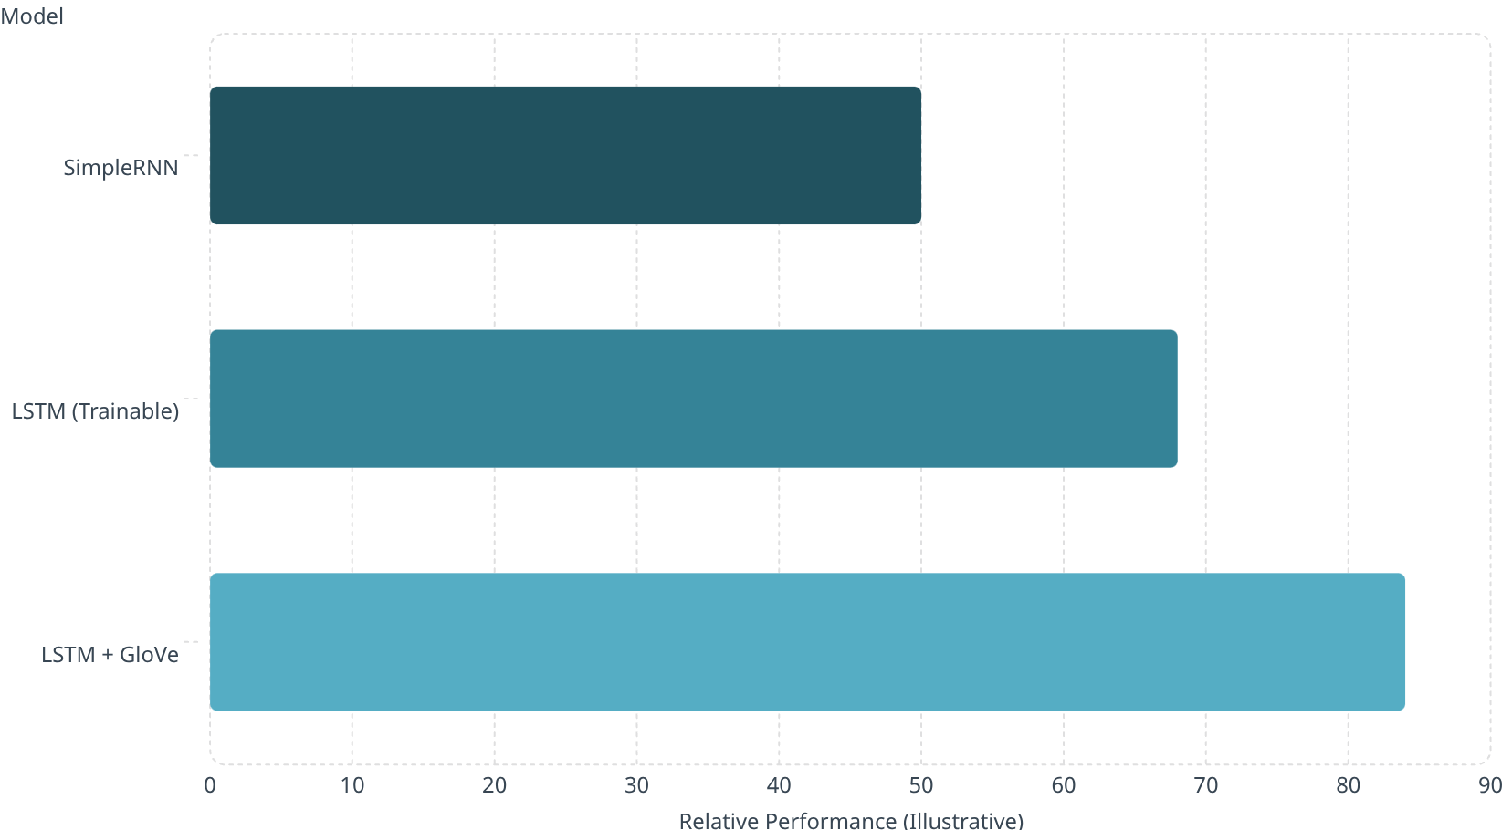

Results Summary
Key Observations
SimpleRNN (~50%): Gradient vanishing limits learning to near-random performance
LSTM (trainable): Noticeable improvement, but limited by small training data
LSTM + GloVe: Best overall — pre-trained embeddings provide a strong semantic foundation
Performance values are illustrative approximations based on the qualitative comparisons in the input.
Persistent Challenges
Long sequences exceeding effective memory window
Sarcasm and irony in informal reviews
Domain-specific film terminology

Slide 20

CROSS-PART COMPARISON
Part 2 (Vision) vs. Part 3 (NLP)
Aspect
Part 2 — Vision
Part 3 — NLP
Best Model
Baseline CNN / VGG16
LSTM + GloVe
Transfer Learning
Strong benefit from ImageNet weights
Strong benefit from GloVe embeddings
Main Difficulty
Inter-class visual similarity
Long-range dependencies & sarcasm
Regularization
High — dropout & augmentation
High — dropout & early stopping
Core Lesson: Pre-trained models and proper regularization significantly boost performance across both vision and NLP domains.

Slide 21
Conclusion & Future Directions
What We Accomplished
Future Work
Implemented CNNs from scratch and VGG16 transfer learning for scene classification
Built and compared SimpleRNN vs. LSTM architectures for sentiment analysis
Demonstrated transfer learning's power in both vision and NLP
Gained hands-on experience with the full DL pipeline and best practices
Vision: Experiment with ResNet / EfficientNet architectures
NLP: Replace LSTM with BERT or Transformer models
Deployment: Ship both models as interactive web apps via Gradio or Streamlit
Unik Ghalan · 2409043
AI & Machine Learning · 6CS012

