Slide 1
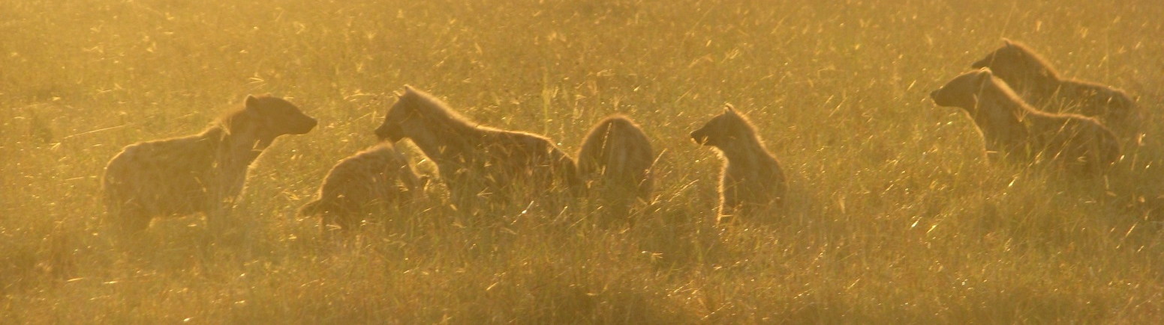
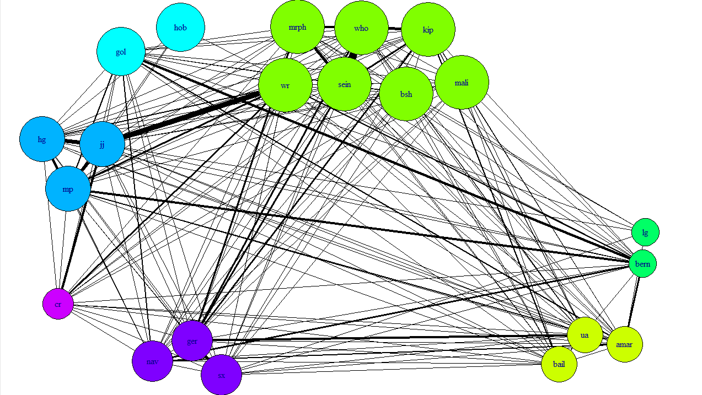
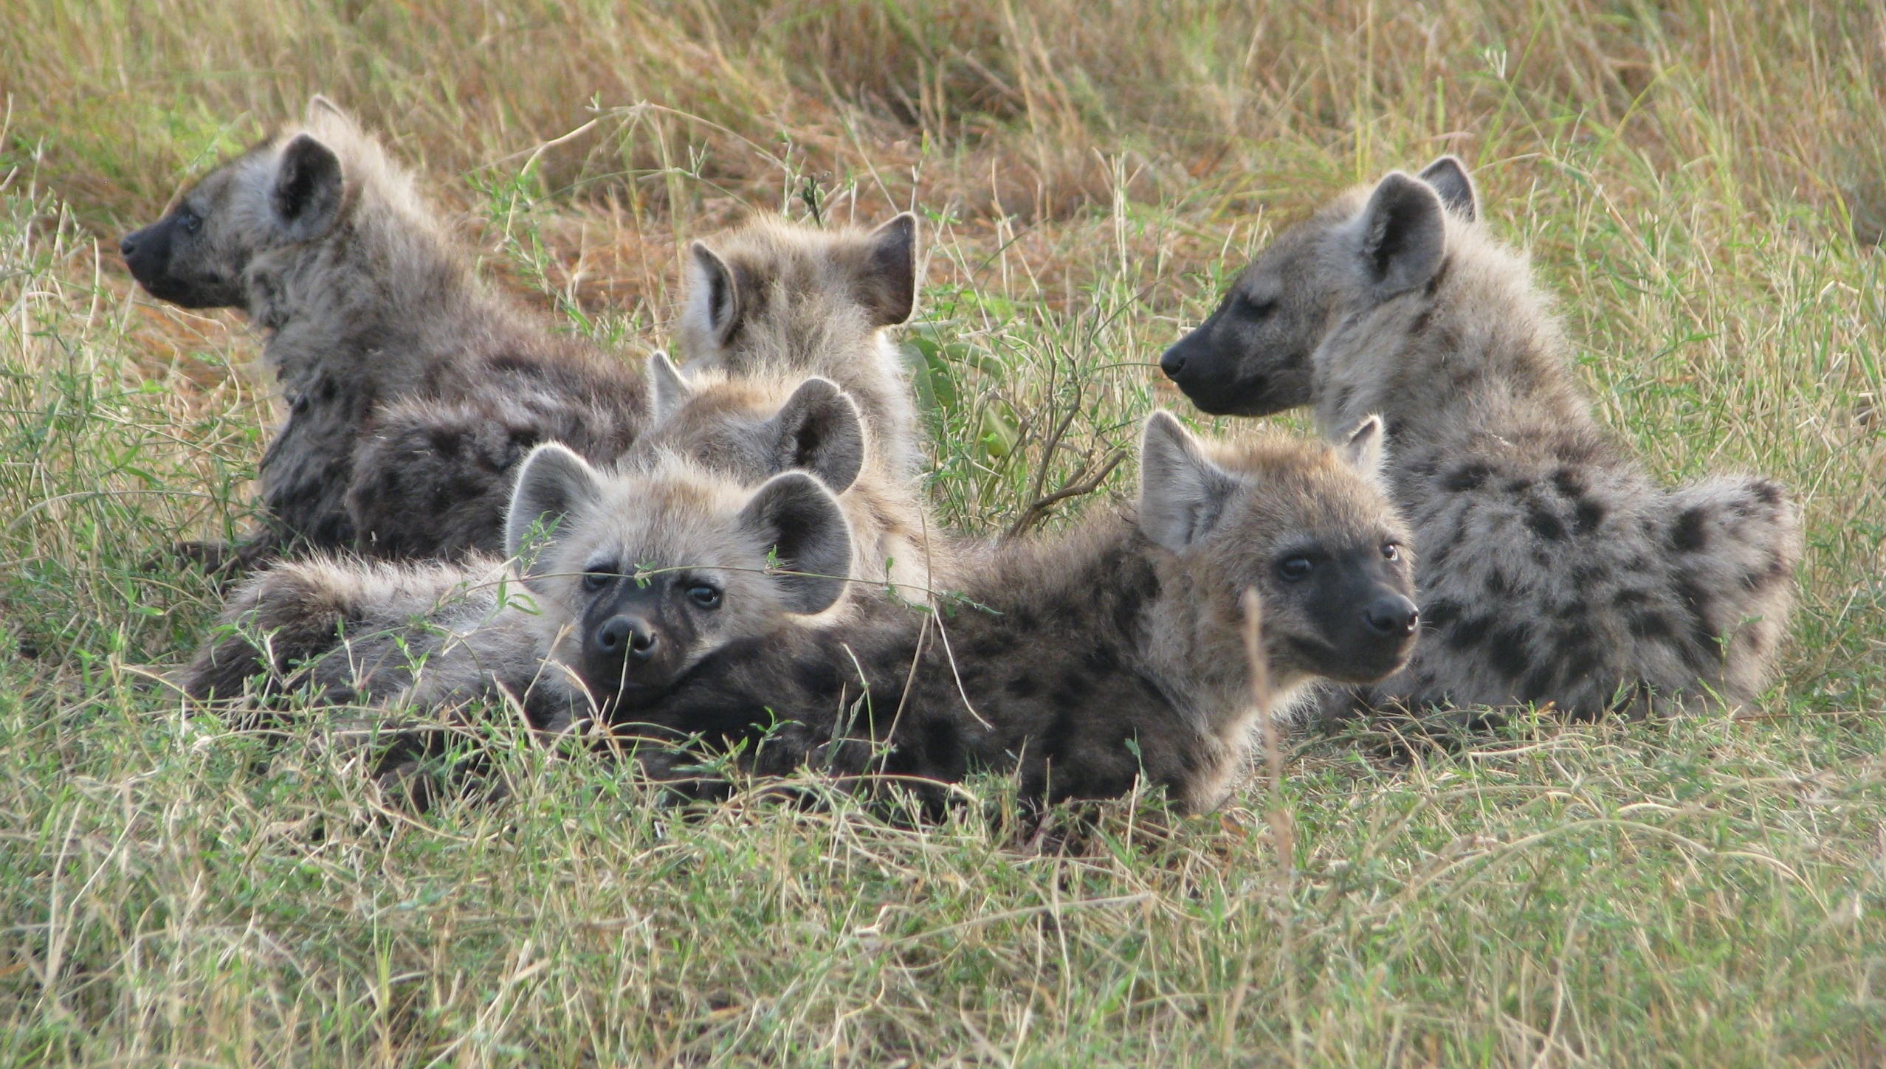

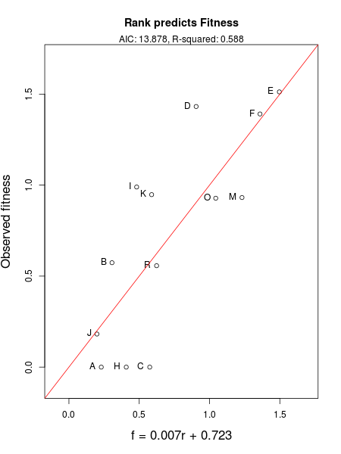
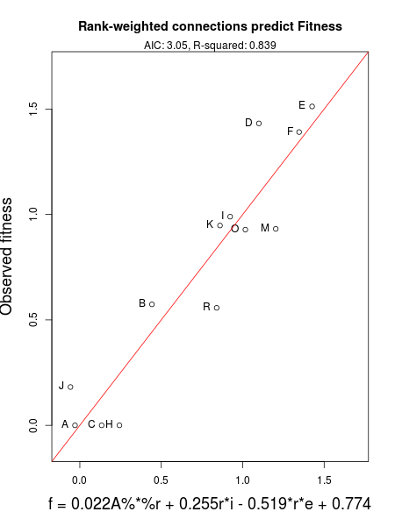
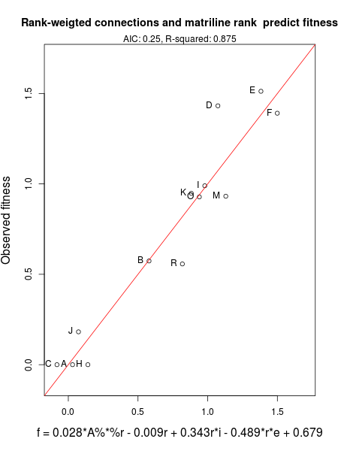
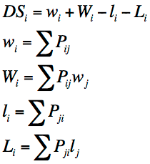





.
Modeling social network dynamics in the spotted hyena (Crocuta crocuta)
Conrad Beckmann¹, Judy Bloom², Jacob Lambert³, Rachael Ward⁴, Amiyaal Ilany⁵, and Jiang Jiang⁵
¹University of Vermont, ²Eastern Connecticut State University, ³University of Tennessee, ⁴Rhodes College
⁵National Institute for Mathematical and Biological Synthesis
Introduction
Spotted hyenas (Crocuta crocuta) maintain a complex social structure.
Sub-Saharan African hyenas live in large clans consisting of 10 – 100 individuals.
Females are dominant to all males and the social structure is matrilineal.
Each hyena has a specific rank determined by its matriline, which affects the individual’s access to resources.
We focused on the Talek clan in Maasai Mara National Reserve, Kenya.
Over the 22 year study, 80,000 observations of hyena interactions were collected, along with profiles of each hyena.
Our model demonstrates that rank and connectivity within a network is a better predictor of fitness than rank alone.
Results
Previously, rank has been shown to affect fitness, however, our results show linear models involving rank and connectivity predict fitness better than rank alone.
Connectivity within and between matrilines affects differently ranked matrilines in different ways.
Matrilines of higher ranks maintained their rank over time.
Lower ranked matrilines were less stable and more likely to disappear or increase in rank.
2
1
1999
Figure 1. Social network between spotted hyenas for different years. Node color represents matrilines. Node size is proportional to rank; highest rank is the largest. Edge-thickness is proportional to strength of the association.
3
Future Work
Use divergence of family trees for a more logical and dynamic definition of matrilines.
Use more biologically relevant time intervals than calendar years.
Generalize the model to apply to other complex social network structures.
7
Methods
All data were divided by year for females in the Talek clan.
Matrilines detected by maternal data and a transitive closure algorithm.
6
4
5
Equation 1. Twice-Weight association index for individual connectivity. Calculated from observations of two hyenas a and b.
Equation 2. Matriline social rank calculations using David score calculations and table of dyadic aggressive interactions
Equation 3. Ratio of matriline births to total clan births.
References
¹Holekamp K.E., Smith J.E., Strelioff C.C., van Horn R.C., and H.E. Watts. 2012. Society, demography, and genetic structure in the spotted hyena. Molecular Ecology 21:613-632.
²Lewis K., Gonzalez M., and J. Kaufman. 2011. Social selection and peer influence in an online social network. Proceedings of the National Academy of Sciences 109(1):68-72.
³Hobson E.A., Avery M.L, and T.F. Wright. 2013. An analytical framework for quantifying and testing patterns of temporal dynamics in social networks. Animal Behaviour 85:83-96.
Equations 4 and 5. External and Internal connectivity for each matriline calculated using individual twice-weight data and detected matrilines.
Figures 2, 3, and 4. Three different linear aggression models attempting to predict fitness from parameters. The y-axis represents the observed fitness, while the x-axis represents the calculated fitness from the model. Because David Score ranks can be negative, a rank-weighted parameter with a positive coefficient indicates a positive correlation for positive ranks and a negative correlation for negative ranks. Similarly, a rank-weighted parameter with a negative coefficient indicates a negative correlation for positive ranks and a positive correlation for negative ranks
Equation 6. Matriline to Matriline connectivity calculated using twice-weight data and dected matrlines
Acknowledgments: This work was conducted with funding from the National Institute for Mathematical and Biological Synthesis, an Institute sponsored by the National Science Foundation, the U.S. Department of Homeland Security, and the U.S. Department of Agriculture through NSF Award #EF-0832858, with additional support from The University of Tennessee, Knoxville. We thank Kay Holekamp for allowing us to use the data collected from her lab.
Notes:
07/08/13
07/08/13
Section Headers: Introduction (can include “Problem” and “Question”), Methods, Results, Conclusions, Literature Cited (approx. 10 citations max.). Each section should be a maximum of 200 words. Width of a text block: about 11 words per line. Height of a text block: no longer than 10 sentences.

