Slide 1
Implicit Feedback for Plant-Pollinator Networks
Jacob Lambert - EISI 2014

Slide 2
Contents
- Plant-pollinator networks
- Recommendation systems
- Collaborative filtering and implicit feedback
- Implicit feedback matrix factorization
- Results
- Discussion/future work

Slide 3
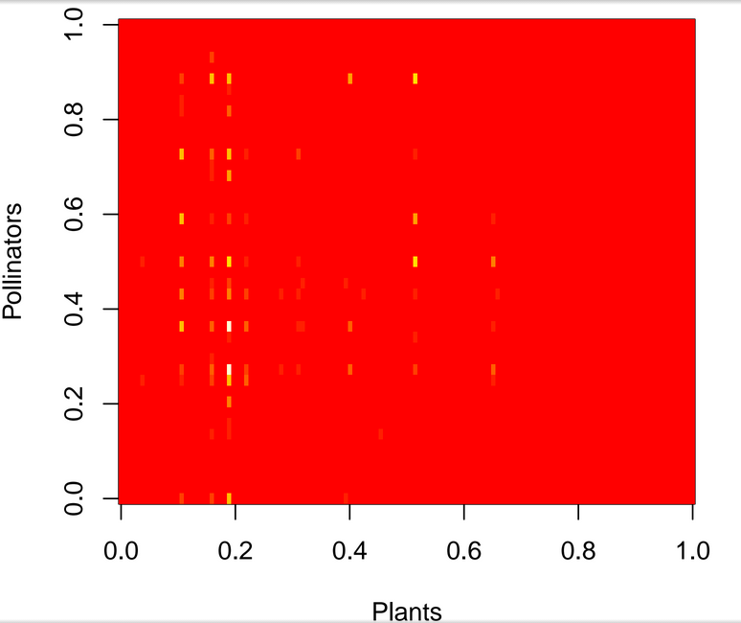
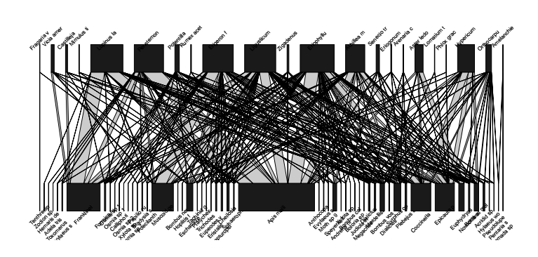
Plant-pollination: Mathematical representations

Slide 4
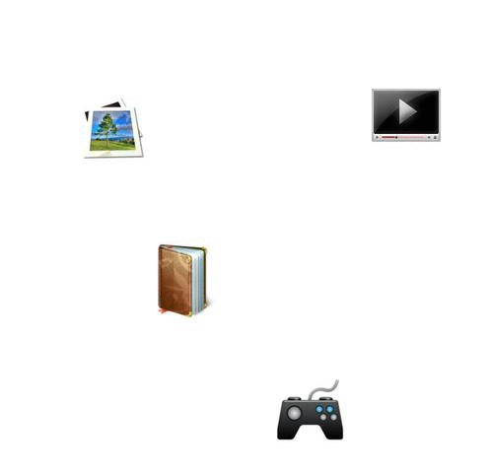


Recommender systems and Collaborative Filtering

Slide 5
Implicit Feedback
TV show recommender / Plant-pollinator dataset
- No ratings
- Implicit positive feedback from behavioural patterns
- Difficult to infer negative feedback

Slide 6
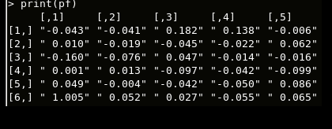
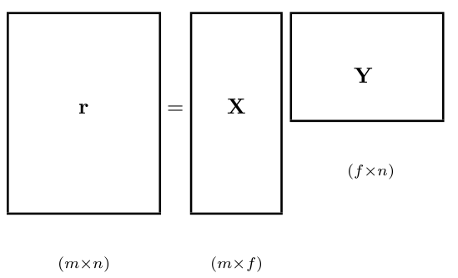




Implicit Feedback Matrix Factorization (IFMF)

Slide 7
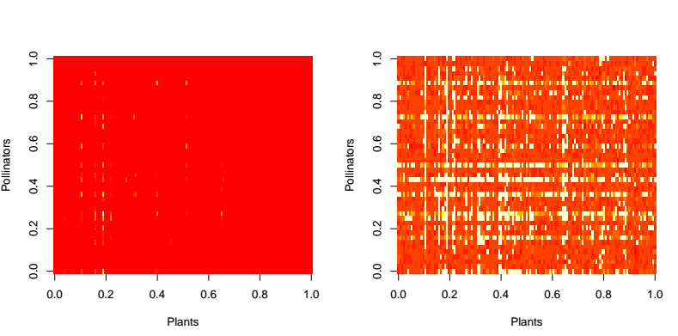
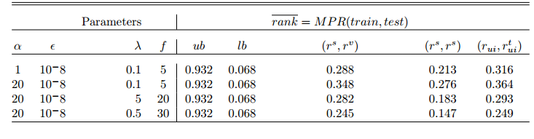
Results and Discussion
- performance ranking
- subsetting training matrix

Slide 8
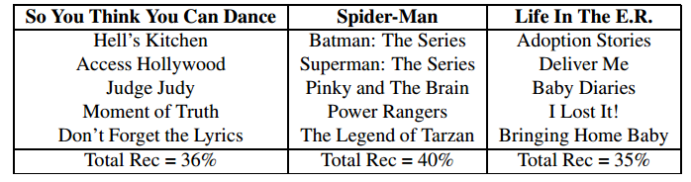
Future Work
Comparison
- popularity-based model
- abundance-based model
- Factor interpretation
- Recommendation
explanations

Slide 9
Acknowledgement
EISI Mentor Team

