Slide 1
Implicit Feedback for Plant-Pollinator Networks
Jacob Lambert - EISI 2014
Notes:
Summer REU program - Plant pollinator networks
8 weeks collecting data/developing project ideas
2 weeks coding/presenting results
I designed this presentation for a group of people very familiar with the project, so I really just presented my specific approach. So let me know if I need to take a step back and explain what’s going on.
Very general, ask questions!

Slide 2
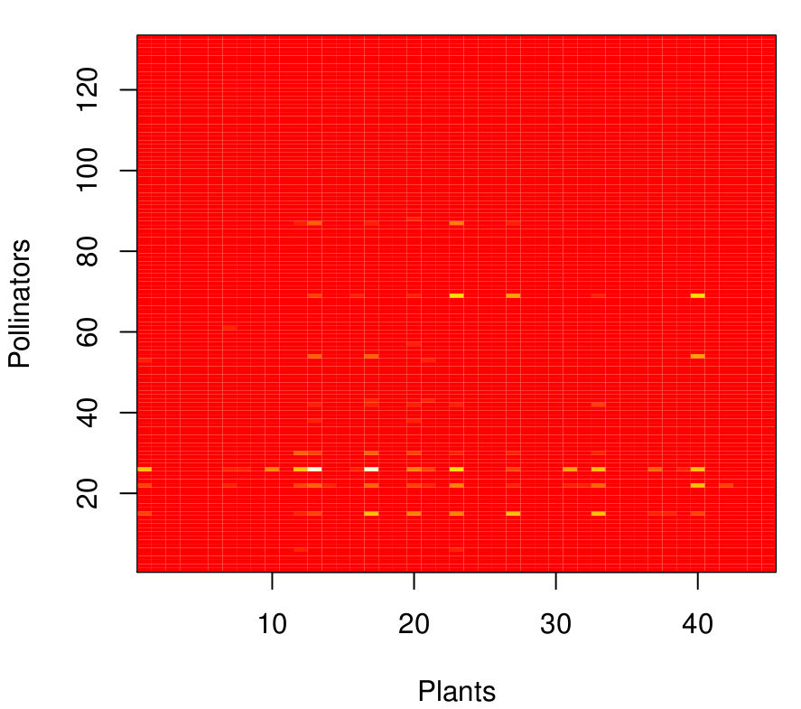
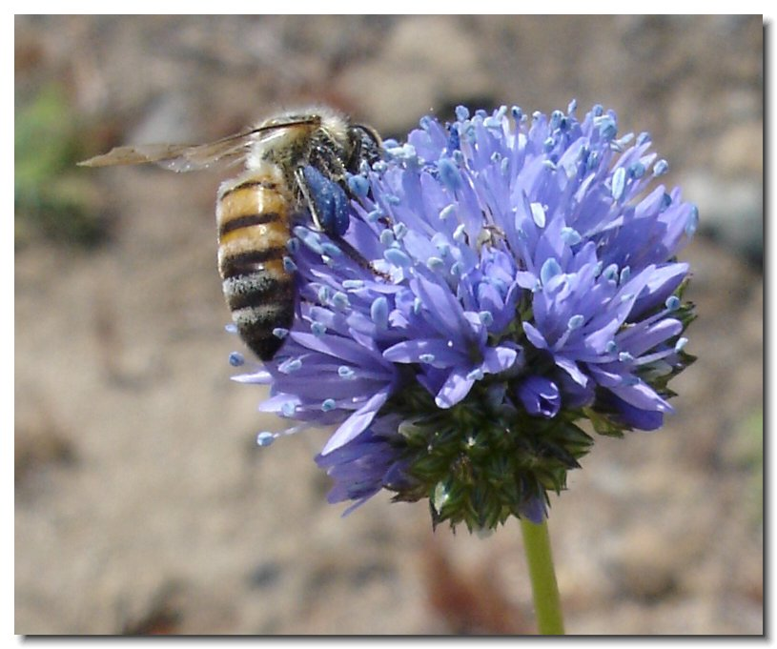
Plant-pollination: Mathematical representations
Notes:
Pollinators are responsible for 75 % of food production, so it’s important that we understand how plant pollinator networks function.
Ecologists and botanists have studied these traditionally for years, but we were interested in a more quantitative approach.

Slide 3


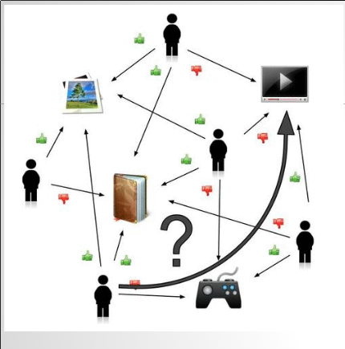
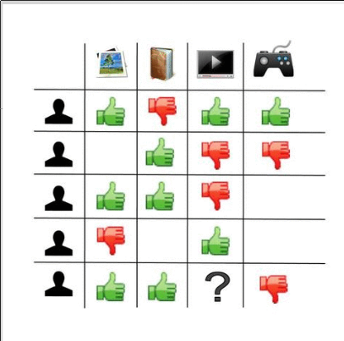
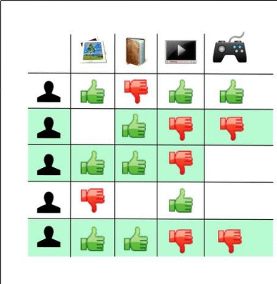
Recommender systems and Collaborative Filtering

Slide 4
Implicit Feedback
TV show recommender / Plant-pollinator dataset
1. No ratings
2. Implicit positive feedback from behavioural patterns
3.Difficult to infer negative feedback

Slide 5
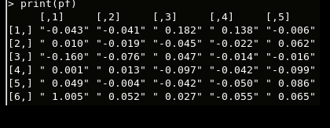
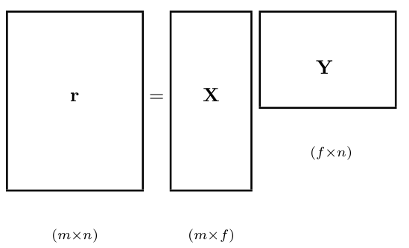




Implicit Feedback Matrix Factorization (IFMF)

Slide 6
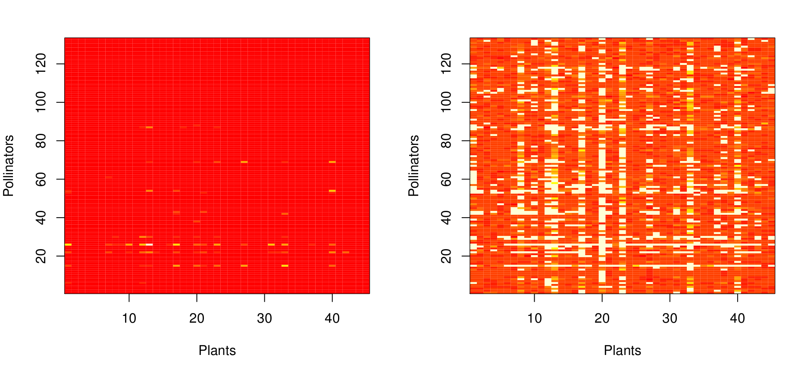
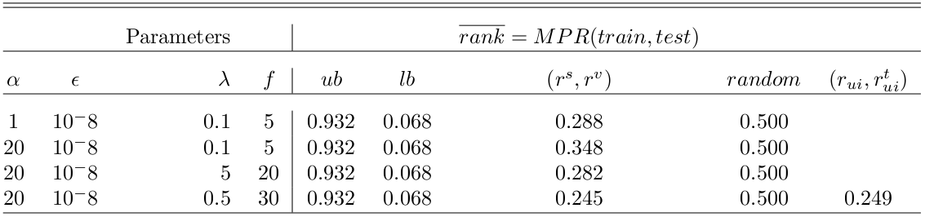
Results and Discussion
- performance ranking
- subsetting training matrix

Slide 7
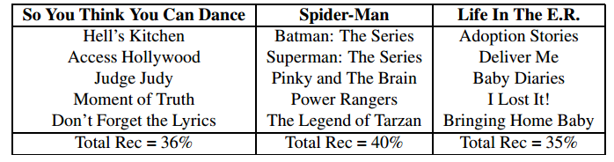
Future Work
Comparison
- popularity-based model
- abundance-based model
- Factor interpretation
- Recommendation
explanations

Slide 8
Acknowledgement
Julia Jones - program administration
Tom Dietterich - computer science advice
Rebecca Hutchinson - method development
Eddie Helderop - ultimate mentor
Andy Moldenke - resident entomologist

Slide 9


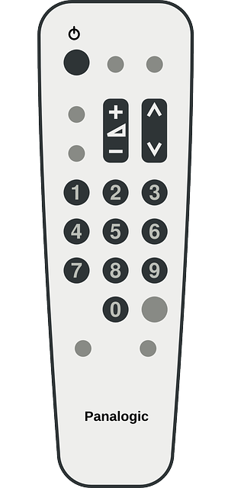

Questions?

