Slide 1
Implicit Feedback for Plant-Pollinator Networks
Jacob Lambert - EISI 2014

Slide 2
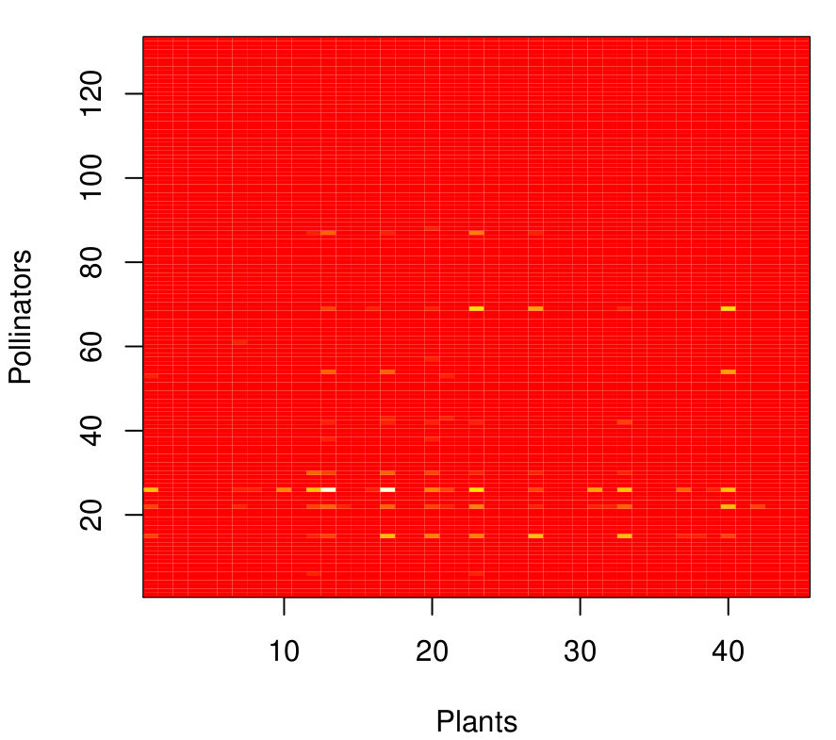
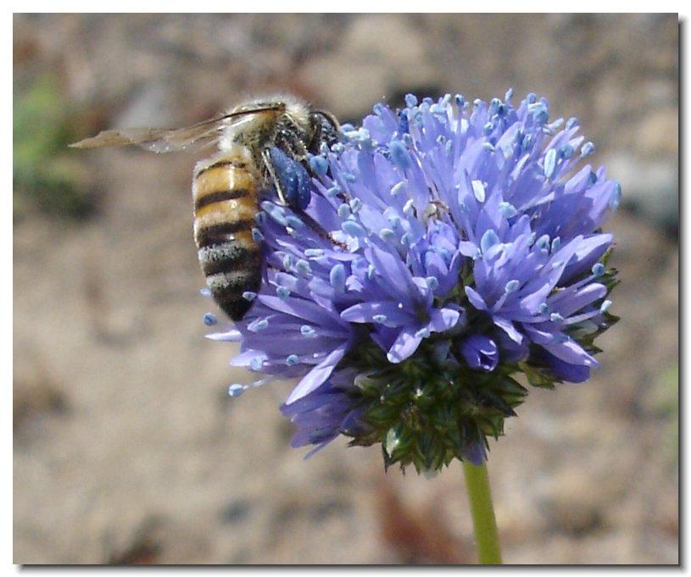
Plant-pollination: Mathematical representations

Slide 3


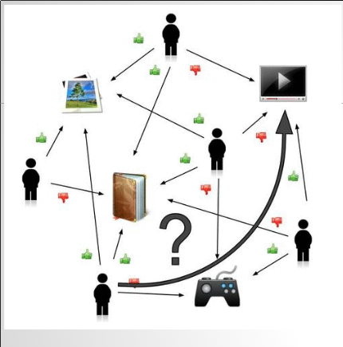
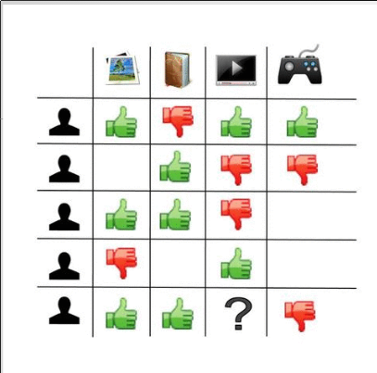
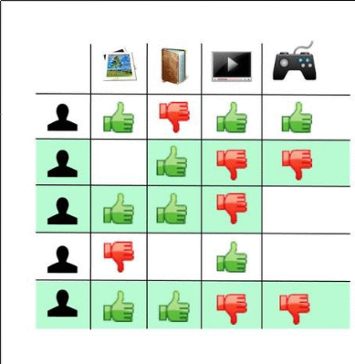
Recommender systems and Collaborative Filtering

Slide 4
Implicit Feedback
TV show recommender / Plant-pollinator dataset
1. No ratings
2. Implicit positive feedback from behavioural patterns
3.Difficult to infer negative feedback

Slide 5
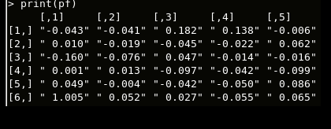
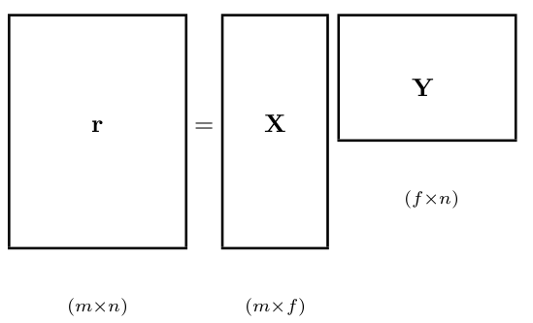




Implicit Feedback Matrix Factorization (IFMF)

Slide 6
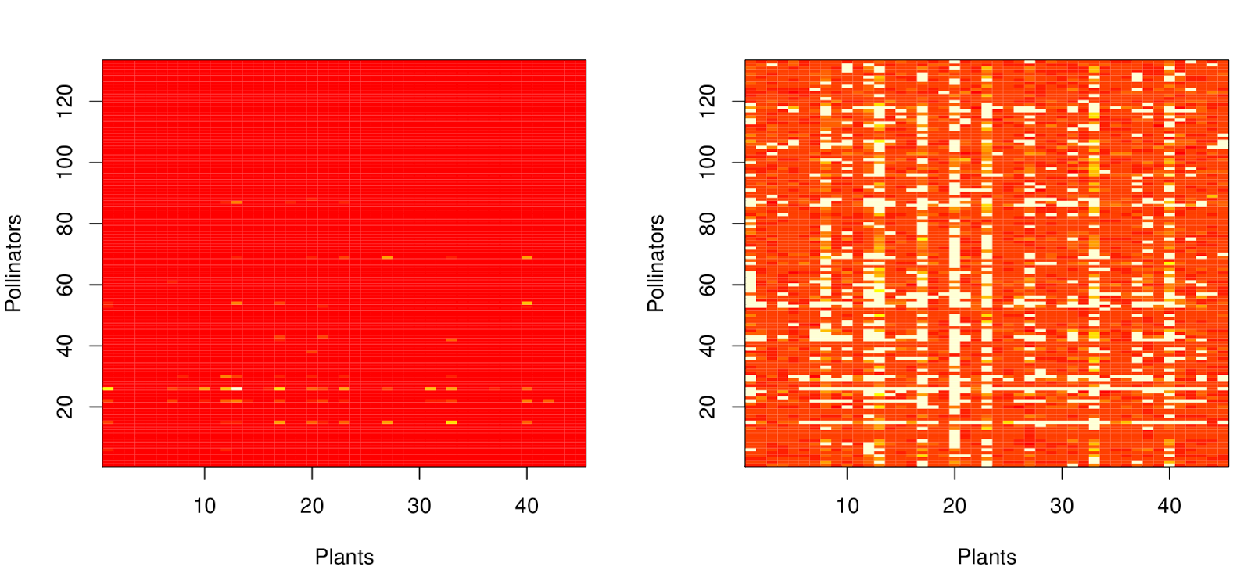
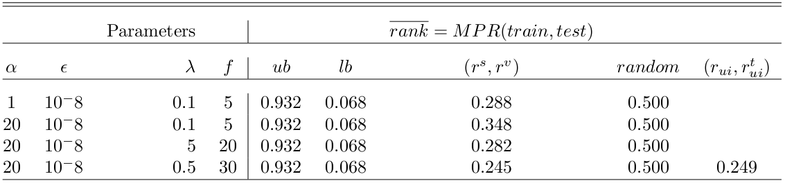
Results and Discussion
- performance ranking
- subsetting training matrix

Slide 7
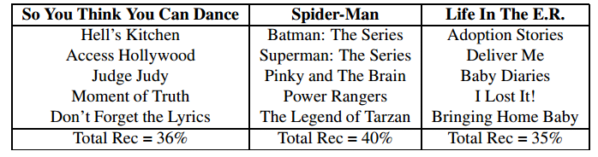
Future Work
Comparison
- popularity-based model
- abundance-based model
- Factor interpretation
- Recommendation
explanations

Slide 8
Acknowledgement
Julia Jones - program administration
Tom Dietterich - computer science advice
Rebecca Hutchinson - method development
Eddie Helderop - ultimate mentor
Andy Moldenke - resident entomologist

Slide 9


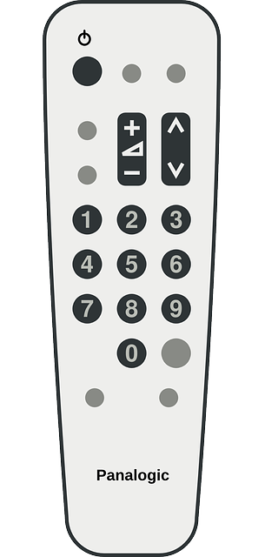

Questions?

