Slide 1
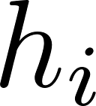
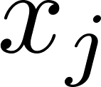
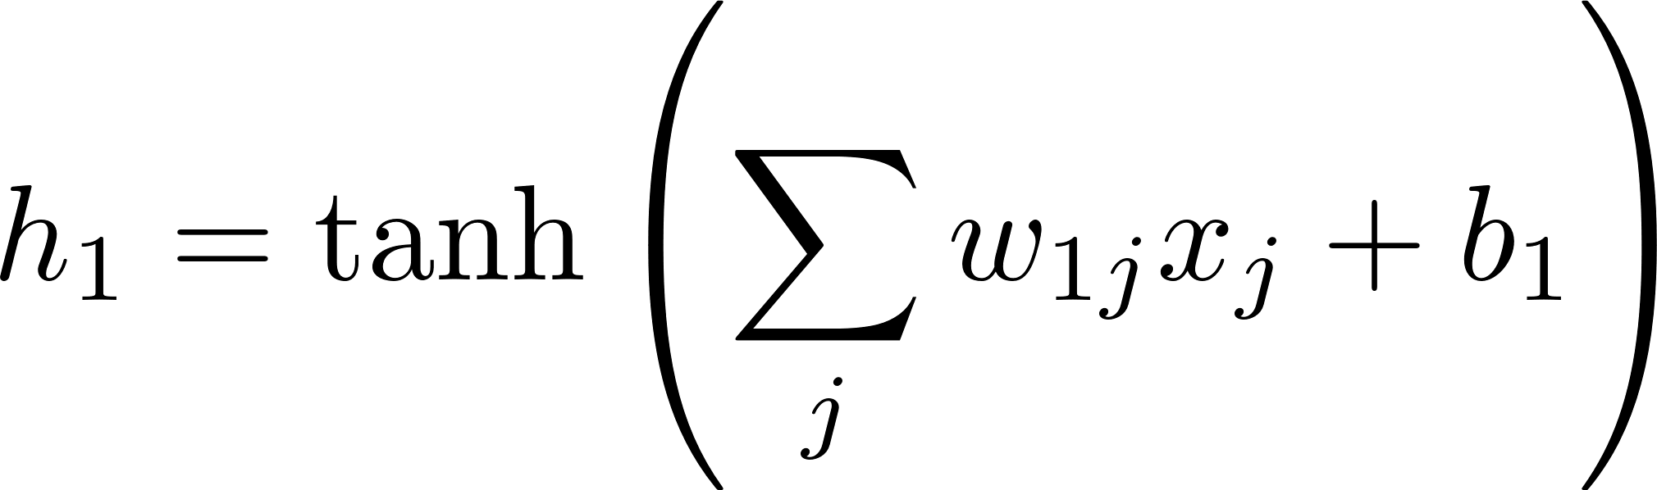

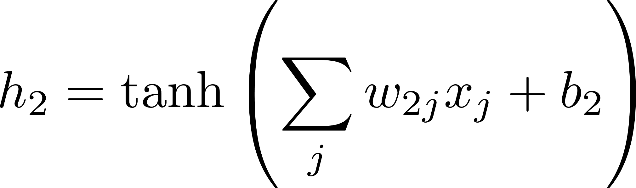


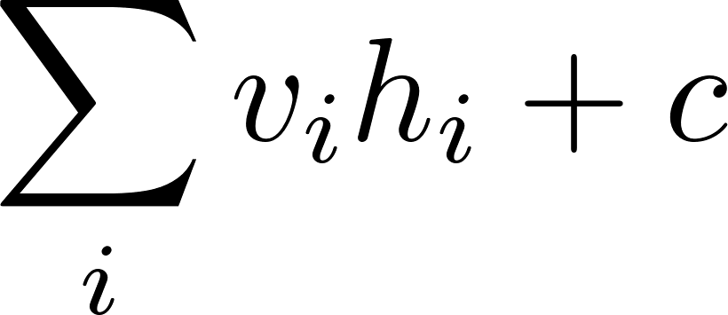
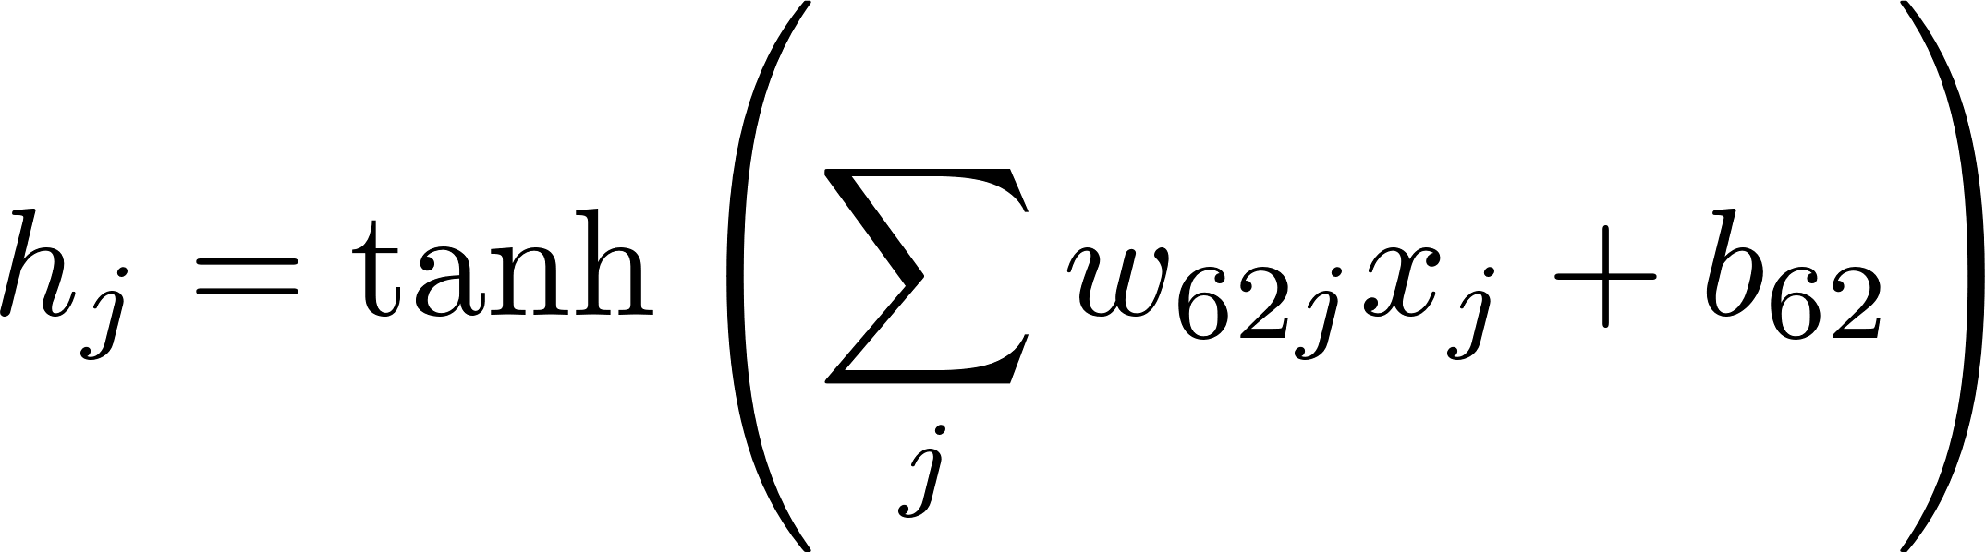
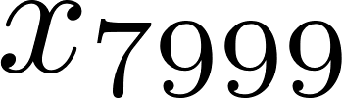
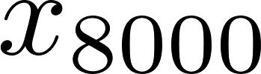


Hidden
(64 embedding nodes)
Input
(8000 vocab)
Output
Parameters:
w (8000*64)
b (64)
v (64)
c (1)
(total 512,129)

Slide 2

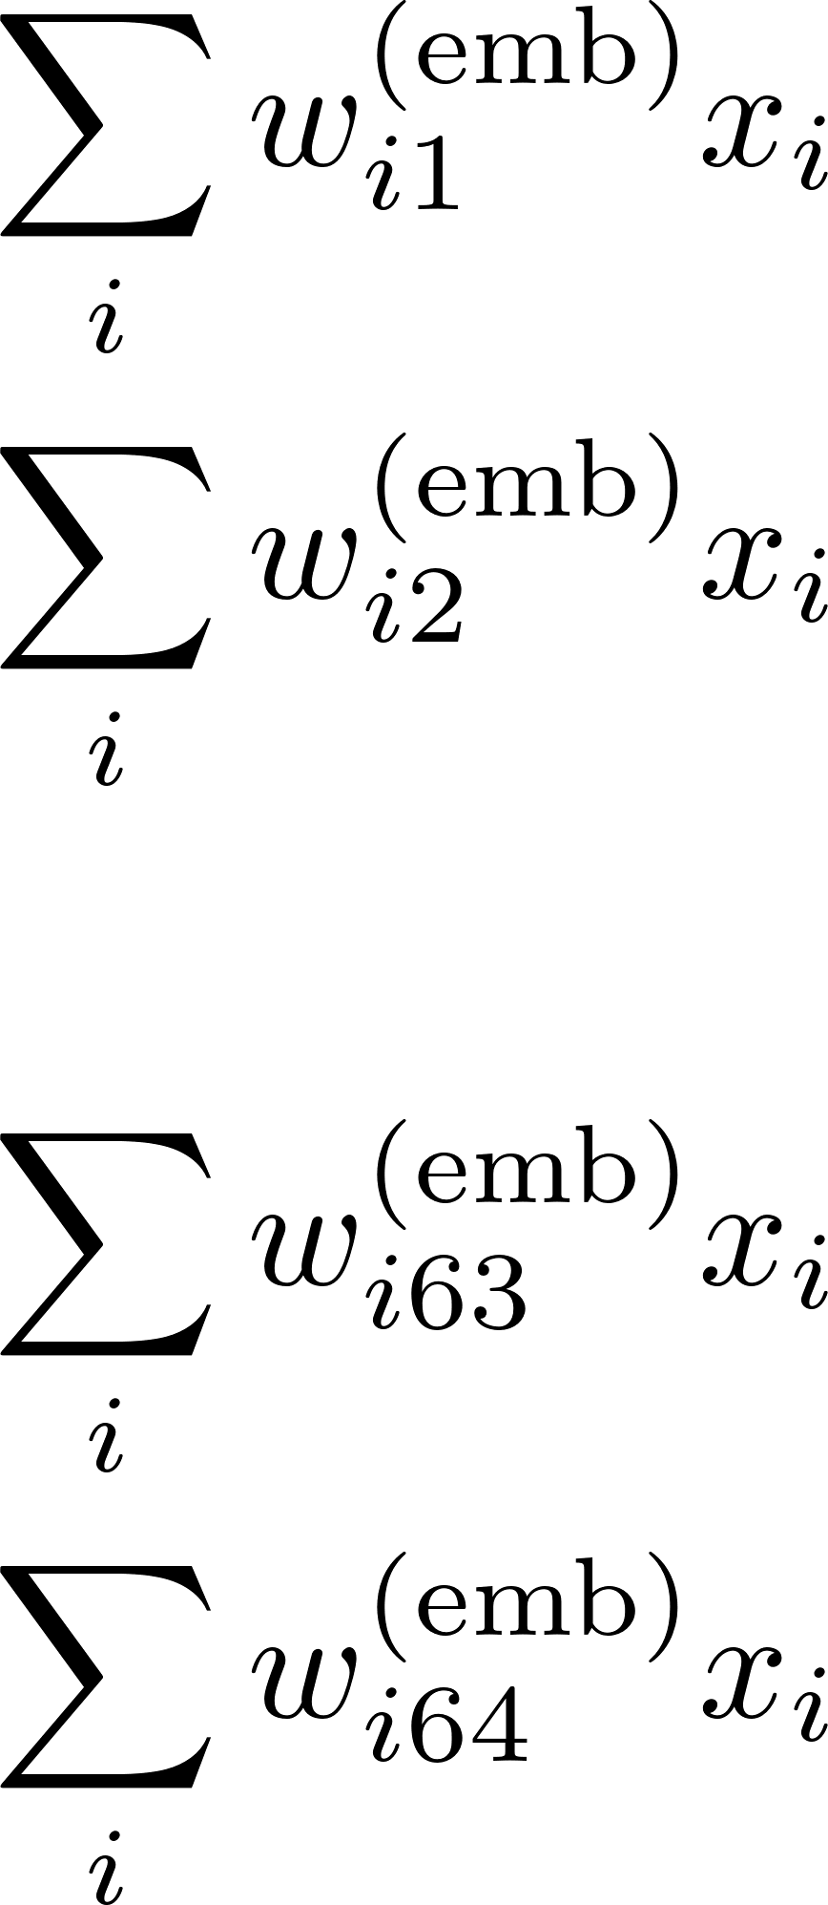
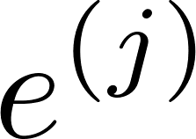
Input
(8000 vocab)
Linear mix
(64 nodes)
Embedding vector
(per word; 64 elements)
Uncle
Aunt
King
Queen
Sketch for 3 embedding dimensions (when there’s really 64, or can be more)
Weights w are N x E = 8000 x 64

Slide 3
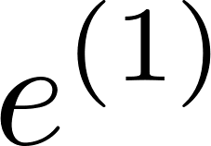
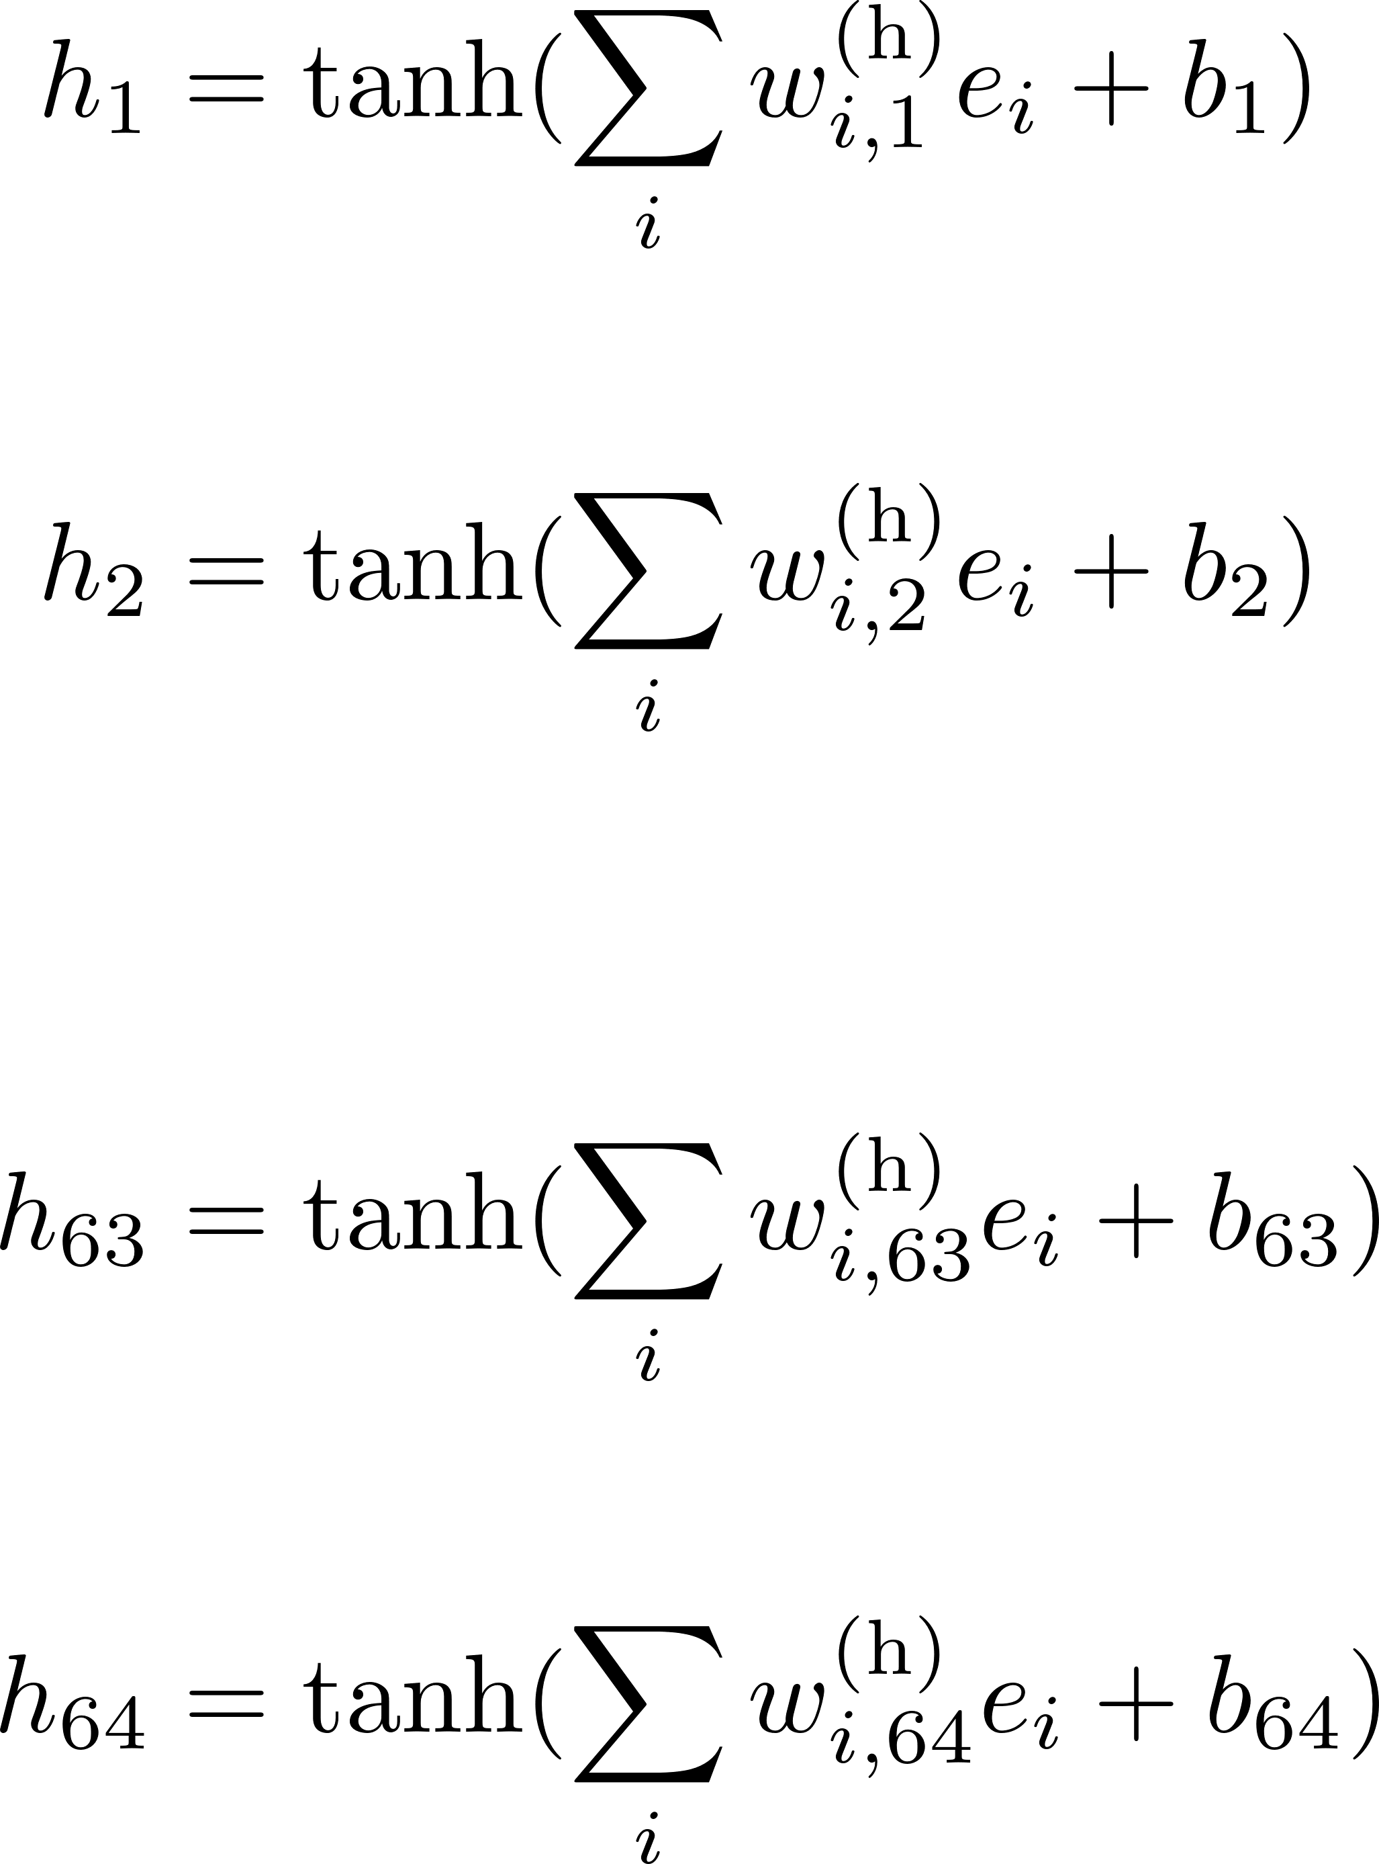
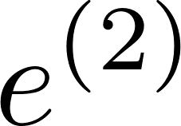
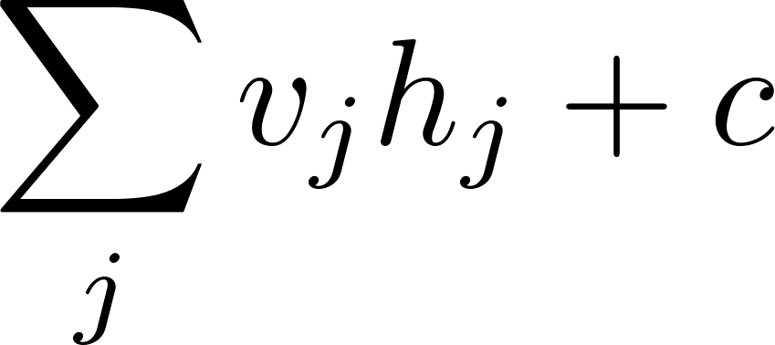
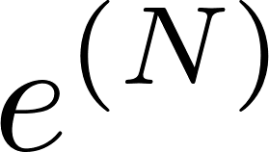
e: Concatenate embedded words
(NxE = 5 x 64 = 320)
Output
Weights w^{h} are E x H where H is the number of hidden nodes. In this case equal to E: (NxE)xH = 5 x 64 x 64

Slide 4
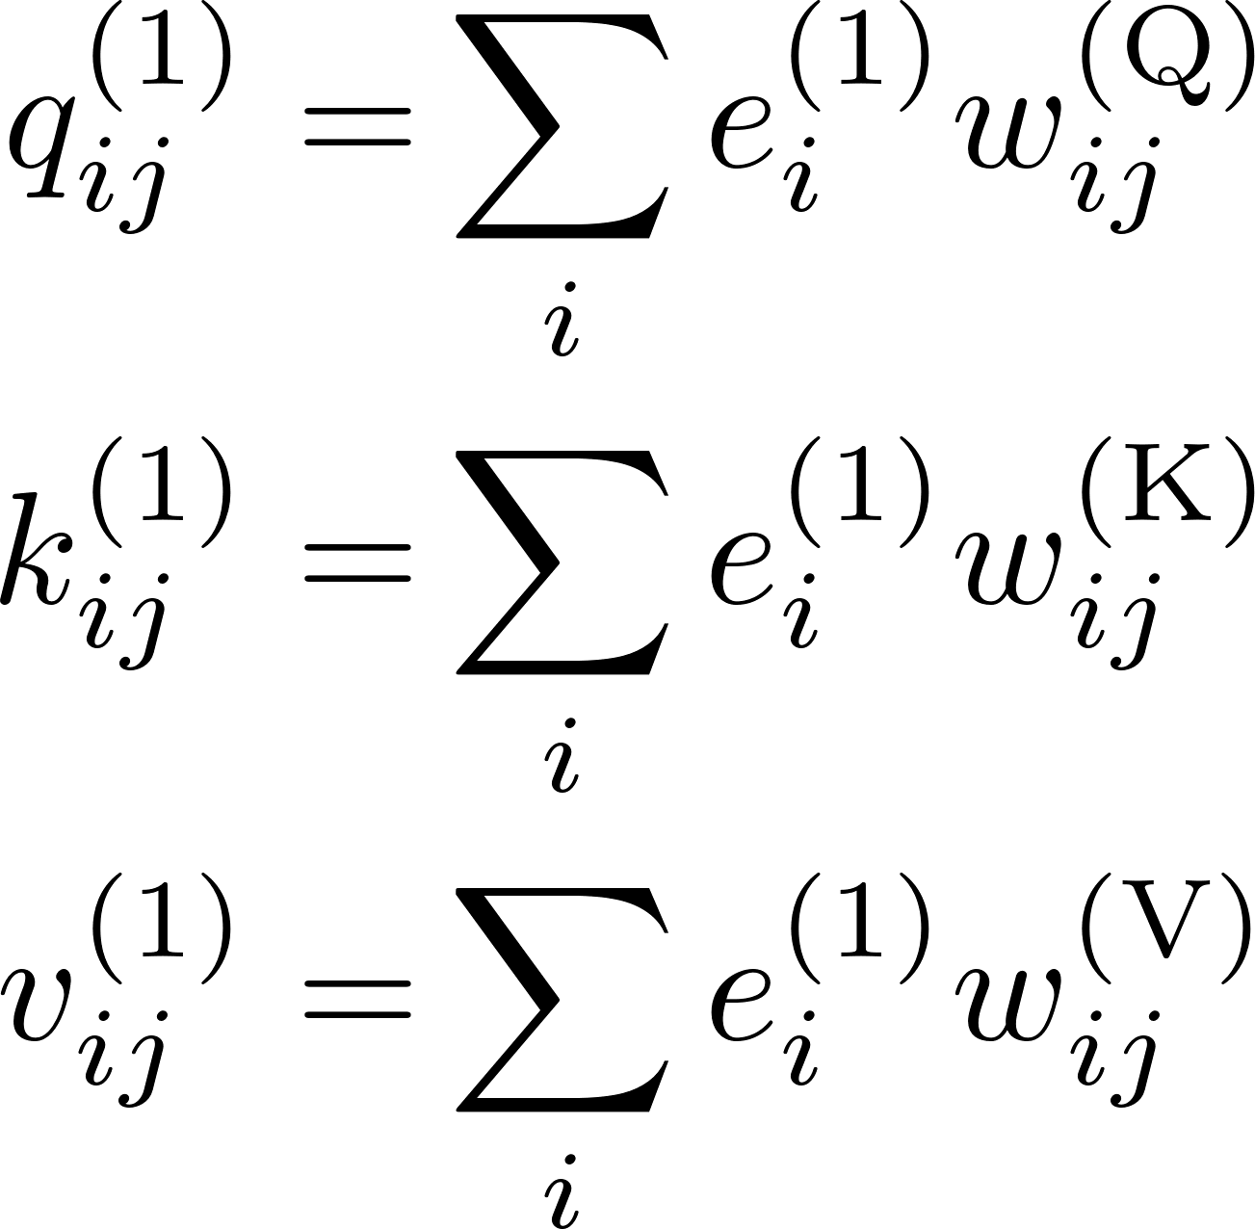
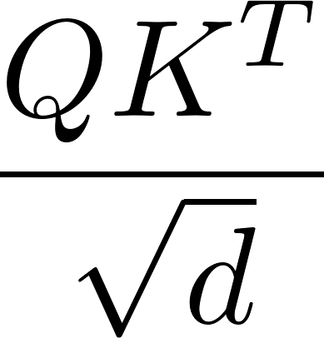
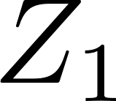

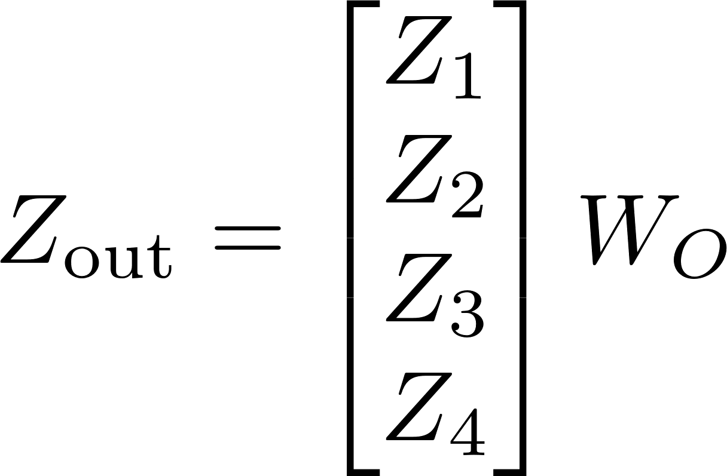
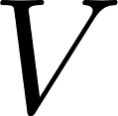
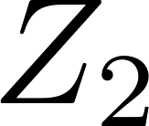
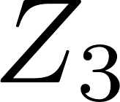
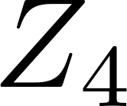
X: stack the N
embedded words (e)
(NxE = 5 x 64)
Each of q,k,v:
one row per word
(Nxd = 5 x 16)
One of h attention heads
(here h=4, and d = E/h = 64/4 = 16)
To another neural layer!
Stacked heads
Output weights, W_{O}
Weights w^{(Q)}, w^{(K)}, w^{(V)} are E x d where d is chosen in training to be E / h and h is the number of ‘heads’ (4 in this example). Note no appearance of N.

Slide 5


