Slide 1
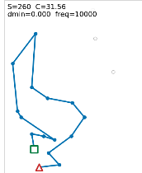
META-HEURISTICS · PROJECT 01
Constructive heuristics
for the Orienteering Problem
Quality, structural diversity, and guided randomization
João Pereira · UFRN · 2026
Notes:
Open by defining the scope: this is Project 01, so the contribution is a controlled comparison of constructive insertion heuristics, not a claim of a state-of-the-art OP solver.
The presentation follows the paper: problem, common framework, experiments, quality, diversity, guided randomization, route structures, and implementation.
Source: Metaheuristics_Report_2_FINAL.tex; route crop from graphs/tsi_2.png.

Slide 2
The route is selective by design
maximize
S(R)
s → selected vertices → t
reward
budget
no repeats
subject to
C(R) ≤ B
NP-hard
Fast feasible solutions matter.
02
Notes:
The Orienteering Problem chooses both which rewarding vertices to visit and in which order. The route starts at s, finishes at t, collects score S(R), and must satisfy the travel budget C(R) ≤ B.
Because OP is NP-hard, the goal here is to build feasible routes quickly. These constructive heuristics do not guarantee optimality.
Source: report Sections 2 and 3; complexity references are Golden et al. (1987) and Vansteenwegen et al. (2011).

Slide 3
Every method changes only one decision
1
enumerate
ΔS(u) = pᵤ
ΔC(i,u,j) = cᵢᵤ + cᵤⱼ − cᵢⱼ
2
score
feasible ⇔ C(R) + ΔC ≤ B
3
insert
4
repeat
Same candidates. Same feasibility. Different selector.
03
Notes:
All methods start from the direct route (s,t). At each iteration, the program evaluates every feasible insertion of an unvisited vertex between consecutive route vertices.
The marginal reward is the inserted vertex score. The marginal cost replaces arc (i,j) with arcs (i,u) and (u,j). Only the selection rule changes; candidate generation and feasibility stay fixed.
This controlled design is what makes the comparison meaningful. Runtime was deliberately not compared because the shared prototype reevaluates complete candidate routes.
Source: report Section 4.1.

Slide 4
The selection rule is the experiment
greedy
lazy
smart
wise
envy
ΔS
−ΔC
ΔS / ΔC
ΔS / ΔC²
ΔS² / ΔC
nonlinear criteria
marginal ↔ total-route formulation
Guided methods sample among strong criteria; pure random samples any feasible insertion.
04
Notes:
The elementary experiment compares five intuitive rules: reward only, cost only, and three nonlinear score-cost ratios.
For smart, wise, and envy, marginal and total-route formulations are not equivalent. That distinction became an explicit part of the experiment.
The guided random methods later sample from marginal-envy, total-envy, and marginal-wise. Pure random insertion is kept as an unrestricted baseline.
Source: report Sections 4.2–4.5.

Slide 5
A large descriptive experiment
89
5,000
1,000
10,000
benchmark instances
runs per method–instance
routes retained for diversity
runs for each route grid
Chao + Tsiligirides
Median score · arc-Jaccard diversity · standard errors
Ryzen 7 5700X · 31.27 GiB · NixOS 26.05 · Rust 1.97.1
Descriptive evidence — no inferential significance test
05
Notes:
The benchmark has 89 classical instances from the Chao and Tsiligirides sets. Each method-instance pair used 5,000 constructions for quality summaries.
Diversity used a uniform reservoir of 1,000 routes from those runs. The qualitative route grids are separate: 10,000 constructions followed by a max-min representative extraction.
The reported analysis is descriptive. Error bars are standard errors across instances; no inferential significance test was performed.
Hardware and software: AMD Ryzen 7 5700X, 31.27 GiB RAM, NixOS 26.05, Rust 1.97.1, Macroquad 0.4.16, rand 0.10.2, crossbeam-channel 0.5.17. Source: report Section 5.1.

Slide 6
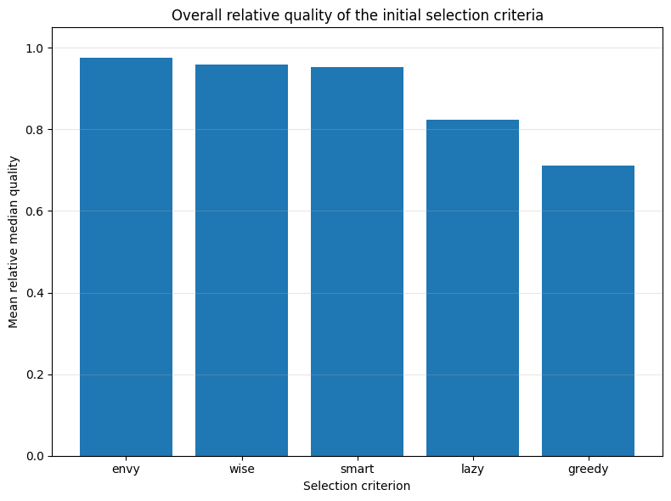
Envy, wise, and smart form the quality tier
TOP TIER
envy
wise
smart
Score-only and cost-only rules leave quality behind.
06
Notes:
Absolute instance scores have different scales, so this chart normalizes each method's median by the best median among the five elementary criteria on the same instance.
Envy ranks first overall, then wise and smart. Lazy and greedy are weaker because each ignores one of the two dimensions: reward or insertion cost.
Source: report Figure 'Mean relative median quality of the five elementary criteria'; graphs/qualidade_simples.png.

Slide 7
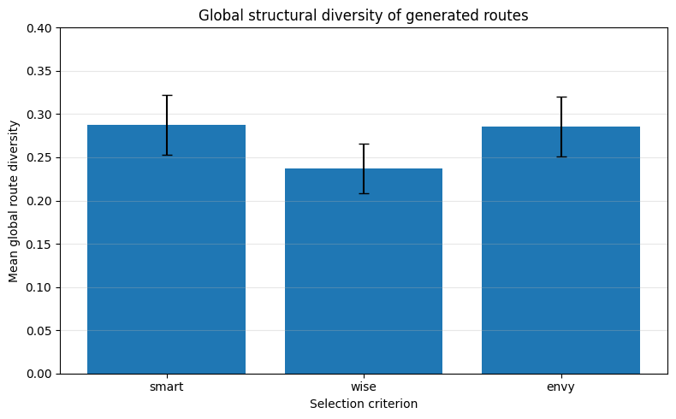
Global spread does not follow quality exactly
≈ 0.29
smart ≈ envy
≈ 0.24
wise
07
Notes:
Global diversity is the average directed-arc Jaccard distance across all route pairs in the retained sample.
Smart and envy have similar global spread, around 0.29, while wise is lower, around 0.24. This already shows that the quality ranking is not a diversity ranking.
Source: report Figure 'Mean global route diversity'; graphs/global_diversity_simple.png.

Slide 8
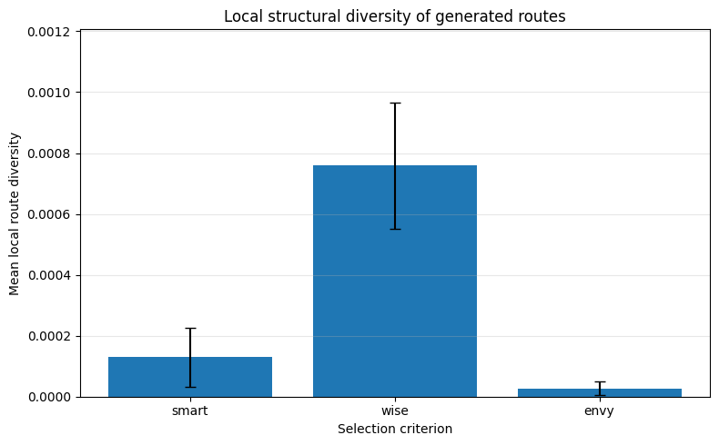
Local neighborhoods reveal a different pattern
WISE
widest local
neighborhoods
local ≠ global
08
Notes:
Local diversity averages the distance from each route to its five nearest neighbors. It measures whether the sample contains tight clusters, not just whether its extremes are far apart.
Wise is much more diverse locally. Smart and especially envy produce clusters of nearly identical routes, even though smart and envy had strong global diversity.
This is why the report defines and interprets global and local diversity separately.
Source: report Figure 'Mean local route diversity'; graphs/diversity_simple.png.

Slide 9
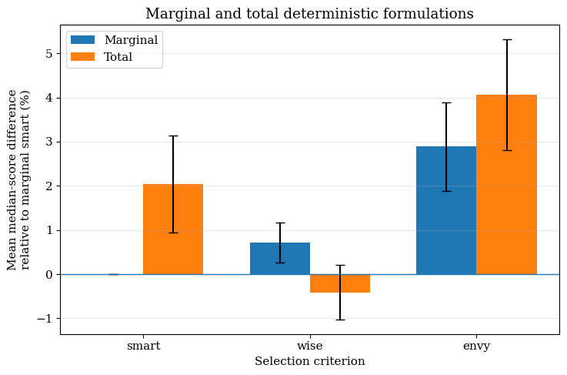
Total-route information helps—selectively
+4.07%
total envy
total smart +2.04%
total wise −0.41%
not universally better
09
Notes:
Marginal-smart is the common reference. Total-envy has the best deterministic mean improvement at 4.07 percent. Marginal-envy gains 2.89 percent, and total-smart gains 2.04 percent.
But total-route information is not automatically superior: total-wise is about 0.41 percent below the marginal-smart reference, while marginal-wise is about 0.72 percent above it.
The result supports naming the exact formulation instead of treating smart, wise, and envy as single rules.
Source: report Figure 'Marginal and total deterministic formulations'; graphs/determinisc_vs_marginal_quality.png.

Slide 10
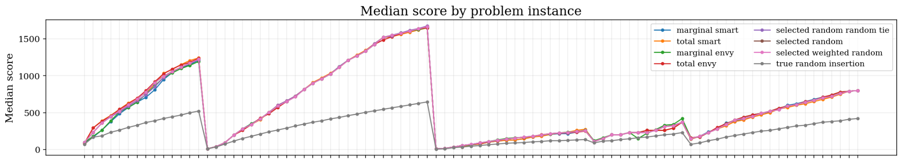
Guided randomization tracks the quality frontier
+3.80%
+3.55–3.80%
−44.17%
best guided method
all guided methods
pure random insertion
10
Notes:
The three guided methods follow the deterministic curves closely across the 89 instances. Their mean improvements over marginal-smart range from 3.55 to 3.80 percent.
Pure random insertion is visibly separated and loses about 44.17 percent in mean median score. Randomness alone is not competitive; the candidate choice still needs guidance.
The x-axis labels were intentionally cropped for presentation readability; the complete by-instance figure remains in the paper.
Source: report Section 5.6 and graphs/randomized_median_by_instance.png.

Slide 11
Guidance expands exploration
quality vs. marginal smart
global diversity retained vs. pure random
best deterministic
+4.07%
30%
guided random
+3.55–3.80%
70%
pure random
−44.17%
100%
Bars summarize the reported ranges: deterministic 28–31%; guided 69–71%.
11
Notes:
This is the main trade-off. The best deterministic result reaches 4.07 percent quality improvement but retains only roughly 28 to 31 percent of pure-random global diversity.
The guided methods stay close in quality, at 3.55 to 3.80 percent, while retaining about 69 to 71 percent of pure-random global diversity.
Pure random defines the diversity reference but pays a very large quality penalty. The conclusion is not 'more randomness is better'; it is 'guided randomness improves exploration efficiently.'
Source: report Section 5.6 and Conclusion. The displayed 30% and 70% bars are rounded visual summaries of the reported ranges.

Slide 12
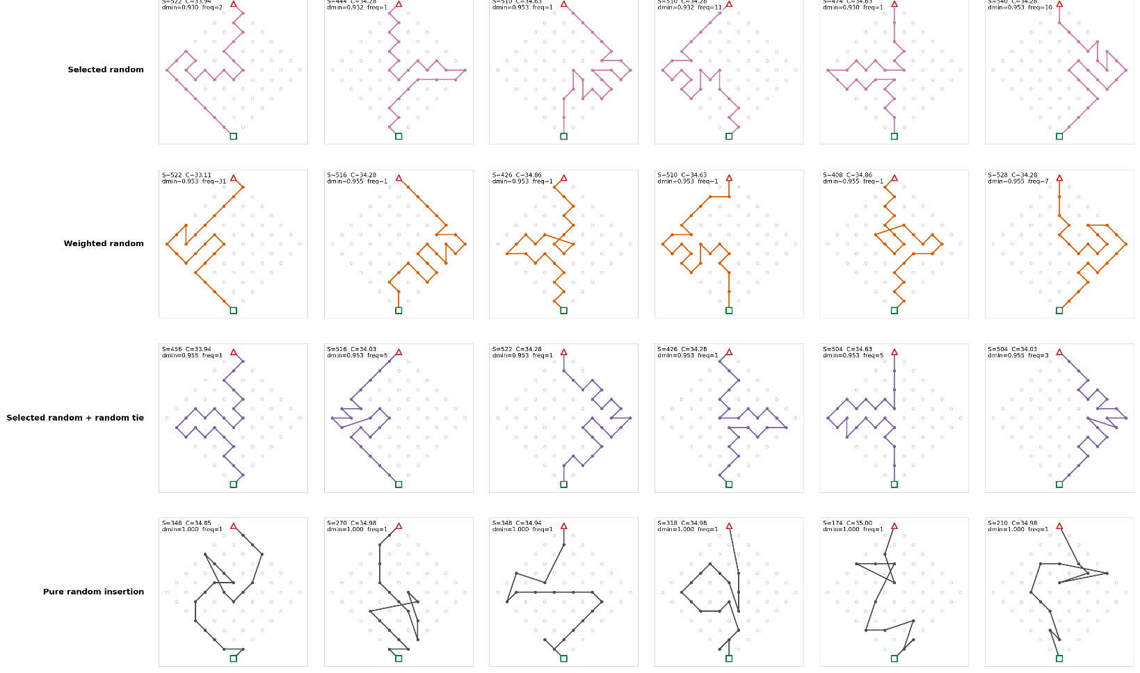
The same method can reach structurally distant routes
12
Notes:
This crop uses the current final-comparison grid for set_64_1_35. It shows the three guided methods and pure-random insertion, each with up to six max-min diverse representatives selected from 10,000 constructions.
The rows make the qualitative result concrete: guided methods explore substantially different arc structures, while preserving much higher scores than pure random.
These grids are diagnostic examples, not the basis for ranking methods. Exact duplicates were merged before the representative extraction.
Source: report Section 5.7 and graphs/64_35.png. Portuguese headers were excluded by cropping; the route evidence itself is unchanged.

Slide 13
TAKEAWAYS
Guided randomness wins the compromise
+4.07%
+3.80%
69–71%
best deterministic
(total envy)
best guided
randomized method
pure-random global
diversity retained
Randomness should expand the search—not replace judgment.
João Pereira · UFRN
Notes:
Close with three results. Total-envy is the strongest deterministic alternative, at approximately 4.07 percent above marginal-smart. The best guided method reaches about 3.80 percent. Guided methods retain about 69 to 71 percent of pure-random global diversity.
The unrestricted random baseline confirms the other side of the trade-off: it is diverse but loses about 44.17 percent in quality.
The practical conclusion is to use randomness to broaden structural exploration while keeping a strong score-cost rule in control.
Source: report Conclusion.

