Slide 1
3D Tic-Tac-Toe
G13: Yash Shah, Nick Toledo, Stephen Lambert, Omar Flores

Slide 2
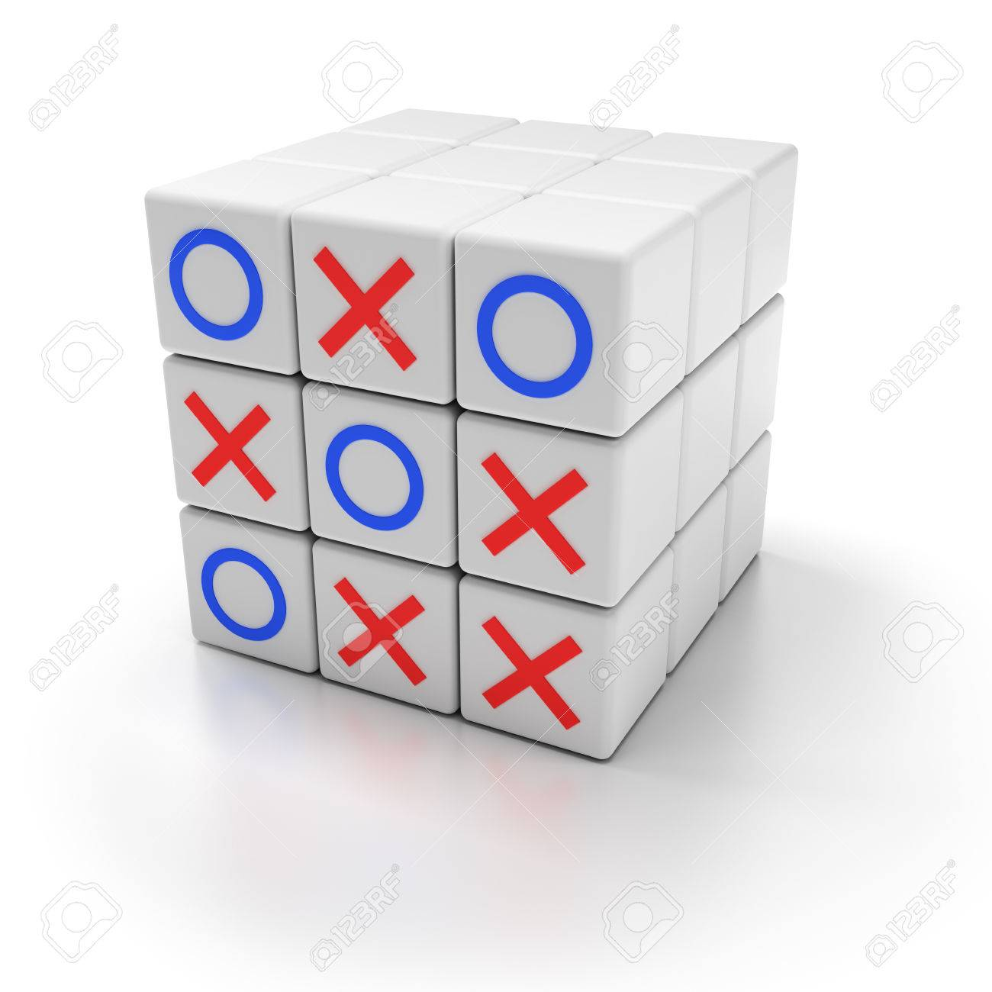
Recap
3D Extension of traditional Tic-Tac-Toe
Rotate cube to access all 6 sides
Connect 3 on any side to win!

Slide 3

Requirements and Design Goals
Allow third party accounts through API’s (Google Play Games, Apple Game Center, Steam)
Allow purchases through third party account API’s
Allow for both online and local play.
Allow for playing Solo, with Friends, or with random players.

Slide 4
Requirements and Design Goals
Want to be able to set AI difficulty for offline games.
We want to update all players in a game when a player places a piece on the board.
Allow players to make microtransactions for themes and cosmetics.

Slide 5
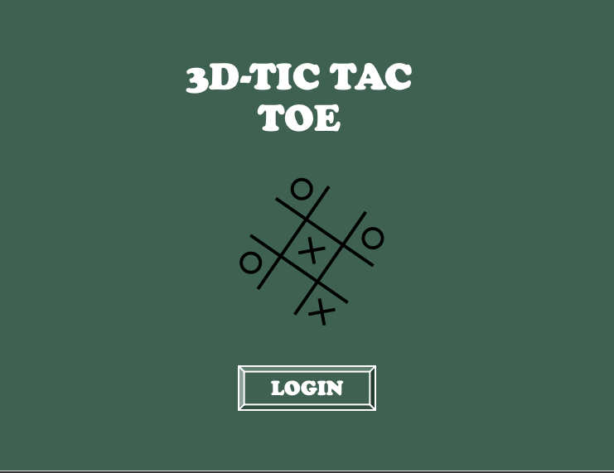
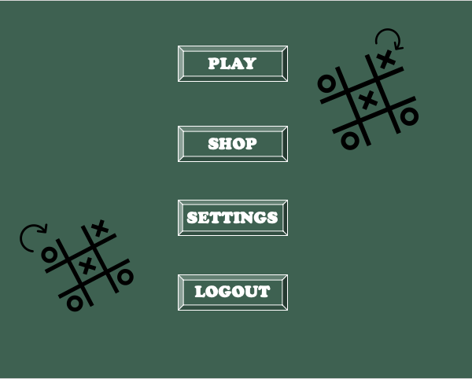
Menu UI

Slide 6
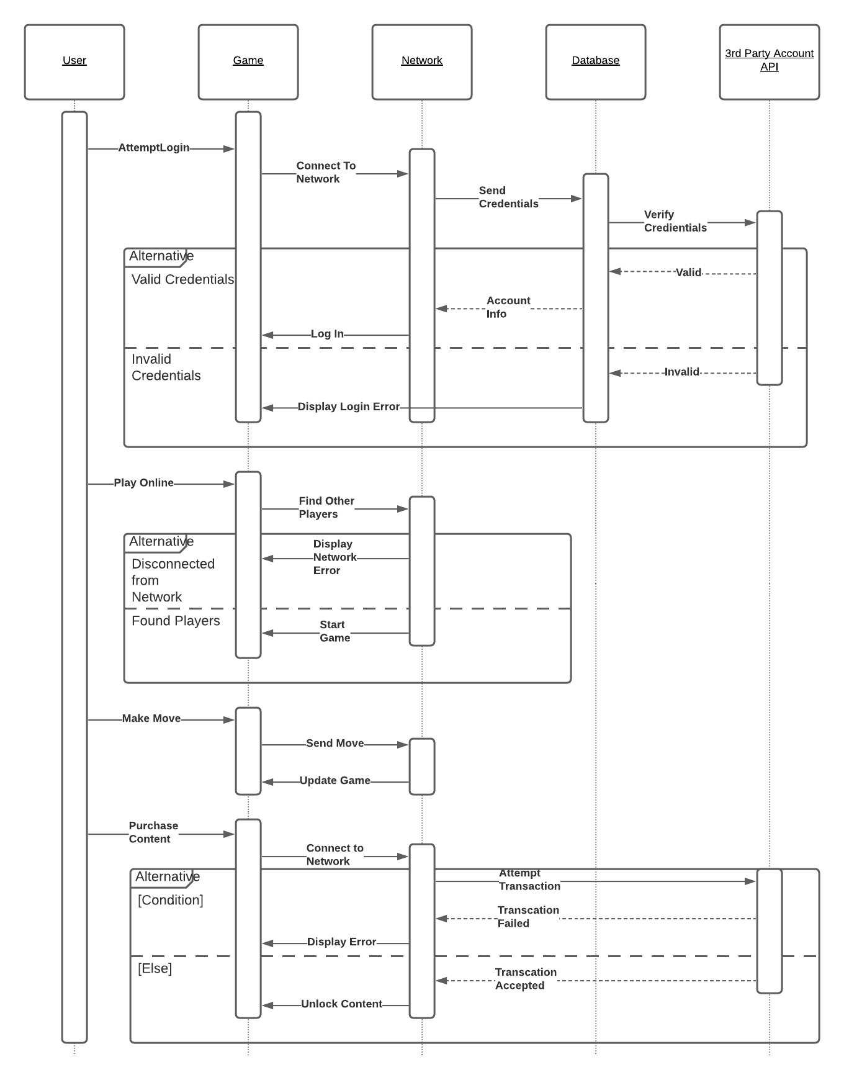
Dynamic Modeling of Use Cases

Slide 7
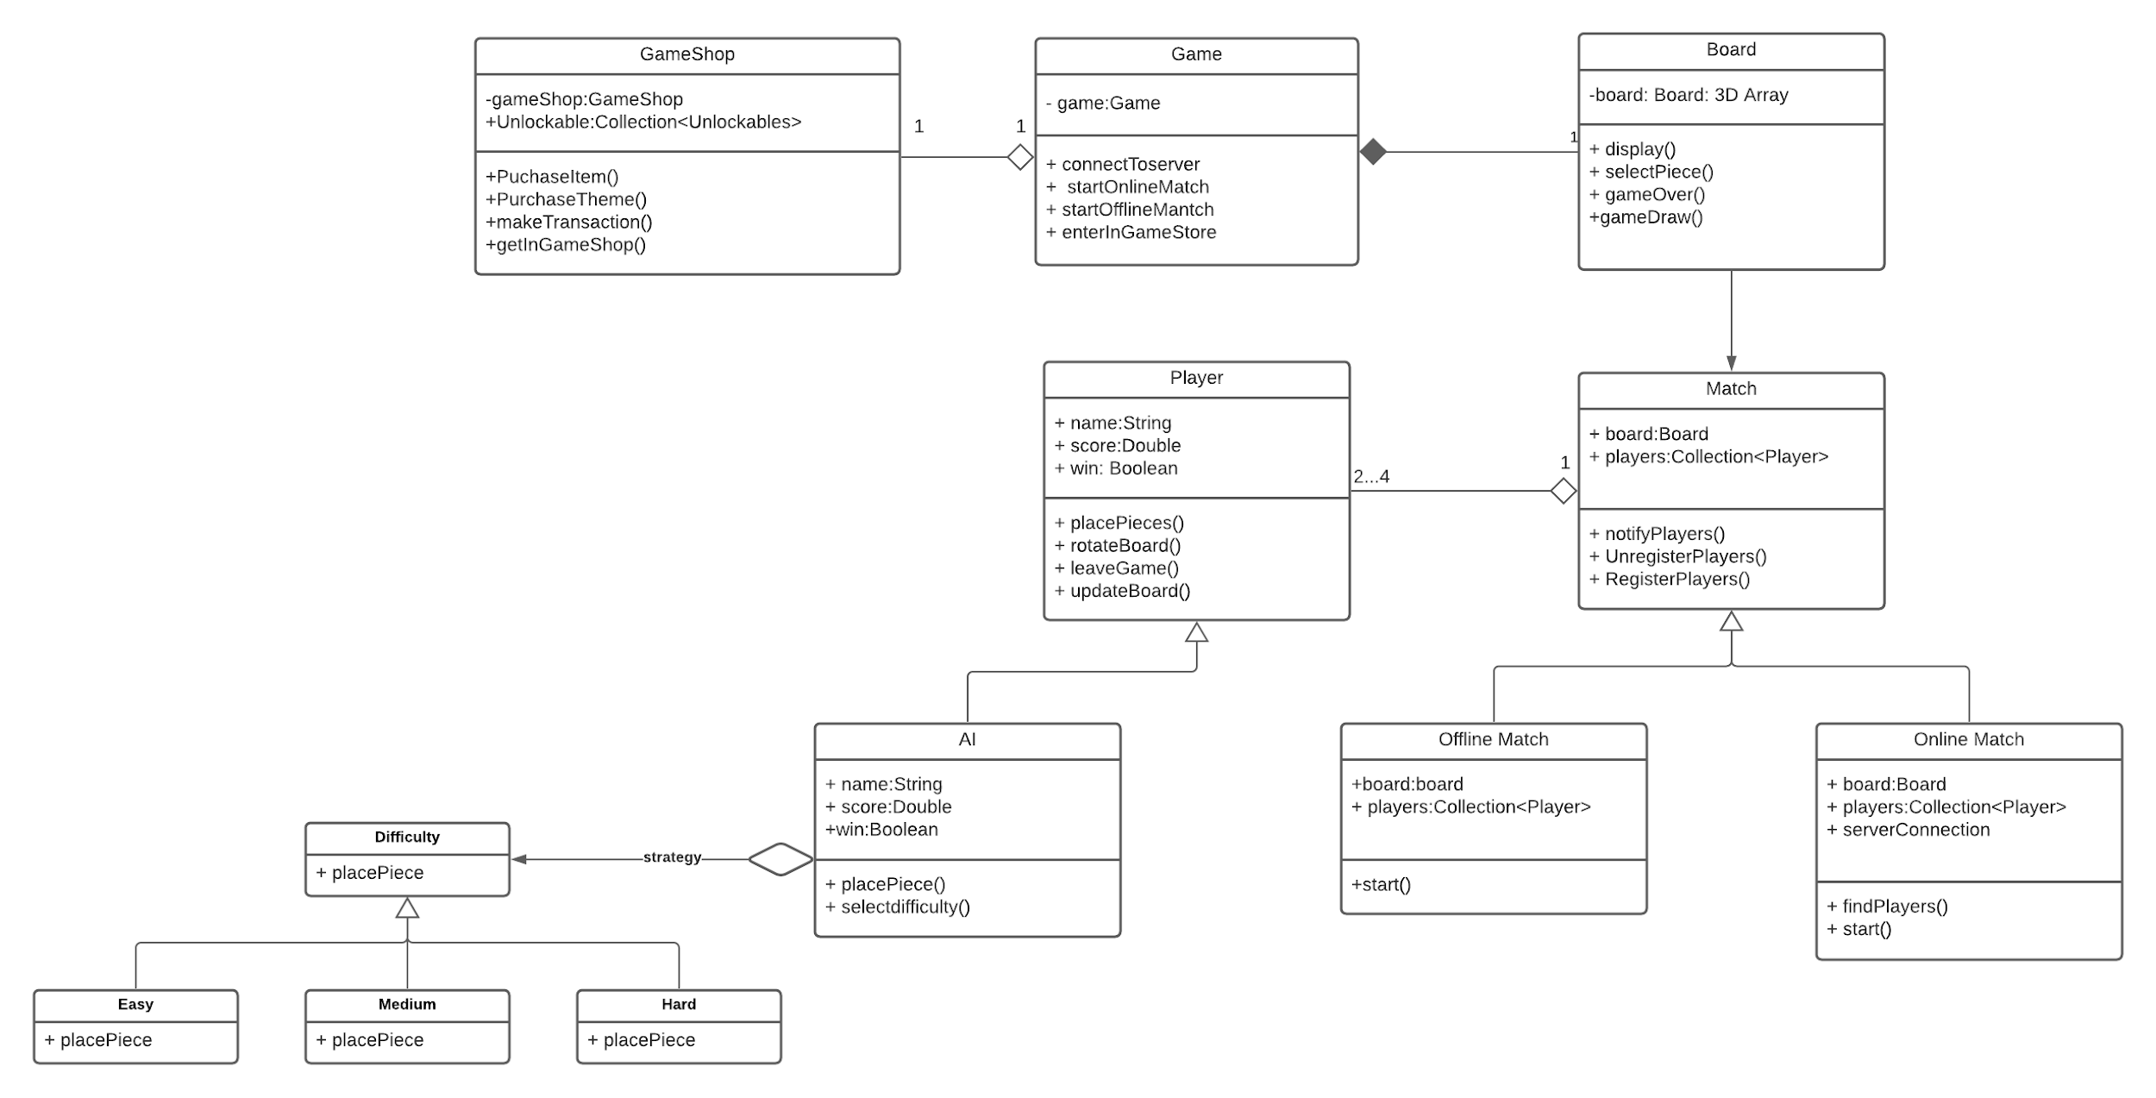
System Design

Slide 8
Design Patterns Used
Singleton
Observer
Strategy

Slide 9
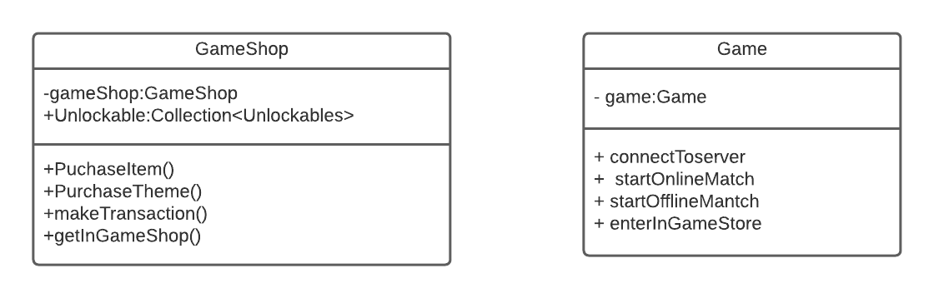
Singleton

Slide 10
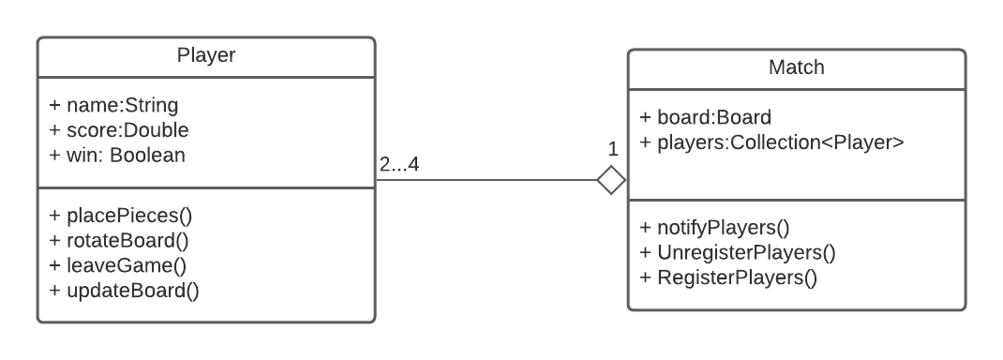
Observer

Slide 11
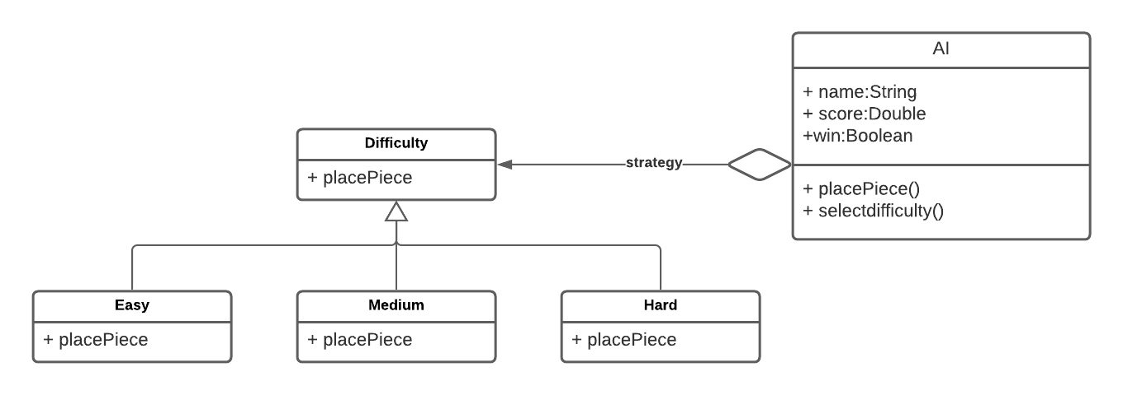
Strategy

Slide 12
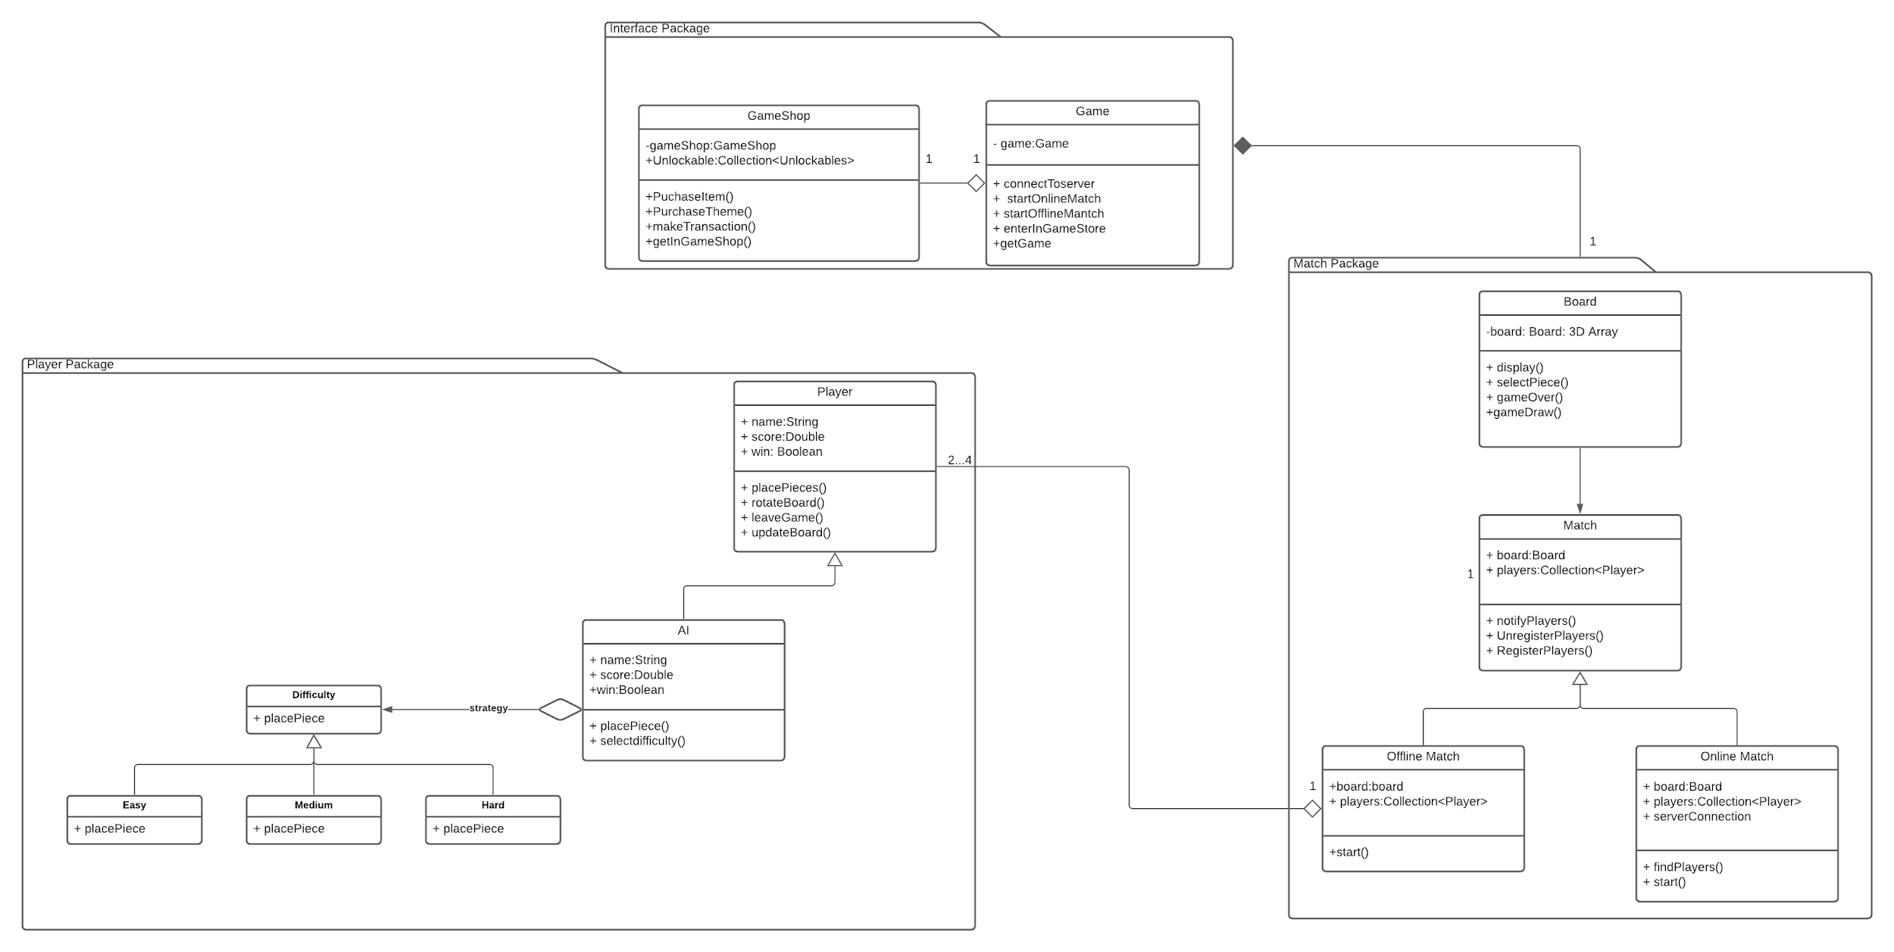
Initial SubSystem Decomposition

Slide 13

Additional Design Considerations?
Blocking Explicit Language
To target younger audiences, there should be language filters in place.
Adding holiday and event themes through updates.
Options for impaired vision users.
Adding chat functionality during matches.

Slide 14

Possible Limitations
Server Congestion
As more players begin to use our application, more servers will need to be added.
Learning Curve
For some demographics there may be a slight learning curve.
Complexity of the game should be kept minimal to avoid losing users.
Budget
Want to stay within $200,000.
Development
Testing
Marketing

