Slide 1
3D Tic-Tac-Toe
By- Yash Shah, Holy Toledough, Stephen Lambert, Omar Flores

Slide 2
Project Description
Multiplayer game available on a PC and a mobile device
Game board designed on a 3x3 cube
Each player can rotate the board in any direction, place their characters, and see a live update of the game
Goal: connect three characters on any side of the board
Designed to be fun for every player and create income for the developers

Slide 3
Purpose
Extend a single player game into a multiplayer game that has multiple dimensions
Create a user friendly application that gives live updates of the gameboard, and detects the top three players

Slide 4
Clients Business
The gaming industry
Allows for creativity and new development projects
The team was inspired by modern video games, and classic childhood games

Slide 5
Goals
Create a new multiplayer and multi dimensional game
Profitable: covering the cost of development and future improvements.

Slide 6
Measurement
Measured using customer reviews, number of downloads, and user activity
Importance: developers determine success, failure, and find ways to improve
Customer reviews shows the developers how the users feel, and if users are happy
User activity shows how many users are playing the game weekly or monthly and if they are most likely to continue playing
Helps developers find ways to keep new and existing users

Slide 7
Facts and Assumptions
Anyone over the age of 3
Users are familiar with using a phone, computer, or tablet

Slide 8
The Scope of the Work
The main purpose of this would be to entertain people on a regular basis and also make an income from this game.

Slide 9
Current Situation
At this very point, there are a couple of ways this product can be revised because it's a 3D game and it can be implemented in multidimensional ways. Even though our group has decided a pattern in which it will be implemented but in the future, there are high chances that the product will be made in an entirely different way.

Slide 10
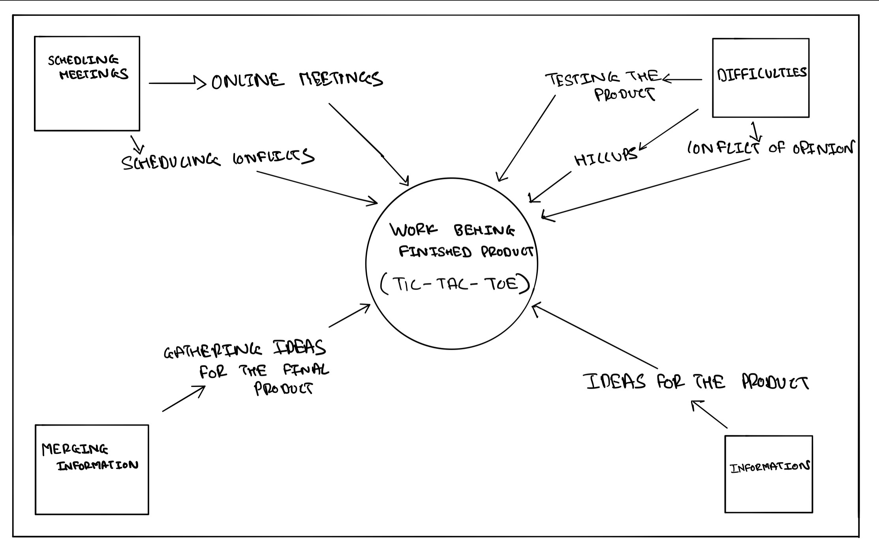
The Context of the Work

Slide 11
Work Partitioning
Event Name | Input and output | Summary
Ideas | Getting ideas of peers (input) | Gathering all the ideas
Working on Product | Applying all the ideas for the product (output) | Testing all the ideas for the development of the final product
Problems in the development phase | Dealing with opinion conflicts and issues (input) | Solving all the issues before the release of the final product

Slide 12
Competing Products
When we think of the direct competitors of the current product, there are no other products like this but the original Tic tac Toe will be the direct competitor to this product. The only shortcoming of this product will be to understand the entire game due to its complicated working methodology.

Slide 13
Scope of the Product
Where?
Internet
Next?
Account creation
Play

Slide 14
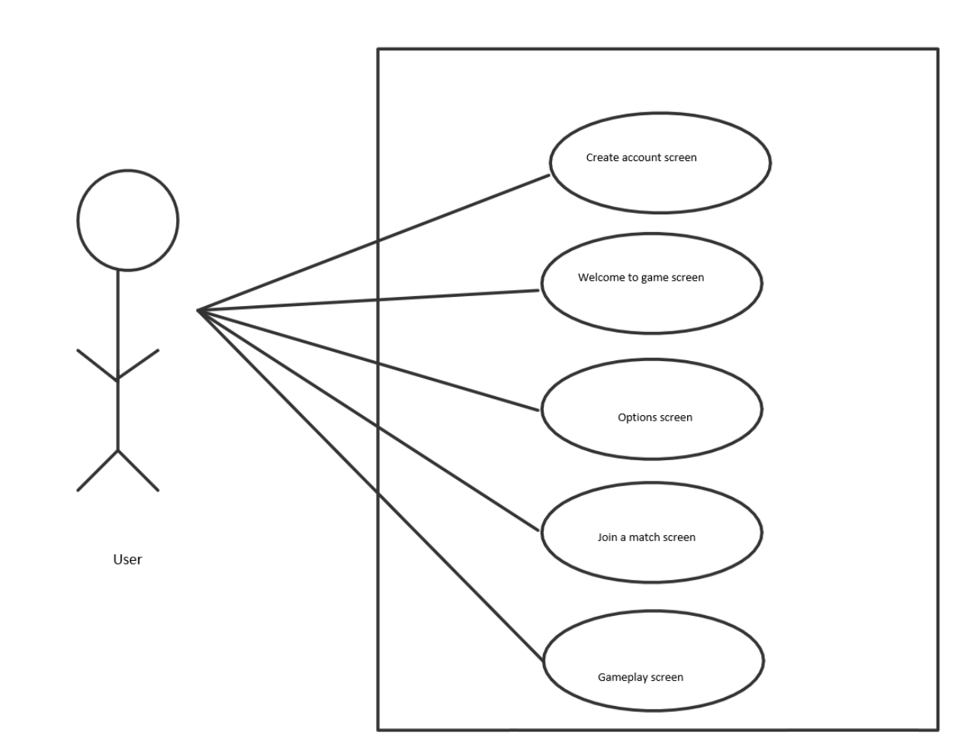

Slide 15
Stakeholders
Clients ?
Us
Stakeholders/Investors
Customer ?
Gamers
Strategic enthusiasts

Slide 16
Hands-On Users of Product
Gamers
Anyone with access to online

Slide 17
Maintenance Users & Service Technicians
Service Administrators
Game Developers
Software Developers

Slide 18
Other Stakeholders
Testers
Marketing Experts
Business Analysts

Slide 19
User Participation
Beta
Feedback

Slide 20
Different Users
Key Users
Gamers
Secondary Users
Strategic Enthusiasts
Older audience
Unimportant
Children

Slide 21
Constraints
Product will...
Be designed to run on average mobile specs.
Designed for both IOS and Android devices.
Target the most forward compatibility for mobile OS versions.
Should be released ….
Before any major mobile updates.

Slide 22
Collaborative Applications & Off-The-Shelf Software
Mobile
Allows the use of Google and Apple accounts.
Connects to Google Play Games and Apple Game Center to play with friends and track achievements.
PC
Utilize pre-existing Steam platform to allow users to save game data, interact with pre-existing friends lists, and track achievements.

Slide 23
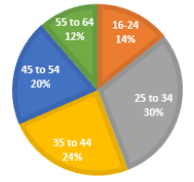
Anticipated Workplace Environment
Mobile version will be able to used in both loud and quiet environments, will allow for both audio and visual game cues.
Application will be targeting all age demographics, so the interface and mechanics should be easy enough to casually played by older audiences as well as children.

Slide 24
Budget Constraints
We are asking for $400,000
Why?
Development - Initial game as well as additional content to keep consumers engaged.
App Testing - Gamers have little tolerance for bugs.
Marketing - Increase visibility and ranking on App stores in order to reach a large audience.

