Slide 1
Zombie Dash Group 13
Demo: Nick Toledo, Omar Flores, Stephen Lambert, Yash Shah
Originally Developed by: Spring 2019 Group 14

Slide 2
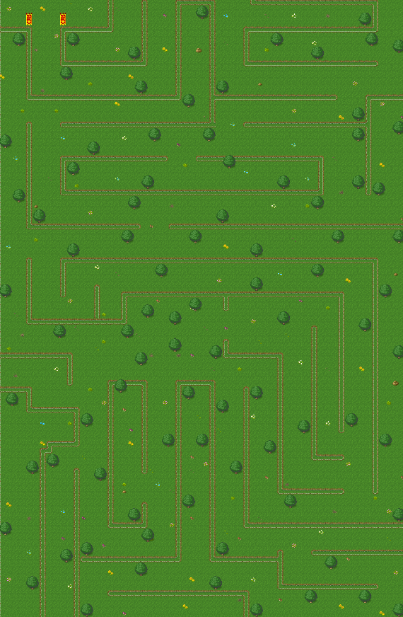
Abstract
Zombie Dash is a survival game with puzzle elements which are implemented in the form of a different mazes as the map.
The main aim of this game is to find an exit after entering the map and before time runs out, the individual should also try to avoid or kill the zombies and find an exit within the time limit by staying alive.

Slide 3
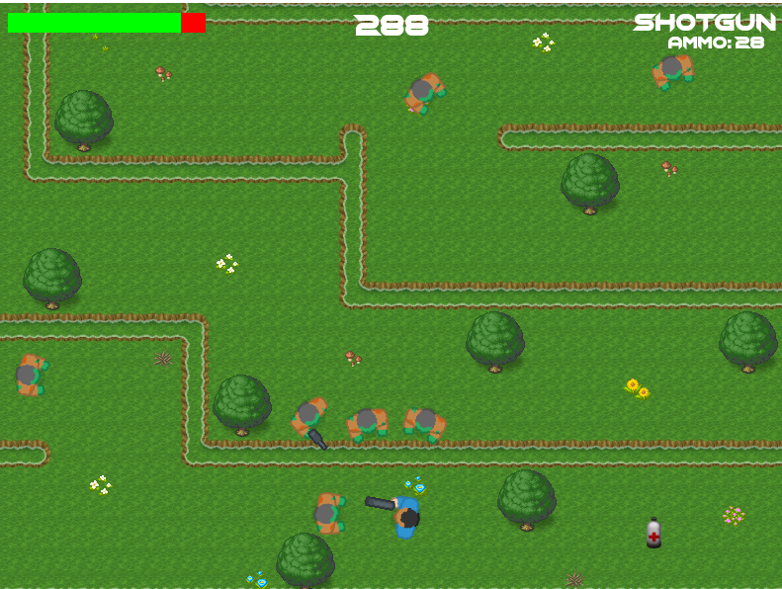
Gameplay
When playing the game, Different kind of guns can be equipped to the player while playing and the ammo will be limited in every gameplay.
Each gameplay will be time restricted and will also be played with a health limit in which if the player loses all of the health, the player will die and the game will end.
The player can also change characters from the shop so the player can have different clothes.

Slide 4
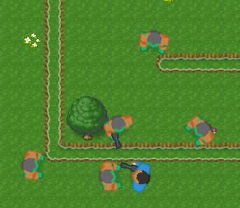
Zombies
Zombies spawn at different coordinates of the map
Zombies’ movement speed is random
Zombies may spawn with weapon or not
Zombies have 30 health damage box
Zombies detect player
Near zombies, they’ll start following the player
Move far enough and the zombies will stop following
If the zombie was shot, they’ll always follow the player

Slide 5
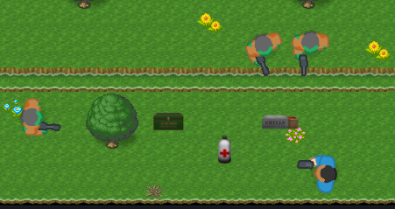
Random Item Drops
Killing Zombies May Drop:
Weapon ammunition
Machine gun or Shotgun ammo
Health Packages
Health can only be used when injured

Slide 6



Energy System
Playing the game cost energy, but players can gain energy in the game by watching ads, or by purchasing energy from the shop.

Slide 7
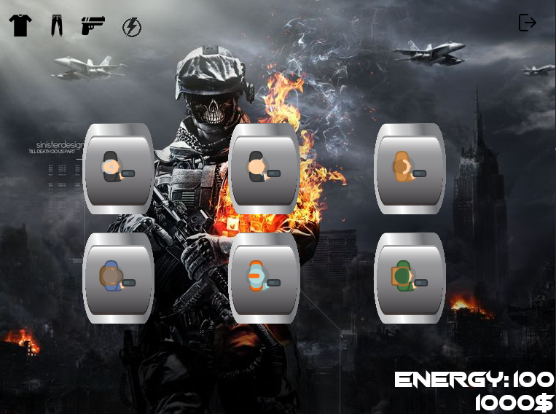
Revenue
Developers can gain revenue in this game from the the in game shop.
In the shop players can purchase characters to play as, also players can purchase energy instead of watching ads.
Developers can also gain revenue by showing unskippable ads.

Slide 8

Gameplay Video

