Slide 1
資訊安全架構NIST CSF 與MITRE D3FEND
姓名:董宸維
學號:A100E111
指導教授:偉大恩師曾龍大大
https://csrc.nist.gov/pubs/cswp/29/the-nist-cybersecurity-framework-20/ipd

Slide 2
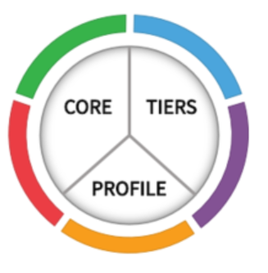
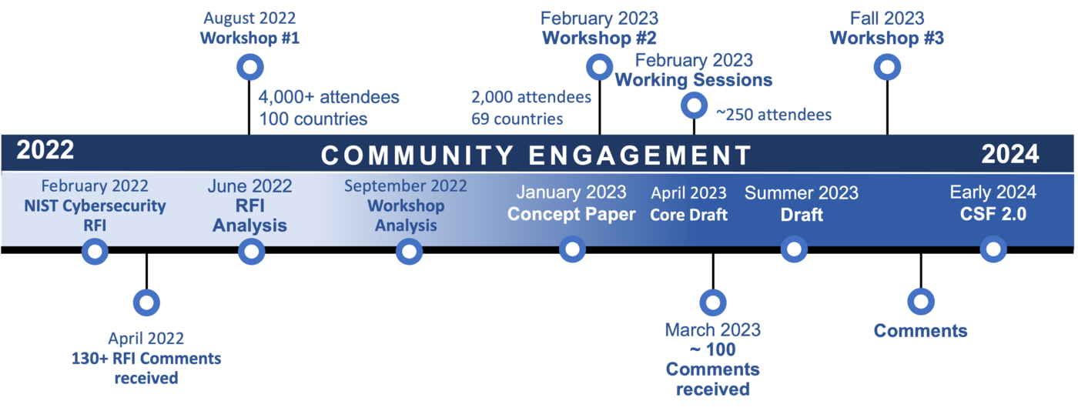
NIST CSF(Cybersecurity Framework)
NIST 是美國商務部的國家標準與技術研究所。
NIST CSF可幫助各種規模的企業更好地理解、管理和降低其​​網絡安全風險，並保護其網路和資料。
NIST CSF為企業提供最佳實踐大綱，幫助決定將時間和金錢用於網絡安全保護。
1.框架核心 (Framework Core) | 使用易於理解的通用語言提供了一組所需的網絡安全活動和結果。 核心指導組織以補充組織現有網絡安全和風險管理流程的方式管理和降低其​​網絡安全風險。
2.框架設定檔 (Framework Profile) | Framework Profiles are an organization’s unique alignment of their organizational requirements and objectives, risk appetite, and resources against the desired outcomes of the Framework Core. Profiles are primarily used to identify and prioritize opportunities for improving cybersecurity at an organization. 設定檔主要用於識別和優先考慮改善組織網絡安全的機會。
3.實施層級 (Implementation Tiers) | 框架實施層通過提供有關組織如何看待網絡安全風險管理的背景來幫助組織。Tiers 指導組織考慮其網絡安全計劃的適當嚴格程度，並且通常用作討論風險偏好、任務優先級和預算的溝通工具。
https://csrc.nist.gov/pubs/cswp/29/the-nist-cybersecurity-framework-20/ipd
https://www.nist.gov/cyberframework/framework

Slide 3
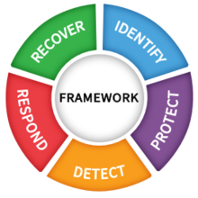
NIST CSF(Cybersecurity Framework)1.1
框架核心包含識別(Identify)、保護(Protect)、偵測(Detect)、回應(Respond)及復原(Recover)5大功能面向。
這5大功能面向，主要是針對企業遭受攻擊的各個階段，也就是事前(識別與防禦)、事中(偵測)，以及事後(因應與復原)，所需採取的措施，進行探討
功能 | 識別(Identify) | 保護(Protect) | 偵測(Detect) | 回應(Respond) | 復原(Recover)
類別 | 資產管理 營運環境Business Environment (ID.BE) 治理Governance (ID.GV) 風險評估 Risk Assessment (ID.RA) 風險管理策略 Risk Management Strategy (ID.RM) 供應鏈的風險管理Supply Chain Risk Management | 存取控制 認知與教育訓練 資料安全 資料保護與程式 維護 防護技術 | 異常與事件 持續性的安全監控 檢測流程 | 回應計畫 溝通 分析 緩解 改善 | 復原計畫 改善 溝通

Slide 4
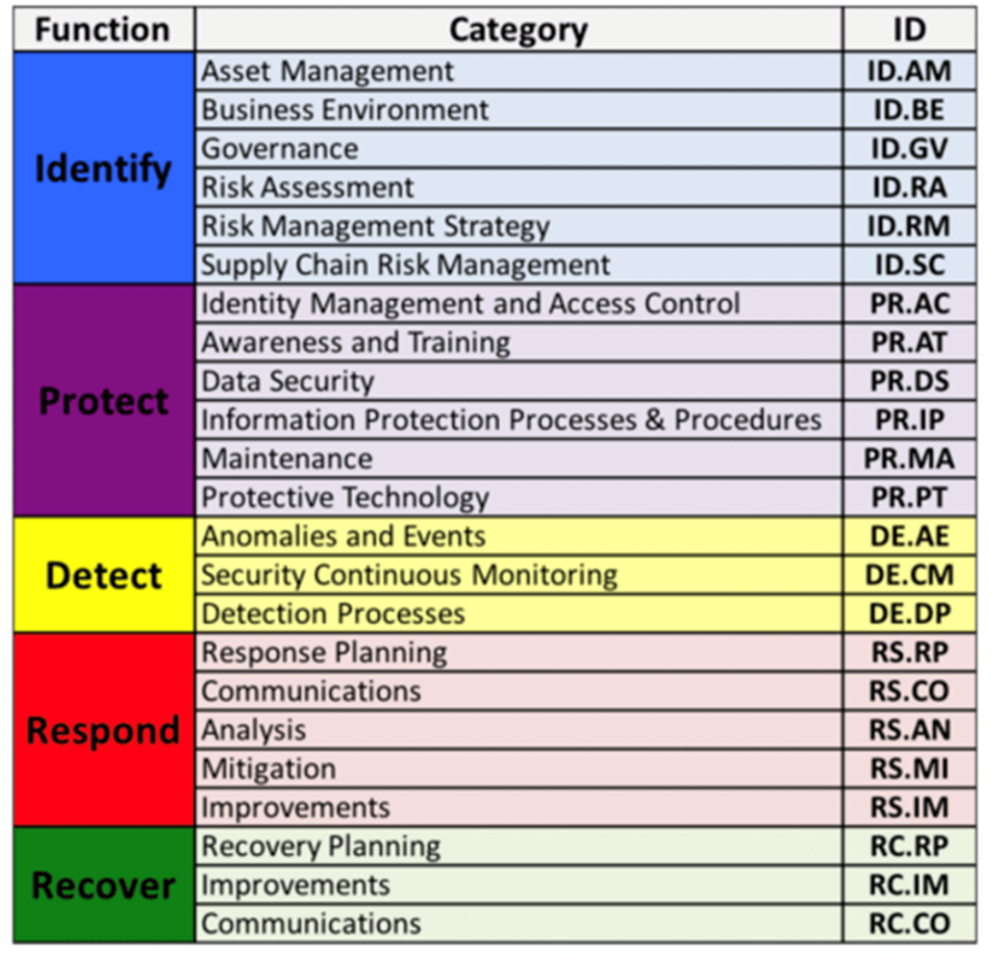

Slide 5
功能 1:識別(Identify) ID
識別(Identify) ID
資產管理 Asset Management (ID.AM): | The data, personnel, devices, systems, and facilities that enable the organization to achieve business purposes are identified and managed consistent with their relative importance to organizational objectives and the organization’s risk strategy.
生產力環境 Business Environment (ID.BE) | The organization’s mission, objectives, stakeholders, and activities are understood and prioritized; this information is used to inform cybersecurity roles, responsibilities, and risk management decisions.
治理 Governance ID.GV | The policies, procedures, and processes to manage and monitor the organization’s regulatory, legal, risk, environmental, and operational requirements are understood and inform the management of cybersecurity risk.
風險評估 Risk Assessment ID.RA | The organization understands the cybersecurity risk to organizational operations (including mission, functions, image, or reputation), organizational assets, and individuals.
ID.RM 風險管理策略 Risk Management Strategy | The organization’s priorities, constraints, risk tolerances, and assumptions are established and used to support operational risk decisions.
ID.SC 供應鏈的風險管理 Supply Chain Risk Management | The organization’s priorities, constraints, risk tolerances, and assumptions are established and used to support risk decisions associated with managing supply chain risk. The organization has established and implemented the processes to identify, assess and manage supply chain risks.
以及

Slide 6
資產管理Asset Management(ID.AM): 子項目Subcategory | Informative References
ID.AM-1: Physical devices and systems within the organization are inventoried 組織的實體設備和系統已清點 實體裝置的清查 | · CIS CSC 1
 | · COBIT 5 BAI09.01, BAI09.02
 | · ISA 62443-2-1:2009 4.2.3.4
 | · ISA 62443-3-3:2013 SR 7.8
 | · ISO/IEC 27001:2013 A.8.1.1, A.8.1.2
 | · NIST SP 800-53 Rev. 4 CM-8, PM-5
ID.AM-2: Software platforms and applications within the organization are inventoried 清點組織的軟件平臺和應用程式 軟體平臺與應用程式的盤點 | · CIS CSC 2
 | · COBIT 5 BAI09.01, BAI09.02, BAI09.05
 | · ISA 62443-2-1:2009 4.2.3.4
 | · ISA 62443-3-3:2013 SR 7.8
 | · ISO/IEC 27001:2013 A.8.1.1,A.8.1.2, A.12.5.1
 | · NIST SP 800-53 Rev. 4 CM-8, PM-5
ID.AM-3: Organizational communication and data flows are mapped 組織通信和資料流已映射|對應 資料流量的管理 | · CIS CSC 12
 | · COBIT 5 DSS05.02
 | · ISA 62443-2-1:2009 4.2.3.4
 | · ISO/IEC 27001:2013 A.13.2.1, Information Transfer Policies and Procedures A.13.2.2 Agreements on Information Transfer
 | · NIST SP 800-53 Rev. 4 AC-4, CA-3, CA-9, PL-8
ID.AM-4: External information systems are catalogued 外部資訊系統被編目 資訊系統編目列管 | · CIS CSC 12
 | · COBIT 5 APO02.02, APO10.04, DSS01.02
 | · ISO/IEC 27001:2013 A.11.2.6 Security of Equipment and Assets Off-Premises
 | · NIST SP 800-53 Rev. 4 AC-20, SA-9
ID.AM-5: Resources (e.g., hardware, devices, data, time, personnel, and software) are prioritized based on their classification, criticality, and business value資源調度的優先順序 資源須根據其分類、關鍵性和業務價值進行優先級排序 | · CIS CSC 13, 14
 | · COBIT 5 APO03.03, APO03.04, APO12.01, BAI04.02, BAI09.02
 | · ISA 62443-2-1:2009 4.2.3.6
 | · ISO/IEC 27001:2013 A.8.2.1 Classification of Information
 | · NIST SP 800-53 Rev. 4 CP-2, RA-2, SA-14, SC-6
ID.AM-6: Cybersecurity roles and responsibilities for the entire workforce and third-party stakeholders (e.g., suppliers, customers, partners) are established 與外部合作夥伴之間的所扮演的資安任務 為全體員工和協力廠商利益相關者（例如，供應商、客戶、合作夥伴）建置其網絡安全角色和責任 | · CIS CSC 17, 19
 | · COBIT 5 APO01.02, APO07.06, APO13.01, DSS06.03
 | · ISA 62443-2-1:2009 4.3.2.3.3
 | · ISO/IEC 27001:2013 A.6.1.1 Information Security Roles & Responsibilities
 | · NIST SP 800-53 Rev. 4 CP-2, PS-7, PM-11

Slide 7
資產管理Asset Management(ID.AM): 子項目Subcategory
子項目Subcategory | Informative References
ID.AM-1: Physical devices and systems within the organization are inventoried 組織的實體設備和系統已清點 實體裝置的清查 | · CIS CSC 1
 | · COBIT 5 BAI09.01, BAI09.02
 | · ISA 62443-2-1:2009 4.2.3.4
 | · ISA 62443-3-3:2013 SR 7.8
 | · ISO/IEC 27001:2013 A.8.1.1, A.8.1.2
 | · NIST SP 800-53 Rev. 4 CM-8, PM-5
ISO/IEC 27001: 2013 A.8.1.1 Inventory of Assets 資產清冊
與資訊和資訊處理設施相關的任何資產都需要在整個生命週期內進行識別和管理，並始終保持最新狀態。
必須對這些資產進行登記或盤點，根據其重要性顯示如何管理和控制這些資產（這也與下面的信息分類完全吻合）。
資訊的生命週期通常包括創建、處理、存儲、傳輸、刪除和銷毀階段。
瞭解如何制定 ISO 27001 資產清單
閱讀以 ISO 27001 方式管理您的資訊資產
瞭解 ISO 27001 在 ISMS.online 中進行資產盤點的綜合方法
https://www.isms.online/iso-27001/annex-a-8-asset-management/

Slide 8
資產管理Asset Management(ID.AM): 子項目Subcategory
子項目Subcategory | Informative References
ID.AM-1: Physical devices and systems within the organization are inventoried 組織的實體設備和系統已清點 實體裝置的清查 | · CIS CSC 1
 | · COBIT 5 BAI09.01, BAI09.02
 | · ISA 62443-2-1:2009 4.2.3.4
 | · ISA 62443-3-3:2013 SR 7.8
 | · ISO/IEC 27001:2013 A.8.1.1, A.8.1.2
 | · NIST SP 800-53 Rev. 4 CM-8, PM-5
ISO/IEC 27001: 2013 A.8.1.2 Ownership of Assets資產擁有者
所有資訊資產都必須有擁有者。資產管理擁有權也可以與法定擁有權不同，並且可以在個人、部門或其他實體進行。創建資產時應分配擁有權。
資產擁有者負責在資產的整個生命週期內對資產進行有效管理。他們也可以委託管理，只要兩者都有記錄，擁有權就可以在該生命週期內發生變化。
https://www.isms.online/iso-27001/annex-a-8-asset-management/

Slide 9
生產力環境 Business Environment (ID.BE)
ID.BE-1: The organization’s role in the supply chain is identified and communicated
ID.BE-2: The organization’s place in critical infrastructure and its industry sector is identified and communicated
ID.BE-3: Priorities for organizational mission, objectives, and activities are established and communicated
ID.BE-4: Dependencies and critical functions for delivery of critical services are established
ID.BE-5: Resilience requirements to support delivery of critical services are established for all operating states (e.g. under duress/attack, during recovery, normal operations)

Slide 10
治理 GovernanceID.GV
ID.GV-1: Organizational cybersecurity policy is established and communicated
ID.GV-2: Cybersecurity roles and responsibilities are coordinated and aligned with internal roles and external partners
ID.GV-3: Legal and regulatory requirements regarding cybersecurity, including privacy and civil liberties obligations, are understood and managed
ID.GV-4: Governance and risk management processes address cybersecurity risks

Slide 11
風險評估Risk Assessment (ID.RA)
風險評估Risk Assessment (ID.RA): The organization understands the cybersecurity risk to organizational operations (including mission, functions, image, or reputation), organizational assets, and individuals.
ID.RA-1: Asset vulnerabilities are identified and documented | · CIS CSC 4
 | · COBIT 5 APO12.01, APO12.02, APO12.03, APO12.04, DSS05.01, DSS05.02
 | · ISA 62443-2-1:2009 4.2.3, 4.2.3.7, 4.2.3.9, 4.2.3.12
 | · ISO/IEC 27001:2013 A.12.6.1, A.18.2.3
 | · NIST SP 800-53 Rev. 4 CA-2, CA-7, CA-8, RA-3, RA-5, SA-5, SA-11, SI-2, SI-4, SI-5
ID.RA-2: Cyber threat intelligence is received from information sharing forums and sources | · CIS CSC 4
 | · COBIT 5 BAI08.01
 | · ISA 62443-2-1:2009 4.2.3, 4.2.3.9, 4.2.3.12
 | · ISO/IEC 27001:2013 A.6.1.4
 | · NIST SP 800-53 Rev. 4 SI-5, PM-15, PM-16
ID.RA-3: Threats, both internal and external, are identified and documented | · CIS CSC 4
 | · COBIT 5 APO12.01, APO12.02, APO12.03, APO12.04
 | · ISA 62443-2-1:2009 4.2.3, 4.2.3.9, 4.2.3.12
 | · ISO/IEC 27001:2013 Clause 6.1.2
 | · NIST SP 800-53 Rev. 4 RA-3, SI-5, PM-12, PM-16
ID.RA-4: Potential business impacts and likelihoods are identified | · CIS CSC 4
 | · COBIT 5 DSS04.02
 | · ISA 62443-2-1:2009 4.2.3, 4.2.3.9, 4.2.3.12
 | · ISO/IEC 27001:2013 A.16.1.6, Clause 6.1.2
 | · NIST SP 800-53 Rev. 4 RA-2, RA-3, SA-14, PM-9, PM-11
ID.RA-5: Threats, vulnerabilities, likelihoods, and impacts are used to determine risk | · CIS CSC 4
 | · COBIT 5 APO12.02
 | · ISO/IEC 27001:2013 A.12.6.1
 | · NIST SP 800-53 Rev. 4 RA-2, RA-3, PM-16
ID.RA-6: Risk responses are identified and prioritized | · CIS CSC 4
 | · COBIT 5 APO12.05, APO13.02
 | · ISO/IEC 27001:2013 Clause 6.1.3
 | · NIST SP 800-53 Rev. 4 PM-4, PM-9

Slide 12
風險管理策略Risk Management Strategy (ID.RM)
ID.RM-1: Risk management processes are established, managed, and agreed to by organizational stakeholders
ID.RM-2: Organizational risk tolerance is determined and clearly expressed
ID.RM-3: The organization’s determination of risk tolerance is informed by its role in critical infrastructure and sector specific risk analysis

Slide 13
ID.SC 供應鏈的風險管理 Supply Chain Risk Management
ID.SC-1: Cyber supply chain risk management processes are identified, established, assessed, managed, and agreed to by organizational stakeholders
ID.SC-2: Suppliers and third party partners of information systems, components, and services are identified, prioritized, and assessed using a cyber supply chain risk assessment process
ID.SC-3: Contracts with suppliers and third-party partners are used to implement appropriate measures designed to meet the objectives of an organization’s cybersecurity program and Cyber Supply Chain Risk Management Plan.
ID.SC-4: Suppliers and third-party partners are routinely assessed using audits, test results, or other forms of evaluations to confirm they are meeting their contractual obligations.
ID.SC-5: Response and recovery planning and testing are conducted with suppliers and third-party providers

Slide 14
功能 2:保護(Protect) PR
保護(Protect)
存取控制 認知與教育訓練 資料安全 資料保護與程式 維護 防護技術 Protective Technology (PR.PT):
Protective Technology (PR.PT): Technical security solutions are managed to ensure the security and resilience of systems and assets, consistent with related policies, procedures, and agreements.
PR.PT-1: Audit/log records are determined, documented, implemented, and reviewed in accordance with policy | · CIS CSC 1, 3, 5, 6, 14, 15, 16
 | · COBIT 5 APO11.04, BAI03.05, DSS05.04, DSS05.07, MEA02.01
 | · ISA 62443-2-1:2009 4.3.3.3.9, 4.3.3.5.8, 4.3.4.4.7, 4.4.2.1, 4.4.2.2, 4.4.2.4
 | · ISA 62443-3-3:2013 SR 2.8, SR 2.9, SR 2.10, SR 2.11, SR 2.12
 | · ISO/IEC 27001:2013 A.12.4.1, A.12.4.2, A.12.4.3, A.12.4.4, A.12.7.1
 | · NIST SP 800-53 Rev. 4 AU Family
PR.PT-2: Removable media is protected and its use restricted according to policy | · CIS CSC 8, 13
 | · COBIT 5 APO13.01, DSS05.02, DSS05.06
 | · ISA 62443-3-3:2013 SR 2.3
 | · ISO/IEC 27001:2013 A.8.2.1, A.8.2.2, A.8.2.3, A.8.3.1, A.8.3.3, A.11.2.9
 | · NIST SP 800-53 Rev. 4 MP-2, MP-3, MP-4, MP-5, MP-7, MP-8
PR.PT-3: The principle of least functionality is incorporated by configuring systems to provide only essential capabilities | · CIS CSC 3, 11, 14
 | · COBIT 5 DSS05.02, DSS05.05, DSS06.06
 | · ISA 62443-2-1:2009 4.3.3.5.1, 4.3.3.5.2, 4.3.3.5.3, 4.3.3.5.4, 4.3.3.5.5, 4.3.3.5.6, 4.3.3.5.7, 4.3.3.5.8, 4.3.3.6.1, 4.3.3.6.2, 4.3.3.6.3, 4.3.3.6.4, 4.3.3.6.5, 4.3.3.6.6, 4.3.3.6.7, 4.3.3.6.8, 4.3.3.6.9, 4.3.3.7.1, 4.3.3.7.2, 4.3.3.7.3, 4.3.3.7.4
 | · ISA 62443-3-3:2013 SR 1.1, SR 1.2, SR 1.3, SR 1.4, SR 1.5, SR 1.6, SR 1.7, SR 1.8, SR 1.9, SR 1.10, SR 1.11, SR 1.12, SR 1.13, SR 2.1, SR 2.2, SR 2.3, SR 2.4, SR 2.5, SR 2.6, SR 2.7
 | · ISO/IEC 27001:2013 A.9.1.2
 | · NIST SP 800-53 Rev. 4 AC-3, CM-7
PR.PT-4: Communications and control networks are protected | · CIS CSC 8, 12, 15
 | · COBIT 5 DSS05.02, APO13.01
 | · ISA 62443-3-3:2013 SR 3.1, SR 3.5, SR 3.8, SR 4.1, SR 4.3, SR 5.1, SR 5.2, SR 5.3, SR 7.1, SR 7.6
 | · ISO/IEC 27001:2013 A.13.1.1, A.13.2.1, A.14.1.3
 | · NIST SP 800-53 Rev. 4 AC-4, AC-17, AC-18, CP-8, SC-7, SC-19, SC-20, SC-21, SC-22, SC-23, SC-24, SC-25, SC-29, SC-32, SC-36, SC-37, SC-38, SC-39, SC-40, SC-41, SC-43
PR.PT-5: Mechanisms (e.g., failsafe, load balancing, hot swap) are implemented to achieve resilience requirements in normal and adverse situations | · COBIT 5 BAI04.01, BAI04.02, BAI04.03, BAI04.04, BAI04.05, DSS01.05
 | · ISA 62443-2-1:2009 4.3.2.5.2
 | · ISA 62443-3-3:2013 SR 7.1, SR 7.2
 | · ISO/IEC 27001:2013 A.17.1.2, A.17.2.1
 | · NIST SP 800-53 Rev. 4 CP-7, CP-8, CP-11, CP-13, PL-8, SA-14, SC-6

Slide 15
存取控制
PR.AC-1: Identities and credentials are issued, managed, verified, revoked, and audited for authorized devices, users and processes
PR.AC-2: Physical access to assets is managed and protected
PR.AC-3: Remote access is managed
PR.AC-4: Access permissions and authorizations are managed, incorporating the principles of least privilege and separation of duties
PR.AC-5: Network integrity is protected (e.g., network segregation, network segmentation)
PR.AC-6: Identities are proofed and bound to credentials and asserted in interactions
PR.AC-7: Users, devices, and other assets are authenticated (e.g., single-factor, multi-factor) commensurate with the risk of the transaction (e.g., individuals’ security and privacy risks and other organizational risks)

Slide 16
認知與教育訓練
PR.AT-1: All users are informed and trained
PR.AT-2: Privileged users understand their roles and responsibilities
PR.AT-3: Third-party stakeholders (e.g., suppliers, customers, partners) understand their roles and responsibilities
PR.AT-4: Senior executives understand their roles and responsibilities
PR.AT-5: Physical and cybersecurity personnel understand their roles and responsibilities

Slide 17
資料安全
PR.DS-1: Data-at-rest is protected
PR.DS-2: Data-in-transit is protected
PR.DS-3: Assets are formally managed throughout removal, transfers, and disposition
PR.DS-4: Adequate capacity to ensure availability is maintained
PR.DS-5: Protections against data leaks are implemented
PR.DS-6: Integrity checking mechanisms are used to verify software, firmware, and information integrity
PR.DS-7: The development and testing environment(s) are separate from the production environment
PR.DS-8: Integrity checking mechanisms are used to verify hardware integrity

Slide 18
資料保護與程式
PR.IP-1: A baseline configuration of information technology/industrial control systems is created and maintained incorporating security principles (e.g. concept of least functionality)
PR.IP-2: A System Development Life Cycle to manage systems is implemented
PR.IP-3: Configuration change control processes are in place
PR.IP-4: Backups of information are conducted, maintained, and tested
PR.IP-5: Policy and regulations regarding the physical operating environment for organizational assets are met
PR.IP-6: Data is destroyed according to policy
PR.IP-7: Protection processes are improved
PR.IP-8: Effectiveness of protection technologies is shared
PR.IP-9: Response plans (Incident Response and Business Continuity) and recovery plans (Incident Recovery and Disaster Recovery) are in place and managed
PR.IP-10: Response and recovery plans are tested
PR.IP-11: Cybersecurity is included in human resources practices (e.g., deprovisioning, personnel screening)
PR.IP-12: A vulnerability management plan is developed and implemented

Slide 19
PR.MA-1: Maintenance and repair of organizational assets are performed and logged, with approved and controlled tools
PR.MA-2: Remote maintenance of organizational assets is approved, logged, and performed in a manner that prevents unauthorized access

Slide 20
功能 3:偵測(Detect)
異常與事件
持續性的安全監控
檢測流程

Slide 21
異常與事件
DE.AE-1: A baseline of network operations and expected data flows for users and systems is established and managed
DE.AE-2: Detected events are analyzed to understand attack targets and methods
DE.AE-3: Event data are collected and correlated from multiple sources and sensors
DE.AE-4: Impact of events is determined
DE.AE-5: Incident alert thresholds are established

Slide 22
持續性的安全監控
DE.CM-1: The network is monitored to detect potential cybersecurity events
DE.CM-2: The physical environment is monitored to detect potential cybersecurity events
DE.CM-3: Personnel activity is monitored to detect potential cybersecurity events
DE.CM-4: Malicious code is detected
DE.CM-5: Unauthorized mobile code is detected
DE.CM-6: External service provider activity is monitored to detect potential cybersecurity events
DE.CM-7: Monitoring for unauthorized personnel, connections, devices, and software is performed
DE.CM-8: Vulnerability scans are performed

Slide 23
檢測流程
DE.DP-1: Roles and responsibilities for detection are well defined to ensure accountability
DE.DP-2: Detection activities comply with all applicable requirements
DE.DP-3: Detection processes are tested
DE.DP-4: Event detection information is communicated
DE.DP-5: Detection processes are continuously improved

Slide 24
功能 4:回應(Respond)
回應計畫
RS.RP-1: Response plan is executed during or after an incident
溝通
分析
緩解
改善
RS.IM-1: Response plans incorporate lessons learned
RS.IM-2: Response strategies are updated

Slide 25
回應計畫

Slide 26
溝通
RS.CO-1: Personnel know their roles and order of operations when a response is needed
RS.CO-2: Incidents are reported consistent with established criteria
RS.CO-3: Information is shared consistent with response plans
RS.CO-4: Coordination with stakeholders occurs consistent with response plans
RS.CO-5: Voluntary information sharing occurs with external stakeholders to achieve broader cybersecurity situational awareness

Slide 27
分析
RS.AN-1: Notifications from detection systems are investigated
RS.AN-2: The impact of the incident is understood
RS.AN-3: Forensics are performed
RS.AN-4: Incidents are categorized consistent with response plans
RS.AN-5: Processes are established to receive, analyze and respond to vulnerabilities disclosed to the organization from internal and external sources (e.g. internal testing, security bulletins, or security researchers)

Slide 28
RS.MI-1: Incidents are contained
RS.MI-2: Incidents are mitigated
RS.MI-3: Newly identified vulnerabilities are mitigated or documented as accepted risks

Slide 29
功能 5:復原(Recover)
復原計畫
RC.RP-1: Recovery plan is executed during or after a cybersecurity incident
改善
RC.IM-1: Recovery plans incorporate lessons learned
RC.IM-2: Recovery strategies are updated
溝通
RC.CO-1: Public relations are managed
RC.CO-2: Reputation is repaired after an incident
RC.CO-3: Recovery activities are communicated to internal and external stakeholders as well as executive and management teams

Slide 30
 | 1. 複 | 網路安全框架(Cybersecurity Framework, CSF)為美國國家標準暨技術研究院(National Institute of Standards and Technology, NIST)彙整後所提出，作為整體網路安全架構之規劃藍圖參考，請問該CSF之 組成元素包含下列哪些項目? (A) 框架核心(Framework Core) (B) 框架設定檔(Framework Profile) (C) 實施程式(Framework Procedure) (D) 實施層級(Implementation Tiers)
 | 2. 複 | NIST網路安全框架（ Cybersecurity Framework, CSF）有關「框架核心（ Framework Core）」係由識別 Identify）、保護Protect）、偵測 Detect）、回應 Respond）與復原 Recover等功能所組成。 請問關於「保護（ Protect）」功能的敘述，下列哪些正確？ (A) 包含身份管理與存取控制(Identity Management and Access Control)與意識和訓練(Awareness and Training) (B) 包含資料安全(Data Security)與資訊保護流程與程式(Information Protection Processes and Procedures) (C) 包含維護(Maintenance)與保護技術(Protective Technology) (D) 包含資產管理(Asset Management)與風險評估(Risk Assessment)

Slide 31
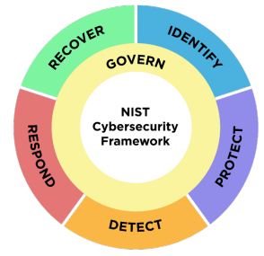
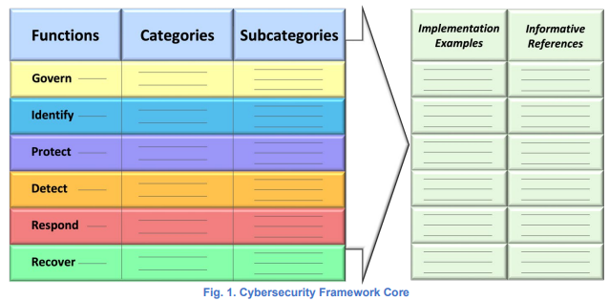
NIST CSF 2.0(draft)
https://nvlpubs.nist.gov/nistpubs/CSWP/NIST.CSWP.29.ipd.pdf

Slide 32
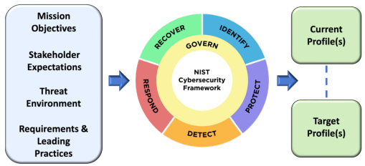
Fig. 3. Cybersecurity Framework Profiles

Slide 33
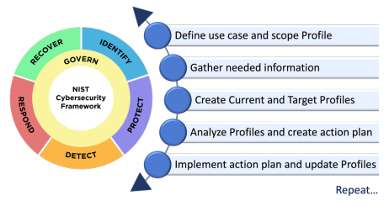
Fig. 4. Steps for creating and using Cybersecurity Framework Profiles

Slide 35
MITRE D3FEND:七大防禦戰術
Tactics(七大防禦戰術)
1.建模 戰術 Model
2.強化 戰術Harden
3.偵測 戰術Detect
4.隔離 戰術Isolate
5.欺騙 戰術Deceive
6.逐出|移除戰術Evict
7.回復戰術Restore

Slide 36
1.建模 戰術 Model
1.資產盤點|清冊(Asset Inventory)
資產漏洞列舉 Asset Vulnerability Enumeration
設定清冊 Configuration Inventory
資料清冊 Data Inventory
硬件元件清冊 Hardware Component Inventory
網路節點清冊 Network Node Inventory
軟體清冊 Software Inventory

Slide 37

1.建模 戰術 Model
資產漏洞列舉 Asset Vulnerability Enumeration(ID:D3-AVE)
定義
資產漏洞枚舉透過識別其漏洞的知識來豐富庫存項目。
Definition
Asset vulnerability enumeration enriches inventory items with knowledge identifying their vulnerabilities.
數位工件關係
這種防禦技術與特定的數位製品有關。 點擊工件節點以獲取更多資訊。
Digital Artifact Relationships
This defensive technique is related to specific digital artifacts. Click the artifact node for more information.

Slide 38
1.建模 戰術 Model
2. 網路映射| Network Mapping
邏輯鏈路映射 Logical Link Mapping
活動邏輯鏈路映射 Active Logical Link Mapping
被動邏輯鏈路映射 Passive Logical Link Mapping
網路流量策略映射 Network Traffic Policy Mapping
實體鏈路映射 Physical Link Mapping
活動物理鏈路映射 Active Physical Link Mapping

Slide 39
1.建模 戰術 Model
網路流量策略映射 Network Traffic Policy Mapping
(ID:D3-NTPM)
定義
網路流量策略會對應識別並建模網路、傳輸和/或應用程式層級允許的資料路徑。
同義詞
防火牆對映 、DLP 策略對應IPS策略映射和網路安全網關策略映射。
數位工件關係
這種防禦技術與特定的數位製品有關。 點擊工件節點以獲取更多資訊。
Definition
Network traffic policy mapping identifies and models the allowed pathways of data at the network, tranport, and/or application levels.
Synonyms
Firewall Mapping , DLP Policy Mapping IPS Policy Mapping , and Web Security Gateway Policy Mapping .
Digital Artifact Relationships
This defensive technique is related to specific digital artifacts. Click the artifact node for more information.

Slide 40
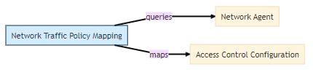
1.建模 戰術 Model
網路流量策略映射 Network Traffic Policy Mapping
(ID:D3-NTPM)

Slide 41
1.建模 戰術 Model
3. 運營活動映射| Operational Activity Mapping
訪問建模 Access Modeling
操作依賴關係映射 Operational Dependency Mapping
操作風險評估 Operational Risk Assessment
組織結構圖 Organization Mapping

Slide 42
1.建模 戰術 Model
操作風險評估 Operational Risk Assessment(ID:D3-ORA)
定義
營運風險評估可以識別組織單獨和整體活動的漏洞和風險，並對其進行建模。
同義詞： 任務風險評估 。
Definition
Operational risk assessment identifies and models the vulnerabilities of, and risks to, an organization's activities individually and as a whole.
Synonyms: Mission Risk Assessment .

Slide 43
1.建模 戰術 Model
4. 系統映射| System Mapping
資料交換映射 Data Exchange Mapping
服務依賴關係映射 Service Dependency Mapping
系統依賴關係映射 System Dependency Mapping
系統漏洞評估 System Vulnerability Assessment

Slide 44
1.建模 戰術 Model
資料交換映射 Data Exchange Mapping(ID:D3-DEM)
定義
資料交換映射識別並建模組織對應用層系統之間的資料類型、格式和容量流的預期設計。
同義詞：
資訊交換映射 和資料流映射 .
數位工件關係：
這種防禦技術與特定的數位製品有關。 點擊工件節點以獲取更多資訊。
Definition
Data exchange mapping identifies and models the organization's intended design for the flows of the data types, formats, and volumes between systems at the application layer.
Synonyms
Information Exchange Mapping , and Data Flow Mapping .
Digital Artifact Relationships
This defensive technique is related to specific digital artifacts. Click the artifact node for more information.

Slide 45

1.建模 戰術 Model
資料交換映射 Data Exchange Mapping(ID:D3-DEM)

Slide 46
2.強化 戰術(Harden)
1.應用程式強化 | Application Hardening
應用配置強化 Application Configuration Hardening
消除死代碼 Dead Code Elimination
異常處理程序指針驗證 Exception Handler Pointer Validation
指針認證 Pointer Authentication
行程段執行的預防機制 Process Segment Execution Prevention
段地址偏移隨機化 Segment Address Offset Randomization
堆棧幀金絲雀驗證 Stack Frame Canary Validation(避免buffer overflow)

Slide 47
2.強化 戰術(Harden)
消除死代碼 Dead Code Elimination (ID:D3-DCE)
定義
刪除無法存取的或“死代碼”來自編譯的原始碼。
怎麼運作的
死代碼是正常程式執行時認為無法存取的程式碼。死代碼可以透過在永遠不會計算為 true 的條件下新增程式碼來建立。應刪除死程式碼，因為如果意外或惡意強制執行，此類程式碼可能會產生意外結果。
死代碼識別通常由實現程式流程分析以查找無法存取的程式碼的演算法來執行。透過指示編譯器透過編譯器標誌（即“-fdce”）刪除程式碼來消除死程式碼。用於死代碼消除。
注意事項
在某些運行時條件下，程式碼也可能被視為無法存取。不同的部署系統和環境可能包含一些對於給定環境無法存取的程式碼。此技術不考慮無法存取程式碼的運行時條件。

Slide 48
2.強化 戰術(Harden)
消除死代碼 Dead Code Elimination (ID:D3-DCE)
Definition
Removing unreachable or "dead code" from compiled source code.
How it works
Dead code is code that is considered unreachable by normal program execution. Dead code can be created by adding code under a condition that never evaluates to true. Dead code should be removed since this type of code can produce unexpected results, if accidentally or maliciously forced to execute.
Dead code identification is typically performed by algorithms that implement program flows analysis looking for unreachable code. The dead code is eliminated by instructing compilers to remove the code through compiler flags, i.e., '-fdce' is used for Dead Code Elimination.
Considerations
Code can also be deemed unreachable for certain run-time conditions. Different deployed systems and environments may contain some code that is unreachable for the given environment. This technique does not consider run-time conditions for unreachable code.

Slide 49
2.強化 戰術(Harden)
2.憑證強化 |(Credential Hardening)
生物辨識認證 Biometric Authentication
基於憑證的身份驗證 Certificate-based Authentication
證書固定 Certificate Pinning
憑證輪換 Credential Rotation
憑證傳輸範圍 Credential Transmission Scoping
網域信任策略 Domain Trust Policy
多重身份驗證 Multi-factor Authentication
一次性密碼 One-time Password
強密碼政策 Strong Password Policy
使用者帳號權限 User Account Permissions

Slide 50
2.強化 戰術(Harden)
憑證傳輸範圍 Credential Transmission Scoping
(ID:D3-CTS)
定義
將憑證傳輸限製到一組範圍內的依賴方。
同義詞
防網釣身分驗證 。
數位工件關係
這種防禦技術與特定的數位製品有關。 點擊工件節點以獲取更多資訊。
Definition
Limiting the transmission of a credential to a scoped set of relying parties.
Synonyms
Phishing Resistant Authentication .
Digital Artifact Relationships
This defensive technique is related to specific digital artifacts. Click the artifact node for more information.

Slide 51

2.強化 戰術(Harden)
憑證傳輸範圍 Credential Transmission Scoping
(ID:D3-CTS)

Slide 52
2.強化 戰術(Harden)
3.訊息強化 | Message Hardening
訊息認證 (Message Authentication)
訊息加密 (Message Encryption)
傳輸代理身份驗證 (Transfer Agent Authentication)

Slide 53
2.強化 戰術(Harden)
傳輸代理身份驗證 (Transfer Agent Authentication)
(ID: D3-TAAN)
定義
驗證訊息傳遞基礎架構的伺服器元件是否有權傳送特定訊息。
怎麼運作的
根據協定的不同，傳輸代理身份驗證可以透過不同的方式完成。在電子郵件中，寄件者策略框架 (SPF)、網域金鑰識別電子郵件 (DKIM) 或基於網域的訊息驗證報告和一致性 (DMARC) 用於驗證寄件者網域所有權。
SPF
SPF 協定允許郵件網域擁有者指定他們在發送電子郵件時使用的郵件伺服器。 SPF 要求使用在網域名稱系統 (DNS) 中發布的 SPF 記錄。這些記錄記錄了電子郵件寄件者的授權 IP。 SPF 使用返迴路徑位址進行網域 IP 識別。轉送的電子郵件可能會導致返迴路徑驗證問題。

Slide 54
2.強化 戰術(Harden)
傳輸代理身份驗證 (Transfer Agent Authentication)
(ID: D3-TAAN)
DKIM
DKIM 也會使用 DNS 中的記錄項目進行身份驗證，但不依賴簡單的返迴路徑進行驗證。簽名標頭被添加到電子郵件中，並使用加密來確保安全。這增加了額外的複雜性，並要求 DKIM 伺服器配置可識別的加密簽章。額外的複雜性導致驗證過程可以承受複雜的電子郵件路由。
DMARC
DMARC 是一種電子郵件策略和身分驗證協議，旨在確保「寄件者」是正確的。電子郵件欄位未被欺騙。 DMARC 使用 SPF 記錄和 DKIM 發布的金鑰驗證。 DMARC 還有一個決策策略框架，包含在 DMARC 記錄中，用於處理被拒絕的電子郵件。 DMARC 框架也使用該網域允許的寄件者的驗證狀態來更新 DMARC 網域。

Slide 55
2.強化 戰術(Harden)
傳輸代理身份驗證 (Transfer Agent Authentication)
(ID: D3-TAAN)
注意事項
需要進行額外的工作來確保所有 SPF、DKIM 和 DMARC 記錄都是最新的。
需要維護 DKIM 簽章金鑰。
在沒有 DKIM 和 DMARC 的情況下使用 SPF 可以驗證返迴路徑域，但不能防止顯示的「寄件者：」位址被欺騙。
電子郵件中未透過電子郵件驗證方法簽署或驗證的部分（例如郵件正文或標題「收件者：」和「主題：」欄位）可以變更或修改。
電子郵件身分驗證並不能取代進行電子郵件內容分析的需要，因為寄件者網域以外的可執行檔案、附件或連結或電子郵件的其他部分不會得到驗證。

Slide 56
2.強化 戰術(Harden)
傳輸代理身份驗證 (Transfer Agent Authentication)
(ID: D3-TAAN)
Definition
Validating that server components of a messaging infrastructure are authorized to send a particular message.
How it works
Transfer Agent Authentication can be accomplished in different ways for depending on the protocol. In Email, Sender Policy Framework (SPF), Domain Key Identified Email (DKIM) or Domain-based Message Authentication Reporting and Conformance (DMARC) to validate sender domain ownership.
SPF
SPF protocol allows for mail domain owners to specify the mail servers they use when sending email. SPF requires the use of SPF records published in the Domain Name System (DNS). The records record the authorized IPs for email senders. SPF uses the return-path address for domain IP identification. Email that is forwarded may cause the return-path validation problems.

Slide 57
2.強化 戰術(Harden)
傳輸代理身份驗證 (Transfer Agent Authentication)
(ID: D3-TAAN)
DKIM
DKIM also uses a record entry in DNS for authentication but does not rely on the simple return-path for validation. A signature header is added to email and encryption is used for security. This adds an additional layer of complexity and requires that DKIM servers be configured identified cryptographic signatures. The additional complexity results in a validation process that can survive complex routing of emails.
DMARC
DMARC is an email policy and authentication protocol that seeks to ensure that the "From" field of emails is not spoofed. DMARC makes use of both SPF records and DKIM published key validation. DMARC also has a decision policy framework, contained in a DMARC record, for handling of rejected email. The DMARC framework also updates DMARC domains with authentication statues for allowed senders of that domain.

Slide 58
2.強化 戰術(Harden)
傳輸代理身份驗證 (Transfer Agent Authentication)
(ID: D3-TAAN)
Considerations
Additional work is required to ensure that all SPF, DKIM and DMARC records are current and up to date.
Maintenance of DKIM signing keys is needed.
Using SPF without DKIM and DMARC verifies the Return-Path domain however does not prevent spoofing of the displayed From: address.
Parts of an email that are not signed or verified by email authentication methods, such as the message body or the header To: and Subject: fields, can be altered or modified.
Email message authentication does not replace the need to do email content analysis since executables, attachments, or links or other parts of the email beyond the sender domain are not verified.

Slide 59
2.強化 戰術(Harden)
4.平台強化 |(Platform Hardening)
電腦啟動元件的認證機制 Bootloader Authentication
硬碟加密 Disk Encryption
驅動程式載入的完整性檢查 Driver Load Integrity Checking
檔案加密 File Encryption
本地檔案權限 Local File Permissions
射頻屏蔽 RF Shielding
軟體更新 Software Update
系統配置權限 System Configuration Permissions
TPM 啟動完整性 TPM Boot Integrity

Slide 60
2.強化 戰術(Harden)
檔案加密 File Encryption(ID:D3-FE)
定義
使用加密金鑰加密檔案。
怎麼運作的
文件使用單一密鑰進行加密和解密，或使用單獨的密鑰進行加密。單密鑰加密是對稱加密，使用兩個不同密鑰的加密是不對稱加密。
對稱密碼學
對稱加密使用相同的金鑰來加密和解密檔案。大規模管理金鑰有時會使用非對稱金鑰交換協議，例如 Diffie-Hellman 可用於與其他協定共用對稱加密金鑰。
非對稱密碼學
非對稱加密通常使用基於 X.509 標準的公鑰和私鑰憑證來完成。文件使用公鑰加密並使用私鑰解密。非對稱加密通常比對稱加密慢，並且不廣泛用於大檔案加密，但在金鑰包裝、金鑰交換和數位簽章中很流行。
注意事項
持續監控以確保私鑰不會洩露且憑證授權單位 (CA) 受到信任。
在多個裝置之間安全傳輸私鑰。
數位工件關係：
這種防禦技術與特定的數位製品有關。 點擊工件節點以獲取更多資訊。

Slide 61
2.強化 戰術(Harden)
檔案加密 File Encryption(ID:D3-FE)
Definition
Encrypting a file using a cryptographic key.
How it Works
Files are encrypted using either a single key for both encryption and decryption or separate keys. Single key encryption is symmetric encryption and using two key distinct keys is asymmetric encryption.
Symmetric Cryptography
Symmetric encryption uses the same cryptographic key for both the encryption and decryption a file. Managing keys at scale sometimes uses asymmetric key exchange protocols such as Diffie-Hellman can be used to share the symmetric cryptographic key with the others.
Asymmetric Cryptography
Asymmetric encryption is typically accomplished using public and private key certificates based on the X.509 standard. Files are encrypted using the public key and decrypted using their private key. Asymmetric encryption is typically slower than symmetric encryption and not widely used for large file encryption, but is popular for key wrapping, key exchanges, and digital signatures.
Considerations
Continuous monitoring to ensure private keys are not compromised and the certificate authority (CA) is trusted.
Secure transfer of private keys between multiple devices.
Digital Artifact Relationships:
This defensive technique is related to specific digital artifacts. Click the artifact node for more information.

Slide 62

2.強化 戰術(Harden)
檔案加密 File Encryption(ID:D3-FE)

Slide 63
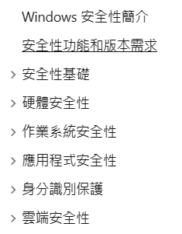
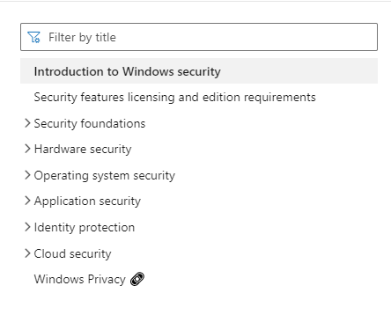
Windows Security
https://learn.microsoft.com/zh-tw/windows/security/operating-system-security/system-security/windows-defender-security-center/windows-defender-security-center

Slide 64
3.偵測 戰術Detect
1.檔案分析(File Analysis)
2.識別碼分析( Identifier Analysis)
3.訊息分析( Message Analysis)
4.網路流量分析(Network Traffic Analysis)
5.平台監控(Platform Monitoring)
6.行程分析(Process Analysis)
7. 使用者行為分析(User behavior analytics ("UBA"))
行程(Process) == 在記憶體執行的程式(Program)

Slide 65
3.偵測 戰術Detect
1.檔案分析(File Analysis)
動態分析( Dynamic Analysis)
檔案分析( Emulated File Analysis)
檔案內容分析( File Content Analysis)
檔案內容規則( File Content Rules)
檔案雜湊分析( File Hashing)

Slide 66
3.偵測 戰術Detect
動態分析 Dynamic Analysis(ID:D3-DA)
定義
在合成“沙箱”中執行或開啟文件環境來確定該文件是否為惡意程式或該文件是否利用了其他程式（例如文件閱讀器）。
同義詞： 惡意軟體爆炸 和惡意軟體沙盒。
怎麼運作的
分析一段程式碼在受控環境（例如沙箱、虛擬機器或模擬器）中執行時與系統的交互作用。這暴露了程式碼片段的自然行為，而不需要對程式碼進行反彙編。
注意事項
惡意軟體通常會偵測到虛假環境，然後相應地改變其行為。例如，它可以偵測到系統時鐘正在加速，以使其執行通常只會在稍後執行的命令，或者機器的硬體製造商是虛擬化提供者。
惡意軟體可以嘗試確定它是否正在被調試，並相應地改變其行為。
為了獲得最大保真度，模擬環境和真實環境應盡可能相似，因為惡意軟體在不同環境中的執行方式可能不同。
有時，惡意軟體行為僅在特定條件下（在特定係統日期、特定時間後或發送特定命令後）才會觸發，並且無法透過虛擬環境中的短暫執行來檢測。
實施
杜鵑沙盒
數位工件關係：
這種防禦技術與特定的數位製品有關。 點擊工件節點以獲取更多資訊。

Slide 67
3.偵測 戰術Detect
動態分析 Dynamic Analysis(ID:D3-DA)
Definition
Executing or opening a file in a synthetic "sandbox" environment to determine if the file is a malicious program or if the file exploits another program such as a document reader.
Synonyms: Malware Detonation , and Malware Sandbox .
How it works
Analyzing the interaction of a piece of code with a system while the code is being executed in a controlled environment such as a sandbox, virtual machine, or simulator. This exposes the natural behavior of the piece of code without requiring the code to be disassembled.
Considerations
Malware often detects a fake environment, then changes its behavior accordingly. For example, it could detect that the system clock is being sped up in an effort to get it to execute commands that it would normally only execute at a later time, or that the hardware manufacturer of the machine is a virtualization provider.
Malware can attempt to determine if it is being debugged, and change its behavior accordingly.
For maximum fidelity, the simulated and real environments should be as similar as possible because the malware could perform differently in different environments.
Sometimes the malware behavior is triggered only under certain conditions (on a specific system date, after a certain time, or after it is sent a specific command) and can't be detected through a short execution in a virtual environment.
Implementations
Cuckoo Sandbox
Digital Artifact Relationships:
This defensive technique is related to specific digital artifacts. Click the artifact node for more information.

Slide 68

3.偵測 戰術Detect
動態分析 Dynamic Analysis(ID:D3-DA)

Slide 69
3.偵測 戰術Detect
2.標識符分析 Identifier Analysis
同形文字檢測 Homoglyph Detection
識別碼活動分析 Identifier Activity Analysis
識別碼信譽分析 Identifier Reputation Analysis
網域名信譽分析 Domain Name Reputation Analysis
檔案雜湊信譽分析 File Hash Reputation Analysis
IP位址信譽分析 IP Reputation Analysis
URL信譽分析 URL Reputation Analysis
URL分析 URL Analysis

Slide 70
3.偵測 戰術Detect
同形文字檢測 Homoglyph Detection (ID:D3-HD)
定義
使用各種技術比較字串以確定是否向使用者呈現欺騙性或惡意字串。
怎麼運作的
在這種情況下，同形文字是一種欺騙性字串或單詞，看起來像可信單詞，但由不同的字符組成，例如：goooogle.com 與 google.com。這常見於網路釣魚和拼字錯誤搶注攻擊中，人們透過社會工程活動進行利用。
注意事項
在非常大的環境中，由於產生的流量很大，處理 DNS 查詢的運算成本可能會很高
合法的公司和產品在名稱中使用非字典單詞，這可能會導致許多誤報
數位工件關係：
這種防禦技術與特定的數位製品有關。 點擊工件節點以獲取更多資訊。

Slide 71
3.偵測 戰術Detect
同形文字檢測 Homoglyph Detection (ID:D3-HD)
Definition
Comparing strings using a variety of techniques to determine if a deceptive or malicious string is being presented to a user.
How it works
A homoglyph, in this context, is a deceptive string or word which looks like a trusted word, but is composed of different characters, for example: goooogle.com versus google.com. This is commonly found in phishing and typo squatting attacks where a human exploiting through a social engineering campaign.
Considerations
In very large environments processing DNS queries can be computationally expensive due to the amount of traffic that is generated
Legitimate companies and products use non-dictionary words in their names that could result in many false positives
Digital Artifact Relationships:
This defensive technique is related to specific digital artifacts. Click the artifact node for more information.

Slide 72

3.偵測 戰術Detect
同形文字檢測 Homoglyph Detection (ID:D3-HD)

Slide 73
3.偵測 戰術Detect
3.訊息分析Message Analysis
寄件者MTA信譽分析 Sender MTA Reputation Analysis
寄件者信譽分析 Sender Reputation Analysis

Slide 74
3.偵測 戰術Detect
寄件者MTA信譽分析 Sender MTA Reputation Analysis(ID:D3-SMRA)
定義
表徵郵件傳輸代理程式 (MTA) 的信譽以確定電子郵件中的安全風險。
怎麼運作的
寄件者郵件傳輸代理程式 (MTA) 信任評級可以被視為安全風險等級和/或與電子郵件標頭中的寄件者 MTA 相關聯的信任等級的指示符。
確定信任評級時考慮的特徵可能包括：
MTA 與企業互動的時間長度
從 MTA 發送電子郵件的寄件者域數量
MTA 向其發送電子郵件的企業中的收件者數量
從該 MTA 收到的電子郵件數量
從該 MTA 收到的電子郵件回覆數
例如，較高的 MTA 與企業互動的時間長度值或從 MTA 收到的電子郵件數量可能會導致較高的信任評級。信任評級將寄件者 MTA 分類為未評級、中立、可信、可疑或惡意。
注意事項
如果寄件者的網域被欺騙並被用來發送未經授權的電子郵件，則來自寄件者 MTA 的合法電子郵件隨著時間的推移可能會收到較低的信任評級。
數位工件關係：
這種防禦技術與特定的數位製品有關。 點擊工件節點以獲取更多資訊。

Slide 75
3.偵測 戰術Detect
寄件者MTA信譽分析 Sender MTA Reputation Analysis(ID:D3-SMRA)
Definition
Characterizing the reputation of mail transfer agents (MTA) to determine the security risk in emails.
How it works
The sender message transfer agent (MTA) trust rating can be considered an indicator of the level of security risk and/or a trust level associated with sender MTAs in an email header.
The features considered in determining the trust rating may include:
Length of time MTA has interacted with the enterprise
Number of sender domains sending emails from the MTA
Number of recipients in the enterprise the MTA sends emails to
Number of emails received from this MTA
Number of email replies received from this MTA
For example, higher values for the length of time an MTA has interacted with the enterprise, or number of emails received from an MTA can result in a higher trust rating. The trust rating categorizes the sender MTA as unrated, neutral, trusted, suspicious, or malicious.
Considerations
Legitimate emails from a sender MTA may receive a lower trust rating over time if the sender's domain gets spoofed and is used to send unauthorized emails.
Digital Artifact Relationships:
This defensive technique is related to specific digital artifacts. Click the artifact node for more information.

Slide 76

3.偵測 戰術Detect
寄件者MTA信譽分析 Sender MTA Reputation Analysis(ID:D3-SMRA)

Slide 77
3.偵測 戰術Detect
4.網路流量分析(Network Traffic Analysis)
管理網路活動分析(Administrative Network Activity Analysis)
位元組序列檢視(Byte Sequence Emulation)
憑證分析(Certificate Analysis)
主動式憑證分析( Active Certificate Analysis)
被動式憑證分析( Passive Certificate Analysis)
客戶端-伺服器負載分析(Client-server Payload Profiling)
連線嘗試分析(Connection Attempt Analysis)
DNS流量分析(DNS Traffic Analysis)
網路檔案雕刻(File Carving)
流入會話量體分析(Inbound Session Volume Analysis)
IPC流量分析(IPC Traffic Analysis)
網路流量社群偏差(Network Traffic Community Deviation)
每主機下載上傳比率分析(Per Host Download-Upload Ratio Analysis)
協定元資料異常偵測(Protocol Metadata Anomaly Detection)
中介模式分析(Relay Pattern Analysis)
遠端終端會話偵測(Remote Terminal Session Detection)
RPC 流量分析(RPC Traffic Analysis)

Slide 78
3.偵測 戰術Detect
DNS流量分析 DNS Traffic Analysis(ID:D3-DNSTA)
定義
分析網域元數據，包括名稱和 DNS 記錄，以確定該網域是否可能解析為不良主機。
同義詞： 網域分析 。
怎麼運作的
該技術可以透過多種方式來實現。
一個範例分析確定網域是否是透過演算法產生的。域生成演算法 (DGA) 有時用於自動建立解析為 C2 基礎設施的域名，而無需直接將相關域編碼到惡意程式碼中。
另一種方法分析有關已訪問的域的信息，包括域名是否長於常見長度、是否訪問了動態DNS域、是否訪問了快速通量域以及是否訪問了最近創建的域。這些因素用於制定分數，如果該分數超過特定閾值，則會產生警報。
收集的惡意軟體樣本可以在虛擬環境中執行，以識別執行期間連接到的網路域。然後將網路域產生簽章以識別其他主機的壞域。
此技術不會檢查網域中託管的內容。
注意事項
DNS 會產生大量流量，即時分析可能會佔用大量資源。
如果伺服器受到損害（例如，作為水坑攻擊的一部分），但指向該伺服器的 DNS 資訊未更改，則此技術將無法擷取此類事件。
數位工件關係：
這種防禦技術與特定的數位製品有關。 點擊工件節點以獲取更多資訊。

Slide 79
3.偵測 戰術Detect
DNS流量分析 DNS Traffic Analysis(ID:D3-DNSTA)
Definition
Characterizing the reputation of mail transfer agents (MTA) to determine the security risk in emails.
How it works
The sender message transfer agent (MTA) trust rating can be considered an indicator of the level of security risk and/or a trust level associated with sender MTAs in an email header.
The features considered in determining the trust rating may include:
Length of time MTA has interacted with the enterprise
Number of sender domains sending emails from the MTA
Number of recipients in the enterprise the MTA sends emails to
Number of emails received from this MTA
Number of email replies received from this MTA
For example, higher values for the length of time an MTA has interacted with the enterprise, or number of emails received from an MTA can result in a higher trust rating. The trust rating categorizes the sender MTA as unrated, neutral, trusted, suspicious, or malicious.
Considerations
Legitimate emails from a sender MTA may receive a lower trust rating over time if the sender's domain gets spoofed and is used to send unauthorized emails.
Digital Artifact Relationships:
This defensive technique is related to specific digital artifacts. Click the artifact node for more information.

Slide 80

3.偵測 戰術Detect
DNS流量分析 DNS Traffic Analysis(ID:D3-DNSTA)

Slide 81
3.偵測 戰術Detect
D3-FC 網路檔案雕刻(File Carving)
定義：透過使用網路串流重組(reassembly)軟體從網路應用協定中識別與提取在流量中的檔案
運作原理
協定串流重組軟體(Protocol stream reassembly software)透過分析擷取的網路資料封包重新建立定向位元組流(directional byte stream)
一旦串流被重組，就會應用模式匹配(pattern matching)來確定它是否包含感興趣的檔案
感興趣的文件包含可執行檔、 archive文件或文件檔案
擷取文件後，將使用標準文件分析技術進行處理
範例網路協定包含 HTTP、SMTP、FTP、HTTP/2 及 TLS/HTTP/Dropbox
範例工具：NetworkMiner可自動化進行File Carving

Slide 82
3.偵測 戰術Detect
D3-RPA:Relay Pattern Analysis
定義：偵測在內部網路與外部網路之間中繼流量的內部主機
運作原理
中繼(Relay)可能使用各種代理、轉送或路由技術來橋接受保護網路與外部網路
用來偵測中繼網路的防禦分析可以透過比較多個主機之間的網路會話
幾乎相似的網路統計資料的主機可能是中繼網路的一部分
統計資料可以包含發送與接收的位元組數、會話發起時間、資料包大小或資料包到達時間資料
挑戰與注意事項
複雜的內部網路 VPN 或路由封裝可能會影響偵測分析
此外，不需要的資料包可能不會被轉發，並且可能會在中繼處添加額外的資料包，從而使檢測更加複雜

Slide 83
3.偵測 戰術Detect
D3-BSE: Byte Sequence Emulation
定義：分析位元組序列(Byte Sequence )並確定它們是否可能是某種惡意 shellcode。(同義詞： Shellcode 傳輸偵測)
運作原理
對位元組(視為機器碼指令或組合語言)進行分析，並比對已知 shellcode 的常見元件的指令，例如堆疊樞軸(stack pivots)、讀取記憶體位址表(Memory Address Table)以及禁用保護或執行程式碼的函數之系統呼叫(system calls)
如果位元組序列包含與惡意 shellcode 中使用的序列類似的序列，則整個位元組序列將被標記，並且可以呼叫後續技術​​來處理
原理類似IDS/IPS使用signature(特徵碼)進行偵測
同樣會有False Negatives與False Positives問題

Slide 84
3.偵測 戰術Detect
5.平台監控(Platform Monitoring)
檔案完整性監控 File Integrity Monitoring
韌體行為分析 Firmware Behavior Analysis
韌體嵌入監控程式碼 Firmware Embedded Monitoring Code
韌體驗證(Firmware Verification)
周邊韌體驗證( Peripheral Firmware Verification)
系統韌體驗證( System Firmware Verification)
作業系統監控(Operating System Monitoring)
端點健康信標 Endpoint Health Beacon
輸入設備分析 Input Device Analysis
記憶體邊界追蹤 Memory Boundary Tracking
預定工作分析 Scheduled Job Analysis
系統守護程式監控 System Daemon Monitoring
系統檔案分析 System File Analysis
服務二進位驗證 Service Binary Verification
系統初始化配置分析 System Init Config Analysis
使用者會話初始化配置分析 User Session Init Config Analysis

Slide 85
3.偵測 戰術Detect
檔案完整性監控 File Integrity Monitoring(ID:D3-FIM)
定義
偵測電腦系統中檔案的任何可疑變更。
怎麼運作的
Windows 和 Unix 中有許多工具可以監視系統中的特定文件，並在建立、修改或刪除任何工件時產生警報。他們透過將當前工件與先前的快照進行比較來實現這一點。
Unix - Unix 系統有一個名為 tripwire 的檔案完整性檢查工具。 Tripwire 首先初始化一個資料庫作為比較的基礎，然後掃描系統以將目前檔案系統的狀態與初始基礎資料庫進行比較。此外，使用者可以定義指定潛在違規行為的策略。
Windows - 在 Microsoft Azure 中，可以啟用檔案完整性監控，它可以追蹤檔案和登錄項目的建立、刪除和特定檔案的修改。
注意事項
由於電腦系統的非靜態特性，檔案可能會不斷變化。文件完整性監控在針對小範圍的關鍵文件以限制正常使用過程中可能被修改的不必要文件的數量時效果最佳。定義策略的準確性和精確性也會影響該技術的有效性。
數位工件關係：
這種防禦技術與特定的數位製品有關。 點擊工件節點以獲取更多資訊。

Slide 86
3.偵測 戰術Detect
檔案完整性監控 File Integrity Monitoring(ID:D3-FIM)
Definition
Detecting any suspicious changes to files in a computer system.
How it Works
There are a number of tools in Windows and Unix that can monitor specific files in a system and generate alerts if any artifacts have been created, modified, or removed. They accomplish this by comparing the current artifacts to a previous snapshot.
Unix - Unix systems have a file integrity checker tool called tripwire. Tripwire first initializes a database that serves as a basis for comparison and can then scan the system to compare the state of the current file system against the initial baseline database. Additionally, users can define policies that specify potential violations.
Windows - In Microsoft Azure, file integrity monitoring can be enabled which can track file and registry key creation, removals, and modifications of specific files.
Considerations
Files can change constantly due to the non-static nature of a computer system. File Integrity Monitoring works best when pointed at a narrow scope of critical files to limit the number of unneccessary files that may be modified over the course of normal use. The accuracy and precision of defined policies also affect the efficacy of this technique.
Digital Artifact Relationships:
This defensive technique is related to specific digital artifacts. Click the artifact node for more information.

Slide 87

3.偵測 戰術Detect
檔案完整性監控 File Integrity Monitoring(ID:D3-FIM)

Slide 88
3.偵測 戰術Detect
6.流程分析(Process Analysis)
資料庫查詢字串分析 Database Query String Analysis
檔案存取模式分析 File Access Pattern Analysis
間接分支呼叫分析 Indirect Branch Call Analysis
流程程式碼段驗證 Process Code Segment Verification
流程自我修改偵測 Process Self-Modification Detection
流程產生分析 Process Spawn Analysis
流程譜系分析 Process Lineage Analysis
腳本執行分析 Script Execution Analysis
陰影堆疊比較 Shadow Stack Comparisons
系統呼叫分析 System Call Analysis
檔案建立分析 File Creation Analysis

Slide 89
3.偵測 戰術Detect
檔案存取模式分析 File Access Pattern Analysis(ID:D3-FAPA)
定義
分析進程存取的文件以識別未經授權的活動。
怎麼運作的
透過識別與惡意進程關聯的檔案存取模式來偵測檔案修改惡意軟體（例如擦除器和勒索軟體）。文件存取模式的範例包括存取大量文件、存取多種文件類型、存取位於目錄中多個位置的文件以及複製文件並將該文件的內容加密到副本中。
注意事項
某些文件存取操作在統計上可能與授權活動沒有區別。
數位工件關係：
這種防禦技術與特定的數位製品有關。 點擊工件節點以獲取更多資訊。

Slide 90
3.偵測 戰術Detect
檔案存取模式分析 File Access Pattern Analysis(ID:D3-FAPA)
Definition
Analyzing the files accessed by a process to identify unauthorized activity.
How it works
File modifying malware such as wipers and ransomware are detected by identifying file access patterns that are associated with a malicious process. Examples of file access patterns include accessing a large number of files, accessing multiple file types, files being accessed located in multiple locations in a directory, and copying a file and encrypting the contents of that file into a copy.
Considerations
Certain file access actions may not be statistically different from authorized activity.
Digital Artifact Relationships:
This defensive technique is related to specific digital artifacts. Click the artifact node for more information.

Slide 91
3.偵測 戰術Detect
檔案存取模式分析 File Access Pattern Analysis(ID:D3-FAPA)

Slide 92
3.偵測 戰術Detect
7. 使用者行為分析User behavior analytics (UBA)
身份驗證事件閾值分析 Authentication Event Thresholding
授權事件閾值分析 Authorization Event Thresholding
憑證洩漏範圍分析 Credential Compromise Scope Analysis
網域帳戶監控 Domain Account Monitoring
工作職能存取模式分析 Job Function Access Pattern Analysis
本地帳戶監控 Local Account Monitoring
資源訪問模式分析 Resource Access Pattern Analysis
會話持續時間分析 Session Duration Analysis
使用者資料傳輸分析 User Data Transfer Analysis
使用者地理位置登入模式分析 User Geolocation Logon Pattern Analysis
Web會話活動分析 Web Session Activity Analysis

Slide 93
3.偵測 戰術Detect
授權事件閾值分析 Authorization Event Thresholding(ID:D3-AZET)
定義
收集授權事件，建立基線使用者檔案，判斷授權事件與基準檔案是否一致。
怎麼運作的
收集授權事件資料以建立基線使用者設定檔。識別偏離基線並超過靜態或動態閾值的授權事件以採取進一步行動。授權事件可以包括成功和失敗的授權嘗試以及與權限相關的事件，包括檢視、編輯、刪除、建立檔案、資料庫等。
注意事項
根據所考慮資料的複雜性，對於以簡單分析視圖查看事件的人類分析師來說，異常值可能並不明顯。如果惡意活動與良性活動在統計上沒有差異，則不會滿足警報閾值。
數位工件關係：
這種防禦技術與特定的數位製品有關。 點擊工件節點以獲取更多資訊。

Slide 94
3.偵測 戰術Detect
授權事件閾值分析 Authorization Event Thresholding(ID:D3-AZET)
Definition
Collecting authorization events, creating a baseline user profile, and determining whether authorization events are consistent with the baseline profile.
How it works
Authorization event data is collected to create a baseline user profile. Authorization events that deviate from the baseline and exceed a static or dynamic threshold are identified for further action. Authorization events can include successful and failed authorization attempts as well as events related to permissions including viewing, editing, deleting, creating files, databases etc.
Considerations
Depending on the complexity of the data considered, outliers may not be obvious to a human analyst reviewing events in simplistic analytic views. If malicious activity is not statistically different from benign activity, an alert threshold will not be met.
Digital Artifact Relationships:
This defensive technique is related to specific digital artifacts. Click the artifact node for more information.

Slide 95

3.偵測 戰術Detect
授權事件閾值分析 Authorization Event Thresholding(ID:D3-AZET)

Slide 96
4.隔離 戰術Isolate
1.程式執行隔離戰技 Execution Isolation
白名單程式清冊:允許執行 Executable Allowlisting
黑名單程式清冊:不允許執行 Executable Denylisting
硬體為基礎的程式隔離 Hardware-based Process Isolation
輸出/輸入埠限制 IO Port Restriction
作業系統核心為基礎的程式隔離 Kernel-based Process Isolation
強制型存取控制 Mandatory Access Control
作業系統的系統呼叫過濾機制 System Call Filtering

Slide 97
4.隔離 戰術Isolate
白名單程式清冊:允許執行 Executable Allowlisting(ID:D3-EAL)
定義
在開啟文件之前使用數位簽章來驗證文件。
同義詞： 文件簽章驗證 。
怎麼運作的
該技術是通用的，有多種計算和驗證數位簽章的方法。 數位憑證是根據憑證授權單位 (CA) 頒發的私鑰/公鑰對產生的。使用私鑰對檔案的哈希值進行加密。當另一個用戶下載該檔案時，該用戶的系統使用公鑰來解密哈希值，並為下載的檔案建立一個新的哈希值。將公鑰解密的雜湊值與新雜湊值進行比較，如果不匹配，則採用進一步的技術，例如檔案刪除、檔案隔離或可執行黑名單 可以被呼叫。
當決定是否執行檔時可以呼叫該技術。
注意事項
下載或創建大量軟體的組織使管理變得複雜，特別是工程或科學組織。
數位工件關係：
這種防禦技術與特定的數位製品有關。 點擊工件節點以獲取更多資訊。

Slide 98
4.隔離 戰術Isolate
白名單程式清冊:允許執行 Executable Allowlisting(ID:D3-EAL)
Definition
Using a digital signature to authenticate a file before opening.
Synonyms: File Signature Authentication .
How it works
This technique is generic and there are numerous ways to compute and authenticate digital signatures. A digital certificate is generated from a private/public key pair issued by a certificate authority (CA). A hash of the file is encrypted using the private key. When the file is downloaded by another user, the user's system uses the public key to decrypt the hash and a new hash is created of the downloaded file. The hash decrypted by the public key is compared to the new hash and if there is a mismatch, further techniques, such as file deletion, file quarantine, or Executable Blacklisting may be invoked.
This technique may be invoked when deciding whether to execute a file.
Considerations
Organizations which download or create high volumes of software make management complex, in particular engineering or scientific organizations.
Digital Artifact Relationships:
This defensive technique is related to specific digital artifacts. Click the artifact node for more information.

Slide 99

4.隔離 戰術Isolate
白名單程式清冊:允許執行 Executable Allowlisting(ID:D3-EAL)

Slide 100
4.隔離 戰術Isolate
2.網路隔離戰技 Network Isolation
廣播網域隔離 Broadcast Domain Isolation
DNS允許請單 DNS Allowlisting
DNS隔離請單 DNS Denylisting
正向解析網域名隔離請單 Forward Resolution Domain Denylisting
分層網域名隔離請單 Hierarchical Domain Denylisting
同形異音字符隔離請單 Homoglyph Denylisting
正向解析IP隔離請單 Forward Resolution IP Denylisting
反向解析IP隔離請單 Reverse Resolution IP Denylisting
加密通道 Encrypted Tunnels
網路流量過濾 Network Traffic Filtering
入站流量過濾 Inbound Traffic Filtering
電子郵件過濾 Email Filtering
出站流量過濾 Outbound Traffic Filtering

Slide 101
4.隔離 戰術Isolate
DNS允許請單 DNS Allowlisting (ID:D3-DNSAL)
定義
僅允許解析批准的域及其子域。
同義詞： DNS 白名單 。
數位工件關係：
這種防禦技術與特定的數位製品有關。 點擊工件節點以獲取更多資訊。

Slide 102
4.隔離 戰術Isolate
DNS允許請單 DNS Allowlisting (ID:D3-DNSAL)
Definition
Permitting only approved domains and their subdomains to be resolved.
Synonyms: DNS Whitelisting .
Digital Artifact Relationships:
This defensive technique is related to specific digital artifacts. Click the artifact node for more information.

Slide 103
4.隔離 戰術Isolate
DNS允許請單 DNS Allowlisting (ID:D3-DNSAL)

Slide 104
5.欺騙 戰術Deceive
1.Decoy Environment
部分連結到企業生產系統 Connected Honeynet
與企業生產系統充分連結 Integrated Honeynet
不會連結到企業生產系統 Standalone Honeynet

Slide 105
5.欺騙 戰術Deceive
部分連結到企業生產系統 Connected Honeynet(ID:D3-CHN)
定義
誘餌服務、系統或環境，連接到企業網絡，並模擬或模擬網路的某些功能，而不暴露對生產系統的完全存取權。
怎麼運作的
誘餌蜜罐部署在企業環境中，模擬某些服務或作業系統的一部分來吸引攻擊者。
注意事項
連接的蜜網提供了模擬某些功能但不像整合蜜網那麼複雜之間的權衡。連接的蜜網可能無法提供足夠的功能來偵測新的攻擊模式或零日漏洞，但可以為特定的已知漏洞提供足夠的功能。
數位工件關係：
這種防禦技術與特定的數位製品有關。 點擊工件節點以獲取更多資訊。

Slide 106
5.欺騙 戰術Deceive
部分連結到企業生產系統 Connected Honeynet(ID:D3-CHN)
Definition
A decoy service, system, or environment, that is connected to the enterprise network, and simulates or emulates certain functionality to the network, without exposing full access to a production system.
How it works
Decoy honeypots are deployed within the enterprise environment that emulate certain services or portions of an OS to attract attackers.
Considerations
A connected honeynet provides a tradeoff between emulating certain functionality but not being as sophisticated as an integrated honeynet. The connected honeynet may not provide enough functionality to detect new attack patterns or zero day exploits but could provide enough functionality for specific known vulnerabilities.
Digital Artifact Relationships:
This defensive technique is related to specific digital artifacts. Click the artifact node for more information.

Slide 107

5.欺騙 戰術Deceive
部分連結到企業生產系統 Connected Honeynet(ID:D3-CHN)

Slide 108
5.欺騙 戰術Deceive
2.誘餌物件 Decoy Object
誘餌檔案 Decoy File
誘餌網路資源 Decoy Network Resource
誘餌身份 Decoy Persona
公開釋出誘餌 Decoy Public Release
會話標記誘餌 Decoy Session Token
使用者憑證誘餌 Decoy User Credential

Slide 109
5.欺騙 戰術Deceive
誘餌身份 Decoy Persona(ID:D3-DP)
定義
建立虛假的線上身分來誤導、欺騙和/或與對手互動。
怎麼運作的
創建虛假線上身分的目的是為了以直接或間接的方式與對手互動。這包括關聯的電子郵件地址、社交媒體帳戶和其他線上通訊資料。
注意事項
包括電話號碼和線上社交資料，以及自動或手動回應與角色的聯繫以提高真實感。
持續更新和管理誘餌角色和線上活動串流，以確保角色不會變得陳舊和過時。
數位工件關係：
這種防禦技術與特定的數位製品有關。 點擊工件節點以獲取更多資訊。

Slide 110
5.欺騙 戰術Deceive
誘餌身份 Decoy Persona(ID:D3-DP)
Definition
Establishing a fake online identity to misdirect, deceive, and or interact with adversaries.
How it works
A false online identity is created for the purposes of interacting with adversaries in a direct or indirect manner. This includes the associated email addresses, social media accounts, and other online communication profiles.
Considerations
Include phone numbers and online social profiles as well as automatically or manually responding to contact made to the persona to improve realism.
Continuous updating and managing the decoy personas and online activity streams to ensure personas do not become stale and outdated.
Digital Artifact Relationships:
This defensive technique is related to specific digital artifacts. Click the artifact node for more information.

Slide 111

5.欺騙 戰術Deceive
誘餌身份 Decoy Persona(ID:D3-DP)

Slide 112
6.逐出|移除戰術Evict
1.憑證驅逐 (Credential Eviction)
帳戶鎖定 (Account Locking)
身份驗證緩存失效 (Authentication Cache Invalidation)
撤銷憑證 (Credential Revoking)

Slide 113
6.逐出|移除戰術Evict
撤銷憑證 Credential Revoking(ID:D3-CR)
定義
永久刪除一組憑證以防止它們被用於身份驗證。
怎麼運作的
具有帳戶管理企業策略的管理伺服器提供刪除權限、帳戶或憑證的功能。應撤銷受損的憑證，以防止進一步的惡意活動。
數位工件關係：
這種防禦技術與特定的數位製品有關。 點擊工件節點以獲取更多資訊。

Slide 114
6.逐出|移除戰術Evict
撤銷憑證 Credential Revoking(ID:D3-CR)
Definition
Deleting a set of credentials permanently to prevent them from being used to authenticate.
How it works
Management servers with enterprise policies for account management provide the ability remove permissions, accounts, or credentials. Compromised credentials should be revoked to prevent further malicious activity.
Digital Artifact Relationships:
This defensive technique is related to specific digital artifacts. Click the artifact node for more information.

Slide 115

6.逐出|移除戰術Evict
撤銷憑證 Credential Revoking(ID:D3-CR)

Slide 116
6.逐出|移除戰術Evict
2.文件驅逐File Eviction
文件刪除(File Removal)
電子郵件刪除(Email Removal)

Slide 117
6.逐出|移除戰術Evict
文件刪除 File Removal(ID:D3-FR)
定義
文件刪除技術從電腦系統中刪除惡意工件或程式。
同義詞： 檔案刪除 。
怎麼運作的
攻擊者可能會將檔案或程式放入電腦的檔案系統中以執行惡意操作。作為驅逐過程的一部分，應刪除這些文件和程序，以防止進一步洩漏或重新感染。惡意類型檔案的範例包括直接有害的惡意軟體和意圖欺騙使用者的內容檔案（例如網路釣魚）。
在 Windows 系統上，應使用防毒 (AV) 軟體安全且永久刪除惡意檔案。防毒軟體可能會先隔離可疑的惡意文件，這是將文件從原始位置移動到新位置並進行更改以使其無法執行的過程。然後，使用者可以驗證該文件是否為良性文件，然後將其永久刪除。
注意事項
當確定出於安全目的應刪除文件時，組織（或實施組織策略的系統）可能會確定不應簡單地從企業的任務系統中刪除該文件，但透過批准的機制隔離到安全系統，以便安全人員進行後續調查。
在 Windows 系統上，在檔案總管中刪除檔案不會永久刪除檔案 - 而是將其傳送到回收站。必須清空回收站，或必須執行替代步驟才能完全刪除檔案。即使如此，在某些情況下，資料可能會保留在磁碟中，因此可能需要資料粉碎工具來完全擦除檔案。因此，建議使用AV工具。
數位工件關係：
這種防禦技術與特定的數位製品有關。 點擊工件節點以獲取更多資訊。

Slide 118
6.逐出|移除戰術Evict
文件刪除 File Removal(ID:D3-FR)
Definition
The file removal technique deletes malicious artifacts or programs from a computer system.
Synonyms: File Deletion .
How it works
Adversaries may place files or programs into a computer's file system to perform malicious actions. As part of the eviction process, these files and programs should be removed to prevent further compromise or reinfection. Examples of malicious types of files are malware which is directly harmful and content files with the intent to deceive users (e.g., phishing.)
On Windows systems, antivirus (AV) software should be used to safely and permanently remove malicious files. AV software may first quarantine a suspected malicious file, which is the process of moving a file from its original location to a new location and makes changes so that it cannot be executed. Users can then verify that the file is not benign and then permanently delete it.
Considerations
When it is determined that a file should be removed for security purposes, the organization--or systems implementing an organization's policies--may determine that the file should not simply be deleted from the enterprise's mission systems, but be quarantined to a secure system by an approved mechanism, so as to allow follow-up investigation by security staff.
On Windows systems, deleting a file in File Explorer does not permanently delete a file - it sends it to the Recycle Bin instead. The Recycle Bin must be emptied, or alternative steps must be performed to remove files completely. Even then, in some cases the data may persist in disk, so data shredder tools may be needed to completely wipe a file. Thus, AV tools are recommended.
Digital Artifact Relationships:
This defensive technique is related to specific digital artifacts. Click the artifact node for more information.

Slide 119
6.逐出|移除戰術Evict
3.行程驅逐Process Eviction
行程暫停(Process Suspension)
行程終止(Process Termination)

Slide 120
6.逐出|移除戰術Evict
文件刪除 File Removal(ID:D3-PS)
定義
暫停電腦系統上正在運作的進程。
怎麼運作的
如果正在運行的進程表現出異常、未經授權或惡意行為，則可能會暫停該進程以減輕其直接影響。防禦者可以選擇暫停而不是終止來首先分析該過程，如果認為是良性的則恢復該過程。
系統提供的功能
Windows工具
在 Windows 中，SysInternals Suite 中的PsSuspend 命令列公用程式提供暫停本機或遠端系統上的程序的功能。
數位工件關係：
這種防禦技術與特定的數位製品有關。 點擊工件節點以獲取更多資訊

Slide 121
6.逐出|移除戰術Evict
文件刪除 File Removal(ID:D3-PS)
Definition
Suspending a running process on a computer system.
How it works
A running process might be suspended to mitigate its immediate effects if it is exhibiting anomalous, unauthorized, or malicious behavior. Defenders may choose to suspend rather than terminate to analyze the process first and resume the process if deemed benign.
System-provided functions
Windows tools
In Windows, the PsSuspend command line utility from the SysInternals Suite provides functionality to suspend processes on a local or remote system.
Digital Artifact Relationships:
This defensive technique is related to specific digital artifacts. Click the artifact node for more information.

Slide 122

6.逐出|移除戰術Evict
文件刪除 File Removal(ID:D3-PS)

Slide 123
7.回復戰術 Restore
1.存取權的回復機制 (Restore Access)
網路存取權回復 (Restore Network Access)
使用者帳號存取權回復 ( Restore User Account Access)
帳號解鎖 (Unlock Account)

Slide 124
7.回復戰術 Restore
使用者帳號存取權回復 Restore User Account Access(ID:D3-RUAA)
定義
恢復使用者帳戶對資源的存取權限。
數位工件關係：
這種防禦技術與特定的數位製品有關。 點擊工件節點以獲取更多資訊。

Slide 125
7.回復戰術 Restore
使用者帳號存取權回復 Restore User Account Access(ID:D3-RUAA)
Definition
Restoring a user account's access to resources.
Digital Artifact Relationships:
This defensive technique is related to specific digital artifacts. Click the artifact node for more information.

Slide 126

7.回復戰術 Restore
使用者帳號存取權回復 Restore User Account Access(ID:D3-RUAA)

Slide 127
7.回復戰術 Restore
2.物件的回復機制(Restore Object)
憑證重發(Reissue Credential)
設定檔回復(Restore Configuration)
資料庫回復( Restore Database)
硬碟回復( Restore Disk Image)
檔案回復( Restore File)
Email回復( Restore Email)
軟體回復( Restore Software)

Slide 128
7.回復戰術 Restore
資料庫回復 Restore Database(ID:D3-RD)
定義
恢復軟體配置。
數位工件關係：
這種防禦技術與特定的數位製品有關。 點擊工件節點以獲取更多資訊。

Slide 129
7.回復戰術 Restore
資料庫回復 Restore Database(ID:D3-RD)
Definition
Restoring the data in a database.
Digital Artifact Relationships:
This defensive technique is related to specific digital artifacts. Click the artifact node for more information.

Slide 130
7.回復戰術 Restore
資料庫回復 Restore Database(ID:D3-RD)

Slide 131
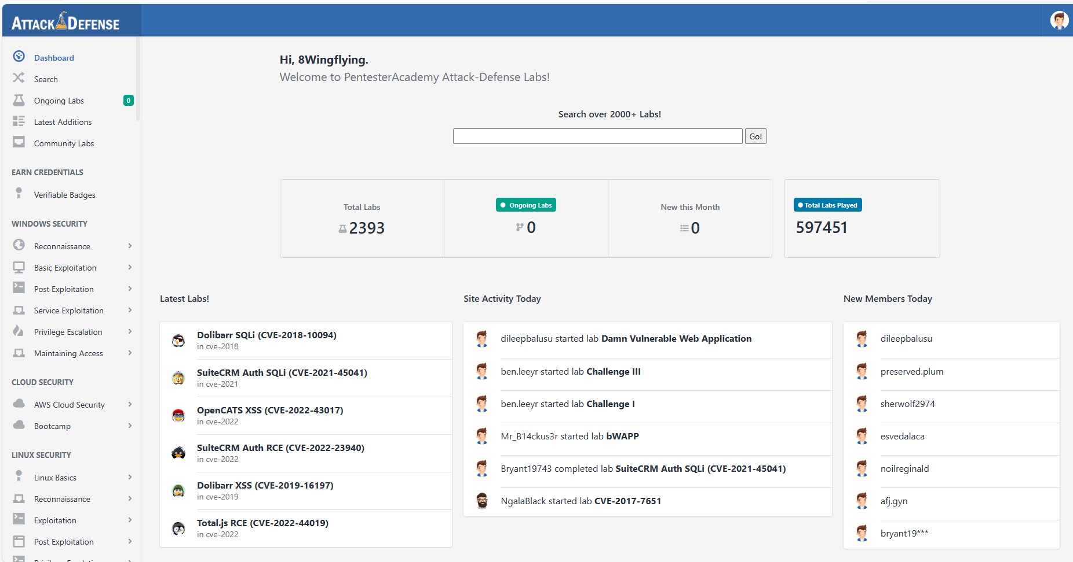
https://www.attackdefense.com/

Slide 132
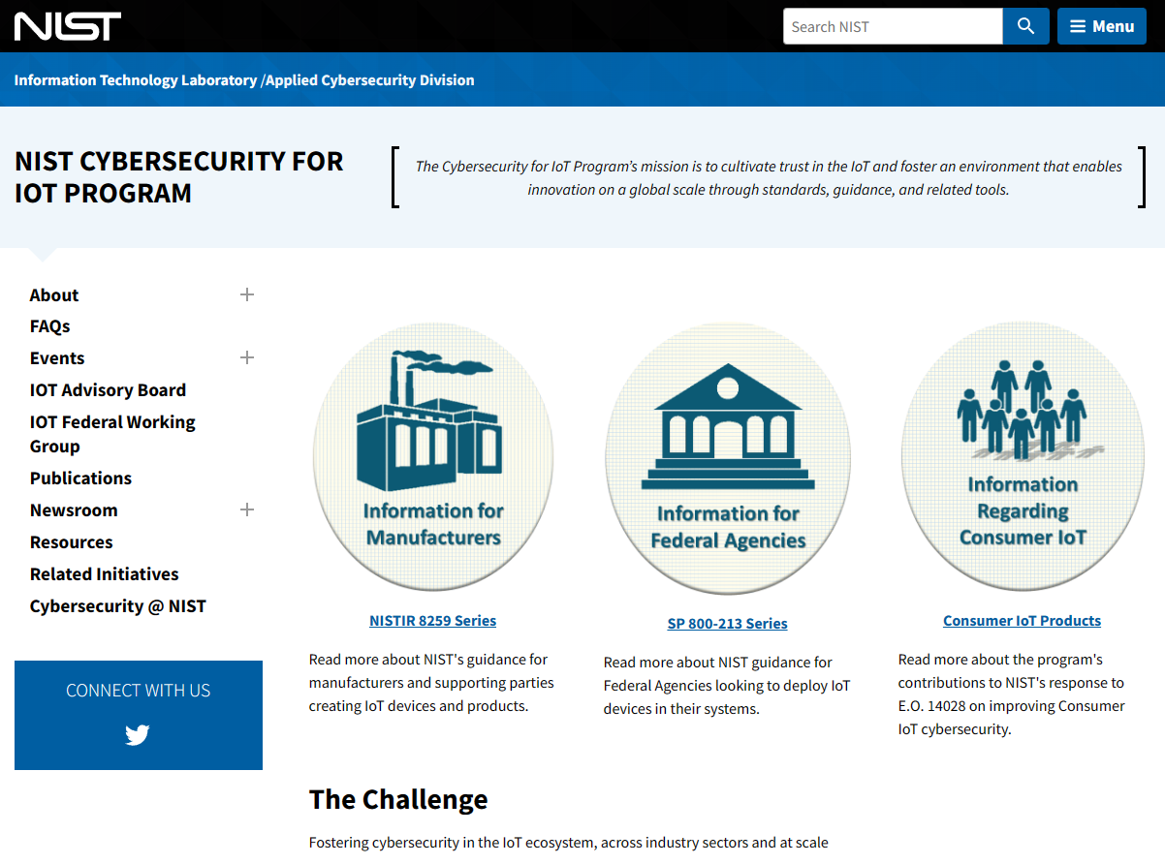
https://www.nist.gov/itl/applied-cybersecurity/nist-cybersecurity-iot-program

Slide 133
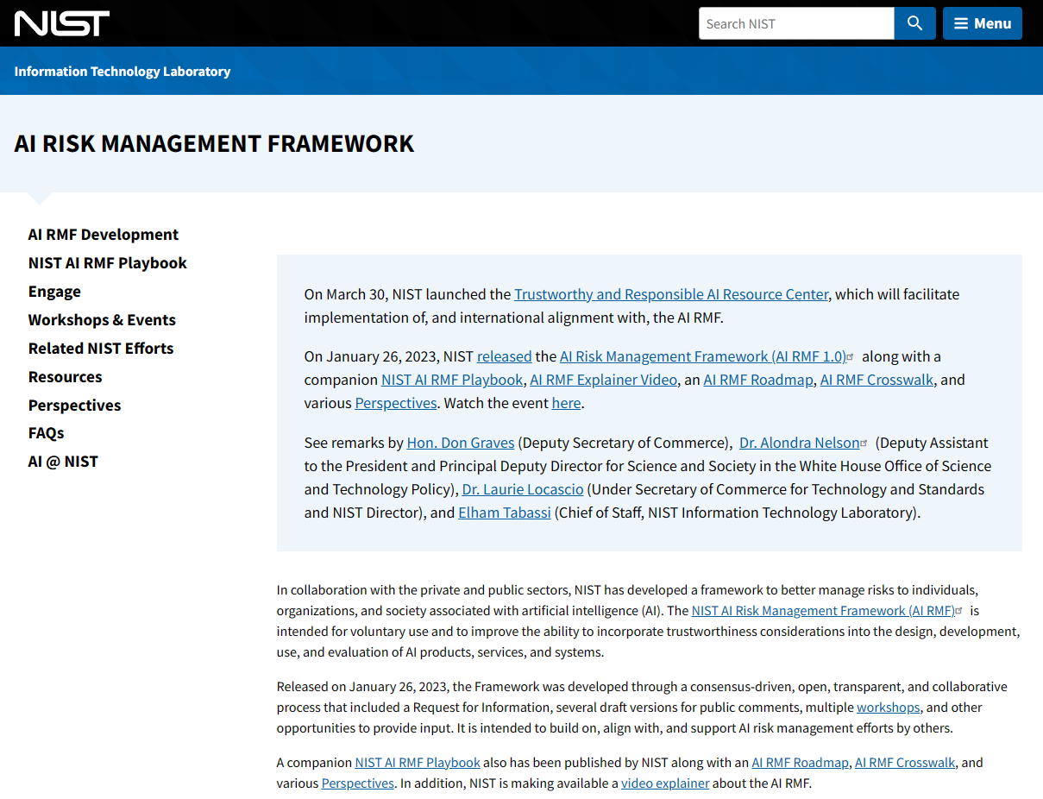
AI RISK MANAGEMENT FRAMEWORK
https://www.nist.gov/itl/ai-risk-management-framework

Slide 134
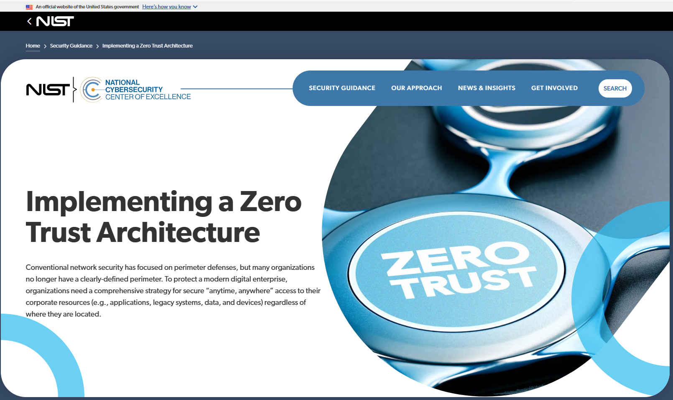
https://www.nccoe.nist.gov/projects/implementing-zero-trust-architecture

