Slide 1
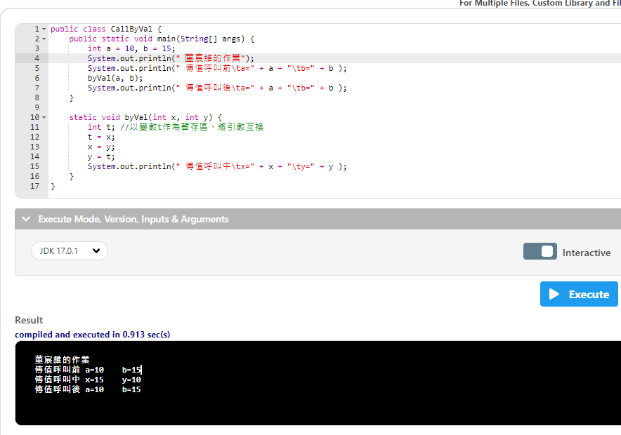

Slide 2
public class CallByVal {
public static void main(String[] args) {
int a = 10, b = 15;
宣告 int a = 10, b = 15
System.out.println(" 董宸維的作業");
System.out.println(" 傳值呼叫前\ta=" + a + "\tb=" + b );
byVal(a, b);
System.out.println(" 傳值呼叫後\ta=" + a + "\tb=" + b );
}
static void byVal(int x, int y) {
int t; //以變數t作為暫存區，將引數互換
t = x;
x = y;
y = t;
System.out.println(" 傳值呼叫中\tx=" + x + "\ty=" + y );
}
}

Slide 3
public class CallByVal {
public static void main(String[] args) {
int a = 10, b = 15;
System.out.println(" 董宸維的作業");
System.out.println(“ 傳值呼叫前\t a=” + a + “\t b=" + b );
/t空四格的意思
byVal(a, b);
System.out.println(" 傳值呼叫後\ta=" + a + "\tb=" + b );
}
static void byVal(int x, int y) {
int t; //以變數t作為暫存區，將引數互換
t = x;
x = y;
y = t;
System.out.println(" 傳值呼叫中\tx=" + x + "\ty=" + y );
}
}

Slide 4
public class CallByVal {
public static void main(String[] args) {
int a = 10, b = 15;
System.out.println(" 董宸維的作業");
System.out.println(" 傳值呼叫前\ta=" + a + "\tb=" + b );
byVal(a, b);
呼叫副程式代入(10,15)
System.out.println(" 傳值呼叫後\ta=" + a + "\tb=" + b );
}
static void byVal(int x, int y) {
int t; //以變數t作為暫存區，將引數互換
t = x;
x = y;
y = t;
System.out.println(" 傳值呼叫中\tx=" + x + "\ty=" + y );
}
}

Slide 5
public class CallByVal {
public static void main(String[] args) {
int a = 10, b = 15;
System.out.println(" 董宸維的作業");
System.out.println(" 傳值呼叫前\ta=" + a + "\tb=" + b );
byVal(a, b);
System.out.println(" 傳值呼叫後\ta=" + a + "\tb=" + b );
}
static void byVal(int x, int y) {
進入這裡顯示x=a,y=b
int t; //以變數t作為暫存區，將引數互換
t = x;
x = y;
y = t;
System.out.println(" 傳值呼叫中\tx=" + x + "\ty=" + y );
}
}

Slide 6
public class CallByVal {
public static void main(String[] args) {
int a = 10, b = 15;
System.out.println(" 董宸維的作業");
System.out.println(" 傳值呼叫前\ta=" + a + "\tb=" + b );
byVal(a, b);
System.out.println(" 傳值呼叫後\ta=" + a + "\tb=" + b );
}
static void byVal(int x, int y) {
int t; //以變數t作為暫存區，將引數互換
宣告一個整數 t
t = x;
x = y;
y = t;
System.out.println(" 傳值呼叫中\tx=" + x + "\ty=" + y );
}
}

Slide 7
public class CallByVal {
public static void main(String[] args) {
int a = 10, b = 15;
System.out.println(" 董宸維的作業");
System.out.println(" 傳值呼叫前\ta=" + a + "\tb=" + b );
byVal(a, b);
System.out.println(" 傳值呼叫後\ta=" + a + "\tb=" + b );
}
static void byVal(int x, int y) {
int t; //以變數t作為暫存區，將引數互換
t = x;
t = x -->t = 10
x = y;
y = t;
System.out.println(" 傳值呼叫中\tx=" + x + "\ty=" + y );
}
}

Slide 8
public class CallByVal {
public static void main(String[] args) {
int a = 10, b = 15;
System.out.println(" 董宸維的作業");
System.out.println(" 傳值呼叫前\ta=" + a + "\tb=" + b );
byVal(a, b);
System.out.println(" 傳值呼叫後\ta=" + a + "\tb=" + b );
}
static void byVal(int x, int y) {
int t; //以變數t作為暫存區，將引數互換
t = x;
x = y;
x = y --> x = 15
y = t;
System.out.println(" 傳值呼叫中\tx=" + x + "\ty=" + y );
}
}

Slide 9
public class CallByVal {
public static void main(String[] args) {
int a = 10, b = 15;
System.out.println(" 董宸維的作業");
System.out.println(" 傳值呼叫前\ta=" + a + "\tb=" + b );
byVal(a, b);
System.out.println(" 傳值呼叫後\ta=" + a + "\tb=" + b );
}
static void byVal(int x, int y) {
int t; //以變數t作為暫存區，將引數互換
t = x;
x = y;
y = t;
y = t --> y = 10
System.out.println(" 傳值呼叫中\tx=" + x + "\ty=" + y );
}
}

Slide 10
public class CallByVal {
public static void main(String[] args) {
int a = 10, b = 15;
System.out.println(" 董宸維的作業");
System.out.println(" 傳值呼叫前\ta=" + a + "\tb=" + b );
byVal(a, b);
System.out.println(" 傳值呼叫後\ta=" + a + "\tb=" + b );
}
static void byVal(int x, int y) {
int t; //以變數t作為暫存區，將引數互換
t = x;
x = y;
y = t;
System.out.println(" 傳值呼叫中\tx=" + x + "\ty=" + y );
由於質被改變所以印出來是a = 15, b = 10
}
}

Slide 11
public class CallByVal {
public static void main(String[] args) {
int a = 10, b = 15;
System.out.println(" 董宸維的作業");
System.out.println(" 傳值呼叫前\ta=" + a + "\tb=" + b );
byVal(a, b);
System.out.println(" 傳值呼叫後\ta=" + a + "\tb=" + b );
質沒有被改變所以印出來還是a = 10, b = 15
}
static void byVal(int x, int y) {
int t; //以變數t作為暫存區，將引數互換
t = x;
x = y;
y = t;
System.out.println(" 傳值呼叫中\tx=" + x + "\ty=" + y );
}
}

Slide 12
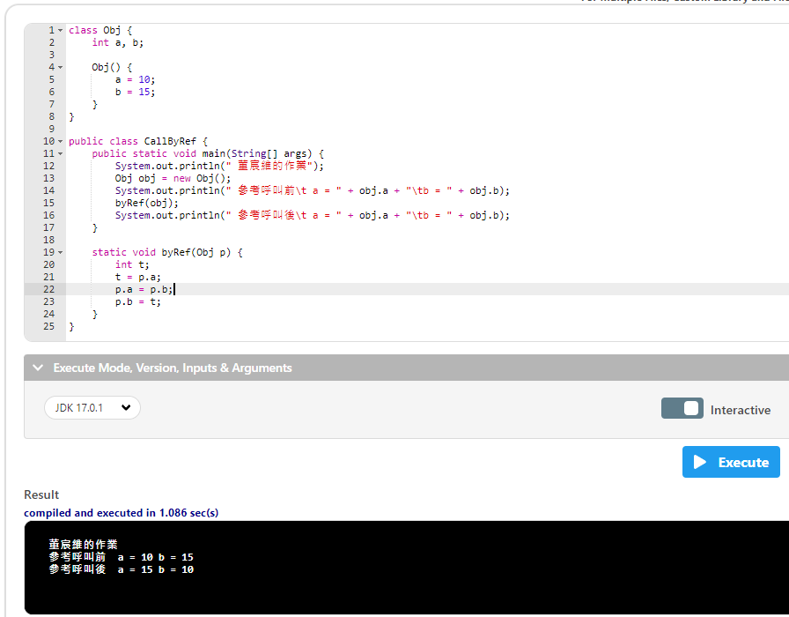

Slide 13
class Obj {
宣告一個類別Obj
int a, b;
Obj() {
a = 10;
b = 15;
}
}
public class CallByRef {
public static void main(String[] args) {
System.out.println(" 董宸維的作業");
Obj obj = new Obj();
System.out.println(" 參考呼叫前\t a = " + obj.a + "\tb = " + obj.b);
byRef(obj);
System.out.println(" 參考呼叫後\t a = " + obj.a + "\tb = " + obj.b);
}
static void byRef(Obj p) {
int t;
t = p.a;
p.a = p.b;
p.b = t;
}
}

Slide 14
class Obj {
int a, b;
宣告整數 a,b
Obj() {
a = 10;
b = 15;
}
}
public class CallByRef {
public static void main(String[] args) {
System.out.println(" 董宸維的作業");
Obj obj = new Obj();
System.out.println(" 參考呼叫前\t a = " + obj.a + "\tb = " + obj.b);
byRef(obj);
System.out.println(" 參考呼叫後\t a = " + obj.a + "\tb = " + obj.b);
}
static void byRef(Obj p) {
int t;
t = p.a;
p.a = p.b;
p.b = t;
}
}

Slide 15
class Obj {
int a, b;
Obj() {
建立一個預設建構子
a = 10;
b = 15;
}
}
public class CallByRef {
public static void main(String[] args) {
System.out.println(" 董宸維的作業");
Obj obj = new Obj();
System.out.println(" 參考呼叫前\t a = " + obj.a + "\tb = " + obj.b);
byRef(obj);
System.out.println(" 參考呼叫後\t a = " + obj.a + "\tb = " + obj.b);
}
static void byRef(Obj p) {
int t;
t = p.a;
p.a = p.b;
p.b = t;
}
}
()沒有寫入任何參數
建構子constructor

Slide 16
class Obj {
int a, b;
Obj() {
a = 10;
b = 15;
宣告 a = 10, b = 15
}
}
public class CallByRef {
public static void main(String[] args) {
System.out.println(" 董宸維的作業");
Obj obj = new Obj();
System.out.println(" 參考呼叫前\t a = " + obj.a + "\tb = " + obj.b);
byRef(obj);
System.out.println(" 參考呼叫後\t a = " + obj.a + "\tb = " + obj.b);
}
static void byRef(Obj p) {
int t;
t = p.a;
p.a = p.b;
p.b = t;
}
}

Slide 17
class Obj {
int a, b;
Obj() {
a = 10;
b = 15;
}
}
public class CallByRef {
public static void main(String[] args) {
System.out.println(" 董宸維的作業");
Obj obj = new Obj();
使用Obj()的類別套件資料傳入 obj
System.out.println(" 參考呼叫前\t a = " + obj.a + "\tb = " + obj.b);
byRef(obj);
System.out.println(" 參考呼叫後\t a = " + obj.a + "\tb = " + obj.b);
}
static void byRef(Obj p) {
int t;
t = p.a;
p.a = p.b;
p.b = t;
}
}

Slide 18
class Obj {
int a, b;
Obj() {
a = 10;
b = 15;
}
}
public class CallByRef {
public static void main(String[] args) {
System.out.println(" 董宸維的作業");
Obj obj = new Obj();
System.out.println(" 參考呼叫前\t a = " + obj.a + "\tb = " + obj.b);
呼叫出來的質會是a = 10, b = 15
byRef(obj);
System.out.println(" 參考呼叫後\t a = " + obj.a + "\tb = " + obj.b);
}
static void byRef(Obj p) {
int t;
t = p.a;
p.a = p.b;
p.b = t;
}
}

Slide 19
class Obj {
int a, b;
Obj() {
a = 10;
b = 15;
}
}
public class CallByRef {
public static void main(String[] args) {
System.out.println(" 董宸維的作業");
Obj obj = new Obj();
System.out.println(" 參考呼叫前\t a = " + obj.a + "\tb = " + obj.b);
byRef(obj);
呼叫副程式代入(obj)的質
System.out.println(" 參考呼叫後\t a = " + obj.a + "\tb = " + obj.b);
}
static void byRef(Obj p) {
int t;
t = p.a;
p.a = p.b;
p.b = t;
}
}

Slide 20
class Obj {
int a, b;
Obj() {
a = 10;
b = 15;
}
}
public class CallByRef {
public static void main(String[] args) {
System.out.println(" 董宸維的作業");
Obj obj = new Obj();
System.out.println(" 參考呼叫前\t a = " + obj.a + "\tb = " + obj.b);
byRef(obj);
System.out.println(" 參考呼叫後\t a = " + obj.a + "\tb = " + obj.b);
}
static void byRef(Obj p) {
byRef(Obj p)是代入a = 10, b = 15
int t;
t = p.a;
p.a = p.b;
p.b = t;
}
}

Slide 21
class Obj {
int a, b;
Obj() {
a = 10;
b = 15;
}
}
public class CallByRef {
public static void main(String[] args) {
System.out.println(" 董宸維的作業");
Obj obj = new Obj();
System.out.println(" 參考呼叫前\t a = " + obj.a + "\tb = " + obj.b);
byRef(obj);
System.out.println(" 參考呼叫後\t a = " + obj.a + "\tb = " + obj.b);
}
static void byRef(Obj p) {
int t;
宣告一個整數 t
t = p.a;
p.a = p.b;
p.b = t;
}
}

Slide 22
class Obj {
int a, b;
Obj() {
a = 10;
b = 15;
}
}
public class CallByRef {
public static void main(String[] args) {
System.out.println(" 董宸維的作業");
Obj obj = new Obj();
System.out.println(" 參考呼叫前\t a = " + obj.a + "\tb = " + obj.b);
byRef(obj);
System.out.println(" 參考呼叫後\t a = " + obj.a + "\tb = " + obj.b);
}
static void byRef(Obj p) {
int t;
t = p.a;
t = p.a -->t = 10
p.a = p.b;
p.b = t;
}
}

Slide 23
class Obj {
int a, b;
Obj() {
a = 10;
b = 15;
}
}
public class CallByRef {
public static void main(String[] args) {
System.out.println(" 董宸維的作業");
Obj obj = new Obj();
System.out.println(" 參考呼叫前\t a = " + obj.a + "\tb = " + obj.b);
byRef(obj);
System.out.println(" 參考呼叫後\t a = " + obj.a + "\tb = " + obj.b);
}
static void byRef(Obj p) {
int t;
t = p.a;
p.a = p.b;
p.a = p.b --> p.a = 15
p.b = t;
}
}

Slide 24
class Obj {
int a, b;
Obj() {
a = 10;
b = 15;
}
}
public class CallByRef {
public static void main(String[] args) {
System.out.println(" 董宸維的作業");
Obj obj = new Obj();
System.out.println(" 參考呼叫前\t a = " + obj.a + "\tb = " + obj.b);
byRef(obj);
System.out.println(" 參考呼叫後\t a = " + obj.a + "\tb = " + obj.b);
}
static void byRef(Obj p) {
int t;
t = p.a;
p.a = p.b;
p.b = t;
p.b = t --> p.b = 10
}
}

Slide 25
class Obj {
int a, b;
Obj() {
a = 10;
b = 15;
}
}
public class CallByRef {
public static void main(String[] args) {
System.out.println(" 董宸維的作業");
Obj obj = new Obj();
System.out.println(" 參考呼叫前\t a = " + obj.a + "\tb = " + obj.b);
byRef(obj);
System.out.println(" 參考呼叫後\t a = " + obj.a + "\tb = " + obj.b);
}
static void byRef(Obj p) {
int t;
t = p.a;
p.a = p.b;
p.b = t;
}
}

Slide 26
class Obj {
int a, b;
Obj() {
a = 10;
b = 15;
}
}
public class CallByRef {
public static void main(String[] args) {
System.out.println(" 董宸維的作業");
Obj obj = new Obj();
System.out.println(" 參考呼叫前\t a = " + obj.a + "\tb = " + obj.b);
byRef(obj);
System.out.println(" 參考呼叫後\t a = " + obj.a + "\tb = " + obj.b);
}
static void byRef(Obj p) {
int t;
t = p.a;
p.a = p.b;
p.b = t;
}
}

Slide 27
class Obj {
int a, b;
Obj() {
a = 10;
b = 15;
}
}
public class CallByRef {
public static void main(String[] args) {
System.out.println(" 董宸維的作業");
Obj obj = new Obj();
System.out.println(" 參考呼叫前\t a = " + obj.a + "\tb = " + obj.b);
byRef(obj);
System.out.println(" 參考呼叫後\t a = " + obj.a + "\tb = " + obj.b);
}
static void byRef(Obj p) {
int t;
t = p.a;
p.a = p.b;
p.b = t;
}
}

Slide 28
class Obj {
int a, b;
Obj() {
a = 10;
b = 15;
}
}
public class CallByRef {
public static void main(String[] args) {
System.out.println(" 董宸維的作業");
Obj obj = new Obj();
System.out.println(" 參考呼叫前\t a = " + obj.a + "\tb = " + obj.b);
byRef(obj);
System.out.println(" 參考呼叫後\t a = " + obj.a + "\tb = " + obj.b);
}
static void byRef(Obj p) {
int t;
t = p.a;
p.a = p.b;
p.b = t;
}
}

Slide 29
class Obj {
int a, b;
Obj() {
a = 10;
b = 15;
}
}
public class CallByRef {
public static void main(String[] args) {
System.out.println(" 董宸維的作業");
Obj obj = new Obj();
System.out.println(" 參考呼叫前\t a = " + obj.a + "\tb = " + obj.b);
byRef(obj);
System.out.println(" 參考呼叫後\t a = " + obj.a + "\tb = " + obj.b);
}
static void byRef(Obj p) {
int t;
t = p.a;
p.a = p.b;
p.b = t;
}
}

Slide 30
class Obj {
int a, b;
Obj() {
a = 10;
b = 15;
}
}
public class CallByRef {
public static void main(String[] args) {
System.out.println(" 董宸維的作業");
Obj obj = new Obj();
System.out.println(" 參考呼叫前\t a = " + obj.a + "\tb = " + obj.b);
byRef(obj);
System.out.println(" 參考呼叫後\t a = " + obj.a + "\tb = " + obj.b);
}
static void byRef(Obj p) {
int t;
t = p.a;
p.a = p.b;
p.b = t;
}
}

Slide 31
class Obj {
int a, b;
Obj() {
a = 10;
b = 15;
}
}
public class CallByRef {
public static void main(String[] args) {
System.out.println(" 董宸維的作業");
Obj obj = new Obj();
System.out.println(" 參考呼叫前\t a = " + obj.a + "\tb = " + obj.b);
byRef(obj);
System.out.println(" 參考呼叫後\t a = " + obj.a + "\tb = " + obj.b);
}
static void byRef(Obj p) {
int t;
t = p.a;
p.a = p.b;
p.b = t;
}
}

Slide 32
class Obj {
int a, b;
Obj() {
a = 10;
b = 15;
}
}
public class CallByRef {
public static void main(String[] args) {
System.out.println(" 董宸維的作業");
Obj obj = new Obj();
System.out.println(" 參考呼叫前\t a = " + obj.a + "\tb = " + obj.b);
byRef(obj);
System.out.println(" 參考呼叫後\t a = " + obj.a + "\tb = " + obj.b);
}
static void byRef(Obj p) {
int t;
t = p.a;
p.a = p.b;
p.b = t;
}
}

Slide 33
class Obj {
int a, b;
Obj() {
a = 10;
b = 15;
}
}
public class CallByRef {
public static void main(String[] args) {
System.out.println(" 董宸維的作業");
Obj obj = new Obj();
System.out.println(" 參考呼叫前\t a = " + obj.a + "\tb = " + obj.b);
byRef(obj);
System.out.println(" 參考呼叫後\t a = " + obj.a + "\tb = " + obj.b);
}
static void byRef(Obj p) {
int t;
t = p.a;
p.a = p.b;
p.b = t;
}
}

Slide 34
class Obj {
int a, b;
Obj() {
a = 10;
b = 15;
}
}
public class CallByRef {
public static void main(String[] args) {
System.out.println(" 董宸維的作業");
Obj obj = new Obj();
System.out.println(" 參考呼叫前\t a = " + obj.a + "\tb = " + obj.b);
byRef(obj);
System.out.println(" 參考呼叫後\t a = " + obj.a + "\tb = " + obj.b);
}
static void byRef(Obj p) {
int t;
t = p.a;
p.a = p.b;
p.b = t;
}
}

Slide 35
class Obj {
int a, b;
Obj() {
a = 10;
b = 15;
}
}
public class CallByRef {
public static void main(String[] args) {
System.out.println(" 董宸維的作業");
Obj obj = new Obj();
System.out.println(" 參考呼叫前\t a = " + obj.a + "\tb = " + obj.b);
byRef(obj);
System.out.println(" 參考呼叫後\t a = " + obj.a + "\tb = " + obj.b);
}
static void byRef(Obj p) {
int t;
t = p.a;
p.a = p.b;
p.b = t;
}
}

Slide 36
class Obj {
int a, b;
Obj() {
a = 10;
b = 15;
}
}
public class CallByRef {
public static void main(String[] args) {
System.out.println(" 董宸維的作業");
Obj obj = new Obj();
System.out.println(" 參考呼叫前\t a = " + obj.a + "\tb = " + obj.b);
byRef(obj);
System.out.println(" 參考呼叫後\t a = " + obj.a + "\tb = " + obj.b);
}
static void byRef(Obj p) {
int t;
t = p.a;
p.a = p.b;
p.b = t;
}
}

Slide 37
class Obj {
int a, b;
Obj() {
a = 10;
b = 15;
}
}
public class CallByRef {
public static void main(String[] args) {
System.out.println(" 董宸維的作業");
Obj obj = new Obj();
System.out.println(" 參考呼叫前\t a = " + obj.a + "\tb = " + obj.b);
byRef(obj);
System.out.println(" 參考呼叫後\t a = " + obj.a + "\tb = " + obj.b);
}
static void byRef(Obj p) {
int t;
t = p.a;
p.a = p.b;
p.b = t;
}
}

Slide 38
class Obj {
int a, b;
Obj() {
a = 10;
b = 15;
}
}
public class CallByRef {
public static void main(String[] args) {
System.out.println(" 董宸維的作業");
Obj obj = new Obj();
System.out.println(" 參考呼叫前\t a = " + obj.a + "\tb = " + obj.b);
byRef(obj);
System.out.println(" 參考呼叫後\t a = " + obj.a + "\tb = " + obj.b);
}
static void byRef(Obj p) {
int t;
t = p.a;
p.a = p.b;
p.b = t;
}
}

Slide 39
class Obj {
int a, b;
Obj() {
a = 10;
b = 15;
}
}
public class CallByRef {
public static void main(String[] args) {
System.out.println(" 董宸維的作業");
Obj obj = new Obj();
System.out.println(" 參考呼叫前\t a = " + obj.a + "\tb = " + obj.b);
byRef(obj);
System.out.println(" 參考呼叫後\t a = " + obj.a + "\tb = " + obj.b);
}
static void byRef(Obj p) {
int t;
t = p.a;
p.a = p.b;
p.b = t;
}
}

Slide 40
class Obj {
int a, b;
Obj() {
a = 10;
b = 15;
}
}
public class CallByRef {
public static void main(String[] args) {
System.out.println(" 董宸維的作業");
Obj obj = new Obj();
System.out.println(" 參考呼叫前\t a = " + obj.a + "\tb = " + obj.b);
byRef(obj);
System.out.println(" 參考呼叫後\t a = " + obj.a + "\tb = " + obj.b);
}
static void byRef(Obj p) {
int t;
t = p.a;
p.a = p.b;
p.b = t;
}
}

Slide 41
class Obj {
int a, b;
Obj() {
a = 10;
b = 15;
}
}
public class CallByRef {
public static void main(String[] args) {
System.out.println(" 董宸維的作業");
Obj obj = new Obj();
System.out.println(" 參考呼叫前\t a = " + obj.a + "\tb = " + obj.b);
byRef(obj);
System.out.println(" 參考呼叫後\t a = " + obj.a + "\tb = " + obj.b);
}
static void byRef(Obj p) {
int t;
t = p.a;
p.a = p.b;
p.b = t;
}
}

Slide 42
class Obj {
int a, b;
Obj() {
a = 10;
b = 15;
}
}
public class CallByRef {
public static void main(String[] args) {
System.out.println(" 董宸維的作業");
Obj obj = new Obj();
System.out.println(" 參考呼叫前\t a = " + obj.a + "\tb = " + obj.b);
byRef(obj);
System.out.println(" 參考呼叫後\t a = " + obj.a + "\tb = " + obj.b);
}
static void byRef(Obj p) {
int t;
t = p.a;
p.a = p.b;
p.b = t;
}
}

Slide 43
class Obj {
int a, b;
Obj() {
a = 10;
b = 15;
}
}
public class CallByRef {
public static void main(String[] args) {
System.out.println(" 董宸維的作業");
Obj obj = new Obj();
System.out.println(" 參考呼叫前\t a = " + obj.a + "\tb = " + obj.b);
byRef(obj);
System.out.println(" 參考呼叫後\t a = " + obj.a + "\tb = " + obj.b);
}
static void byRef(Obj p) {
int t;
t = p.a;
p.a = p.b;
p.b = t;
}
}

Slide 44
class Obj {
int a, b;
Obj() {
a = 10;
b = 15;
}
}
public class CallByRef {
public static void main(String[] args) {
System.out.println(" 董宸維的作業");
Obj obj = new Obj();
System.out.println(" 參考呼叫前\t a = " + obj.a + "\tb = " + obj.b);
byRef(obj);
System.out.println(" 參考呼叫後\t a = " + obj.a + "\tb = " + obj.b);
}
static void byRef(Obj p) {
int t;
t = p.a;
p.a = p.b;
p.b = t;
}
}

Slide 45
class Obj {
int a, b;
Obj() {
a = 10;
b = 15;
}
}
public class CallByRef {
public static void main(String[] args) {
System.out.println(" 董宸維的作業");
Obj obj = new Obj();
System.out.println(" 參考呼叫前\t a = " + obj.a + "\tb = " + obj.b);
byRef(obj);
System.out.println(" 參考呼叫後\t a = " + obj.a + "\tb = " + obj.b);
}
static void byRef(Obj p) {
int t;
t = p.a;
p.a = p.b;
p.b = t;
}
}

Slide 46
class Obj {
int a, b;
Obj() {
a = 10;
b = 15;
}
}
public class CallByRef {
public static void main(String[] args) {
System.out.println(" 董宸維的作業");
Obj obj = new Obj();
System.out.println(" 參考呼叫前\t a = " + obj.a + "\tb = " + obj.b);
byRef(obj);
System.out.println(" 參考呼叫後\t a = " + obj.a + "\tb = " + obj.b);
}
static void byRef(Obj p) {
int t;
t = p.a;
p.a = p.b;
p.b = t;
}
}

Slide 47
class Obj {
int a, b;
Obj() {
a = 10;
b = 15;
}
}
public class CallByRef {
public static void main(String[] args) {
System.out.println(" 董宸維的作業");
Obj obj = new Obj();
System.out.println(" 參考呼叫前\t a = " + obj.a + "\tb = " + obj.b);
byRef(obj);
System.out.println(" 參考呼叫後\t a = " + obj.a + "\tb = " + obj.b);
}
static void byRef(Obj p) {
int t;
t = p.a;
p.a = p.b;
p.b = t;
}
}

Slide 48
class Obj {
int a, b;
Obj() {
a = 10;
b = 15;
}
}
public class CallByRef {
public static void main(String[] args) {
System.out.println(" 董宸維的作業");
Obj obj = new Obj();
System.out.println(" 參考呼叫前\t a = " + obj.a + "\tb = " + obj.b);
byRef(obj);
System.out.println(" 參考呼叫後\t a = " + obj.a + "\tb = " + obj.b);
}
static void byRef(Obj p) {
int t;
t = p.a;
p.a = p.b;
p.b = t;
}
}

Slide 49
class Obj {
int a, b;
Obj() {
a = 10;
b = 15;
}
}
public class CallByRef {
public static void main(String[] args) {
System.out.println(" 董宸維的作業");
Obj obj = new Obj();
System.out.println(" 參考呼叫前\t a = " + obj.a + "\tb = " + obj.b);
byRef(obj);
System.out.println(" 參考呼叫後\t a = " + obj.a + "\tb = " + obj.b);
}
static void byRef(Obj p) {
int t;
t = p.a;
p.a = p.b;
p.b = t;
}
}

Slide 50
class Obj {
int a, b;
Obj() {
a = 10;
b = 15;
}
}
public class CallByRef {
public static void main(String[] args) {
System.out.println(" 董宸維的作業");
Obj obj = new Obj();
System.out.println(" 參考呼叫前\t a = " + obj.a + "\tb = " + obj.b);
byRef(obj);
System.out.println(" 參考呼叫後\t a = " + obj.a + "\tb = " + obj.b);
}
static void byRef(Obj p) {
int t;
t = p.a;
p.a = p.b;
p.b = t;
}
}

Slide 51
class Obj {
int a, b;
Obj() {
a = 10;
b = 15;
}
}
public class CallByRef {
public static void main(String[] args) {
System.out.println(" 董宸維的作業");
Obj obj = new Obj();
System.out.println(" 參考呼叫前\t a = " + obj.a + "\tb = " + obj.b);
byRef(obj);
System.out.println(" 參考呼叫後\t a = " + obj.a + "\tb = " + obj.b);
}
static void byRef(Obj p) {
int t;
t = p.a;
p.a = p.b;
p.b = t;
}
}

Slide 52
class Obj {
int a, b;
Obj() {
a = 10;
b = 15;
}
}
public class CallByRef {
public static void main(String[] args) {
System.out.println(" 董宸維的作業");
Obj obj = new Obj();
System.out.println(" 參考呼叫前\t a = " + obj.a + "\tb = " + obj.b);
byRef(obj);
System.out.println(" 參考呼叫後\t a = " + obj.a + "\tb = " + obj.b);
}
static void byRef(Obj p) {
int t;
t = p.a;
p.a = p.b;
p.b = t;
}
}

Slide 53
class Obj {
int a, b;
Obj() {
a = 10;
b = 15;
}
}
public class CallByRef {
public static void main(String[] args) {
System.out.println(" 董宸維的作業");
Obj obj = new Obj();
System.out.println(" 參考呼叫前\t a = " + obj.a + "\tb = " + obj.b);
byRef(obj);
System.out.println(" 參考呼叫後\t a = " + obj.a + "\tb = " + obj.b);
}
static void byRef(Obj p) {
int t;
t = p.a;
p.a = p.b;
p.b = t;
}
}

Slide 54
class Obj {
int a, b;
Obj() {
a = 10;
b = 15;
}
}
public class CallByRef {
public static void main(String[] args) {
System.out.println(" 董宸維的作業");
Obj obj = new Obj();
System.out.println(" 參考呼叫前\t a = " + obj.a + "\tb = " + obj.b);
byRef(obj);
System.out.println(" 參考呼叫後\t a = " + obj.a + "\tb = " + obj.b);
}
static void byRef(Obj p) {
int t;
t = p.a;
p.a = p.b;
p.b = t;
}
}

