Slide 1
JAVA物件導向程式開發報告
程式設計二
學生:
老師:偉大的恩師龍大大

Slide 2
Agenda
物件導向技術(Object-Oriented) 結構化程式開發
核心觀念: 類別(class)與物件(object)

Slide 3
public class Ccar {
public double gas, tbo;
public double max_dist = 0;
public void maxDist() {
max_dist = gas * tbo;
}
public double dist(double oil) {
return oil * tbo;
}
}
Ccar
+gas
宣告屬性
+tbo
+max_dist
+maxDist()
宣告方法
+dist()

Slide 4
public class BuildObject {
public static void main(String[] args) {
Ccar car1; //宣告car1物件
car1 = new Ccar(); //建立car1物件
car1.gas = 40; //設定car1物件的屬性值
car1.tbo = 13.6;
car1.maxDist(); //呼叫car1物件的方法
double distance = car1.dist(20); //呼叫car1物件的方法,並取得傳回值
System.out.println("car1汽車資訊：");
System.out.println("最大載油量：" + car1.gas + " L");
System.out.println("平均耗油量：" + car1.tbo + " km/L");
System.out.println("加滿油可行駛 " + car1.max_dist + " km");
System.out.println("加油20L可行駛 " + distance + " km");
Ccar car2 = new Ccar(); //宣告並建立car2物件
car2.gas = 60; //設定car2物件的屬性值
car2.tbo = 9.5;
}
}

Slide 5
Ccar
Ccar car1= new Ccar();
+gas
Ccar car1;
car1 = new Ccar(); car2 = new Ccar();
+tbo
+max_dist
+maxDist()
+dist()
car1
car2

Slide 6
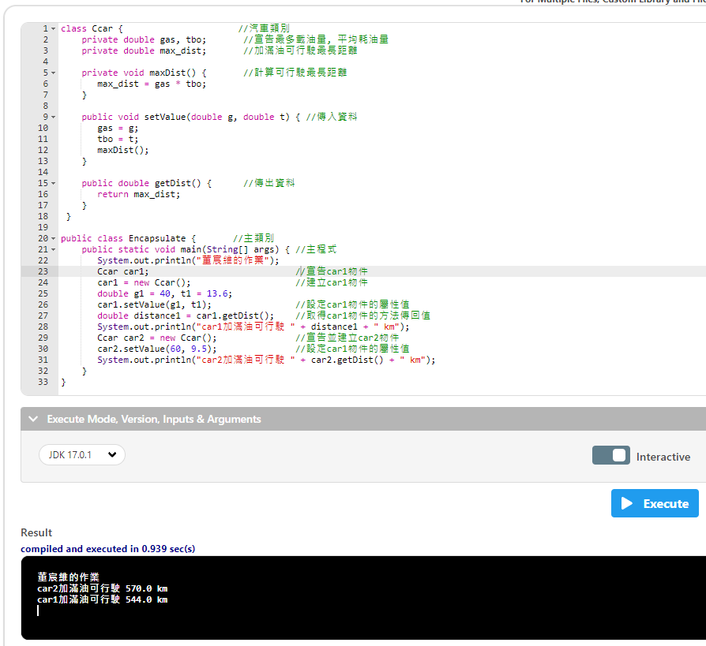
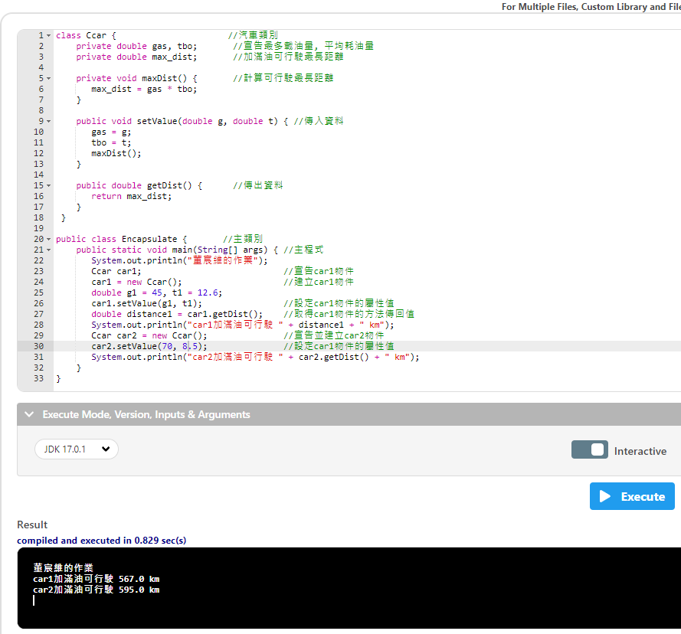

Slide 7
class Ccar {
private double gas, tbo;
private double max_dist;
private void maxDist() {
max_dist = gas * tbo;
}
public void setValue(double g, double t) {
gas = g;
tbo = t;
maxDist();
}
public double getDist() {
return max_dist;
}
}
Ccar
private私人存取
-gas
-tbo
-max_dist
public大家都可以存取
+setValue()
+getDist()

Slide 8
class Ccar {
private double gas, tbo;
private double max_dist;
private void maxDist() {
max_dist = gas * tbo;
}
public void setValue(double g, double t) {
gas = g;
tbo = t;
maxDist();
}
public double getDist() {
return max_dist;
}
}
public class Encapsulate {
public static void main(String[] args) {
System.out.println("董宸維的作業");
Ccar car1;
car1 = new Ccar();
double g1 = 45, t1 = 12.6;
car1.setValue(g1, t1);
double distance1 = car1.getDist();
System.out.println("car1加滿油可行駛 " + distance1 + " km");
Ccar car2 = new Ccar();
car2.setValue(70,8.5);
System.out.println("car2加滿油可行駛 " + car2.getDist() + " km");
}
}

Slide 9
class Ccar { //汽車類別
private double gas, tbo; //宣告最多載油量, 平均耗油量
private double max_dist; //加滿油可行駛最長距離
private void maxDist() { //計算可行駛最長距離
max_dist = gas * tbo;
}
public void setValue(double g, double t) { //傳入資料
gas = g;
tbo = t;
maxDist();
}
public double getDist() { //傳出資料
return max_dist;
}
}
public class Encapsulate { //主類別
public static void main(String[] args) { //主程式
System.out.println("董宸維的作業");
Ccar car1; //宣告car1物件
car1 = new Ccar(); //建立car1物件
double g1 = 45, t1 = 12.6;
car1.setValue(g1, t1); //設定car1物件的屬性值
double distance1 = car1.getDist(); //取得car1物件的方法傳回值
System.out.println("car1加滿油可行駛 " + distance1 + " km");
Ccar car2 = new Ccar(); //宣告並建立car2物件
car2.setValue(70,8.5); //設定car1物件的屬性值
System.out.println("car2加滿油可行駛 " + car2.getDist() + " km");
}
}

