Slide 1
第四作業

Slide 2
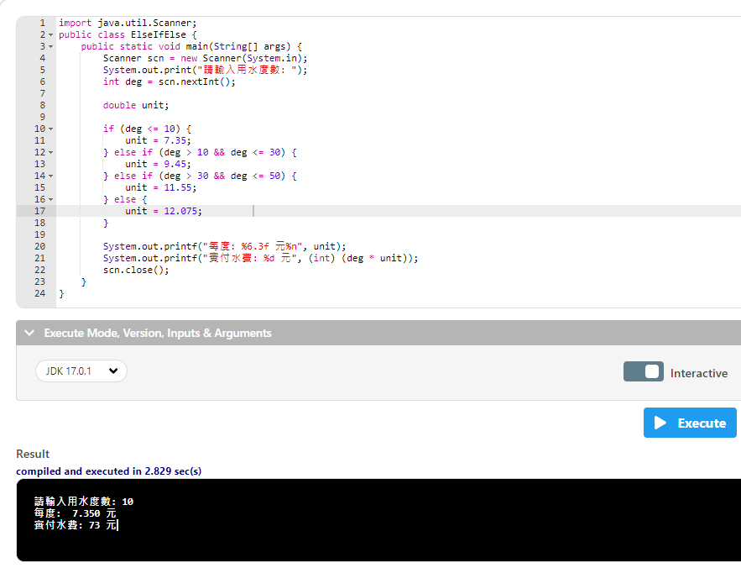

Slide 3
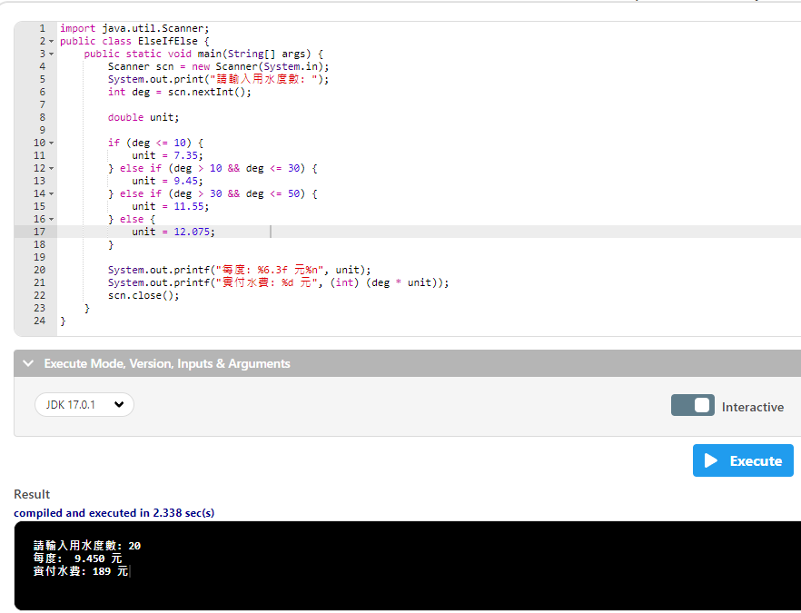

Slide 4
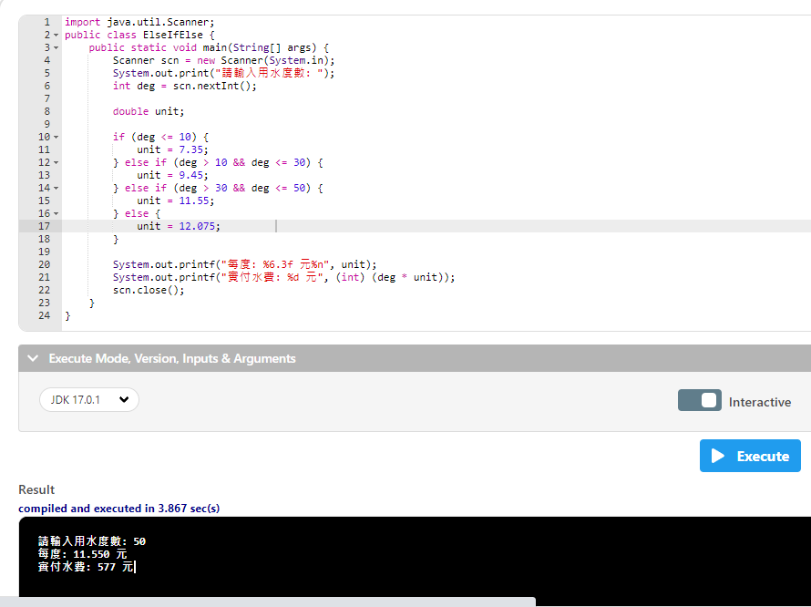

Slide 5
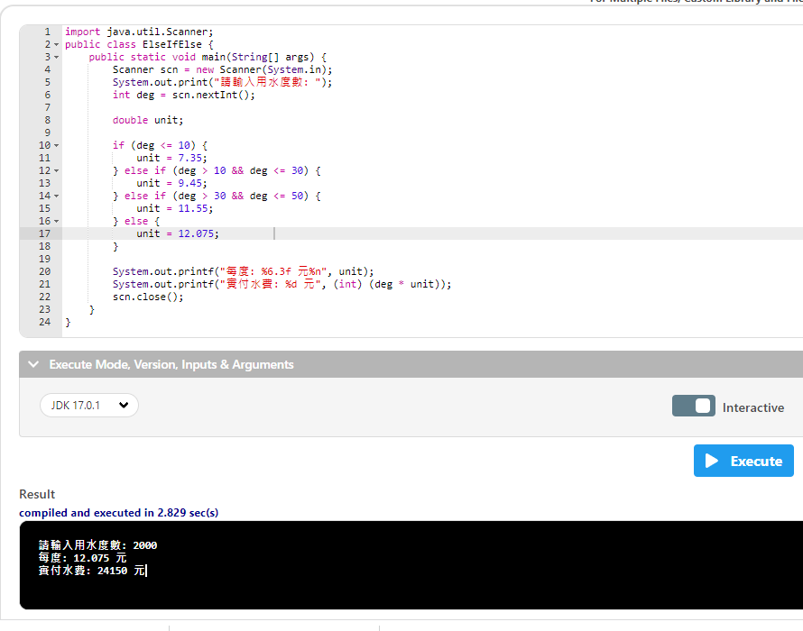

Slide 6
import java.util.Scanner;
public class ElseIfElse {
public static void main(String[] args) {
Scanner scn = new Scanner(System.in);
使用Scanner的類別套件scn是物件可以自己取名字
系統等待輸入 資料傳入新的Scanner再回傳給 scn
System.out.print("請輸入用水度數: ");
int deg = scn.nextInt();
double unit;
if (deg <= 10) {
unit = 7.35;
} else if (deg > 10 && deg <= 30) {
unit = 9.45;
} else if (deg > 30 && deg <= 50) {
unit = 11.55;
} else {
unit = 12.075;
}
System.out.printf("每度: %6.3f 元%n", unit);
System.out.printf("實付水費: %d 元", (int) (deg * unit));
scn.close();
}
}

Slide 7
import java.util.Scanner;
public class ElseIfElse {
public static void main(String[] args) {
Scanner scn = new Scanner(System.in);
System.out.print("請輸入用水度數: ");
int deg = scn.nextInt(); //scn.next(); 如果寫這樣是回傳字串 整數自己取名子輸入進來的值會把它認定為整數
double unit;
if (deg <= 10) {
unit = 7.35;
} else if (deg > 10 && deg <= 30) {
unit = 9.45;
} else if (deg > 30 && deg <= 50) {
unit = 11.55;
} else {
unit = 12.075;
}
System.out.printf("每度: %6.3f 元%n", unit);
System.out.printf("實付水費: %d 元", (int) (deg * unit));
scn.close();
}
}

Slide 8
import java.util.Scanner;
public class ElseIfElse {
public static void main(String[] args) {
Scanner scn = new Scanner(System.in);
System.out.print("請輸入用水度數: ");
int deg = scn.nextInt();
double unit;
宣告double
if (deg <= 10) {
unit = 7.35;
} else if (deg > 10 && deg <= 30) {
unit = 9.45;
} else if (deg > 30 && deg <= 50) {
unit = 11.55;
} else {
unit = 12.075;
}
System.out.printf("每度: %6.3f 元%n", unit);
System.out.printf("實付水費: %d 元", (int) (deg * unit));
scn.close();
}
}

Slide 9
import java.util.Scanner;
public class ElseIfElse {
public static void main(String[] args) {
Scanner scn = new Scanner(System.in);
System.out.print("請輸入用水度數: ");
int deg = scn.nextInt();
double unit;
if (deg <= 10) {
如果輸入進來的值<=10就會進入
unit = 7.35;
} else if (deg > 10 && deg <= 30) {
unit = 9.45;
} else if (deg > 30 && deg <= 50) {
unit = 11.55;
} else {
unit = 12.075;
}
System.out.printf("每度: %6.3f 元%n", unit);
System.out.printf("實付水費: %d 元", (int) (deg * unit));
scn.close();
}
}

Slide 10
import java.util.Scanner;
public class ElseIfElse {
public static void main(String[] args) {
Scanner scn = new Scanner(System.in);
System.out.print("請輸入用水度數: ");
int deg = scn.nextInt();
double unit;
if (deg <= 10) {
unit = 7.35;
如果輸入的值<=10就會得到 unit = 7.35答案
} else if (deg > 10 && deg <= 30) {
unit = 9.45;
} else if (deg > 30 && deg <= 50) {
unit = 11.55;
} else {
unit = 12.075;
}
System.out.printf("每度: %6.3f 元%n", unit);
System.out.printf("實付水費: %d 元", (int) (deg * unit));
scn.close();
}
}

Slide 11
import java.util.Scanner;
public class ElseIfElse {
public static void main(String[] args) {
Scanner scn = new Scanner(System.in);
System.out.print("請輸入用水度數: ");
int deg = scn.nextInt();
double unit;
if (deg <= 10) {
unit = 7.35;
} else if (deg > 10 && deg <= 30) {
如果輸入進來的值>10或者 <=30就會進入
unit = 9.45;
} else if (deg > 30 && deg <= 50) {
unit = 11.55;
} else {
unit = 12.075;
}
System.out.printf("每度: %6.3f 元%n", unit);
System.out.printf("實付水費: %d 元", (int) (deg * unit));
scn.close();
}
}

Slide 12
import java.util.Scanner;
public class ElseIfElse {
public static void main(String[] args) {
Scanner scn = new Scanner(System.in);
System.out.print("請輸入用水度數: ");
int deg = scn.nextInt();
double unit;
if (deg <= 10) {
unit = 7.35;
} else if (deg > 10 && deg <= 30) {
unit = 9.45;
如果輸入的值 >10 <=30就會得到 unit = 9.45答案
} else if (deg > 30 && deg <= 50) {
unit = 11.55;
} else {
unit = 12.075;
}
System.out.printf("每度: %6.3f 元%n", unit);
System.out.printf("實付水費: %d 元", (int) (deg * unit));
scn.close();
}
}

Slide 13
import java.util.Scanner;
public class ElseIfElse {
public static void main(String[] args) {
Scanner scn = new Scanner(System.in);
System.out.print("請輸入用水度數: ");
int deg = scn.nextInt();
double unit;
if (deg <= 10) {
unit = 7.35;
} else if (deg > 10 && deg <= 30) {
unit = 9.45;
} else if (deg > 30 && deg <= 50) {
如果輸入進來的值>30或者 <=50就會進入
unit = 11.55;
} else {
unit = 12.075;
}
System.out.printf("每度: %6.3f 元%n", unit);
System.out.printf("實付水費: %d 元", (int) (deg * unit));
scn.close();
}
}

Slide 14
import java.util.Scanner;
public class ElseIfElse {
public static void main(String[] args) {
Scanner scn = new Scanner(System.in);
System.out.print("請輸入用水度數: ");
int deg = scn.nextInt();
double unit;
if (deg <= 10) {
unit = 7.35;
} else if (deg > 10 && deg <= 30) {
unit = 9.45;
} else if (deg > 30 && deg <= 50) {
unit = 11.55;
如果輸入的值 >30 <=50就會得到 unit = 11.55答案
} else {
unit = 12.075;
}
System.out.printf("每度: %6.3f 元%n", unit);
System.out.printf("實付水費: %d 元", (int) (deg * unit));
scn.close();
}
}

Slide 15
import java.util.Scanner;
public class ElseIfElse {
public static void main(String[] args) {
Scanner scn = new Scanner(System.in);
System.out.print("請輸入用水度數: ");
int deg = scn.nextInt();
double unit;
if (deg <= 10) {
unit = 7.35;
} else if (deg > 10 && deg <= 30) {
unit = 9.45;
} else if (deg > 30 && deg <= 50) {
unit = 11.55;
} else {
如果以上都沒有就會進入這裡
unit = 12.075;
}
System.out.printf("每度: %6.3f 元%n", unit);
System.out.printf("實付水費: %d 元", (int) (deg * unit));
scn.close();
}
}

Slide 16
import java.util.Scanner;
public class ElseIfElse {
public static void main(String[] args) {
Scanner scn = new Scanner(System.in);
System.out.print("請輸入用水度數: ");
int deg = scn.nextInt();
double unit;
if (deg <= 10) {
unit = 7.35;
} else if (deg > 10 && deg <= 30) {
unit = 9.45;
} else if (deg > 30 && deg <= 50) {
unit = 11.55;
} else {
unit = 12.075;
進入這裡就會得到 unit = 12.075答案
}
System.out.printf("每度: %6.3f 元%n", unit);
System.out.printf("實付水費: %d 元", (int) (deg * unit));
scn.close();
}
}

Slide 17
import java.util.Scanner;
public class ElseIfElse {
public static void main(String[] args) {
Scanner scn = new Scanner(System.in);
System.out.print("請輸入用水度數: ");
int deg = scn.nextInt();
double unit;
if (deg <= 10) {
unit = 7.35;
} else if (deg > 10 && deg <= 30) {
unit = 9.45;
} else if (deg > 30 && deg <= 50) {
unit = 11.55;
} else {
unit = 12.075;
}
System.out.printf("每度: %6.3f 元%n", unit);
printf是有用到 %輸出才要加 f
%6.3f 總長度,表示 oo.xxx
%f 浮點數(包括float和double)
%n是斷行
System.out.printf("實付水費: %d 元", (int) (deg * unit));
scn.close();
}
}

Slide 18
import java.util.Scanner;
public class ElseIfElse {
public static void main(String[] args) {
Scanner scn = new Scanner(System.in);
System.out.print("請輸入用水度數: ");
int deg = scn.nextInt();
double unit;
if (deg <= 10) {
unit = 7.35;
} else if (deg > 10 && deg <= 30) {
unit = 9.45;
} else if (deg > 30 && deg <= 50) {
unit = 11.55;
} else {
unit = 12.075;
}
System.out.printf("每度: %6.3f 元%n", unit);
System.out.printf("實付水費: %d 元", (int) (deg * unit));
輸入進來的值乘於得到的答案以正數呈現
再回傳給%d
%d只接收整數
scn.close();
}
}

Slide 19
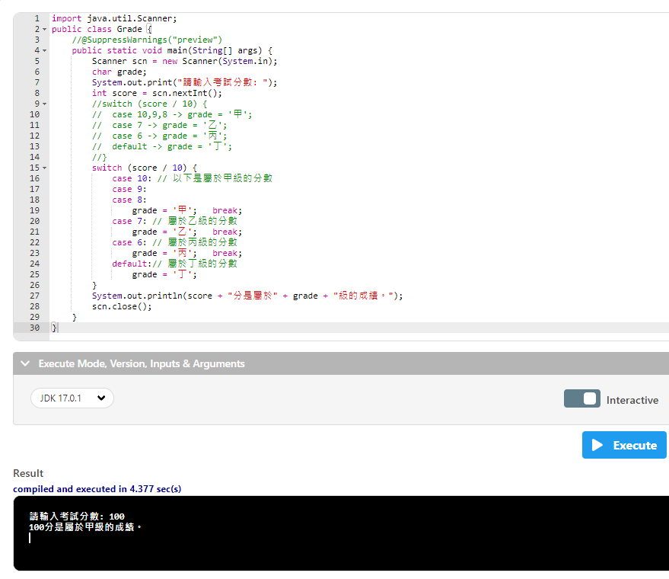

Slide 20
import java.util.Scanner;
public class Grade {
public static void main(String[] args) {
Scanner scn = new Scanner(System.in);
char grade;
char宣告字串
System.out.print("請輸入考試分數: ");
int score = scn.nextInt();
switch (score / 10) {
case 10: // 以下是屬於甲級的分數
case 9:
case 8:
grade = '甲'; break;
case 7: // 屬於乙級的分數
grade = '乙'; break;
case 6: // 屬於丙級的分數
grade = '丙'; break;
default:// 屬於丁級的分數
grade = '丁';
}
System.out.println(score + "分是屬於" + grade + "級的成績。");
scn.close();
}
}

Slide 21
import java.util.Scanner;
public class Grade {
public static void main(String[] args) {
Scanner scn = new Scanner(System.in);
char grade;
System.out.print("請輸入考試分數: ");
int score = scn.nextInt();
switch (score / 10) {
輸入進來的分數除10
case 10: // 以下是屬於甲級的分數
case 9:
case 8:
grade = '甲'; break;
case 7: // 屬於乙級的分數
grade = '乙'; break;
case 6: // 屬於丙級的分數
grade = '丙'; break;
default:// 屬於丁級的分數
grade = '丁';
}
System.out.println(score + "分是屬於" + grade + "級的成績。");
scn.close();
}
}

Slide 22
import java.util.Scanner;
public class Grade {
public static void main(String[] args) {
Scanner scn = new Scanner(System.in);
char grade;
System.out.print("請輸入考試分數: ");
int score = scn.nextInt();
switch (score / 10) {
case 10: // 以下是屬於甲級的分數
case 9:
case 8:
grade = ‘甲 '; break;
輸入進來的值除完後如果等於上述答案就會是grade = ‘甲 ’;這個字串
break;之後再離開
case 7: // 屬於乙級的分數
grade = '乙'; break;
case 6: // 屬於丙級的分數
grade = '丙'; break;
default:// 屬於丁級的分數
grade = '丁';
}
System.out.println(score + "分是屬於" + grade + "級的成績。");
scn.close();
}
}

Slide 23
import java.util.Scanner;
public class Grade {
public static void main(String[] args) {
Scanner scn = new Scanner(System.in);
char grade;
System.out.print("請輸入考試分數: ");
int score = scn.nextInt();
switch (score / 10) {
case 10: // 以下是屬於甲級的分數
case 9:
case 8:
grade = '甲'; break;
case 7: // 屬於乙級的分數
grade = '乙'; break;
case 6: // 屬於丙級的分數
grade = '丙'; break;
輸入進來的值除完後如果等於上述答案就會是grade = ‘乙 ’或 ’丙 ’;這個字串
break;之後再離開
default:// 屬於丁級的分數
grade = '丁';
}
System.out.println(score + "分是屬於" + grade + "級的成績。");
scn.close();
}
}

Slide 24
import java.util.Scanner;
public class Grade {
public static void main(String[] args) {
Scanner scn = new Scanner(System.in);
char grade;
System.out.print("請輸入考試分數: ");
int score = scn.nextInt();
switch (score / 10) {
case 10: // 以下是屬於甲級的分數
case 9:
case 8:
grade = '甲'; break;
case 7: // 屬於乙級的分數
grade = '乙'; break;
case 6: // 屬於丙級的分數
grade = '丙'; break;
default:// 屬於丁級的分數
grade = '丁';
以上都沒有就會進入默認
}
System.out.println(score + "分是屬於" + grade + "級的成績。");
scn.close();
}
}

Slide 25
import java.util.Scanner;
public class Grade {
public static void main(String[] args) {
Scanner scn = new Scanner(System.in);
char grade;
System.out.print("請輸入考試分數: ");
int score = scn.nextInt();
switch (score / 10) {
case 10: // 以下是屬於甲級的分數
case 9:
case 8:
grade = '甲'; break;
case 7: // 屬於乙級的分數
grade = '乙'; break;
case 6: // 屬於丙級的分數
grade = '丙'; break;
default:// 屬於丁級的分數
grade = '丁';
}
System.out.println(score + "分是屬於" + grade + "級的成績。");
輸入的成績+ “分是屬於” +得到的字串答案+ "級的成績”
scn.close();
}
}

Slide 26
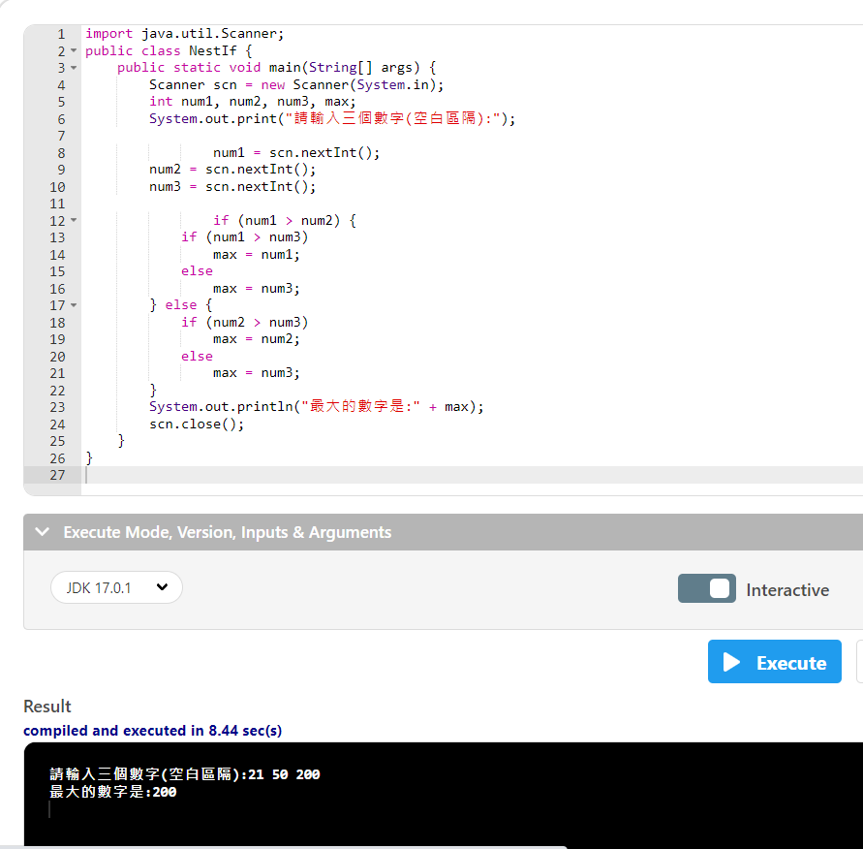

Slide 27
import java.util.Scanner;
public class NestIf {
public static void main(String[] args) {
Scanner scn = new Scanner(System.in);
int num1, num2, num3, max;
宣告整數變數
System.out.print("請輸入三個數字(空白區隔):");
num1 = scn.nextInt();
num2 = scn.nextInt();
num3 = scn.nextInt();
if (num1 > num2) {
if (num1 > num3)
max = num1;
else
max = num3;
} else {
if (num2 > num3)
max = num2;
else
max = num3;
}
System.out.println("最大的數字是:" + max);
scn.close();
}
}

Slide 28
import java.util.Scanner;
public class NestIf {
public static void main(String[] args) {
Scanner scn = new Scanner(System.in);
int num1, num2, num3, max;
System.out.print("請輸入三個數字(空白區隔):");
num1 = scn.nextInt();
num2 = scn.nextInt();
num3 = scn.nextInt();
輸入3個整數
if (num1 > num2) {
if (num1 > num3)
max = num1;
else
max = num3;
} else {
if (num2 > num3)
max = num2;
else
max = num3;
}
System.out.println("最大的數字是:" + max);
scn.close();
}
}

Slide 29
import java.util.Scanner;
public class NestIf {
public static void main(String[] args) {
Scanner scn = new Scanner(System.in);
int num1, num2, num3, max;
System.out.print("請輸入三個數字(空白區隔):");
num1 = scn.nextInt();
num2 = scn.nextInt();
num3 = scn.nextInt();
if (num1 > num2) {
如果1>2就會進入
if (num1 > num3)
max = num1;
else
max = num3;
} else {
if (num2 > num3)
max = num2;
else
max = num3;
}
System.out.println("最大的數字是:" + max);
scn.close();
}
}

Slide 30
import java.util.Scanner;
public class NestIf {
public static void main(String[] args) {
Scanner scn = new Scanner(System.in);
int num1, num2, num3, max;
System.out.print("請輸入三個數字(空白區隔):");
num1 = scn.nextInt();
num2 = scn.nextInt();
num3 = scn.nextInt();
if (num1 > num2) {
if (num1 > num3)
進入之後如果1>3就會進入
max = num1;
else
max = num3;
} else {
if (num2 > num3)
max = num2;
else
max = num3;
}
System.out.println("最大的數字是:" + max);
scn.close();
}
}

Slide 31
import java.util.Scanner;
public class NestIf {
public static void main(String[] args) {
Scanner scn = new Scanner(System.in);
int num1, num2, num3, max;
System.out.print("請輸入三個數字(空白區隔):");
num1 = scn.nextInt();
num2 = scn.nextInt();
num3 = scn.nextInt();
if (num1 > num2) {
if (num1 > num3)
max = num1;
就會的到答案1
else
max = num3;
} else {
if (num2 > num3)
max = num2;
else
max = num3;
}
System.out.println("最大的數字是:" + max);
scn.close();
}
}

Slide 32
import java.util.Scanner;
public class NestIf {
public static void main(String[] args) {
Scanner scn = new Scanner(System.in);
int num1, num2, num3, max;
System.out.print("請輸入三個數字(空白區隔):");
num1 = scn.nextInt();
num2 = scn.nextInt();
num3 = scn.nextInt();
if (num1 > num2) {
if (num1 > num3)
max = num1;
else
進入之後如果1沒有>3就會進入
max = num3;
} else {
if (num2 > num3)
max = num2;
else
max = num3;
}
System.out.println("最大的數字是:" + max);
scn.close();
}
}

Slide 33
import java.util.Scanner;
public class NestIf {
public static void main(String[] args) {
Scanner scn = new Scanner(System.in);
int num1, num2, num3, max;
System.out.print("請輸入三個數字(空白區隔):");
num1 = scn.nextInt();
num2 = scn.nextInt();
num3 = scn.nextInt();
if (num1 > num2) {
if (num1 > num3)
max = num1;
else
max = num3;
就會的到答案3
} else {
if (num2 > num3)
max = num2;
else
max = num3;
}
System.out.println("最大的數字是:" + max);
scn.close();
}
}

Slide 34
import java.util.Scanner;
public class NestIf {
public static void main(String[] args) {
Scanner scn = new Scanner(System.in);
int num1, num2, num3, max;
System.out.print("請輸入三個數字(空白區隔):");
num1 = scn.nextInt();
num2 = scn.nextInt();
num3 = scn.nextInt();
if (num1 > num2) {
if (num1 > num3)
max = num1;
else
max = num3;
} else {
如果1沒有>2就會進入
if (num2 > num3)
max = num2;
else
max = num3;
}
System.out.println("最大的數字是:" + max);
scn.close();
}
}

Slide 35
import java.util.Scanner;
public class NestIf {
public static void main(String[] args) {
Scanner scn = new Scanner(System.in);
int num1, num2, num3, max;
System.out.print("請輸入三個數字(空白區隔):");
num1 = scn.nextInt();
num2 = scn.nextInt();
num3 = scn.nextInt();
if (num1 > num2) {
if (num1 > num3)
max = num1;
else
max = num3;
} else {
if (num2 > num3)
進入之後如果2>3就會進入
max = num2;
else
max = num3;
}
System.out.println("最大的數字是:" + max);
scn.close();
}
}

Slide 36
import java.util.Scanner;
public class NestIf {
public static void main(String[] args) {
Scanner scn = new Scanner(System.in);
int num1, num2, num3, max;
System.out.print("請輸入三個數字(空白區隔):");
num1 = scn.nextInt();
num2 = scn.nextInt();
num3 = scn.nextInt();
if (num1 > num2) {
if (num1 > num3)
max = num1;
else
max = num3;
} else {
if (num2 > num3)
max = num2;
就會的到答案2
else
max = num3;
}
System.out.println("最大的數字是:" + max);
scn.close();
}
}

Slide 37
import java.util.Scanner;
public class NestIf {
public static void main(String[] args) {
Scanner scn = new Scanner(System.in);
int num1, num2, num3, max;
System.out.print("請輸入三個數字(空白區隔):");
num1 = scn.nextInt();
num2 = scn.nextInt();
num3 = scn.nextInt();
if (num1 > num2) {
if (num1 > num3)
max = num1;
else
max = num3;
} else {
if (num2 > num3)
max = num2;
else
進入之後如果2沒有>3就會進入
max = num3;
}
System.out.println("最大的數字是:" + max);
scn.close();
}
}

Slide 38
import java.util.Scanner;
public class NestIf {
public static void main(String[] args) {
Scanner scn = new Scanner(System.in);
int num1, num2, num3, max;
System.out.print("請輸入三個數字(空白區隔):");
num1 = scn.nextInt();
num2 = scn.nextInt();
num3 = scn.nextInt();
if (num1 > num2) {
if (num1 > num3)
max = num1;
else
max = num3;
} else {
if (num2 > num3)
max = num2;
else
max = num3;
就會的到答案1
}
System.out.println("最大的數字是:" + max);
scn.close();
}
}

Slide 39
import java.util.Scanner;
public class NestIf {
public static void main(String[] args) {
Scanner scn = new Scanner(System.in);
int num1, num2, num3, max;
System.out.print("請輸入三個數字(空白區隔):");
num1 = scn.nextInt();
num2 = scn.nextInt();
num3 = scn.nextInt();
if (num1 > num2) {
if (num1 > num3)
max = num1;
else
max = num3;
} else {
if (num2 > num3)
max = num2;
else
max = num3;
}
System.out.println("最大的數字是:" + max);
上面判斷結束後就會顯示結果
scn.close();
}
}

Slide 40
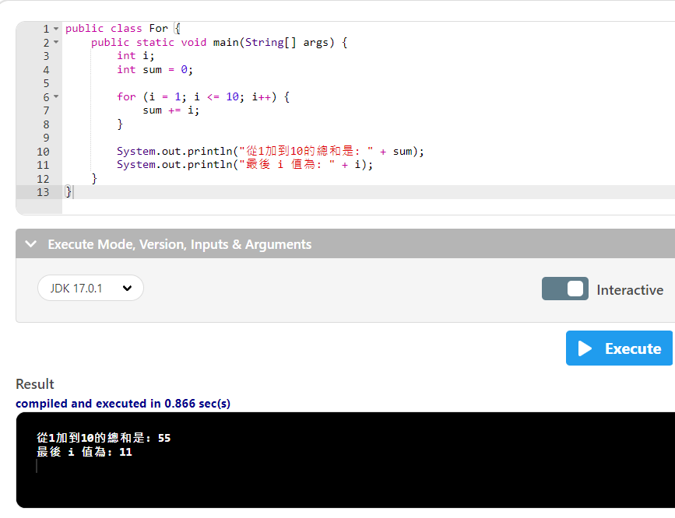

Slide 41
public class For {
public static void main(String[] args) {
int i;
宣告1個整數變數
int sum = 0;
for (i = 1; i <= 10; i++) {
sum += i;
}
System.out.println("從1加到10的總和是: " + sum);
System.out.println("最後 i 值為: " + i);
}
}

Slide 42
public class For {
public static void main(String[] args) {
int i;
int sum = 0;
再宣告1個整數變數=0
for (i = 1; i <= 10; i++) {
sum += i;
}
System.out.println("從1加到10的總和是: " + sum);
System.out.println("最後 i 值為: " + i);
}
}

Slide 43
public class For {
public static void main(String[] args) {
int i;
int sum = 0;
for (i = 1; i <= 10; i++) {
如果 i=1; i<=10時就會進入結束之後再 i+1
sum += i;
}
System.out.println("從1加到10的總和是: " + sum);
System.out.println("最後 i 值為: " + i);
}
}

Slide 44
public class For {
public static void main(String[] args) {
int i;
int sum = 0;
for (i = 1; i <= 10; i++) {
sum += i;
sum += i; == >sum = sum +i;
}
System.out.println("從1加到10的總和是: " + sum);
System.out.println("最後 i 值為: " + i);
}
}

Slide 45
public class For {
public static void main(String[] args) {
int i;
int sum = 0;
for (i = 1; i <= 10; i++) {
sum += i;
}
System.out.println("從1加到10的總和是: " + sum);
System.out.println("最後 i 值為: " + i);
再顯示出1+到10的合,跟i總共跑了幾圈
}
}

Slide 46
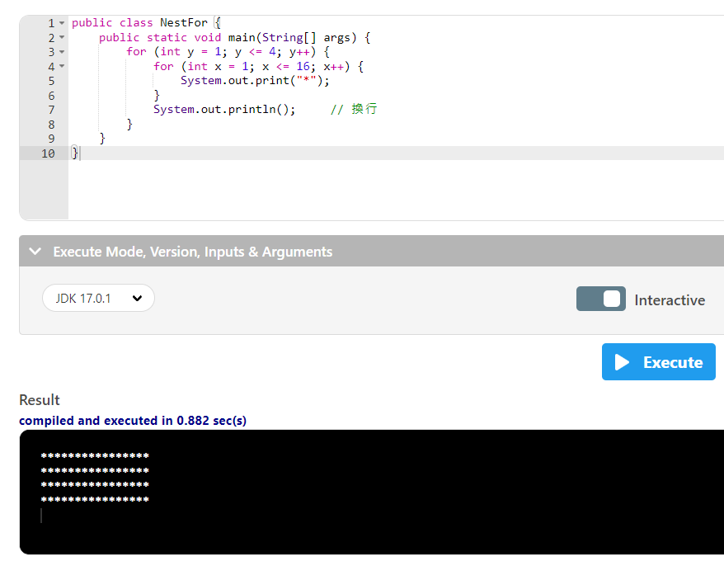

Slide 47
public class NestFor {
public static void main(String[] args) {
for (int y = 1; y <= 4; y++) {
宣告y整數變數=1;y<=4時就會進入;之後再y+1
for (int x = 1; x <= 16; x++) {
System.out.print("*");
}
System.out.println(); // 換行
}
}
}

Slide 48
public class NestFor {
public static void main(String[] args) {
for (int y = 1; y <= 4; y++) {
for (int x = 1; x <= 16; x++) {
宣告x整數變數=1;x<=16時就會進入;之後再x+1
System.out.print("*");
}
System.out.println(); // 換行
}
}
}

Slide 49
public class NestFor {
public static void main(String[] args) {
for (int y = 1; y <= 4; y++) {
for (int x = 1; x <= 16; x++) {
System.out.print("*");
}
System.out.println();
有加ln就會換行
}
}
}

Slide 50
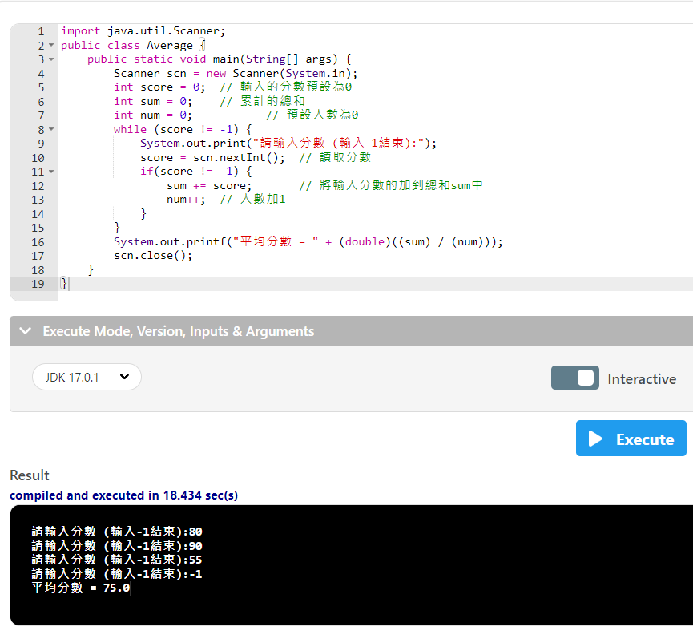

Slide 51
import java.util.Scanner;
public class Average {
public static void main(String[] args) {
Scanner scn = new Scanner(System.in);
int score = 0; // 輸入的分數預設為0
int sum = 0; // 累計的總和
int num = 0; // 預設人數為0
宣告3個整數變數
while (score != -1) {
System.out.print("請輸入分數 (輸入-1結束):");
score = scn.nextInt(); // 讀取分數
if(score != -1) {
sum += score; // 將輸入分數的加到總和sum中
num++; // 人數加1
}
}
System.out.printf("平均分數 = " + (double)((sum) / (num)));
scn.close();
}
}

Slide 52
import java.util.Scanner;
public class Average {
public static void main(String[] args) {
Scanner scn = new Scanner(System.in);
int score = 0; // 輸入的分數預設為0
int sum = 0; // 累計的總和
int num = 0; // 預設人數為0
while (score != -1) {
如果輸入的不等於 -1就會進入
System.out.print("請輸入分數 (輸入-1結束):");
score = scn.nextInt(); // 讀取分數
if(score != -1) {
sum += score; // 將輸入分數的加到總和sum中
num++; // 人數加1
}
}
System.out.printf("平均分數 = " + (double)((sum) / (num)));
scn.close();
}
}

Slide 53
import java.util.Scanner;
public class Average {
public static void main(String[] args) {
Scanner scn = new Scanner(System.in);
int score = 0; // 輸入的分數預設為0
int sum = 0; // 累計的總和
int num = 0; // 預設人數為0
while (score != -1) {
System.out.print("請輸入分數 (輸入-1結束):");
score = scn.nextInt(); // 讀取分數
if(score != -1) {
如果輸入的不等於-1就會進入
sum += score; // 將輸入分數的加到總和sum中
num++; // 人數加1
}
}
System.out.printf("平均分數 = " + (double)((sum) / (num)));
scn.close();
}
}

Slide 54
import java.util.Scanner;
public class Average {
public static void main(String[] args) {
Scanner scn = new Scanner(System.in);
int score = 0; // 輸入的分數預設為0
int sum = 0; // 累計的總和
int num = 0; // 預設人數為0
while (score != -1) {
System.out.print("請輸入分數 (輸入-1結束):");
score = scn.nextInt(); // 讀取分數
if(score != -1) {
sum += score; // 將輸入分數的加到總和sum中
sum += score; == >sum = sum +score;
num++; // 人數加1
}
}
System.out.printf("平均分數 = " + (double)((sum) / (num)));
scn.close();
}
}

Slide 55
import java.util.Scanner;
public class Average {
public static void main(String[] args) {
Scanner scn = new Scanner(System.in);
int score = 0; // 輸入的分數預設為0
int sum = 0; // 累計的總和
int num = 0; // 預設人數為0
while (score != -1) {
System.out.print("請輸入分數 (輸入-1結束):");
score = scn.nextInt(); // 讀取分數
if(score != -1) {
sum += score; // 將輸入分數的加到總和sum中
num++; // 人數加1
num+1
}
}
System.out.printf("平均分數 = " + (double)((sum) / (num)));
scn.close();
}
}

Slide 56
import java.util.Scanner;
public class Average {
public static void main(String[] args) {
Scanner scn = new Scanner(System.in);
int score = 0; // 輸入的分數預設為0
int sum = 0; // 累計的總和
int num = 0; // 預設人數為0
while (score != -1) {
System.out.print("請輸入分數 (輸入-1結束):");
score = scn.nextInt(); // 讀取分數
if(score != -1) {
sum += score; // 將輸入分數的加到總和sum中
num++; // 人數加1
}
}
System.out.printf("平均分數 = " + (double)((sum) / (num)));
先把得到的總成績除輸入的人數,會有小數所以要以double來顯示
scn.close();
}
}

Slide 57
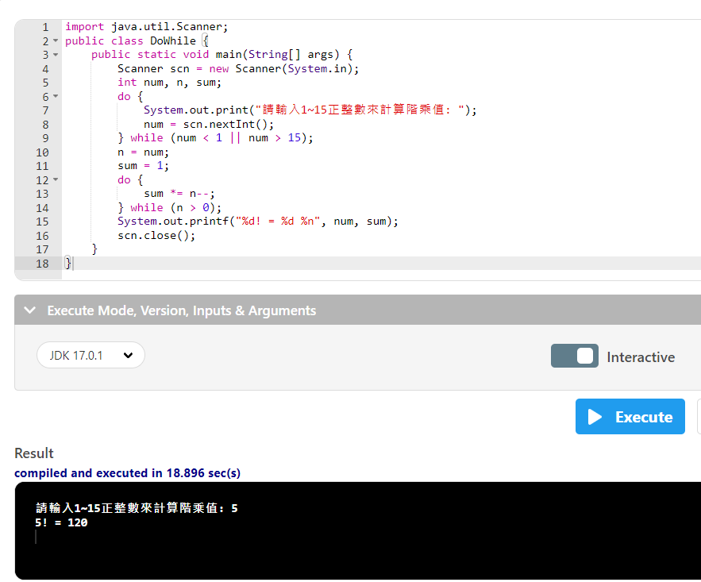

Slide 58
import java.util.Scanner;
public class DoWhile {
public static void main(String[] args) {
Scanner scn = new Scanner(System.in);
int num, n, sum;
宣告3個整數變數
do {
System.out.print("請輸入1~15正整數來計算階乘值: ");
num = scn.nextInt();
} while (num < 1 || num > 15);
n = num;
sum = 1;
do {
sum *= n--;
} while (n > 0);
System.out.printf("%d! = %d %n", num, sum);
scn.close();
}
}

Slide 59
import java.util.Scanner;
public class DoWhile {
public static void main(String[] args) {
Scanner scn = new Scanner(System.in);
int num, n, sum;
do {
會先執行敘述的內容
System.out.print("請輸入1~15正整數來計算階乘值: ");
num = scn.nextInt();
} while (num < 1 || num > 15);
n = num;
sum = 1;
do {
sum *= n--;
} while (n > 0);
System.out.printf("%d! = %d %n", num, sum);
scn.close();
}
}

Slide 60
import java.util.Scanner;
public class DoWhile {
public static void main(String[] args) {
Scanner scn = new Scanner(System.in);
int num, n, sum;
do {
System.out.print("請輸入1~15正整數來計算階乘值: ");
num = scn.nextInt();
} while (num < 1 || num > 15);
如果輸入的值<1或者>15就會進入,因為後面沒有 { }所以沒有內容會直接跳下一行
n = num;
sum = 1;
do {
sum *= n--;
} while (n > 0);
System.out.printf("%d! = %d %n", num, sum);
scn.close();
}
}

Slide 61
import java.util.Scanner;
public class DoWhile {
public static void main(String[] args) {
Scanner scn = new Scanner(System.in);
int num, n, sum;
do {
System.out.print("請輸入1~15正整數來計算階乘值: ");
num = scn.nextInt();
} while (num < 1 || num > 15);
n = num;
num的值傳到 n裡面
sum = 1;
do {
sum *= n--;
} while (n > 0);
System.out.printf("%d! = %d %n", num, sum);
scn.close();
}
}

Slide 62
import java.util.Scanner;
public class DoWhile {
public static void main(String[] args) {
Scanner scn = new Scanner(System.in);
int num, n, sum;
do {
System.out.print("請輸入1~15正整數來計算階乘值: ");
num = scn.nextInt();
} while (num < 1 || num > 15);
n = num;
sum = 1;
設定sum=1
do {
sum *= n--;
} while (n > 0);
System.out.printf("%d! = %d %n", num, sum);
scn.close();
}
}

Slide 63
import java.util.Scanner;
public class DoWhile {
public static void main(String[] args) {
Scanner scn = new Scanner(System.in);
int num, n, sum;
do {
System.out.print("請輸入1~15正整數來計算階乘值: ");
num = scn.nextInt();
} while (num < 1 || num > 15);
n = num;
sum = 1;
do {
會先執行敘述的內容
sum *= n--;
} while (n > 0);
System.out.printf("%d! = %d %n", num, sum);
scn.close();
}
}

Slide 64
import java.util.Scanner;
public class DoWhile {
public static void main(String[] args) {
Scanner scn = new Scanner(System.in);
int num, n, sum;
do {
System.out.print("請輸入1~15正整數來計算階乘值: ");
num = scn.nextInt();
} while (num < 1 || num > 15);
n = num;
sum = 1;
do {
sum *= n--;
sum = sum*n;之後再 n = n-1;
} while (n > 0);
System.out.printf("%d! = %d %n", num, sum);
scn.close();
}
}

Slide 65
import java.util.Scanner;
public class DoWhile {
public static void main(String[] args) {
Scanner scn = new Scanner(System.in);
int num, n, sum;
do {
System.out.print("請輸入1~15正整數來計算階乘值: ");
num = scn.nextInt();
} while (num < 1 || num > 15);
n = num;
sum = 1;
do {
sum *= n--;
} while (n > 0);
如果n>0就會重新進入do裡面 , 如果沒有就會離開
System.out.printf("%d! = %d %n", num, sum);
scn.close();
}
}

Slide 66
import java.util.Scanner;
public class DoWhile {
public static void main(String[] args) {
Scanner scn = new Scanner(System.in);
int num, n, sum;
do {
System.out.print("請輸入1~15正整數來計算階乘值: ");
num = scn.nextInt();
} while (num < 1 || num > 15);
n = num;
sum = 1;
do {
sum *= n--;
} while (n > 0);
System.out.printf("%d! = %d %n", num, sum);
num是我們輸入的字
sum是最後乘起來的答案
scn.close();
}
}

Slide 67
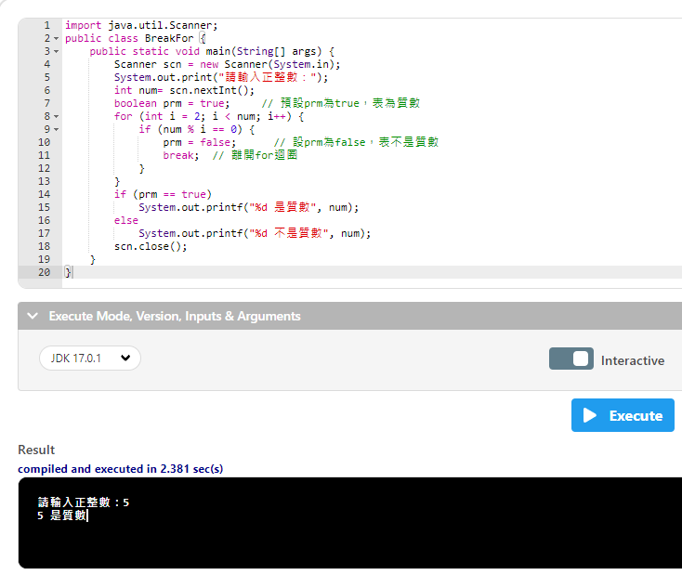

Slide 68
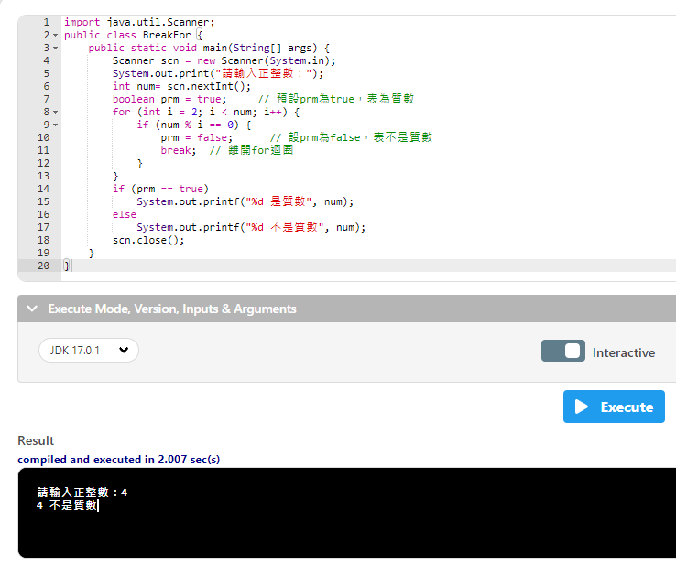

Slide 69
import java.util.Scanner;
public class BreakFor {
public static void main(String[] args) {
Scanner scn = new Scanner(System.in);
System.out.print("請輸入正整數：");
int num= scn.nextInt();
boolean prm = true; // 預設prm為true，表為質數
建立一個布林值為真
for (int i = 2; i < num; i++) {
if (num % i == 0) {
prm = false; // 設prm為false，表不是質數
break; // 離開for迴圈
}
}
if (prm == true)
System.out.printf("%d 是質數", num);
else
System.out.printf("%d 不是質數", num);
scn.close();
}
}

Slide 70
import java.util.Scanner;
public class BreakFor {
public static void main(String[] args) {
Scanner scn = new Scanner(System.in);
System.out.print("請輸入正整數：");
int num= scn.nextInt();
boolean prm = true; // 預設prm為true，表為質數
for (int i = 2; i < num; i++) {
建立1個整數變數 i=2;i<輸入值時會進入;之後再 i+1
if (num % i == 0) {
prm = false; // 設prm為false，表不是質數
break; // 離開for迴圈
}
}
if (prm == true)
System.out.printf("%d 是質數", num);
else
System.out.printf("%d 不是質數", num);
scn.close();
}
}

Slide 71
import java.util.Scanner;
public class BreakFor {
public static void main(String[] args) {
Scanner scn = new Scanner(System.in);
System.out.print("請輸入正整數：");
int num= scn.nextInt();
boolean prm = true; // 預設prm為true，表為質數
for (int i = 2; i < num; i++) {
if (num % i == 0) {
如果輸入的值的餘數 = 0時就會進入
prm = false; // 設prm為false，表不是質數
break; // 離開for迴圈
}
}
if (prm == true)
System.out.printf("%d 是質數", num);
else
System.out.printf("%d 不是質數", num);
scn.close();
}
}

Slide 72
import java.util.Scanner;
public class BreakFor {
public static void main(String[] args) {
Scanner scn = new Scanner(System.in);
System.out.print("請輸入正整數：");
int num= scn.nextInt();
boolean prm = true; // 預設prm為true，表為質數
for (int i = 2; i < num; i++) {
if (num % i == 0) {
prm = false; // 設prm為false，表不是質數
把布林值改為假
break; // 離開for迴圈
}
}
if (prm == true)
System.out.printf("%d 是質數", num);
else
System.out.printf("%d 不是質數", num);
scn.close();
}
}

Slide 73
import java.util.Scanner;
public class BreakFor {
public static void main(String[] args) {
Scanner scn = new Scanner(System.in);
System.out.print("請輸入正整數：");
int num= scn.nextInt();
boolean prm = true; // 預設prm為true，表為質數
for (int i = 2; i < num; i++) {
if (num % i == 0) {
prm = false; // 設prm為false，表不是質數
break; // 離開for迴圈
離開迴圈
}
}
if (prm == true)
System.out.printf("%d 是質數", num);
else
System.out.printf("%d 不是質數", num);
scn.close();
}
}

Slide 74
import java.util.Scanner;
public class BreakFor {
public static void main(String[] args) {
Scanner scn = new Scanner(System.in);
System.out.print("請輸入正整數：");
int num= scn.nextInt();
boolean prm = true; // 預設prm為true，表為質數
for (int i = 2; i < num; i++) {
if (num % i == 0) {
prm = false; // 設prm為false，表不是質數
break; // 離開for迴圈
}
}
if (prm == true)
如果布林值為真就會進入
System.out.printf("%d 是質數", num);
else
System.out.printf("%d 不是質數", num);
scn.close();
}
}

Slide 75
import java.util.Scanner;
public class BreakFor {
public static void main(String[] args) {
Scanner scn = new Scanner(System.in);
System.out.print("請輸入正整數：");
int num= scn.nextInt();
boolean prm = true; // 預設prm為true，表為質數
for (int i = 2; i < num; i++) {
if (num % i == 0) {
prm = false; // 設prm為false，表不是質數
break; // 離開for迴圈
}
}
if (prm == true)
System.out.printf("%d 是質數", num);
num是我們輸入的整數所以要用%d
else
System.out.printf("%d 不是質數", num);
scn.close();
}
}

Slide 76
import java.util.Scanner;
public class BreakFor {
public static void main(String[] args) {
Scanner scn = new Scanner(System.in);
System.out.print("請輸入正整數：");
int num= scn.nextInt();
boolean prm = true; // 預設prm為true，表為質數
for (int i = 2; i < num; i++) {
if (num % i == 0) {
prm = false; // 設prm為false，表不是質數
break; // 離開for迴圈
}
}
if (prm == true)
System.out.printf("%d 是質數", num);
else
如果布林值為假就會進入
System.out.printf("%d 不是質數", num);
scn.close();
}
}

Slide 77
import java.util.Scanner;
public class BreakFor {
public static void main(String[] args) {
Scanner scn = new Scanner(System.in);
System.out.print("請輸入正整數：");
int num= scn.nextInt();
boolean prm = true; // 預設prm為true，表為質數
for (int i = 2; i < num; i++) {
if (num % i == 0) {
prm = false; // 設prm為false，表不是質數
break; // 離開for迴圈
}
}
if (prm == true)
System.out.printf("%d是質數", num);
else
System.out.printf("%d不是質數", num);
num是我們輸入的整數所以要用%d
scn.close();
}
}

Slide 78
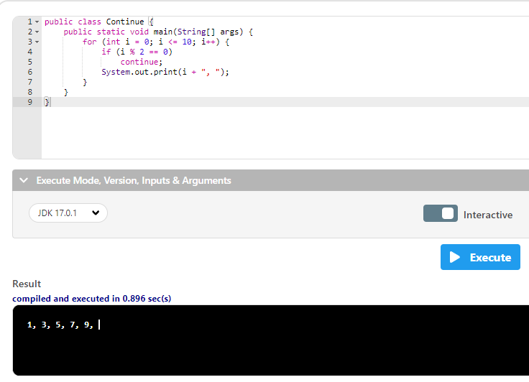

Slide 79
public class Continue {
public static void main(String[] args) {
for (int i = 0; i <= 10; i++) {
建立1個整數變數 i=0;i<10時會進入;之後再 i+1
if (i % 2 == 0)
continue;
System.out.print(i + ", ");
}
}
}

Slide 80
public class Continue {
public static void main(String[] args) {
for (int i = 0; i <= 10; i++) {
if (i % 2 == 0)
I 除 2的餘數 = 0時會進入
continue;
System.out.print(i + ", ");
}
}
}

Slide 81
public class Continue {
public static void main(String[] args) {
for (int i = 0; i <= 10; i++) {
if (i % 2 == 0)
continue;
跳過這一輪
System.out.print(i + ", ");
這個就不會執行
}
}
}

Slide 82
public class Continue {
public static void main(String[] args) {
for (int i = 0; i <= 10; i++) {
if (i % 2 == 0)
continue;
System.out.print(i + ", ");
如果沒有跳過就會列印出 i的值
}
}
}

