Slide 2
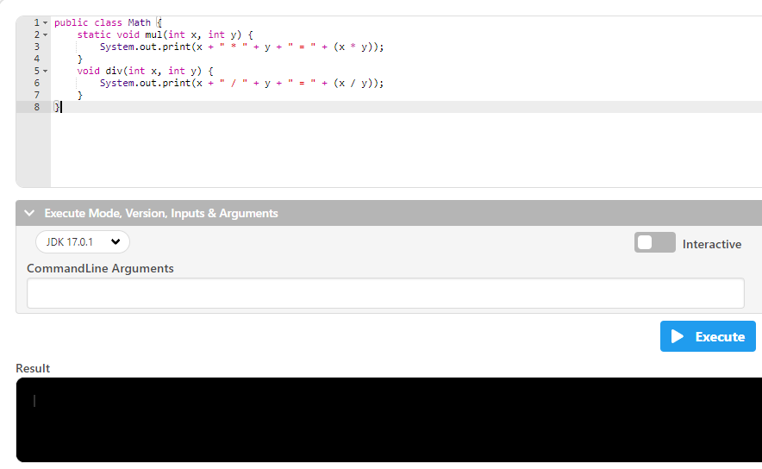

Slide 3
public class Math {
static void mul(int x, int y) {
有一個方法mul
System.out.print(x + " * " + y + " = " + (x * y));
}
void div(int x, int y) {
System.out.print(x + " / " + y + " = " + (x / y));
}
}

Slide 4
public class Math {
static void mul(int x, int y) {
System.out.print(x + " * " + y + " = " + (x * y));
x乘y=(x*y的合)
}
void div(int x, int y) {
System.out.print(x + " / " + y + " = " + (x / y));
}
}

Slide 5
public class Math {
static void mul(int x, int y) {
System.out.print(x + " * " + y + " = " + (x * y));
}
void div(int x, int y) {
不回傳值主程式
System.out.print(x + " / " + y + " = " + (x / y));
}
}

Slide 6
public class Math {
static void mul(int x, int y) {
System.out.print(x + " * " + y + " = " + (x * y));
}
void div(int x, int y) {
System.out.print(x + " / " + y + " = " + (x / y));
x除y=(x/y的合)
}
}

