Slide 1
JAVA物件導向程式開發報告
程式設計二
學生:A100E111董宸維
老師:偉大的恩師龍大大

Slide 2
Agenda
物件導向技術(Object-Oriented) 結構化程式開發
核心觀念: 類別(class)與物件(object)
物件導向技術三要素:封裝|繼承|多形
物件導向封裝技術範例與實測
物件導向繼承範例與實測
物件導向多形範例與實測

Slide 3
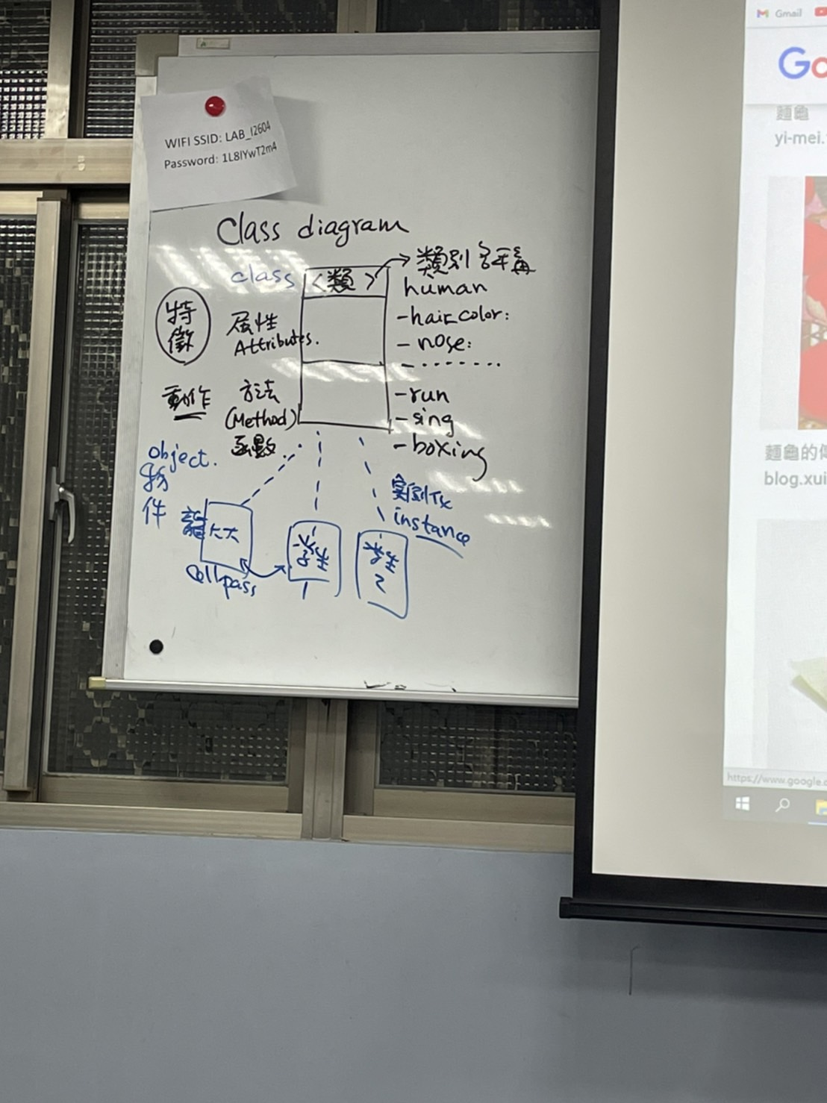
類別(class)與物件(object) 類別圖(class diagram)

Slide 4
public class Ccar {
public double gas, tbo;
public double max_dist = 0;
public void maxDist() {
max_dist = gas * tbo;
}
public double dist(double oil) {
return oil * tbo;
}
}
Ccar
+gas
宣告屬性
+tbo
+max_dist
+maxDist()
宣告方法
+dist()

Slide 5
public class BuildObject {
public static void main(String[] args) {
Ccar car1; //宣告car1物件
car1 = new Ccar(); //建立car1物件
car1.gas = 40; //設定car1物件的屬性值
car1.tbo = 13.6;
car1.maxDist(); //呼叫car1物件的方法
double distance = car1.dist(20); //呼叫car1物件的方法,並取得傳回值
System.out.println("car1汽車資訊：");
System.out.println("最大載油量：" + car1.gas + " L");
System.out.println("平均耗油量：" + car1.tbo + " km/L");
System.out.println("加滿油可行駛 " + car1.max_dist + " km");
System.out.println("加油20L可行駛 " + distance + " km");
Ccar car2 = new Ccar(); //宣告並建立car2物件
car2.gas = 60; //設定car2物件的屬性值
car2.tbo = 9.5;
}
}

Slide 6
Ccar
Ccar car1= new Ccar();
+gas
Ccar car1;
car1 = new Ccar(); car2 = new Ccar();
+tbo
+max_dist
+maxDist()
+dist()
car1
car2

Slide 7
物件導向封裝技術範例與實測
封裝是使用成員存取修飾子，來定義類別內部的資料成員和方法成員的存取限制，其目的用來保護類別內部的成員，免於受到外部程式的不當存取。
1. public (公開)
2. private (私有)
3. protected (保護)

Slide 8
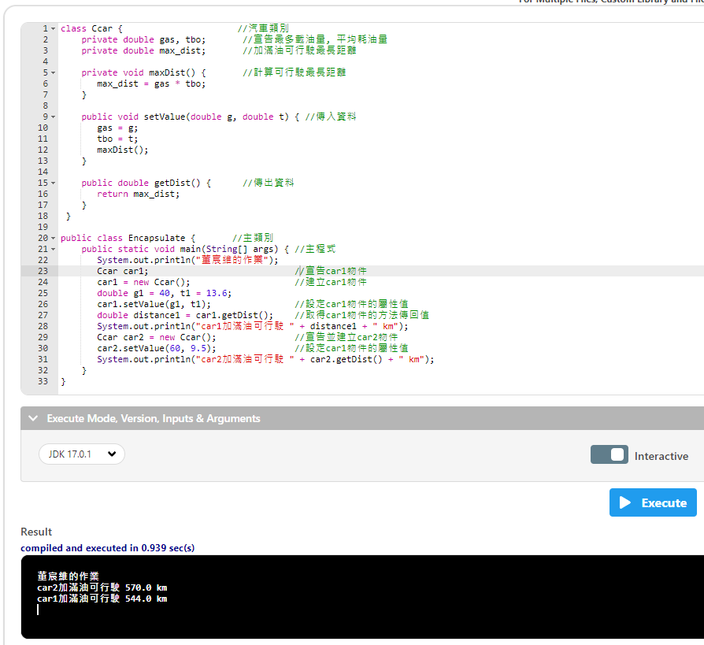
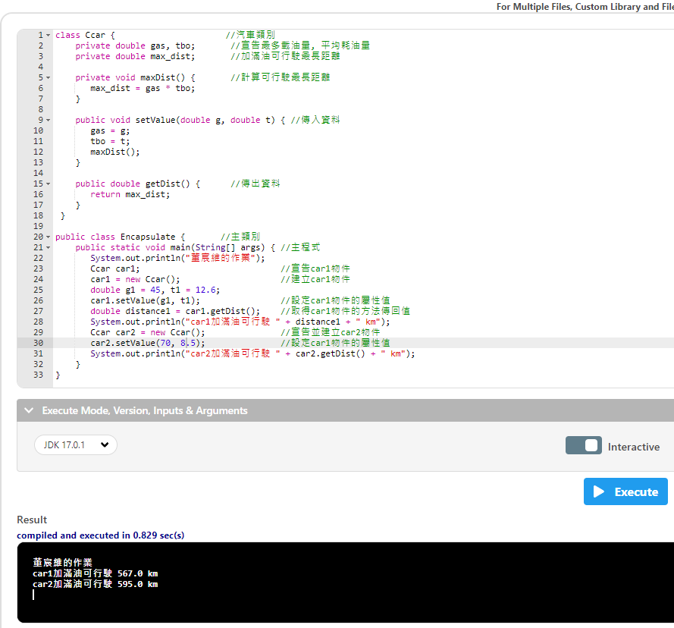

Slide 9
class Ccar {
private double gas, tbo;
private double max_dist;
private void maxDist() {
max_dist = gas * tbo;
}
public void setValue(double g, double t) {
gas = g;
tbo = t;
maxDist();
}
public double getDist() {
return max_dist;
}
}
Ccar
private私人存取
-gas
-tbo
-max_dist
public大家都可以存取
+setValue()
+getDist()

Slide 10
class Ccar {
private double gas, tbo;
private double max_dist;
private void maxDist() {
max_dist = gas * tbo;
}
public void setValue(double g, double t) {
gas = g;
tbo = t;
maxDist();
}
public double getDist() {
return max_dist;
}
}
public class Encapsulate {
public static void main(String[] args) {
System.out.println("董宸維的作業");
Ccar car1;
car1 = new Ccar();
double g1 = 45, t1 = 12.6;
car1.setValue(g1, t1);
double distance1 = car1.getDist();
System.out.println("car1加滿油可行駛 " + distance1 + " km");
Ccar car2 = new Ccar();
car2.setValue(70,8.5);
System.out.println("car2加滿油可行駛 " + car2.getDist() + " km");
}
}
1
2
3
4
5

Slide 11
方法多載
「多載」是指同一個類別內，有兩個以上相同名稱的方法，但是因為各個方法所要傳入的引數個數不同，或者是引數的資料型別不同，則這些方法將被視為不同，且各有各自的內容。

Slide 12
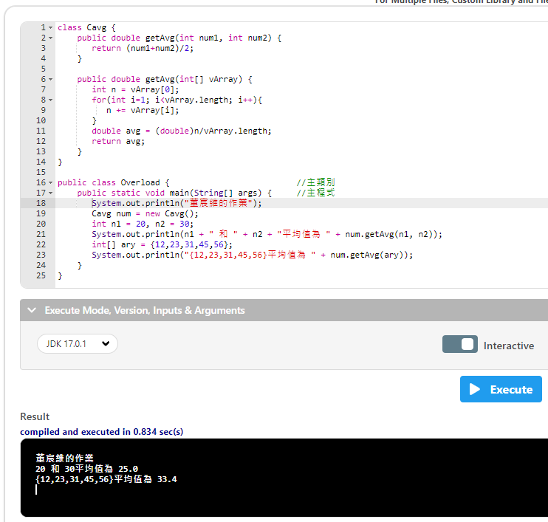

Slide 13
class Cavg {
public double getAvg(int num1, int num2) {
return (num1+num2)/2;
}
public double getAvg(int[] vArray) {
int n = vArray[0];
for(int i=1; i<vArray.length; i++){
n += vArray[i];
}
double avg = (double)n/vArray.length;
return avg;
}
}
public class Overload {
public static void main(String[] args) {
System.out.println("董宸維的作業");
Cavg num = new Cavg();
int n1 = 20, n2 = 30;
System.out.println(n1 + " 和 " + n2 + "平均值為 " + num.getAvg(n1, n2));
int[] ary = {12,23,31,45,56};
System.out.println("{12,23,31,45,56}平均值為 " + num.getAvg(ary));
}
}
叫做多載
一個類別裡面有2個一模一樣的方法

