Slide 1
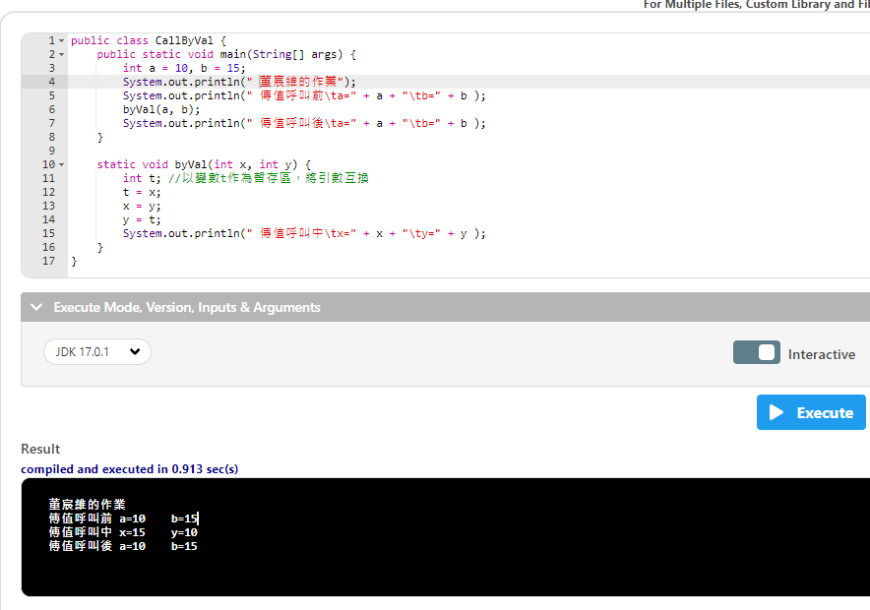

Slide 2
public class CallByVal {
public static void main(String[] args) {
int a = 10, b = 15;
宣告 int a = 10, b = 15
System.out.println(" 董宸維的作業");
System.out.println(" 傳值呼叫前\ta=" + a + "\tb=" + b );
byVal(a, b);
System.out.println(" 傳值呼叫後\ta=" + a + "\tb=" + b );
}
static void byVal(int x, int y) {
int t; //以變數t作為暫存區，將引數互換
t = x;
x = y;
y = t;
System.out.println(" 傳值呼叫中\tx=" + x + "\ty=" + y );
}
}

Slide 3
public class CallByVal {
public static void main(String[] args) {
int a = 10, b = 15;
System.out.println(" 董宸維的作業");
System.out.println(“ 傳值呼叫前\t a=” + a + “\t b=" + b );
/t空四格的意思
byVal(a, b);
System.out.println(" 傳值呼叫後\ta=" + a + "\tb=" + b );
}
static void byVal(int x, int y) {
int t; //以變數t作為暫存區，將引數互換
t = x;
x = y;
y = t;
System.out.println(" 傳值呼叫中\tx=" + x + "\ty=" + y );
}
}

Slide 4
public class CallByVal {
public static void main(String[] args) {
int a = 10, b = 15;
System.out.println(" 董宸維的作業");
System.out.println(" 傳值呼叫前\ta=" + a + "\tb=" + b );
byVal(a, b);
呼叫副程式代入(10,15)
System.out.println(" 傳值呼叫後\ta=" + a + "\tb=" + b );
}
static void byVal(int x, int y) {
int t; //以變數t作為暫存區，將引數互換
t = x;
x = y;
y = t;
System.out.println(" 傳值呼叫中\tx=" + x + "\ty=" + y );
}
}

Slide 5
public class CallByVal {
public static void main(String[] args) {
int a = 10, b = 15;
System.out.println(" 董宸維的作業");
System.out.println(" 傳值呼叫前\ta=" + a + "\tb=" + b );
byVal(a, b);
System.out.println(" 傳值呼叫後\ta=" + a + "\tb=" + b );
}
static void byVal(int x, int y) {
進入這裡顯示x=a,y=b
int t; //以變數t作為暫存區，將引數互換
t = x;
x = y;
y = t;
System.out.println(" 傳值呼叫中\tx=" + x + "\ty=" + y );
}
}

Slide 6
public class CallByVal {
public static void main(String[] args) {
int a = 10, b = 15;
System.out.println(" 董宸維的作業");
System.out.println(" 傳值呼叫前\ta=" + a + "\tb=" + b );
byVal(a, b);
System.out.println(" 傳值呼叫後\ta=" + a + "\tb=" + b );
}
static void byVal(int x, int y) {
int t; //以變數t作為暫存區，將引數互換
宣告一個整數 t
t = x;
x = y;
y = t;
System.out.println(" 傳值呼叫中\tx=" + x + "\ty=" + y );
}
}

Slide 7
public class CallByVal {
public static void main(String[] args) {
int a = 10, b = 15;
System.out.println(" 董宸維的作業");
System.out.println(" 傳值呼叫前\ta=" + a + "\tb=" + b );
byVal(a, b);
System.out.println(" 傳值呼叫後\ta=" + a + "\tb=" + b );
}
static void byVal(int x, int y) {
int t; //以變數t作為暫存區，將引數互換
t = x;
t = x -->t = 10
x = y;
y = t;
System.out.println(" 傳值呼叫中\tx=" + x + "\ty=" + y );
}
}

Slide 8
public class CallByVal {
public static void main(String[] args) {
int a = 10, b = 15;
System.out.println(" 董宸維的作業");
System.out.println(" 傳值呼叫前\ta=" + a + "\tb=" + b );
byVal(a, b);
System.out.println(" 傳值呼叫後\ta=" + a + "\tb=" + b );
}
static void byVal(int x, int y) {
int t; //以變數t作為暫存區，將引數互換
t = x;
x = y;
x = y --> x = 15
y = t;
System.out.println(" 傳值呼叫中\tx=" + x + "\ty=" + y );
}
}

Slide 9
public class CallByVal {
public static void main(String[] args) {
int a = 10, b = 15;
System.out.println(" 董宸維的作業");
System.out.println(" 傳值呼叫前\ta=" + a + "\tb=" + b );
byVal(a, b);
System.out.println(" 傳值呼叫後\ta=" + a + "\tb=" + b );
}
static void byVal(int x, int y) {
int t; //以變數t作為暫存區，將引數互換
t = x;
x = y;
y = t;
y = t --> y = 10
System.out.println(" 傳值呼叫中\tx=" + x + "\ty=" + y );
}
}

Slide 10
public class CallByVal {
public static void main(String[] args) {
int a = 10, b = 15;
System.out.println(" 董宸維的作業");
System.out.println(" 傳值呼叫前\ta=" + a + "\tb=" + b );
byVal(a, b);
System.out.println(" 傳值呼叫後\ta=" + a + "\tb=" + b );
}
static void byVal(int x, int y) {
int t; //以變數t作為暫存區，將引數互換
t = x;
x = y;
y = t;
System.out.println(" 傳值呼叫中\tx=" + x + "\ty=" + y );
由於質被改變所以印出來是a = 15, b = 10
}
}

Slide 11
public class CallByVal {
public static void main(String[] args) {
int a = 10, b = 15;
System.out.println(" 董宸維的作業");
System.out.println(" 傳值呼叫前\ta=" + a + "\tb=" + b );
byVal(a, b);
System.out.println(" 傳值呼叫後\ta=" + a + "\tb=" + b );
質沒有被改變所以印出來還是a = 10, b = 15
}
static void byVal(int x, int y) {
int t; //以變數t作為暫存區，將引數互換
t = x;
x = y;
y = t;
System.out.println(" 傳值呼叫中\tx=" + x + "\ty=" + y );
}
}

Slide 12
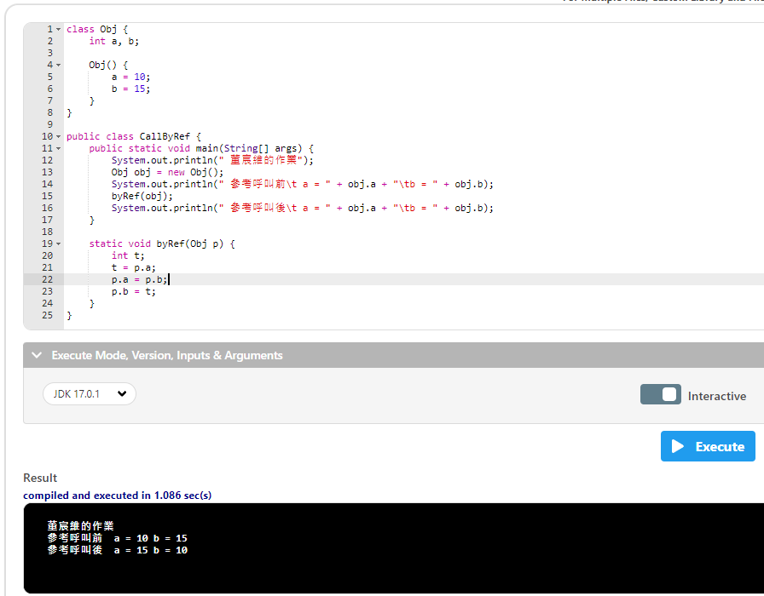

Slide 13
class Obj {
宣告一個類別Obj
int a, b;
Obj() {
a = 10;
b = 15;
}
}
public class CallByRef {
public static void main(String[] args) {
System.out.println(" 董宸維的作業");
Obj obj = new Obj();
System.out.println(" 參考呼叫前\t a = " + obj.a + "\tb = " + obj.b);
byRef(obj);
System.out.println(" 參考呼叫後\t a = " + obj.a + "\tb = " + obj.b);
}
static void byRef(Obj p) {
int t;
t = p.a;
p.a = p.b;
p.b = t;
}
}

Slide 14
class Obj {
int a, b;
宣告整數 a,b
Obj() {
a = 10;
b = 15;
}
}
public class CallByRef {
public static void main(String[] args) {
System.out.println(" 董宸維的作業");
Obj obj = new Obj();
System.out.println(" 參考呼叫前\t a = " + obj.a + "\tb = " + obj.b);
byRef(obj);
System.out.println(" 參考呼叫後\t a = " + obj.a + "\tb = " + obj.b);
}
static void byRef(Obj p) {
int t;
t = p.a;
p.a = p.b;
p.b = t;
}
}

Slide 15
class Obj {
int a, b;
Obj() {
建立一個預設建構子
a = 10;
b = 15;
}
}
public class CallByRef {
public static void main(String[] args) {
System.out.println(" 董宸維的作業");
Obj obj = new Obj();
System.out.println(" 參考呼叫前\t a = " + obj.a + "\tb = " + obj.b);
byRef(obj);
System.out.println(" 參考呼叫後\t a = " + obj.a + "\tb = " + obj.b);
}
static void byRef(Obj p) {
int t;
t = p.a;
p.a = p.b;
p.b = t;
}
}
()沒有寫入任何參數
建構子constructor

Slide 16
class Obj {
int a, b;
Obj() {
a = 10;
b = 15;
宣告 a = 10, b = 15
}
}
public class CallByRef {
public static void main(String[] args) {
System.out.println(" 董宸維的作業");
Obj obj = new Obj();
System.out.println(" 參考呼叫前\t a = " + obj.a + "\tb = " + obj.b);
byRef(obj);
System.out.println(" 參考呼叫後\t a = " + obj.a + "\tb = " + obj.b);
}
static void byRef(Obj p) {
int t;
t = p.a;
p.a = p.b;
p.b = t;
}
}

Slide 17
class Obj {
int a, b;
Obj() {
a = 10;
b = 15;
}
}
public class CallByRef {
public static void main(String[] args) {
System.out.println(" 董宸維的作業");
Obj obj = new Obj();
使用Obj()的類別套件資料傳入 obj
System.out.println(" 參考呼叫前\t a = " + obj.a + "\tb = " + obj.b);
byRef(obj);
System.out.println(" 參考呼叫後\t a = " + obj.a + "\tb = " + obj.b);
}
static void byRef(Obj p) {
int t;
t = p.a;
p.a = p.b;
p.b = t;
}
}

Slide 18
class Obj {
int a, b;
Obj() {
a = 10;
b = 15;
}
}
public class CallByRef {
public static void main(String[] args) {
System.out.println(" 董宸維的作業");
Obj obj = new Obj();
System.out.println(" 參考呼叫前\t a = " + obj.a + "\tb = " + obj.b);
呼叫出來的質會是a = 10, b = 15
byRef(obj);
System.out.println(" 參考呼叫後\t a = " + obj.a + "\tb = " + obj.b);
}
static void byRef(Obj p) {
int t;
t = p.a;
p.a = p.b;
p.b = t;
}
}

Slide 19
class Obj {
int a, b;
Obj() {
a = 10;
b = 15;
}
}
public class CallByRef {
public static void main(String[] args) {
System.out.println(" 董宸維的作業");
Obj obj = new Obj();
System.out.println(" 參考呼叫前\t a = " + obj.a + "\tb = " + obj.b);
byRef(obj);
呼叫副程式代入(obj)的質
System.out.println(" 參考呼叫後\t a = " + obj.a + "\tb = " + obj.b);
}
static void byRef(Obj p) {
int t;
t = p.a;
p.a = p.b;
p.b = t;
}
}

Slide 20
class Obj {
int a, b;
Obj() {
a = 10;
b = 15;
}
}
public class CallByRef {
public static void main(String[] args) {
System.out.println(" 董宸維的作業");
Obj obj = new Obj();
System.out.println(" 參考呼叫前\t a = " + obj.a + "\tb = " + obj.b);
byRef(obj);
System.out.println(" 參考呼叫後\t a = " + obj.a + "\tb = " + obj.b);
}
static void byRef(Obj p) {
byRef(Obj p)是代入a = 10, b = 15
int t;
t = p.a;
p.a = p.b;
p.b = t;
}
}

Slide 21
class Obj {
int a, b;
Obj() {
a = 10;
b = 15;
}
}
public class CallByRef {
public static void main(String[] args) {
System.out.println(" 董宸維的作業");
Obj obj = new Obj();
System.out.println(" 參考呼叫前\t a = " + obj.a + "\tb = " + obj.b);
byRef(obj);
System.out.println(" 參考呼叫後\t a = " + obj.a + "\tb = " + obj.b);
}
static void byRef(Obj p) {
int t;
宣告一個整數 t
t = p.a;
p.a = p.b;
p.b = t;
}
}

Slide 22
class Obj {
int a, b;
Obj() {
a = 10;
b = 15;
}
}
public class CallByRef {
public static void main(String[] args) {
System.out.println(" 董宸維的作業");
Obj obj = new Obj();
System.out.println(" 參考呼叫前\t a = " + obj.a + "\tb = " + obj.b);
byRef(obj);
System.out.println(" 參考呼叫後\t a = " + obj.a + "\tb = " + obj.b);
}
static void byRef(Obj p) {
int t;
t = p.a;
t = p.a -->t = 10
p.a = p.b;
p.b = t;
}
}

Slide 23
class Obj {
int a, b;
Obj() {
a = 10;
b = 15;
}
}
public class CallByRef {
public static void main(String[] args) {
System.out.println(" 董宸維的作業");
Obj obj = new Obj();
System.out.println(" 參考呼叫前\t a = " + obj.a + "\tb = " + obj.b);
byRef(obj);
System.out.println(" 參考呼叫後\t a = " + obj.a + "\tb = " + obj.b);
}
static void byRef(Obj p) {
int t;
t = p.a;
p.a = p.b;
p.a = p.b --> p.a = 15
p.b = t;
}
}

Slide 24
class Obj {
int a, b;
Obj() {
a = 10;
b = 15;
}
}
public class CallByRef {
public static void main(String[] args) {
System.out.println(" 董宸維的作業");
Obj obj = new Obj();
System.out.println(" 參考呼叫前\t a = " + obj.a + "\tb = " + obj.b);
byRef(obj);
System.out.println(" 參考呼叫後\t a = " + obj.a + "\tb = " + obj.b);
}
static void byRef(Obj p) {
int t;
t = p.a;
p.a = p.b;
p.b = t;
p.b = t --> p.b = 10
}
}

Slide 25
class Obj {
int a, b;
Obj() {
a = 10;
b = 15;
}
}
public class CallByRef {
public static void main(String[] args) {
System.out.println(" 董宸維的作業");
Obj obj = new Obj();
System.out.println(" 參考呼叫前\t a = " + obj.a + "\tb = " + obj.b);
byRef(obj);
System.out.println(" 參考呼叫後\t a = " + obj.a + "\tb = " + obj.b);
由於呼叫 byRef(obj)質已有改變所以 obj.a = 15 obj.b = 10
}
static void byRef(Obj p) {
int t;
t = p.a;
p.a = p.b;
p.b = t;
}
}

Slide 26
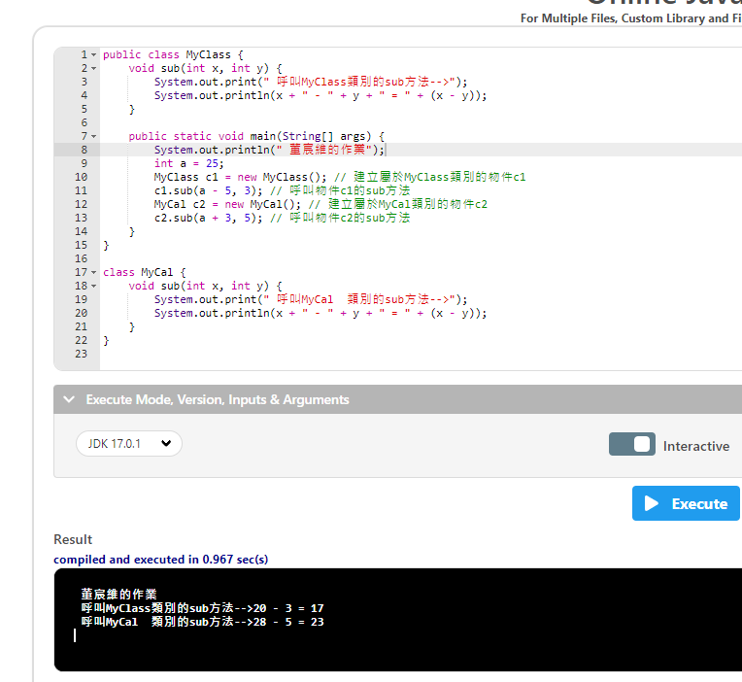

Slide 27
public class MyClass {
void sub(int x, int y) {
在 MyClass宣告sub(擁有兩個正整數)
System.out.print(" 呼叫MyClass類別的sub方法-->");
System.out.println(x + " - " + y + " = " + (x - y));
}
public static void main(String[] args) {
System.out.println(" 董宸維的作業");
int a = 25;
MyClass c1 = new MyClass(); // 建立屬於MyClass類別的物件c1
c1.sub(a - 5, 3); // 呼叫物件c1的sub方法
MyCal c2 = new MyCal(); // 建立屬於MyCal類別的物件c2
c2.sub(a + 3, 5); // 呼叫物件c2的sub方法
}
}
class MyCal {
void sub(int x, int y) {
在 MyCal宣告sub(擁有兩個正整數)
System.out.print(" 呼叫MyCal 類別的sub方法-->");
System.out.println(x + " - " + y + " = " + (x - y));
}
}

Slide 28
public class MyClass {
void sub(int x, int y) {
System.out.print(" 呼叫MyClass類別的sub方法-->");
System.out.println(x + " - " + y + " = " + (x - y));
}
public static void main(String[] args) {
System.out.println(" 董宸維的作業");
int a = 25;
宣告一個整數變數 a = 25
MyClass c1 = new MyClass(); // 建立屬於MyClass類別的物件c1
c1.sub(a - 5, 3); // 呼叫物件c1的sub方法
MyCal c2 = new MyCal(); // 建立屬於MyCal類別的物件c2
c2.sub(a + 3, 5); // 呼叫物件c2的sub方法
}
}
class MyCal {
void sub(int x, int y) {
System.out.print(" 呼叫MyCal 類別的sub方法-->");
System.out.println(x + " - " + y + " = " + (x - y));
}
}

Slide 29
public class MyClass {
void sub(int x, int y) {
System.out.print(" 呼叫MyClass類別的sub方法-->");
System.out.println(x + " - " + y + " = " + (x - y));
}
public static void main(String[] args) {
System.out.println(" 董宸維的作業");
int a = 25;
MyClass c1 = new MyClass(); // 建立屬於MyClass類別的物件c1
使用 MyClass的類別套件資料傳入 c1物件
c1.sub(a - 5, 3); // 呼叫物件c1的sub方法
MyCal c2 = new MyCal(); // 建立屬於MyCal類別的物件c2
c2.sub(a + 3, 5); // 呼叫物件c2的sub方法
}
}
class MyCal {
void sub(int x, int y) {
System.out.print(" 呼叫MyCal 類別的sub方法-->");
System.out.println(x + " - " + y + " = " + (x - y));
}
}

Slide 30
public class MyClass {
void sub(int x, int y) {
System.out.print(" 呼叫MyClass類別的sub方法-->");
System.out.println(x + " - " + y + " = " + (x - y));
}
public static void main(String[] args) {
System.out.println(" 董宸維的作業");
int a = 25;
MyClass c1 = new MyClass(); // 建立屬於MyClass類別的物件c1
c1.sub(a - 5, 3); // 呼叫物件c1的sub方法
c1物件呼叫 MyClass裡面的 sub方法 (x=25-5,y=3)
MyCal c2 = new MyCal(); // 建立屬於MyCal類別的物件c2
c2.sub(a + 3, 5); // 呼叫物件c2的sub方法
}
}
class MyCal {
void sub(int x, int y) {
System.out.print(" 呼叫MyCal 類別的sub方法-->");
System.out.println(x + " - " + y + " = " + (x - y));
}
}

Slide 31
public class MyClass {
void sub(int x, int y) {
System.out.print(“ 呼叫 MyClass類別的 sub方法-->");
System.out.println(x + " - " + y + " = " + (x - y));
進入這裡顯示 20 – 3 = 17
}
public static void main(String[] args) {
System.out.println(" 董宸維的作業");
int a = 25;
MyClass c1 = new MyClass(); // 建立屬於MyClass類別的物件c1
c1.sub(a - 5, 3); // 呼叫物件c1的sub方法
MyCal c2 = new MyCal(); // 建立屬於MyCal類別的物件c2
c2.sub(a + 3, 5); // 呼叫物件c2的sub方法
}
}
class MyCal {
void sub(int x, int y) {
System.out.print(" 呼叫MyCal 類別的sub方法-->");
System.out.println(x + " - " + y + " = " + (x - y));
}
}

Slide 32
public class MyClass {
void sub(int x, int y) {
System.out.print(" 呼叫MyClass類別的sub方法-->");
System.out.println(x + " - " + y + " = " + (x - y));
}
public static void main(String[] args) { System.out.println(" 董宸維的作業");
int a = 25;
MyClass c1 = new MyClass(); // 建立屬於MyClass類別的物件c1
c1.sub(a - 5, 3); // 呼叫物件c1的sub方法
MyCal c2 = new MyCal(); // 建立屬於MyCal類別的物件c2
使用 MyClass的類別套件資料傳入 c2物件
c2.sub(a + 3, 5); // 呼叫物件c2的sub方法
}
}
class MyCal {
void sub(int x, int y) {
System.out.print(" 呼叫MyCal 類別的sub方法-->");
System.out.println(x + " - " + y + " = " + (x - y));
}
}

Slide 33
public class MyClass {
void sub(int x, int y) {
System.out.print(" 呼叫MyClass類別的sub方法-->");
System.out.println(x + " - " + y + " = " + (x - y));
}
public static void main(String[] args) {
System.out.println(" 董宸維的作業");
int a = 25;
MyClass c1 = new MyClass(); // 建立屬於MyClass類別的物件c1
c1.sub(a - 5, 3); // 呼叫物件c1的sub方法
MyCal c2 = new MyCal(); // 建立屬於MyCal類別的物件c2
c2.sub(a + 3, 5); // 呼叫物件c2的sub方法
c2物件呼叫 MyCal裡面的 sub方法 (x=25+3,y=5)
}
}
class MyCal {
void sub(int x, int y) {
System.out.print(" 呼叫MyCal 類別的sub方法-->");
System.out.println(x + " - " + y + " = " + (x - y));
}
}

Slide 34
public class MyClass {
void sub(int x, int y) {
System.out.print(" 呼叫MyClass類別的sub方法-->");
System.out.println(x + " - " + y + " = " + (x - y));
}
public static void main(String[] args) {
System.out.println(" 董宸維的作業");
int a = 25;
MyClass c1 = new MyClass(); // 建立屬於MyClass類別的物件c1
c1.sub(a - 5, 3); // 呼叫物件c1的sub方法
MyCal c2 = new MyCal(); // 建立屬於MyCal類別的物件c2
c2.sub(a + 3, 5); // 呼叫物件c2的sub方法
}
}
class MyCal {
void sub(int x, int y) {
System.out.print(“ 呼叫 MyCal 類別的 sub方法-->");
System.out.println(x + " - " + y + " = " + (x - y));
進入這裡顯示 28 – 5 = 23
}
}

Slide 35
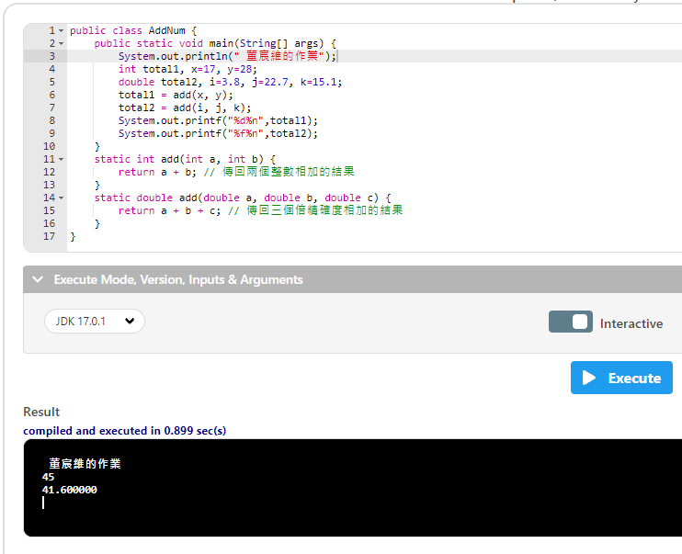
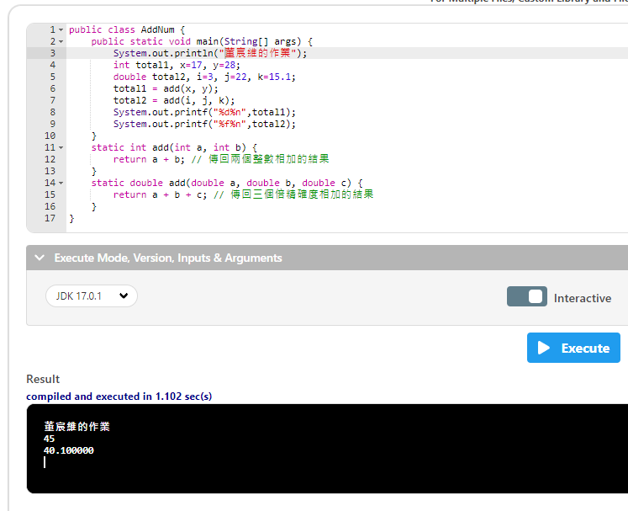
會自行在double裡面自行添加小數

Slide 36
public class AddNum {
public static void main(String[] args) {
System.out.println(" 董宸維的作業");
int total1, x=17, y=28;
宣告 3個整數變數
double total2, i=3.8, j=22.7, k=15.1;
total1 = add(x, y);
total2 = add(i, j, k);
System.out.printf("%d%n",total1);
System.out.printf("%f%n",total2);
}
static int add(int a, int b) {
return a + b; // 傳回兩個整數相加的結果
}
static double add(double a, double b, double c) {
return a + b + c; // 傳回三個倍精確度相加的結果
}
}

Slide 37
public class AddNum {
public static void main(String[] args) {
System.out.println(" 董宸維的作業");
int total1, x=17, y=28;
double total2, i=3.8, j=22.7, k=15.1;
宣告 4個浮點數
total1 = add(x, y);
total2 = add(i, j, k);
System.out.printf("%d%n",total1);
System.out.printf("%f%n",total2);
}
static int add(int a, int b) {
return a + b; // 傳回兩個整數相加的結果
}
static double add(double a, double b, double c) {
return a + b + c; // 傳回三個倍精確度相加的結果
}
}

Slide 38
public class AddNum {
public static void main(String[] args) {
System.out.println(" 董宸維的作業");
int total1, x=17, y=28;
double total2, i=3.8, j=22.7, k=15.1;
total1 = add(x, y);
用 add(x, y) 的質傳入 total1
total2 = add(i, j, k);
System.out.printf("%d%n",total1);
System.out.printf("%f%n",total2);
}
static int add(int a, int b) {
因為傳入的是正整數所以要用 int
return a + b; // 傳回兩個整數相加的結果
}
static double add(double a, double b, double c) {
return a + b + c; // 傳回三個倍精確度相加的結果
}
}

Slide 39
public class AddNum {
public static void main(String[] args) {
System.out.println(" 董宸維的作業");
int total1, x=17, y=28;
double total2, i=3.8, j=22.7, k=15.1;
total1 = add(x, y);
total2 = add(i, j, k);
System.out.printf("%d%n",total1);
System.out.printf("%f%n",total2);
}
static int add(int a, int b) {
return a + b; // 傳回兩個整數相加的結果
回傳 a + b 的結果
}
static double add(double a, double b, double c) {
return a + b + c; // 傳回三個倍精確度相加的結果
}
}

Slide 40
public class AddNum {
public static void main(String[] args) {
System.out.println(" 董宸維的作業");
int total1, x=17, y=28;
double total2, i=3.8, j=22.7, k=15.1;
total1 = add(x, y);
total2 = add(i, j, k);
用 add(i,j,k) 的質傳入 total2
System.out.printf("%d%n",total1);
System.out.printf("%f%n",total2);
}
static int add(int a, int b) {
return a + b; // 傳回兩個整數相加的結果
}
static double add(double a, double b, double c) {
因為傳入的是浮點數所以要用 double
return a + b + c; // 傳回三個倍精確度相加的結果
}
}

Slide 41
public class AddNum {
public static void main(String[] args) {
System.out.println(" 董宸維的作業");
int total1, x=17, y=28;
double total2, i=3.8, j=22.7, k=15.1;
total1 = add(x, y);
total2 = add(i, j, k);
System.out.printf("%d%n",total1);
System.out.printf("%f%n",total2);
}
static int add(int a, int b) {
return a + b; // 傳回兩個整數相加的結果
}
static double add(double a, double b, double c) {
return a + b + c; // 傳回三個倍精確度相加的結果
回傳 a + b + c 的結果 , 如果值是正整數了話也會視作為浮點數下去運算
}
}

Slide 42
public class AddNum {
public static void main(String[] args) {
System.out.println(" 董宸維的作業");
int total1, x=17, y=28;
double total2, i=3.8, j=22.7, k=15.1;
total1 = add(x, y);
total2 = add(i, j, k);
System.out.printf("%d%n",total1);
列印出 a + b 的回傳值 因為是正整數所以要用 %d
System.out.printf("%f%n",total2);
}
static int add(int a, int b) {
return a + b; // 傳回兩個整數相加的結果
}
static double add(double a, double b, double c) {
return a + b + c; // 傳回三個倍精確度相加的結果
}
}

Slide 43
public class AddNum {
public static void main(String[] args) {
System.out.println(" 董宸維的作業");
int total1, x=17, y=28;
double total2, i=3.8, j=22.7, k=15.1;
total1 = add(x, y);
total2 = add(i, j, k);
System.out.printf("%d%n",total1);
System.out.printf("%f%n",total2);
列印出 a + b + c 的回傳值 因為是浮點數所以要用 %f
}
static int add(int a, int b) {
return a + b; // 傳回兩個整數相加的結果
}
static double add(double a, double b, double c) {
return a + b + c; // 傳回三個倍精確度相加的結果
}
}

Slide 44
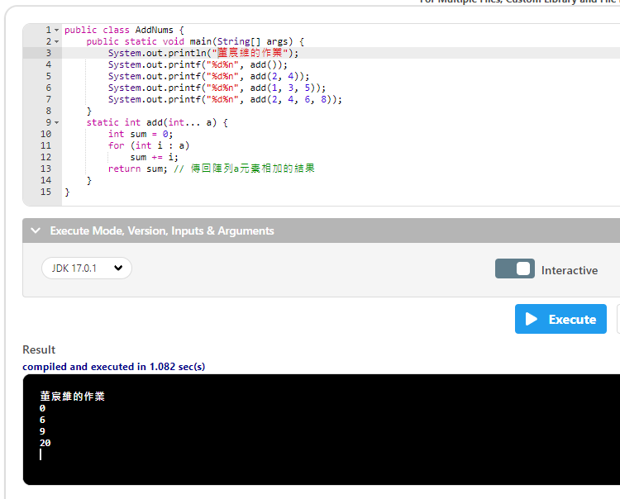

Slide 45
public class AddNums {
public static void main(String[] args) {
System.out.println("董宸維的作業");
System.out.printf("%d%n", add());
使用 add()這個方法列印出答案
System.out.printf("%d%n", add(2, 4));
System.out.printf("%d%n", add(1, 3, 5));
System.out.printf("%d%n", add(2, 4, 6, 8));
}
static int add(int... a) {
int sum = 0;
for (int i : a)
sum += i;
return sum; // 傳回陣列a元素相加的結果
}
}

Slide 46
public class AddNums {
public static void main(String[] args) {
System.out.println("董宸維的作業");
System.out.printf("%d%n", add());
System.out.printf("%d%n", add(2, 4));
System.out.printf("%d%n", add(1, 3, 5));
System.out.printf("%d%n", add(2, 4, 6, 8));
}
static int add(int... a) {
設定 add方法 (有很多的整數 值傳入a)
int sum = 0;
for (int i : a)
sum += i;
return sum; // 傳回陣列a元素相加的結果
}
}

Slide 47
public class AddNums {
public static void main(String[] args) {
System.out.println("董宸維的作業");
System.out.printf("%d%n", add());
System.out.printf("%d%n", add(2, 4));
System.out.printf("%d%n", add(1, 3, 5));
System.out.printf("%d%n", add(2, 4, 6, 8));
}
static int add(int... a) {
int sum = 0;
設 sum = 0為整數變數
for (int i : a)
sum += i;
return sum; // 傳回陣列a元素相加的結果
}
}

Slide 48
public class AddNums {
public static void main(String[] args) {
System.out.println("董宸維的作業");
System.out.printf("%d%n", add());
System.out.printf("%d%n", add(2, 4));
System.out.printf("%d%n", add(1, 3, 5));
System.out.printf("%d%n", add(2, 4, 6, 8));
}
static int add(int... a) {
int sum = 0;
for (int i : a)
設一個整數變數 i : 從陣列第一個值取值取到最後一個值
sum += i;
return sum; // 傳回陣列a元素相加的結果
}
}

Slide 49
public class AddNums {
public static void main(String[] args) {
System.out.println("董宸維的作業");
System.out.printf("%d%n", add());
System.out.printf("%d%n", add(2, 4));
System.out.printf("%d%n", add(1, 3, 5));
System.out.printf("%d%n", add(2, 4, 6, 8));
}
static int add(int... a) {
int sum = 0;
for (int i : a)
sum += i;
sum = sum +i;
i++ ==> i = i + 1;
return sum; // 傳回陣列a元素相加的結果
}
}

Slide 50
public class AddNums {
public static void main(String[] args) {
System.out.println("董宸維的作業");
System.out.printf("%d%n", add());
System.out.printf("%d%n", add(2, 4));
System.out.printf("%d%n", add(1, 3, 5));
System.out.printf("%d%n", add(2, 4, 6, 8));
}
static int add(int... a) {
int sum = 0;
for (int i : a)
sum += i;
return sum; // 傳回陣列a元素相加的結果
回傳 sum的值
}
}

Slide 51
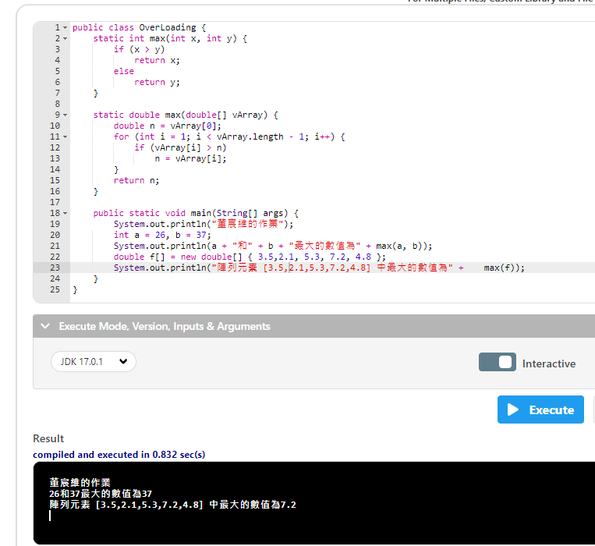

Slide 52
public class OverLoading {
static int max(int x, int y) {
宣告max這個方法(有2個整數變數)
if (x > y)
return x;
else
return y;
}
static double max(double[] vArray) {
double n = vArray[0];
for (int i = 1; i < vArray.length - 1; i++) {
if (vArray[i] > n)
n = vArray[i];
}
return n;
}
public static void main(String[] args) {
System.out.println("董宸維的作業");
int a = 26, b = 37;
System.out.println(a + "和" + b + "最大的數值為" + max(a, b));
double f[] = new double[] { 3.5,2.1, 5.3, 7.2, 4.8 };
System.out.println("陣列元素 [3.5,2.1,5.3,7.2,4.8] 中最大的數值為" +max(f));
}
}

Slide 53
public class OverLoading {
static int max(int x, int y) {
if (x > y)
return x;
else
return y;
}
static double max(double[] vArray) {
宣告max(有浮點數陣列 vArray讀取傳入值 )
double n = vArray[0];
for (int i = 1; i < vArray.length - 1; i++) {
if (vArray[i] > n)
n = vArray[i];
}
return n;
}
public static void main(String[] args) {
System.out.println("董宸維的作業");
int a = 26, b = 37;
System.out.println(a + "和" + b + "最大的數值為" + max(a, b));
double f[] = new double[] { 3.5,2.1, 5.3, 7.2, 4.8 };
System.out.println("陣列元素 [3.5,2.1,5.3,7.2,4.8] 中最大的數值為" +max(f));
}
}

Slide 54
public class OverLoading {
static int max(int x, int y) {
if (x > y)
return x;
else
return y;
}
static double max(double[] vArray) {
double n = vArray[0];
for (int i = 1; i < vArray.length - 1; i++) {
if (vArray[i] > n)
n = vArray[i];
}
return n;
}
public static void main(String[] args) {
System.out.println("董宸維的作業");
int a = 26, b = 37;
宣告 2個整數變數
System.out.println(a + "和" + b + "最大的數值為" + max(a, b));
double f[] = new double[] { 3.5,2.1, 5.3, 7.2, 4.8 };
System.out.println("陣列元素 [3.5,2.1,5.3,7.2,4.8] 中最大的數值為" +max(f));
}
}

Slide 55
public class OverLoading {
static int max(int x, int y) {
if (x > y)
return x;
else
return y;
}
static double max(double[] vArray) {
double n = vArray[0];
for (int i = 1; i < vArray.length - 1; i++) {
if (vArray[i] > n)
n = vArray[i];
}
return n;
}
public static void main(String[] args) {
System.out.println("董宸維的作業");
int a = 26, b = 37;
System.out.println(a + "和" + b + "最大的數值為" + max(a, b));
用 max方法裡面的整數方法
double f[] = new double[] { 3.5,2.1, 5.3, 7.2, 4.8 };
System.out.println("陣列元素 [3.5,2.1,5.3,7.2,4.8] 中最大的數值為" +max(f));
}
}

Slide 56
public class OverLoading {
static int max(int x, int y) {
if (x > y)
如果 x > y就會進入
return x;
else
否則會進入else裡面
return y;
}
static double max(double[] vArray) {
double n = vArray[0];
for (int i = 1; i < vArray.length - 1; i++) {
if (vArray[i] > n)
n = vArray[i];
}
return n;
}
public static void main(String[] args) {
System.out.println("董宸維的作業");
int a = 26, b = 37;
System.out.println(a + "和" + b + "最大的數值為" + max(a, b));
double f[] = new double[] { 3.5,2.1, 5.3, 7.2, 4.8 };
System.out.println("陣列元素 [3.5,2.1,5.3,7.2,4.8] 中最大的數值為" +max(f));
}
}

Slide 57
public class OverLoading {
static int max(int x, int y) {
if (x > y)
return x;
如果 x>y會回傳 x的值
else
return y;
如果 x>y不成立會回傳 y的值
}
static double max(double[] vArray) {
double n = vArray[0];
for (int i = 1; i < vArray.length - 1; i++) {
if (vArray[i] > n)
n = vArray[i];
}
return n;
}
public static void main(String[] args) {
System.out.println("董宸維的作業");
int a = 26, b = 37;
System.out.println(a + "和" + b + "最大的數值為" + max(a, b));
double f[] = new double[] { 3.5,2.1, 5.3, 7.2, 4.8 };
System.out.println("陣列元素 [3.5,2.1,5.3,7.2,4.8] 中最大的數值為" +max(f));
}
}

Slide 58
public class OverLoading {
static int max(int x, int y) {
if (x > y)
return x;
else
return y;
}
static double max(double[] vArray) {
double n = vArray[0];
for (int i = 1; i < vArray.length - 1; i++) {
if (vArray[i] > n)
n = vArray[i];
}
return n;
}
public static void main(String[] args) {
System.out.println("董宸維的作業");
int a = 26, b = 37;
System.out.println(a + "和" + b + "最大的數值為" + max(a, b));
double f[] = new double[] { 3.5,2.1, 5.3, 7.2, 4.8 };
使用double[]這個方法內容有{ 3.5,2.1, 5.3, 7.2, 4.8 }傳入 f []裡面
System.out.println("陣列元素 [3.5,2.1,5.3,7.2,4.8] 中最大的數值為" +max(f));
}
}

Slide 59
public class OverLoading {
static int max(int x, int y) {
if (x > y)
return x;
else
return y;
}
static double max(double[] vArray) {
double n = vArray[0];
設收到的陣列從第 0位開始
for (int i = 1; i < vArray.length - 1; i++) {
if (vArray[i] > n)
n = vArray[i];
}
return n;
}
public static void main(String[] args) {
System.out.println("董宸維的作業");
int a = 26, b = 37;
System.out.println(a + "和" + b + "最大的數值為" + max(a, b));
double f[] = new double[] { 3.5,2.1, 5.3, 7.2, 4.8 };
System.out.println("陣列元素 [3.5,2.1,5.3,7.2,4.8] 中最大的數值為" +max(f));
}
}

Slide 60
public class OverLoading {
static int max(int x, int y) {
if (x > y)
return x;
else
return y;
}
static double max(double[] vArray) {
double n = vArray[0];
for (int i = 1; i < vArray.length - 1; i++) {
設 i = 1 ; i < 陣列的總長度 – 1 ; i + 1
if (vArray[i] > n)
n = vArray[i];
}
return n;
}
public static void main(String[] args) {
System.out.println("董宸維的作業");
int a = 26, b = 37;
System.out.println(a + "和" + b + "最大的數值為" + max(a, b));
double f[] = new double[] { 3.5,2.1, 5.3, 7.2, 4.8 };
System.out.println("陣列元素 [3.5,2.1,5.3,7.2,4.8] 中最大的數值為" +max(f));
}
}

Slide 61
public class OverLoading {
static int max(int x, int y) {
if (x > y)
return x;
else
return y;
}
static double max(double[] vArray) {
double n = vArray[0];
for (int i = 1; i < vArray.length - 1; i++) {
if (vArray[i] > n)
i=迴圈的次數也等於第幾個陣列的值
vArray[i]的值 > n了話就會進入 ,n第一個得到的值
n = vArray[i];
}
return n;
}
public static void main(String[] args) {
System.out.println("董宸維的作業");
int a = 26, b = 37;
System.out.println(a + "和" + b + "最大的數值為" + max(a, b));
double f[] = new double[] { 3.5,2.1, 5.3, 7.2, 4.8 };
System.out.println("陣列元素 [3.5,2.1,5.3,7.2,4.8] 中最大的數值為" +max(f));
}
}

Slide 62
public class OverLoading {
static int max(int x, int y) {
if (x > y)
return x;
else
return y;
}
static double max(double[] vArray) {
double n = vArray[0];
for (int i = 1; i < vArray.length - 1; i++) {
if (vArray[i] > n)
n = vArray[i];
把 vArray[i]得到的新的值傳給 n
}
return n;
}
public static void main(String[] args) {
System.out.println("董宸維的作業");
int a = 26, b = 37;
System.out.println(a + "和" + b + "最大的數值為" + max(a, b));
double f[] = new double[] { 3.5,2.1, 5.3, 7.2, 4.8 };
System.out.println("陣列元素 [3.5,2.1,5.3,7.2,4.8] 中最大的數值為" +max(f));
}
}

Slide 63
public class OverLoading {
static int max(int x, int y) {
if (x > y)
return x;
else
return y;
}
static double max(double[] vArray) {
double n = vArray[0];
for (int i = 1; i < vArray.length - 1; i++) {
if (vArray[i] > n)
n = vArray[i];
}
return n;
迴圈跑完之後最大值就會回傳給
}
public static void main(String[] args) {
System.out.println("董宸維的作業");
int a = 26, b = 37;
System.out.println(a + "和" + b + "最大的數值為" + max(a, b));
double f[] = new double[] { 3.5,2.1, 5.3, 7.2, 4.8 };
System.out.println("陣列元素 [3.5,2.1,5.3,7.2,4.8] 中最大的數值為" +max(f));
}
}

Slide 64
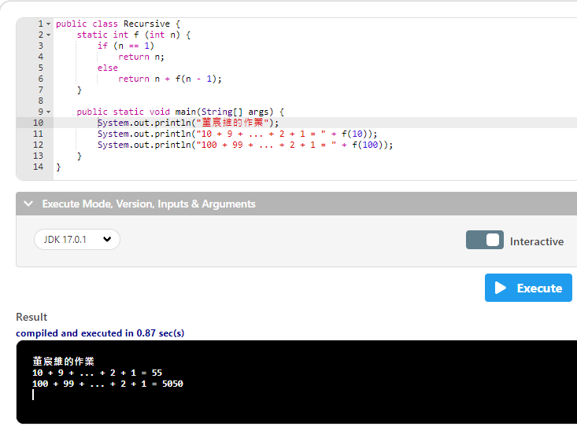

Slide 65
public class Recursive {
static int f (int n) {
宣告 f這個方法(有 1個整數變數 )
if (n == 1)
return n;
else
return n + f(n - 1);
}
public static void main(String[] args) {
System.out.println("董宸維的作業");
System.out.println("10 + 9 + ... + 2 + 1 = " + f(10));
System.out.println("100 + 99 + ... + 2 + 1 = " + f(100));
}
}

Slide 66
public class Recursive {
static int f (int n) {
if (n == 1)
return n;
else
return n + f(n - 1);
}
public static void main(String[] args) {
System.out.println("董宸維的作業");
System.out.println("10 + 9 + ... + 2 + 1 = " + f(10));
呼叫 f方法給 10這個值
System.out.println("100 + 99 + ... + 2 + 1 = " + f(100));
}
}

Slide 67
public class Recursive {
static int f (int n) {
if (n == 1)
如果 n=1就會進入
return n;
else
否則進入這裡
return n + f(n - 1);
}
public static void main(String[] args) {
System.out.println("董宸維的作業");
System.out.println("10 + 9 + ... + 2 + 1 = " + f(10));
System.out.println("100 + 99 + ... + 2 + 1 = " + f(100));
}
}

Slide 68
public class Recursive {
static int f (int n) {
if (n == 1)
return n;
進入後回傳總和給 n
else
return n + f(n - 1);
進入後 n + f(n - 1)
例如 n+f(10-1)因為還不等於 1所以沒有辦法離開
f(9-1)
f(8-1)
f(7-1)
f(6-1)
f(5-1)
f(4-1)
f(3-1)
f(2-1)因為等於 1所以離開
}
public static void main(String[] args) {
System.out.println("董宸維的作業");
System.out.println("10 + 9 + ... + 2 + 1 = " + f(10));
System.out.println("100 + 99 + ... + 2 + 1 = " + f(100));
}
}
總和要往上回加

Slide 69
public class Recursive {
static int f (int n) {
if (n == 1)
return n;
else
return n + f(n - 1);
}
public static void main(String[] args) {
System.out.println("董宸維的作業");
System.out.println("10 + 9 + ... + 2 + 1 = " + f(10));
System.out.println("100 + 99 + ... + 2 + 1 = " + f(100));
呼叫 f方法給 100這個值
}
}

