Slide 1
第四作業

Slide 2
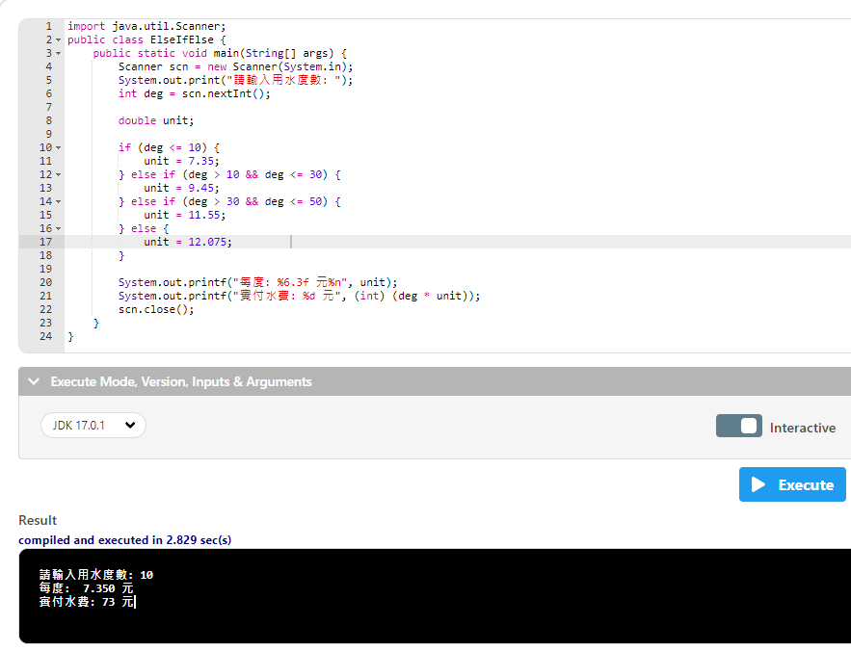

Slide 3
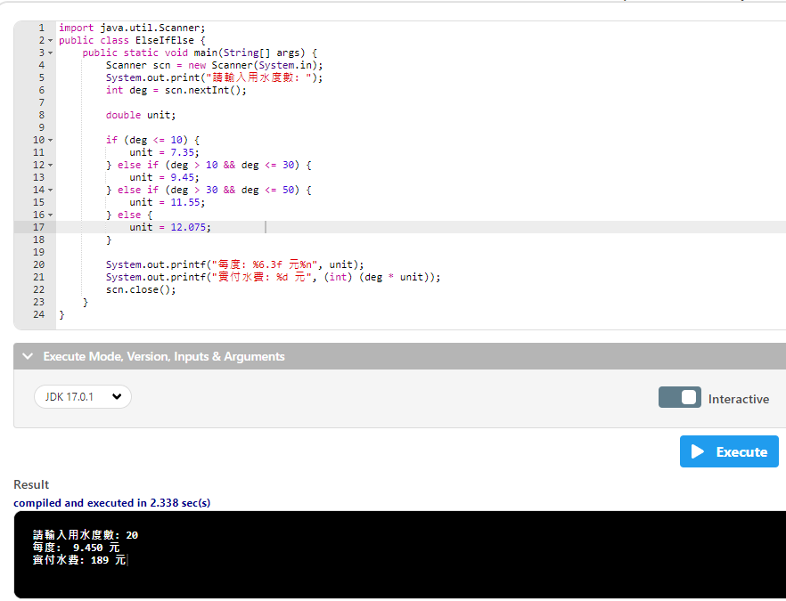

Slide 4
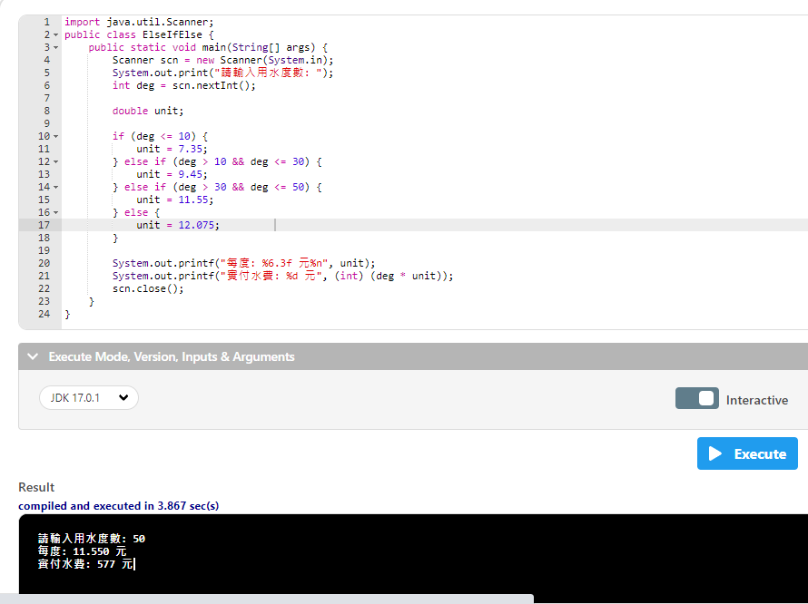

Slide 5
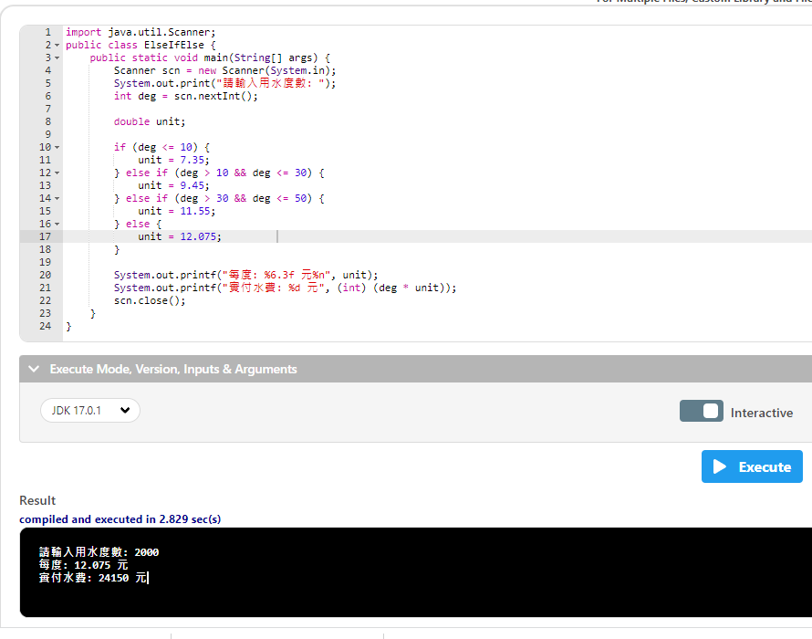

Slide 6
import java.util.Scanner;
public class ElseIfElse {
public static void main(String[] args) {
Scanner scn = new Scanner(System.in);
使用Scanner的類別套件scn是物件可以自己取名字
系統等待輸入 資料傳入新的Scanner再回傳給 scn
System.out.print("請輸入用水度數: ");
int deg = scn.nextInt();
double unit;
if (deg <= 10) {
unit = 7.35;
} else if (deg > 10 && deg <= 30) {
unit = 9.45;
} else if (deg > 30 && deg <= 50) {
unit = 11.55;
} else {
unit = 12.075;
}
System.out.printf("每度: %6.3f 元%n", unit);
System.out.printf("實付水費: %d 元", (int) (deg * unit));
scn.close();
}
}

Slide 7
import java.util.Scanner;
public class ElseIfElse {
public static void main(String[] args) {
Scanner scn = new Scanner(System.in);
System.out.print("請輸入用水度數: ");
int deg = scn.nextInt(); //scn.next(); 如果寫這樣是回傳字串 整數自己取名子輸入進來的值會把它認定為整數
double unit;
if (deg <= 10) {
unit = 7.35;
} else if (deg > 10 && deg <= 30) {
unit = 9.45;
} else if (deg > 30 && deg <= 50) {
unit = 11.55;
} else {
unit = 12.075;
}
System.out.printf("每度: %6.3f 元%n", unit);
System.out.printf("實付水費: %d 元", (int) (deg * unit));
scn.close();
}
}

Slide 8
import java.util.Scanner;
public class ElseIfElse {
public static void main(String[] args) {
Scanner scn = new Scanner(System.in);
System.out.print("請輸入用水度數: ");
int deg = scn.nextInt();
double unit;
宣告double
if (deg <= 10) {
unit = 7.35;
} else if (deg > 10 && deg <= 30) {
unit = 9.45;
} else if (deg > 30 && deg <= 50) {
unit = 11.55;
} else {
unit = 12.075;
}
System.out.printf("每度: %6.3f 元%n", unit);
System.out.printf("實付水費: %d 元", (int) (deg * unit));
scn.close();
}
}

Slide 9
import java.util.Scanner;
public class ElseIfElse {
public static void main(String[] args) {
Scanner scn = new Scanner(System.in);
System.out.print("請輸入用水度數: ");
int deg = scn.nextInt();
double unit;
if (deg <= 10) {
如果輸入進來的值<=10就會進入
unit = 7.35;
} else if (deg > 10 && deg <= 30) {
unit = 9.45;
} else if (deg > 30 && deg <= 50) {
unit = 11.55;
} else {
unit = 12.075;
}
System.out.printf("每度: %6.3f 元%n", unit);
System.out.printf("實付水費: %d 元", (int) (deg * unit));
scn.close();
}
}

Slide 10
import java.util.Scanner;
public class ElseIfElse {
public static void main(String[] args) {
Scanner scn = new Scanner(System.in);
System.out.print("請輸入用水度數: ");
int deg = scn.nextInt();
double unit;
if (deg <= 10) {
unit = 7.35;
如果輸入的值<=10就會得到 unit = 7.35答案
} else if (deg > 10 && deg <= 30) {
unit = 9.45;
} else if (deg > 30 && deg <= 50) {
unit = 11.55;
} else {
unit = 12.075;
}
System.out.printf("每度: %6.3f 元%n", unit);
System.out.printf("實付水費: %d 元", (int) (deg * unit));
scn.close();
}
}

Slide 11
import java.util.Scanner;
public class ElseIfElse {
public static void main(String[] args) {
Scanner scn = new Scanner(System.in);
System.out.print("請輸入用水度數: ");
int deg = scn.nextInt();
double unit;
if (deg <= 10) {
unit = 7.35;
} else if (deg > 10 && deg <= 30) {
如果輸入進來的值>10或者 <=30就會進入
unit = 9.45;
} else if (deg > 30 && deg <= 50) {
unit = 11.55;
} else {
unit = 12.075;
}
System.out.printf("每度: %6.3f 元%n", unit);
System.out.printf("實付水費: %d 元", (int) (deg * unit));
scn.close();
}
}

Slide 12
import java.util.Scanner;
public class ElseIfElse {
public static void main(String[] args) {
Scanner scn = new Scanner(System.in);
System.out.print("請輸入用水度數: ");
int deg = scn.nextInt();
double unit;
if (deg <= 10) {
unit = 7.35;
} else if (deg > 10 && deg <= 30) {
unit = 9.45;
如果輸入的值 >10 <=30就會得到 unit = 9.45答案
} else if (deg > 30 && deg <= 50) {
unit = 11.55;
} else {
unit = 12.075;
}
System.out.printf("每度: %6.3f 元%n", unit);
System.out.printf("實付水費: %d 元", (int) (deg * unit));
scn.close();
}
}

Slide 13
import java.util.Scanner;
public class ElseIfElse {
public static void main(String[] args) {
Scanner scn = new Scanner(System.in);
System.out.print("請輸入用水度數: ");
int deg = scn.nextInt();
double unit;
if (deg <= 10) {
unit = 7.35;
} else if (deg > 10 && deg <= 30) {
unit = 9.45;
} else if (deg > 30 && deg <= 50) {
如果輸入進來的值>30或者 <=50就會進入
unit = 11.55;
} else {
unit = 12.075;
}
System.out.printf("每度: %6.3f 元%n", unit);
System.out.printf("實付水費: %d 元", (int) (deg * unit));
scn.close();
}
}

Slide 14
import java.util.Scanner;
public class ElseIfElse {
public static void main(String[] args) {
Scanner scn = new Scanner(System.in);
System.out.print("請輸入用水度數: ");
int deg = scn.nextInt();
double unit;
if (deg <= 10) {
unit = 7.35;
} else if (deg > 10 && deg <= 30) {
unit = 9.45;
} else if (deg > 30 && deg <= 50) {
unit = 11.55;
如果輸入的值 >30 <=50就會得到 unit = 11.55答案
} else {
unit = 12.075;
}
System.out.printf("每度: %6.3f 元%n", unit);
System.out.printf("實付水費: %d 元", (int) (deg * unit));
scn.close();
}
}

Slide 15
import java.util.Scanner;
public class ElseIfElse {
public static void main(String[] args) {
Scanner scn = new Scanner(System.in);
System.out.print("請輸入用水度數: ");
int deg = scn.nextInt();
double unit;
if (deg <= 10) {
unit = 7.35;
} else if (deg > 10 && deg <= 30) {
unit = 9.45;
} else if (deg > 30 && deg <= 50) {
unit = 11.55;
} else {
如果以上都沒有就會進入這裡
unit = 12.075;
}
System.out.printf("每度: %6.3f 元%n", unit);
System.out.printf("實付水費: %d 元", (int) (deg * unit));
scn.close();
}
}

Slide 16
import java.util.Scanner;
public class ElseIfElse {
public static void main(String[] args) {
Scanner scn = new Scanner(System.in);
System.out.print("請輸入用水度數: ");
int deg = scn.nextInt();
double unit;
if (deg <= 10) {
unit = 7.35;
} else if (deg > 10 && deg <= 30) {
unit = 9.45;
} else if (deg > 30 && deg <= 50) {
unit = 11.55;
} else {
unit = 12.075;
進入這裡就會得到 unit = 12.075答案
}
System.out.printf("每度: %6.3f 元%n", unit);
System.out.printf("實付水費: %d 元", (int) (deg * unit));
scn.close();
}
}

Slide 17
import java.util.Scanner;
public class ElseIfElse {
public static void main(String[] args) {
Scanner scn = new Scanner(System.in);
System.out.print("請輸入用水度數: ");
int deg = scn.nextInt();
double unit;
if (deg <= 10) {
unit = 7.35;
} else if (deg > 10 && deg <= 30) {
unit = 9.45;
} else if (deg > 30 && deg <= 50) {
unit = 11.55;
} else {
unit = 12.075;
}
System.out.printf("每度: %6.3f 元%n", unit);
printf是有用到 %輸出才要加 f
%6.3f 總長度,表示 oo.xxx
%f 浮點數(包括float和double)
%n是斷行
System.out.printf("實付水費: %d 元", (int) (deg * unit));
scn.close();
}
}

Slide 18
import java.util.Scanner;
public class ElseIfElse {
public static void main(String[] args) {
Scanner scn = new Scanner(System.in);
System.out.print("請輸入用水度數: ");
int deg = scn.nextInt();
double unit;
if (deg <= 10) {
unit = 7.35;
} else if (deg > 10 && deg <= 30) {
unit = 9.45;
} else if (deg > 30 && deg <= 50) {
unit = 11.55;
} else {
unit = 12.075;
}
System.out.printf("每度: %6.3f 元%n", unit);
System.out.printf("實付水費: %d 元", (int) (deg * unit));
輸入進來的值乘於得到的答案以正數呈現
再回傳給%d
%d只接收整數
scn.close();
}
}

Slide 19
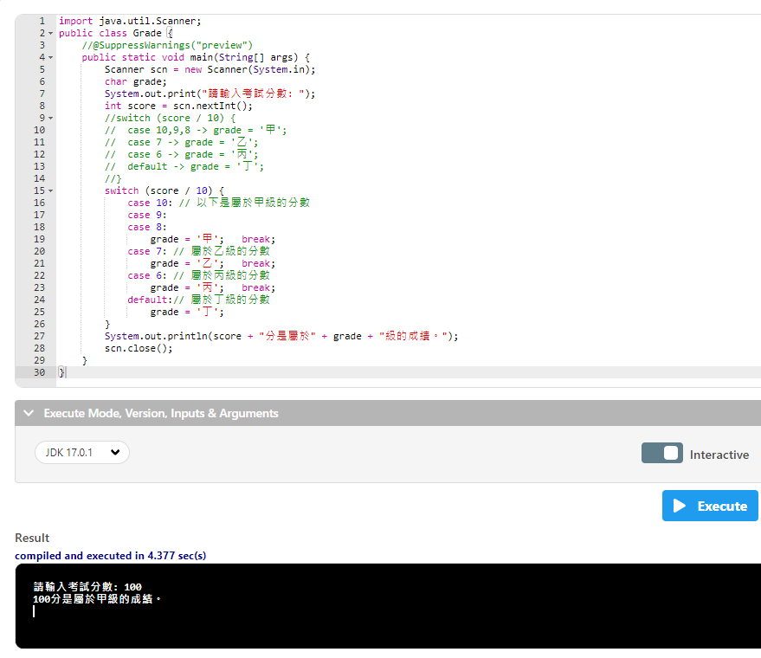

Slide 20
import java.util.Scanner;
public class Grade {
public static void main(String[] args) {
Scanner scn = new Scanner(System.in);
char grade;
char宣告字串
System.out.print("請輸入考試分數: ");
int score = scn.nextInt();
switch (score / 10) {
case 10: // 以下是屬於甲級的分數
case 9:
case 8:
grade = '甲'; break;
case 7: // 屬於乙級的分數
grade = '乙'; break;
case 6: // 屬於丙級的分數
grade = '丙'; break;
default:// 屬於丁級的分數
grade = '丁';
}
System.out.println(score + "分是屬於" + grade + "級的成績。");
scn.close();
}
}

Slide 21
import java.util.Scanner;
public class Grade {
public static void main(String[] args) {
Scanner scn = new Scanner(System.in);
char grade;
System.out.print("請輸入考試分數: ");
int score = scn.nextInt();
switch (score / 10) {
輸入進來的分數除10
case 10: // 以下是屬於甲級的分數
case 9:
case 8:
grade = '甲'; break;
case 7: // 屬於乙級的分數
grade = '乙'; break;
case 6: // 屬於丙級的分數
grade = '丙'; break;
default:// 屬於丁級的分數
grade = '丁';
}
System.out.println(score + "分是屬於" + grade + "級的成績。");
scn.close();
}
}

Slide 22
import java.util.Scanner;
public class Grade {
public static void main(String[] args) {
Scanner scn = new Scanner(System.in);
char grade;
System.out.print("請輸入考試分數: ");
int score = scn.nextInt();
switch (score / 10) {
case 10: // 以下是屬於甲級的分數
case 9:
case 8:
grade = ‘甲 '; break;
輸入進來的值除完後如果等於上述答案就會是grade = ‘甲 ’;這個字串
break;之後再離開
case 7: // 屬於乙級的分數
grade = '乙'; break;
case 6: // 屬於丙級的分數
grade = '丙'; break;
default:// 屬於丁級的分數
grade = '丁';
}
System.out.println(score + "分是屬於" + grade + "級的成績。");
scn.close();
}
}

Slide 23
import java.util.Scanner;
public class Grade {
public static void main(String[] args) {
Scanner scn = new Scanner(System.in);
char grade;
System.out.print("請輸入考試分數: ");
int score = scn.nextInt();
switch (score / 10) {
case 10: // 以下是屬於甲級的分數
case 9:
case 8:
grade = '甲'; break;
case 7: // 屬於乙級的分數
grade = '乙'; break;
case 6: // 屬於丙級的分數
grade = '丙'; break;
輸入進來的值除完後如果等於上述答案就會是grade = ‘乙 ’或 ’丙 ’;這個字串
break;之後再離開
default:// 屬於丁級的分數
grade = '丁';
}
System.out.println(score + "分是屬於" + grade + "級的成績。");
scn.close();
}
}

Slide 24
import java.util.Scanner;
public class Grade {
public static void main(String[] args) {
Scanner scn = new Scanner(System.in);
char grade;
System.out.print("請輸入考試分數: ");
int score = scn.nextInt();
switch (score / 10) {
case 10: // 以下是屬於甲級的分數
case 9:
case 8:
grade = '甲'; break;
case 7: // 屬於乙級的分數
grade = '乙'; break;
case 6: // 屬於丙級的分數
grade = '丙'; break;
default:// 屬於丁級的分數
grade = '丁';
以上都沒有就會進入默認
}
System.out.println(score + "分是屬於" + grade + "級的成績。");
scn.close();
}
}

Slide 25
import java.util.Scanner;
public class Grade {
public static void main(String[] args) {
Scanner scn = new Scanner(System.in);
char grade;
System.out.print("請輸入考試分數: ");
int score = scn.nextInt();
switch (score / 10) {
case 10: // 以下是屬於甲級的分數
case 9:
case 8:
grade = '甲'; break;
case 7: // 屬於乙級的分數
grade = '乙'; break;
case 6: // 屬於丙級的分數
grade = '丙'; break;
default:// 屬於丁級的分數
grade = '丁';
}
System.out.println(score + "分是屬於" + grade + "級的成績。");
輸入的成績+ “分是屬於” +得到的字串答案+ "級的成績”
scn.close();
}
}

