Slide 1
JAVA物件導向程式開發報告
程式設計二
學生:A100E111董宸維
老師:偉大的恩師龍大大

Slide 2
public class Ccar {
public double gas, tbo;
public double max_dist = 0;
public void maxDist() {
max_dist = gas * tbo;
}
public double dist(double oil) {
return oil * tbo;
}
}
Ccar
+gas
宣告屬性
+tbo
+max_dist
+maxDist()
宣告方法
+dist()

Slide 3
public class BuildObject {
public static void main(String[] args) {
Ccar car1;
car1 = new Ccar();
car1.gas = 40;
car1.tbo = 13.6;
car1.maxDist();
double distance = car1.dist(20);
System.out.println("car1汽車資訊：");
System.out.println("最大載油量：" + car1.gas + " L");
System.out.println("平均耗油量：" + car1.tbo + " km/L");
System.out.println("加滿油可行駛 " + car1.max_dist + " km");
System.out.println("加油20L可行駛 " + distance + " km");
Ccar car2 = new Ccar(); //宣告並建立car2物件
car2.gas = 60; //設定car2物件的屬性值
car2.tbo = 9.5;
}
}
Ccar
car1
car2

Slide 4
Ccar
Ccar car1= new Ccar();
+gas
Ccar car1;
car1 = new Ccar(); car2 = new Ccar();
+tbo
+max_dist
+maxDist()
+dist()
car1
car2

Slide 5
Agenda
物件導向技術(Object-Oriented) 結構化程式開發
核心觀念: 類別(class)與物件(object)
物件導向技術三要素:封裝|繼承|多形
物件導向封裝(Encapsulation)技術範例與實測
物件導向繼承範例與實測
物件導向多形範例與實測

Slide 6
物件導向封裝技術範例與實測
封裝是使用成員存取修飾子，來定義類別內部的資料成員和方法成員的存取限制，其目的用來保護類別內部的成員，免於受到外部程式的不當存取。
1. public (公開)允許給任何類別的程式呼叫
2. private (私有)只允許自身類別內的程式呼叫
3. protected (保護)只允許自身類別或繼承自身類別的子類別呼叫

Slide 7
方法多載
「多載」是指同一個類別內，有兩個以上相同名稱的方法，但是因為各個方法所要傳入的引數個數不同，或者是引數的資料型別不同，則這些方法將被視為不同，且各有各自的內容。

Slide 8
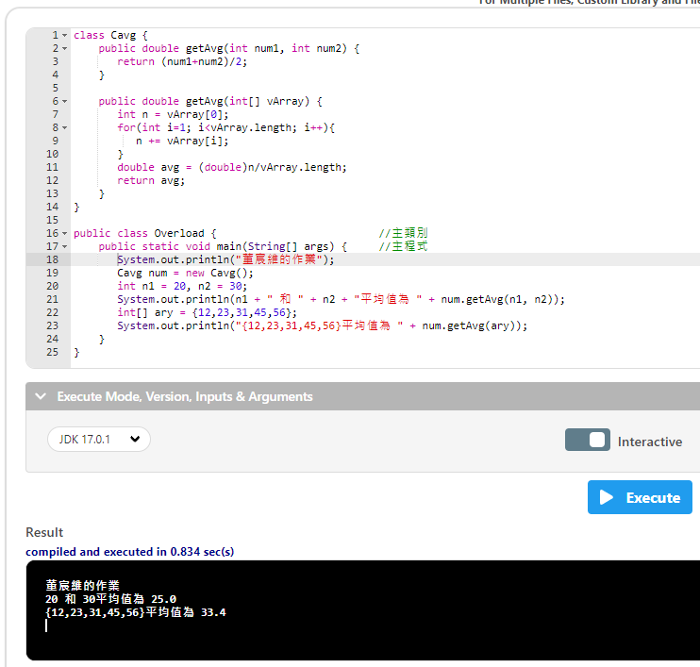
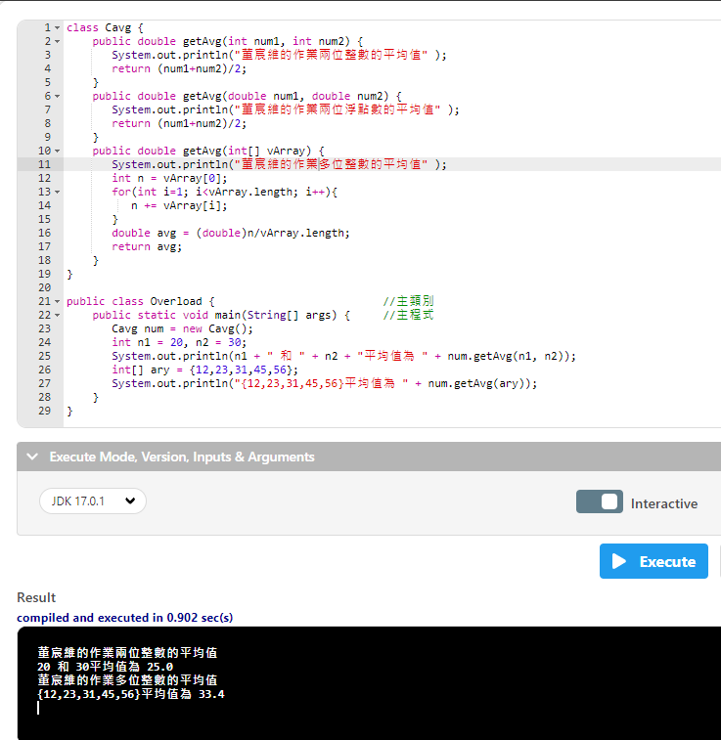

Slide 9
class Cavg {
public double getAvg(int num1, int num2) {
return (num1+num2)/2;
}
public double getAvg(int[] vArray) {
int n = vArray[0];
for(int i=1; i<vArray.length; i++){
n += vArray[i];
}
double avg = (double)n/vArray.length;
return avg;
}
}
public class Overload {
public static void main(String[] args) {
System.out.println("董宸維的作業");
Cavg num = new Cavg();
int n1 = 20, n2 = 30;
System.out.println(n1 + " 和 " + n2 + "平均值為 " + num.getAvg(n1, n2));
int[] ary = {12,23,31,45,56};
System.out.println("{12,23,31,45,56}平均值為 " + num.getAvg(ary));
}
}
叫做多載
一個類別裡面有2個一模一樣的方法

Slide 10
建構式(Constructor)
類別名稱 物件變數 = new 建構式名稱()
()沒有寫預設建構值

Slide 11
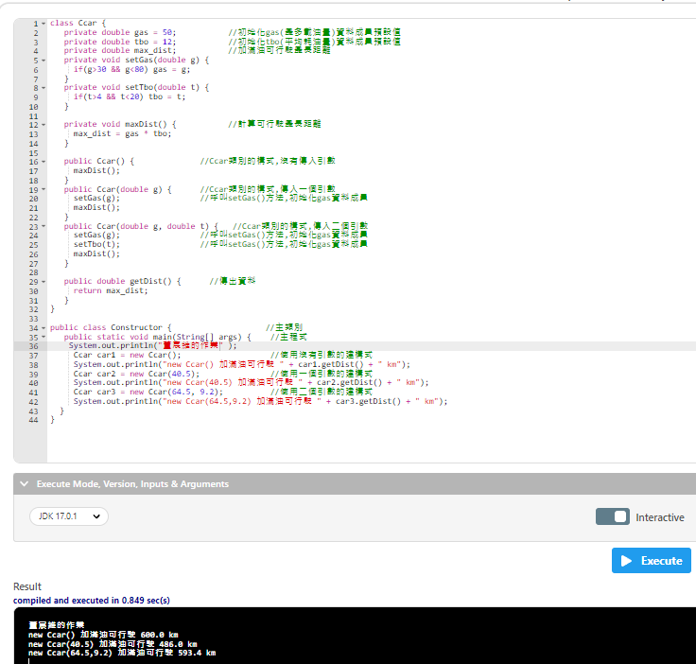

Slide 12
宣告只允許自身類別內的程式呼叫
class Ccar {
private double gas = 50;
private double tbo = 12;
private double max_dist;
private void setGas(double g) {
if(g>30 && g<80) gas = g;
}
private void setTbo(double t) {
if(t>4 && t<20) tbo = t;
}
private void maxDist() {
max_dist = gas * tbo;
}
public Ccar() {
maxDist();
}
public Ccar(double g) {
setGas(g);
maxDist();
}
public Ccar(double g, double t) {
setGas(g);
setTbo(t);
maxDist();
}
3
public double getDist() {
return max_dist;
}
}
3
5
4
public class Constructor {
public static void main(String[] args) {
System.out.println("董宸維的作業" );
Ccar car1 = new Ccar();
類別名稱 物件變數 = new 建構式名稱 ()
System.out.println("new Ccar() 加滿油可行駛 " + car1.getDist() + " km");
Ccar car2 = new Ccar(40.5);
類別名稱 物件變數 = new 建構式名稱 (帶入參數)
System.out.println("new Ccar(40.5) 加滿油可行駛 " + car2.getDist() + " km");
Ccar car3 = new Ccar(64.5, 9.2);
類別名稱 物件變數 = new 建構式名稱 (帶入參數)
System.out.println("new Ccar(64.5,9.2) 加滿油可行駛 " + car3.getDist() + " km");
}
}
3
3
3
1
2
2
2
1
1
允許給任何類別的程式呼叫

Slide 13
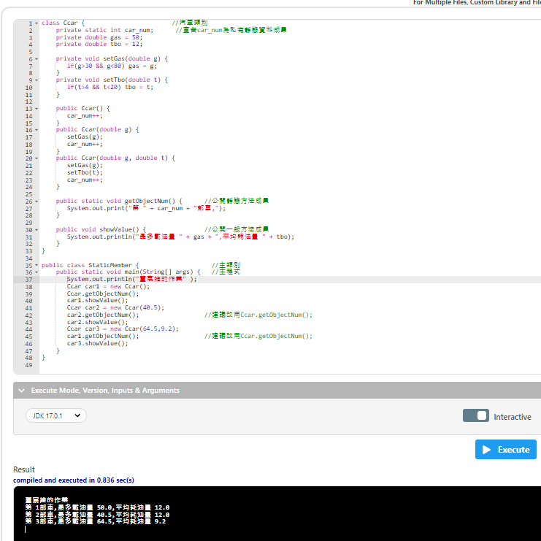

Slide 14
宣告只允許自身類別內的程式呼叫
class Ccar {
private static int car_num;
private double gas = 50;
private double tbo = 12;
private void setGas(double g) {
if(g>30 && g<80) gas = g;
}
private void setTbo(double t) {
if(t>4 && t<20) tbo = t;
}
public Ccar() {
car_num++;
}
public Ccar(double g) {
setGas(g);
car_num++;
}
public Ccar(double g, double t) {
setGas(g);
setTbo(t);
car_num++;
}
public static void getObjectNum() {
System.out.print("第 " + car_num + "部車,");
}
3
public void showValue() {
System.out.println("最多載油量 " + gas + ",平均耗油量 " + tbo);
}
}
public class StaticMember {
public static void main(String[] args) {
System.out.println("董宸維的作業" );
Ccar car1 = new Ccar();
Ccar.getObjectNum();
car1.showValue();
Ccar car2 = new Ccar(40.5);
Ccar.getObjectNum();
car2.showValue();
Ccar car3 = new Ccar(64.5,9.2);
Ccar.getObjectNum();
car3.showValue();
}
}
1
1
1
4
2
2
2
允許給任何類別的程式呼叫

Slide 15
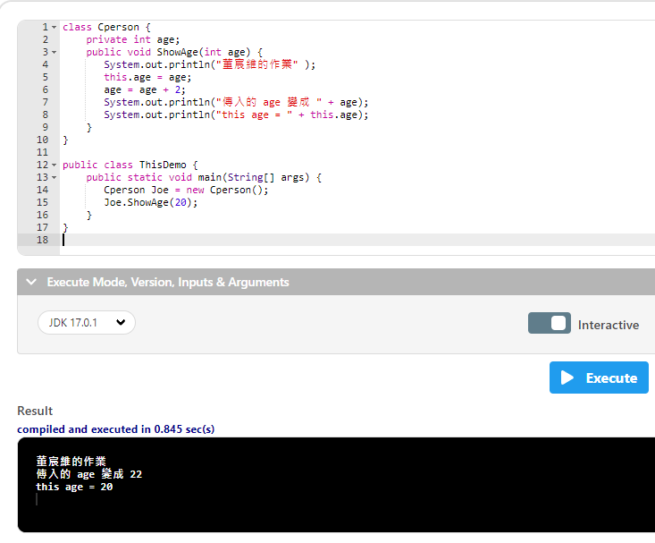

Slide 16
class Cperson {
private int age;
只允許自身類別內的程式呼叫的整數變數
public void ShowAge(int age) {
System.out.println("董宸維的作業" );
this.age = age;
age = age + 2;
System.out.println("傳入的 age 變成 " + age);
System.out.println("this age = " + this.age);
}
}
public class ThisDemo {
public static void main(String[] args) {
Cperson Joe = new Cperson();
Joe.ShowAge(20);
}
}

Slide 17
class Cperson {
private int age;
public void ShowAge(int age) {
允許給任何類別的方法 (參數)
System.out.println("董宸維的作業" );
this.age = age;
age = age + 2;
System.out.println("傳入的 age 變成 " + age);
System.out.println("this age = " + this.age);
}
}
public class ThisDemo {
public static void main(String[] args) {
Cperson Joe = new Cperson();
Joe.ShowAge(20);
}
}

Slide 18
class Cperson {
private int age;
public void ShowAge(int age) {
System.out.println("董宸維的作業" );
this.age = age;
age裡的值傳入this.age裡面
age = age + 2;
System.out.println("傳入的 age 變成 " + age);
System.out.println("this age = " + this.age);
}
}
public class ThisDemo {
public static void main(String[] args) {
Cperson Joe = new Cperson();
Joe.ShowAge(20);
}
}

Slide 19
class Cperson {
private int age;
public void ShowAge(int age) {
System.out.println("董宸維的作業" );
this.age = age;
age = age + 2;
age+2傳入原本的 age裡取代舊的值
System.out.println("傳入的 age 變成 " + age);
System.out.println("this age = " + this.age);
}
}
public class ThisDemo {
public static void main(String[] args) {
Cperson Joe = new Cperson();
Joe.ShowAge(20);
}
}

Slide 20
class Cperson {
private int age;
public void ShowAge(int age) {
System.out.println("董宸維的作業" );
this.age = age;
age = age + 2;
System.out.println("傳入的 age 變成 " + age);
這裡最終的值= age+2
System.out.println("this age = " + this.age);
}
}
public class ThisDemo {
public static void main(String[] args) {
Cperson Joe = new Cperson();
Joe.ShowAge(20);
}
}

Slide 21
class Cperson {
private int age;
public void ShowAge(int age) {
System.out.println("董宸維的作業" );
this.age = age;
age = age + 2;
System.out.println("傳入的 age 變成 " + age);
System.out.println("this age = " + this.age);
最初傳入的值
}
}
public class ThisDemo {
public static void main(String[] args) {
Cperson Joe = new Cperson();
Joe.ShowAge(20);
}
}

Slide 22
class Cperson {
private int age;
public void ShowAge(int age) {
System.out.println("董宸維的作業" );
this.age = age;
age = age + 2;
System.out.println("傳入的 age 變成 " + age);
System.out.println("this age = " + this.age);
}
}
public class ThisDemo {
public static void main(String[] args) {
Cperson Joe = new Cperson();
類別名稱 物件變數 = new 建構式名稱()
Joe.ShowAge(20);
}
}

Slide 23
class Cperson {
private int age;
public void ShowAge(int age) {
System.out.println("董宸維的作業" );
this.age = age;
age = age + 2;
System.out.println("傳入的 age 變成 " + age);
System.out.println("this age = " + this.age);
}
}
public class ThisDemo {
public static void main(String[] args) {
Cperson Joe = new Cperson();
Joe.ShowAge(20);
使用這個類別裡面的方法代入20這個值
}
}

