Slide 1


RRU-Net: The Ringed Residual U-Net for Image Splicing Forgery Detection
Master’s degree in Artificial Intelligence and Robotics
Authors: Denise Landini Alessandro Lambertini
Academic Year: 2020-2021
Course: Vision and Perception Professor: Irene Amerini

Slide 2
Introduction
Why RRU-Net ?
Goal: image splicing forgery detection.
RRU-Net is an end-to-end image essence attribute segmentation network.
Characteristics:
It is indipendent of human visual system
It can locate the forger regions without preprocessing and post-processing
It decreases incorrect prediction becuase it uses in a better way the contextual spatial information in an image
It guarantess that the discrimination of image essence attribute features be more evident while the features are extracted among the layers’ network. This can obtain better and stable performance than the traditional feature extraction-based detection methods and existing CNN-based detection method.

Slide 3
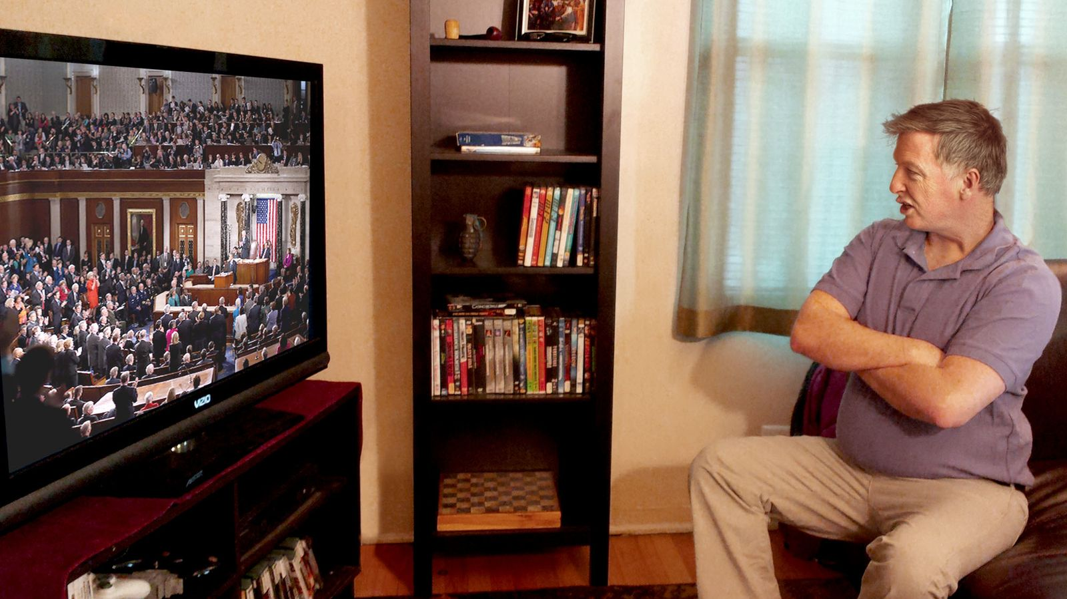
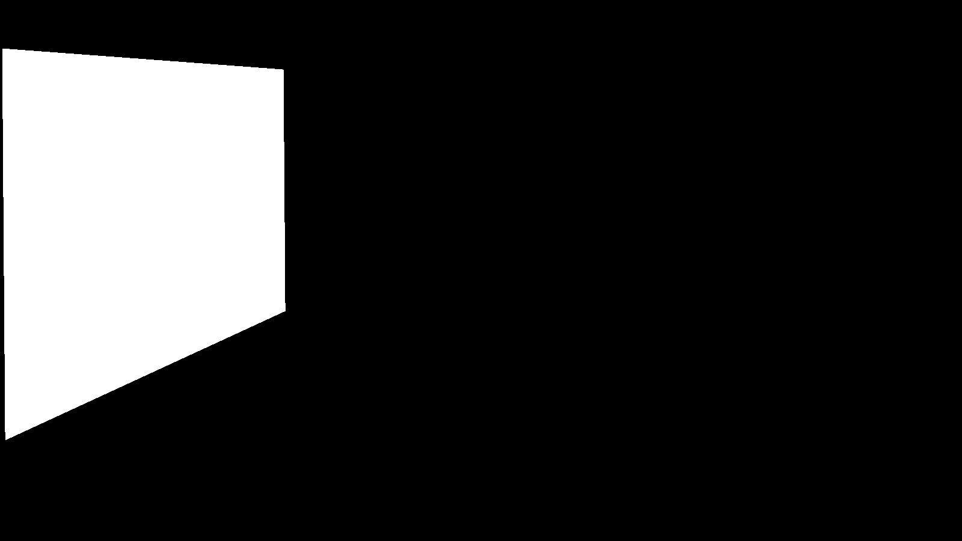
Dataset
Structure
The dataset is composed by 184 images.
In each image we have to identify what is the forgery object/person/detail.
Input image
Output image
In this example, we can see that the image on the television is the forgery object.

Slide 4
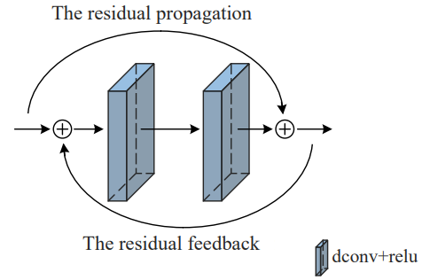
Architecture
Residual Propagation and Residual Feedback
The RRU structure combines:
RESIDUAL PROPAGATION
RESIDUAL FEEDBACK
It recalls the input feature information, to solve the gradient degradation problem.
Architecture:
It is added in each stacked layers
It has 2 convolutional layers
It uses ReLU as activation function.
It is an automatic learning method that consolidate the input feature information to make the differences of image essence attributes between the untampered and tampered regions be amplified.
Architecture:
It uses a sigmoid activation function in order to learn a nonlinear interaction between discriminate feature channels and avoid diffusion of feature information.
Figure: Representation of residual propagation and residual feedback.

Slide 5
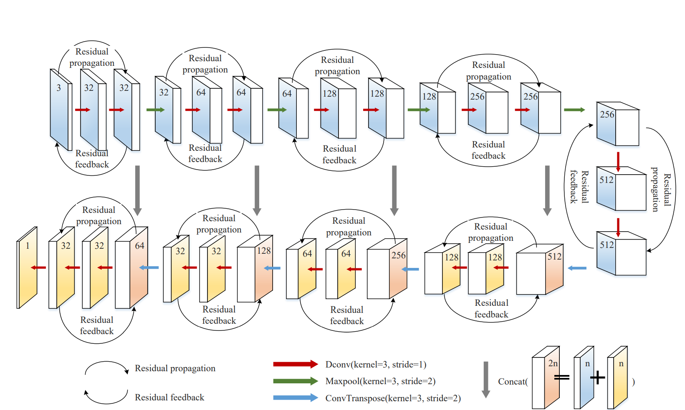
Architecture
Complete structure of RRU-Net
Figure: RRU-Net architecture. The numbers on the box represent the numbers of features.

Slide 6
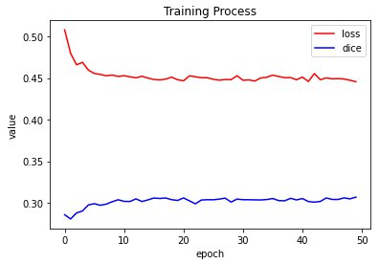
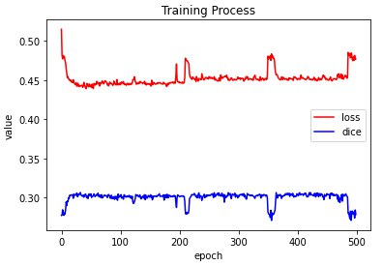
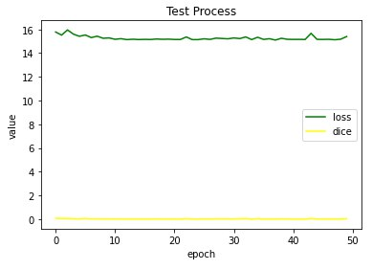
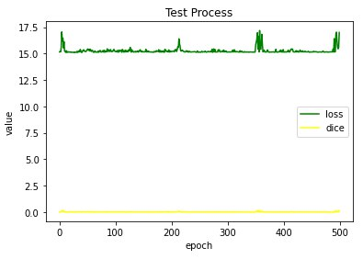
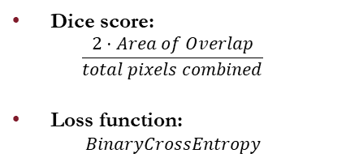
Evaluation of RRU-Net
Metrics used
Dice score:
$$\frac{2⋅Area of Overlap}{total pixels combined}$$
Loss function:
$$BinaryCrossEntropy$$
Discussion: First, we trained the network 50 times as we read in the paper but we though that it can improve the performance, so we trained a lot the network to see 2 things:
As far as the network can improve
At which point we can see the phenomenon of overfitting.
Figure 1: Values of dice and loss function for training and test processes after 50 epochs.
Figure 2: Values of dice and loss function for training and test processes after 500 epochs.

Slide 7
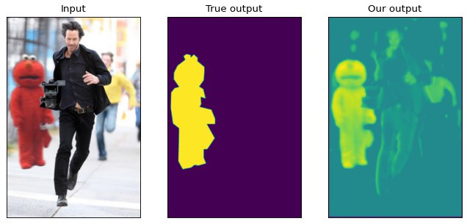
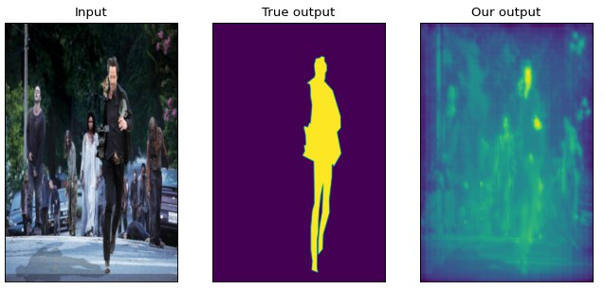
Results obtained
Comparison with true output and our output
In Figure 1, we can see that in our output the forgery “person” is noticed, but we have not the result as clear as in the second output that is the true output.
In Figure 2, we can see that in our output the forgery person is not noticed so much, the only better forgery points that are noticed are the face and one hand.
Reason: we suppose that the reasons is due to the different dataset that we have used. In fact, our dataset is small, instead those of the paper is more complex.
Figure 1: One of the better output that we have obtained.
Figure 2: One of the worse output that we have obtained.

Slide 8
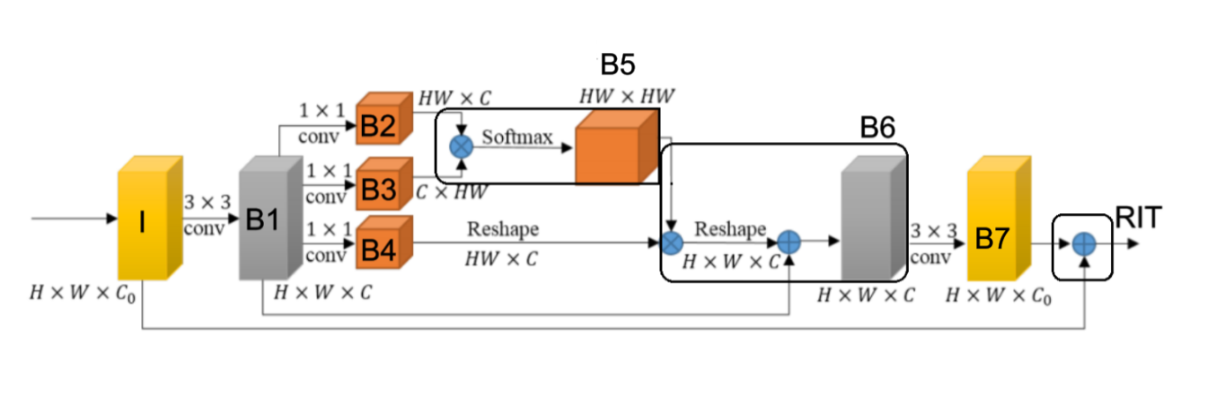
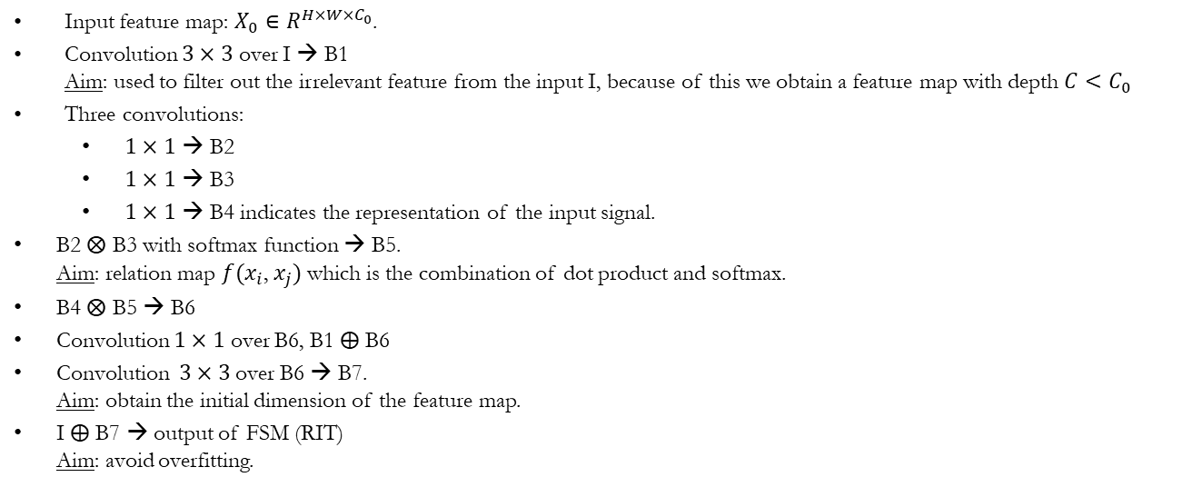
Personal Research
FSM block
We have decided to add the FSM block between the encoder and the decoder in order to see if the performance are better. FSM is used with U-Net to improve the performance and to capture long-range spatial information.
Input feature map: $X_{0}∈R^{H×W×C_{0}}$.
Convolution $3×3$ over I → B1 Aim: used to filter out the irrelevant feature from the input I, because of this we obtain a feature map with depth ${C<C}_{0}$
Three convolutions:
$1×1$ → B2
$1×1$ → B3
$1×1$ → B4 indicates the representation of the input signal.
B2 $⨂$ B3 with softmax function → B5. Aim: relation map ${f(x}_{i}$, $x_{j})$ which is the combination of dot product and softmax.
B4 $⨂$ B5 → B6
Convolution $1×1$ over B6, B1 $⨁$ B6
Convolution $3×3$ over B6 → B7. Aim: obtain the initial dimension of the feature map.
I $⨁$ B7 → output of FSM (RIT) Aim: avoid overfitting.
Figure: FSM architecture.

Slide 9
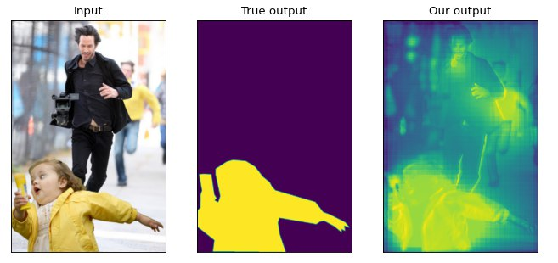
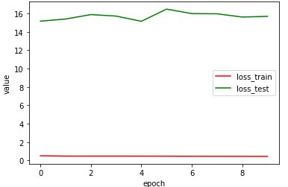
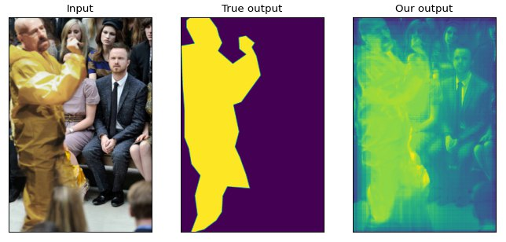
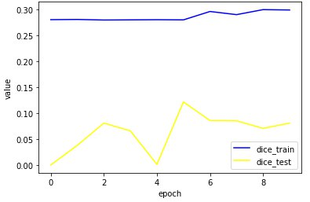
Result obtained with FSM block
In the Figures, we can see that by adding the FSM block our network are able to detect the forgery and a kind of halo is created around it.
During the training we have faster better performance, so we think that the FSM block will help to improve the performance of RRU-Net.
Figure 1: Example 1 by using FSM block.
Figure 2: Example 2 by using FSM block.
Figure 3: Values of loss function and dice for training and test processes after 10 epochs.

Slide 10
Comparisons of results obtained
Conclusion
Model | Dice | #Parameters
RRU-Net (paper) | 0.7 | 4.09M
RRU-Net (our) | 0.1 | 4.09M
RRU-Net with FSM | 0.1 | 4.25M
Conclusions:
The dataset that we have used is different form which in the paper. In fact, our dataset is smaller than that used in the paper, so the performance are different.
We think that if we use a better dataset and we train our network with FSM block, we will obtain better performance than using only RRU-Net
RRU-Net with FSM allow us to have faster better performance.

Slide 11
Thanks for the attention!
Denise Landini Alessandro Lambertini

