Slide 1
Beadjeweled
Joseph Blackman (jctblackman) Lambert Wang (lwang5)
Notes:
Instructions are unclear. You don't need to make a match on every move.
Borders getting stuck on mobile.
Make the game more eventful.
Users don't really utilize combos very much
bug: It's possible to fail the tutorial
Another user figured that you can move things wherever
Some kind of indicator for chains and also a chaining tutorial to show that chains get a ton of points.
drops and swaps should stay white
Matches should be the color of the tile(s) matched

Slide 2
Casual (recap)
Match-3 Game
No time constraint
No entry difficulty
Simple controls, with a strong tutorial
Quick levels with score not time progression

Slide 3
Mobile Friendly (recap)
Only one player action: Drag to swap tiles
Small maximum size: 10x10
Audio and visual feedback for making matches
Audio and visual feedback for making chains

Slide 4
Response to playtesting
Moves don’t need to make matches / Users don’t make chains
Reworked the tutorial
Make the game more eventful
Added another sound effect and colored clears
Bugfixes
Possible to fail the tutorial, possible auto-win levels
Misleading cover image
Updated to newer graphics and all icons

Slide 5
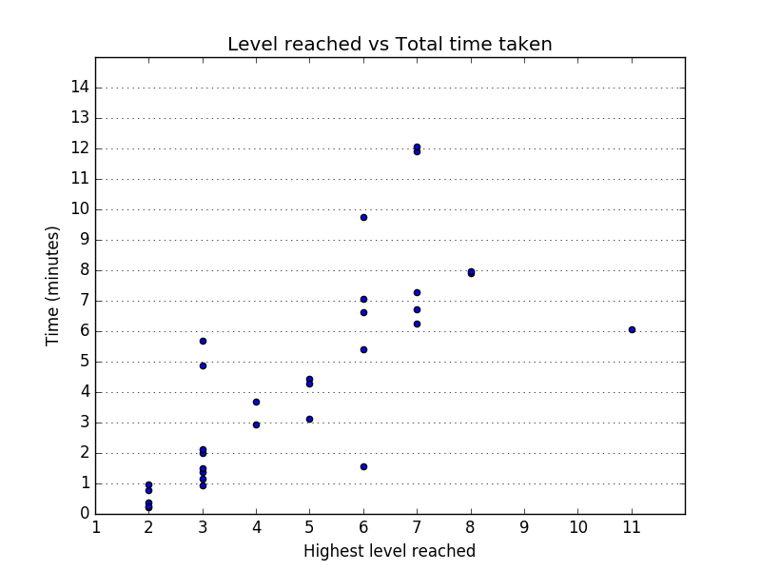

Slide 6
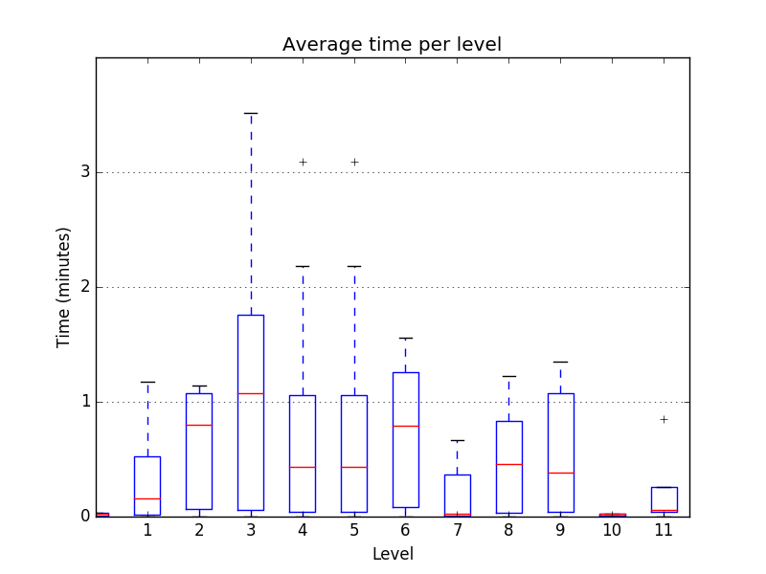

Slide 7
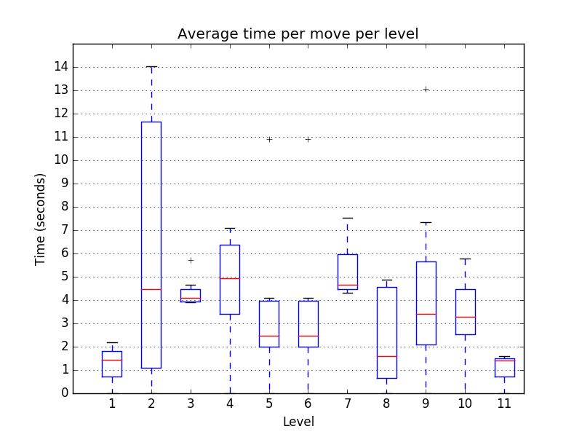

Slide 8
Response to analytics
Players weren’t utilizing multi-clears
Changed internal scoring algorithm
Players take longer to make moves on later levels
Made the randomizer less aggressive

Slide 9
Demo time!
Final Version

Slide 10
Experience Goals (recap)
Maximize actions per minute (frequency control)
We don’t want players sitting around doing nothing
We want players to be making moves even if they are low-impact
We want players to be moving throughout the game (so maximize level reached per session)
Levels have no time constraint
You can progress levels by taking the lowest-effort path
Skilled players will complete levels faster but that isn’t visible - No timer

Slide 11
Survey (5 responses total)
Did you try to combo?
Yes 5
No 0
Was it clear to you when combos occurred?
Yes 5
No 0
Maybe 0
Do you think the glyphs looked okay?
Yes 5
No 0
Have you played match 3 games before?
Yes 4
No 0
Maybe 1
Did you reach the endless levels?
Yes 0
No 5
What did we learn?
We’re pretty bad at making surveys
Users know what combos are and try to go after them
The unicode glyphs render correctly, provided we properly test them on the target hardware
Despite having played match-3 games, a majority of our users were unable to reach the endless levels

Slide 12
Questions/comments?

