Slide 1
Merlin and the Dragons
Team \sum_{n=1}^{12}\phi(n)
Joseph (jctblackman@wpi)
Lambert (lwang5@wpi)

Slide 2
Story Summary (Unchanged)
King Vortigern wishes to construct a castle in the mountains of Eryri.
He rebuilds his castle but it’s destroyed every night
He calls twelve wise men to advise him, but they cannot help
Eventually, the young boy Merlin finds the source of the destruction to be two dueling dragons and tells King Vortigern
Vortigern gains wisdom and leaves the mountain to build elsewhere
W. Jenkyn Thomas, The Welsh Fairy Book (London: T. Fisher Unwin, Ltd., n.d. [first published 1907]), pp. 66-70.
Notes:
Merlin the Magician
Rescues King Vortigern
Why the Red Dragon Is the Emblem of Wales
W. Jenkyn Thomas
After the Treachery of the Long Knives, King Vortigern called together his twelve wise men and asked them what he should do.
They said to him, "Retire to the remote boundaries of your kingdom, and there build and fortify a city to defend yourself. The Saxon people you have received are treacherous, and they are seeking to subdue you by guile. Even during your life they will, if they can, seize upon all the countries which are subject to your power. How much more will they attempt it after your death?"
The king was pleased with this advice, and departing with his wise men traveled through many parts of his territories in search of a convenient place for building a citadel. Far and wide they traveled, but nowhere could they find a suitable place until they came to the mountains of Eryri, in Gwynedd. On the summit of one of these, which was then called Dinas Ffaraon, they discovered a fine place to build a fortress.
The wise men said to the king, "Build here a city, for in this place you will be secure against the barbarians."
Then the king sent for artificers, carpenters, and stonemasons, and collected all the materials for building. In the night, however, the whole of these disappeared, and by morning nothing remained of all that had been provided. Materials were procured from all parts a second time, but a second time they disappeared in the night. A third time everything was brought together for building, but by morning again not a trace of them remained.
Vortigern called his wise men together and asked them the cause of this marvel.
They replied: "You must find a child born without a father, put him to death, and sprinkle with his blood the ground on which the citadel is to be built, or you will never accomplish your purpose."
This did not appear such strange advice to King Vortigern as it does to us. In olden times there were very cruel practices in connection with building. Sometimes a human victim was sacrificed in order that his blood might be used as cement. At other times a living person was walled in a new building -- often an innocent little child.
The king thought the advice of his wise men was good and sent messengers throughout Britain in search of a child born without a father. After having inquired in vain in all the provinces, they came to a field in Bassaleg, where a party of boys were playing at ball.
Two of them were quarrelling, and one of them said to the other, "0 boy without a father, no good will ever happen to you."
The messengers concluded that this was the boy they were searching for. They had him led away and conducted him before Vortigern the king.
The next day the king, his wise men, his soldiers and retinue, his artificers, carpenters, and stonemasons, assembled for the ceremony of putting the boy to death.
Then the boy said to the king, "Why have your servants brought me hither?"
"That you may be put to death," replied the king, "and that the ground on which my citadel is to stand may be sprinkled with your blood, without which I shall be unable to build it."
"Who," said the boy, "instructed you to do this?"
"My wise men," replied the king.
"Order them hither," returned the boy.
This being done, he thus questioned the wise men: "By what means was it revealed to you that this citadel could not be built unless the spot were sprinkled with my blood? Speak without disguise, and declare who discovered me to you."
Then turning to the king, "I will soon," said he, "unfold to you everything; but I desire to question your wise men and wish them to disclose to you what is hidden underneath this pavement."
They could not do so and acknowledged their ignorance.
Thereupon the boy said, "There is a pool; come and dig." They did so, and found a pool, even as the boy had said.
"Now," he continued, turning to the wise men again, "tell me what is in the pool."
But they were ashamed and made no reply.
"I," said the boy, "can discover it to you if the wise men cannot. There are two vases in the pool."
They examined and found that it was so. Continuing his questions, " What is in the vases? " he asked. They were again silent.
"There is a tent in them," said the boy. "Separate them and you shall find it so."
This being done by the king's command, there was found in them a folded tent. The boy, going on with his questions, asked the wise men what was in it. But they knew not what to reply.
"There are," said he, "two serpents, one white and one red. Unfold the tent."
They obeyed, and two sleeping serpents were discovered.
"Consider attentively," said the boy, "what the serpents do."
They began to struggle with each other, and the white one, raising himself up, threw down the other into the middle of the tent and sometimes drove him to the edge of it, and this was repeated thrice. At length the red one, apparently the weaker of the two, recovering his strength, expelled the white one from the tent, and the latter, being pursued through the pool by the red one, disappeared.
Then the boy asked the wise men what was signified by this wonderful omen, but they had again to confess their ignorance.
"I will now," said he to the king, "unfold to you the meaning of this mystery. The pool is the emblem of this world, and the tent that of your kingdom. The two serpents are two dragons; the red serpent is your dragon, but the white serpent is the dragon of the Saxons, who occupy several provinces and districts of Britain, even almost from sea to sea. At length, however, our people shall rise and drive the Saxon race beyond the sea whence they have come. But do you depart from this place where you are not permitted to erect a citadel, you must seek another spot for laying your foundations."
Vortigern, perceiving the ignorance and deceit of the magicians, ordered them to be put to death, and their graves were dug in a neighboring field.
The boy's life was spared. He became known to fame afterwards as the great magician Myrddin Emrys (or Merlin, as he is called in English), and the mountain on which he proved his mighty power was called in after time Dinas Emrys instead of Dinas Ffaraon.
He remained in the Dinas for a long time, until he was joined by Aurelius Ambrosius, who persuaded him to go away with him. When they were about to set out, Myrddin placed all his treasure in a golden cauldron and hid it in a cave. On the mouth of the cave he rolled a huge stone, which he covered up with earth and green turf, so that it was impossible for anyone to find it. This wealth he intended to be the property of some special person in a future generation. This heir is to be a youth with yellow hair and blue eyes, and when he comes to the Dinas a bell will ring to invite him into the cave, which will open out of its own accord as soon as his foot touches it.
Source: W. Jenkyn Thomas, The Welsh Fairy Book (London: T. Fisher Unwin, Ltd., n.d. [first published 1907]), pp. 66-70.
Edited by D. L. Ashliman.
Thomas's title for this legend is "Why the Red Dragon Is the Emblem of Wales."
This legend is also told by Geoffrey of Monmouth in his Historia Regum Britanniae (ca. 1136). Link to an English translation of this work: The British History of Geoffrey of Monmouth, translated from he Latin by A. Thompson (London: James Bohn, 1842). The episode under discussion is found in book 6, ch. 17-19 (pp. 127-30).

Slide 3
Game Plot Introduction Summary (Unchanged)
> Be me
> 1147 anno domini
> 11 year old wizard
> King Vort wants to build another stupid castle
> Walls crack and fall down down every month like my puberty voice
> He hires a bunch of ancient accountants to investigate
Today
> Walking around the castle one day
> Trying to get attention of that one beautiful handmaiden with the green dress
> Rumbling
> Not again
> Castle falls apart earth splitting
> Need to save my life
> Grabs nearest thing
> O shit magic staff
> Use magic to save self
> Fall into pitch darkness and now at the bottom of cave
> Can’t see and peed my pants

Slide 4
Features
Single-player side-scrolling adventure
Find and use powerful magic artifacts
Solve puzzles with brilliant sorcery
Constant difficulty curve
Due to level design and item acquisition
Changes:
No longer can use multiple tools

Slide 5
Controls/Conveying Information
Instructions/controls
Simple movement (walking and jumping)
Simple usage of items (magic tools)
Passive effect
Active effect: Left click use/interact
Story
Premise delivered in dialogue with characters
No more “cutscenes”
Instead, unskippable text
Throughout game, Merlin is focused on solving mystery for the King
Conclusion delivered via final level

Slide 6
Target Audience
Players interested in a narrative-based game.
Specifically with ties to high fantasy (dragons, magic).
The game is narrative; it shouldn’t be primarily focused on gameplay
Any puzzles shouldn’t require high precision or timing.
Doesn’t mean puzzles have to be easy, though.

Slide 7
Experience Goals
Experience Goals
Challenging yet solvable puzzles
Balanced use of tools
Telemetry
Level completion
Usage of tools
Notes:
Experience goals. In one paragraph, explain the emotions and/or peak moments you want your target audience to experience while playing your game.
Measurable goals and analytic strategy. In a second paragraph, explain your measurable experience goals, and how you will instrument your game to collect the data you need to provably achieve them.
Your design must include two or more experience goals that can be measured using the Perlenspiel database functions.

Slide 8
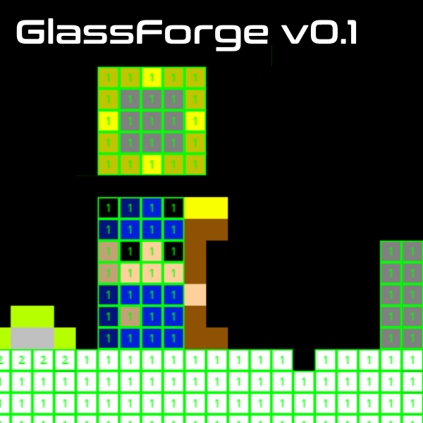
GlassForge Engine
Perlenspiel wrapper to provide additional game engine functionality
Collision Model
Class Based Objects
Streamlined Level Editing
Animated Sprites
Eventing
Movement Simulation
github.com/magellantoo/imgd3900_site

Slide 9
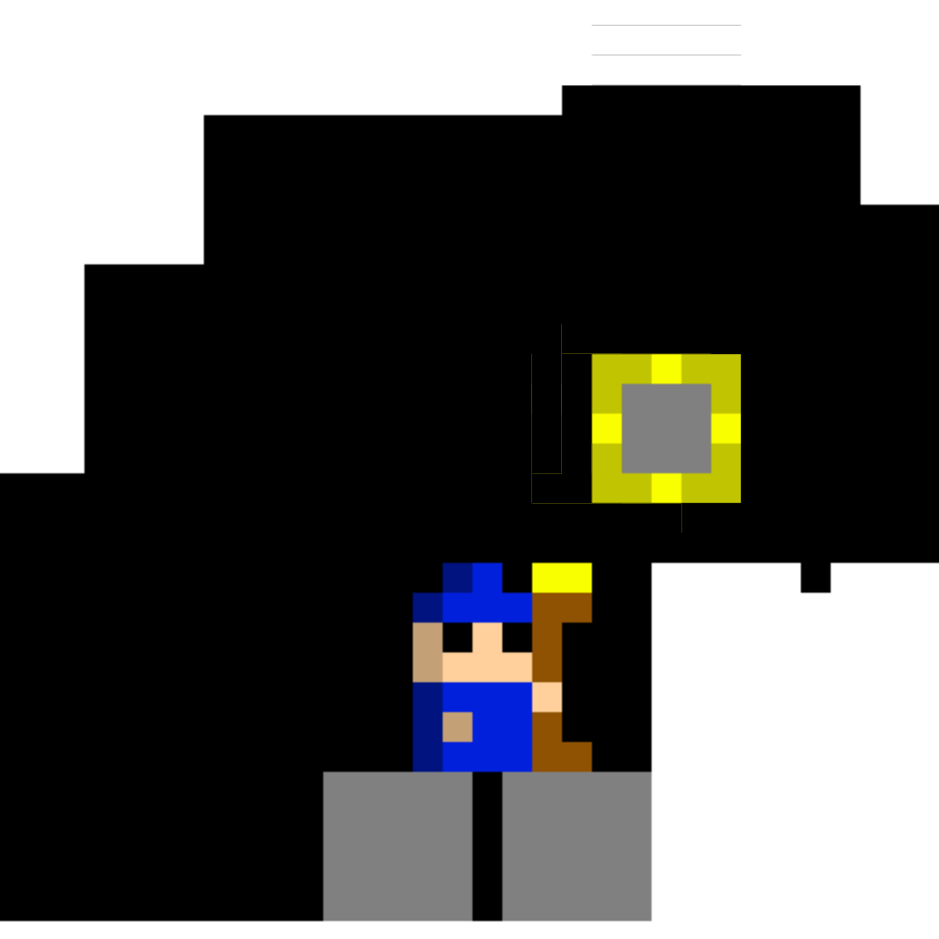
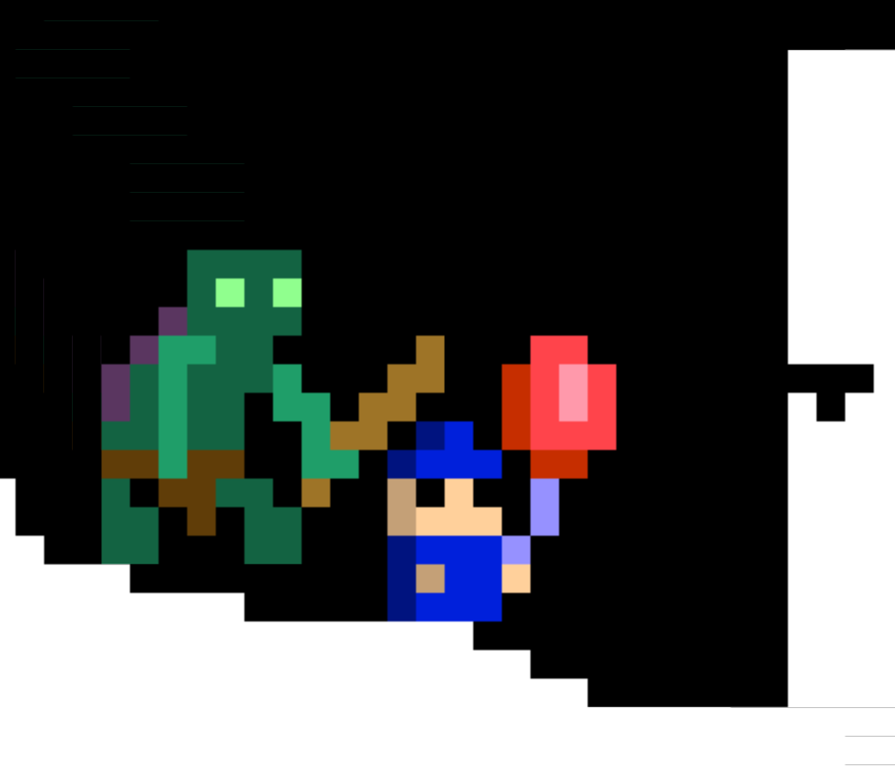
Original Concept Art vs.
Final Screenshots
Changes:
No weapon switch
Higher fidelity sprites
Detailed terrain
<opinion>
We think game looks better than concept art
</opinion>

Slide 10
Surveys
Research Questions:
Does the player understand the story?
What kinds of gameplay (tools, puzzles, and enemy suggestions) do the players enjoy?

Slide 11
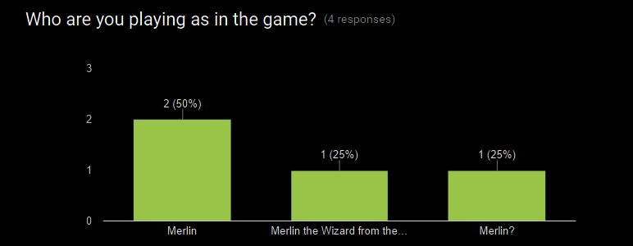
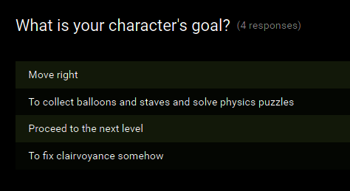
Survey #1 Story Feedback
Players were unable to decipher a plot from our gameplay.
Resulting changes:
Added more status-text on levels
Added NPCs to talk to
Added level fade to focus on status text

Slide 12
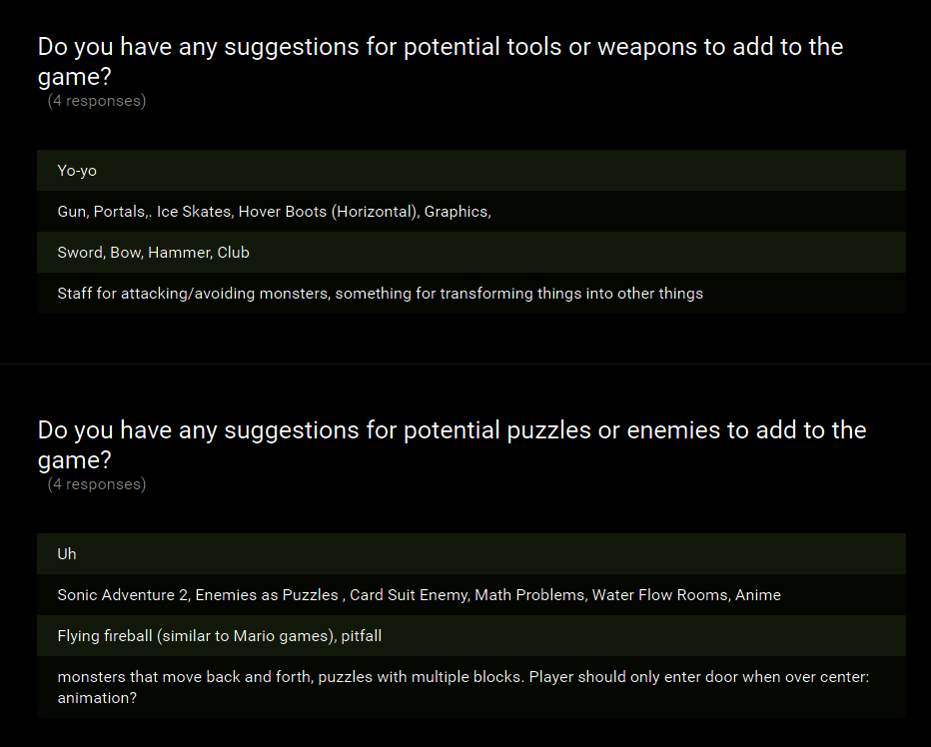
Survey #1
Gameplay Suggestions
Players wanted to attack monsters
Players wanted a lot of different enemies
Resultant Changes:
Increased puzzle variety
Patrolling Troll
Block Puzzles
Pressure Plate Puzzles
We did not implement combat with enemies

Slide 13
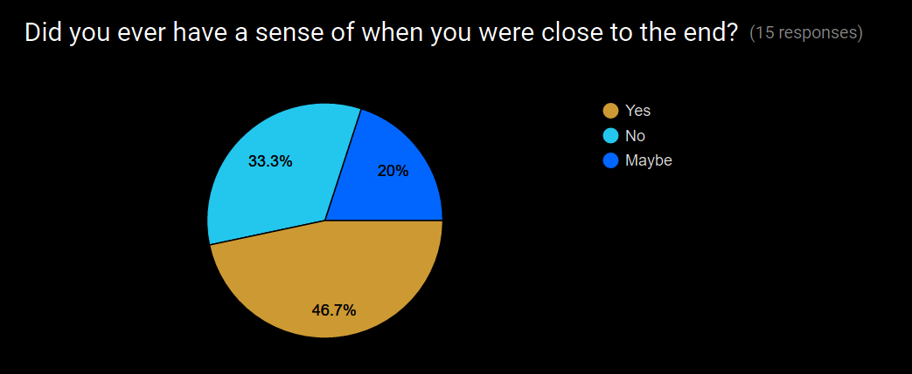
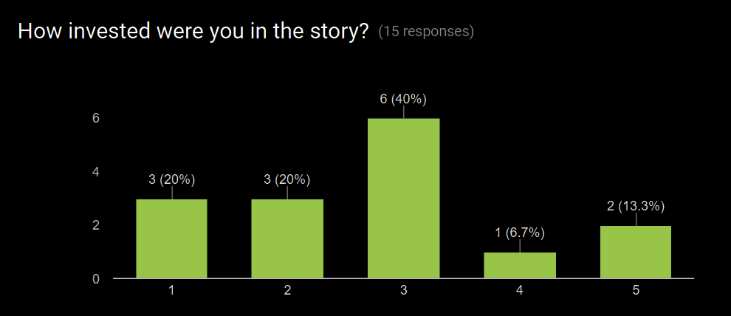

Survey #2 Story Feedback
The ending to the story was a little abrupt.
Players didn’t have strong feelings either way about the story.

Slide 14
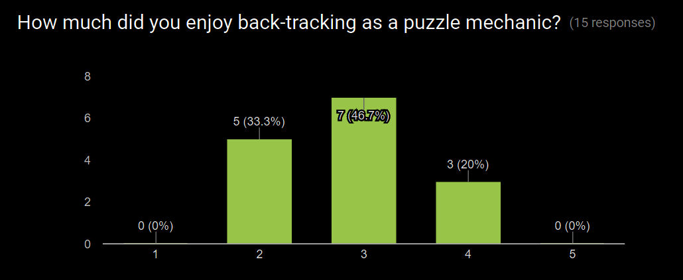
Survey #2
Gameplay
Feedback
Players were fine with the backtracking puzzles

Slide 15


Survey #2 Magic Tool Feedback
Players enjoyed using the staff and solving block puzzles
They did not enjoy using the passive movement-altering tools

Slide 16
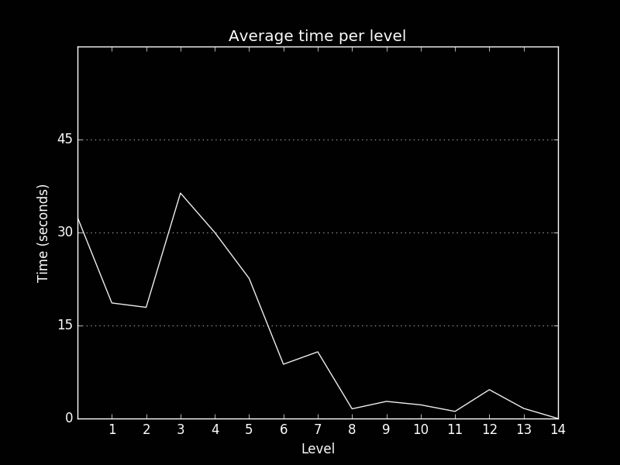
Telemetry Feedback

Slide 17
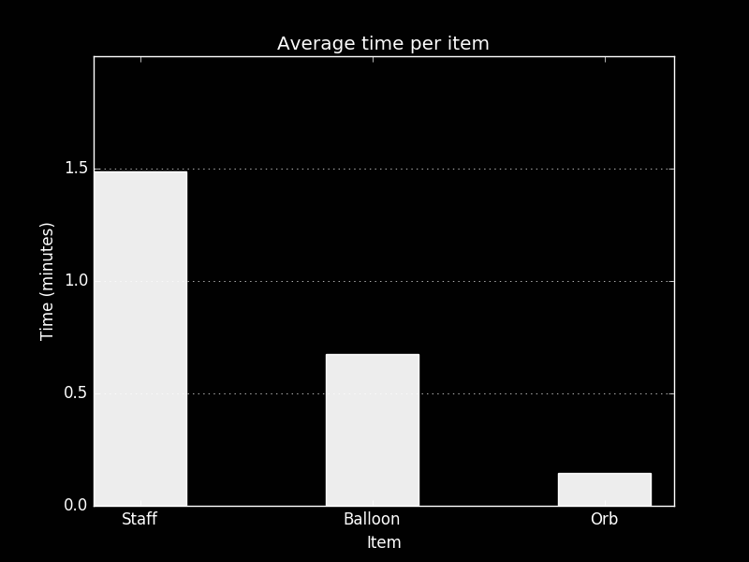
Telemetry Feedback

Slide 18
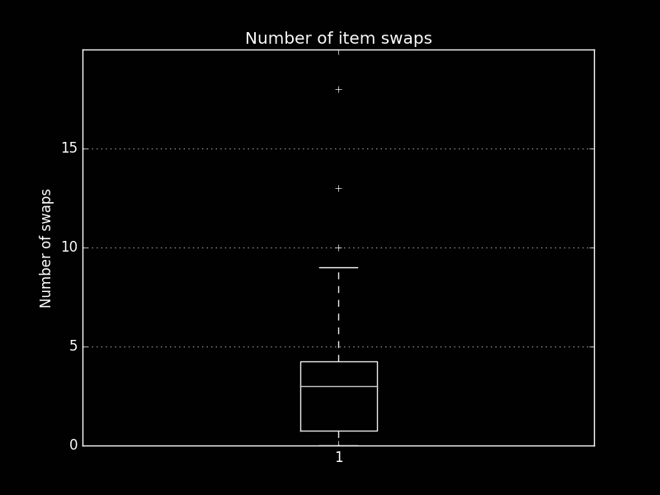
Telemetry Feedback

Slide 19


Questions?

