Slide 1
IMGD3900 Assignment 6
Presented by Joseph and Lambert

Slide 2
Experience Goal
Maximize amount of time spent in order to complete the maze.
Disregard runs where user quits before completion.

Slide 3
Instrumentation
Record initial actor and exit position
We did not end up looking at this data
Record gold location types
Dead end: Adjacent to 3 walls
Corridor: Between 2 walls
Corner: Adjacent to 2 adjacent walls
Intersection: Adjacent to 0 or 1 wall
Record minimum spanning tree distance
Good approximation of gold spacing

Slide 4
Testing Variables
We randomized 3 things for our tests
Initial Actor position
Exit position
Gold location type
Dead end, Corner, Corridor, Intersection
Gold location
All gold was placed on the same location type for each run

Slide 5
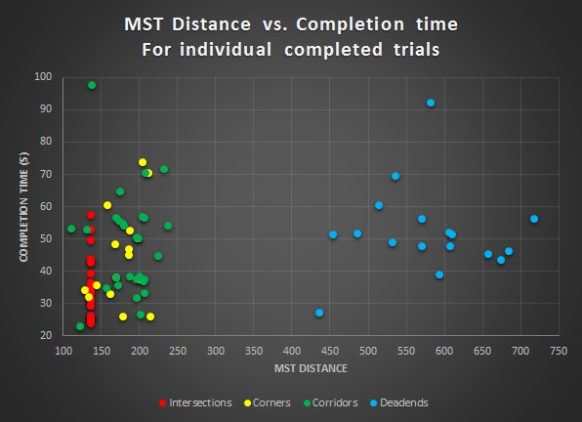
Results
Graph 1: Minimum Spanning Tree size and completion time for each completed trial

Slide 6
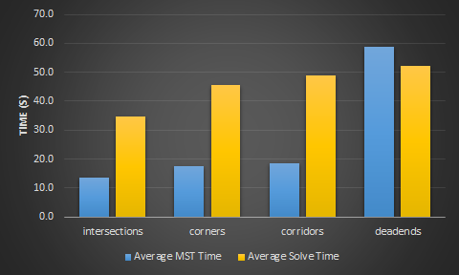
Results (cont.)
Gold Location | Trials | Avg MST | Avg time (s)
intersections | 22 | 136 | 34.7
corners | 15 | 177 | 45.6
corridors | 27 | 185 | 49.1
deadends | 17 | 587 | 52.1
Table 1: An overview of the data collected for each gold location type
Graph 2: Bar chart showing data from Table 1

Slide 7
Discussion
Corner placement is related to MST distance.
MST distance is directly correlated with solve time.
To maximize time, the gold placement algorithm should construct a graph that maximizes MST distance.

Slide 8
Limitations
We only show completed trials.
The maze has exactly 10 intersections.
We computed the MST rather than the TSP.
Notes:
During the testing period, we closed the page many times and this meant it was not feasible to differentiate our tests with users actually closing the page.

Slide 9
Questions?

