Slide 1
Beadjeweled
Joseph Blackman (jctblackman) Lambert Wang (lwang5)
Notes:
Instructions are unclear. You don't need to make a match on every move.
Borders getting stuck on mobile.
Make the game more eventful.
Users don't really utilize combos very much
bug: It's possible to fail the tutorial
Another user figured that you can move things wherever
Some kind of indicator for chains and also a chaining tutorial to show that chains get a ton of points.
drops and swaps should stay white
Matches should be the color of the tile(s) matched

Slide 2
Casual (recap)
Match-3 Game
No time constraint
No entry difficulty
Simple tutorial showing controls
Short levels
Nothing has changed

Slide 3
Mobile Friendly (recap)
Only one player action: Drag to swap tiles
Maximum size: 10x10
Simple audio cues for making matches
Advanced audio cues for making a chain
Changed from combo to chain
Nothing has changed

Slide 4
Playtesting
Instructions are unclear. You don't need to make a match on every move.
Changed first and second tutorial level
Make the game more eventful
Added another sound effect
Users don't really utilize chains very much
Added third tutorial
Bug: It's possible to fail the tutorial
Fixed
Matches should be the color of the tile(s) matched and drops and swaps should stay white
Done

Slide 5
Critique
Change title
Done
Change cover image
Done
Row-by-row drops
Done
Make randomizer less aggressive
Done

Slide 6
Demo time!
Final Version

Slide 7
Experience Goals (recap)
Maximize actions per minute (frequency control)
We don’t want players sitting around doing nothing
We want players to be making moves even if they are low-impact
Levels increase at a fixed score cap
We want players to be moving throughout the game (so maximize level reached per session)
Levels have no time constraint
You can progress levels by taking the lowest-effort path
Skilled players will complete levels faster but that isn’t visible - No timer

Slide 8
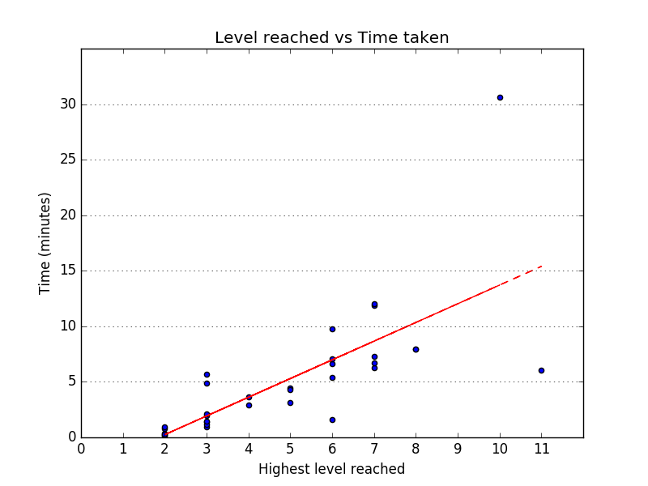
Analytics
Results

Slide 9
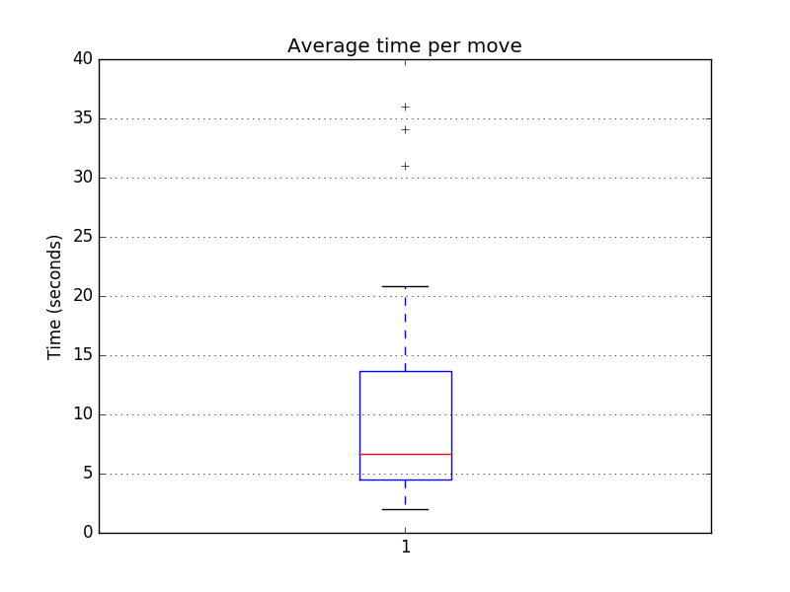
Analytics
Results

Slide 10
Survey (5 responses total)
Did you try to combo?
Yes 5
No 0
Was it clear to you when combos occurred?
Yes 5
No 0
Maybe 0
Do you think the glyphs looked okay?
Yes 5
No 0
Have you played match 3 games before?
Yes 4
No 0
Maybe 1
Did you reach the endless levels?
Yes 0
No 5
What did we learn?
We’re pretty bad at making surveys
Users know what combos are and try to go after them
The unicode glyphs renders correctly
Despite having played match-3 games, a majority of our users were unable to reach the endless levels

Slide 11
Questions/comments?

