Slide 1
UNEP EGR 2023 Chapter 2
William Lamb

Slide 2
Authorship
Invitation of second LA underway
Wider author team reflects key data contributions
EDGAR team, Global Carbon Budget team, Giacomo Grassi, Lucas Chancel, Lewis Akenji
Considering further additions in the context of regional and gender balance

Slide 3
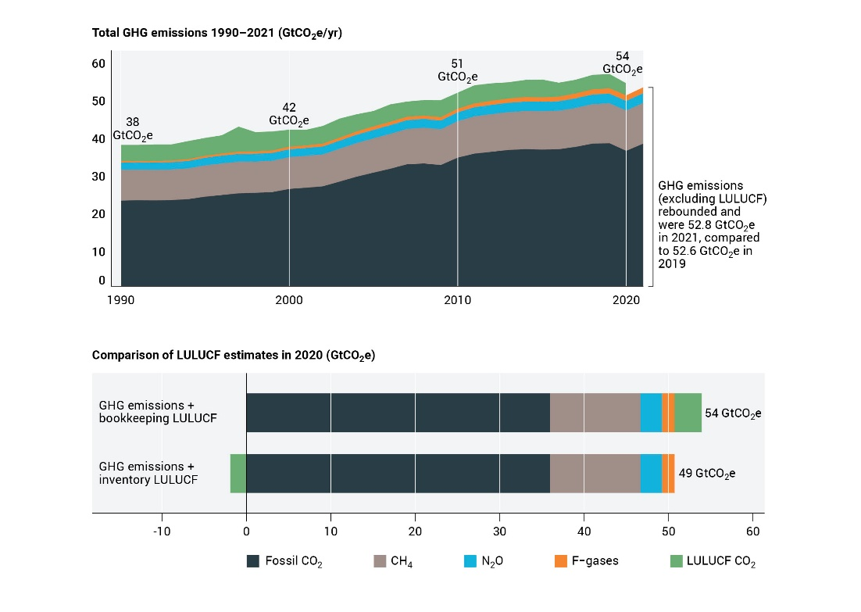
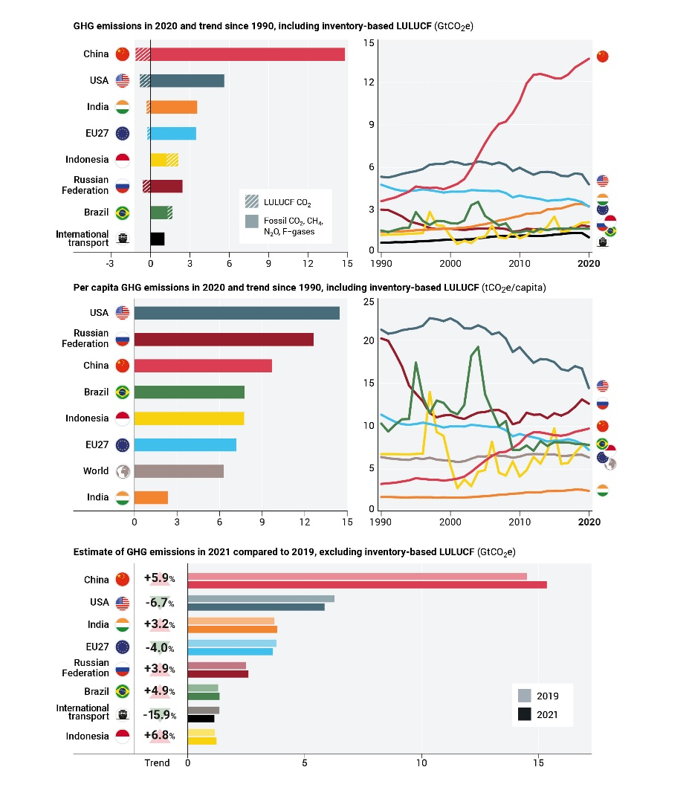
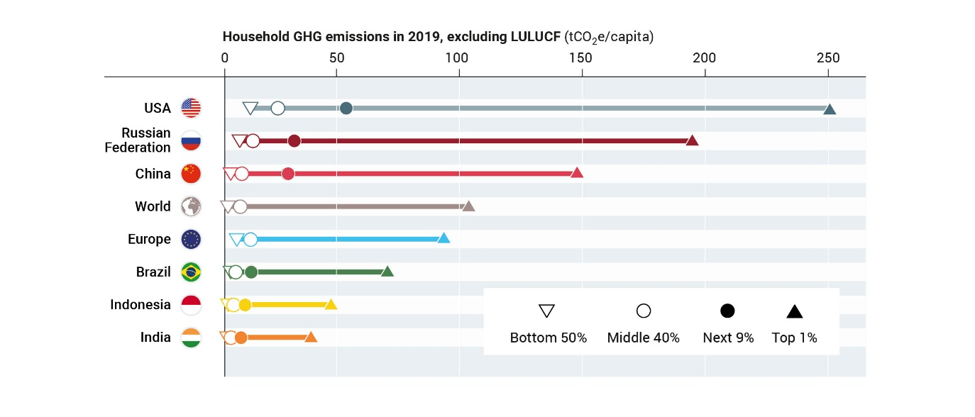
Length and figures
4-5 pp, 2700-3500 words
3 figures

Slide 4
Key questions
What were total global GHG emissions in 2022, what are the main trends (total emissions, sectors and top emitters)?
Are there any signs of emissions peaking at global, sectoral, and country level ?
Which countries and global sectors have peaked in GHG emissions and reduced for at least 10 years ?
How does the inclusion of inequality and fairness perspectives influence the assessment of status and trends?

Slide 5
Content
Trends: Global emissions in 2022 and the main explanations and drivers of emissions trends (gases, sectors and top emitters, as in previous years). It is the hope that a total GHG emissions estimate including LULUCF can be provided this year.
Peaking: Assessment of status and signs of emissions peaking (globally, regionally, nationally and at sectoral level).
Tricky as dependent on (1) metric; (2) time frame; (3) exclusions. Main message = some have peaked but reductions insufficient.
Equity (national): Assessing historical responsibilities, fairness and equity dimensions of the GHG emissions status and trends. Authors suggest to “Keep the method simple, but go beyond cumulative CO₂ emissions.”
Simple climate model run? Could engage Piers Forster to run it.
Equity (household): Consumption- and income/wealth-based emissions and trends (potentially broken down by sectors) – do they change the picture?
Suggestion from Navros: marginal contribution of CO2 increase to welfare
[Thought on that: very simple summing of emissions increases by region or income level? Countries don’t like that though!]
Link to chapter 6?

Slide 6
Notes

