Slide 1
UNEP EGR 2023 Chapter 2
William Lamb, Giacomo Grassi, Monica Crippa, Julia Pongratz, Diego Guizzardi, Lucas Chancel, Glen Peters, Jing Meng

Slide 2
Authorship
Lead Authors
William Lamb
Contributing Authors
Giacomo Grassi
Monica Crippa
Julia Pongratz
Diego Guizzardi
Lucas Chancel
Glen Peters
Jing Meng
?

Slide 3
Content
10% Setup
30% Part 1: Global trends
30% Part 2: National trends
30% Part 3: Unequal contributions to climate change
4-5 pp, 2700-3500 words
3 figures

Slide 4
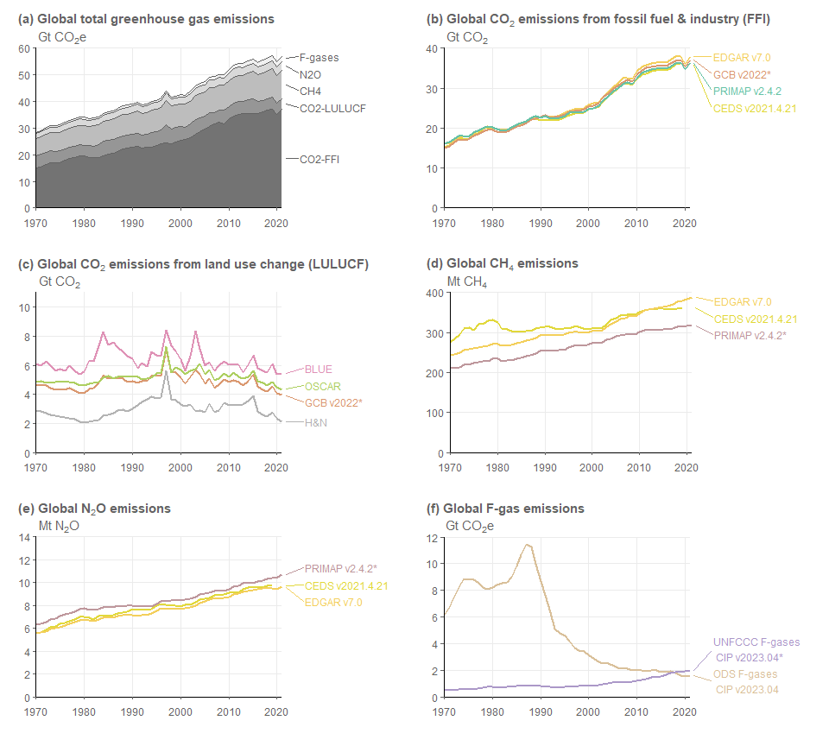
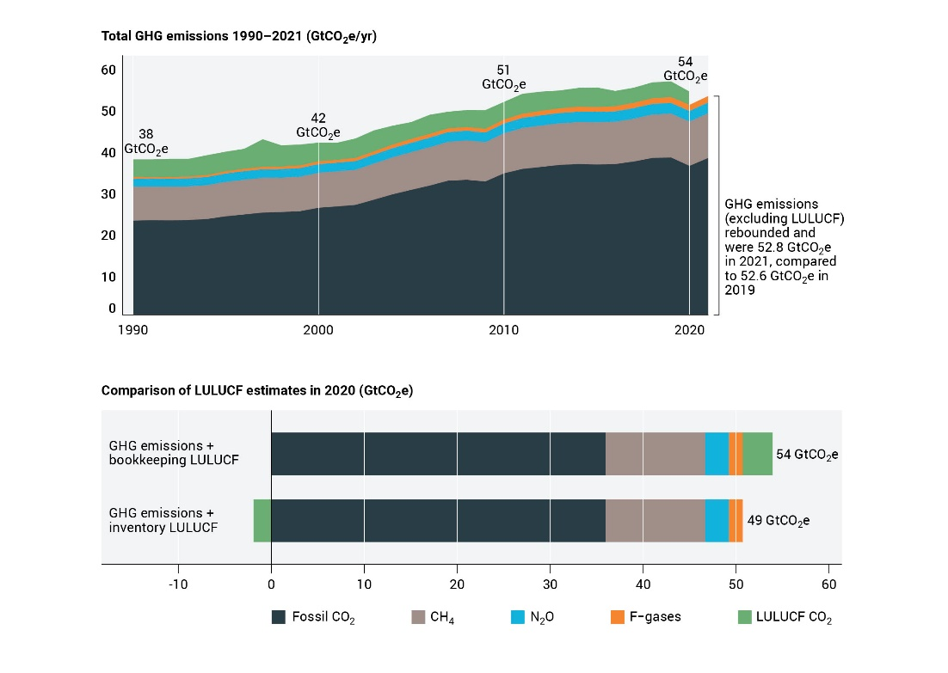
Part 1: Global trends
A full 2022 estimate is possible
Bookkeeping LULUCF for global estimates
(with comparison to inventory)
Uncertainty assessment

Slide 5
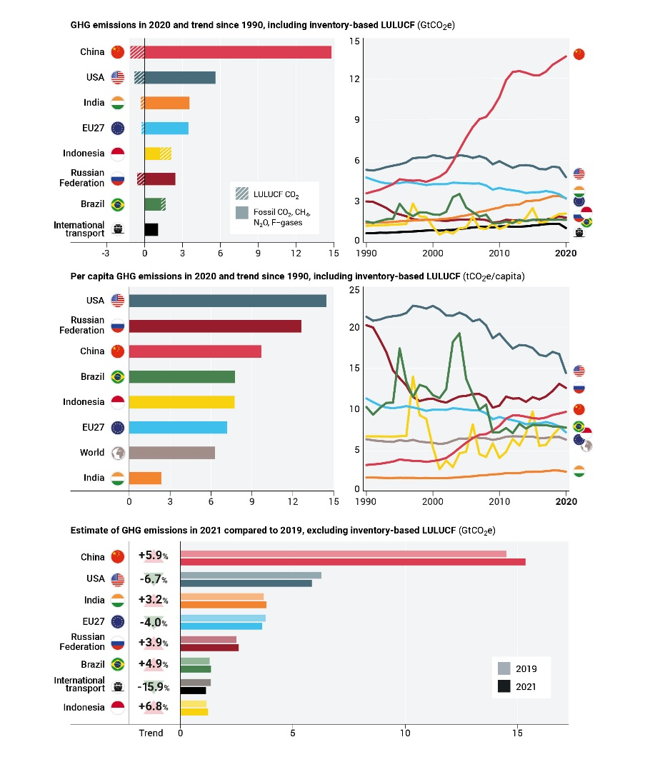
Part 2: National trends
Show inventory-based LULUCF for countries
Show latest growth rates above

Slide 6
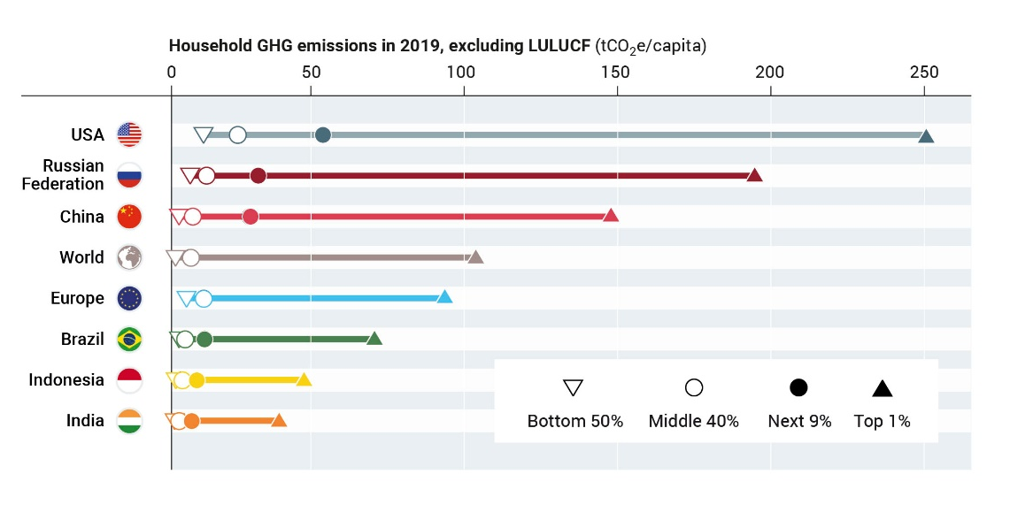
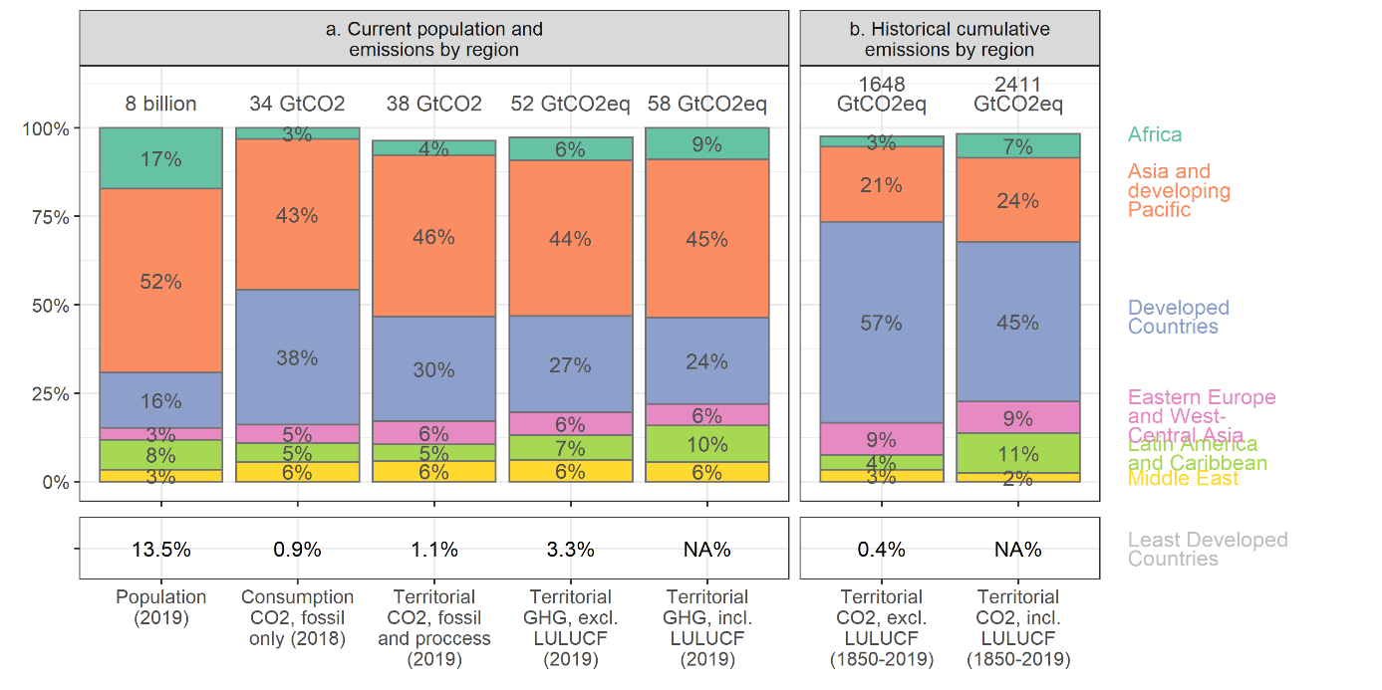
Part 3: Equity aspects
Population
Current GHG
Historical CO2
Historical climate
Inequality/household aspect
This figure -> or this one ?

Slide 7
Notes

