Slide 1
Kcahtod
Ellipsis-Goldman Sachs Hackathon
Cloud Based Credit Scoring System

Slide 2
Contents Page
1
Overview
2
Business Case
Business Problem, Benefits, Risk
3
Solution Architecture
4
Conclusion
Diagram, Breakdown

Slide 3
Overview
Non-bank financial institutions (NBFCs) play a critical role in promoting financial inclusion by serving under-banked individuals. However, NBFCs face challenges when assigning accurate credit scores from human error or biases in current credit scoring models. Leveraging on Goldman Sachs’s 150 years of financial expertise and cloud technologies, Kcahtod proposes a cloud based credit scoring system.
Our cloud based credit scoring system ingests customer records from partner NBFCs and uses Goldman Sachs proprietary algorithm to return an aggregated credit score.

Slide 4
Business Problem
NBFC susceptible to credit risk due to lack of vital information
Human errors introduced by credit data furnishers during data collection or credit scoring process
NBFC customers do not get fair analysis of financial credibility

Slide 5
Business Solution
Cloud Based Credit Scoring System
Ingest
01
Ingest and process a customer’s financial transactions and records across various partner NBFCs using proprietary algorithm from Goldman Sachs
Return
02
Goldman Sachs will return aggregated customer credit score

Slide 6



Benefits
Holistic Credit History View
Promote Financial Inclusion
Leverage on Goldman Sachs expertise in capital and risk management and insights across partner NBFCs
Increasing use of NBFC refines the credit rating algorithm and improve accuracy of credit score provided for low-income individuals
Secure Data
Tech Stack Agnostic
NBFCs’ data encrypted securely in private cloud shared with Goldman Sachs
Data is served through consumable API endpoint and NBFCs will not face compatibility issues when integrating existing infrastructure

Slide 7
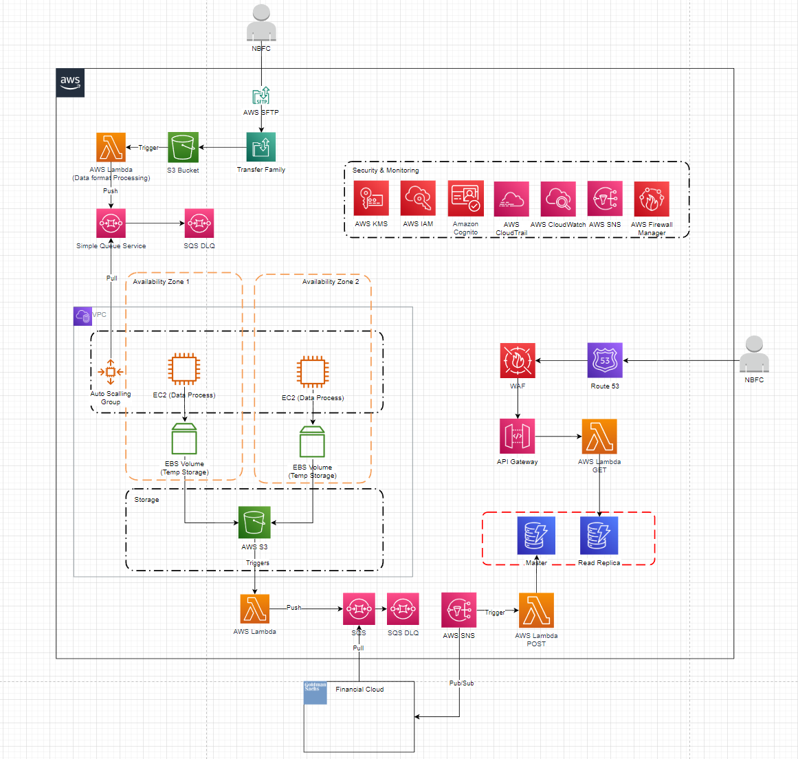
Solution Architecture Diagram

Slide 8




Solution Architecture Diagram Breakdown
01
02
AWS S3 Bucket is used to 1. Store raw customer records from partner NBFCs 2. Store cleaned customer records
AWS lambda is used to 1. Push customer records to queue to be deposited into S3 bucket
2. Pull customer records from S3 bucket to be passed into GS’s credit scoring model
3. Pull customer records from queue after being passed through GS credit scoring model
4. Pull credit scores from the private cloud
04
03
Nodejs is subscribed to the SQS. Customer records are pulled from the SQS to be processed
Amazon DynamoDB is our database of choice

Slide 9
Conclusion
In conclusion, our Cloud Based Scoring System leverages on Goldman Sach’s 150 years of financial expertise and cloud solutions. It considers the security of customer records by using a private cloud and multiple AWS security technologies.

Slide 10
Reference
Sinha, S. (2020, December 23). Banks still in search for 'right' nbfcs to partner with - ET BFSI. ETBFSI.com. https://bfsi.economictimes.indiatimes.com/news/nbfc/banks-still-in-search-for-right-nbfcs-to-partner-with/79878526
Shaji, A. M. (2020, July 23). Major challenges faced by NBFCs & Their Solutions. Enterslice. https://enterslice.com/learning/challenges-faced-by-nbfcs/
Singletary, M. (2020, October 16). Perspective | credit scores are supposed to be race-neutral. that's impossible. The Washington Post. https://www.washingtonpost.com/business/2020/10/16/how-race-affects-your-credit-score/
Sinha, S. (2016, July 29). Wrong credit report haunting your loan application? here's how you get it corrected. The Economic Times. https://economictimes.indiatimes.com/wealth/spend/wrong-credit-report-haunting-your-loan-application-heres-how-you-get-it-corrected/articleshow/53409666.cms
Campisi, N. (2021, December 17). From inherent racial bias to incorrect data-the problems with current credit scoring models. Forbes. https://www.forbes.com/advisor/credit-cards/from-inherent-racial-bias-to-incorrect-data-the-problems-with-current-credit-scoring-models/
Hölzle, U. (2020, December 2). The future isn't just cloud-it's multi-cloud | google cloud blog. Google.
https://cloud.google.com/blog/topics/hybrid-cloud/future-isnt-just-cloud-its-multi-cloud

